Slide 1
Evolution of G
Joel McGlothlin

Slide 2
z_{opt}
*
z₂
g_{max}
β
Δz
z₁
Schluter 1996

Slide 3
*
*
z₂
g_{max}
*
*
z₁
Schluter 1996

Slide 4
Adaptive radiation along g_{max}
z₂
θ
g_{max}
d_{max}
z₁
Schluter 1996

Slide 5



90°
79°
68°
56°
45°
34°
23°
11°
random
expectation
θ
0.0 0.8 1.5 2.3 3.0 3.8 4.5
time (millions of years, est.)
Schluter 1996

Slide 6
Does microevolution predict macroevolution?
Can we predict species divergence (D) from within-population variance (G)?
Does divergence maintain its alignment with g_{max}?

Slide 7
What do we expect?
1. Reasons to expect alignment
2. Reasons to expect no alignment

Slide 8
Divergence away from g_{max} with time
z₂
θ
g_{max}
d_{max}
z₁

Slide 9
Evolution of G
z₂
g_{max}
θ?
?
d_{max}
z₁

Slide 10
Alignment of adaptive landscape with g_{max}
*
z₂
g_{max}
*
*
*
z₁
Schluter 1996

Slide 11
Evolution of G along d_{max}
z₂
θ
d_{max}
z₁

Slide 12
Evolution of G
Simple theory
Simulations
Data from Anolis
Implications for macroevolution

Slide 13
∆G = G(γ-ββ^{T})G
Change in
G matrix
Selection
Lande 1980, Phillips & Arnold 1989

Slide 14
∆G = G(γ-ββ^{T})G + M - R
Mutation
Recombination
Change in
G matrix
Selection
Lande 1980, Phillips & Arnold 1989

Slide 15
∆G = G(γ-ββ^{T})G + M - R
Predictions of this model?
Problems with this model?

Slide 16
Jones et al. G simulation models
Population of
N adults
Production of progeny
Monogamy
Mendelian assortment
Mutation, Recombination
Random choice of N
individuals for the next
generation of adults
> N Survivors
B * N Progeny
https://github.com/JonesLabIdaho

Slide 17
Jones et al. model details
Direct Monte Carlo simulation with each gene and individual specified
Two traits affected by 50 pleiotropic loci
Additive inheritance with no dominance or epistasis
Allelic effects drawn from a bivariate normal distribution with means = 0, variances = 0.05, and mutational correlation r_{μ} = 0.0-0.9
Mutation rate = 0.0002 per haploid locus
Environmental effects drawn from a bivariate normal distribution with mean = 0, variances = 1
Gaussian individual selection surface, with a specified amount of correlational selection and ω = 9 or 49
Each simulation run equilibrated for 10,000 (non-overlapping) generations, followed by several thousand of experimental generations

Slide 18
Mutation
Mutational effect on trait 2
Mutational effect on trait 2
Mutational effect on trait 1
Mutational effect on trait 1

Slide 19
Selection
Individual selection surfaces
Value of trait 2
Value of trait 2
Value of trait 1
Value of trait 1

Slide 20
Visualizing the G-matrix
[
]
G =
G₁₁ G₁₂
G₁₂ G₂₂
G₁₁
G₁₂
eigenvalue
eigenvalue
Trait 2 genetic value
G₂₂
Trait 2 genetic value
eigenvector
Trait 1 genetic value
Trait 1 genetic value

Slide 21
Effect on the G-matrix
φ

Slide 22
Stationary Optimum
(selectional correlation = 0, mutational correlation = 0)
φ
0 Generations 2000

Slide 23
Stronger correlational selection produces a more stable G-matrix
(selectional correlation = 0.75, mutational correlation = 0)
φ
0 Generations 2000
ω (trait 1) | ω (trait 2) | r (ω) | r (μ) | Δφ
49 | 49 | 0 | 0 | 9.1
49 | 49 | 0.25 | 0 | 9.2
49 | 49 | 0.50 | 0 | 8.9
49 | 49 | 0.75 | 0 | 7.8
49 | 49 | 0.85 | 0 | 5.4
49 | 49 | 0.90 | 0 | 4.3

Slide 24
A high correlation between mutational effects produces stability
(selectional correlation = 0, mutational correlation = 0.5)
φ
0 Generations 2000
ω (trait 1) | ω (trait 2) | r (ω) | r (μ) | Δφ
49 | 49 | 0 | 0 | 9.9
49 | 49 | 0 | 0.25 | 7.9
49 | 49 | 0 | 0.50 | 3.6
49 | 49 | 0 | 0.75 | 1.5
49 | 49 | 0 | 0.85 | 1.1
49 | 49 | 0 | 0.90 | 0.9

Slide 25
When the selection matrix and mutation matrix are aligned, G can be very stable
selectional correlation = 0.75, mutational correlation = 0.5
φ
0 Generations 2000
selectional correlation = 0.9, mutational correlation = 0.9
φ
0 Generations 2000

Slide 26
What happens when the optimum moves?
Average value of trait 2
Average value of trait 1

Slide 27
Peak movement along a genetic line of least resistance stabilizes the G-matrix
Average value of trait 2
Average value of trait 2
Average value of trait 1
Average value of trait 1

Slide 28
∆G = G(γ-ββ^{T})G + M

Slide 29
Epistasis – The Multilinear Model
Multivariate extension of the multilinear model of Hansen and Wagner (2001):
Additive model:
z = a₁ + a₂ + a₃ + …+ e
Multilinear model:
z = a₁ + a₂ + εa₁a₂ + … + e
Only slightly more complex for the multivariate case

Slide 30
Epistasis Results
Epistasis allows selection to shape the distribution of new mutations
N | r_{ω} | V₁ | V₂ | r_{V} | M₁ | M₂ | r_{μ}
128 | 0 | 0.77 | 0.79 | 0.05 | 0.71 | 0.82 | 0.02
256 | 0 | 0.80 | 0.84 | -0.02 | 0.46 | 0.50 | -0.01
1024 | 0 | 0.70 | 0.70 | 0.00 | 0.17 | 0.16 | -0.01
2048 | 0 | 0.68 | 0.65 | -0.02 | 0.14 | 0.14 | -0.01
128 | 0.90 | 0.33 | 0.32 | 0.41 | 0.43 | 0.42 | 0.08
256 | 0.90 | 0.33 | 0.33 | 0.45 | 0.24 | 0.26 | 0.14
1024 | 0.90 | 0.28 | 0.28 | 0.40 | 0.11 | 0.12 | 0.16
2048 | 0.90 | 0.26 | 0.27 | 0.40 | 0.10 | 0.10 | 0.18
Generations = 5000, ε variance = 1.0, ω = 49, μ = 0.0005

Slide 31
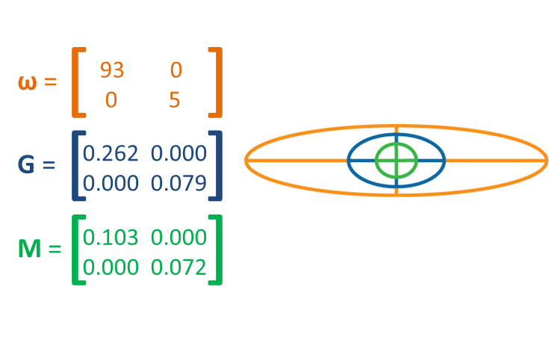

Slide 32
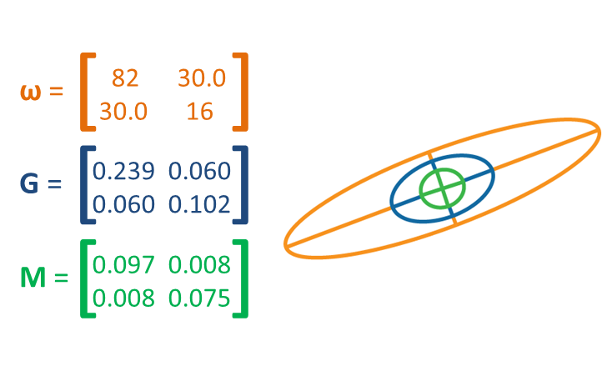

Slide 33
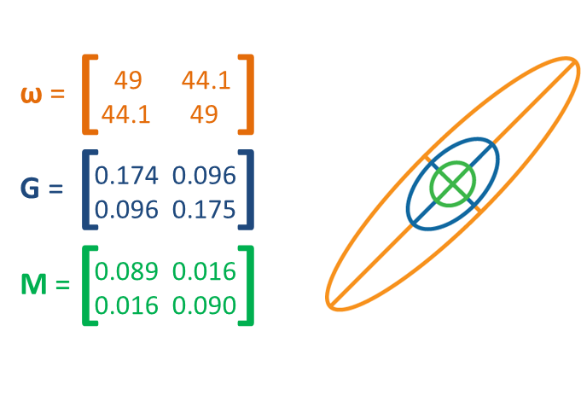

Slide 34
Conclusions from G matrix simulations

Slide 35
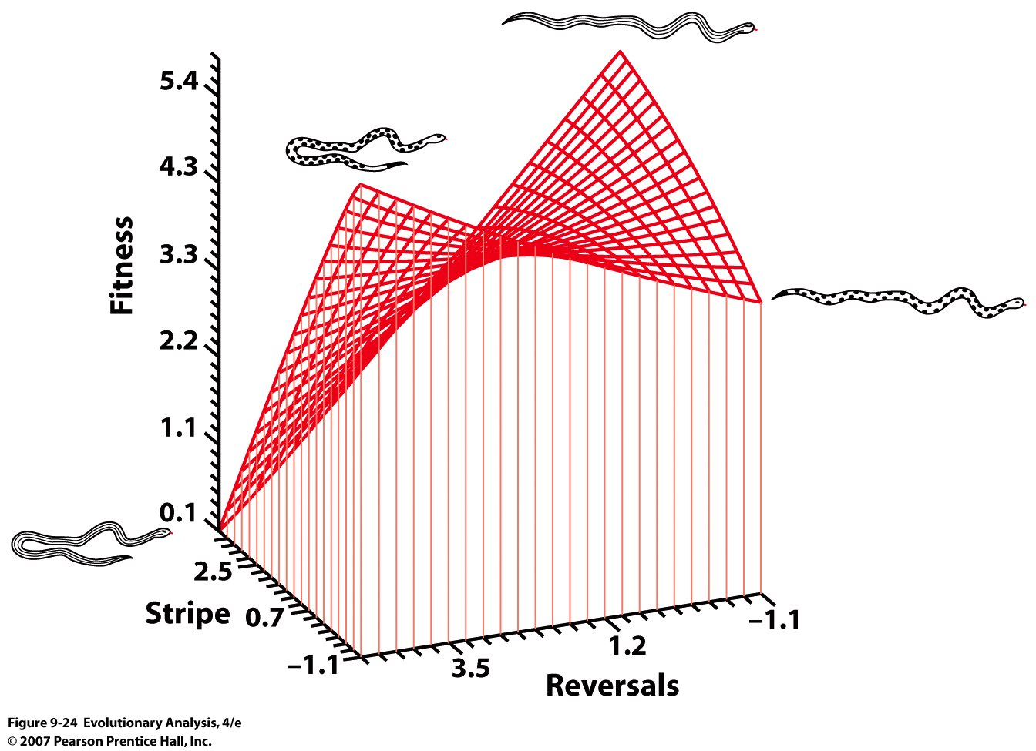
Brodie 1992

Slide 36
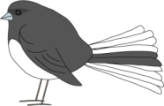
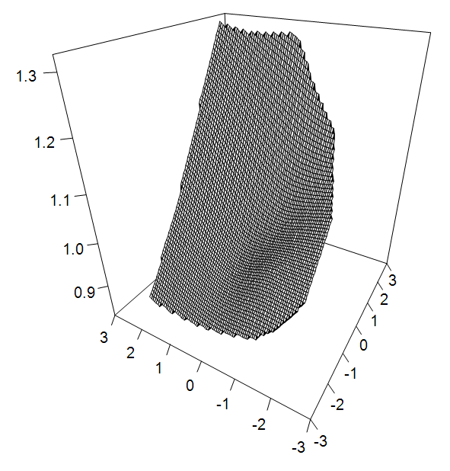
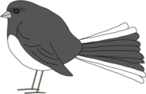


Mating
success
Body size
Plumage
McGlothlin et al. 2005

Slide 37
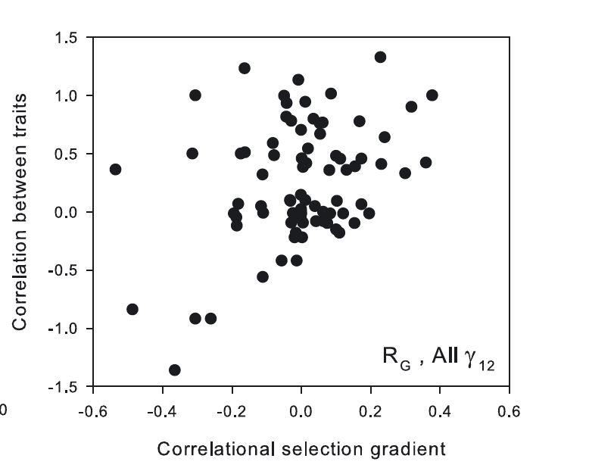
Roff & Fairbairn 2012

Slide 38
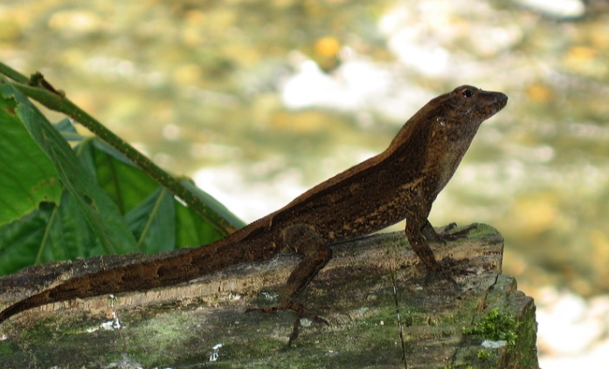
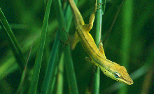
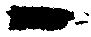
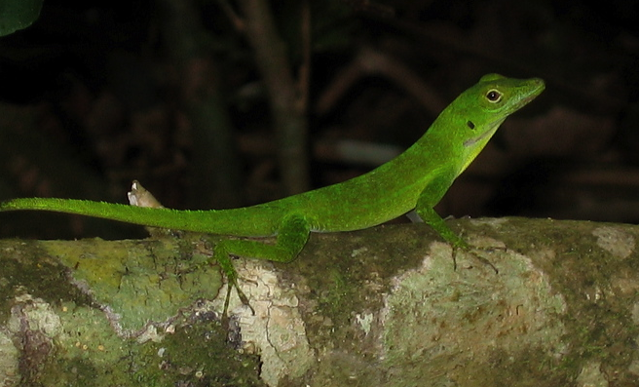
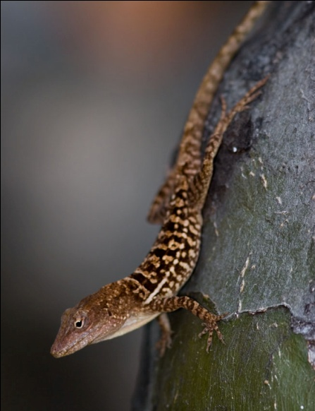

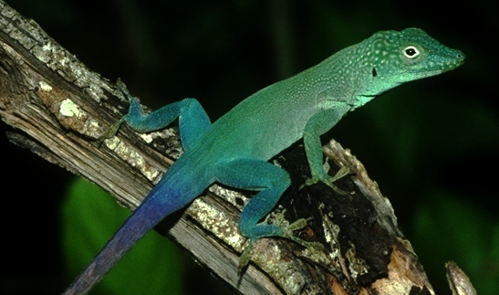
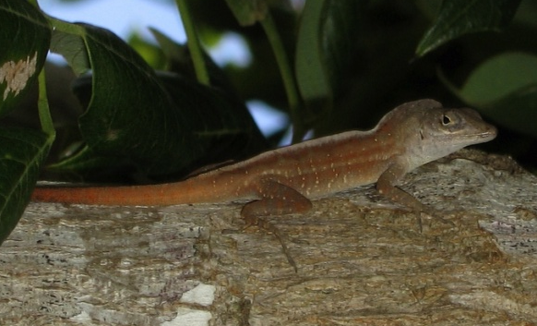

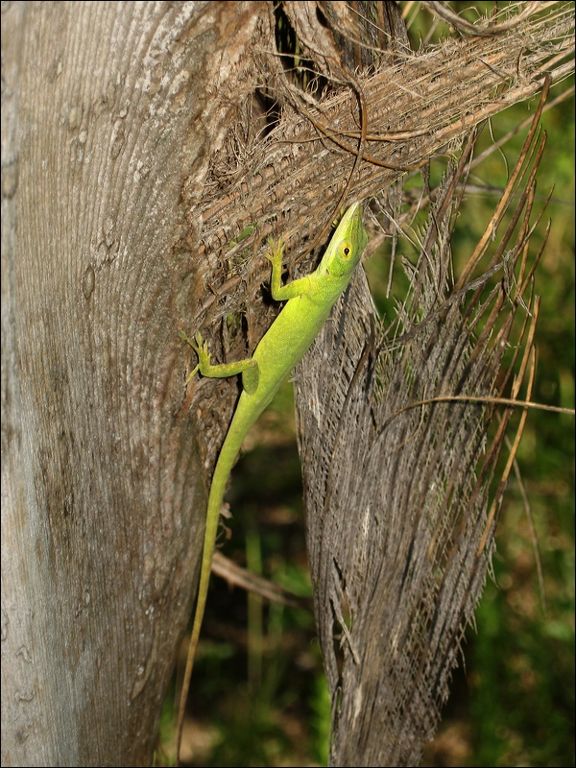
TG
22.5
GB
26.6
TC
40.9
TG
30.9
TC
41.5
37.1
TG
TC

Slide 39
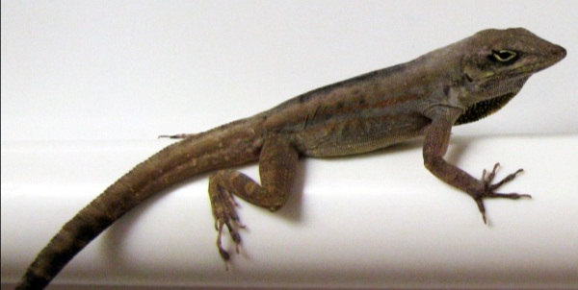
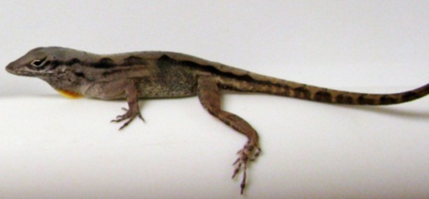
♂
♀
♀
Half
sibs
Full sibs
Full sibs

Slide 40
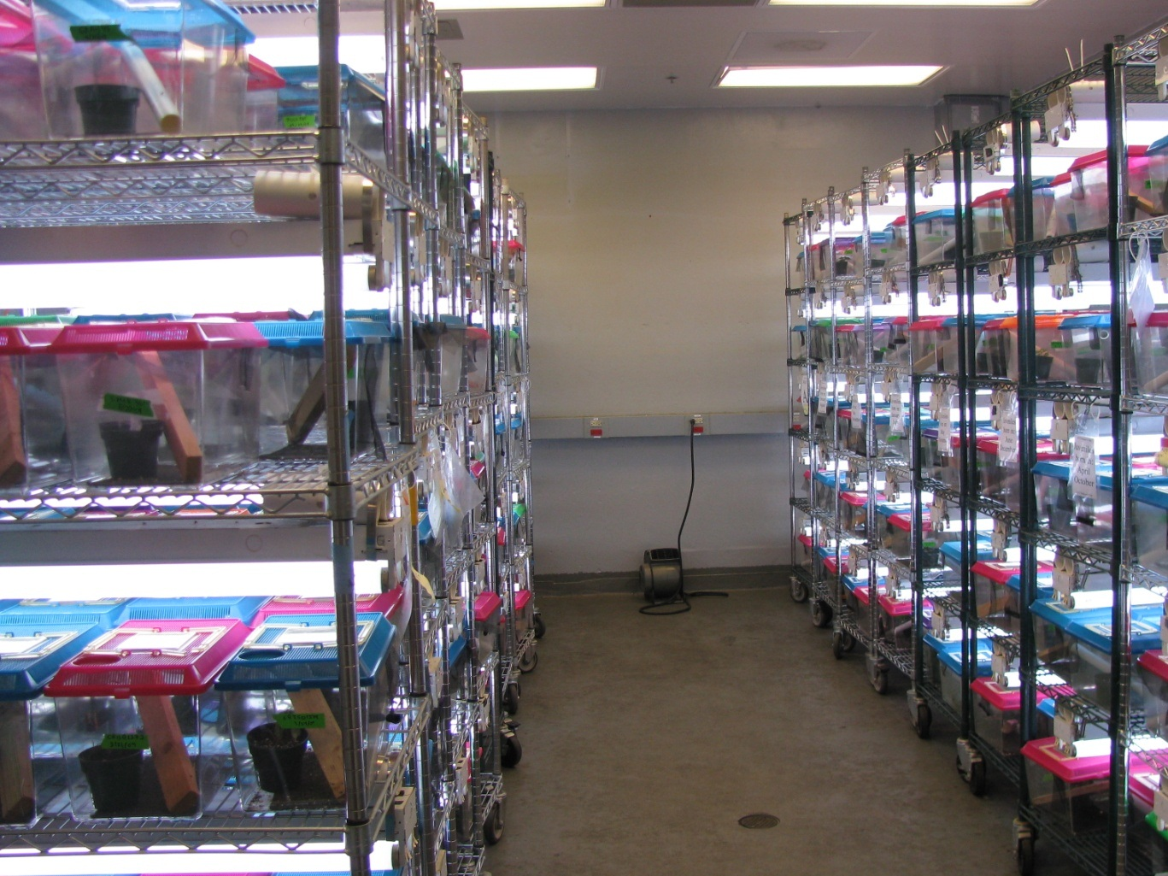
2845 juveniles,
reared to 6 months

Slide 41
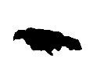

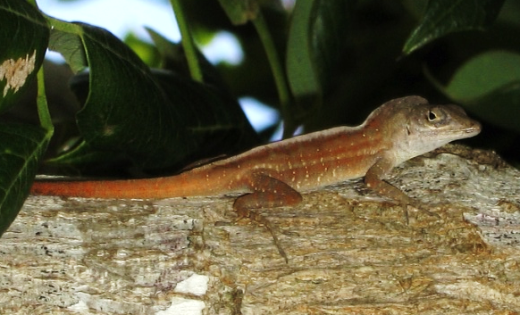

Shorter hindlimbs,
wider bodies
TC
0.15
TC
0.10
TC
0.05
0.00
Divergence axis 2 (d₂, 18.5%)
-0.05
TG
TG
-0.10
-0.15
GB
TG
-0.20
Longer hindlimbs,
narrower bodies
Shorter limbs,
narrower heads
-0.30
-0.25
-0.20
-0.15
-0.10
-0.05
0.00
0.05
0.10
0.15
0.20
0.25
0.30
Longer limbs,
wider heads
Divergence axis 1 (d₁, 73.5%)

Slide 42
A
C
A. cristatellus Trunk-ground
A. pulchellus Grass-bush
A. evermanni Trunk-crown
A. lineatopus Trunk-ground
A. grahami Trunk-crown
A. sagrei Trunk-ground
A. smaragdinus Trunk-crown
0.24
-0.12 | 0.44
-0.21 | 0.48 | 0.55
0.43 | 0.09 | -0.26 | -0.19
0.13 | 0.11 | -0.08 | 0.02 | 0.81
0.40 | 0.05 | -0.05 | -0.08 | 0.84 | 0.78
0.48 | 0.01 | -0.15 | -0.11 | 0.81 | 0.77 | 0.89
0.70
0.81 | 0.57
0.28 | 0.19 | 0.36
0.59 | 0.12 | 0.19 | -0.05
0.63 | 0.20 | 0.23 | -0.18 | 0.90
0.38 | 0.12 | 0.20 | 0.17 | 0.66 | 0.63
0.36 | 0.09 | 0.17 | 0.18 | 0.55 | 0.62 | 0.91
-0.05
0.03 | 0.71
-0.04 | 0.41 | 0.54
0.31 | 0.04 | 0.05 | 0.19
0.29 | -0.05 | 0.10 | 0.19 | 0.96
0.13 | 0.06 | 0.20 | 0.32 | 0.83 | 0.85
0.18 | 0.06 | 0.13 | 0.25 | 0.79 | 0.82 | 0.97
0.84
0.67 | 0.65
0.30 | 0.27 | 0.41
0.49 | 0.48 | 0.26 | -0.02
0.61 | 0.57 | 0.35 | -0.20 | 0.94
0.63 | 0.35 | 0.63 | 0.24 | 0.54 | 0.52
0.61 | 0.31 | 0.67 | 0.21 | 0.52 | 0.53 | 0.95
0.81
0.43 | 0.38
0.47 | 0.28 | 0.35
0.31 | 0.12 | 0.28 | 0.31
0.24 | 0.22 | 0.19 | 0.14 | 0.79
0.36 | -0.01 | 0.19 | 0.31 | 0.87 | 0.72
0.37 | 0.08 | 0.36 | 0.40 | 0.91 | 0.83 | 0.96
0.38
-0.01 | 0.57
-0.21 | -0.05 | 0.10
0.37 | -0.17 | 0.06 | -0.21
0.06 | -0.32 | -0.11 | 0.15 | 0.74
0.58 | -0.10 | -0.08 | -0.03 | 0.87 | 0.65
0.42 | -0.26 | -0.09 | -0.01 | 0.87 | 0.81 | 0.92
0.23
0.47 | 0.18
0.23 | -0.01 | 0.65
0.72 | 0.60 | 0.23 | 0.26
0.60 | 0.35 | 0.41 | 0.60 | 0.78
0.59 | 0.26 | 0.26 | 0.26 | 0.77 | 0.73
0.64 | 0.03 | 0.31 | 0.48 | 0.72 | 0.81 | 0.92
JL
HW
PECT
UL
HUM
FEM
TIB
PELV
B
HW
PECT
PELV
HUM
UL
FEM
TIB
 | JL | HW | PECT | PELV | HUM | UL | FEM
-0.32 0 1

Slide 43

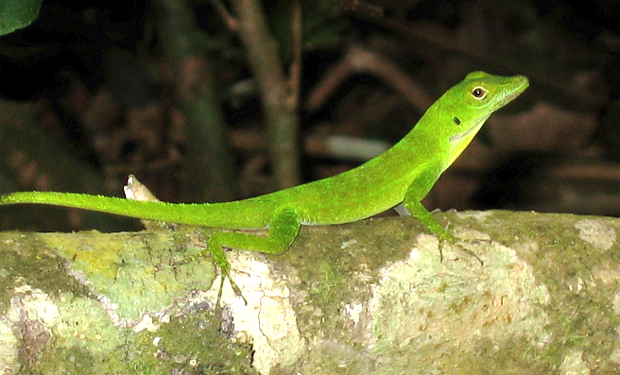
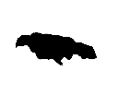
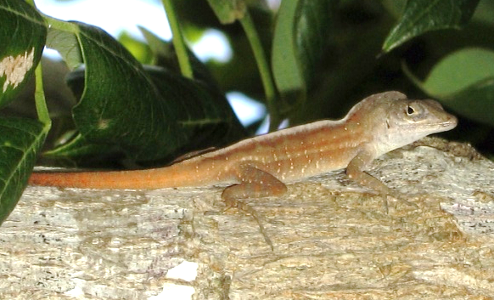

A. cristatellus Trunk-ground
A. pulchellus Grass-bush
A. evermanni Trunk-crown
A. lineatopus Trunk-ground
A. grahami Trunk-crown
A. sagrei Trunk-ground
A. smaragdinus Trunk-crown
0.87
0.89 | 0.90
0.78 | 0.92 | 0.81
0.84 | 0.89 | 0.83 | 0.85
0.88 | 0.82 | 0.84 | 0.75 | 0.87
0.81 | 0.84 | 0.82 | 0.81 | 0.79 | 0.77
TG
TC
TG
TG
TC
TC

Slide 44
TG
G matrix evolution
Matrices differ in size, shape, and orientation
Most matrices share no common PCs
Phylogenetic signal
Ecomorph effect
GB
TC
TG
TC
Is there a signature of genetic constraint in the Anolis radiation?
TG
TC

Slide 45
Common subspace analysis:
How are G matrices most similar?
h₁
Tensor analysis:
How do G matrices differ the most?
e₁

Slide 46
h₁
θ
d₁
Aligned
θ < 36° (P < 0.01)
e₁
θ
d₁

Slide 47
h₁
θ
d₁
Not aligned
θ > 36° (P > 0.01)
e₁
θ
d₁

Slide 48
Common subspace analysis:
How are G matrices most similar?
h₁
 | h₁
avg % variance | 52.8
jaw length | 0.187
head width | 0.139
pectoral | 0.250
pelvis | 0.197
humerus | 0.500
ulna | 0.491
femur | 0.401
tibia | 0.438
h₁ explains 46 – 61% of variance within species
Similar to shared g_{max} (92% of g_{max})

Slide 49
 | d₁ | h₁
% variance | 73.5 | 52.8
jaw length | 0.017 | 0.187
head width | 0.365 | 0.139
pectoral | 0.140 | 0.250
pelvis | 0.216 | 0.197
humerus | 0.323 | 0.500
ulna | 0.532 | 0.491
femur | 0.373 | 0.401
tibia | 0.522 | 0.438
h₁
21.0°
d₁
Most divergence is aligned with g_{max}
Notes:
How did this compare to divergence? Surprisingly, it was closely and significantly aligned at an angle of 21 degrees.
The loadings in these two vectors were similar, particularly so for limb traits.
This shows that most divergence was aligned with gmax.

Slide 50
Tensor analysis:
How do G matrices differ the most?
e₁
 | e₁
% variance | 40.7
jaw length | -0.020
head width | 0.006
pectoral | -0.104
pelvis | -0.019
humerus | 0.459
ulna | 0.411
femur | 0.531
tibia | 0.571
84% of variation among G matrices in 3 subspaces (“eigentensors”)
41% of variation explained by e₁
Notes:
Let’s see what tensor analysis can tell us. Remember, this tells us how G matrices vary.
First, it shows that G varies in a lot of different directions—most variation is in three different “subspaces” or “eigentensors.”
More relevant now, though, is that a huge amount of variance—41%--is in this major axis e1.
The cartoons at the top here are our G matrices aligned along e1, and suggest that the major difference here is that G becomes wider as you move along e1.

Slide 51
 | d₁ | h₁ | e₁
% variance | 73.5 | 52.8 | 40.7
jaw length | 0.017 | 0.187 | -0.020
head width | 0.365 | 0.139 | 0.006
pectoral | 0.140 | 0.250 | -0.104
pelvis | 0.216 | 0.197 | -0.019
humerus | 0.323 | 0.500 | 0.459
ulna | 0.532 | 0.491 | 0.411
femur | 0.373 | 0.401 | 0.531
tibia | 0.522 | 0.438 | 0.571
h₁
21.0°
d₁
e₁
e₁
32.1°
30.4°
d₁
h₁

Slide 52
Shorter hindlimbs,
wider bodies
TC
TC
0.15
h₁
0.10
0.05
0.00
d₁
Divergence axis 2 (d₂, 18.5%)
TG
TC
-0.05
TG
-0.10
GB
-0.15
-0.20
TG
Longer hindlimbs,
narrower bodies
Shorter limbs,
narrower heads
-0.30
-0.25
-0.20
-0.15
-0.10
-0.05
0.00
0.05
0.10
0.15
0.20
0.25
0.30
Longer limbs,
wider heads
Divergence axis 1 (d₁, 73.5%)

Slide 53
TG
GB
Deeply conserved genetic line of least resistance aligned with deep divergence
(40+ my)
Triple alignment of divergence, g_{max}, and change in G
Signature of constraint persists even as constraints evolve
TC
TG
TC
TG
TC

Slide 54
-1.5
-2
log D
-2.5
-3
-3.5
log D = 1.93 + 1.40 log G
-4
R²: 0.88
-6
-4.5
-4
-3.5
-3
-2.5
-6.5
log G
-7
log D_{G}
-7.5
-8
-8.5
-9
log D_{G} = -1.35 + 1.83 log G
-9.5
R²: 0.98
-4.5
-4
-3.5
-3
-2.5
log G

Slide 55
Conclusions from Anolis work

Slide 56
General discussion

