Slide 1
Paradox of predictability
EQGW 2025

Slide 2
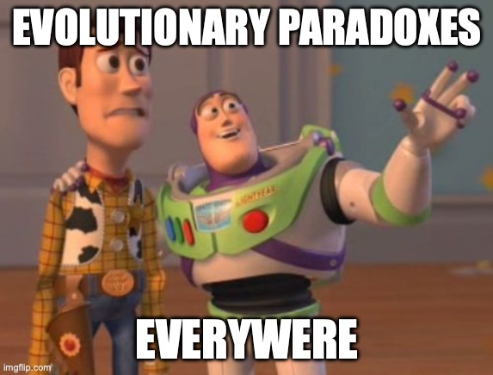

Slide 3
Is macroevolution just microevolution+time?
Notes:
One of the greatest questions that students of macroevolution ponder is to what degree can we extrapolate microevolutionary processes to a macroevolutionary context. Or, in other words, if is macroevolution just microevolution plus time.
If there is a discontinuity between these levels of analysis, then our ability to make inference at large scales is compromised. As an historical science, macroevolution cannot directly test predictions about the fundamental processes of evolution, such as selection and drift, which are the realm of microevolutionary studies. However, if that bridge is closed, then our ability to narrow into biological causes at large scales can be severely reduced.
Then, what is the answer to this question? If I can summarize honestly the consensus of the field on this question, it would go something like this:

Slide 4
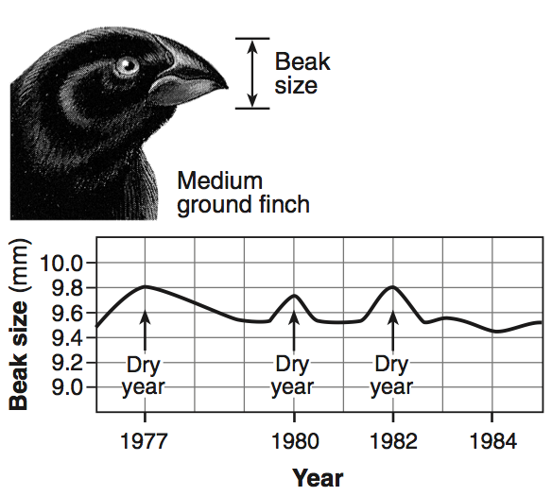
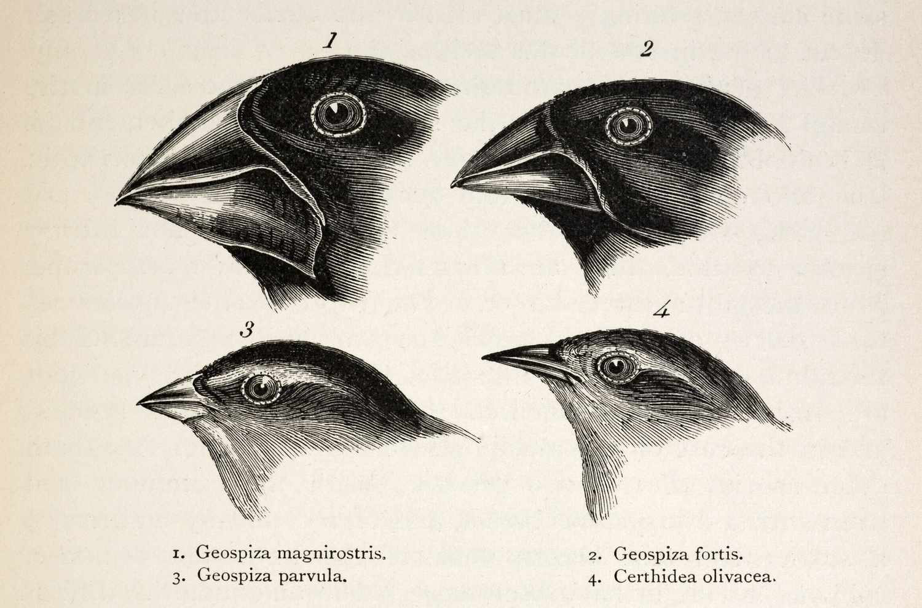
Microevolution
MACROEVOLUTION
Within species
Small time scale (ys, gens)
Reduced magnitude
Multiple species
Large time scale (mys, geological time)
Larger magnitude
Notes:
Classically we’ve have classified evolutionary phenomena in two categories.
One is the microevolutionary scale, where we evaluate change within species, at a restricted time scale and usually involves changes that are reduced in magnitude.
On the other side, we have macroevolution, which involves the analysis of multiple species, at larger time scales and involves changes of larger magnitude.
Two classical examples of these are the microevolutionary changes of Darwin finches beaks as a response to drought events, and the macroevolutionaty trend of increase brainsize in the lineage leading to humans.

Slide 5
Microevolution
MACROEVOLUTION
Within species
Small time scale (ys, gens)
Reduced magnitude
Multiple species
Large time scale (mys, geological time)
Larger magnitude
Is there a difference
(other than time)?
Notes:
Classically we’ve have classified evolutionary phenomena in two categories.
One is the microevolutionary scale, where we evaluate change within species, at a restricted time scale and usually involves changes that are reduced in magnitude.
On the other side, we have macroevolution, which involves the analysis of multiple species, at larger time scales and involves changes of larger magnitude.
Two classical examples of these are the microevolutionary changes of Darwin finches beaks as a response to drought events, and the macroevolutionaty trend of increase brainsize in the lineage leading to humans.

Slide 6
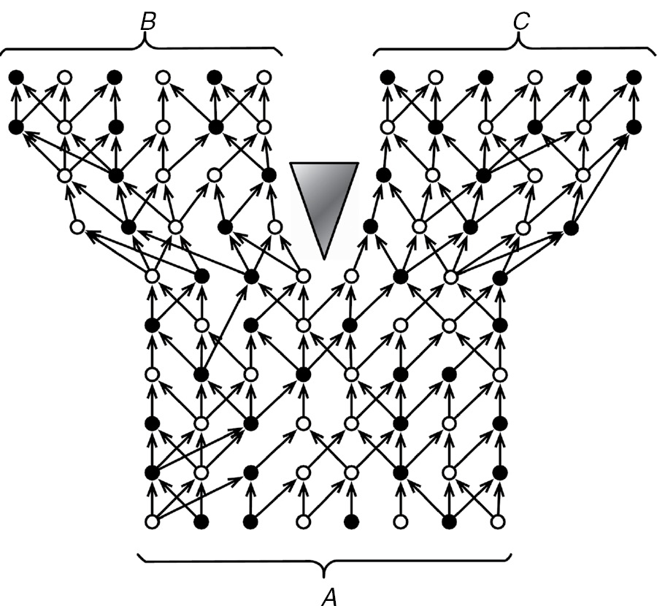
Population dynamics
Hennig, 1966

Slide 7

No additional processes required
Population dynamics
Hennig, 1966

Slide 8
No additional processes required
Population dynamics
Models
Hennig, 1966

Slide 9
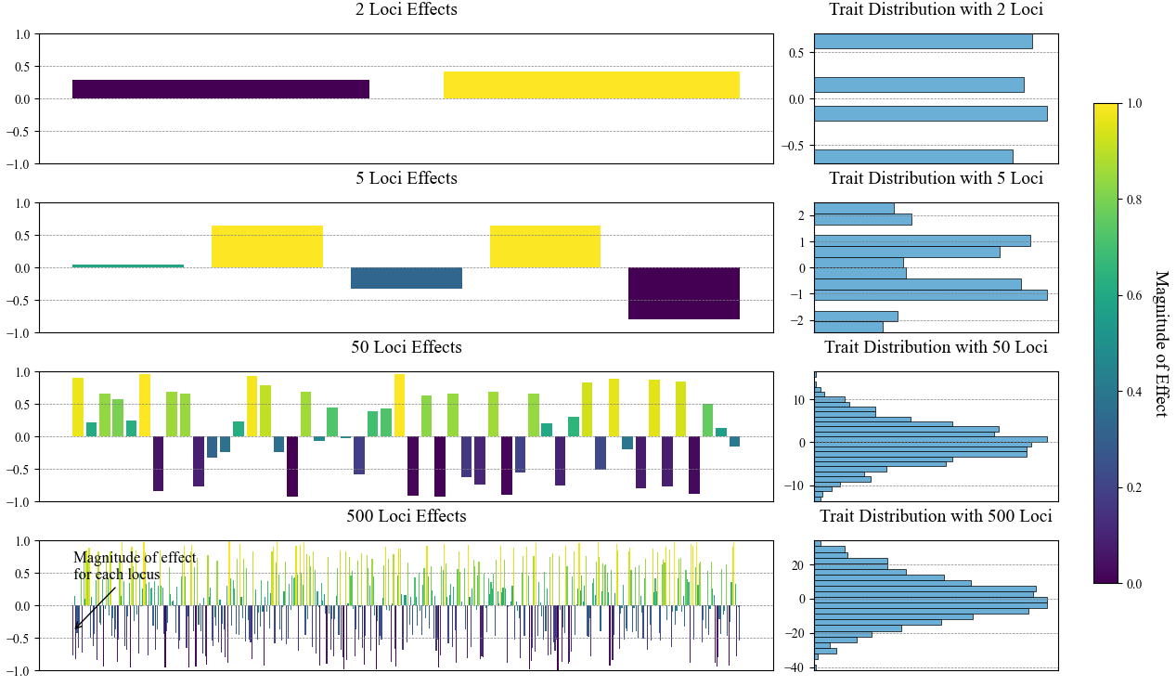
Infinitesimal model of trait variation
Allows for the statistical treatment of the evolution of continuous traits

Slide 10
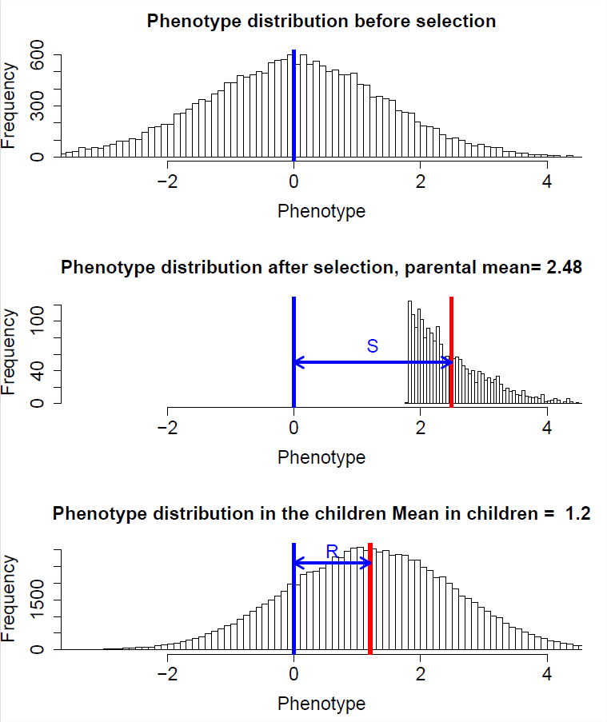

Models of trait evolution based on evolutionary processes
Directional selection
$${R=Sh}^{2}$$
$$∆\overline{z}\left(t\right)=\left[{\overline{z}}_{w}\left(t\right)−\overline{z}\left(t\right)\right] \frac{σ_{a}^{2}}{σ_{p}^{2}}$$

Slide 11
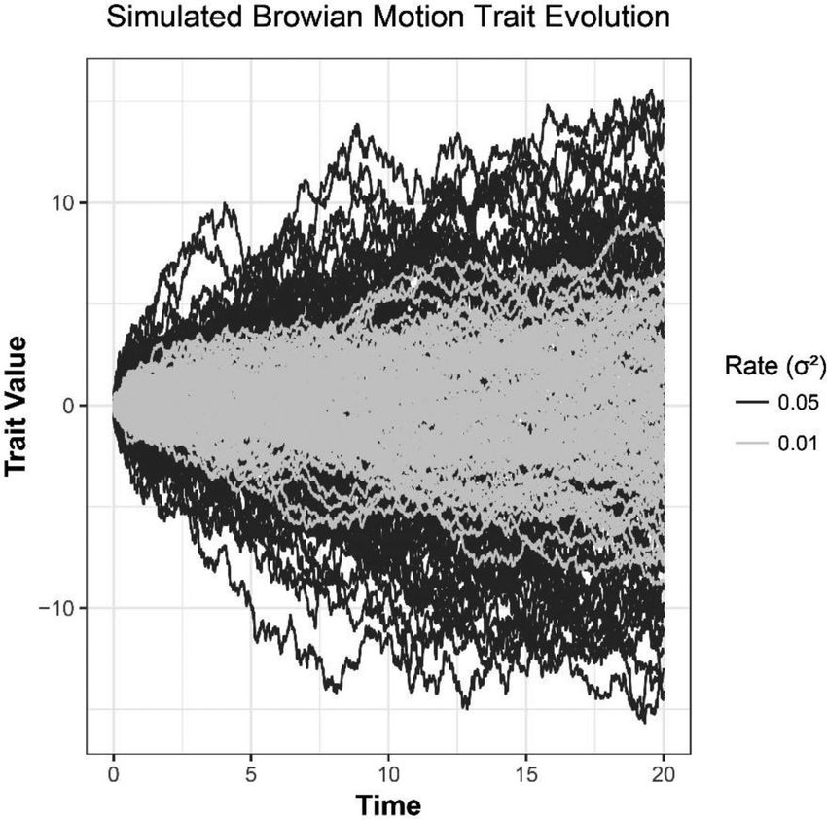

Models of trait evolution based on evolutionary processes
Directional selection
$${R=Sh}^{2}$$
$$∆\overline{z}\left(t\right)=\left[{\overline{z}}_{w}\left(t\right)−\overline{z}\left(t\right)\right] \frac{σ_{a}^{2}}{σ_{p}^{2}}$$
Genetic Drift
$$σ_{b}^{2}\left(t\right)=σ_{a}^{2}\frac{t}{N}$$

Slide 12
Models of trait evolution based on evolutionary processes
Directional selection
$${R=Sh}^{2}$$
$$∆\overline{z}\left(t\right)=\left[{\overline{z}}_{w}\left(t\right)−\overline{z}\left(t\right)\right] \frac{σ_{a}^{2}}{σ_{p}^{2}}$$
Genetic Drift
$$σ_{b}^{2}\left(t\right)=σ_{a}^{2}\frac{t}{N}$$
Null model

Slide 13

Using genetic drift as a null model of macroevolution
$$σ_{b}^{2}\left(t\right)=σ_{a}^{2}\frac{t}{N}$$
Make assumptions of quantitative genetic traits
Generate null expectation under drift
Calculate empirical rates of evolution
Confront them
Slower than drift
Faster than drift
drift
Rates of evolution

Slide 14
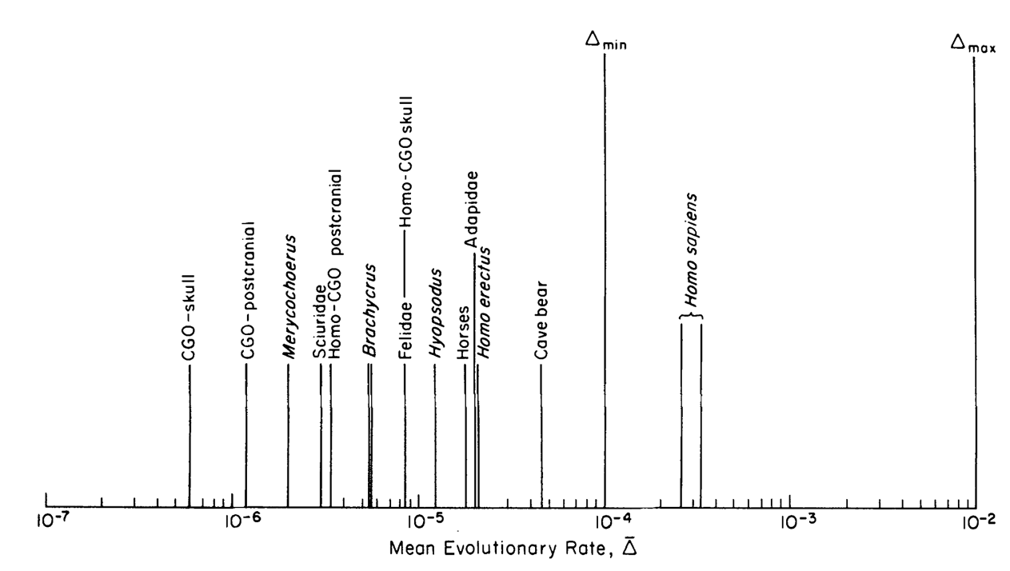
Drift
Consistent with …?
Lynch, 1990
Notes:
BUT in practical sense, when we apply microevolutionary models to macroevolutionary data, then we start to see some conflict. This graph shows how most macroevolutionary change is actually slower than the rates that would be expected under drift, suggesting that an absence of directional selection in shaping large scale trends.

Slide 15
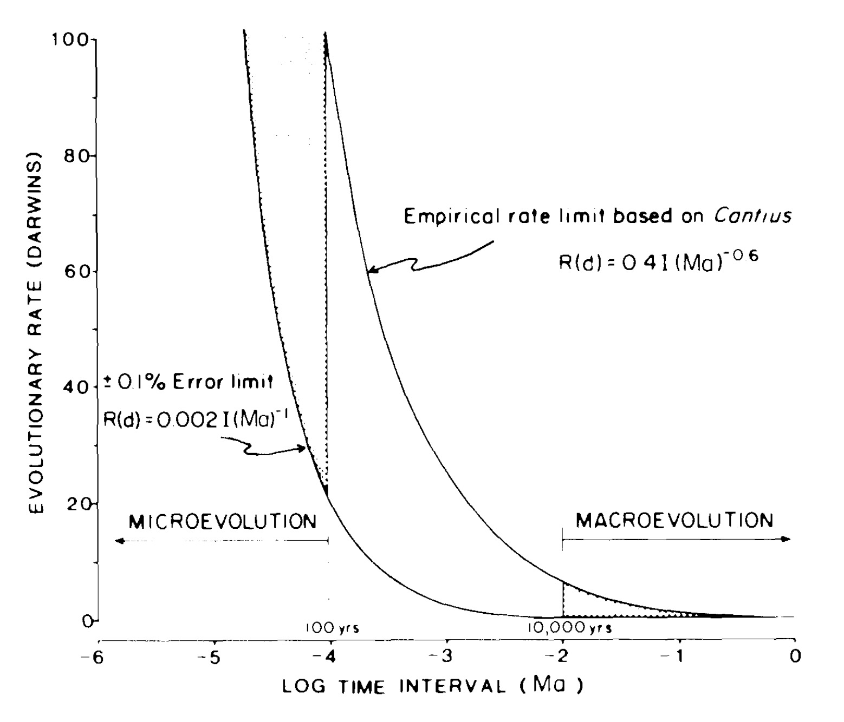
Gingerich, 1987

Slide 16
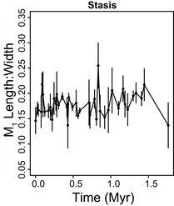
Clyde and Gingerich 1994

Slide 17
Clyde and Gingerich 1994

Slide 18
Low
High
Clyde and Gingerich 1994

Slide 19
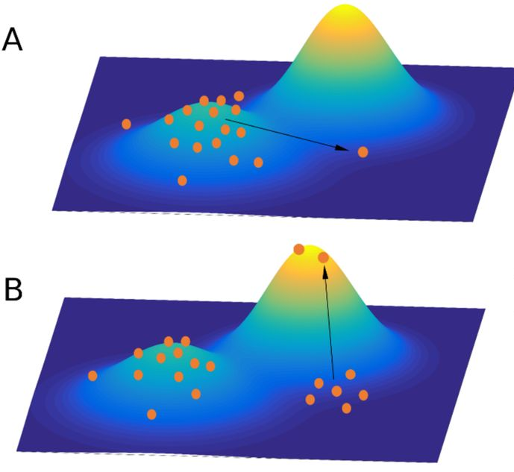
Climbing new peaks is very fast
(given the availability of additive genetic variance), so large scale macroevolutionary dynamics are the result of peak dynamics

Slide 20
Is macroevolution just microevolution+time?
YES. Well, sort of. But in a practical sense, not really… But maybe?
Notes:
yes

Slide 21
Is macroevolution just microevolution+time?
YES. Well, sort of. But in a practical sense, not really… But maybe?
Notes:
Well, sort of.

Slide 22
Is macroevolution just microevolution+time?
YES. Well, sort of. But in a practical sense, not really… But maybe?
Notes:
But in a practical sense, not really…

Slide 23
Is macroevolution just microevolution+time?
YES. Well, sort of. But in a practical sense, not really… But maybe?
Notes:
But in a practical sense, not really…

Slide 24
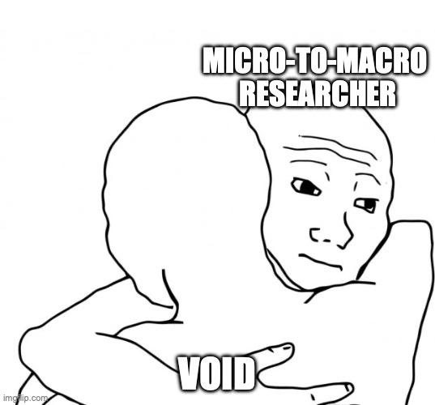
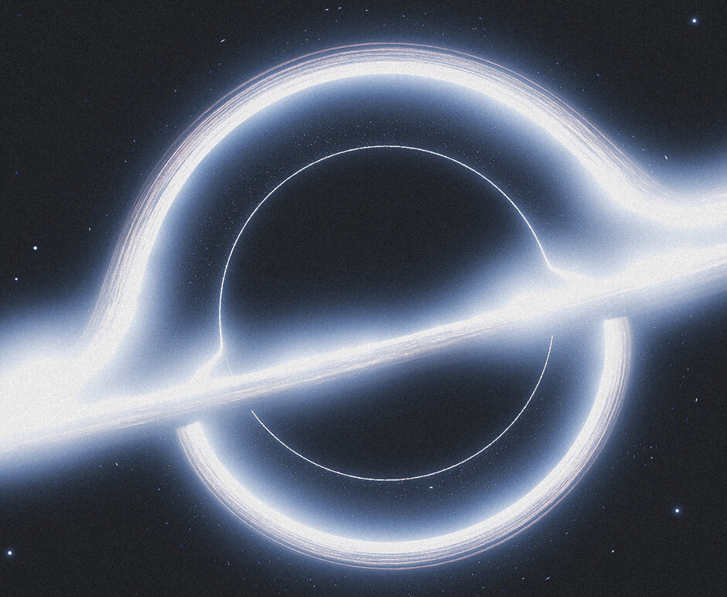

Slide 25


Genetic Drift
Univariate case - rate of evolution is a function of additive genetic variance and a constant
Multivariate case- rates of evolution are a function of additive genetic variance for each trait and a constant (t/Ne)
$$σ_{b}^{2}\left(t\right)=σ_{a}^{2}\frac{t}{N}$$
Univariate
Σ
$$Σ\left(t\right)=G\frac{t}{N}$$
G
Multivariate
Divergence should be proportional to the amount of intraspecific variation

Slide 26
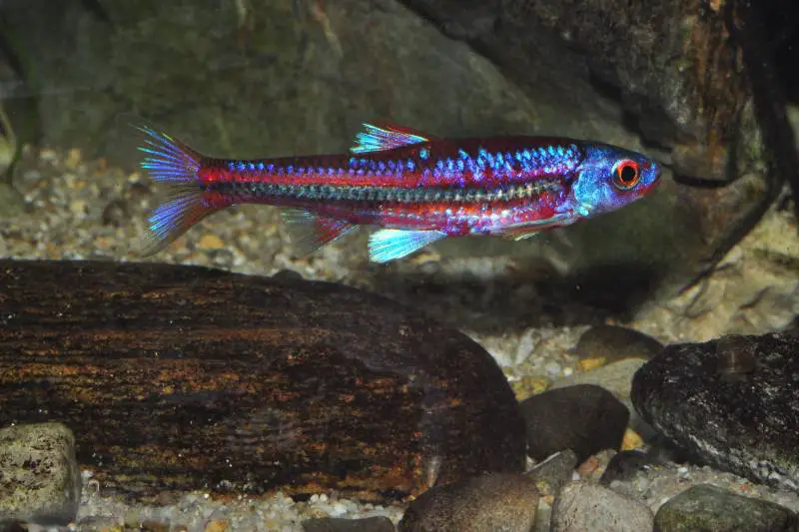
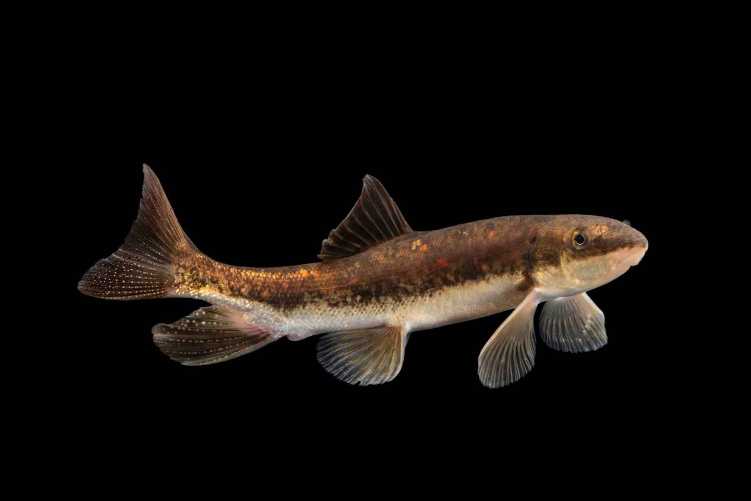
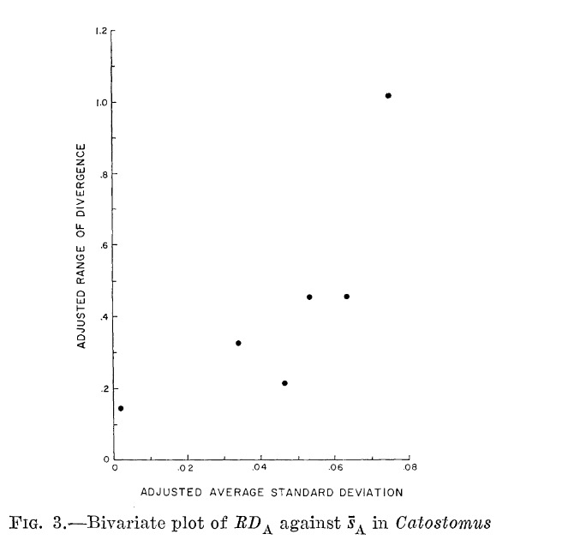
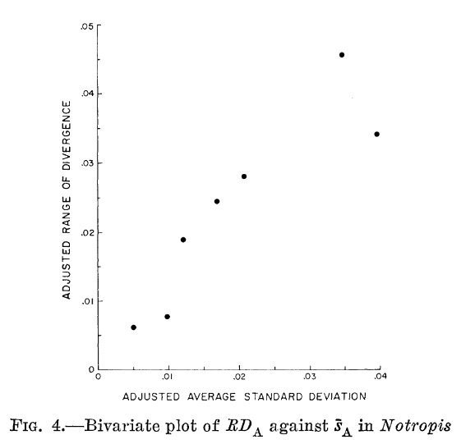
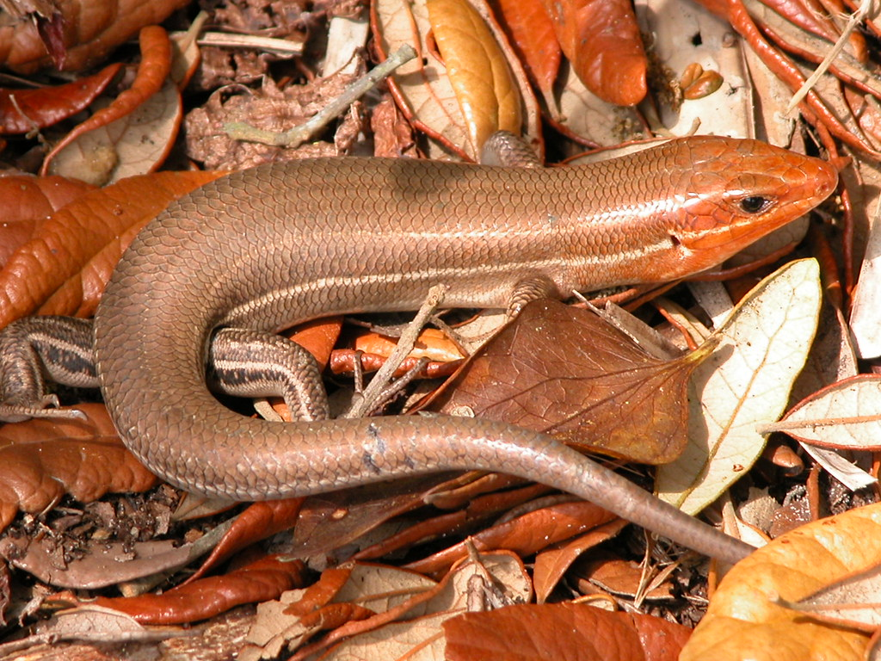
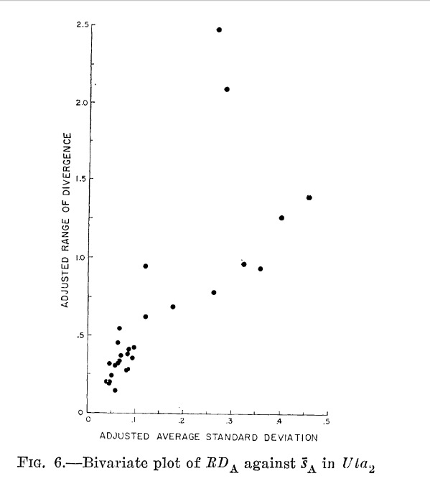
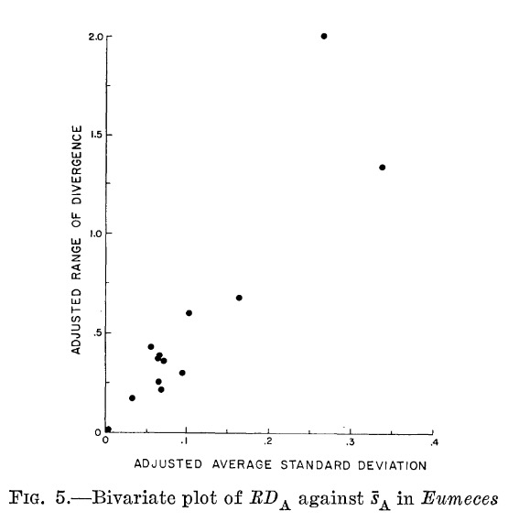
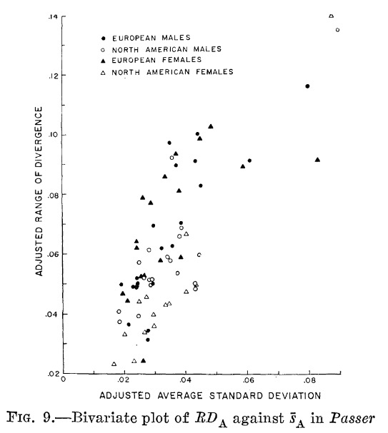
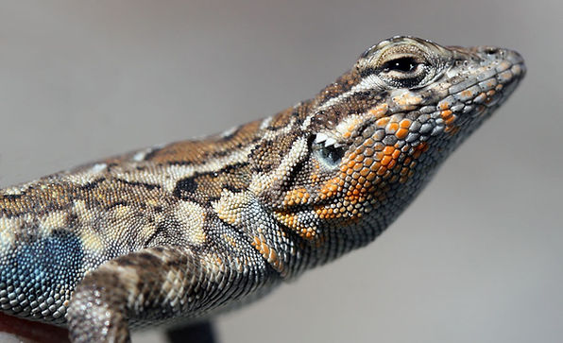
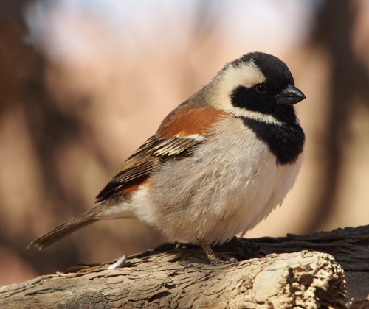
Kluge & Kerfoot (1976)

Slide 27
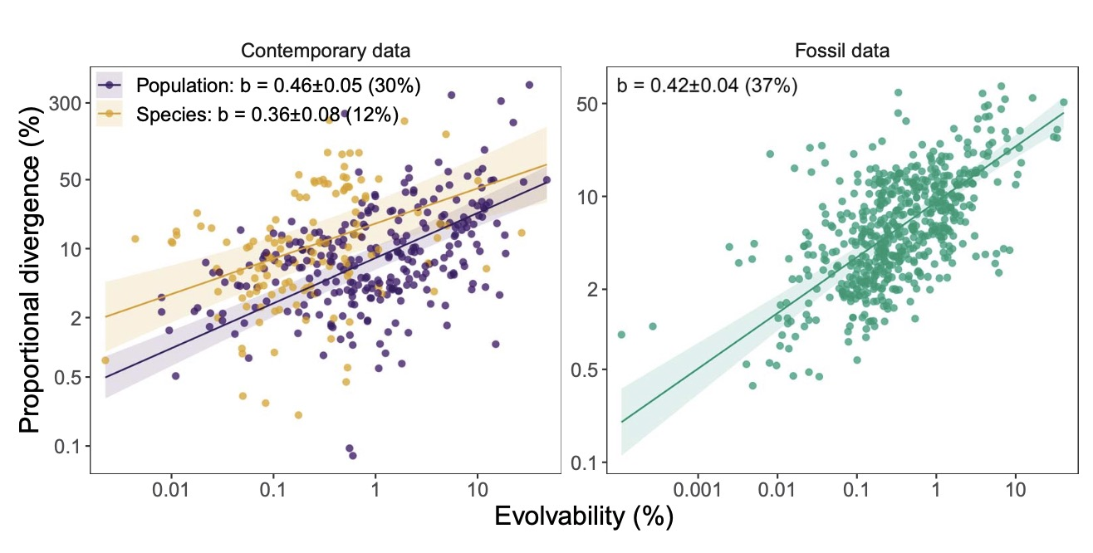
But why?
Holstad et al. 2024

Slide 28

Genetic Drift
$$Σ\left(t\right)=G\frac{t}{N}$$
Σ
Under genetic drift divergence should be proportional to the amount of intraspecific variation
Variation and divergence are proportional
It's possible that traits are evolving neutrally
G

Slide 29
Drift
Drift seams unlikely
Lynch, 1990
Notes:
BUT in practical sense, when we apply microevolutionary models to macroevolutionary data, then we start to see some conflict. This graph shows how most macroevolutionary change is actually slower than the rates that would be expected under drift, suggesting that an absence of directional selection in shaping large scale trends.

Slide 30
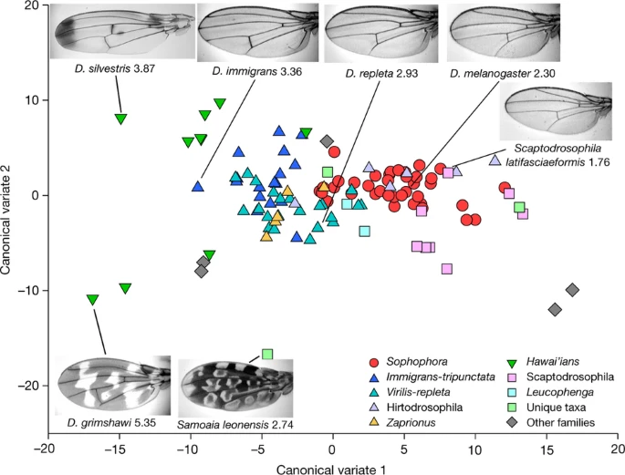
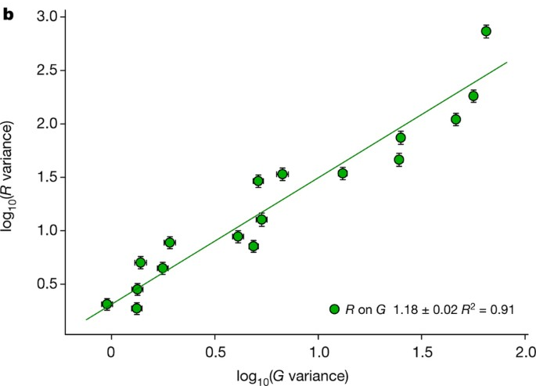
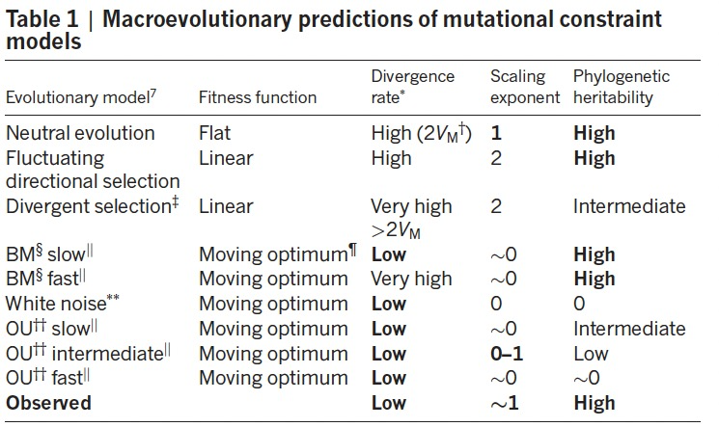
Houle et al. 2017

Slide 31
“paradox of predictability”
Tsuboi et al. 2024
Species can reach peaks rapidly (unlikely to be maladapted)
Rates of evolution are too slow, implying strong influence of stabilizing selection
Evolution is likely dominated by peak distribution and stabilizing selection
Peak distribution should have no relation to phenotypic variation
Still, the amount of trait variation predicts how traits will evolve on large time scales.

Slide 32
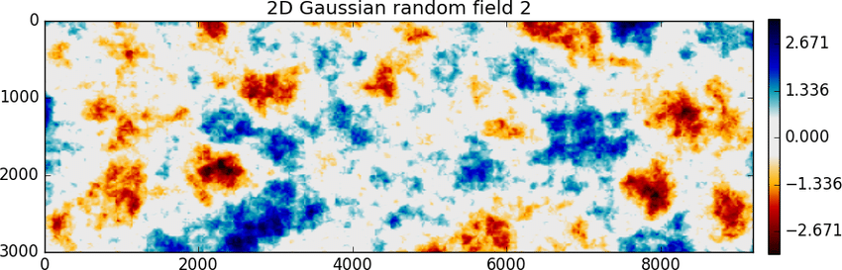
divergence
divergence
evolvability
evolvability
Why?

Slide 33
Potential explanations
Drift in fact , governs (Ackerman & Cheverud 2004)
Constraints
Development defines directions of variation (Rohner & Berger, 2023)
Random selection interacts with G (Holstad et al. 2024)
Structure
Selection
Selection aligns G and divergence (Schluter, 1996)
Development governs scaling of traits at both levels (Gould & Lewontin, 1979)
Selection shapes variation (imitative epigenotype, Riedl, 1978)

Slide 34
Potential explanations
Drift in fact , governs (Ackerman & Cheverud 2004)
Constraints
Development defines directions of variation (Rohner & Berger, 2023)
Random selection interacts with G (Holstad et al. 2024)
Structure
Selection
Selection aligns G and divergence (Schluter, 1996)
Development governs scaling of traits at both levels (Gould & Lewontin, 1979)
Selection shapes variation (imitative epigenotype, Riedl, 1978)

Slide 35
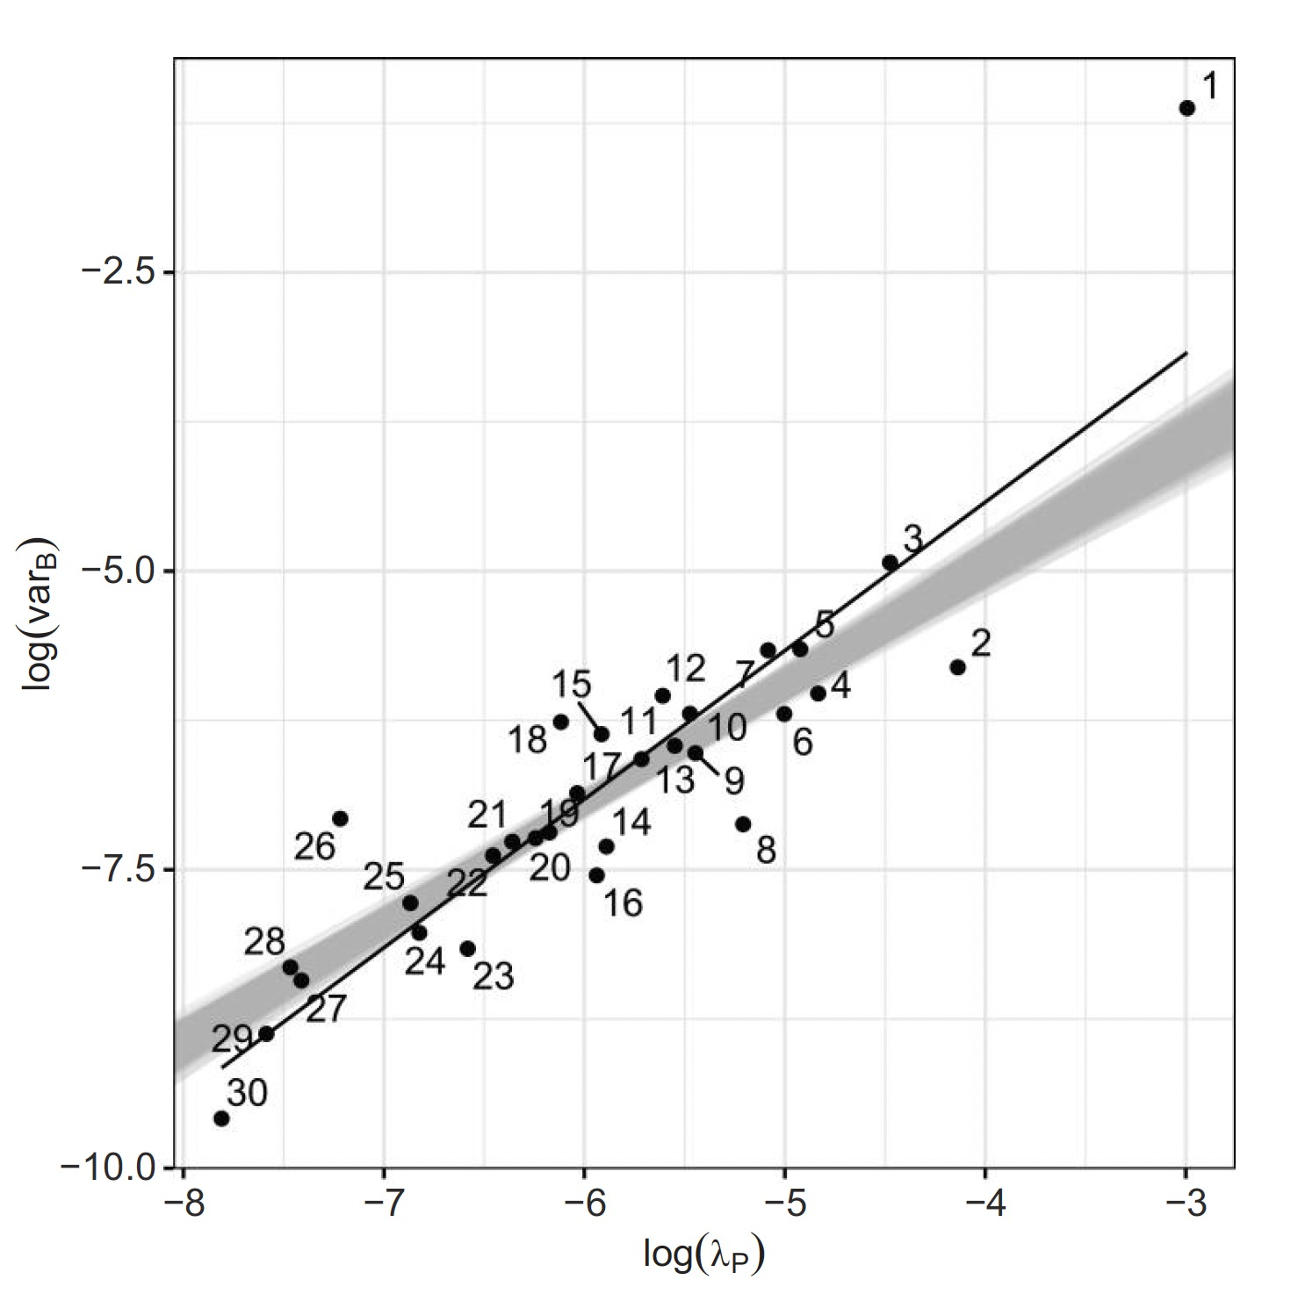
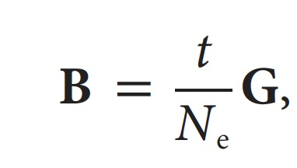
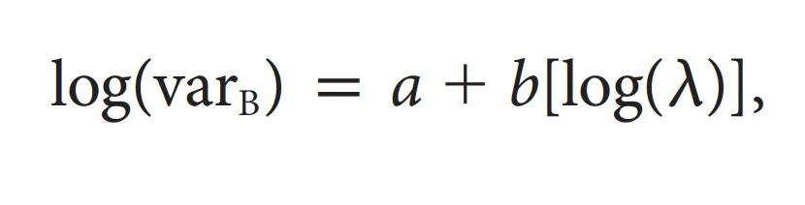
t/Ne -> Nuisance parameter
Machado 2020
Ackerman & Cheverud 2004
Problems?

Slide 36
Potential explanations
Drift in fact , governs (Ackerman & Cheverud 2004)
Constraints
Development defines directions of variation (Rohner & Berger, 2023)
Random selection interacts with G (Holstad et al. 2024)
Structure
Selection
Selection aligns G and divergence (Schluter, 1996)
Development governs scaling of traits at both levels (Gould & Lewontin, 1979)
Selection shapes variation (imitative epigenotype, Riedl, 1978)

Slide 37
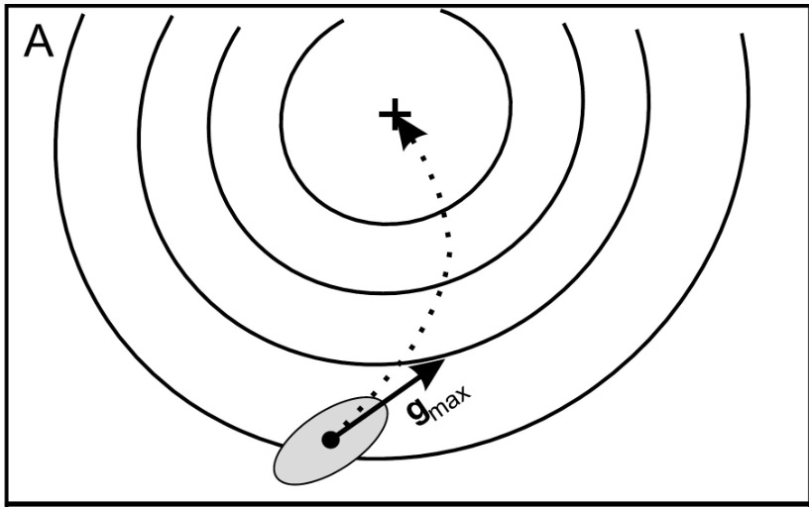

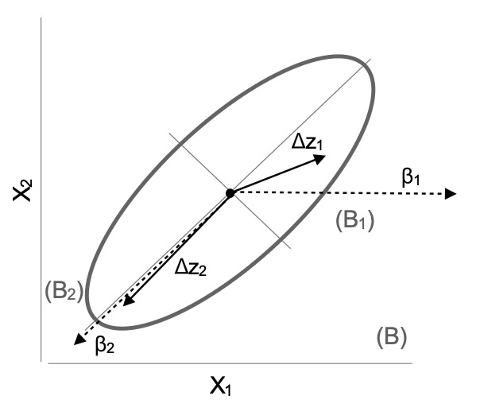
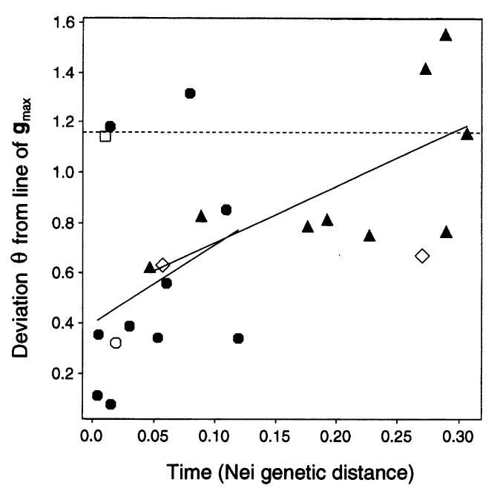
Problems?
Machado 2020
Schluter 1996

Slide 38
Potential explanations
Drift in fact , governs (Ackerman & Cheverud 2004)
Constraints
Development defines directions of variation (Rohner & Berger, 2023)
Random selection interacts with G (Holstad et al. 2024)
Structure
Selection
Selection aligns G and divergence (Schluter, 1996)
Development governs scaling of traits at both levels (Gould & Lewontin, 1979)
Selection shapes variation (imitative epigenotype, Riedl, 1978)

Slide 39
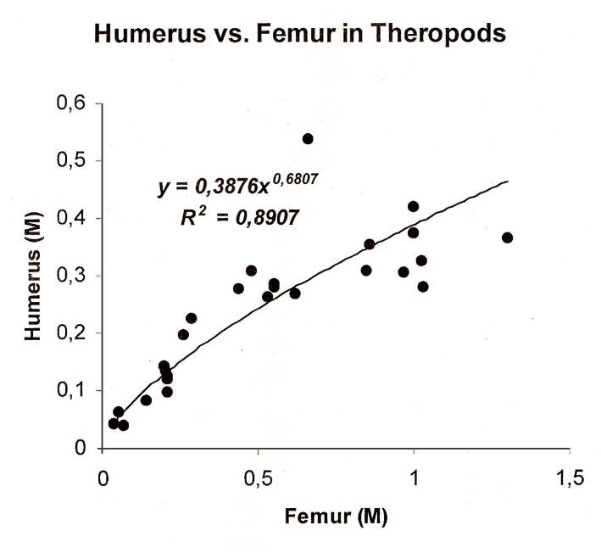
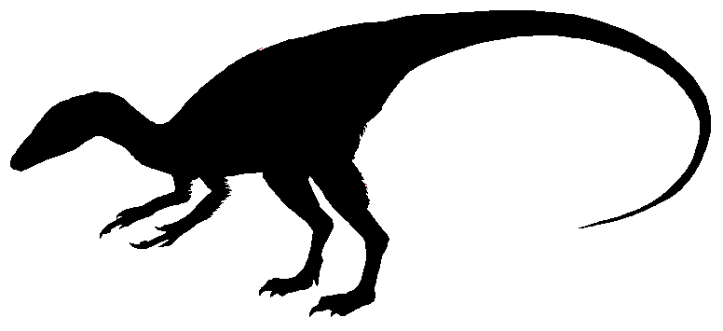
Vargas, 1999
Gould & Lewontin, 1979

Slide 40
Potential explanations
Drift in fact , governs (Ackerman & Cheverud 2004)
Constraints
Development defines directions of variation (Rohner & Berger, 2023)
Random selection interacts with G (Holstad et al. 2024)
Structure
Selection
Selection aligns G and divergence (Schluter, 1996)
Development governs scaling of traits at both levels (Gould & Lewontin, 1979)
Selection shapes variation (imitative epigenotype, Riedl, 1978)

Slide 41
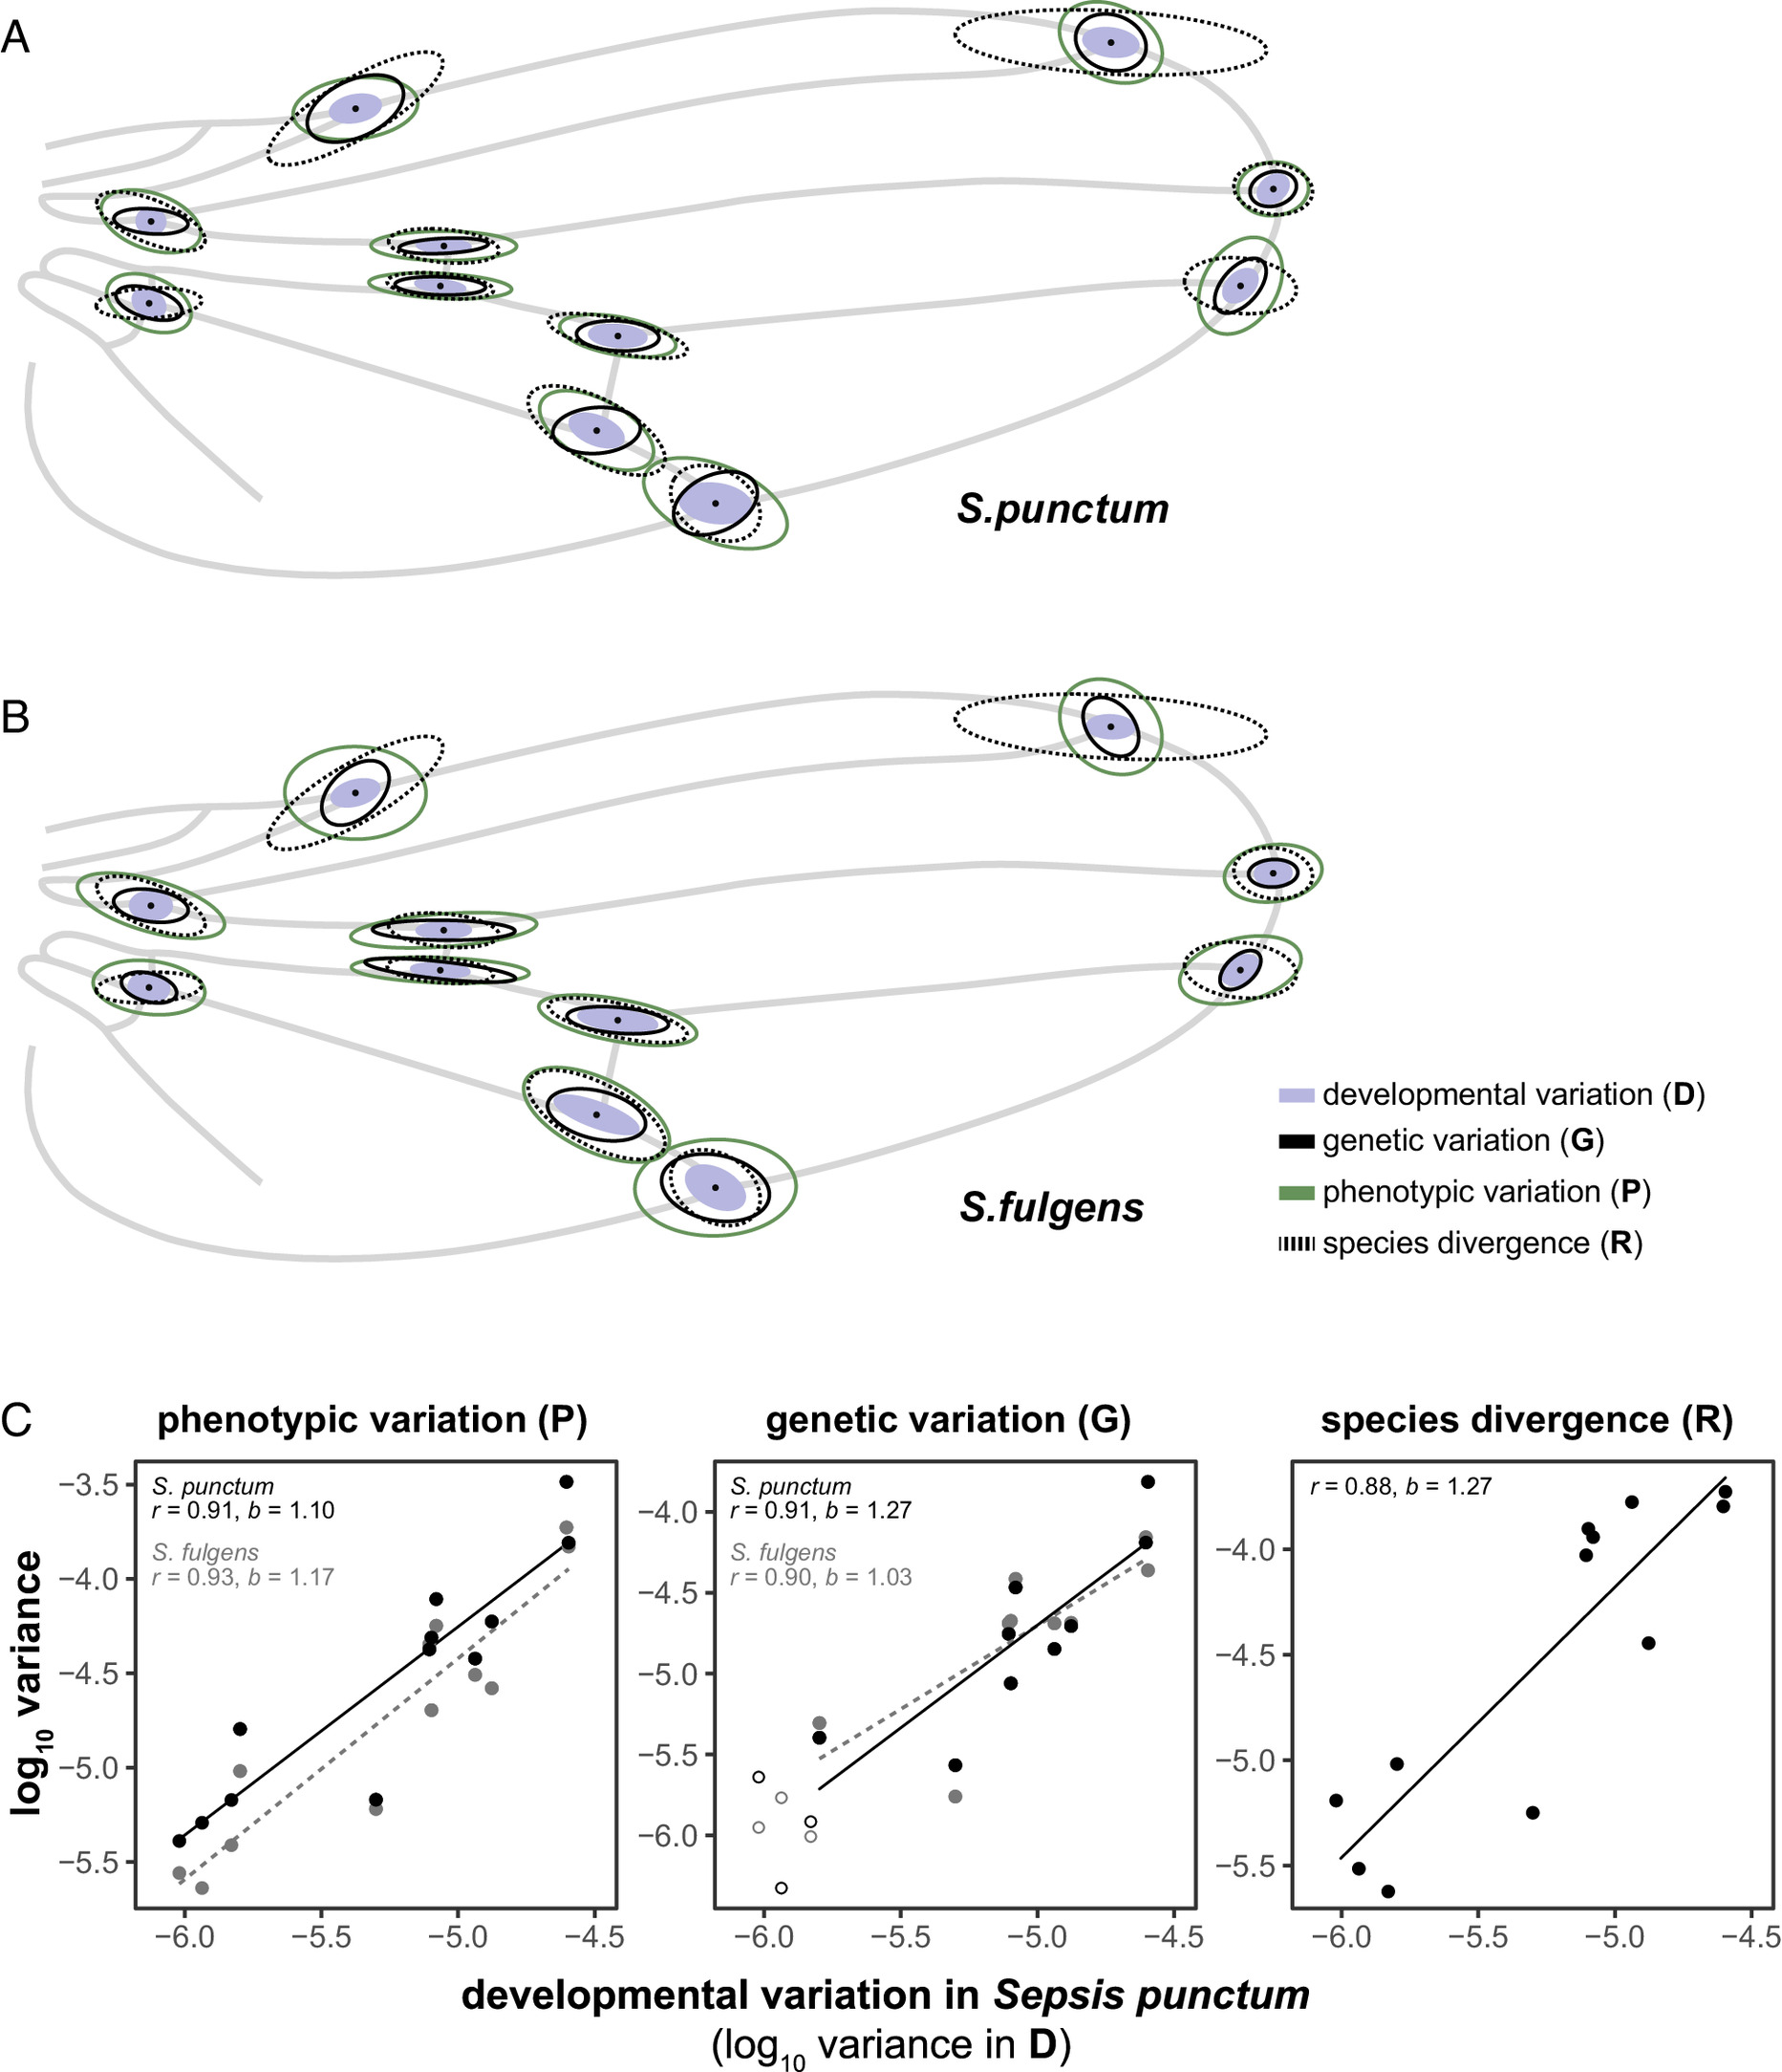
Rohner & Berger, 2023

Slide 42
Potential explanations
Drift in fact , governs (Ackerman & Cheverud 2004)
Constraints
Development defines directions of variation (Rohner & Berger, 2023)
Random selection interacts with G (Holstad et al. 2024)
Structure
Selection
Selection aligns G and divergence (Schluter, 1996)
Development governs scaling of traits at both levels (Gould & Lewontin, 1979)
Selection shapes variation (imitative epigenotype, Riedl, 1978)

Slide 43
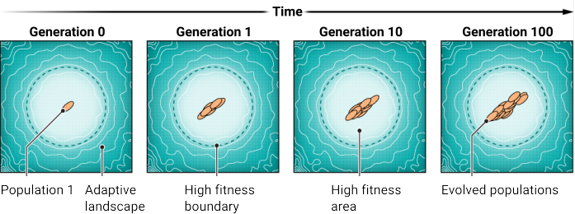
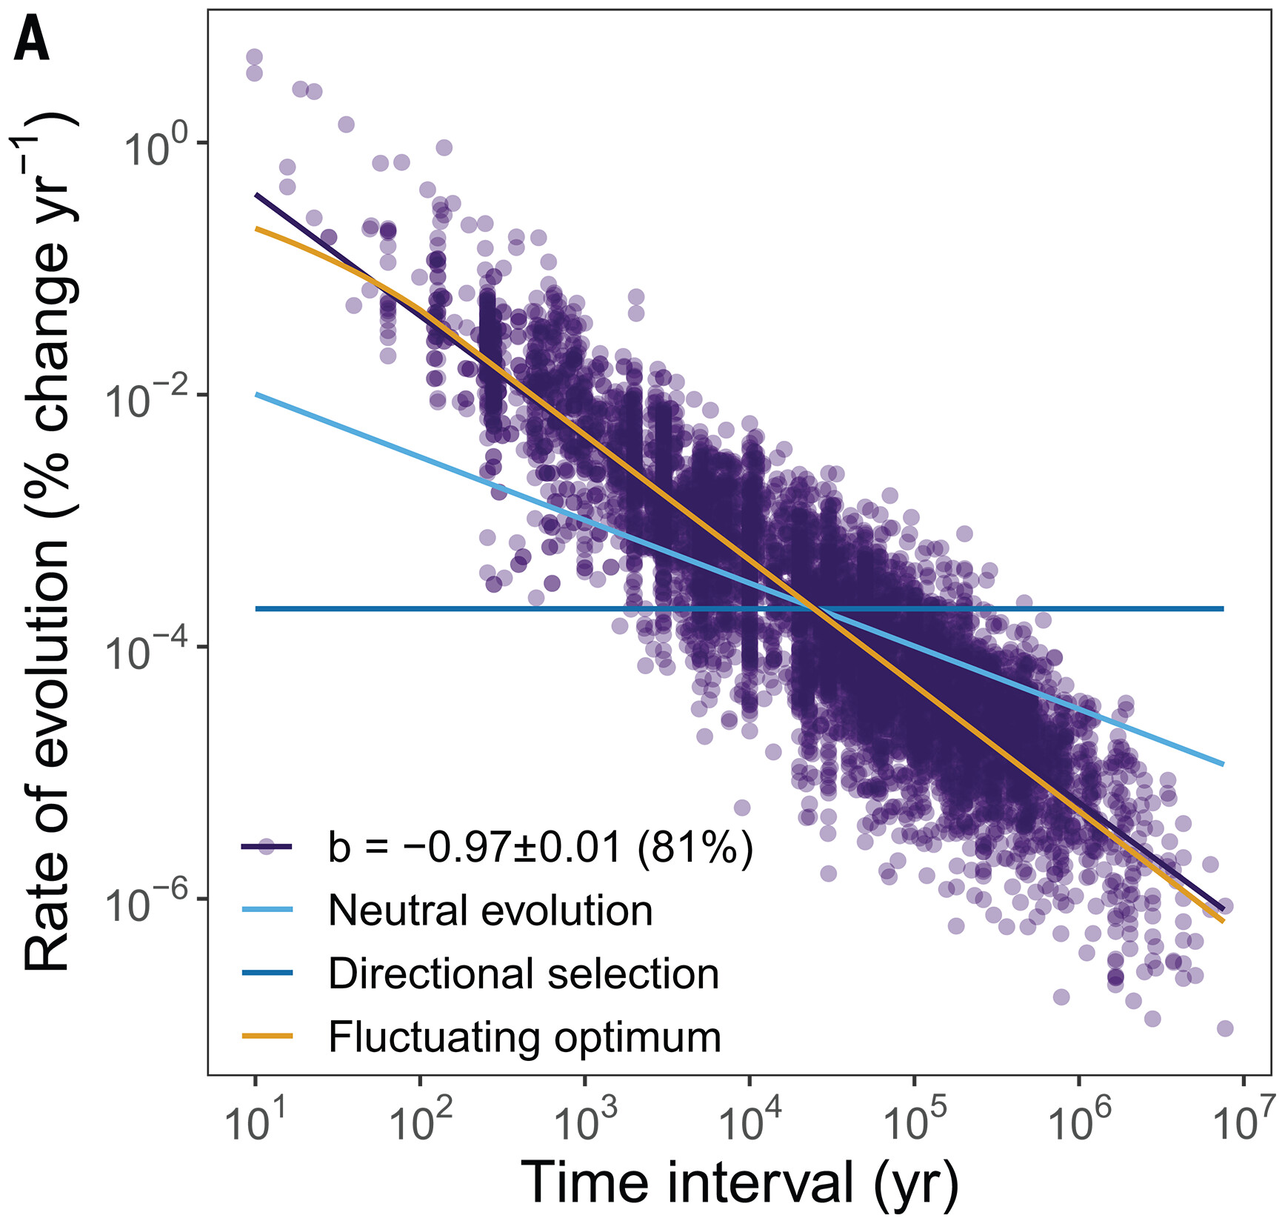
Uyeda & McGlothin, 2024
Holstad et al. 2024

Slide 44
Potential explanations
Drift in fact , governs (Ackerman & Cheverud 2004)
Constraints
Development defines directions of variation (Rohner & Berger, 2023)
Random selection interacts with G (Holstad et al. 2024)
Structure
Selection
Selection aligns G and divergence (Schluter, 1996)
Development governs scaling of traits at both levels (Gould & Lewontin, 1979)
Selection shapes variation (imitative epigenotype, Riedl, 1978)

Slide 45
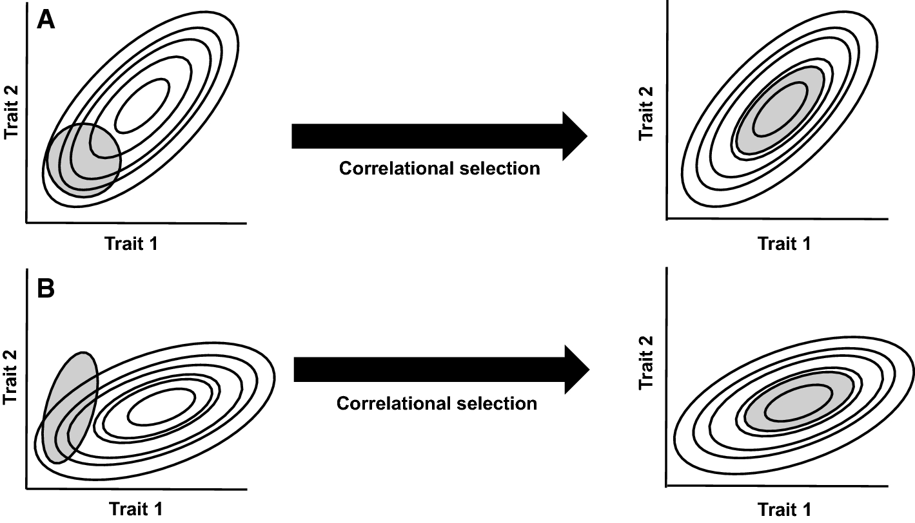
Svensoon 2022
Riedl, 1978

