Slide 1
Multivariate PCM EQGW 2025

Slide 2
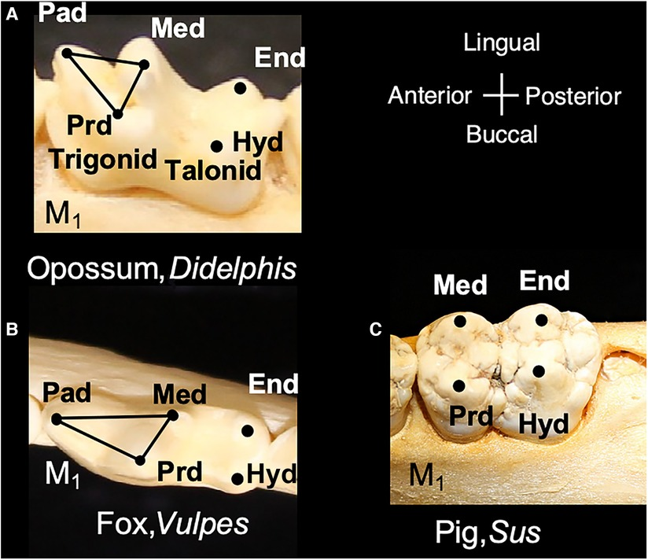
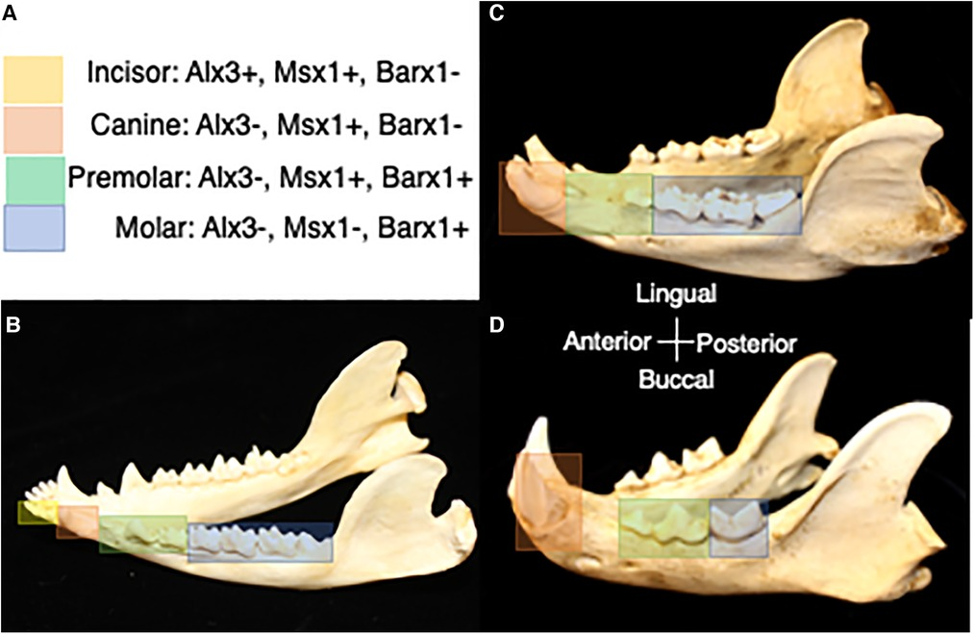
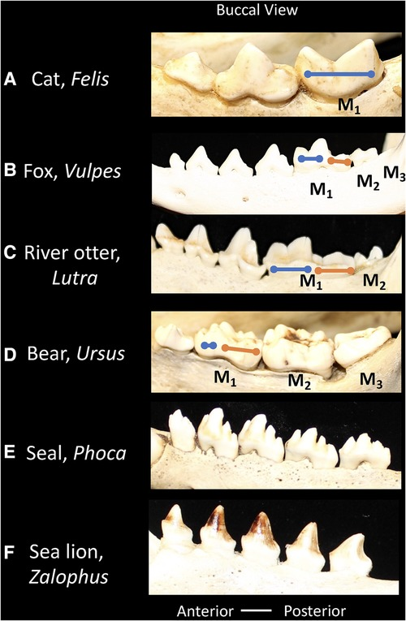
Biological traits can be complex
Single tooth
Dental formulas
Dentition proportions
Popowics & Mulamini 2023

Slide 3
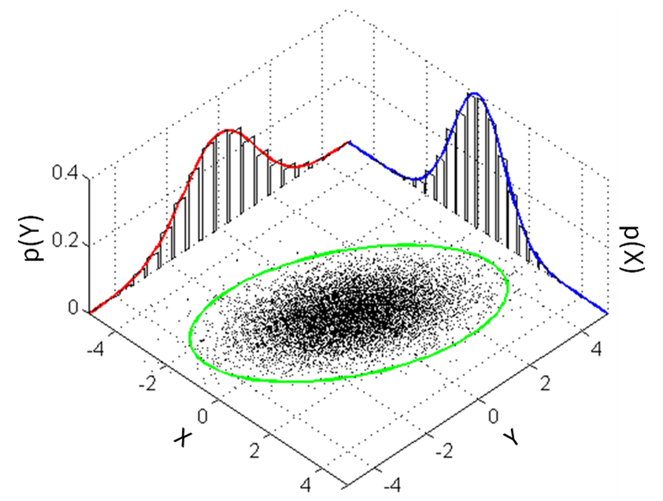

Distribution of individual traits
Degree of trait association
$$σ^{2}→ Σ=\left[\begin{matrix}σ_{x}^{2} & σ_{xy} \\ σ_{xy} & σ_{y}^{2}\end{matrix}\right]$$

Slide 4

Univariate Case
$$dy=−α\left(y(t)−θ(t)\right)dt+σdW$$
?
?
?

Slide 5
Univariate Case
$$dy=−α\left(y(t)−θ(t)\right)dt+σdW$$
Rate of genetic drift
Strength of stabilizing selection
Adaptive peak
Microevolutionary interpretation

Slide 6
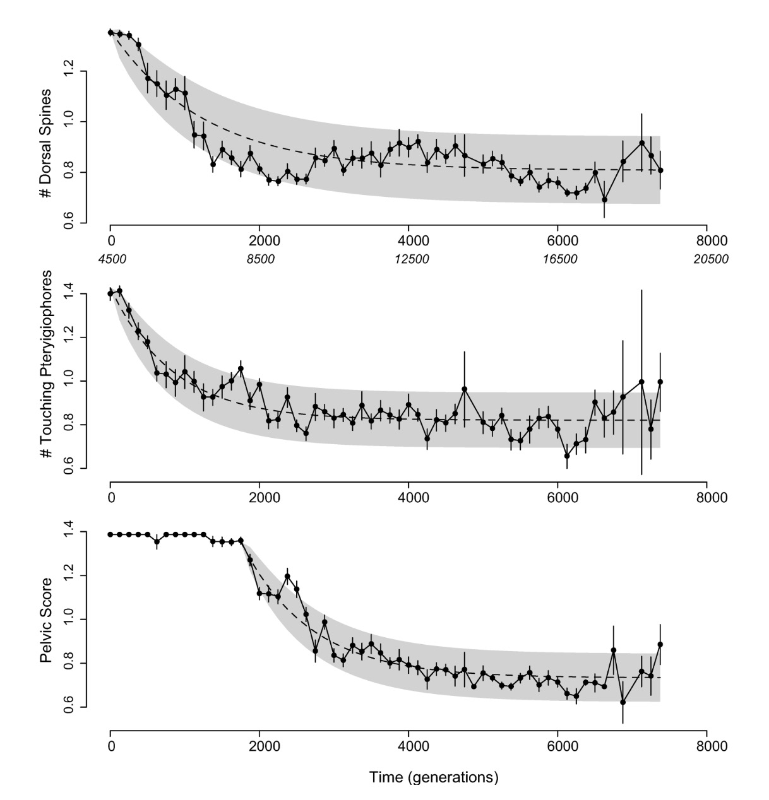
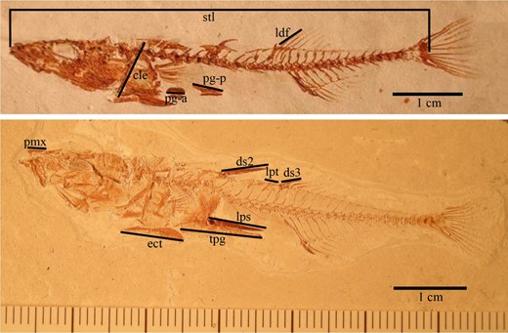
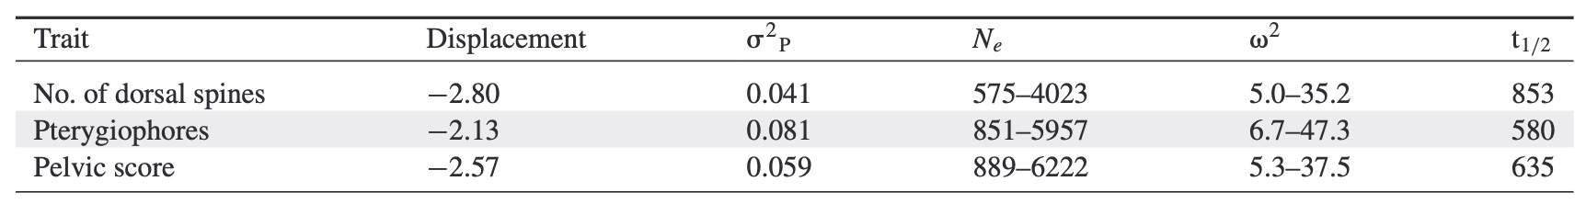
Hunt et al. 2008

Slide 7
But this is not really happening in macroevolution, right?
Hunt et al. 2008

Slide 8
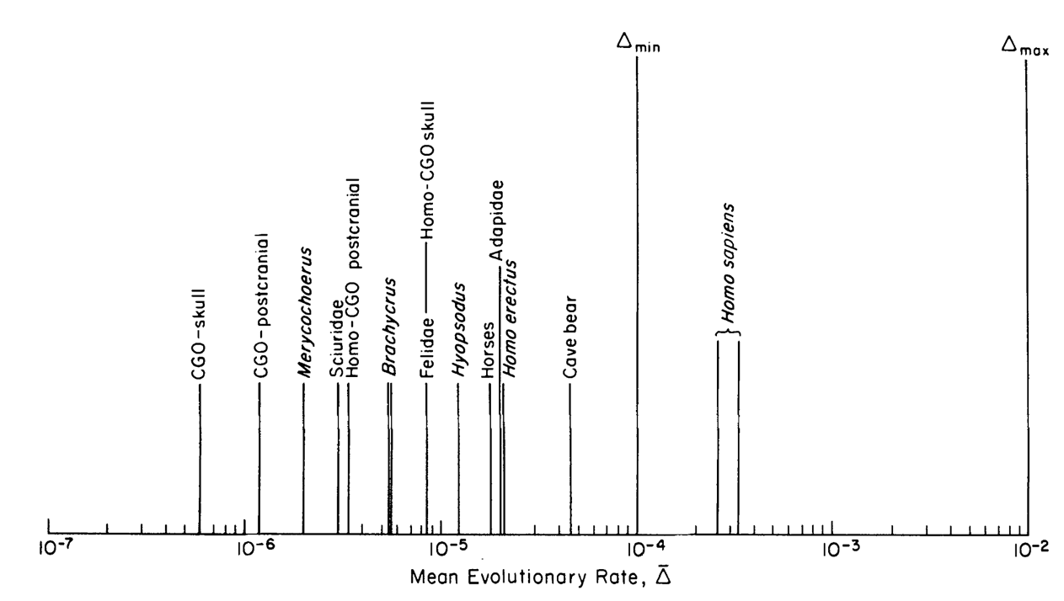
Lynch, 1990

Slide 9
Univariate Case
$$dy=−α\left(y(t)−θ(t)\right)dt+σdW$$
Rate of stochastic evolution
Rate of adaptation
Primary optima
All are scalars= single value
Hansen 1997

Slide 10
Univariate Case
$$dy=−α\left(y(t)−θ(t)\right)dt+σdW$$
Rate of stochastic evolution
Rate of adaptation
Primary optima
All are scalars= single value
What is a “primary optima”?
Hansen 1997

Slide 11
W
Z

Slide 12


Plant type 1
Plant type 2
W
Z- drought tolerance

Slide 13
Plant type 1
Plant type 2
Species-specific adaptive peaks
W
Z- drought tolerance

Slide 14
Plant type 1
Plant type 2
Species-specific adaptive peaks
W
Primary optima 1
Primary optima 2
Z- drought tolerance
“average” optima for that specific selective pressure

Slide 15

Univariate Case
$$dy=−α\left(y(t)−θ(t)\right)dt+σdW$$
Rate of stochastic evolution
Rate of adaptation
Primary optima
All are scalars= single value
$$t_{1/2}=\frac{\log{2}}{α}$$
Phylogenetic half life
Hansen 1997

Slide 16
Univariate Case
$$dy=−α\left(y(t)−θ(t)\right)dt+σdW$$
Rate of stochastic evolution
Rate of adaptation
Primary optima
All are scalars= single value
$$t_{1/2}=\frac{\log{2}}{α}$$
What is the simplest multivariate system you can imagine?
Phylogenetic half life
Hansen 1997

Slide 17
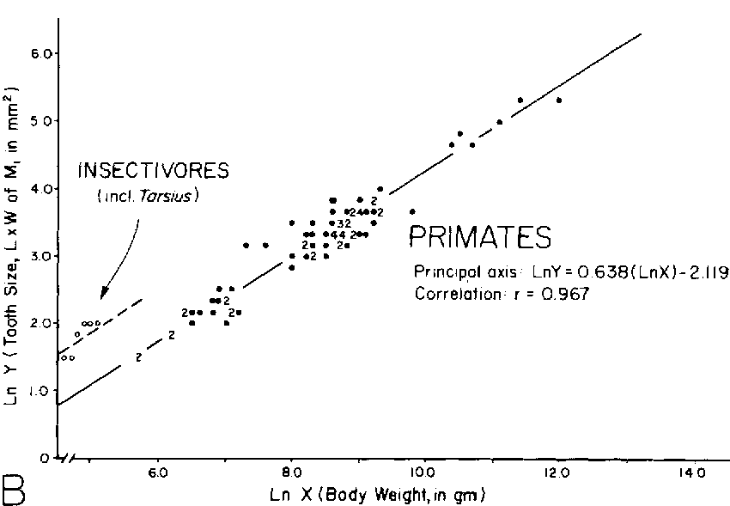

Bivariate analysis
y$=a+bx$
slope
intercept
Gingrinch et al 1982

Slide 18

Univariate Case
$$dy=−α\left(y(t)−θ(t)\right)dt+σdW$$
Rate of stochastic evolution
Rate of adaptation
Primary optima
All are scalars= single value
Linear regression
How would you merge both equations?
y(x)$=a+bx$

Slide 19
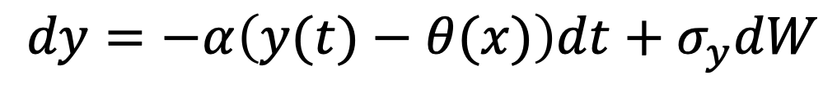


Univariate Case
$$dy=−α\left(y(t)−θ(t)\right)dt+σdW$$
Rate of stochastic evolution
Rate of adaptation
Primary optima
All are scalars= single value
Regression Case
$$dy=−α\left(y(t)−θ(x)\right)dt+σ_{y}dW$$
Rate of adaptation
Rate of stochastic evolution of y
Primary optima as a function of x
Linear regression
$$θ\left(x\right)=a+bx$$
$$dx=σ_{x}dW$$
Rate of stochastic evolution of x
Hansen et al 2008

Slide 20
Univariate Case
$$dy=−α\left(y(t)−θ(t)\right)dt+σdW$$
Rate of stochastic evolution
Rate of adaptation
Primary optima
All are scalars= single value
Regression Case
$$dy=−α\left(y(t)−θ(x)\right)dt+σ_{y}dW$$
Rate of adaptation
Rate of stochastic evolution of y
Primary optima as a function of x
Linear regression
The optimum for y is a function of x, which itself evolves stochastically
$$θ\left(x\right)=a+bx$$
$$dx=σ_{x}dW$$
Rate of stochastic evolution of x
Hansen et al 2008

Slide 21

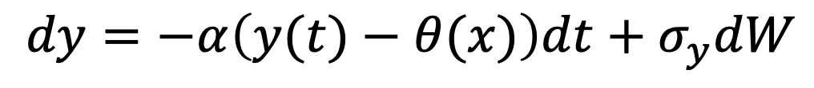
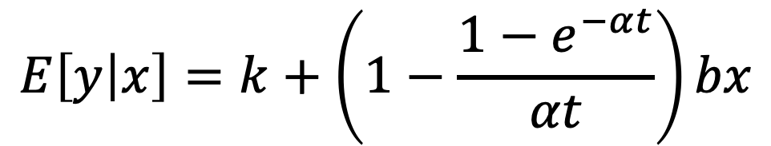
Regression Case
$$dy=−α\left(y(t)−θ(x)\right)dt+σ_{y}dW$$
Rate of adaptation
Rate of stochastic evolution of y
Primary optima as a function of x
$$dx=σ_{x}dW$$
Rate of stochastic evolution of x
$$E\left[y | x\right]=k+\left(1−\frac{1−e^{−αt}}{αt}\right)bx$$
Hansen et al 2008

Slide 22
Regression Case
$$dy=−α\left(y(t)−θ(x)\right)dt+σ_{y}dW$$
Rate of adaptation
Rate of stochastic evolution of y
Primary optima as a function of x
$$dx=σ_{x}dW$$
Rate of stochastic evolution of x
$$E\left[y | x\right]=k+\left(1−\frac{1−e^{−αt}}{αt}\right)bx$$
Optimal regression slope
Phylogenetic correction factor
Hansen et al 2008

Slide 23
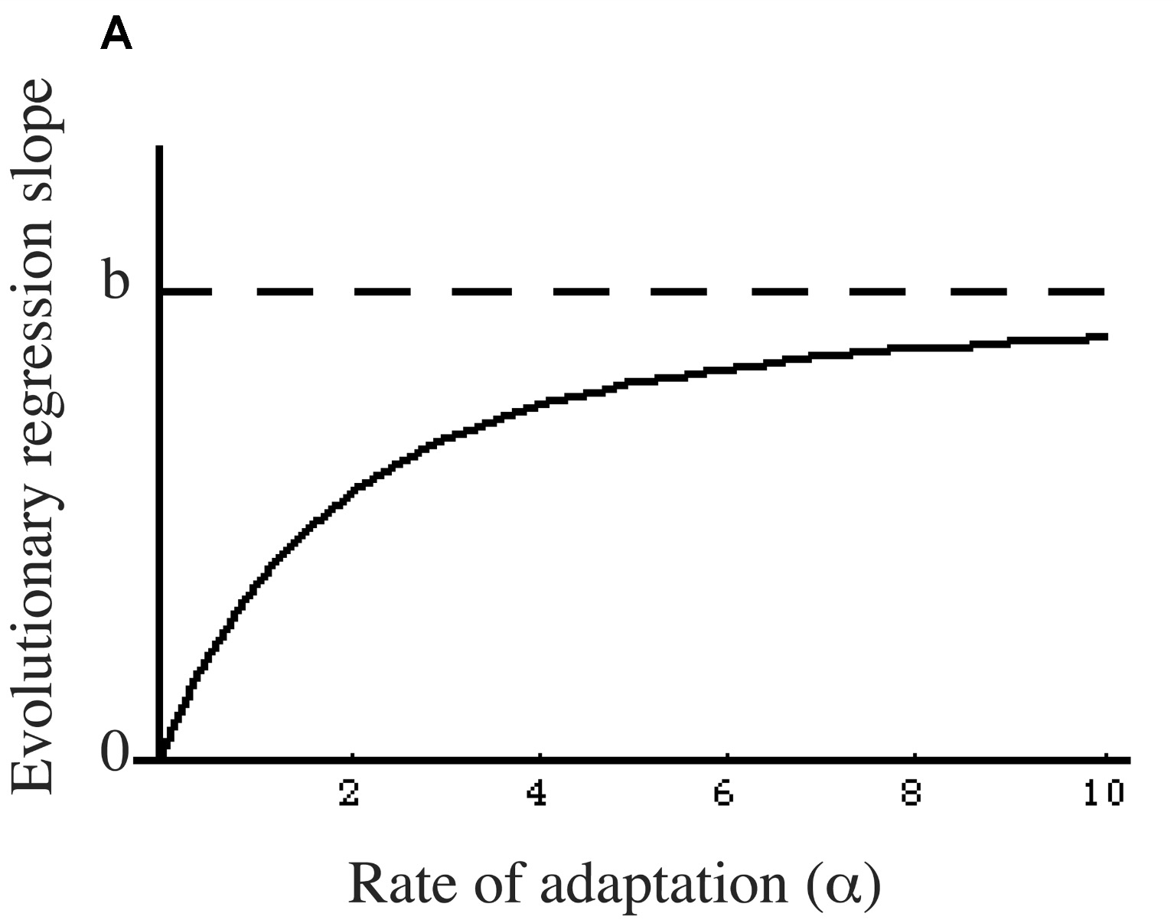
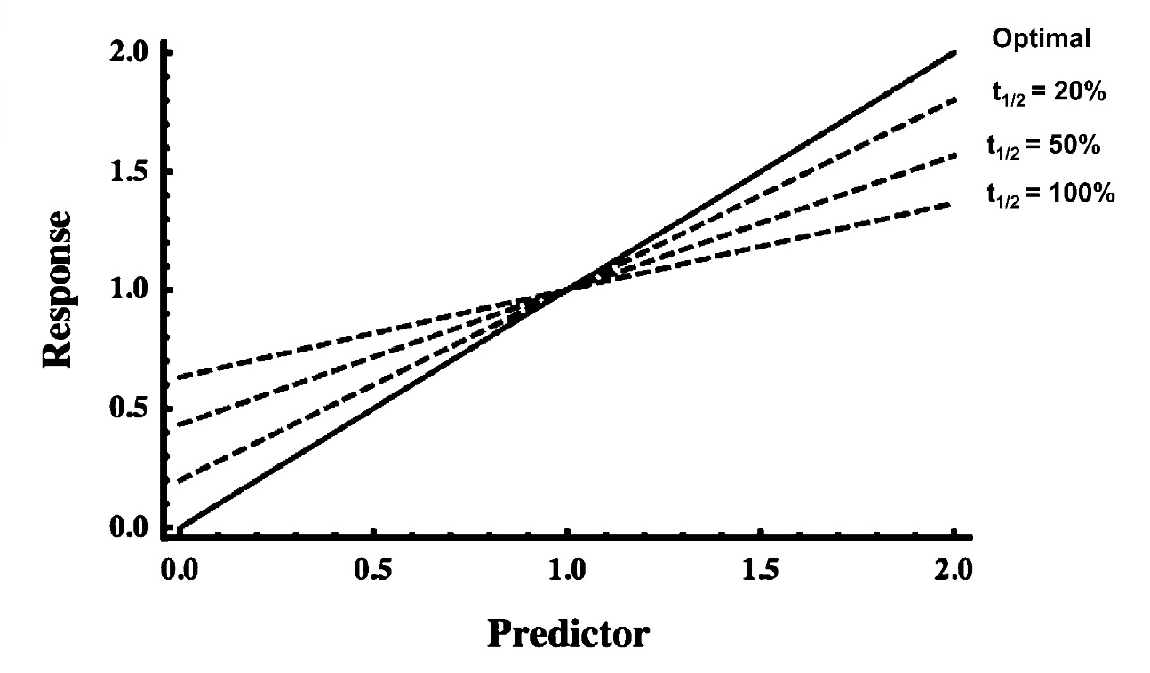
Hansen et al 2008
Hansen & Bartoszek 2012
The faster the rate of adaptation, the shallower the slope will be

Slide 24
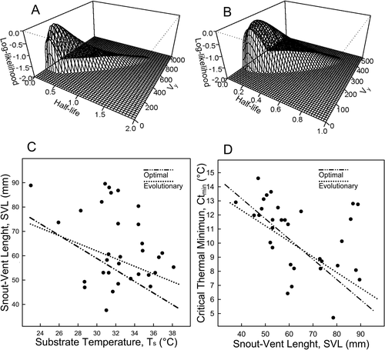
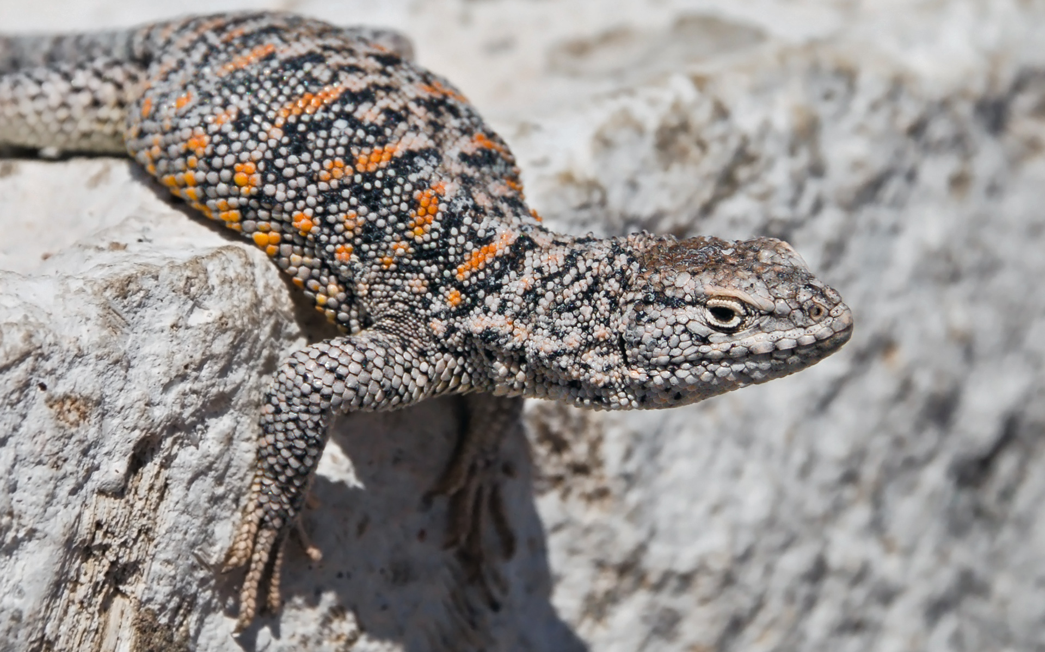
Liolaemus
What do you think this means?
Labra et al. 2009

Slide 25
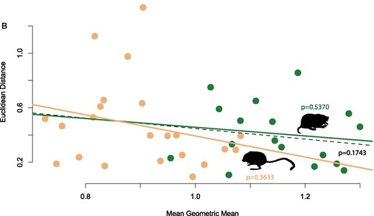
Rensch’s rule
Geomydae
Heteromydae
Calede&Brown, 2023

Slide 26
Regression Case
$$dy=−α\left(y(t)−θ(x)\right)dt+σ_{y}dW$$
Rate of adaptation
Rate of stochastic evolution of y
Primary optima as a function of x
$$dx=σ_{x}dW$$
Rate of stochastic evolution of x
$$E\left[y | x\right]=k+\left(1−\frac{1−e^{−αt}}{αt}\right)bx$$
Optimal regression slope
This models the relationship among traits instantaneously
Phylogenetic correction factor
Hansen et al 2008

Slide 27
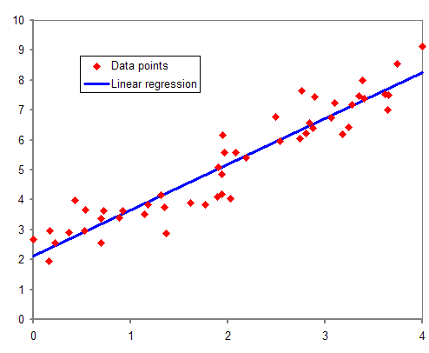
One unit change
Regression models the relationship among traits instantaneously

Slide 28
One unit change
Regression models the relationship among traits instantaneously
Alternatives?

Slide 29


Gs are multivariate analogs of $σ_{a}^{2}$
$$G=\left[\begin{matrix}σ_{x}^{2} & σ_{xy} \\ σ_{xy} & σ_{y}^{2}\end{matrix}\right]$$
What about macroevolutionary parameters?

Slide 30
Univariate Case
$$dy=−α\left(y(t)−θ(t)\right)dt+σdW$$
Rate of stochastic evolution
Rate of adaptation
Primary optima
All are scalars= single value

Slide 31
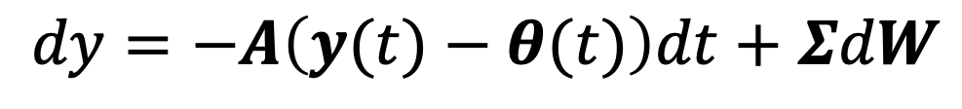
Univariate Case
$$dy=−α\left(y(t)−θ(t)\right)dt+σdW$$
Rate of stochastic evolution
Rate of adaptation
Primary optima
All are scalars= single value
Multivariate Case
$$dy=−A\left(y(t)−θ(t)\right)dt+ΣdW$$
Matrix of rate of adaptation
Rate matrix of stochastic evolution
(Cholesky factor)
Vector of primary optima

Slide 32

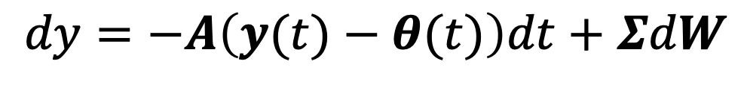

Multivariate Case
$$dy=−A\left(y(t)−θ(t)\right)dt+ΣdW$$
Matrix of rate of adaptation
Rate matrix of stochastic evolution
(Cholesky factor)
Vector of primary optima
$$Σ=\left[\begin{matrix}σ_{x}^{2} & σ_{xy} \\ σ_{xy} & σ_{y}^{2}\end{matrix}\right]$$
$$θ= \begin{matrix}θ_{x} \\ θ_{y}\end{matrix}$$
$σ_{x}^{2}→$rate of stochastic evolution
$σ_{xy}→$rate of stochastic coevolution
$θ_{i}→$ Primary optima for each trait i
symmetric

Slide 33


Multivariate Case
$$dy=−A\left(y(t)−θ(t)\right)dt+ΣdW$$
Matrix of rate of adaptation
Rate matrix of stochastic evolution
(Cholesky factor)
Vector of primary optima
$$A=\left[\begin{matrix}α_{x} & α_{xy} \\ α_{yx} & α_{y}\end{matrix}\right]$$
$α_{i}→$ rate of adaptation for trait i
$α_{xy}→$rate of y tracking x
$α_{yx}→$rate of x tracking y
Not-symmetric

Slide 34
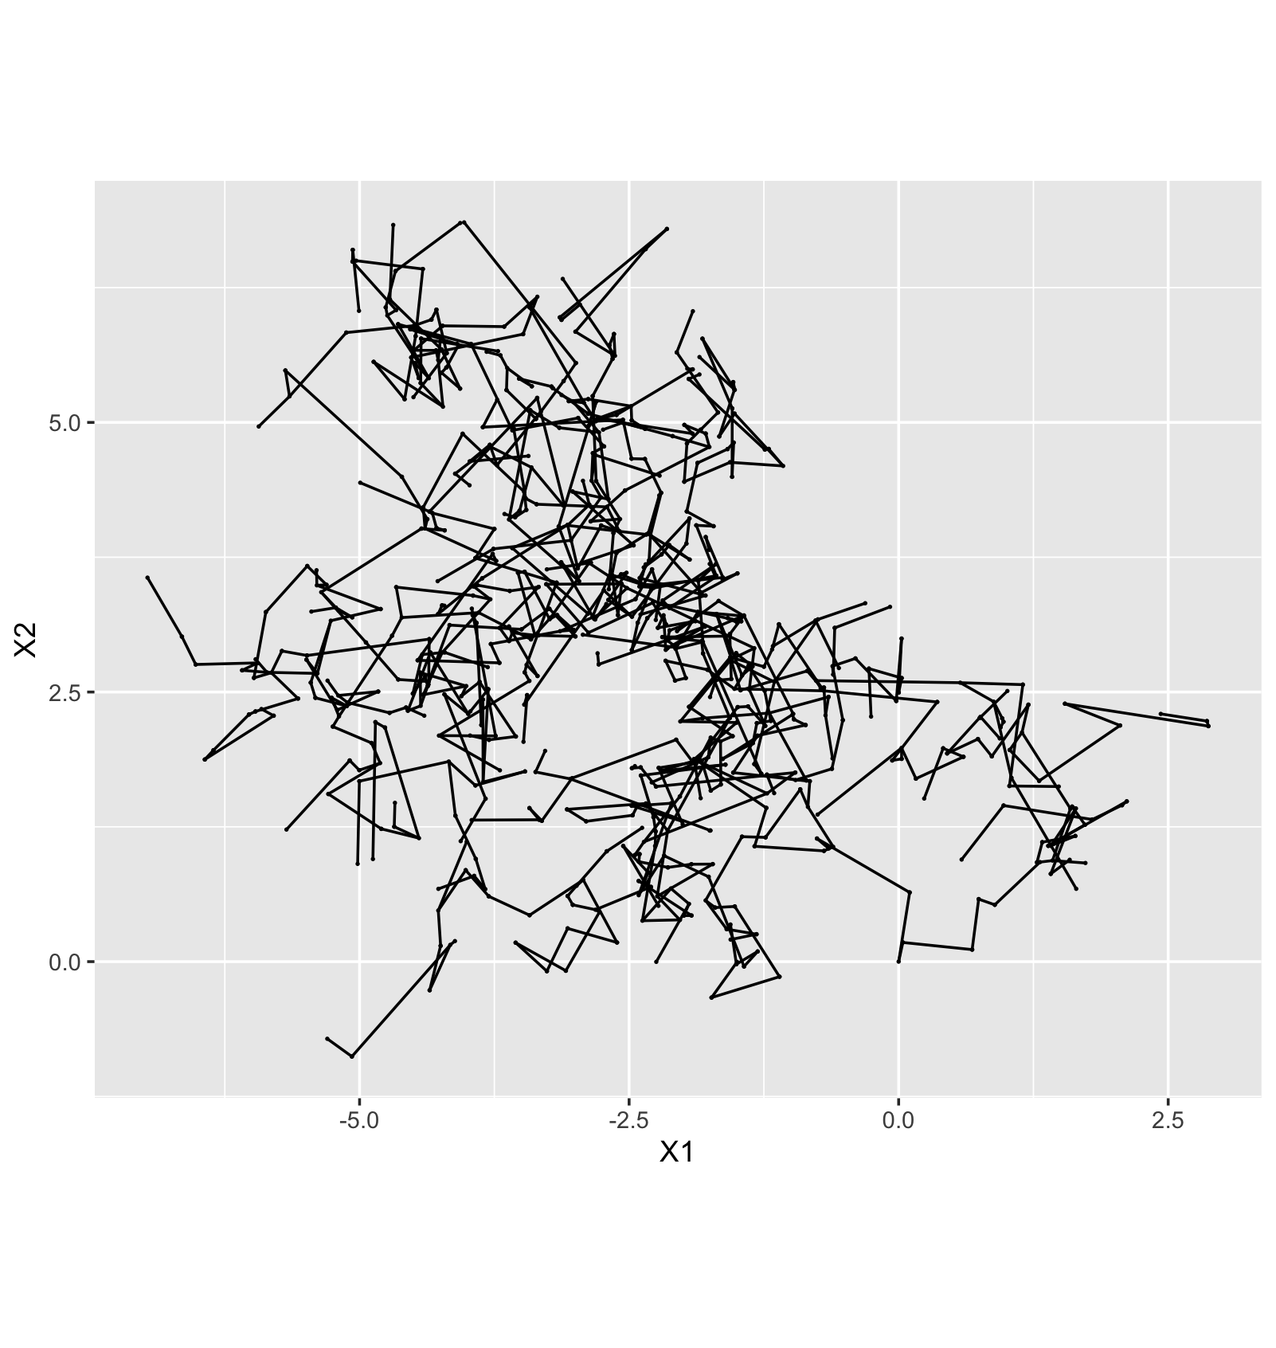


$$Σ=\left[\begin{matrix}1 & 0 \\ 0 & 1\end{matrix}\right]$$
$$A=\left[\begin{matrix}0 & 0 \\ 0 & 0\end{matrix}\right]$$

Slide 35
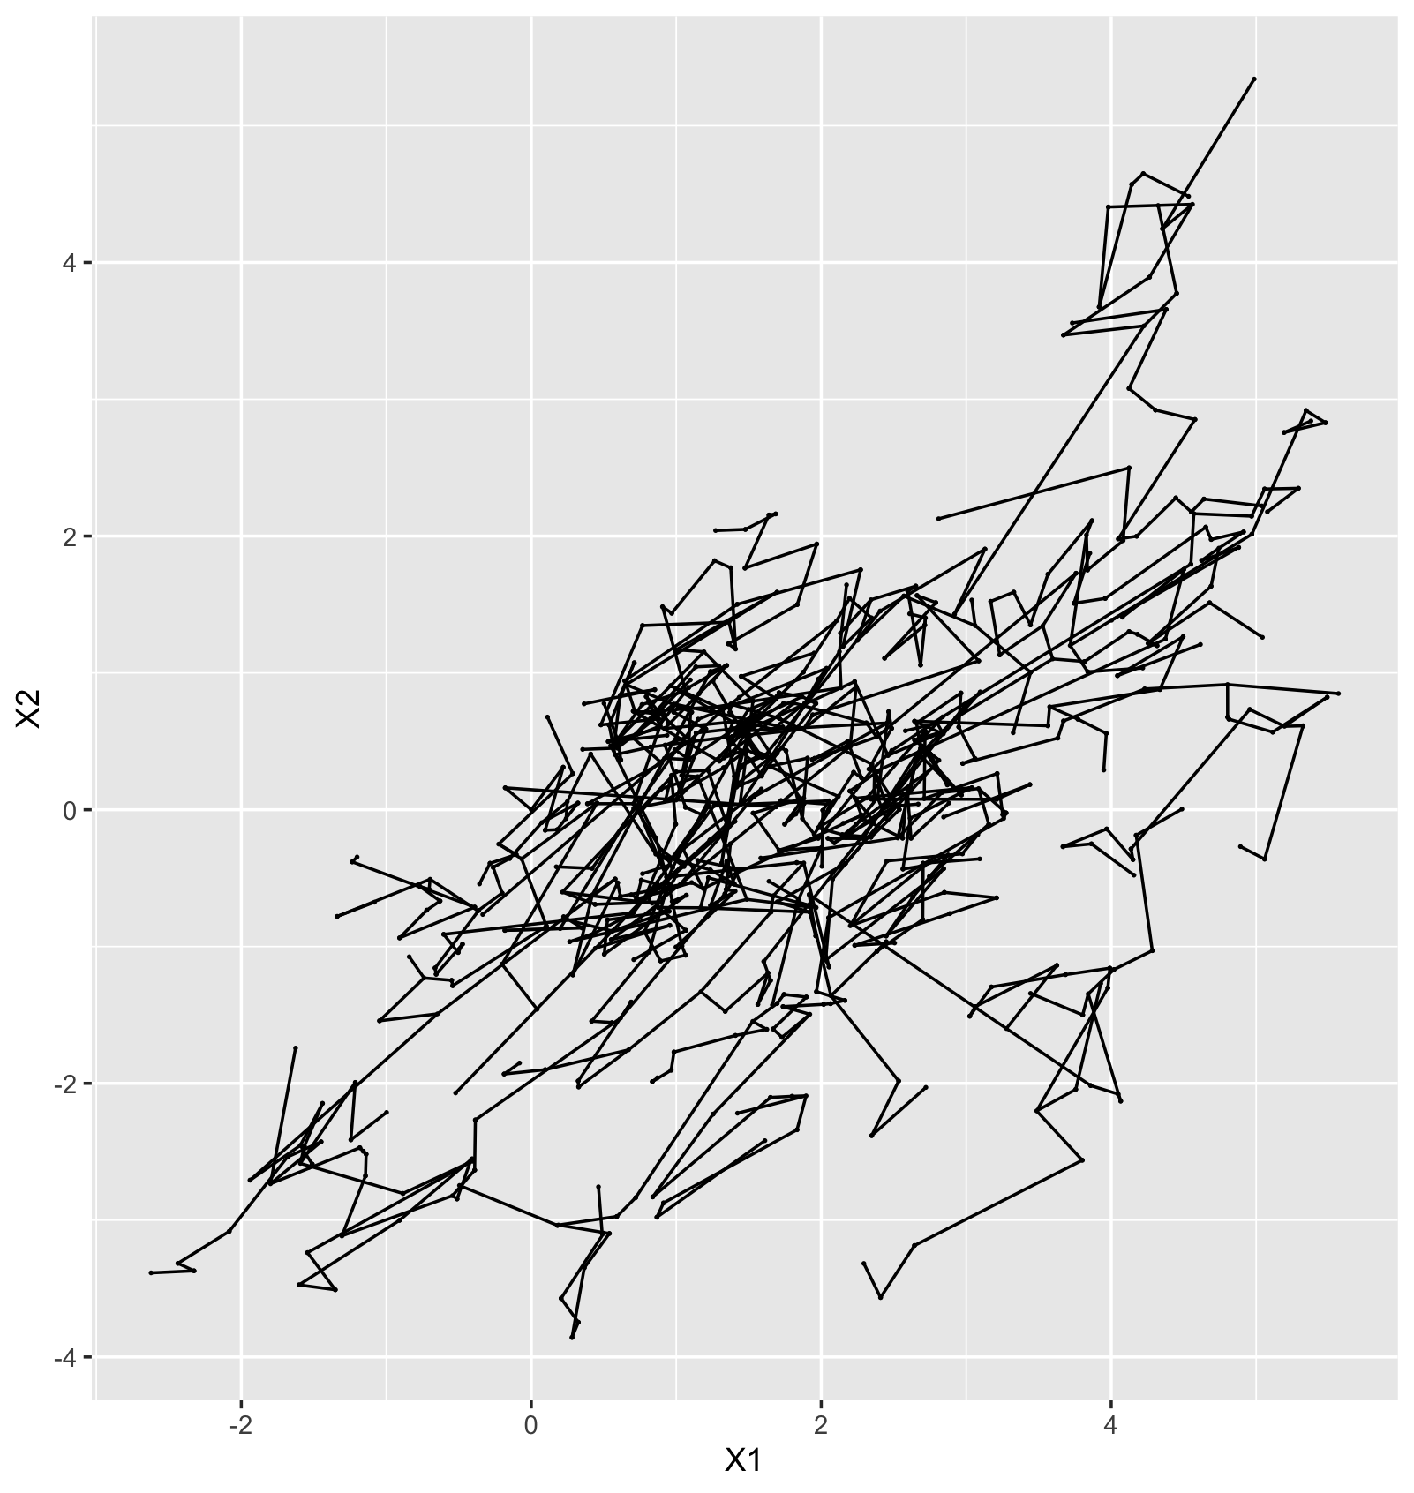

$$Σ=\left[\begin{matrix}1 & 0.3 \\ 0.3 & 1\end{matrix}\right]$$
$$A=\left[\begin{matrix}0 & 0 \\ 0 & 0\end{matrix}\right]$$

Slide 36
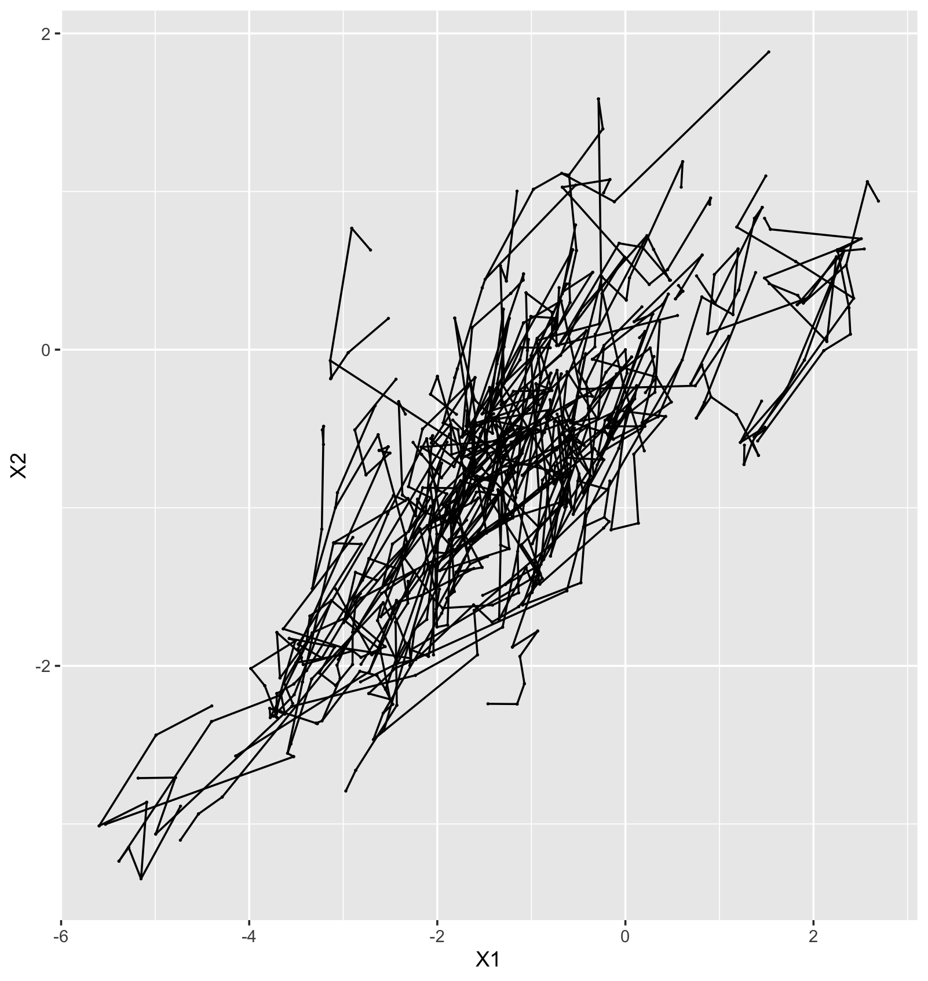

$$Σ=\left[\begin{matrix}1 & 0.3 \\ 0.3 & 1\end{matrix}\right]$$
$$A=\left[\begin{matrix}0.3 & 0 \\ 0 & 0.3\end{matrix}\right]$$

Slide 37
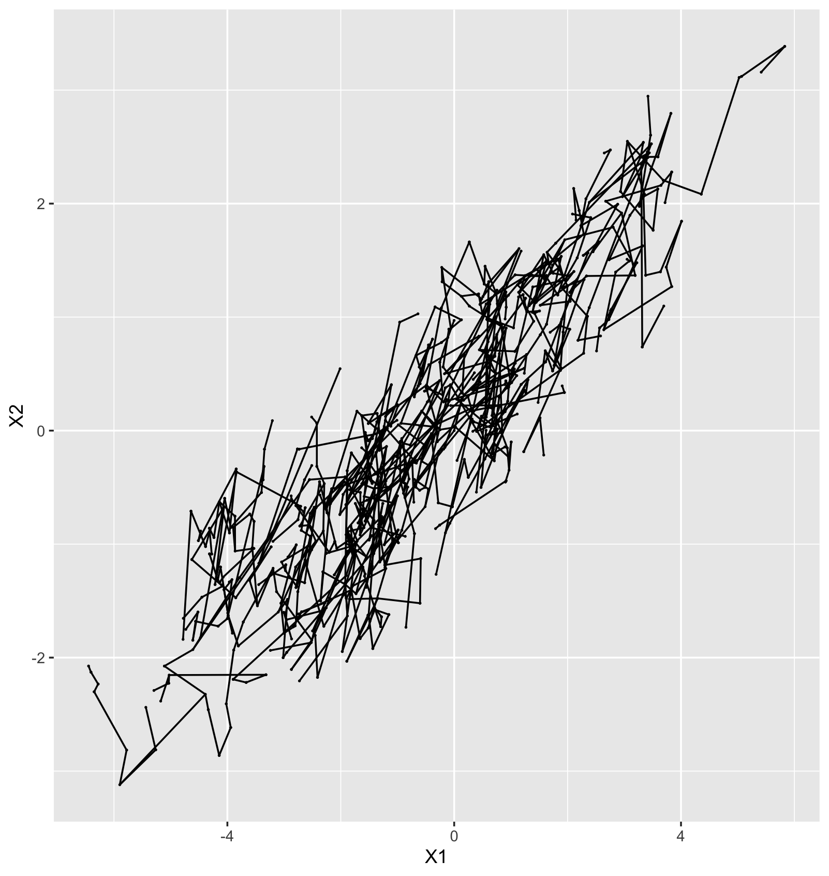

$$Σ=\left[\begin{matrix}1 & 0.3 \\ 0.3 & 1\end{matrix}\right]$$
$$A=\left[\begin{matrix}0.3 & −1 \\ −0.001 & 0.3\end{matrix}\right]$$

Slide 38
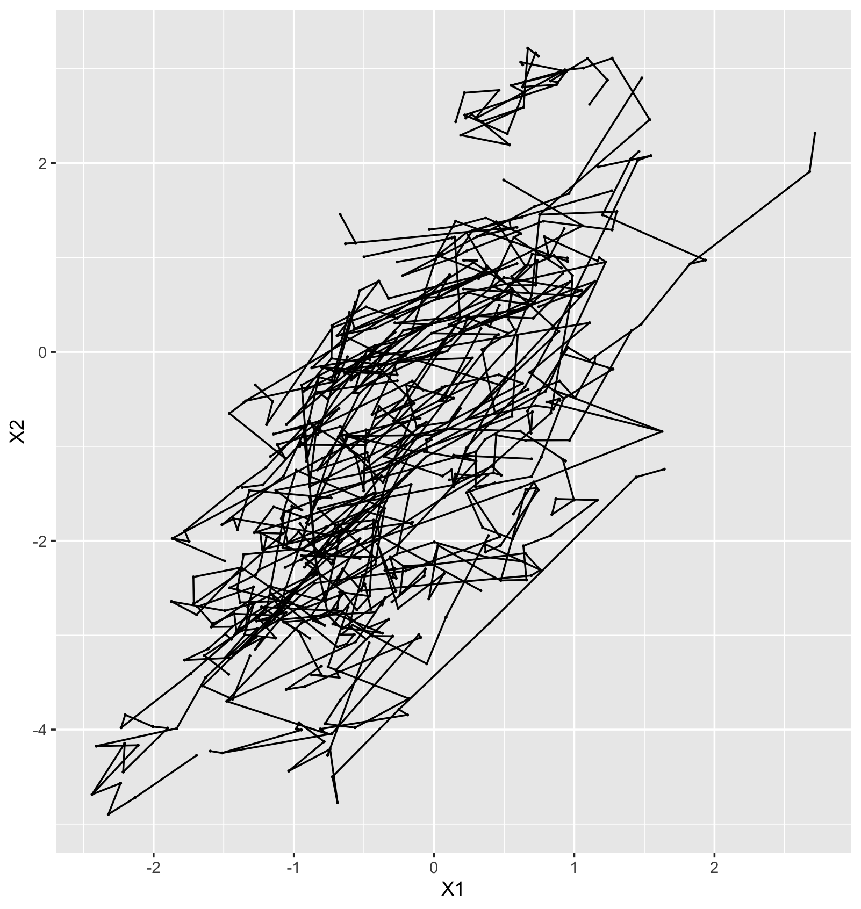

$$Σ=\left[\begin{matrix}1 & 0.3 \\ 0.3 & 1\end{matrix}\right]$$
$$A=\left[\begin{matrix}0.3 & −0.001 \\ −1 & 0.3\end{matrix}\right]$$

Slide 39
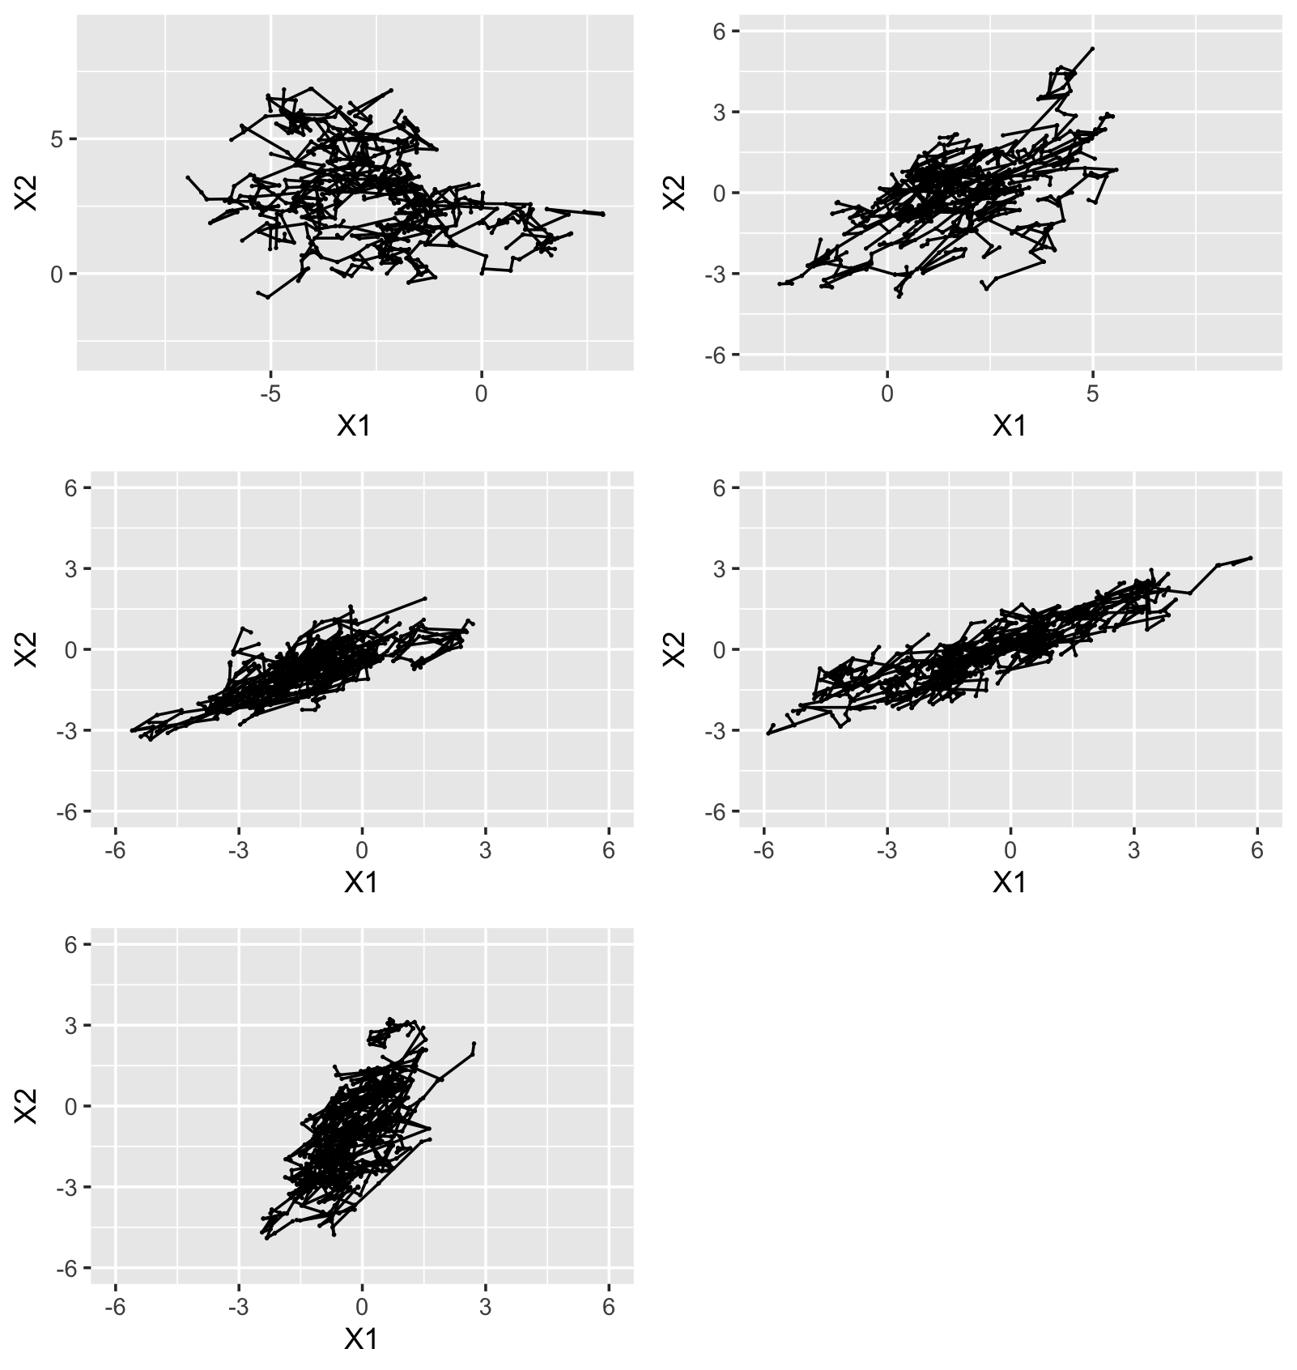
Different parameter combinations imply different patterns
We will fit some of these in the tutorial

Slide 40
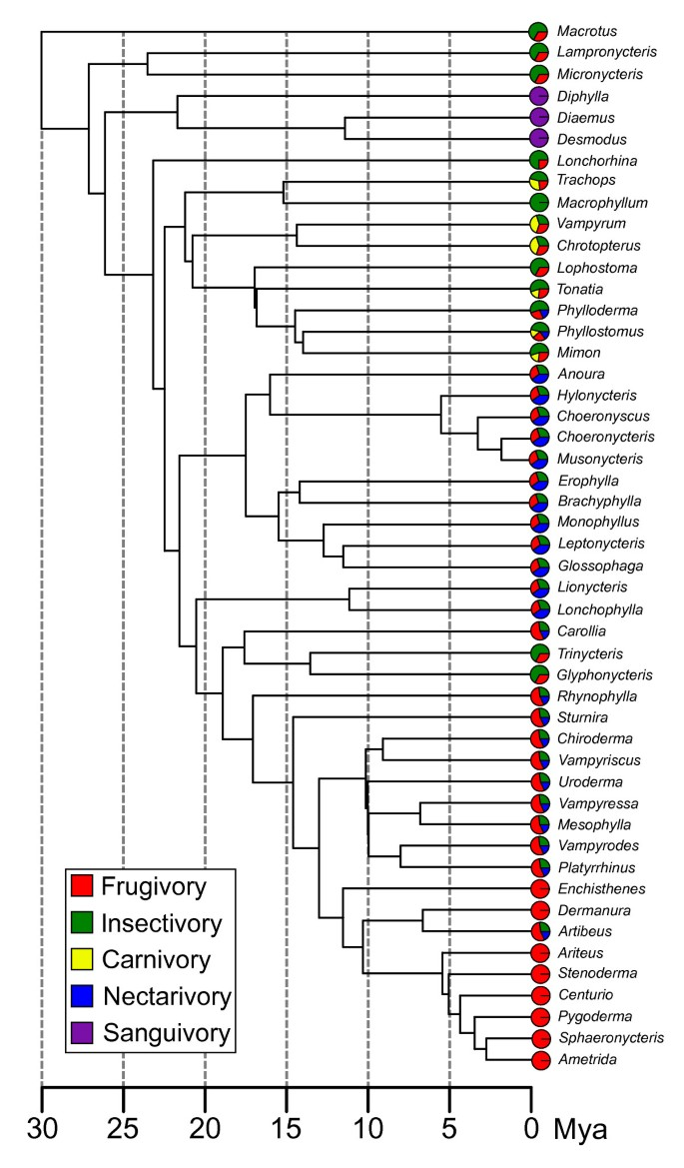
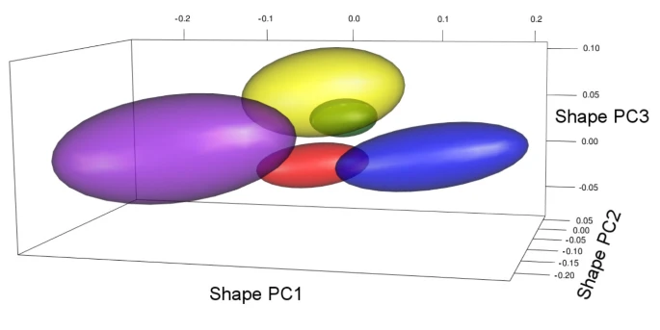
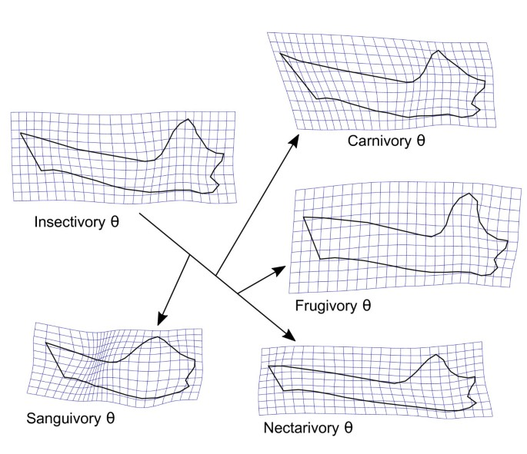
Multivariate approaches also can be fit into multiple regimes
Monteiro & Nogueira 2011

Slide 41
Package | Discrete | Continuous fixed | Continuous random | Regime detection
L1OU (Khabbazian et al., 2016) | X |  |  | X
MVMORPH (Clavel et al., 2015) | X
bayou (Uyeda & Harmon, 2014) | X | X |  | X
OUCH (Butler & King, 2004) | X
PHYLOGENETICEM (Bastide et al., 2017) | X
SURFACE (Ingram & Mahler, 2013) | X |  |  | X
mvSLOUCH (Bartoszek et al., 2012) | X | X | X
PCMfit (Mitov et al., 2019) | X | X | X | X

Slide 42
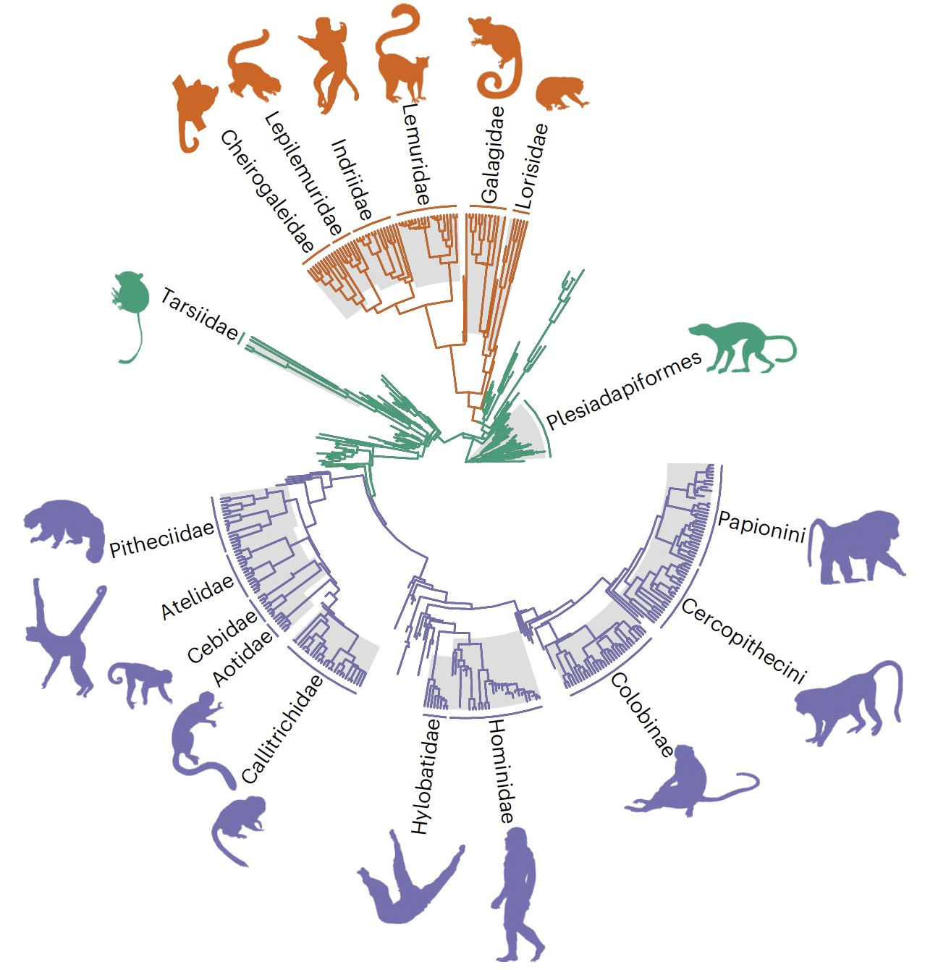
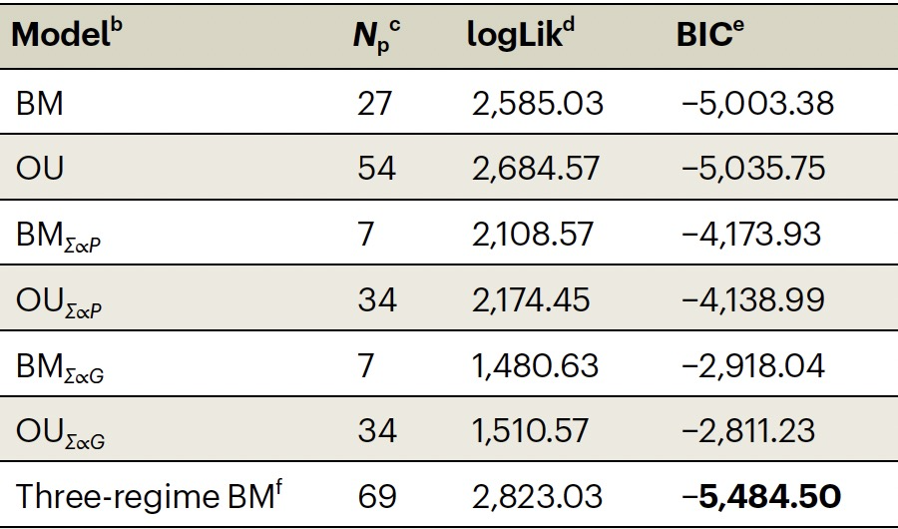
PCMfit
Machado et al. 2023

Slide 43
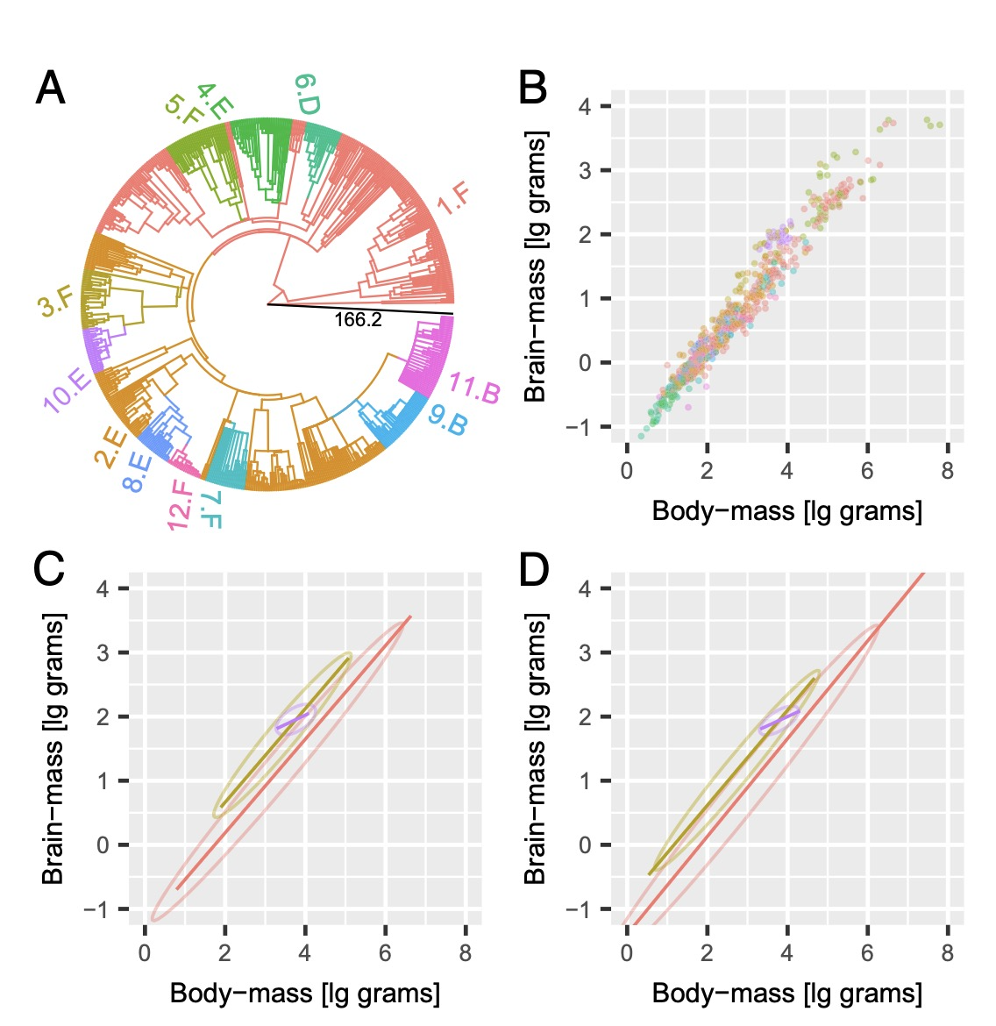
PCMfit
B-Brownian Motion
C-F- OU
Allows for a mixture of models in a single tree
Mitov et al. 2019

Slide 44
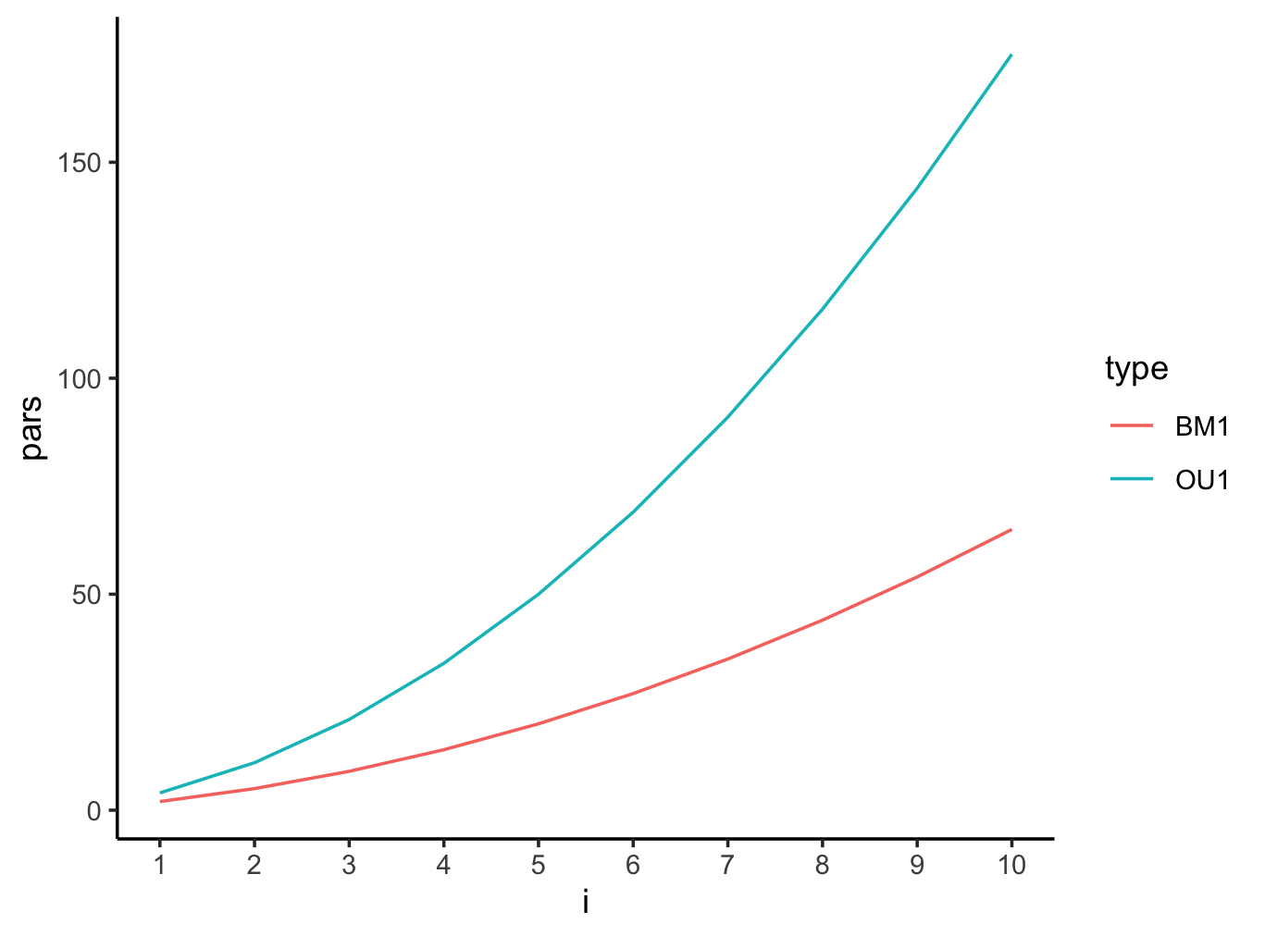
Potential drawbacks of multivariate methods
What should happen to the data?
Parameter number increases with dimensionality of the data

Slide 45
N=1000
N=10
N=5
N=2

