Slide 1

TourEase Custom Travel Solutions
Group 17
Bhagyashri Pagar
Prachi Pradhan
Shrutkeerti Sangolkar
Nirnay Reddy
Umang Mistry

Slide 2
Overview
The Tour Management System addresses the growing demand for personalized travel experiences, moving beyond traditional pre-packaged tours
It simplifies browsing, booking, and payment tracking, enhancing customer satisfaction and loyalty through a user-friendly interface
A robust database ensures efficient storage and real-time management of customer details, tour packages, bookings, vendor services, and payment records
Customers can create tailored itineraries by selecting services like accommodations, transportation, meals, and activities from various vendors
The system focuses on booking management, service integration, and payment tracking while excluding complex analytics and vendor management
It provides flexibility to create, modify, and manage tour packages and bookings, ensuring a seamless and enjoyable user experience

Slide 3
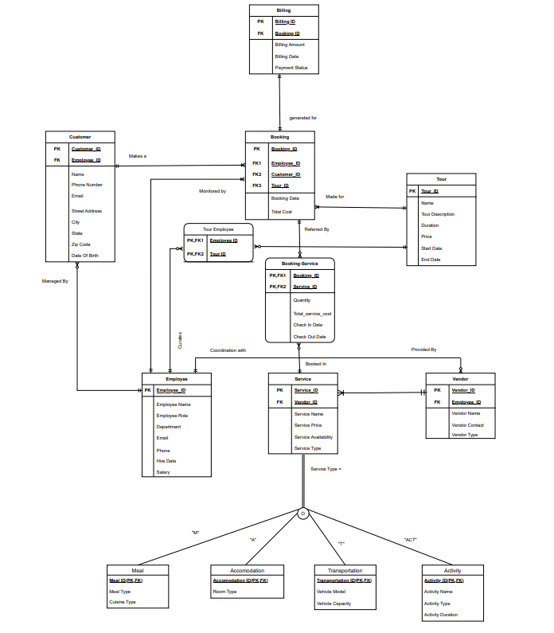
Entity Relationship Diagram

Slide 4
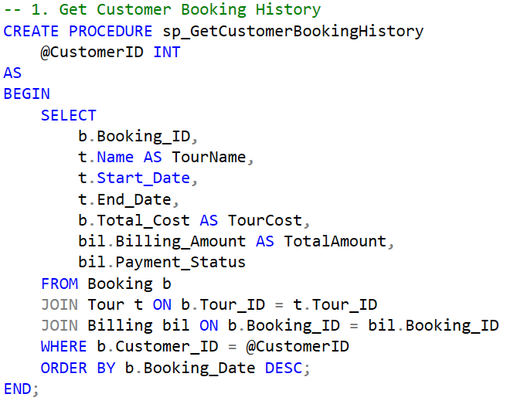
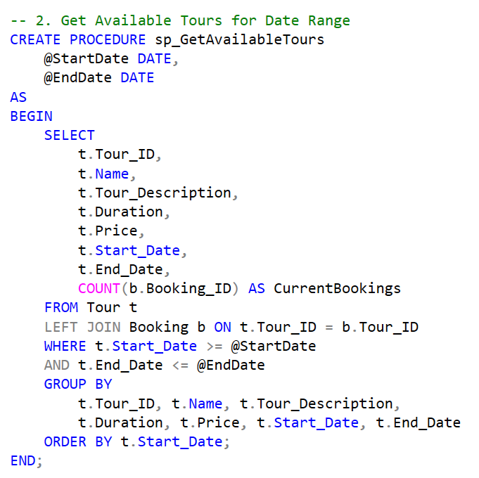
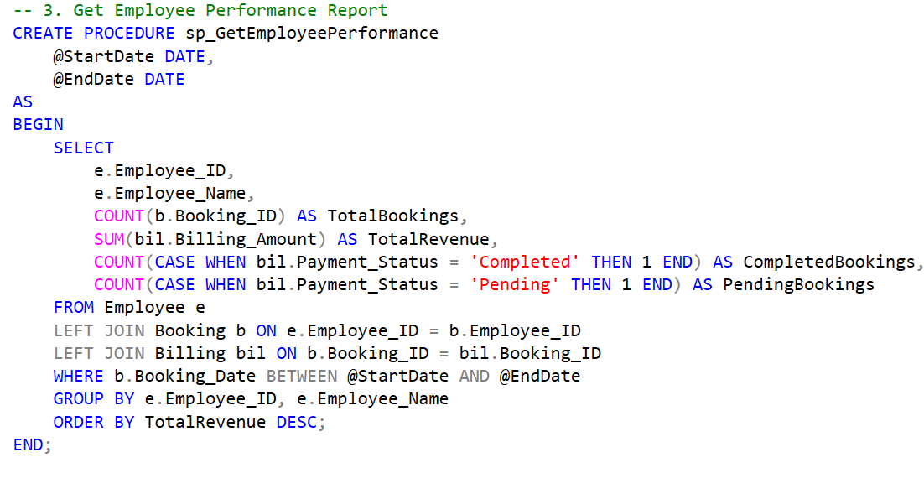
Stored Procedures

Slide 5
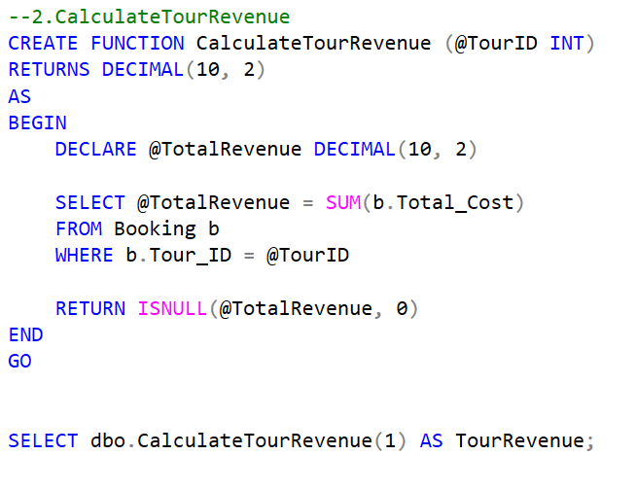
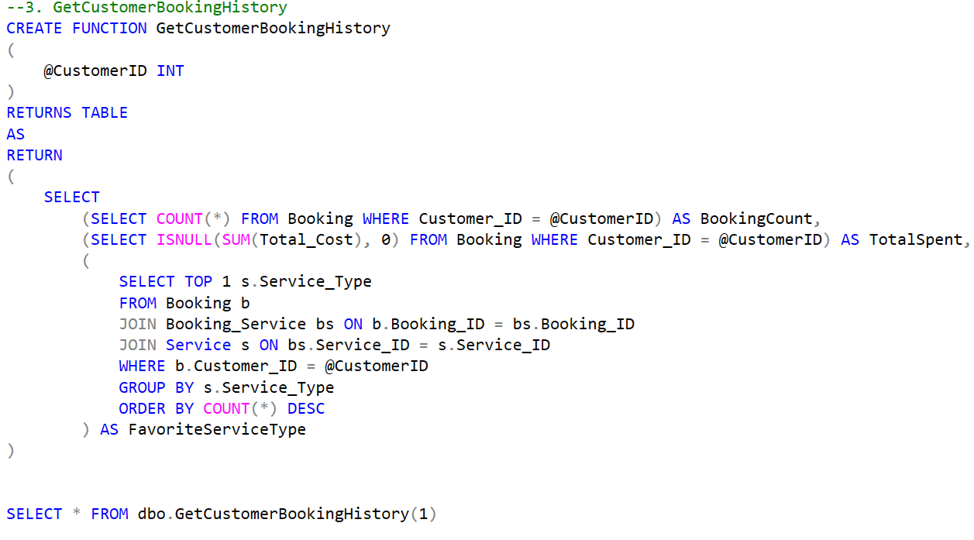
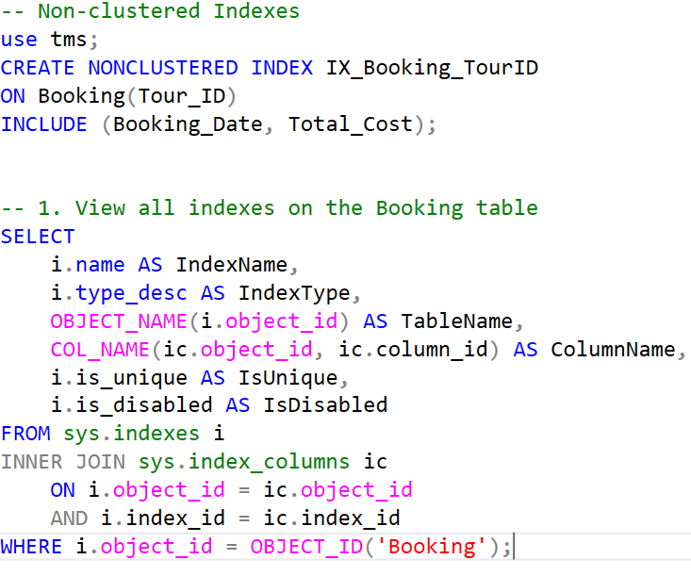
User Defined Functions and Indexes

Slide 6
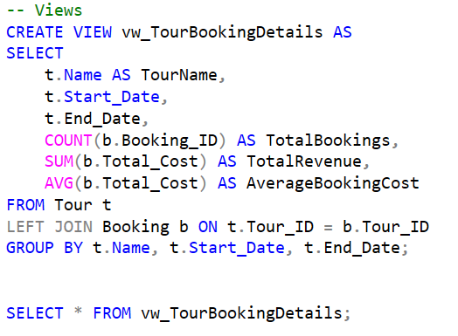
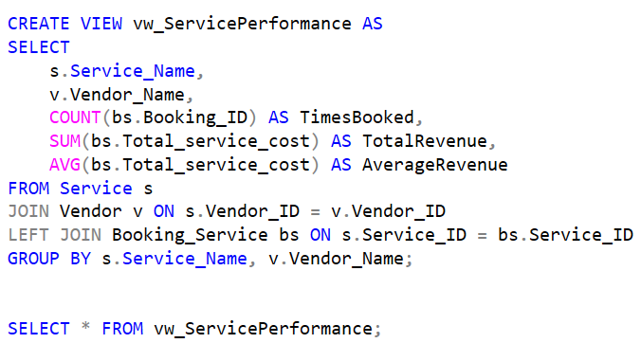
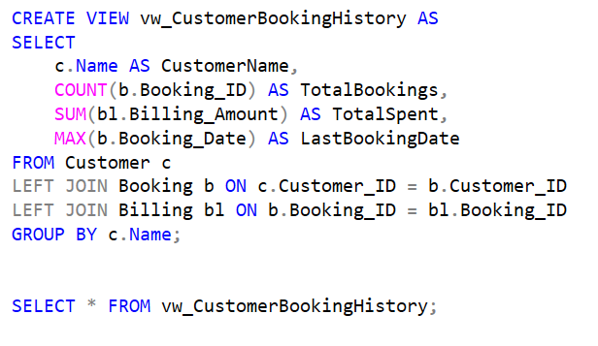
Views

Slide 7
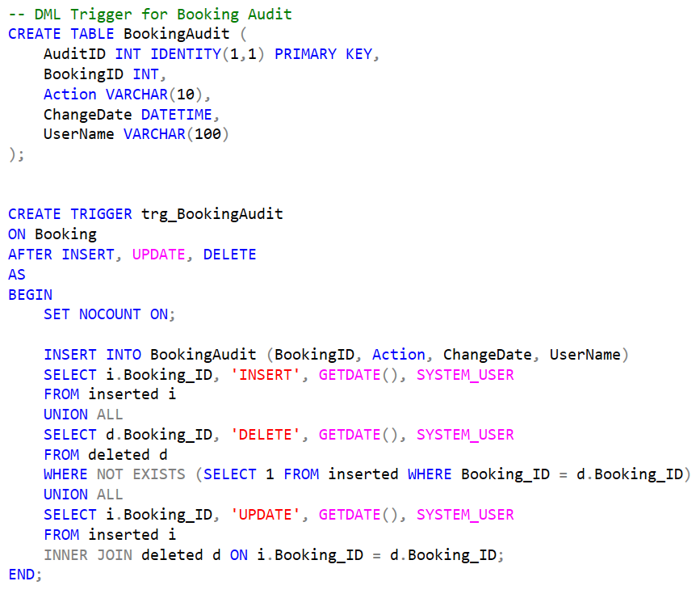
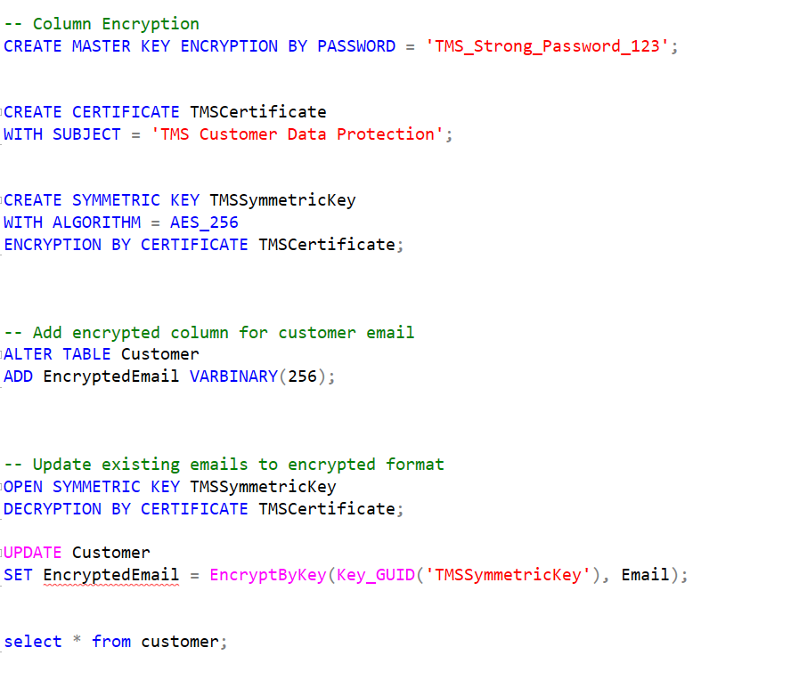
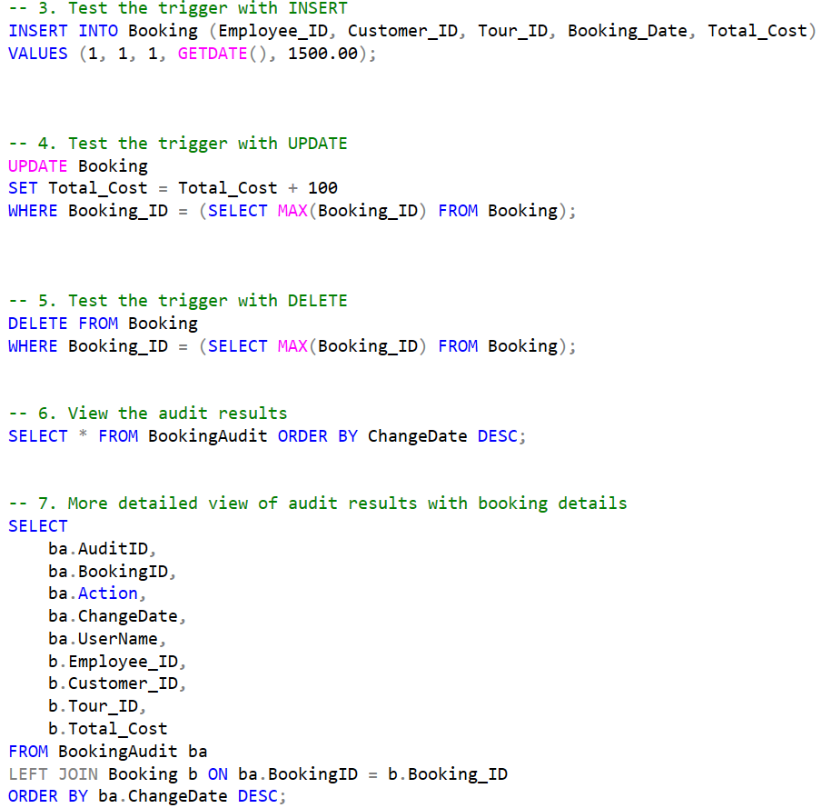
Triggers and Encryption

Slide 8
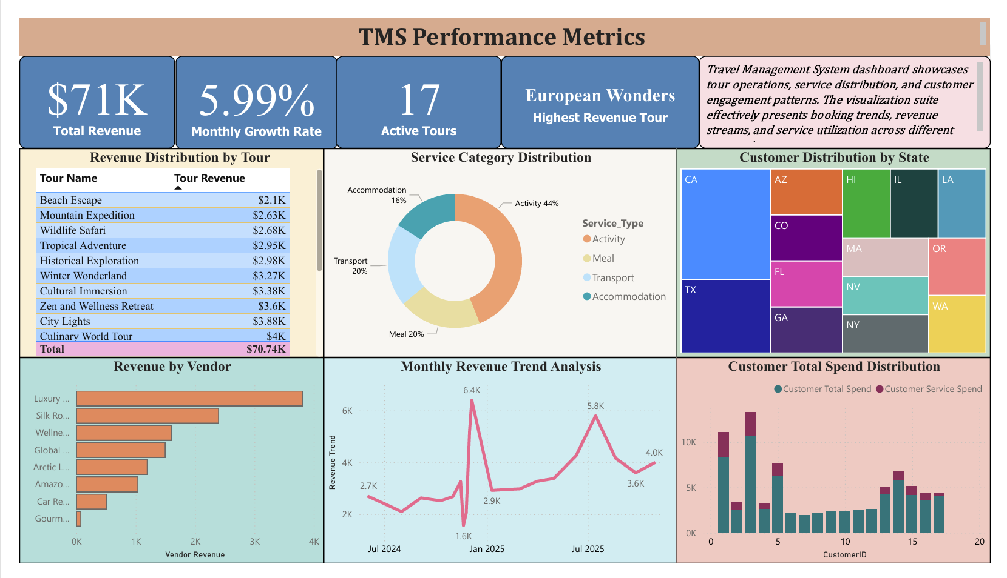
Visualization Report

