Slide 1
Zepto GTM Strategy Data-Driven Optimization
AlgoVision: Data Analytics Case Competition – KOED x IIT Roorkee
Team Name: lokeshkumar.engineer

Slide 2
Agenda
Inventory management
Delivery optimization
Customer insights and personalization
Operational efficiency
Marketing analytics

Slide 3
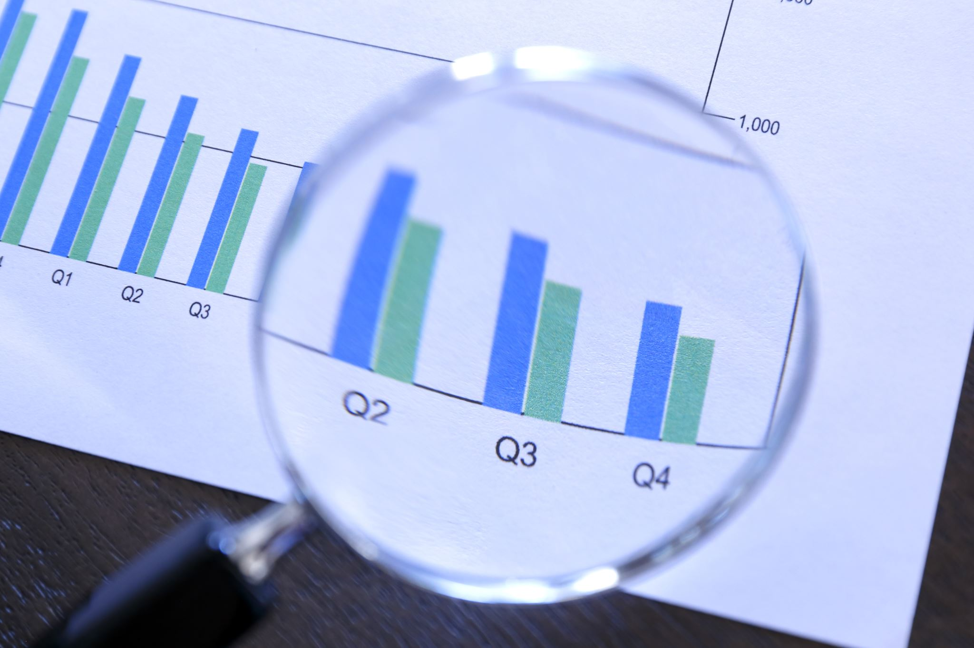
Tools and technologies used

Slide 4
Tools : 1. PowerBI : To create interactive dashboards. 2. MS Excel : To handle data and create plots. 3. Jupyter Notebook : Experimentation with dataset.
Technologies : 1. Python : To manipulate and visualize data. 2. Streamlit: To create web apps for better understanding.

Slide 5
Approach & Methodology
Data Cleaning and preprocessing
Exploratory Data Analysis
Feature Engineering
Implementation and optimization
Results and insights

Slide 6
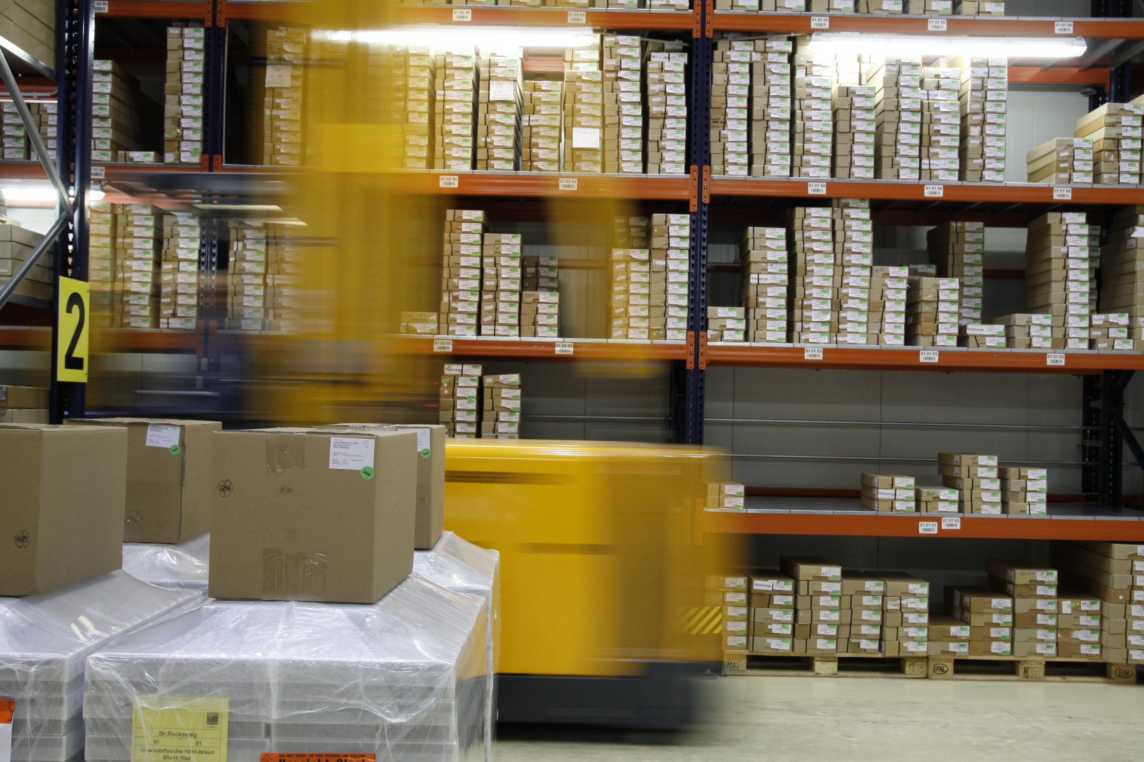
Inventory Management Optimization

Slide 7
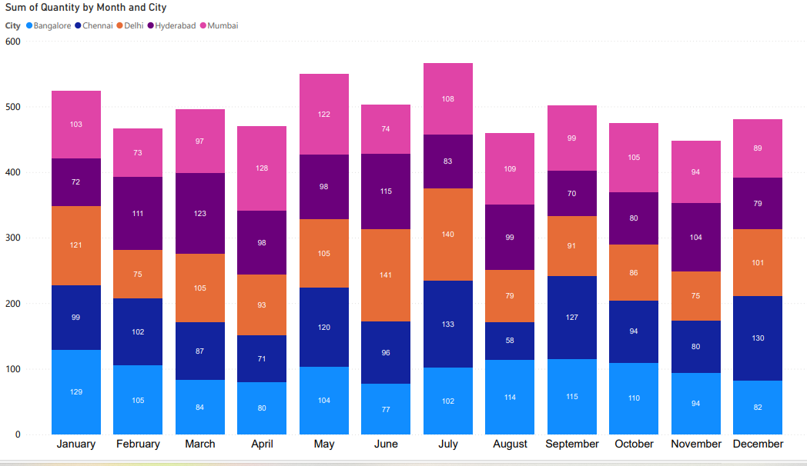
Historical Purchase Data :
In the month of July, the product sales are the highest. Also, the maximum sales appear to have occurred in Delhi.
November sees the lowest sales, with Chennai experiencing the sharpest drop.

Slide 8
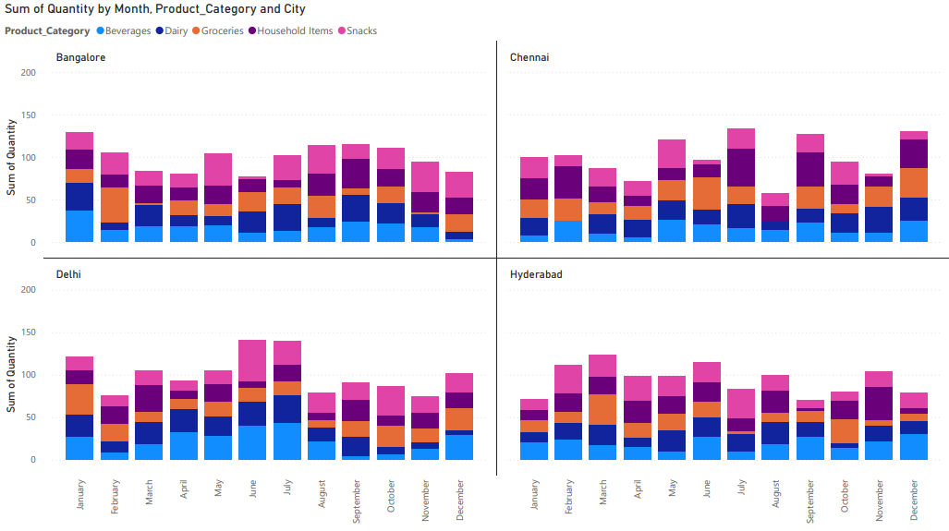
Seasonal Trends and local preferences :
Across four cities, Bangalore and Chennai show similar seasonal purchase patterns, peaking in July.
Delhi and Hyderabad also mirror each other, with a less pronounced July peak.
Household items and snacks consistently drive sales in all locations.
Beverages and dairy show moderate fluctuations throughout the year.

Slide 9
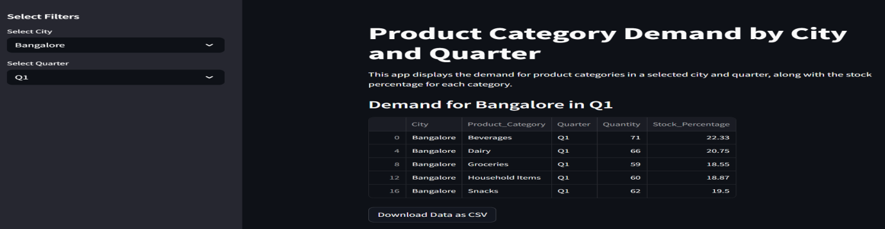
Reducing stockouts and overstocking :
Calculates quarterly demand per city and product category.
Filters data based on selected city and quarter.
Calculates total demand and stock percentage for each product category.

Slide 10

Delivery Optimization

Slide 11
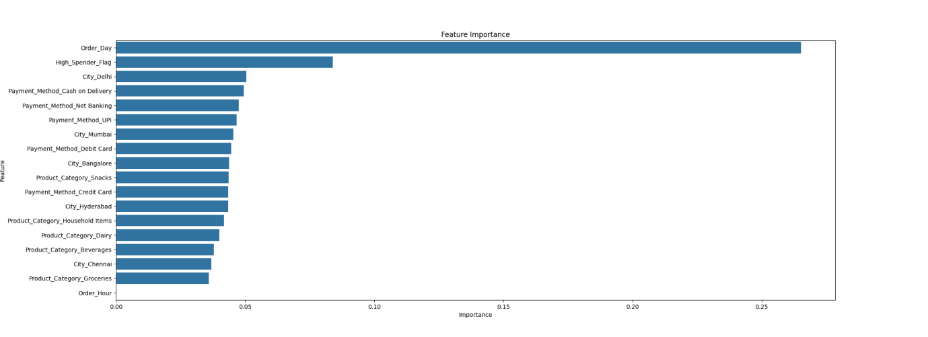
Key Factors Influencing Delivery Time :
showing the relative influence of each feature on the delivery time.
"Order Day" is the most influential feature, suggesting a strong temporal pattern in the data.

Slide 12
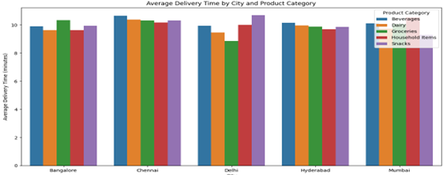
Delivery Time by City and Product category :
In the city Chennai, almost all category deliveries occur after 10 minutes.
Friday sees the highest number of on-time deliveries.
In Mumbai, deliveries are generally completed within 10 minutes.
Groceries are the most consistently delivered on time.

Slide 13

Approach to optimize delivery time :
Dijkstra’s Algorithm: Finds the shortest path between delivery points in a road network, ensuring efficient routing.
Genetic Algorithms: Uses evolutionary techniques to optimize delivery routes by iteratively improving solutions.
Ant Colony Optimization (ACO): Models delivery routes based on ant foraging behavior, enhancing path selection over time.

Slide 14
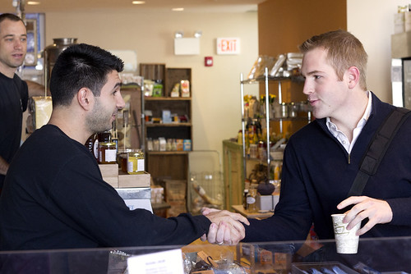
Customer Insights and Personalization

Slide 15
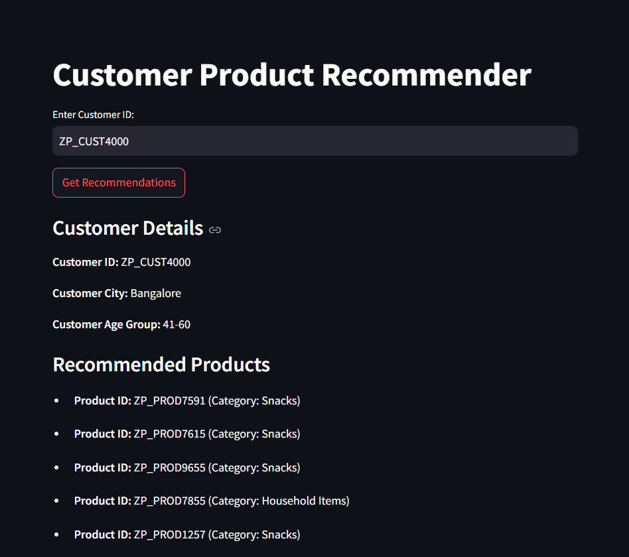
Personalized product recommendations :
Product recommendation system using collaborative filtering.
Recommends products to customers based on their purchase history.
Based on customer IDs and recommend personalized product.

Slide 16
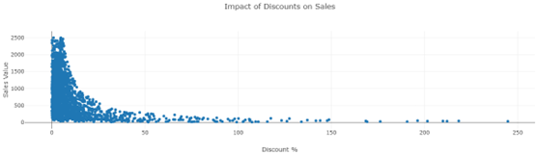
Promotions and discounts :
High Discounts, Low Sales.
A cluster of higher sales values appears to concentrate around the 10% discount range, suggesting this might be an optimal discount level.
Beyond 50% discounts, sales values remain consistently low, implying that extremely high discounts don't necessarily drive more sales.

Slide 17
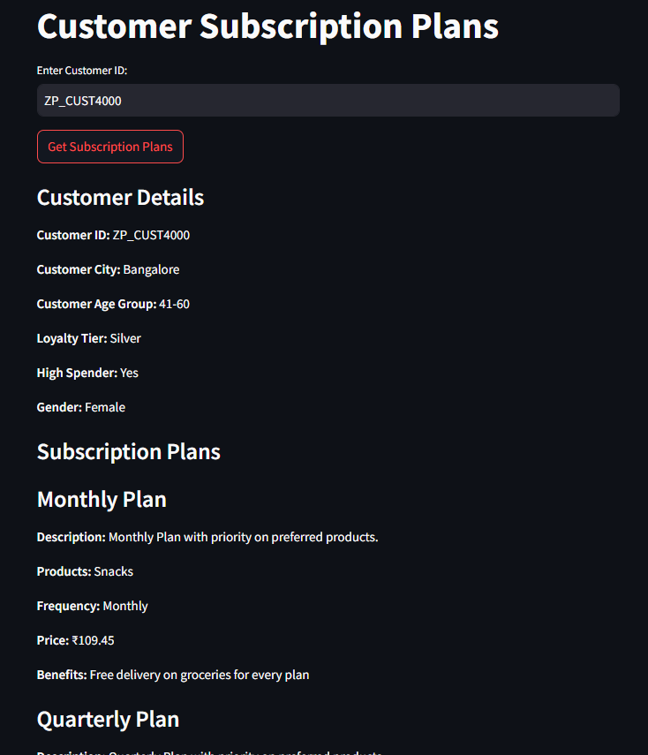
Subscription plans :
analyzes customer behavior (city, age, preferences, etc.) and generates tailored subscription plans (monthly, quarterly, annual) with varying prices, product selections, and benefits based on loyalty tier, spending habits, and gender.

Slide 18

Operational Efficiency

Slide 19
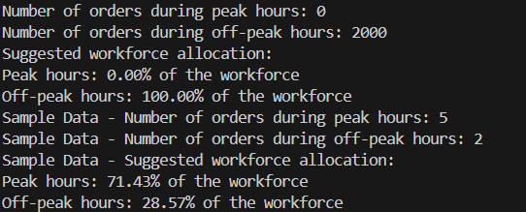
Peak and off-peak hours
Analyzes order data to determine peak and off-peak hours.
Calculates order volumes during these periods and suggests workforce allocation percentages accordingly.

Slide 20
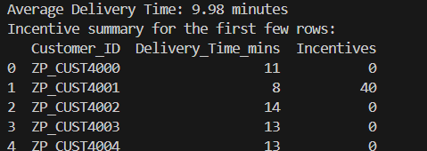
Incentive Allocation for High-Performing Riders :
Calculates rider incentives based on delivery times.
A base incentive and adds bonuses for faster deliveries, with no incentive for deliveries exceeding the average time.

Slide 21

Marketing Analytics

Slide 22
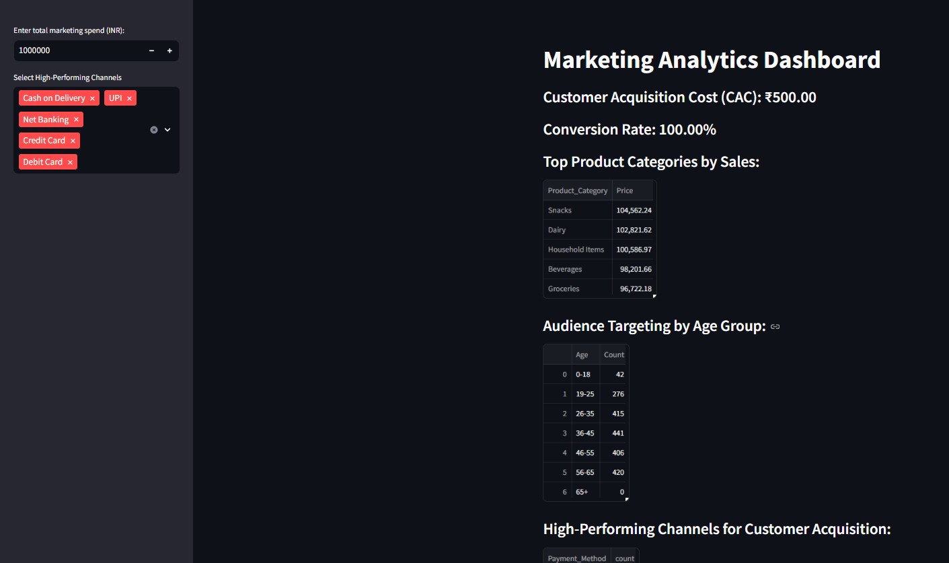
Audience targeting :
analyzes marketing data, calculating CAC and conversion rate.
identifies top product categories and high-performing channels for customer acquisition.
suggests budget allocation across categories based on revenue share, aiding data-driven marketing decisions.

Slide 23
Customer acquisition :
analyzes customer insights based on channel data.
calculates key metrics like Customer Acquisition Cost (CAC) and conversion rate, considering user-defined marketing spend and visitor counts.
It identifies high-performing channels and suggests budget allocation for maximizing ROI across selected or all channels.

Slide 24
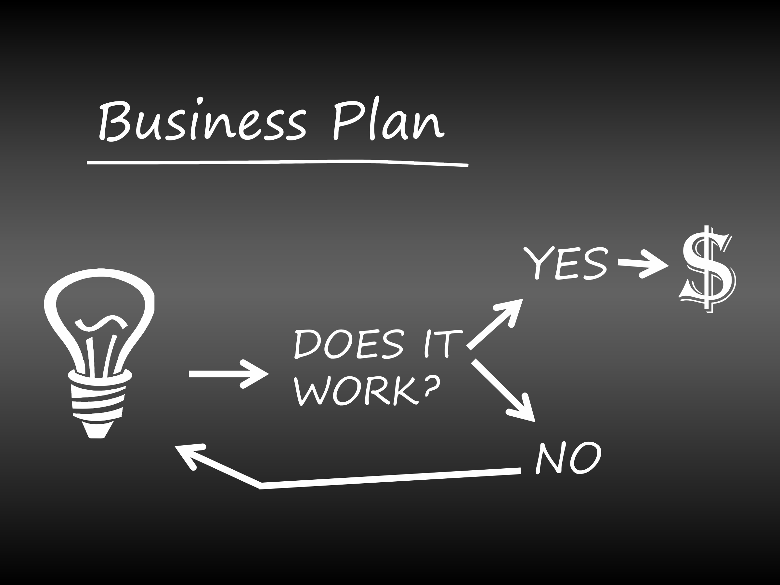
Execution & Implementation Plan :
Short-Term Plan (0-3 months): Model deployment for inventory & delivery.
Mid-Term Plan (3-6 months): Personalization & targeted marketing.
Long-Term Plan (6+ months): Expansion into new cities.

Slide 25
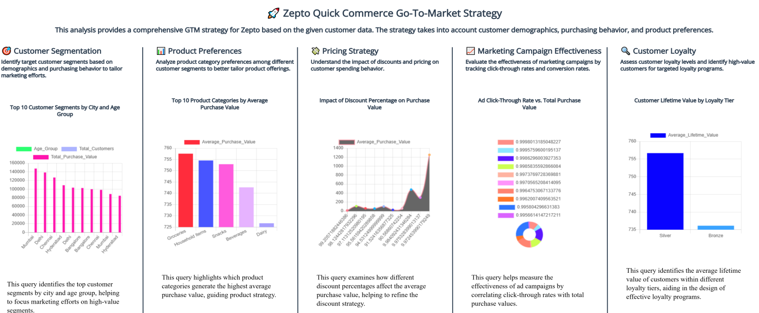

Slide 26
Conclusion Zepto's success in quick commerce is driven by a data-centric approach. They use predictive analytics for demand forecasting, inventory management, and personalized experiences. Operational efficiency is achieved through AI-powered route optimization and performance monitoring. Targeted marketing strategies, informed by market insights, drive customer acquisition and retention. Continuous improvement is ensured through A/B testing and key metric monitoring. Zepto's scalability plan includes hyperlocal marketing and cloud infrastructure. Easy access to their models and strategies is facilitated by "read me" files. This data-driven, agile approach, constantly refined through AI, machine learning, and real-time analytics, positions Zepto for sustained growth and competitive advantage in the fast-paced quick-commerce market.

