Slide 1





Elmerfem: Quench with circuit
Case study: Superbend
F. Trillaud⁽¹⁾ <ftrillaudp@gmail.com>, E. Takala⁽²⁾ <eelis.takala@gmail.com>
⁽¹⁾: Instituto de Ingeniería, UNAM, Mexico
⁽²⁾: Elemental Reality Solutions (ERS), Finland

Slide 2
Miscellaneous
Ubuntu 20.04LTS
Elmerfem 9.0 <http://www.elmerfem.org/blog/>
Salome 9.9.0 <https://www.salome-platform.org/>
Paraview 5.6 <https://www.paraview.org/>

Slide 3
Case study
Three closed coils inside an iron yoke.
Coil cross-section: 0.05 m x 0.05 m
Inner radius: 0.2 m
Magnetic core
Air
Coil 1
Coil 2
Coil 3

Slide 4
Meshes
Coil 1 & 3
Coil 2
Magnetic core
Air

Slide 5
Groups on meshes
Volumes
Racetrack coils (1, 2): Ω_{c1}, Ω_{c2}
Circular coils (3, 4): Ω_{c3}, Ω_{c4}
Magnetic core: Ω_{mc}
Air: Ω_{cc}
Boundaries
Racetrack coils (1, 2): Γ_{c1}, Γ_{c2}
Circular coils (3, 4): Γ_{c3}, Γ_{c4}
Air: Γ_{cc}

Slide 6
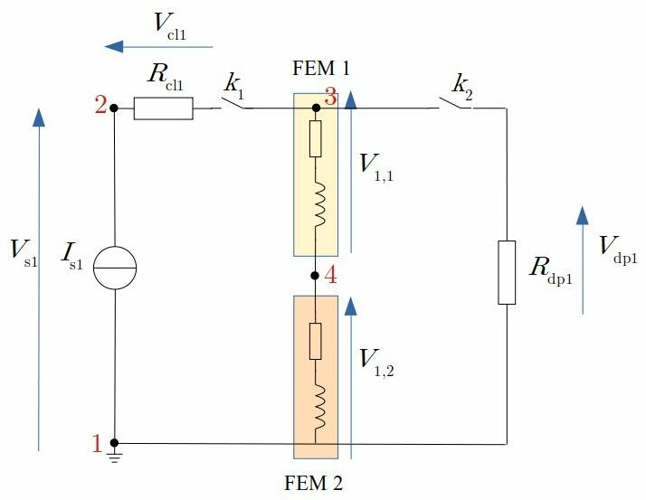
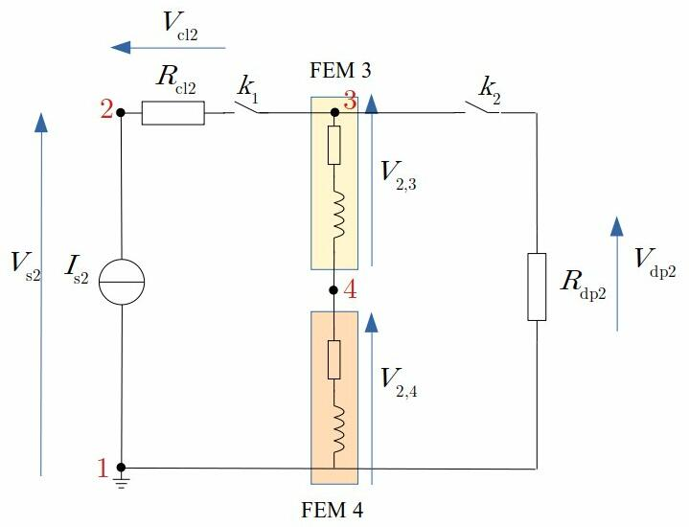
Circuit model
Two circuits with a dumping resistor in parallel:
Racetrack coils 1 and 2 connected in series
Circular coils 3 and 4 connected in series
Circuit 1: racetrack coils 1 & 2
Circuit 2: circular coils 3 & 4

Slide 7
Circuit equations
Both circuits are identical, we present only the equations for the first circuit
Circuit 1
Circuit 1, coil 2
NB: the circuit builder adds additional variables such as voltages

Slide 8
Circuit builder
We used the circuit builder python interface to create the circuit model:
https://pypi.org/project/elmer-circuitbuilder/
https://github.com/ElmerCSC/elmer-elmag/tree/main/CircuitBuilder
We modified by hand the resulting “circuits.definitions_tmp” file. First, we made a copy “circuits.definitions” that is called in the sif file. In this file, we removed the additions to the sif file and the parameters
1 import sys
2 from elmer_circuitbuilder import *
3
4 def main(argv=None):
5 output_file = "circuits.definitions_tmp"
6 # ---------------------------------------------------------------------------
7 c = number_of_circuits(2)
8 # ---------------------------------------------------------------------------
9 c[1].ref_node = 1
10 PS1 = I("IS1", 1, 2, 1.0)
11 Rcl1 = R("Rcl1", 2, 3, 1.0)
12 Rdp1 = R("Rdp1", 3, 1, 1.0)
13 FEM_1 = ElmerComponent("Coil1", 3, 4, 1, ["Coil1"])
14 # FEM_1 = ElmerComponent("Coil1", 3, 4, number of the Component field in sif == 1 associated to coil 1, ["Coil1"])
15 FEM_1.is3D()
16 FEM_1.stranded(1, 0)
17 FEM_1.isClosed()
18 FEM_2 = ElmerComponent("Coil2", 4, 1, 2, ["Coil2"])
19 FEM_2.is3D()
20 FEM_2.stranded(1, 0)
21 FEM_2.isClosed()
22 c[1].components.append([PS1, Rcl1, Rdp1, FEM_1, FEM_2])
23 # ---------------------------------------------------------------------------
24 c[2].ref_node = 1
25 PS2 = I("IS2", 1, 2, 1.0)
26 Rcl2 = R("Rcl2", 2, 3, 1.0)
27 Rdp2 = R("Rdp2", 3, 1, 1.0)
28 FEM_3 = ElmerComponent("Coil3", 3, 4, 3, ["Coil3"])
29 FEM_3.is3D()
30 FEM_3.stranded(1, 0)
31 FEM_3.isClosed()
32 FEM_4 = ElmerComponent("Coil4", 4, 1, 4, ["Coil4"])
33 FEM_4.is3D()
34 FEM_4.stranded(1, 0)
35 FEM_4.isClosed()
36 c[2].components.append([PS2, Rcl2, Rdp2, FEM_3, FEM_4])
37 # ---------------------------------------------------------------------------
38 generate_elmer_circuits(c, output_file)
39 return 0
40
41 if __name__ == "__main__":
42 sys.exit(main() or 0)

Slide 9
Cicuits.definitions
circuitBuilder.py
Circuits.definitions
1 import sys
2 from elmer_circuitbuilder import *
3
4 def main(argv=None):
5 output_file = "circuits.definitions_tmp"
6 # ---------------------------------------------------------------------------
7 c = number_of_circuits(2)
8 # ---------------------------------------------------------------------------
9 c[1].ref_node = 1
10 PS1 = I("IS1", 1, 2, 1.0)
11 Rcl1 = R("Rcl1", 2, 3, 1.0)
12 Rdp1 = R("Rdp1", 3, 1, 1.0)
13 FEM_1 = ElmerComponent("Coil1", 3, 4, 1, ["Coil1"])
14 # FEM_1 = ElmerComponent("Coil1", 3, 4, number of the Component field in sif == 1 associated to coil 1, ["Coil1"])
15 FEM_1.is3D()
16 FEM_1.stranded(1, 0)
17 FEM_1.isClosed()
18 FEM_2 = ElmerComponent("Coil2", 4, 1, 2, ["Coil2"])
19 FEM_2.is3D()
20 FEM_2.stranded(1, 0)
21 FEM_2.isClosed()
22 c[1].components.append([PS1, Rcl1, Rdp1, FEM_1, FEM_2])
23 # ---------------------------------------------------------------------------
24 c[2].ref_node = 1
25 PS2 = I("IS2", 1, 2, 1.0)
26 Rcl2 = R("Rcl2", 2, 3, 1.0)
27 Rdp2 = R("Rdp2", 3, 1, 1.0)
28 FEM_3 = ElmerComponent("Coil3", 3, 4, 3, ["Coil3"])
29 FEM_3.is3D()
30 FEM_3.stranded(1, 0)
31 FEM_3.isClosed()
32 FEM_4 = ElmerComponent("Coil4", 4, 1, 4, ["Coil4"])
33 FEM_4.is3D()
34 FEM_4.stranded(1, 0)
35 FEM_4.isClosed()
36 c[2].components.append([PS2, Rcl2, Rdp2, FEM_3, FEM_4])
37 # ---------------------------------------------------------------------------
38 generate_elmer_circuits(c, output_file)
39 return 0
40
41 if __name__ == "__main__":
42 sys.exit(main() or 0)
1 $ Circuits = 2
2
3 ! Matrix Size Declaration and Matrix Initialization
4 $ C.1.variables = 13
5 $ C.1.perm = zeros(C.1.variables)
6 $ C.1.A = zeros(C.1.variables,C.1.variables)
7 $ C.1.B = zeros(C.1.variables,C.1.variables)
8
9 ! Dof/Unknown Vector Definition
10 $ C.1.name.1 = "i_IS1"
11 $ C.1.name.2 = "i_Rcl1"
12 $ C.1.name.3 = "i_Rdp1"
13 $ C.1.name.4 = "i_component(1)"
14 $ C.1.name.5 = "i_component(2)"
15 $ C.1.name.6 = "v_IS1"
16 $ C.1.name.7 = "v_Rcl1"
17 $ C.1.name.8 = "v_Rdp1"
18 $ C.1.name.9 = "v_component(1)"
19 $ C.1.name.10 = "v_component(2)"
20 $ C.1.name.11 = "u_2_circuit_1"
21 $ C.1.name.12 = "u_3_circuit_1"
22 $ C.1.name.13 = "u_4_circuit_1"
23
24 ! Source Vector Definition
25 $ C.1.source.12 = "IS1_Source"
26
27 ! KCL Equations
28 $ C.1.B(0,0) = -1
29 $ C.1.B(0,1) = 1
30 $ C.1.B(1,1) = -1
31 $ C.1.B(1,2) = 1
32 $ C.1.B(1,3) = 1
33 $ C.1.B(2,3) = -1
34 $ C.1.B(2,4) = 1
35
36 ! KVL Equations
37 $ C.1.B(3,5) = 1
38 $ C.1.B(3,10) = -1
39 $ C.1.B(4,6) = -1
40 $ C.1.B(4,10) = 1
41 $ C.1.B(4,11) = -1
42 $ C.1.B(5,7) = -1
43 $ C.1.B(5,11) = 1
44 $ C.1.B(6,8) = -1
45 $ C.1.B(6,11) = 1
46 $ C.1.B(6,12) = -1
47 $ C.1.B(7,9) = -1
48 $ C.1.B(7,12) = 1
49
50 ! Component Equations
51 $ C.1.B(10,2) = Rdp1
52 $ C.1.B(10,7) = -1
53 $ C.1.B(11,0) = 1
54 $ C.1.B(12,1) = Rcl1
55 $ C.1.B(12,6) = -1
1 ! Matrix Size Declaration and Matrix Initialization
2 $ C.2.variables = 13
3 $ C.2.perm = zeros(C.2.variables)
4 $ C.2.A = zeros(C.2.variables,C.2.variables)
5 $ C.2.B = zeros(C.2.variables,C.2.variables)
6
7 ! Dof/Unknown Vector Definition
8 $ C.2.name.1 = "i_IS2"
9 $ C.2.name.2 = "i_Rcl2"
10 $ C.2.name.3 = "i_Rdp2"
11 $ C.2.name.4 = "i_component(3)"
12 $ C.2.name.5 = "i_component(4)"
13 $ C.2.name.6 = "v_IS2"
14 $ C.2.name.7 = "v_Rcl2"
15 $ C.2.name.8 = "v_Rdp2"
16 $ C.2.name.9 = "v_component(3)"
17 $ C.2.name.10 = "v_component(4)"
18 $ C.2.name.11 = "u_2_circuit_2"
19 $ C.2.name.12 = "u_3_circuit_2"
20 $ C.2.name.13 = "u_4_circuit_2"
21
22 ! Source Vector Definition
23 $ C.2.source.12 = "IS2_Source"
24
25 ! KCL Equations
26 $ C.2.B(0,0) = -1
27 $ C.2.B(0,1) = 1
28 $ C.2.B(1,1) = -1
29 $ C.2.B(1,2) = 1
30 $ C.2.B(1,3) = 1
31 $ C.2.B(2,3) = -1
32 $ C.2.B(2,4) = 1
33
34 ! KVL Equations
35 $ C.2.B(3,5) = 1
36 $ C.2.B(3,10) = -1
37 $ C.2.B(4,6) = -1
38 $ C.2.B(4,10) = 1
39 $ C.2.B(4,11) = -1
40 $ C.2.B(5,7) = -1
41 $ C.2.B(5,11) = 1
42 $ C.2.B(6,8) = -1
43 $ C.2.B(6,11) = 1
44 $ C.2.B(6,12) = -1
45 $ C.2.B(7,9) = -1
46 $ C.2.B(7,12) = 1
47
48 ! Component Equations
49 $ C.2.B(10,2) = Rdp2
50 $ C.2.B(10,7) = -1
51 $ C.2.B(11,0) = 1
52 $ C.2.B(12,1) = Rcl2
53 $ C.2.B(12,6) = -1

Slide 10
Circuit matrix - checked
New variables
To get the large matrix, in preamble of texmath: \setcounter{MaxMatrixCols}{20}
ALL GOOD

Slide 11
Study
Non-linear system using B = μ(H)H and σ(T,B)
Transient simulation:
Charging the magnet
Plateau with quench ignition
Discharge in external resistor (dumping)
Material properties depending on temperature and some cases magnetic field

Slide 12
Information
Multiphysics problem and implementation: Frederic Trillaud at ftrillaudp@gmail.com
FEM coding in Elmerfem, circuit implementation: Eelis Takala at eelis.takala@gmail.com

