Slide 1





Elmerfem: multiple circuits
PART I: No dumping scheme
F. Trillaud⁽¹⁾ <ftrillaudp@gmail.com>, E. Takala⁽²⁾ <eelis.takala@gmail.com>
⁽¹⁾: Instituto de Ingeniería, UNAM, Mexico
⁽²⁾: Elemental Reality Solutions (ERS), Finland

Slide 2
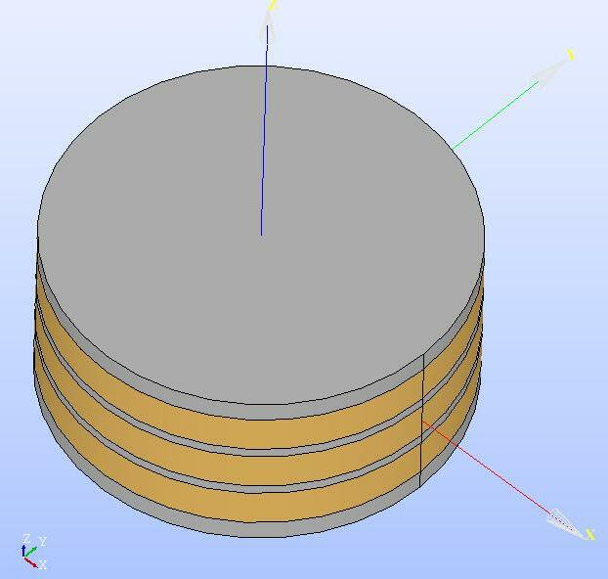
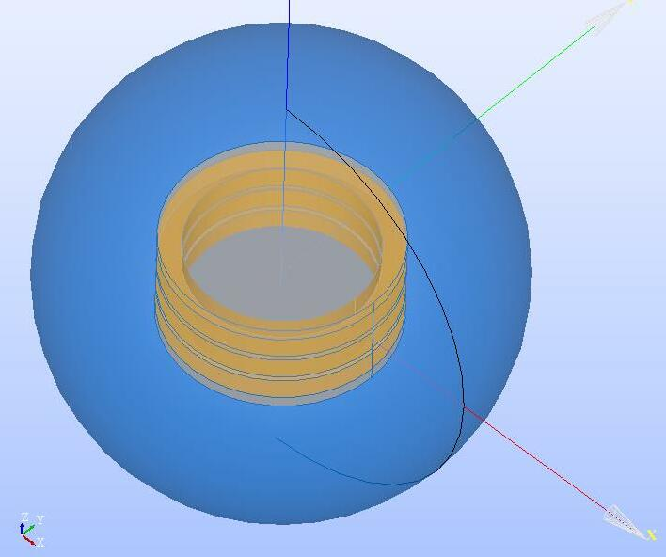
Case study
Three closed coils inside an iron yoke.
Coil cross-section: 0.05 m x 0.05 m
Inner radius: 0.2 m
Magnetic core
Air
Coil 1
Coil 2
Coil 3

Slide 3
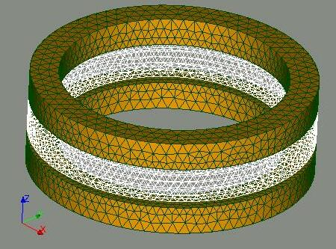
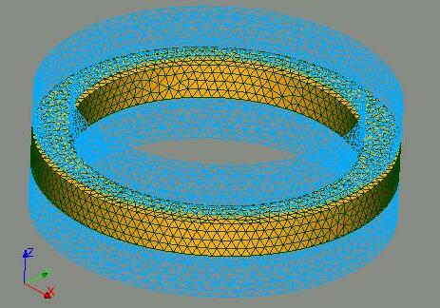
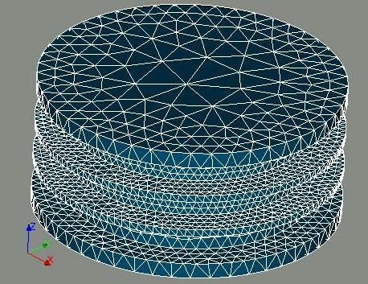
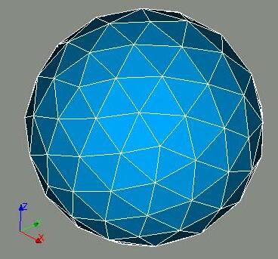
Meshes
Coil 1 & 3
Coil 2
Magnetic core
Air

Slide 4
Groups on meshes
Volumes
Coils (1, 2, 3): Ω_{c1}, Ω_{c2}, Ω_{c3}
Air: Ω_{cc}
Boundaries
Coils (1, 2, 3): Γc1, Γ_{c2}, Γc3
Air: Γcc

Slide 5
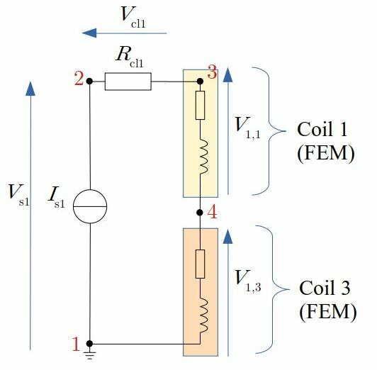
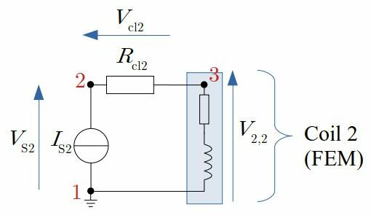
Circuit model
Two circuits:
Coil 1 and 3 connected in series
Coil 2 alone
Circuit 1: coil 1 & 3
Circuit 2: coil 2

Slide 6
Circuit equations
Circuit 1
Circuit 2
Circuit 1, coil 1

Slide 7
Circuit builder
We used the circuit builder python interface to create the circuit model:
https://pypi.org/project/elmer-circuitbuilder/
https://github.com/ElmerCSC/elmer-elmag/tree/main/CircuitBuilder
We modified by hand the resulting “circuits.definitions” file
1 import sys
2 from elmer_circuitbuilder import *
3
4 def main(argv=None):
5 output_file = "circuits.definitions"
6 # ---------------------------------------------------------------------------
7 c = number_of_circuits(2)
8 # ---------------------------------------------------------------------------
9 c[1].ref_node = 1
10 I1 = I("IS1", 1, 2, 100.0)
11 R1 = R("Rcl1", 2, 3, 200.0)
12 FEM_1 = ElmerComponent("Coil1", 3, 4, 1, ["Coil1"])
13 FEM_3 = ElmerComponent("Coil3", 4, 1, 3, ["Coil3"])
14 FEM_1.is3D()
15 FEM_1.stranded(1, 0)
16 FEM_1.isClosed()
17 FEM_3.is3D()
18 FEM_3.stranded(1, 0)
19 FEM_3.isClosed()
20 c[1].components.append([I1, R1, FEM_1, FEM_3])
21 # ---------------------------------------------------------------------------
22 c[2].ref_node = 1
23 I2 = I("IS2", 1, 2, 101.0)
24 R2 = R("Rcl2", 2, 3, 201.0)
25 FEM_2 = ElmerComponent("Coil2", 3, 1, 2, ["Coil2"])
26 FEM_2.is3D()
27 FEM_2.stranded(1, 0)
28 FEM_2.isClosed()
29 c[2].components.append([I2, R2, FEM_2])
30 # ---------------------------------------------------------------------------
31 generate_elmer_circuits(c, output_file)
32 return 0
33
34 if __name__ == "__main__":
35 sys.exit(main() or 0)

Slide 8
Cicuits.definitions
circuitBuilder.py
Circuits.definitions
1 import sys
2 from elmer_circuitbuilder import *
3
4 def main(argv=None):
5 output_file = "circuits.definitions"
6 # ---------------------------------------------------------------------------
7 c = number_of_circuits(2)
8 # ---------------------------------------------------------------------------
9 c[1].ref_node = 1
10 I1 = I("IS1", 1, 2, 100.0)
11 R1 = R("Rcl1", 2, 3, 200.0)
12 FEM_1 = ElmerComponent("Coil1", 3, 4, 1, ["Coil1"])
13 FEM_3 = ElmerComponent("Coil3", 4, 1, 3, ["Coil3"])
14 FEM_1.is3D()
15 FEM_1.stranded(1, 0)
16 FEM_1.isClosed()
17 FEM_3.is3D()
18 FEM_3.stranded(1, 0)
19 FEM_3.isClosed()
20 c[1].components.append([I1, R1, FEM_1, FEM_3])
21 # ---------------------------------------------------------------------------
22 c[2].ref_node = 1
23 I2 = I("IS2", 1, 2, 101.0)
24 R2 = R("Rcl2", 2, 3, 201.0)
25 FEM_2 = ElmerComponent("Coil2", 3, 1, 2, ["Coil2"])
26 FEM_2.is3D()
27 FEM_2.stranded(1, 0)
28 FEM_2.isClosed()
29 c[2].components.append([I2, R2, FEM_2])
30 # ---------------------------------------------------------------------------
31 generate_elmer_circuits(c, output_file)
32 return 0
33
34 if __name__ == "__main__":
35 sys.exit(main() or 0)
1 $ Circuits = 2
2
3 $ C.1.variables = 11
4 $ C.1.perm = zeros(C.1.variables)
5 $ C.1.A = zeros(C.1.variables,C.1.variables)
6 $ C.1.B = zeros(C.1.variables,C.1.variables)
7
8 $ C.1.name.1 = "i_IS1"
9 $ C.1.name.2 = "i_Rcl1"
10 $ C.1.name.3 = "i_component(1)"
11 $ C.1.name.4 = "i_component(3)"
12 $ C.1.name.5 = "v_IS1"
13 $ C.1.name.6 = "v_Rcl1"
14 $ C.1.name.7 = "v_component(1)"
15 $ C.1.name.8 = "v_component(3)"
16 $ C.1.name.9 = "u_2_circuit_1"
17 $ C.1.name.10 = "u_3_circuit_1"
18 $ C.1.name.11 = "u_4_circuit_1"
19
20 $ C.1.source.11 = "IS1"
21
22 $ C.1.B(0,0) = -1
23 $ C.1.B(0,1) = 1
24 $ C.1.B(1,1) = -1
25 $ C.1.B(1,2) = 1
26 $ C.1.B(2,2) = -1
27 $ C.1.B(2,3) = 1
28
29 $ C.1.B(3,4) = 1
30 $ C.1.B(3,8) = -1
31 $ C.1.B(4,5) = -1
32 $ C.1.B(4,8) = 1
33 $ C.1.B(4,9) = -1
34 $ C.1.B(5,6) = -1
35 $ C.1.B(5,9) = 1
36 $ C.1.B(5,10) = -1
37
38 $ C.1.B(8,1) = Rcl1
39 $ C.1.B(8,5) = -1
40 $ C.1.B(9,7) = -1
41 $ C.1.B(9,10) = 1
42 $ C.1.B(10,0) = 1
1 $ C.2.variables = 8
2 $ C.2.perm = zeros(C.2.variables)
3 $ C.2.A = zeros(C.2.variables,C.2.variables)
4 $ C.2.B = zeros(C.2.variables,C.2.variables)
5
6 $ C.2.name.1 = "i_IS2"
7 $ C.2.name.2 = "i_Rcl2"
8 $ C.2.name.3 = "i_component(2)"
9 $ C.2.name.4 = "v_IS2"
10 $ C.2.name.5 = "v_Rcl2"
11 $ C.2.name.6 = "v_component(2)"
12 $ C.2.name.7 = "u_2_circuit_2"
13 $ C.2.name.8 = "u_3_circuit_2"
14
15 $ C.2.source.8 = "IS2"
16
17 $ C.2.B(0,0) = -1
18 $ C.2.B(0,1) = 1
19 $ C.2.B(1,1) = -1
20 $ C.2.B(1,2) = 1
21
22 $ C.2.B(2,3) = 1
23 $ C.2.B(2,6) = -1
24 $ C.2.B(3,4) = -1
25 $ C.2.B(3,6) = 1
26 $ C.2.B(3,7) = -1
27 $ C.2.B(4,5) = -1
28 $ C.2.B(4,7) = 1
29
30 $ C.2.B(6,1) = Rcl2
31 $ C.2.B(6,4) = -1
32 $ C.2.B(7,0) = 1

Slide 9
Results
Deviation between circuits current:
The linear case with B = μ₀H and σ = cst is working
The non-linear case B = μ(H)H and σ = cst is working
The non-linear resistance case B = μ₀H and σ(B) is working
The non-linear resistance case B = μ(H)H and σ(B) is working
See what else?

Slide 10
Information
Full code:
https://drive.google.com/drive/folders/1JQJGZvbyno8A4lw7-U0Y2NS6hF2eZgdj?usp=sharing
Or contact:
Frederic Trillaud at ftrillaudp@gmail.com

