Slide 1


Social Buzz’s content category analysis

Slide 2


Today's agenda
Project recap
Problem
The Analytics team
Process
Insights
Summary

Slide 3

S
Social Bizz is a fast-growing technology unicorn that needs to adapt to a global scale. Accenture has begun a 3 month POC focusing on these tasks:
An audit of Social Buzz’s big data practice
Recommendations for successful IPO
Analysis to find Social Buzz’s top 5 most popular categories of content
Project Recap

Slide 4

Problem
Due to the rapid growth and digital nature of Social Buzz’s core product, the amount of data they create, collect, and analyze is huge. Every day over 100,000 pieces of content, including text, images, videos, and GIFs are posted. All of those constitute highly unstructured data that requires expertise in handling. Social Buzz’s biggest challenge is how to capitalize on this data to gain a deeper understanding of its audience and therefore provide a more personalized and enjoyable experience.

Slide 5



Andrew Fleming Chief Technical Architect
The Analytics team
Marcus Rompton Senior Principle
Emil Roby Data Analyst

Slide 6
Process
1
Data Understanding
2
Data Cleaning
3
Data Modelling
4
Data Analysis
5
Uncover Insights

Slide 7

Insights
6589
25.4%
PHOTO
HIGHEST IN CONTENT TYPE
1897
7.72%
ANIMAL
HIGHEST IN CATEGORY TYPE
1622
6.6%
HEART
HIGHEST IN REACTION TYPE

Slide 8
From the charts, we understood that the top 5 categories based on the score are Animal, Science, Healthy eating, Technology and Food

Slide 9
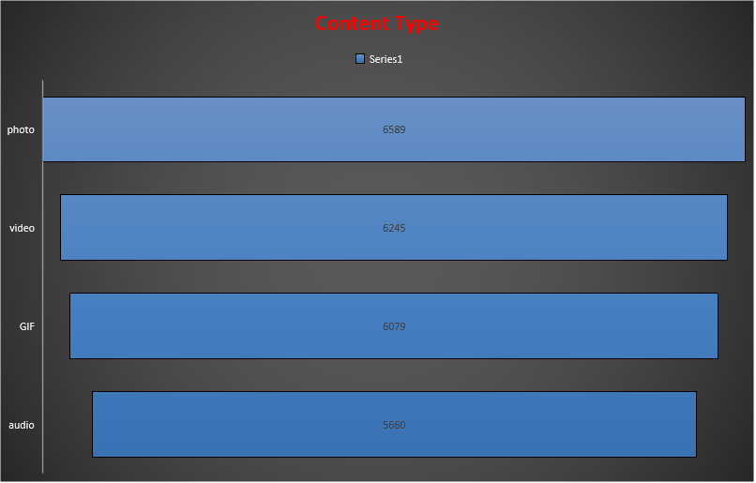
From the charts, we understood that the highest-used content is Photo and the maximum number of reactions from customers was Heart.

Slide 10

Animals and science are the two most popular content categories indicating an innate tendency to seek connections with nature and facts.
Healthy eating and food fall in the top five categories with healthy eating outperforming food by 0.76%. This is a broad indication of an audience within Social Buzz’s user base. Creating campaigns, and working with influencers and brands that support healthy eating and healthy lifestyle can help to boost growth in these 2 categories.
Social Buzz can leverage holiday seasons to boost growth and user engagement within the food content category via relevant social media strategies.
Summary

Slide 11
Thank you!
ANY QUESTIONS?

