Slide 1
Project 3: An investigation into the split of property ownership in Glasgow, Scotland Py-ministers Dan hughes, Eoghan Alton Mohammed Sadek Ahmed, Kashfi Khalid

Slide 2
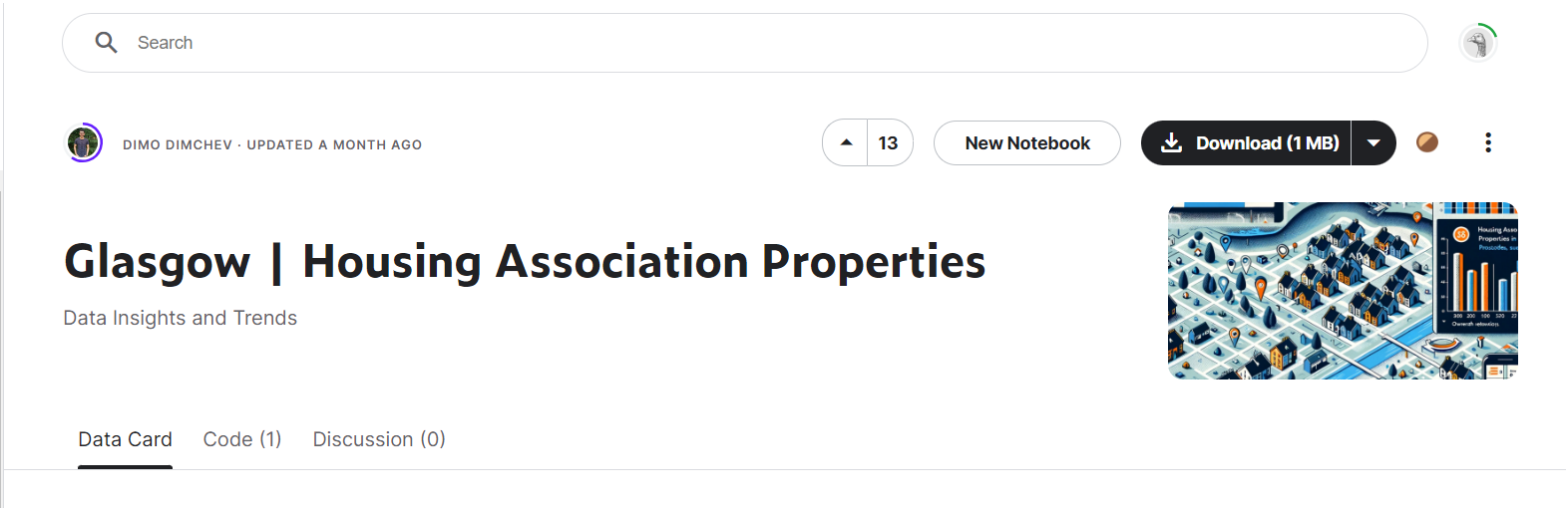
Purpose of this Project
Analyse the state of housing in a major city
We have chosen Glasgow and to investigate the number of houses owned independently and by the housing association

Slide 3
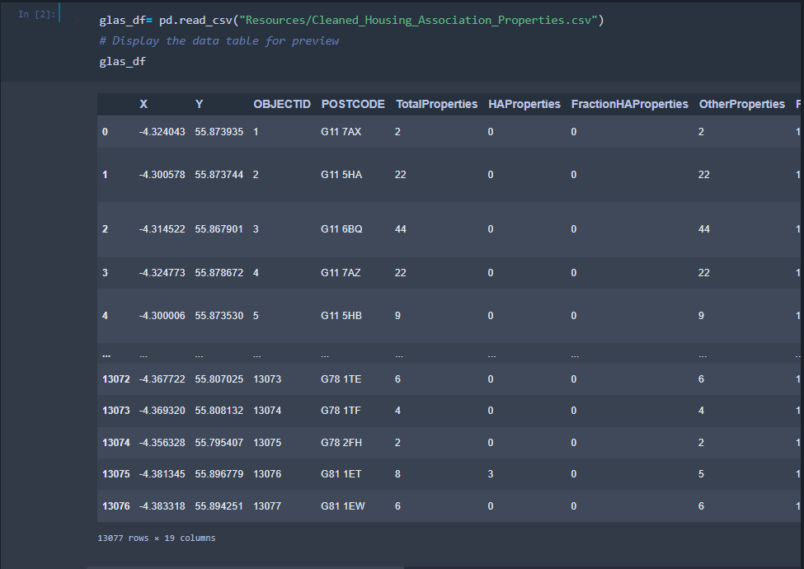
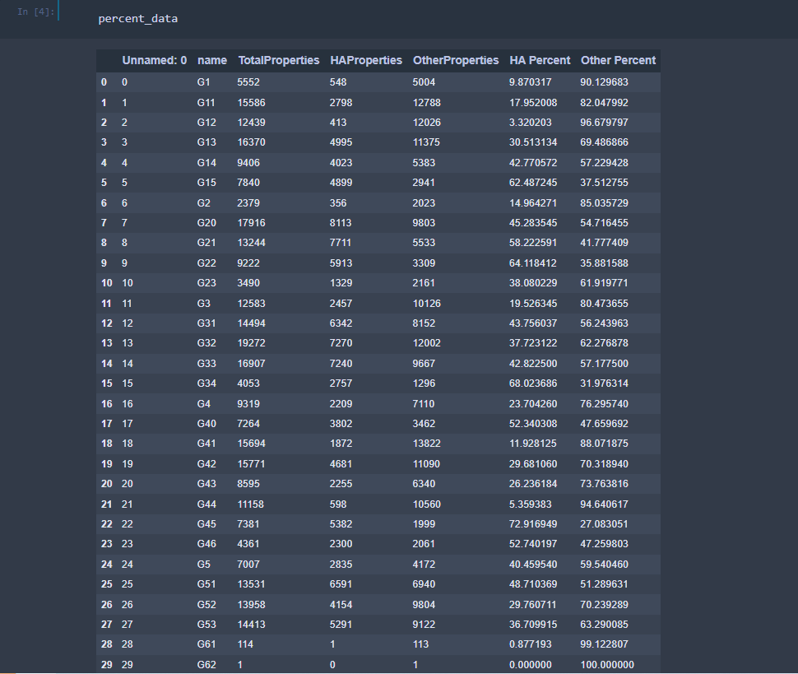
Process
We started off by first importing the data in as a csv and using pandas to help clean up and manipulate the data into something we can analyse

Slide 4
Database
Next, we needed a way to store and access our data for some of the ways we planned on presenting our data for this we turned to SQLite

Slide 5
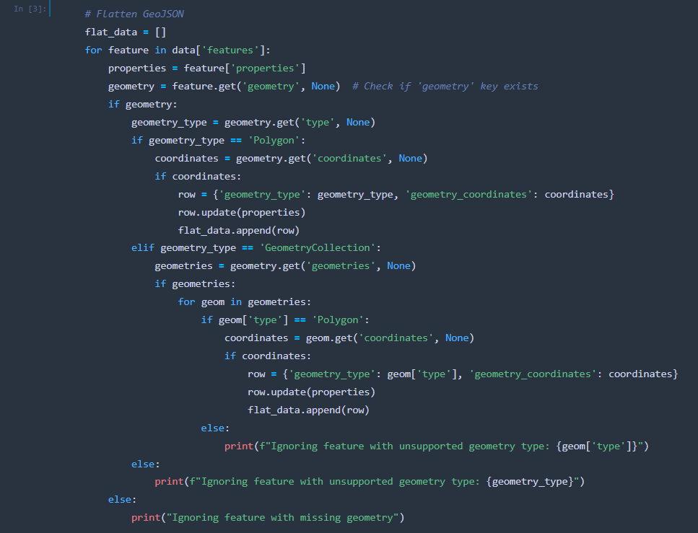
Creating The choropleth
Once the data had been transformed, we worked on creating different ways to present the data
One which way we have chosen is a choropleth

Slide 6
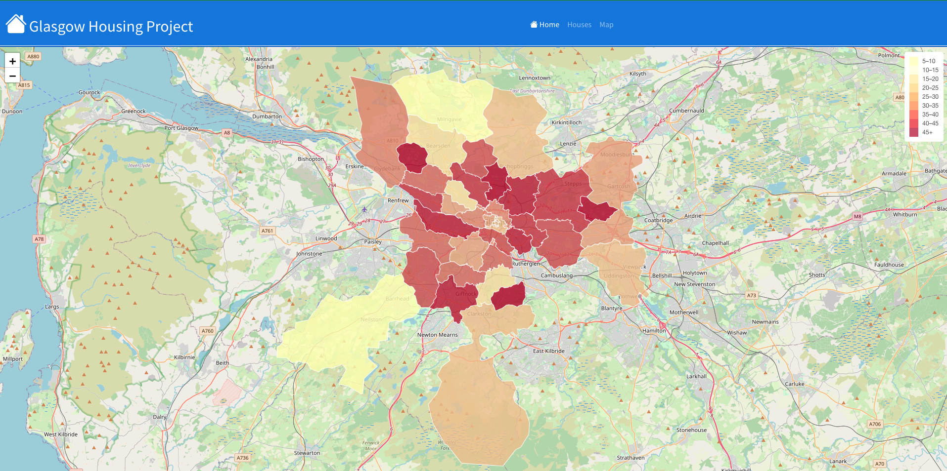

Slide 7
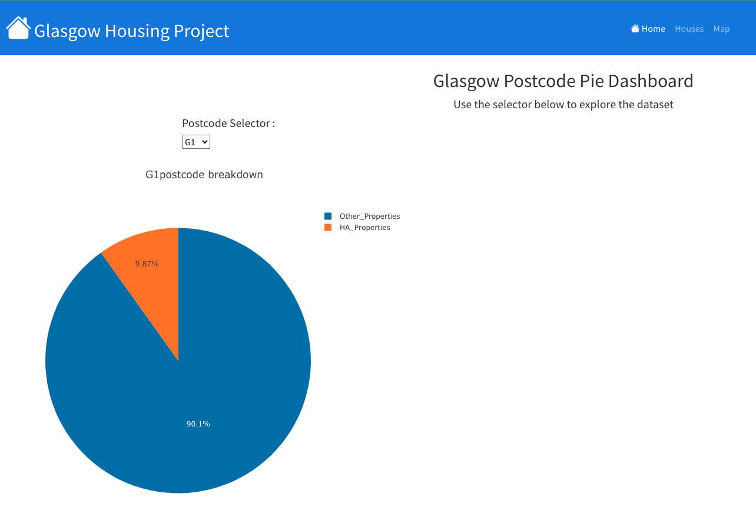
Charts
Another form of presentation we have chosen to display our data in is the form of interactive charts

Slide 8
Conclusions
From a relatively small dataset, we have found some interesting points; no clear sides of city show similar colours on our map
Further investigation would need to be done into areas of high Housing Association owned properties
Good exploratory analysis

Slide 9
Any questions?

