Slide 1


Slide 2
About Us
ERACE Cancer is a group of students and researchers from Stanford University who are working to Establish Race And Class Equality in Cancer
Our educational campaigns target both campus community members and the residents of towns in the Bay Area
Educational efforts consist of forums and discussions on:
1. Social determinants of health
2. Direct dissemination of information on
cancer prevention and early detection to at risk-populations.

Slide 3

Community Assessment
“Community Health Needs Assessment” for Santa Clara and San Mateo counties has identified cancer disparities as a prioritized need¹.
THE CHNA is an assessment made via community feedback and collaborative efforts between experts in clinical care, public health, and other organizations.
1.http://stanfordhospital.org/aboutUs/documents/CHNA-FY13.pdf
Notes:
1. http://stanfordhospital.org/aboutUs/documents/CHNA-FY13.pdf

Slide 4
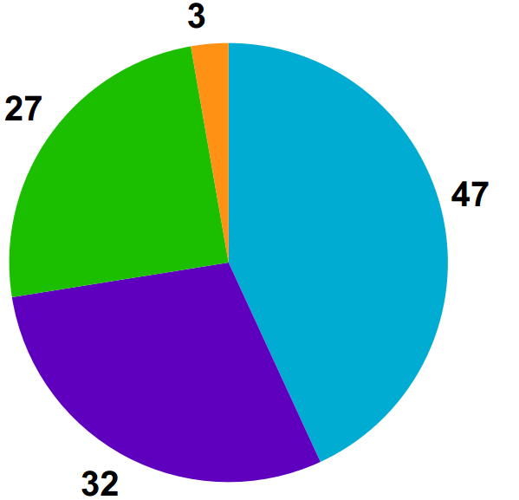
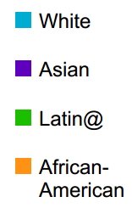
Santa Clara County: Population
1.http://stanfordhospital.org/aboutUs/documents/CHNA-FY13.pdf
Notes:
SCC’s racial/ethnic composition is 47
percent White, 32 percent Asian, 27 percent Latino and
3 percent African American.
*population demographics do not add to 100% due to dual repsonses
more than 100 languages and dialects are spoken in SCC

Slide 5

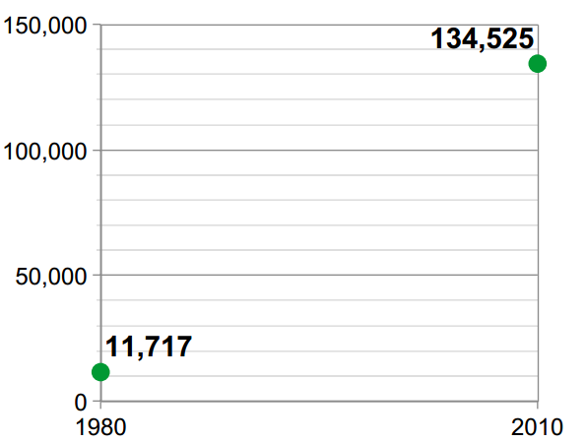
Growing Populations
Latinos represent the fastest growing population followed by the Vietnamese which represent the largest Vietnamese population in any US city¹.
Current API
Population² :
571,718
2050:
750,954
Current Latin@
Population²:
479,210
2050 :
948,986
http://stanfordhospital.org/aboutUs/documents/CHNA-FY13.pdf
http://www.sccgov.org/sites/sccphd/en-us/Partners/Data/Documents/Latino%20Health%202012/LHA_Demographics_oct2012.pdf
Notes:
http://stanfordhospital.org/aboutUs/documents/CHNA-FY13.pdf
http://www.sccgov.org/sites/sccphd/en-us/Partners/Data/Documents/Latino%20Health%202012/LHA_Demographics_oct2012.pdf

Slide 6
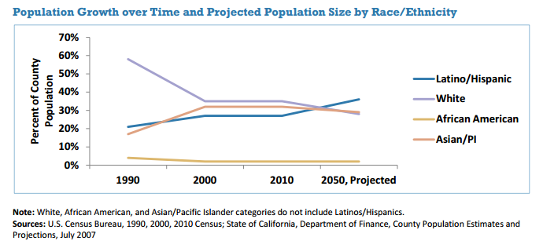
Aging Population
In 2010, 1 in 6 residents were 60+ years and the figure is expected to rise to 1 in 4 by 2030¹.
Though current 60+ year olds are white, demographics are expected to shift to about 47 % White, 29.5% Asian, and 17.8% Latino. ¹
http://stanfordhospital.org/aboutUs/documents/CHNA-FY13.pdf
Notes:
http://stanfordhospital.org/aboutUs/documents/CHNA-FY13.pdf

Slide 7
Review
Large minority population
Aging population
Low socioeconomic status
Cancer
Notes:
Current demographics in santa clara county align with what we know are cancer risks...so how is SCC doing in terms of cancer?

Slide 8
Cancer and Santa Clara
Incidence and mortality of all cancer types in SCC are higher than state averages. ¹
Breast, colorectal, prostate, liver, lung, and cervical cancer are of particular concern. ¹
Not only are they high for state averages, rates are disproportionately high when subdivided by race. ¹
1. http://stanfordhospital.org/aboutUs/documents/CHNA-FY13.pdf
Notes:
Not surprisingly, the facts are not very reassuring.
http://stanfordhospital.org/aboutUs/documents/CHNA-FY13.pdf

Slide 9
SCC Screening Inadequacies
An assessment of Santa Clara County’s Vietnamese community found that they lacked health insurance and had higher rates of certain types of cancer.
Incidence and mortality rates for liver cancer were 4x higher among Vietnamese adults than adults in SCC as a whole.
Cancer screening rates were well below Healthy People (HP) targets.
Cervical cancer: 73% vs. HP 2020’s target of 93%
Colon cancer: 56% vs. HP target of 70.5 percent.
Notes:
HP 2020 are federal health goals for 2020 created by multiple US agencies (FDA, CDC, NIH, Agency for Healthcare Research and Quality, Office of Minority Health, etc.)

Slide 10
Health Disparities - Liver Cancer
The liver cancer incidence rate per 100,000 in the overall county population is 14. BUT:
Notes:
Although rates of liver cancer are highest in the Vietnamese community, Latinos and other Asian populations are disproportionately affected.

Slide 11
Health Disparities - Liver Cancer
The liver cancer incidence rate per 100,000 in the overall county population is 14. BUT:
Notes:
Although rates of liver cancer are highest in the Vietnamese community, Latinos and other Asian populations are disproportionately affected.

Slide 12
Cervical Cancer
http://www.sccgov.org/sites/sccphd/en-us/Partners/Data/Documents/VHA%20Full%20Report,%202011.pdf

Slide 13
Stomach Cancer
http://www.sccgov.org/sites/sccphd/en-us/Partners/Data/Documents/VHA%20Full%20Report,%202011.pdf
Notes:
Yes, the 9, 13, and 14 all stay the same…weird….imporant to note that not all cancer types are HDs – white people get more lung and colorectal cancer

Slide 14
Economic Disparity
Asian and Latino seniors disproportionately live in impoverished conditions relative to white seniors
Notes:
According to the Elder Economic Security Index3 (Elder Index), a measure that provides a county-specific indicator of senior poverty, 67 percent of Latino seniors and 76 percent of Asian seniors are living in impoverished conditions, compared with just 32 percent of White (non-Latino) seniors.

Slide 15
Economic Disparity
Additionally, female seniors and seniors ages 75 and older (any gender) are more likely to experience poverty compared to male seniors and those between the ages of 65 and 74.
Notes:
According to the Elder Economic Security Index3 (Elder Index), a measure that provides a county-specific indicator of senior poverty, 67 percent of Latino seniors and 76 percent of Asian seniors are living in impoverished conditions, compared with just 32 percent of White (non-Latino) seniors.
-where did you get this info from? if it was just from the community assessment, then chances are is that is all we are going to get. I don’t think we have access to the raw data besides what they have calculated for us.

