Slide 1


Slide 2
Cancer Screening
Benefits
Prevent development of disease
Early detection can help improve prognosis (treatment at earlier stage + before symptoms appear)
Considerations tests can yield false-positives (or false negatives)
screening procedures can come with risks
early detection might not help prognosis in some cases
1. http://www.cancer.gov/cancertopics/pdq/screening/overview/patient/page1
Notes:
http://www.cancer.gov/cancertopics/pdq/screening/overview/patient/page1

Slide 3
General Screening Considerations¹
Family History: family history is of certain cancers can be an indicator of susceptibility. Also consider similar lifestyles which translate to risks.
Age: Incidence of cancer directly correlates with age.
The Big 3
Alcohol: recomm. no more than 2 drinks for men per day (one drink per day for women)
Tobacco: Having a 30 years history of smoking or having quit within the last 15 years.
Weight: often indicator of poor nutrition, insufficient exercise, and other complications such as diabetes, high blood pressure, etc.
http://www.cancer.gov/cancertopics/factsheet/Risk/genetic-testing
Notes:
As mentioned earlier.....

Slide 4

Breast
Breast cancer disproportionally affects white women in SCC.
*Note-African-American women are more likely to die from the disease
Encourage self-breast exams starting at age 20
Yearly mammograms for women 40 and older
Clinical breast exam (CBE) about every 3 years for women in their 20s and 30s and every year for women 40 and over ¹
http://www.cancer.org/healthy/findcancerearly/cancerscreeningguidelines/american-cancer-society-guidelines-for-the-early-detection-of-cancer
Notes:
http://www.cancer.org/healthy/findcancerearly/cancerscreeningguidelines/american-cancer-society-guidelines-for-the-early-detection-of-cancer

Slide 5
Self-Breast Exam ¹
Though an SBE is not a screening method, 40% of diagnosed breast cancers were found by women who have found irregularities in their breasts.
Women are recommended to perform a SBE at least once a month. Women who are well acquainted with their breasts are more likely to notice changes.
http://www.nationalbreastcancer.org/breast-self-exam
Notes:
http://www.nationalbreastcancer.org/breast-self-exam

Slide 6
Video
http://www.nationalbreastcancer.org/breast-self-exam
Notes:
this video goes through SBE, clinical breast exams, and mammograms.

Slide 7
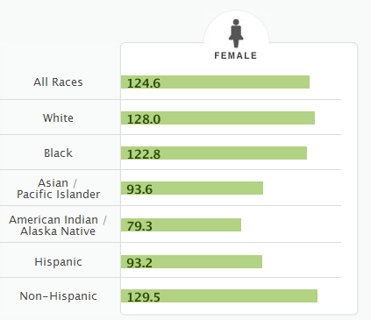
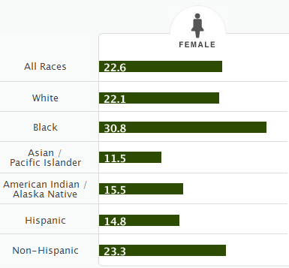
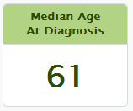
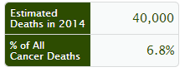
Breast Cancer Stats
http://seer.cancer.gov/statfacts/more.html
Notes:
17% of whites diagnosed with breast cancer in comparison to 25% to blacks
*It is important to note that these percentages do not account for the racial inequality of diagnosis. Health Educators should point out that variation among both race and sex could be indicators of social determinates of health.

Slide 8
Prevention¹
Limit alcohol and tobacco consumption
Maintain a healthy weight and an active lifestyle
Breastfeed! Women who breastfeed have a lower risk of developing breast cancer
Limit dose and duration of hormone therapy (For example, consider alternative methods if you are taking hormone therapy for menopausal symptoms)
Avoid radiation and environmental pollutants (medical imaging methods use high amounts of radiation. Have these methods done only when necessary).
http://www.mayoclinic.org/healthy-living/womens-health/in-depth/breast-cancer-prevention/art-20044676
Notes:
http://www.mayoclinic.org/healthy-living/womens-health/in-depth/breast-cancer-prevention/art-20044676

Slide 9

Liver
Asian Americans are 1.7-11.3X more susceptible to liver cancer than their Caucasian counterparts. Latin@s in SCC are disproportionally affected as well.
Screening advised for those at high risk →
people with cirrhosis and chronic hepatitis B infections
Screening procedures: AFP test and ultrasound of the liver
Note* Screening not advised for those at average risk
1.http://www.cancer.org/healthy/findcancerearly/cancerscreeningguidelines/american-cancer-society-guidelines-for-the-early-detection-of-cancer
Notes:
http://www.cancer.org/healthy/findcancerearly/cancerscreeningguidelines/american-cancer-society-guidelines-for-the-early-detection-of-cancer

Slide 10
AFP Test
Alpha-feto protein is produced by both the level and yolk sac of a developing fetus. Abundance of this protein is extremely low in health adults.
THE AFP test is a blood tests that measures the level of this protein. Amounts higher than the expected 40 micrograms (mg) per liter could be an indication of liver malfunction (the liver accounts for 2/3 of AFP production in adults).
Note* AFP tests by themselves are not definitive and are recommended to be taken in conjuncture with a liver ultrasound
http://www.everydayhealth.com/liver-cancer/alpha-fetoprotein-for-liver-cancer-screening.aspx
Notes:
http://www.everydayhealth.com/liver-cancer/alpha-fetoprotein-for-liver-cancer-screening.aspx

Slide 11
Liver Ultrasound
Ultrasounds are used to detect any abnormal growth or general structural abnormalities in the liver.
The procedure is painless and involves a technician placing a probe over a patient’s skin while they lie down.
http://www.cancer.org/cancer/livercancer/overviewguide/liver-cancer-overview-diagnosed
Notes:
http://www.cancer.org/cancer/livercancer/overviewguide/liver-cancer-overview-diagnosed

Slide 12
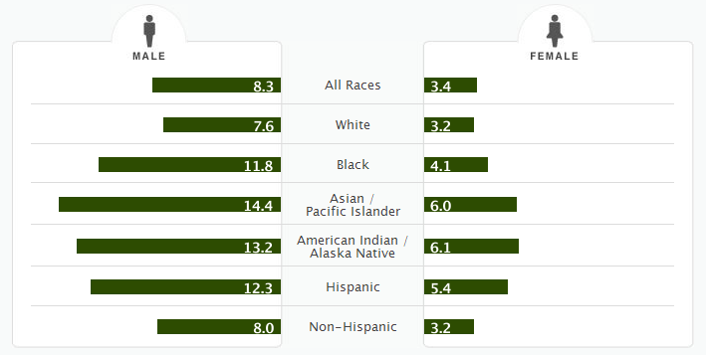
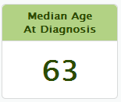
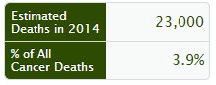
Liver Cancer Stats
http://seer.cancer.gov/statfacts/more.html
Notes:
No apparent racial disparities might be attributed to the very low 5-year survival rate (16.6%). Its fatality might be an indication that treatments are not very effective for anyone.

Slide 13
Prevention
Reducing the risk of cirrhosis (scarring of liver tissue) directly reduces the risk of liver cancer.
Prevention includes:
Minimizing alcohol consumption
Maintaining a healthy weight
Getting vaccinated for hepatitis B (offers 90% protection)
Prevent hepatitis C by knowing the HIV status of your sexual partner, refraining from intravenous drug use, and seeking clean tattoo shops.
http://www.mayoclinic.org/diseases-conditions/liver-cancer/basics/prevention/con-20025222
Notes:
http://www.mayoclinic.org/diseases-conditions/liver-cancer/basics/prevention/con-20025222

Slide 14

Cervical
Latinas and Asian/Pacific Islanders are disproportionally affected in SCC.
Recommendations
Women ages 21-29 should be getting a PAP test every 3 years
Women ages 30-65 should have a PAP test and HPV test every 5 years
Who shouldn’t be tested
women 65+ years of age
women who have had their uterus and cervix removed for cancer un-related reasons
NOTE: Women who have received the HPV vaccine should still follow recommendations
d
http://www.cancer.org/healthy/findcancerearly/cancerscreeningguidelines/american-cancer-society-guidelines-for-the-early-detection-of-cancer
Notes:
http://www.cancer.org/healthy/findcancerearly/cancerscreeningguidelines/american-cancer-society-guidelines-for-the-early-detection-of-cancer

Slide 15
Pap Test
A PAP tests involves collecting cells from the cervix (the narrow part of the uterus directly above the vagina).
HPV Test
HPV test is done as a follow-up test given abnormal PAP test and women 30 years and old
The test is used to detect the present of the human papillomavirus which can lead to genital warts, abnormal cervical cells or cervical cancer.
http://www.mayoclinic.org/tests-procedures/pap-smear/basics/definition/prc-20013038
Notes:
http://www.mayoclinic.org/tests-procedures/pap-smear/basics/definition/prc-20013038

Slide 16
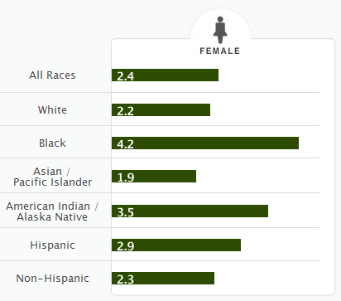
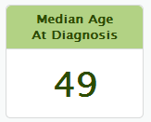
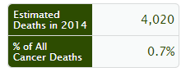
Cervical Cancer Stats
http://seer.cancer.gov/statfacts/more.html
Notes:
28% of whites diagnosed with cervical cancer die in comparison to 45% of blacks and 46% of American Indians.

Slide 17
Prevention
Limit tobacco consumption
Avoid HPV via vaccination
Vaccine: 3 vaccines given over a period of months are currently available that protect against HPV strains 6,11,16,and 18 (Gardasil) and HPV strains 16 and 18 (Cerverix)
Reduce your amount of sexual partners, use condoms when possible.
*Note: Sex is not necessary for infection. As long as contact occurs with an infected area, it is possible to contract HPV.
http://www.cancer.org/cancer/cervicalcancer/moreinformation/cervicalcancerpreventionandearlydetection/cervical-cancer-prevention-and-early-detection-can-cervical-cancer-be-prevented
Notes:
http://www.cancer.org/cancer/cervicalcancer/moreinformation/cervicalcancerpreventionandearlydetection/cervical-cancer-prevention-and-early-detection-can-cervical-cancer-be-prevented

Slide 18
HPV Vaccine
Two vaccines (Cervarix and Gardasil) protect against cervical cancers in women. One vaccine (Gardasil) also protects against genital warts and cancers of the anus, vagina and vulva. Both vaccines are available for females. Only Gardasil is available for males.
Vaccination is highly recommended for boys and girls starting at the age of 11 (before being sexually active).
Young women can be vaccinated before the age of 26 and men to the age of 21 if they did not receive it when they are younger
The vaccine is not licensed to be used for individuals 26 years of age and older.
http://www.cdc.gov/hpv/vaccine.html
Notes:
http://www.cdc.gov/hpv/vaccine.html

Slide 19
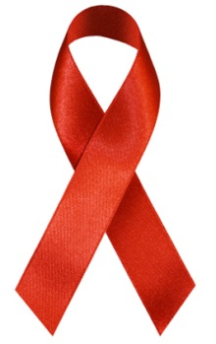
Oral Cancer
Men 45+ years with history of tobacco use and alcohol consumptions are affected. Median age of diagnosis: 62
Risks for developing oral cancer include:
Tobacco use of any kind, including cigarettes, cigars, pipes, chewing tobacco and snuff, among others
Heavy alcohol use
Previous oral cancer diagnosis
Note* A leading cause for oropharyngeal cancer is HPV infection. HPV vaccination and sexual partner history are relevant risk factors
http://www.oralcancerfoundation.org/hpv/
Notes:
Note* The U.S. Preventive Services Task Force (USPSTF) concludes that there is insufficient evidence either for or against routine oral cancer screening in adults. The USPSTF also says that techniques other than the standard oral exam are being evaluated but are still experimental.
http://www.oralcancerfoundation.org/hpv/

Slide 20
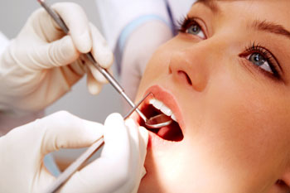
Oral Exam
A dentist will perform an oral exam by checking for lumps, white and/or red patches, sores, and any other abnormalities in the mouth
Note*There is insufficient evidence for or against routine oral screening exams.
http://www.mayoclinic.org/diseases-conditions/mouth-cancer/expert-answers/oral-cancer/faq-20058324
Notes:
http://www.mayoclinic.org/diseases-conditions/mouth-cancer/expert-answers/oral-cancer/faq-20058324

Slide 21
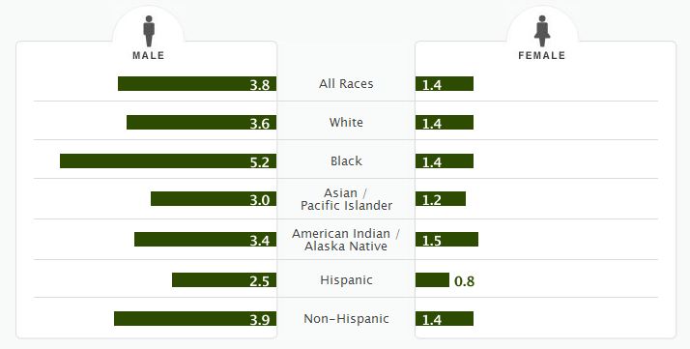
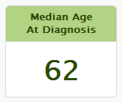
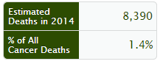
Oral Cancer Stats
http://seer.cancer.gov/statfacts/more.html
Notes:
For men, whites who are diagnosed die at a rate of 21% in comparison to 35% of blacks, 28% Asian/Pacific islanders, and 27% American Indians. American Indian women die at a rate of 34% in comparison to 22% for whites.

Slide 22



Prevention
Limit consumption of alcohol and tobacco
Minimize sun exposure to lip area
Eat the recommended amounts of fruits and vegetables
Visit your dentist regularly.
http://www.mayoclinic.org//
Notes:
http://www.mayoclinic.org/diseases-conditions/mouth-cancer/basics/prevention/con-20026516

Slide 23
Colorectal
Colorectal cancer disproportionally affects Latin@s and African –Americans
Both man and women 50+ years of age are recommended to be screened:
Flexible sigmoidoscopy every 5 years*, or
Colonoscopy every 10 years, or
Double-contrast barium enema every 5 years*, or
CT colonography (virtual colonoscopy) every 5 years*
http://www.cancer.org/healthy/findcancerearly/cancerscreeningguidelines/american-cancer-society-guidelines-for-the-early-detection-of-cancer
Notes:
* If the test is positive, a colonoscopy should be done.
** The multiple stool take-home test should be used. One test done by the doctor in the office is not adequate for testing. A colonoscopy should be done if the test is positive.

Slide 24
Flexible sigmoidoscopy
A Flexible sigmoidoscopy is a test that uses a narrow tube with an attached camera at the end to look into the rectum and lower colon for irritation, swollen tissue, ulcers, and polyps. ¹
Colonoscopy
A colonoscopy uses a colonoscope to look at the entirety of the colon and lower part of the small intestine. Samples can be collected during this procedure. ²
1.http://digestive.niddk.nih.gov/ddiseases/pubs/sigmoidoscopy/
2. http://www.webmd.com/colorectal-cancer/colonoscopy-16695
Notes:
http://digestive.niddk.nih.gov/ddiseases/pubs/sigmoidoscopy/
http://www.webmd.com/colorectal-cancer/colonoscopy-16695

Slide 25
Double-contrast barium enema
This procedure x-rays the large intestine to detect abnormalities. Occasionally, a small amount of air is put into the colon for better imagine. Note* this procedure is safer and cheaper in comparison to the colonoscopy. ^{1,2}
CT colonography
Also an x-ray procedure that combines X-ray and computer technology data to make images of the entire colon and rectum. ³
http://www.nlm.nih.gov/medlineplus/ency/article/003817.htm
http://www.ccalliance.org/screening/double-contrast-barium-enema.html
http://digestive.niddk.nih.gov/ddiseases/pubs/virtualcolonoscopy/
Notes:
http://www.nlm.nih.gov/medlineplus/ency/article/003817.htm
http://www.ccalliance.org/screening/double-contrast-barium-enema.html
http://digestive.niddk.nih.gov/ddiseases/pubs/virtualcolonoscopy/

Slide 26
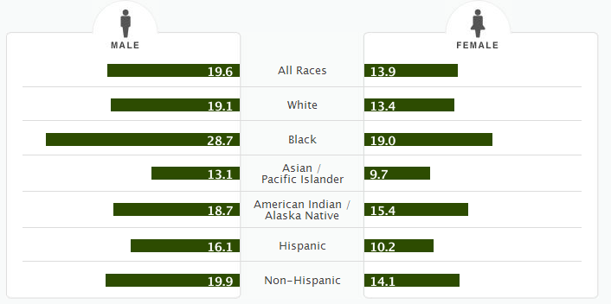
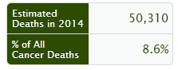
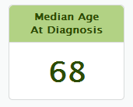
Colorectal Cancer Stats
http://seer.cancer.gov/statfacts/more.html
Notes:
Black males have the highest rate of death after diagnosis (46%) in comparison to 39% in whites and 30% in Asian Americans/Pacific Islanders. Indian American women have the highest number of deaths (43%) in comparison to 40% for black women, 36% for white women, and a low 31% for Asian-Americans and 33% for latinas.

Slide 27
Prevention
Regular testing for early detection
Increase the intensity and amount of physical activity.
Limit intake of red and processed meats.
Get the recommended levels of calcium and vitamin D.
Eat recommended amounts of vegetables and fruits.
Avoid obesity and maintain healthy weight
Avoid excessive alcohol consumption ¹
http://www.cancer.org/cancer/colonandrectumcancer/detailedguide/colorectal-cancer-prevention
Notes:
http://www.cancer.org/cancer/colonandrectumcancer/detailedguide/colorectal-cancer-prevention

Slide 28

Prostate
Prostate cancer disproportionally affects African –Americans and whites.
Current research has not proven that benefits of screening outweigh risks
Men should talk to their doctors about pros and cons of testing starting age 50.
African-American men should consider family history and should talk to their doctor starting age 45.
http://www.cancer.org/healthy/findcancerearly/cancerscreeningguidelines/american-cancer-society-guidelines-for-the-early-detection-of-cancer

Slide 29
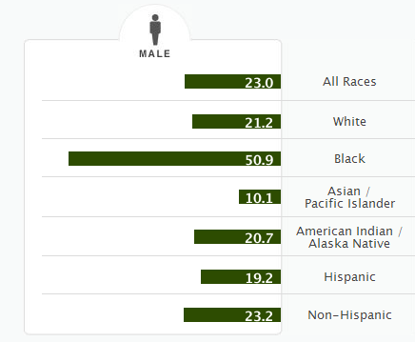
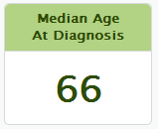
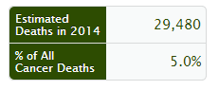
Prostate Cancer Stats
http://seer.cancer.gov/statfacts/more.html
Notes:
Note the disparity in diagnosis between blacks and whites. Black men have 23% deaths and Indian Americans die at 29% in comparison to 15% of white males.

Slide 30
Prevention
Minimize alcohol consumption
Maintain a healthy weight and lifestyle
Eat recommended amounts of fruits and vegetables.
Eat more fat from plants rather than animals
Increase intake of fish, soy, and green tea
http://www.mayoclinic.org/diseases-conditions/prostate-cancer/in-depth/prostate-cancer-prevention/art-20045641
Notes:
http://www.mayoclinic.org/diseases-conditions/prostate-cancer/in-depth/prostate-cancer-prevention/art-20045641

Slide 31

Lung
African-Americans are disproportionately affected with lung cancer is SCC.
Screening recommended for those:
55 to 74 years of age
In fairly good health
Have at least a 30 pack-year smoking history AND are either still smoking or have quit smoking within the last 15 years
http://www.cancer.org/healthy/findcancerearly/cancerscreeningguidelines/american-cancer-society-guidelines-for-the-early-detection-of-cancer

Slide 32
Lung Screening Options
Low-dose helical computed tomography
20% relative reduction in lung cancer–specific mortality and 6.7% reduction of all-cause mortality.
Chest x-ray and/or sputum cytology
Does not reduce mortality from lung cancer in the general population or in ever-smokers.
http://www.cancer.gov/cancertopics/pdq/screening/lung/HealthProfessional
Notes:
http://www.cancer.gov/cancertopics/pdq/screening/lung/HealthProfessional
*Professional medical advice needed for those who need lung cancer screening

Slide 33
Low-dose helical computed tomography
The low-dose spiral CT scan continuously rotates in a spiral motion and takes several 3-dimensional X-rays of the lungs.
Chest X-Ray
The chest x-ray uses invisible electromagnetic energy beams to produce images of internal tissues, bones, and organs on film.
http://www.cancer.gov/cancertopics/pdq/screening/lung/HealthProfessional

Slide 34
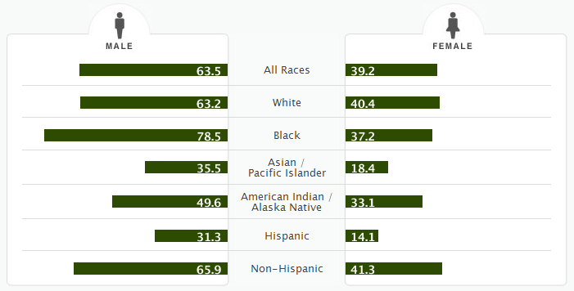
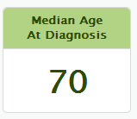
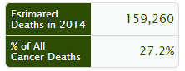
Lung Cancer Stats
http://seer.cancer.gov/statfacts/more.html
Notes:
Black men are disproportionatly diagnosed compared to whites although their death rates do not differ. American Indian men have a 100% death rate if diagnosed.
American Indian women have a 95% death rate, considerably higher to 75% of whites and 73% of black women.

Slide 35
Prevention
Avoid smoking and second hand smoking
Avoid carcinogens if possible
Maintain a healthy lifestyle complete with exercise
http://www.mayoclinic.org/diseases-conditions/lung-cancer/basics/prevention/con-20025531
Notes:
http://www.mayoclinic.org/diseases-conditions/lung-cancer/basics/prevention/con-20025531

