Slide 1


Slide 2
About Us
ERACE Cancer is a group of students and researchers from Stanford University who are working to Establish Race And Class Equality in Cancer
Our educational campaigns target both campus community members and the residents of towns in the Bay Area
Educational efforts consist of forums and discussions on:
1. Social determinants of health
2. Direct dissemination of information on
cancer prevention and early detection to at risk-populations.

Slide 3


Cancer from 2 perspectives
Social Perspectives
-Social determinates of health
-Health disparities → Cancer
Biological Perspective

Slide 4
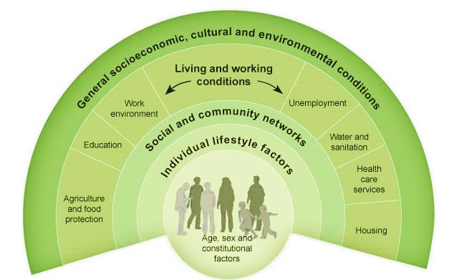
Social Determinates of Health
WHO defines SDH as “the conditions in which people are born, grow, live, work and age.”
1. http://www.who.int/social_determinants/en/
Notes:
-The following illustration aims to capture complex factors and processes involved in determining an individual’s vulnerability to health issues.
-Vulnerability is determined by genetic or developmental differences that can influence risk of susceptibility. Specifically, we are looking at incidence of cancer in Santa Clara County along racial and socioeconomic lines.
http://www.who.int/social_determinants/en/

Slide 5
SDH can lead to Health Disparities
“A population is a health disparity population if there is a significant disparity in the overall rate of disease incidence, prevalence, morbidity, mortality or survival rates in the population as compared to the health status of the general population.” ¹
1. Minority Health and Health Disparities Research and Education Act United States Public Law 106-525 (2000), p. 2498
Notes:
In other words, there is a difference among groups (clustered along racial and socioeconomics lines) that can be determinate factors in getting cancer and dying from it.

Slide 6
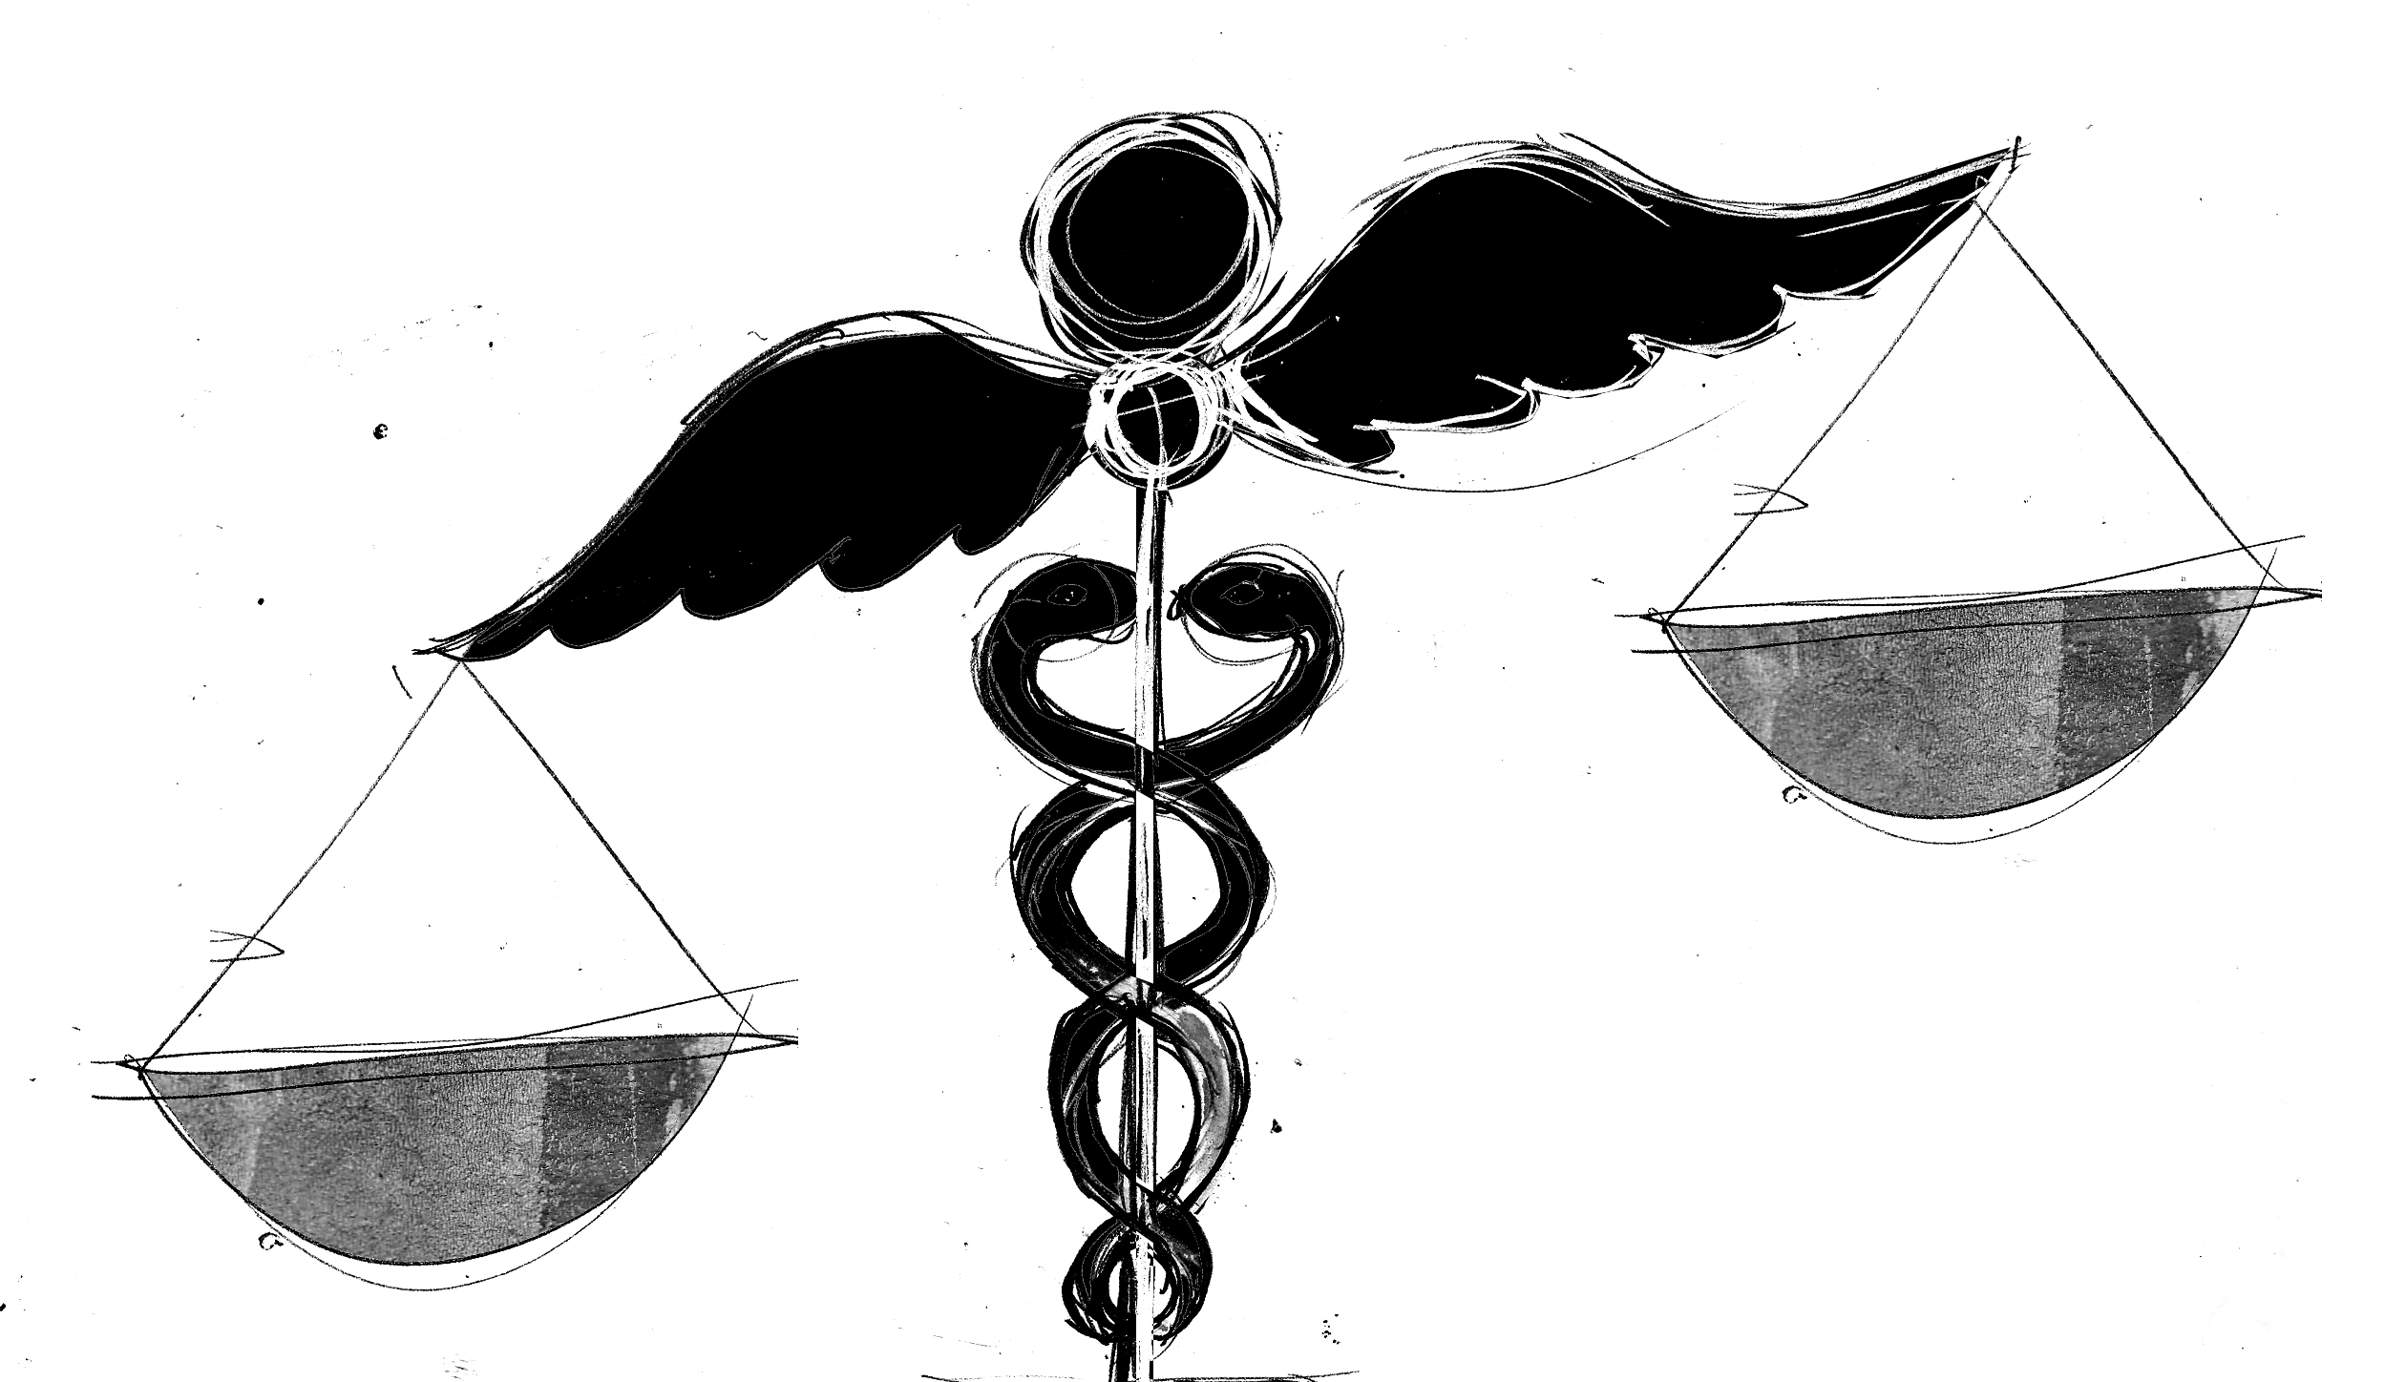
HD and Cancer: The Big 2
Socioeconomic status and access to health¹ care are the most important contributors to cancer disparities followed by race and ethnic background.
1. http://www.cancer.gov/cancertopics/factsheet/disparities/cancer-health-disparities
Notes:
Not surprisingly, access to health care also tops the top 4 community health need list.
http://www.cancer.gov/cancertopics/factsheet/disparities/cancer-health-disparities

Slide 7
How does this work?
SES is often based on a person's income, education level, occupation, and community social status. ¹
SES, more than race or ethnicity, predicts the likelihood of an individual's access to education, certain jobs, health insurance, and living conditions (e.g. environmental toxins) all of which are associated with the risk of developing and surviving cancer. ¹
SES plays a major role in influencing the prevalence of behavioral risk factors (e.g. tobacco and alcohol consumption, physical inactivity, obesity, and health status), as well as in following cancer screening recommendations. ¹
1. http://www.cancer.gov/cancertopics/factsheet/disparities/cancer-health-disparities

Slide 8
Biological Perspective
About 30% of cancer deaths are due to the five leading behavioral and dietary risks:
high body mass index
low fruit and vegetable intake
lack of physical activity
tobacco use
alcohol use.¹
Tobacco use is the most important risk factor for cancer causing over 20% of global cancer deaths and about 70% of global lung cancer deaths².
http://www.who.int/mediacentre/factsheets/fs297/en/
Notes:
http://www.cancer.net/navigating-cancer-care/older-adults/aging-and-cancer
http://www.who.int/mediacentre/factsheets/fs297/en/

Slide 9
Biological Perspective
Other factors include:
Infections
HIV+ individuals have a higher risk of developing certain cancers
Sexually transmitted human papillomaviruses (HPVs) are virtually responsible for all cervical cancers
Helicobacter pylori (H. pylori) is a bacterium that is found in the stomach of about two-thirds of the world’s population and is a major cause of gastric (stomach) cancer
Immunosuppressive drugs (used for organ transplant)
Radiation (long term exposure to radiation such as CT scans, ionizing radiation from nuclear plant accidents)
Alcohol
Environmental risk (asbestos, formaldehyde)
Notes:
You can envision many of these factors being determined by socioeconomic status...
http://www.cancer.gov/cancertopics/causes

