Slide 1
Mobile App for Direct Market Access for Farmers
PIP4004 University Project
Review-3
Batch Number: CIT-G01
Under the Supervision of,
Ms. BHAVYA B
Assistant Professor
Presidency School of Computer Science and Engineering
Roll Number | Student Name
20211CIT0049 | LAKKI REDDY VARSHITHA
20211CIT0052 | ERANTI SAI KISHAN
20211CIT0053 | ERANTI SAI DINESH
20211CIT0067 | PAVANI M
Name of the Program: B.Tech CSE (Internet Of Things)
Name of the HoD: Dr. Anandaraj S P
Name of the Program Project Coordinator: Dr. Sharmasth Vali Y
Name of the School Project Coordinators: Dr. Sampath A K / Mr. Md Ziaur Rahman

Slide 2
Content
Abstract
Literature Survey
Existing Methods – Drawbacks
Objectives
Proposed method
Architecture Diagram
Modules
Hardware and software details
Time line by Gantt chart
References

Slide 3
ABSTRACT
This project focuses on developing a comprehensive platform that bridges the gap between farmers and consumers, allowing users to purchase agricultural products directly from farmers.
The application provides seamless online payments, user and farmer profile management, and real-time inventory updates.
Administrators play a key role in fostering trust by onboarding verified farmers and uploading schemes beneficial to farmers.
Future expansions include vehicle and land renting functionalities as well as fertilizer management to further support farmers.

Slide 4
Literature Survey
Sl.no. | Paper Title | Propose model | Results | Drawbacks
1. | Mobile based agricultural Apps and portals for farmers’ welfare in India 2021 | Mobile applications for agricultural information dissemination, such as Kisan Suvidha, providing weather, market prices, and pest control updates. | Improved decision-making: Farmers get real-time weather and market updates, helping them make informed choices. | Limited awareness and digital literacy: Many farmers are unaware of these apps or struggle to use them effectively.
2. | Mobile Based Agricultural Apps and Portals for Farmers’ Welfare in India 2021 | The paper discusses the development of mobile applications and portals to provide farmers with real-time agricultural information, market intelligence, weather forecasts, and advisory services. | Improved trust and traceability in transactions, reducing fraud. | High computational costs and lack of farmer familiarity with block chain technology.
3. | E-Mandi: Digital Marketplace for Farmers 2022 | Digital platform to connect farmers with buyers via a bidding system for agricultural produce. | Enhanced competition leading to better price discovery for farmers. | Requires high internet penetration; limited adoption in areas with low digital literacy.
4. | Agro Connect: AI-Driven Marketplace for Farmers 2022 | AI-powered app recommending optimal prices and connecting farmers to nearby buyers based on demand. | Reduced time to market and better price optimization. | High processing demands and challenges in adapting AI models to regional variations.
5. | Farmers' Direct Selling Mobile App 2023 | Mobile application enabling farmers to list products and directly negotiate prices with consumers. | Simplified selling process and higher profit margins for farmers. | Limited support for logistics and delivery, restricting usability for large-scale operations.

Slide 5
Literature Survey
Sl.no. | Paper Title | Proposed model | results | Draw backs
6. | Mobile Based Agricultural Apps and Portals for Farmers’ Welfare in India 2023 | Blockchain-based supply chain for tracking agricultural produce from farm to market. | Increased transparency, reduced middlemen exploitation. | High energy consumption and complex implementation costs.
7. | Direct Market Access for Farmers 2024 | The research proposes a digital platform that allows farmers to sell their produce directly to buyers, eliminating intermediaries. | The adoption of these mobile applications has improved farmers' access to information, helping them make informed decisions about crop management, pest control, and market prices. | Despite the benefits, limited digital literacy and lack of internet connectivity in rural areas hinder widespread adoption. Additionally, farmers' reliance on traditional farming practices and middlemen remains a challenge
8. | Mobile App for Direct Market Access for Farmers 2024 | The research proposes the development of a mobile application, FarmConnect, to provide farmers with direct market access by connecting them with consumers and retailers. | During alpha testing, the system successfully allowed farmers to list and manage their produce while enabling real-time updates | While the system effectively connected farmers and consumers, it lacks real-time transaction monitoring
9. | Mobile App For Direct Market Access For Farmers 2024 | GPS-Based Direct Market Access App: A mobile application that connects farmers directly with consumers, wholesalers, and retailers, eliminating middlemen and allowing real-time price negotiation. | Improved Market Accessibility: Farmers gain direct access to buyers, increasing profits and reducing dependency on intermediaries. | Limited Digital Infrastructure: Many rural areas lack proper internet connectivity and smartphone access, making adoption challenging.
10. | Farmers E-Commerce Mobile Application 2024 | "HarvestHub" E-Commerce Platform: A mobile application that allows farmers to buy and sell agricultural products like fruits, vegetables, seeds, and fertilizers in their local language, enhancing market accessibility. | Enhanced Market Access: Farmers can now directly connect with buyers, eliminating middlemen and improving their profits. | Digital Divide: Many farmers still lack access to smartphones and internet connectivity, limiting adoption.

Slide 6
Objectives
Empower farmers with real-time market access to reduce middlemen exploitation.
Enhance decision-making through AI-driven weather and crop predictions.
Facilitate direct selling to consumers and wholesalers.
Improve awareness about government subsidies, loans, and grants.
Increase accessibility with voice-based and multilingual features.
Simplify Product Listing and Management: Enable farmers to easily upload, update, and manage their produce inventory.
Ensure Fair Pricing: Provide transparent price negotiation tools to help farmers receive fair market value.
Streamline Logistics: Facilitate transportation through vehicle rental options for efficient delivery.

Slide 7
Existing methods - Drawbacks
Reliance on Middlemen: Traditional market methods force farmers to depend on intermediaries, reducing their profit margins.
Fragmented Communication: Current systems often lack a direct communication channel between farmers and buyers, leading to delayed or miscommunicated transactions.
Limited Market Reach: Existing methods restrict farmers' access to broader consumer bases, confining them to local markets.
Insufficient Real-Time Data: Most platforms do not provide timely updates on market trends, weather conditions, or inventory, hindering effective decision-making.
Inefficient Transaction Management: Manual or semi-digital processes in current methods result in slow, error-prone transactions.
Lack of Integrated Support: Many existing solutions do not offer comprehensive features such as financial assistance, expert consultation, or access to government schemes, leaving farmers without necessary support.

Slide 8
Proposed Methodology
The proposed mobile application will act as a one-stop platform providing farmers with:
Direct Market Access – Farmers can list and sell products without intermediaries.
Weather & Soil Health Updates – AI-based alerts on weather conditions and soil health analysis.
Expert Consultation – Real-time chat with agricultural experts.
Government Schemes & Subsidies – Easy access to apply for available schemes.
Financial Assistance – Loan eligibility checker and application support.
Knowledge Hub – Videos, guides, and tutorials on modern farming techniques.

Slide 9
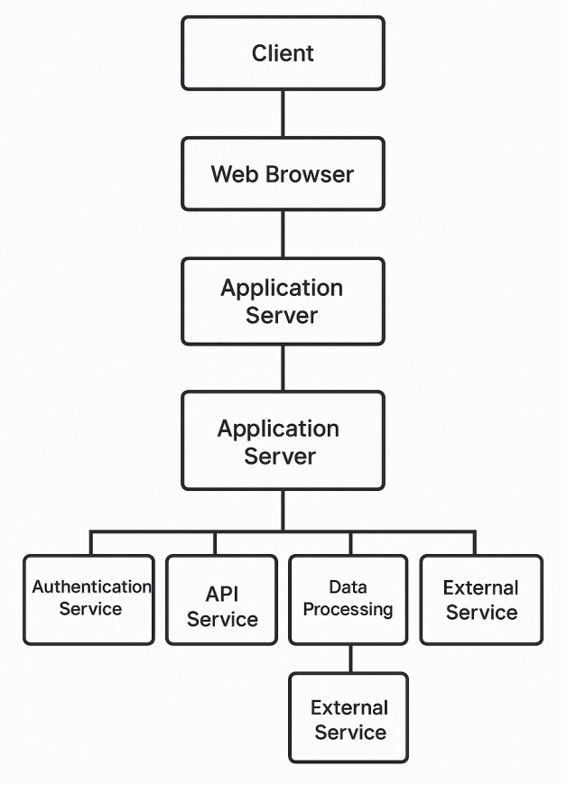
Architecture Diagram

Slide 10
Modules
Farmer Account Creation: Enables quick and secure registration for farmers on the platform.
Farmer Details Updates: Allows farmers to easily update personal and farm information as needed.
Farmer Product Upload: Lets farmers list their produce with detailed descriptions and images.
Customer Account Creation: Facilitates simple profile creation for consumers to browse and shop.
Customer Access to Products: Provides an intuitive interface for customers to view and purchase products.
Machine Learning Analysis: Employs ML models to optimize pricing, predict demand, and personalize recommendations.
Performance & Satisfaction Analytics: Generates insights to enhance farmer performance and customer satisfaction.
Additional In-App Features: Integrates secure online payments, expert consultations, real-time updates, and access to government schemes.

Slide 11
Hardware and software details
Software Components
Build.gradle: Configures the build process using Gradle by specifying dependencies, plugins, and SDK settings for the app.
Google-services.json: Provides necessary configuration and credentials for integrating Google services like Firebase into the application.
Proguard-rules.pro: Contains rules for code obfuscation and optimization, enhancing app security and performance by reducing reverse engineering risks.

Slide 12
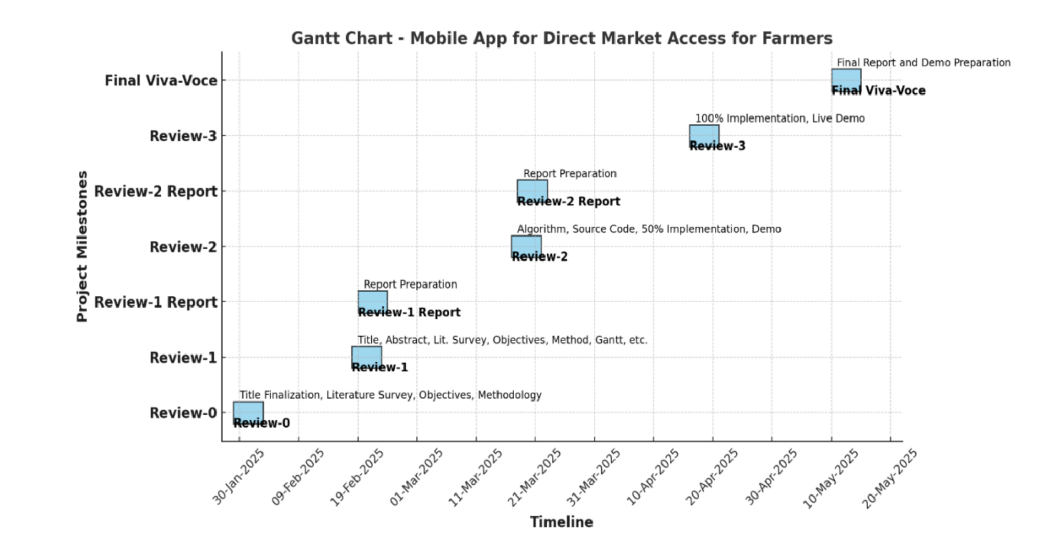
Time Line by Gantt Chart
Figure: 2 Time Line By Gantt Chart

Slide 13
References:
[1] Chang, H.-H., & Meyerhoefer, C.D. (2020). COVID-19 and the demand for online food shopping services: Empirical evidence from Taiwan. American Journal of Agricultural Economics, 103(2), 448–465. 2020– "Android App to Connect Farmers to Retailers and Food Processing Industry." IEEE Xplore. Available at: https://ieeexplore.ieee.org/document/9034434.
[2]IEEE Xplore. (2020). Android App to Connect Farmers to Retailers and Food Processing Industry. Available at: https://ieeexplore.ieee.org/document/9034434.
[3]Saxena, S., & Limbad, A. (2021). Consumption change of household food habits pre and post lockdown during COVID-19: A perspective study of Gujarat and Maharashtra. Global Journal of Interdisciplinary Studies, 4(1), 16–36.
[4]Zhao, L., Zhang, Y., & Zhang, H. (2022). Research on the impact of digital literacy on farmer households' green cooking energy consumption: Evidence from rural China. International Journal of Environmental Research and Public Health, 19(13464).
[5]Manocha, S., Bhullar, P.S., & Sachdeva, T. (2023). Factors determining the investment behaviour of farmers—The moderating role of socioeconomic demographics. Journal of Indian Business Research.
[6]IEEE Xplore. (2023). Smart Kisan: A Mobile App for Farmers' Assistance in Agricultural Activities. Available at: https://ieeexplore.ieee.org/document/10199471.
[7] Hinojosa, C., Sanchez, K., Camacho, A., & Arguello, H. (2023). AgroTIC: Bridging the gap between farmers, agronomists, and merchants through smartphones and machine learning. arXiv preprint, arXiv:2305.12418. Available at: https://arxiv.org/abs/2305.12418.
[8]Kumar, R. (2023). Farmers' use of the mobile phone for accessing agricultural information in Haryana: An analytical study. Open Information Science. Available at: https://www.degruyter.com/document/doi/10.1515/opis-2023-0031/html.
[9]Agriculture & Food Security. (2023). Is agricultural digitization a reality among smallholder farmers in Sub-Saharan Africa? Unpacking the digital agricultural paradox.
[10]Mdoda, L., Christian, M., & Agbugba, I. (2024). Use of information systems (mobile phone app) for enhancing smallholder farmers' productivity in Eastern Cape Province, South Africa: Implications on food security. Journal of the Knowledge Economy, 15, 1993–2009. Available at: https://link.springer.com/article/10.1007/s13132-024-01478-x.

Slide 14
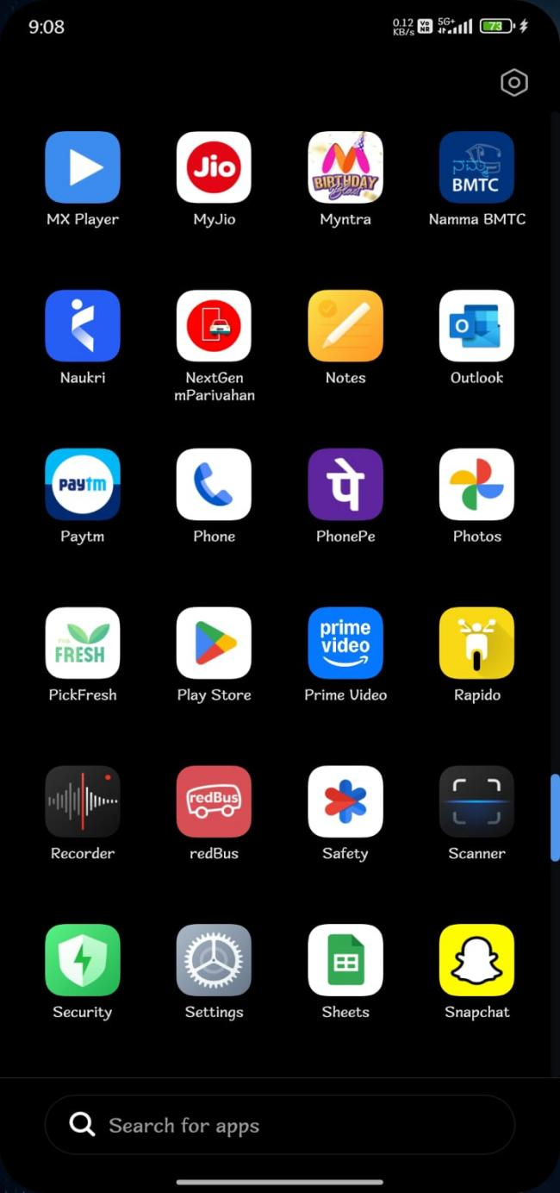

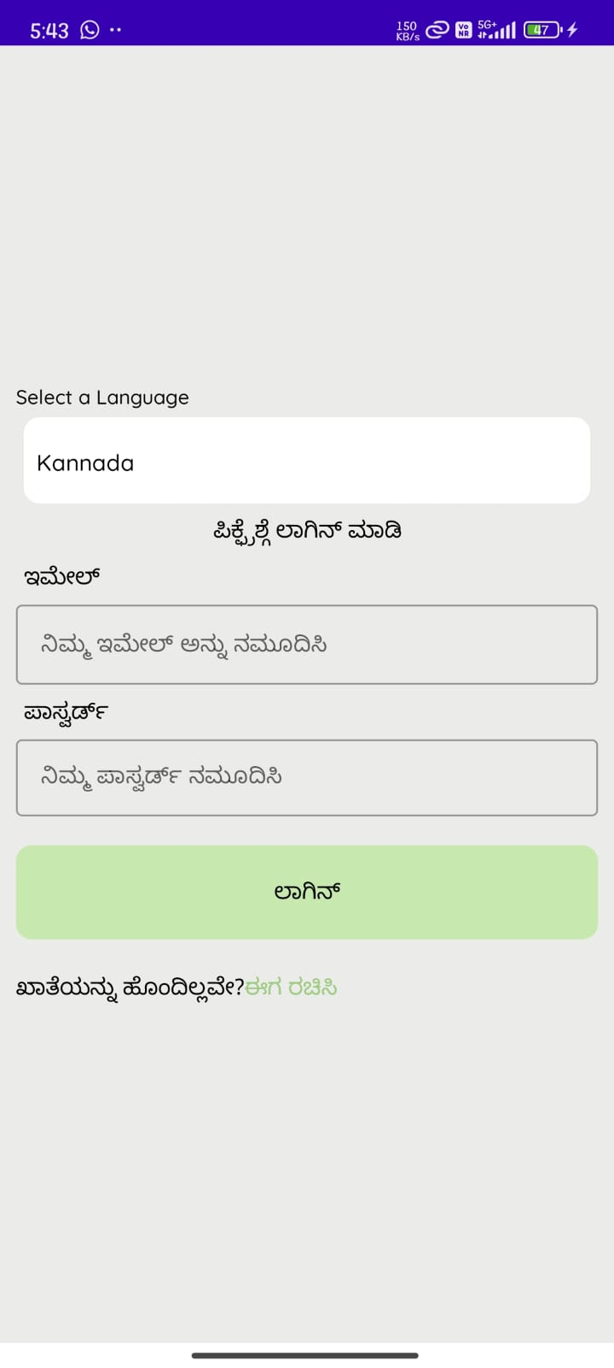
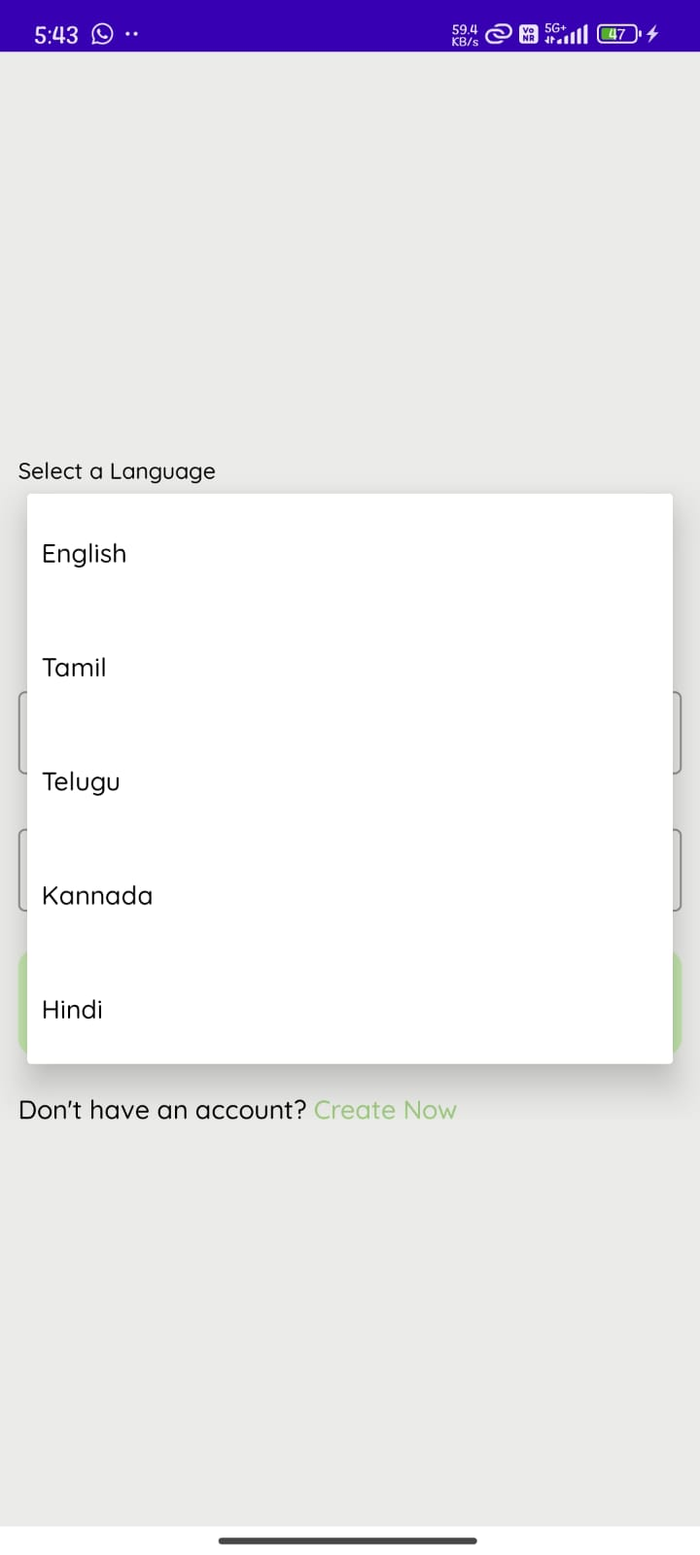
Output
SCREENSHOTS

Slide 15
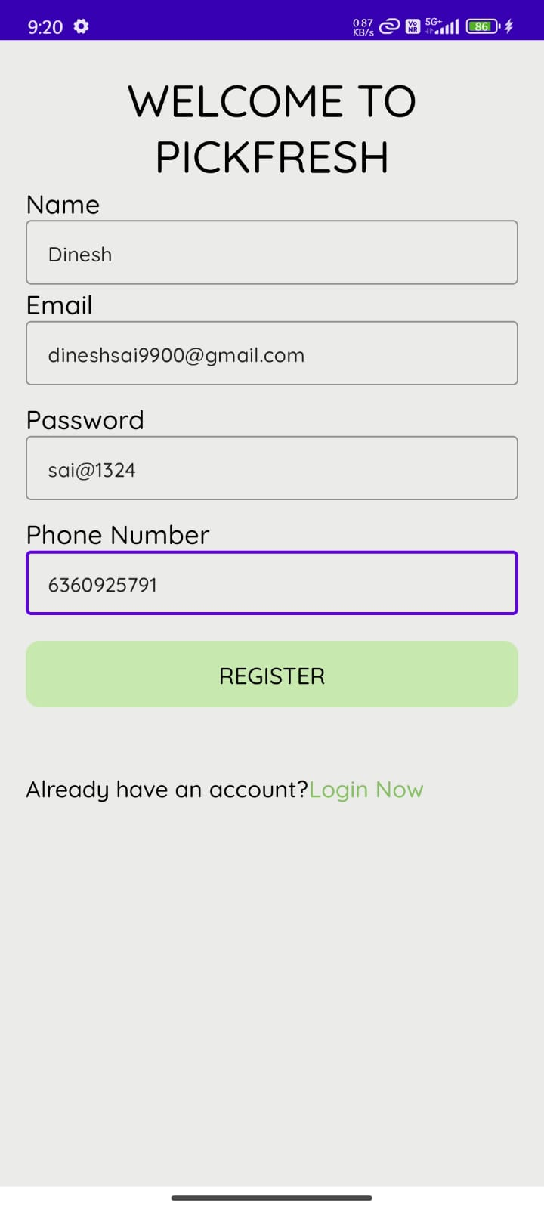
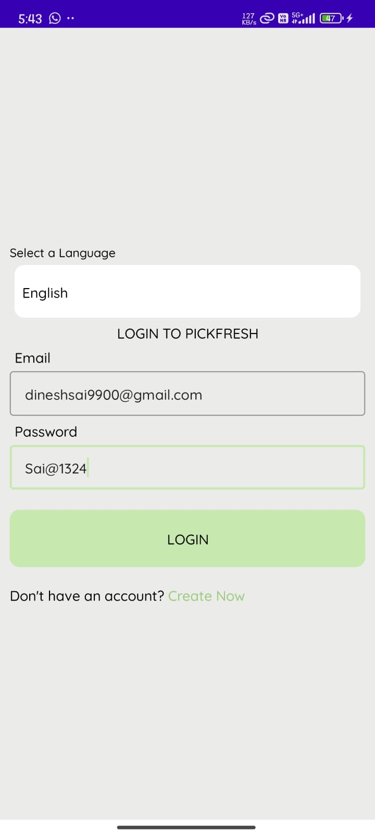
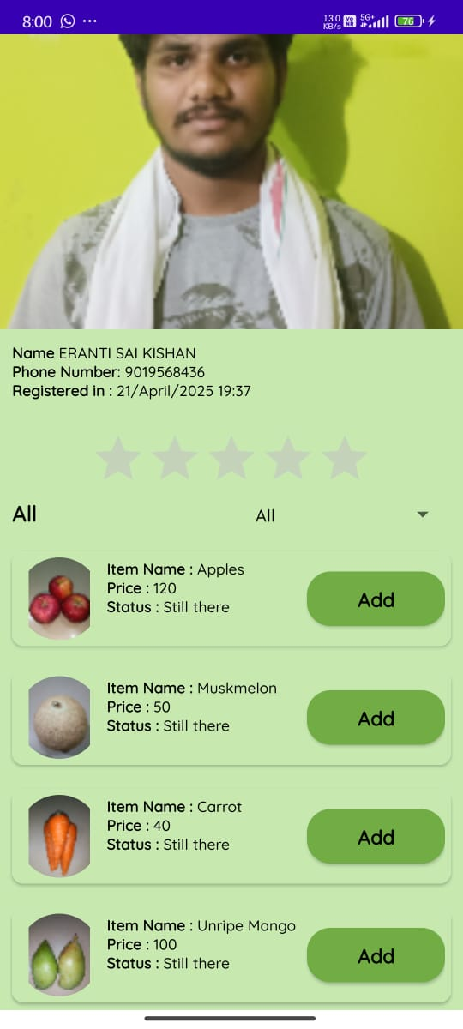
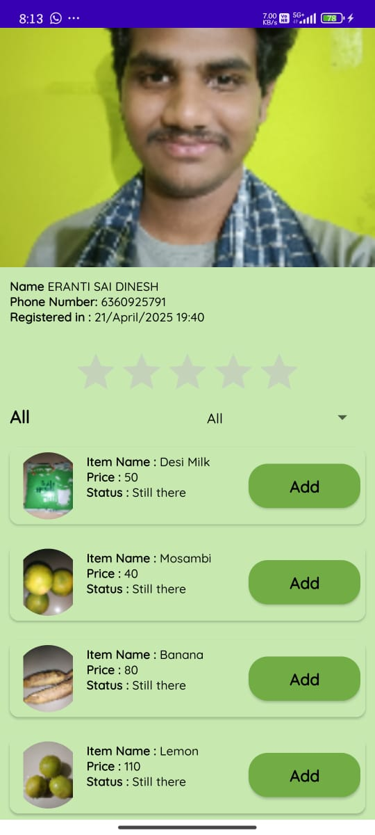
Cont..
.

Slide 16
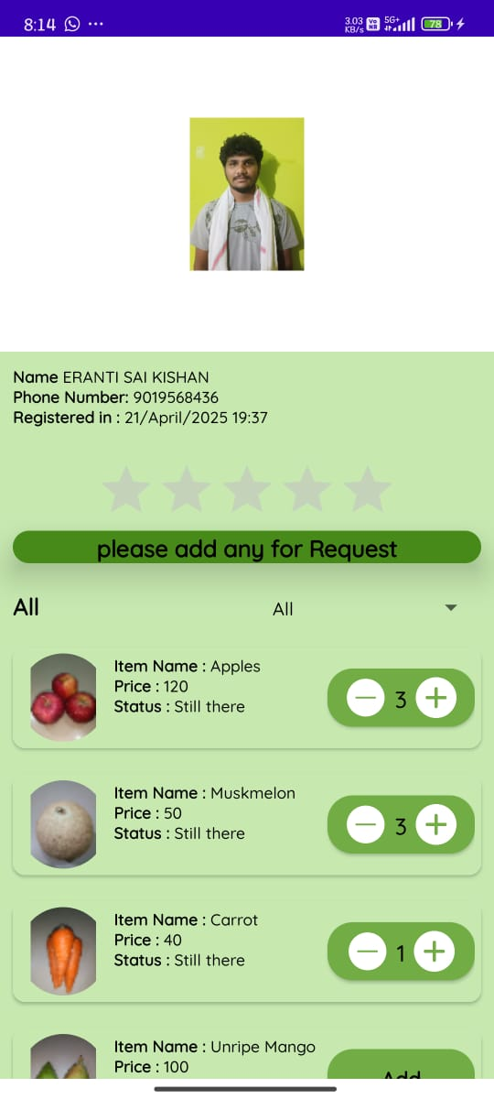
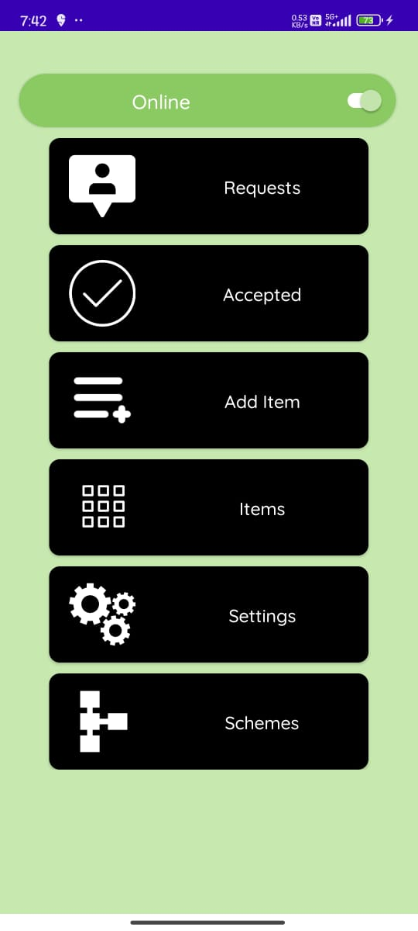
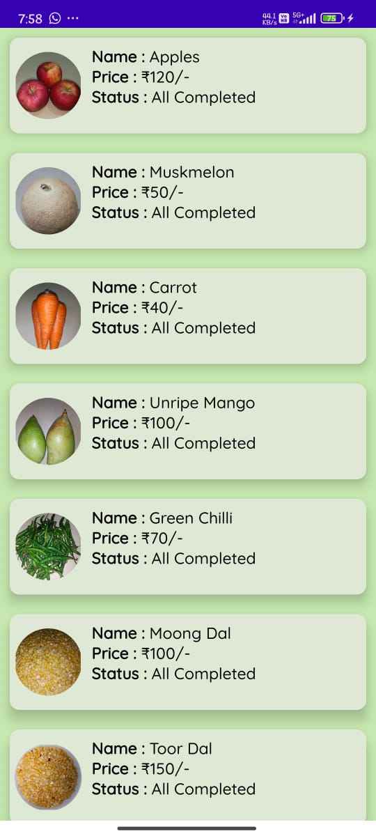
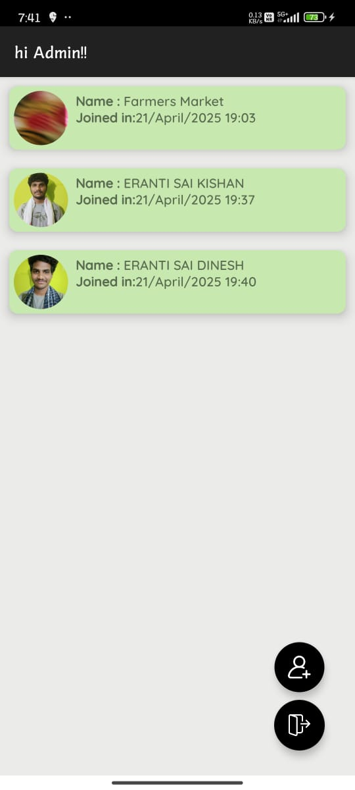
Cont..
.

Slide 17
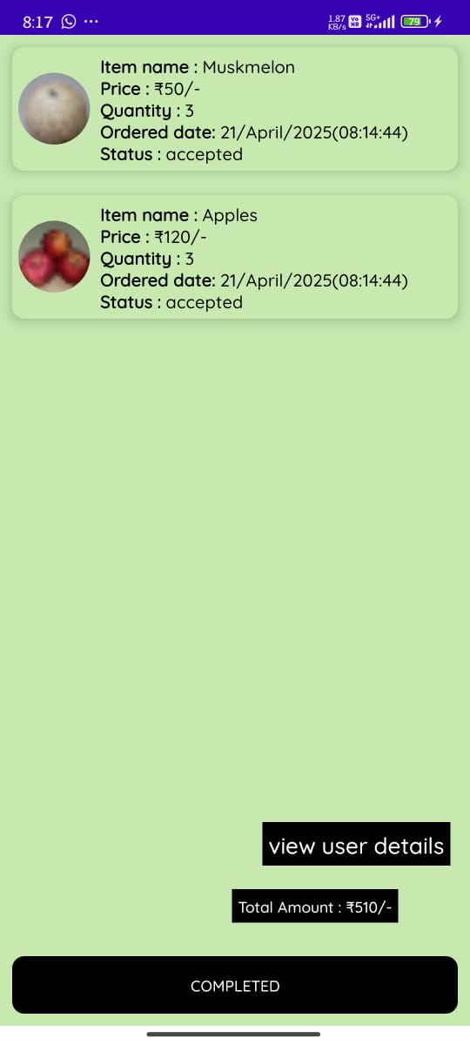
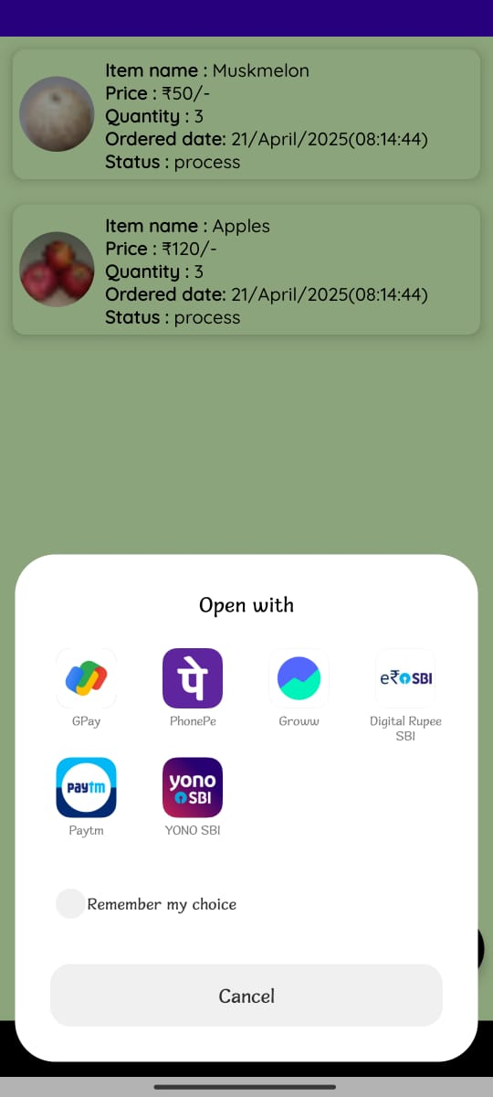
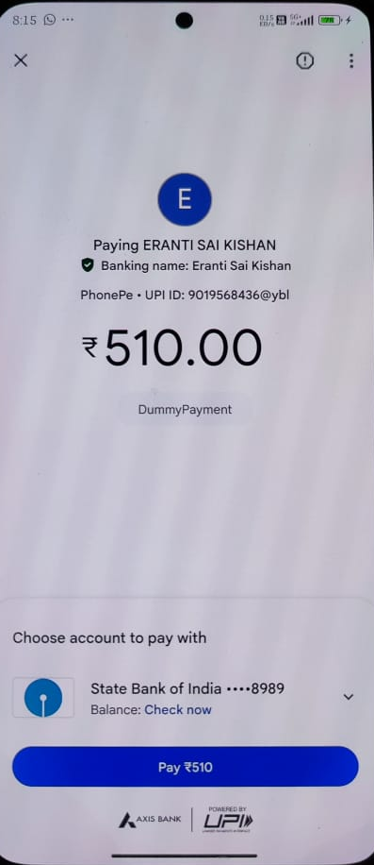
Cont..
.

Slide 18


