Slide 1
Mobile App for Direct Market Access for Farmers
PIP4004 University Project
Review-0
Batch Number: CIT-G01
Under the Supervision of,
Ms. BHAVYA B
Assistant Professor
School of Computer Science and Engineering
Presidency University
Roll Number | Student Name
20211CIT0052 | ERANTI SAI KISHAN
20211CIT0067 | PAVANI M
20211CIT0049 | LAKKI REDDY VARSHITHA
20211CIT0053 | ERANTI SAI DINESH
Name of the Program: B.Tech CSE (Internet Of Things)
Name of the HoD: Dr. Anandaraj S P
Name of the Program Project Coordinator: Dr. Sharmasth Vali Y
Name of the School Project Coordinators: Dr. Sampath A K / Dr. Abdul Khadar A / Mr. Md Ziaur Rahman

Slide 2
Content
Problem Statement
Github Link
Analysis of Problem Statement
Timeline of the Project
References

Slide 3
Problem Statement Number: PSCS_342
Organization: Ministry of Agriculture and Farmers Welfare
Category (Hardware / Software / Both) : SOFTWARE
Problem Description: Farmers often face challenges in accessing markets, leading to lower income due to middlemen. This gap restricts their ability to sell produce at fair prices.
Description: Create a mobile application that connects farmers directly with consumers and retailers. The app should include features for listing produce, negotiating prices, and managing transactions, thereby reducing dependence on intermediaries. Expected Solution: A user-friendly mobile platform that enables farmers to showcase their products and connect with buyers directly, enhancing their income potential.
Difficulty Level: Complex

Slide 4
Github Link
The Github link provided should have public access permission.
Github Link : https://github.com/ERANTI03/CIT-G01-Mobile-App-for-Direct-Market-Access-for-Farmers

Slide 5
Analysis of Problem Statement
Technology Stack Components:
1. Frontend Development
Frameworks/Libraries: React Native or Flutter (cross-platform for iOS & Android)
UI/UX Tools: Figma or Adobe XD for designing intuitive user interfaces
State Management: Redux (React Native) or Riverpod/Bloc (Flutter)
2. Backend Development
Framework: Node.js with Express.js or Django (Python)
Database:
Primary: PostgreSQL or MongoDB (for scalable data storage)
Caching: Redis (for faster data access)
API: RESTful APIs or GraphQL for efficient data communication
3. Cloud and Infrastructure
Cloud Services: AWS (Amazon Web Services) or Google Cloud Platform (GCP)
Server Hosting: AWS EC2 or Firebase (for managed backend services)
Storage: AWS S3 or Firebase Storage (for images of produce)
Containerization: Docker for environment consistency

Slide 6
Analysis of Problem Statement (contd...)
4. Security
Authentication: Firebase Auth, OAuth 2.0, JWT (JSON Web Tokens)
Data Encryption: HTTPS and data encryption at rest
Access Control: Role-based access management (RBAC)
5. Payment Integration
Payment Gateway: Razorpay, Stripe, or PayU for secure transactions
6. Analytics & Monitoring
Analytics: Google Analytics or Firebase Analytics for usage insights
Crash Reporting: Firebase Crashlytics
Performance Monitoring: New Relic or Datadog
7. Communication & Notification
Push Notifications: Firebase Cloud Messaging (FCM)
Real-Time Communication: WebSockets for price negotiation and chat

Slide 7
Analysis of Problem Statement (contd...)
Software and Hardware Requirements:
Software Requirements
•Operating System - Windows 10
•JDK - java
•Plugin - Kotlin
•SDK - Android
•IDE - Android studio
•Database - server script, MySQL

Slide 8
Analysis of Problem Statement (contd...)
Hardware Requirements
•Processor - I3/Intel Processor
•RAM - 8 GB
•Hard Disk - 1TB

Slide 9
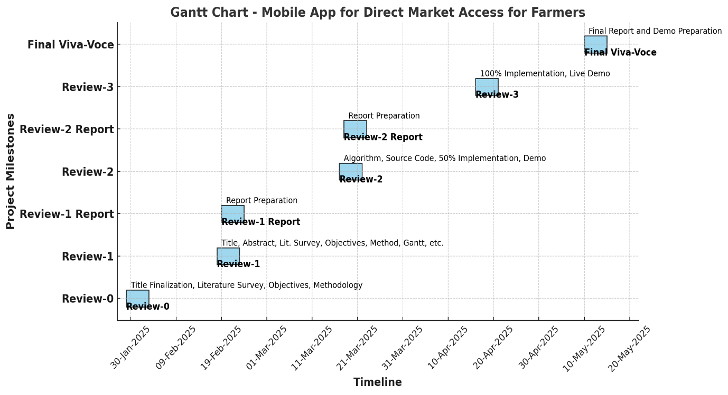
Timeline of the Project (Gantt Chart)

Slide 10
References
Chang, H.-H.; Meyerhoefer, C.D. COVID-19 and the demand for online food shopping services: Empirical evidence from Taiwan. Am. J. Agric. Econ. 2020, 103, 448–465.
Saxena, S.; Limbad, A. Consumption change of household food habits pre and post lockdown during COVID-19: A perspective study of Gujarat and Maharashtra. Glob. J. Interdiscip. Stud. 2021, 4, 16–36.
Zhao, L.; Zhang, Y.; Zhang, H. Research on the Impact of Digital Literacy on Farmer Households’ Green Cooking Energy Consumption: Evidence from Rural China. Int. J. Environ. Res. Public Health 2022, 19, 13464.
Manocha, S.; Bhullar, P.S.; Sachdeva, T. Factors determining the investment behaviour of farmers—The moderating role of socioeconomic demographics. J. Indian Bus. Res. 2023.

Slide 11
References
Issa, I.; Hamm, U. Adoption of Organic Farming as an Opportunity for Syrian Farmers of Fresh Fruit and Vegetables: An Application of the Theory of Planned Behaviour and Structural Equation Modelling. Sustainability 2017, 9, 2024.

Slide 12


