Slide 1

ROS – Lecture 10
October 2016
OpenCV
Vision in ROS
Follow-Bot
Lecturer: Roi Yehoshua
roiyeho@gmail.com

Slide 2

OpenCV
Open Source Computer Vision Library
Contains efficient, well-tested implementations of many popular computer vision algorithms
Created/Maintained by Intel
Routines focused on real time image processing and 2D + 3D computer vision
http://docs.opencv.org/2.4/index.html
http://docs.opencv.org/3.1.0/examples.html (examples)

Slide 3
Basic OpenCV Structures
Point, Point2f - 2D Point
Size - 2D size structure
Rect - 2D rectangle object
RotatedRect - Rect object with angle
Mat - image object

Slide 4

OpenCV Structure Examples
cv::Mat M(2,2, CV_8UC3, cv::Scalar(0,0,255));
CV_8UC3 means we use unsigned char types that are 8 bit long, and we have 3 channels for each pixel
cv::Mat L(500,500, CV_8UC(1), cv::Scalar::all(0));
500X500 pixel GRAYSCALE image
cv::Rect(10, 10, 100, 100)
90x90 rectangle

Slide 5
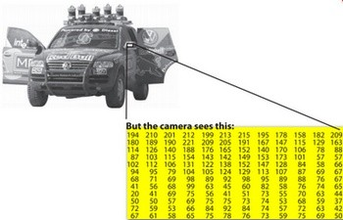
Image Region of Interest (ROI)
cv::Mat mat = getCameraImage(); // allocate matrix
cv::Mat D (mat, cv::Rect(10, 10, 100, 100) ); // ROI using a rectangle

Slide 6
Colors
BGR - The default color. Normal 3 channel color
HSV - Hue is color, Saturation is amount, Value is lightness. 3 channels
GRAYSCALE - Gray values, Single channel
OpenCV requires that images be in BGR or Grayscale in order to be shown

Slide 7
Converting Colorspaces
cv::cvtColor(image, image, code)
CV_<colorspace>2<colorspace>
Examples:
CV_BGR2GRAY
CV_BGR2HSV
CV_BGR2LUV
For example
cv::cvtColor(mat_in, mat_out, CV_BGR2GRAY); //change image to grayscale

Slide 8
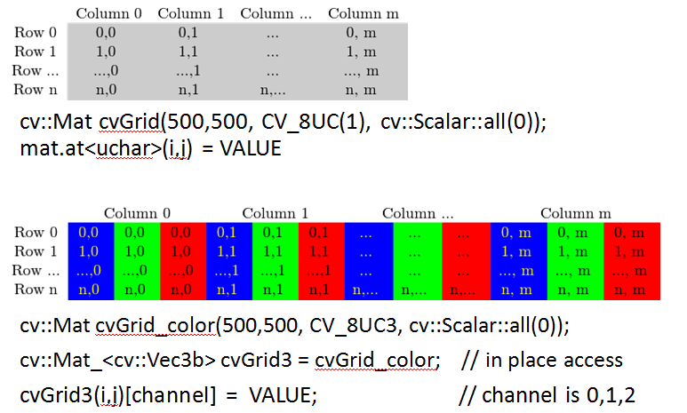
Grayscale vs BGR Storage in Memory Access

Slide 9
Image Intensity
Changing brightness is a point operation on each pixel
If you want to increase the brightness, you have to add some constant value to each pixel
Increasing brightness:
new_img (i, j) = img(i, j) + c
Decrease the brightness:
new_img (i, j) = img(i, j) – c
Increase the brightness by 75 units in OpenCV:
cv::Mat img; // Creating a matrix
img = img + cv::Scalar(75, 75, 75);

Slide 10
Basic Computer Vision Techniques
Filtering
remove noise from image
Segmentation
Partition image into groups of pixels
Similarity can be decided based on intensity, color, pattern
Feature detection
Extract interesting parts from the image
Edge detection, corner detection
For example in navigation systems it may prove useful to extract only floor lines from an image

Slide 11
Kernels
In image processing, many operators are based on applying some function to the pixels within a local window
The convolution operator (kernel) is a function that we apply as a weighted average of the within-window pixels
For example, if the window size is 3x3 pixels, we can define the function by providing a 3x3 weight-matrix. So, at the location of every pixel in the image, we place this 3x3 matrix and perform the element-wise multiplications before summing up. This sum is deemed the output value at that location.

Slide 12
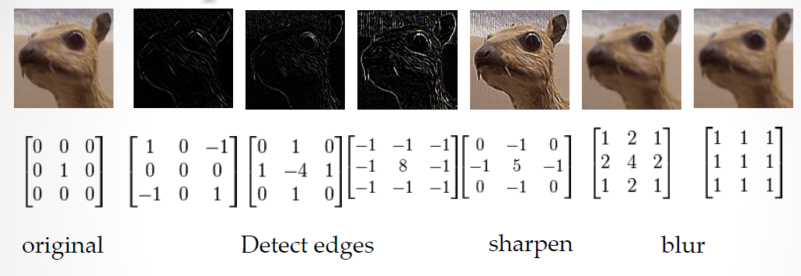
Kernels
Different kernels can cause different effects

Slide 13
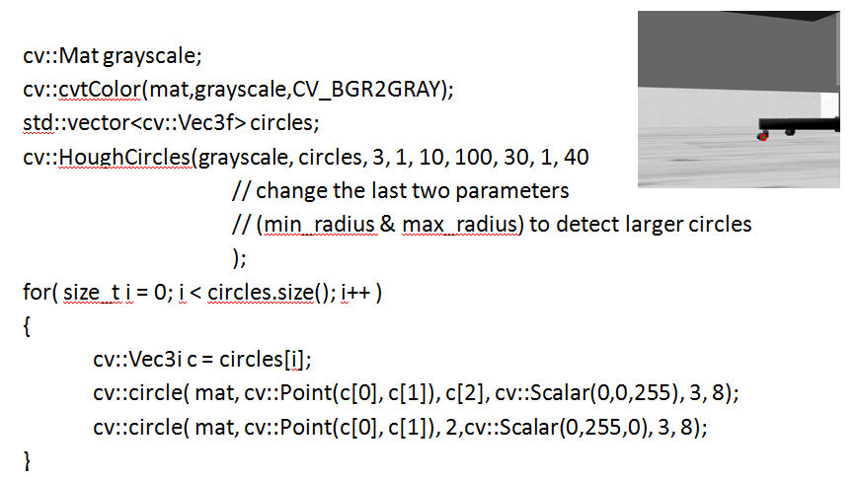
Detecting wheel chairs with OpenCV

Slide 14
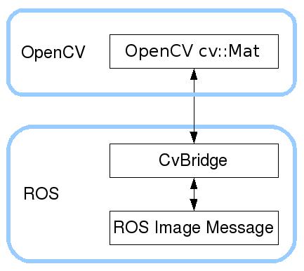
ROS and OpenCV
ROS passes images in its own sensor_msgs/Image message
cv_bridge is a ROS package that provides functions to convert between ROS sensor_msgs/Image messages and the objects used by OpenCV

Slide 15
Acquiring Images
Images in ROS are sent around the system using the sensor_msgs/Image message type
To have images stream into our nodes, we need to subscribe to a topic where they are being published
Each robot will have its own method for doing this, and names may vary
Use rostopic list to find out what topics contain the robot’s camera data

Slide 16
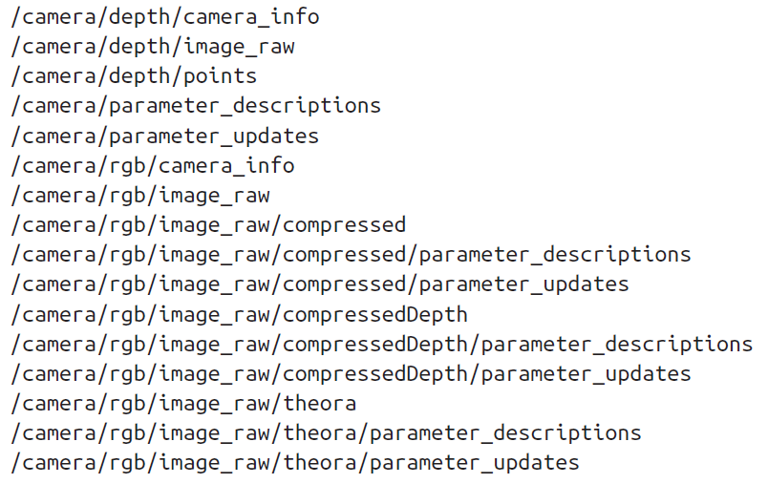
Acquiring Images
Run the TurtleBot simulation and type rostopic list
This prints out a few dozen topics, some of which sound image-related

Slide 17
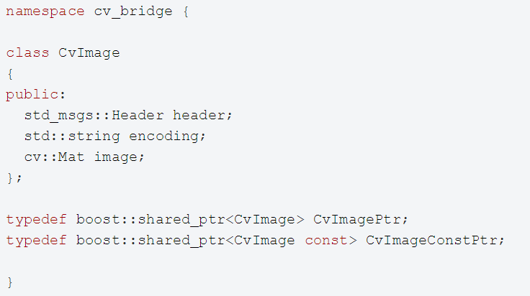
Converting ROS Messages to OpenCV Images
CvBridge defines a CvImage type containing an OpenCV image, its encoding and a ROS header.
CvImage contains exactly the information sensor_msgs/Image does, so we can convert either representation to the other

Slide 18
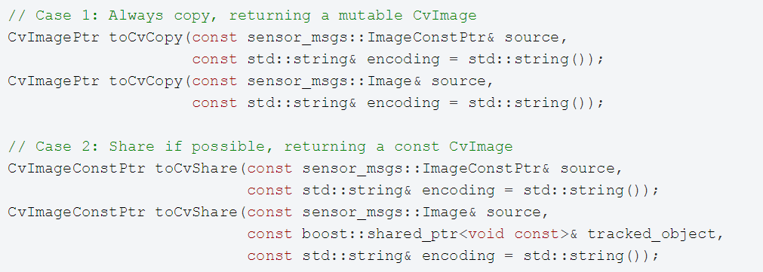
Converting ROS Messages to OpenCV Images
When converting a ROS sensor_msgs/Image message into a CvImage, CvBridge recognizes two distinct use cases:
We want to modify the data in-place. We have to make a copy of the ROS message data.
We won't modify the data. We can safely share the data owned by the ROS message instead of copying.

Slide 19
Image Encodings
If no encoding is given, the destination image encoding will be the same as the image message encoding.
In this case toCvShare is guaranteed to not copy the image data
Image encodings can be any one of the following:
mono8: CV_8UC1, grayscale image
mono16: CV_16UC1, 16-bit grayscale image
bgr8: CV_8UC3, color image with blue-green-red color order
rgb8: CV_8UC3, color image with red-green-blue color order
bgra8: CV_8UC4, BGR color image with an alpha channel
rgba8: CV_8UC4, RGB color image with an alpha channel
mono8 and bgr8 are the two image encodings expected by most OpenCV functions

Slide 20
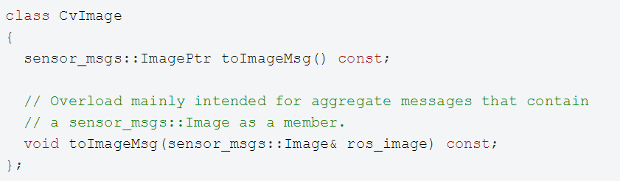
Converting OpenCV Images to ROS Messages
To convert a CvImage into a ROS image message, use the toImageMsg() member function:

Slide 21
An Example ROS Node
We will create a node that listens to a ROS image message topic, converts the image into a cv::Mat, draws a circle on it and displays the image using OpenCV
Create a package with the following dependencies:
Create a class ImageConverter in your /src folder and add the following:
$ cd ~/catkin_ws/src
$ catkin_create_pkg image_converter std_msgs roscpp sensor_msgs cv_bridge image_transport

Slide 22
ImageConverter.h
#include <ros/ros.h>
#include <image_transport/image_transport.h>
class ImageConverter {
private:
ros::NodeHandle nh;
image_transport::ImageTransport imageTransport;
image_transport::Subscriber imageSubscriber;
void imageCallback(const sensor_msgs::ImageConstPtr& msg);
public:
ImageConverter();
virtual ~ImageConverter();
};

Slide 23
ImageConverter.cpp (1)
#include "ImageConverter.h"
#include <cv_bridge/cv_bridge.h>
#include <sensor_msgs/image_encodings.h>
#include <opencv2/imgproc/imgproc.hpp>
#include <opencv2/highgui/highgui.hpp>
static const std::string OPENCV_WINDOW = "Image window";
ImageConverter::ImageConverter() : imageTransport(nh) {
imageSubscriber = imageTransport.subscribe("/camera/rgb/image_raw", 1,
&ImageConverter::imageCallback, this);
// Create a display window
cv::namedWindow(OPENCV_WINDOW);
}
ImageConverter::~ImageConverter() {
// Close the display window
cv::destroyWindow(OPENCV_WINDOW);
}

Slide 24
ImageConverter.cpp (2)
void ImageConverter::imageCallback(const sensor_msgs::ImageConstPtr& msg) {
// convert the ROS image message to a CvImage
cv_bridge::CvImagePtr cv_ptr;
try {
cv_ptr = cv_bridge::toCvCopy(msg, sensor_msgs::image_encodings::BGR8);
}
catch (cv_bridge::Exception& e) {
ROS_ERROR("cv_bridge exception: %s", e.what());
return;
}
// Draw an example circle at the center of the video stream
if (cv_ptr->image.rows > 50 && cv_ptr->image.cols > 50) {
int cx = cv_ptr->image.cols / 2;
int cy = cv_ptr->image.rows / 2;
cv::circle(cv_ptr->image, cv::Point(cx, cy), 25, CV_RGB(255, 0, 0));
}
// Update the GUI window
cv::imshow(OPENCV_WINDOW, cv_ptr->image);
cv::waitKey(3);
}

Slide 25
main.cpp
#include "ImageConverter.h"
int main(int argc, char **argv) {
ros::init(argc, argv, "image_converter");
ImageConverter imageConverter;
ros::spin();
return 0;
}

Slide 26
Launch File
<launch>
<param name="/use_sim_time" value="true" />
<!-- Launch turtle bot world -->
<include file="$(find turtlebot_gazebo)/launch/turtlebot_world.launch"/>
<!-- Launch image converter node -->
<node name="image_converter" pkg="image_converter" type="image_converter" output="screen"/>
</launch>

Slide 27
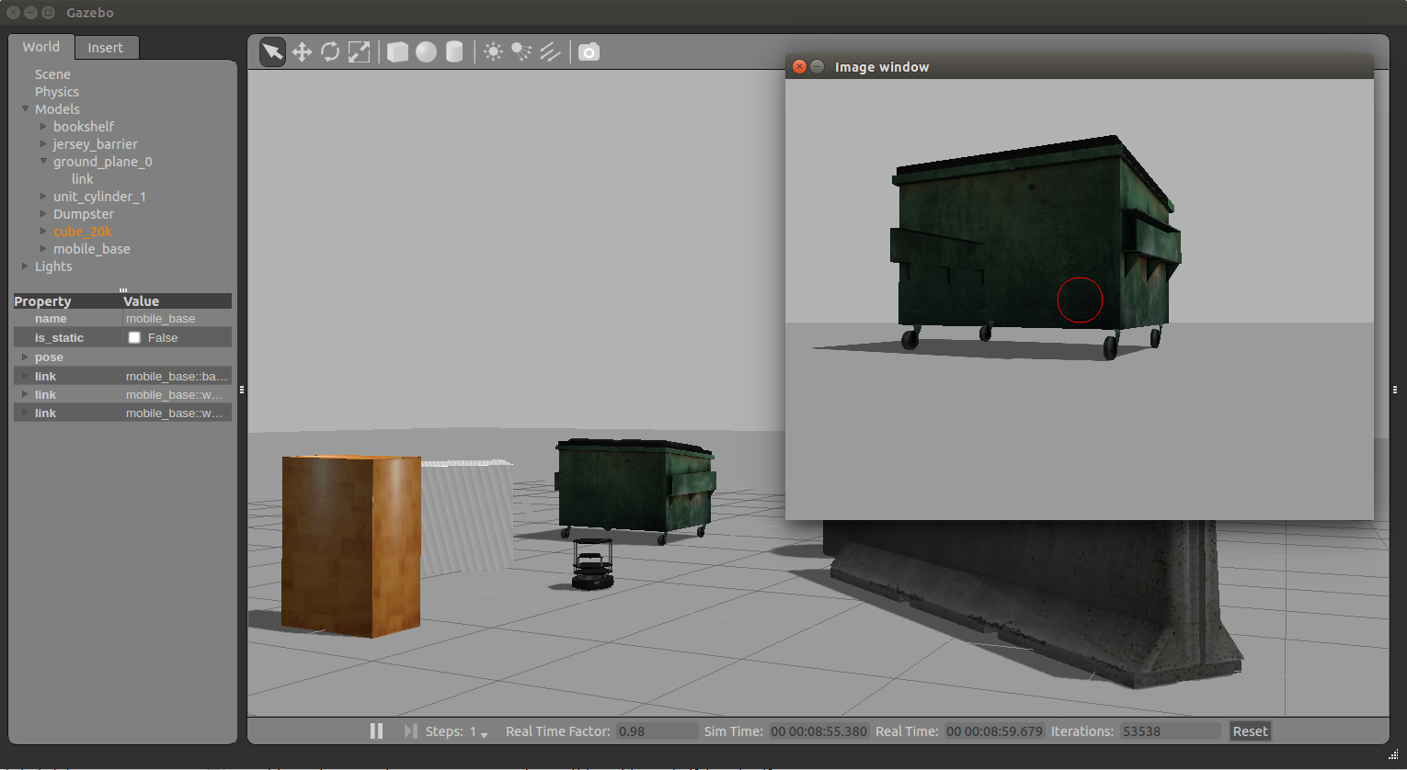
Image Converter Demo

Slide 28
Follow-Bot
We will now create a follow-bot that can follow lines on the ground using a camera
Being able to detect and follow lines is one of the (many) skills required for autonomous driving
To build the system, we will need to do the following steps:
Acquire images from a camera and pass them to OpenCV
Filter the images to identify the center of the line we are to follow
Steer the robot so that the center of the robot stays on the center of the line

Slide 29
Follow-Bot
Create a new package for the follow-bot:
We’ll now create a Gazebo world with a nice bright line in it
First create a models directory in the package and copy course.png and course.material to it
Then create a worlds directory and copy course.world to it
$ cd ~/catkin_ws/src
$ catkin_create_pkg follow_bot std_msgs roscpp sensor_msgs cv_bridge image_transport gazebo_ros

Slide 30

course.png

Slide 31
course.material
material course
{
receive_shadows on
technique
{
pass
{
ambient 0.5 0.5 0.5 1.0
texture_unit
{
texture course.png
}
}
}
}

Slide 32
course.world
<?xml version="1.0"?>
<sdf version="1.4">
<world name="default">
<scene>
<ambient>0 0 0 1</ambient>
<shadows>0</shadows>
<grid>0</grid>
<background>0.7 0.7 0.7 1</background>
</scene>
<include>
<uri>model://sun</uri>
</include>
<model name="ground">
<pose>1 2.3 -.1 0 0 0</pose>
<static>1</static>
<link name="ground">
<collision name="ground_coll">
<geometry>
<box>
<size>10 10 .1</size>
</box>
</geometry>
<surface>
<contact>
<ode/>
</contact>
</surface>
</collision>
<visual name="ground_vis">
<geometry>
<box>
<size>10 10 .1</size>
</box>
</geometry>
<material>
<script>
<uri>model://course.material</uri>
<name>course</name>
</script>
</material>
</visual>
</link>
</model>
</world>
</sdf>

Slide 33
course.launch
Add the following launch file to a /launch subdirectory:
<launch>
<include file="$(find gazebo_ros)/launch/empty_world.launch">
<arg name="use_sim_time" value="true"/>
<arg name="debug" value="false"/>
<arg name="world_name" value="$(find follow_bot)/world/course.world"/>
</include>
<include file="$(find turtlebot_gazebo)/launch/includes/kobuki.launch.xml">
<arg name="base" value="kobuki"/>
<arg name="stacks" value="hexagons"/>
<arg name="3d_sensor" value="kinect"/>
</include>
<node pkg="robot_state_publisher" type="robot_state_publisher" name="robot_state_publisher">
<param name="publish_frequency" type="double" value="30.0" />
</node>
<!-- Fake laser -->
<node pkg="nodelet" type="nodelet" name="laserscan_nodelet_manager" args="manager"/>
<node pkg="nodelet" type="nodelet" name="depthimage_to_laserscan"
args="load depthimage_to_laserscan/DepthImageToLaserScanNodelet laserscan_nodelet_manager">
<param name="scan_height" value="10"/>
<param name="output_frame_id" value="/camera_depth_frame"/>
<param name="range_min" value="0.45"/>
<remap from="image" to="/camera/depth/image_raw"/>
<remap from="scan" to="/scan"/>
</node>
</launch>

Slide 34
package.xml
Add an export to package.xml so the model path "models" inside your package is found by gazebo
<export>
<!-- You can specify that this package is a metapackage here: -->
<!-- <metapackage/> -->
<!-- Other tools can request additional information be placed here -->
<gazebo_ros gazebo_model_path="${prefix}/models"/>
</export>

Slide 35
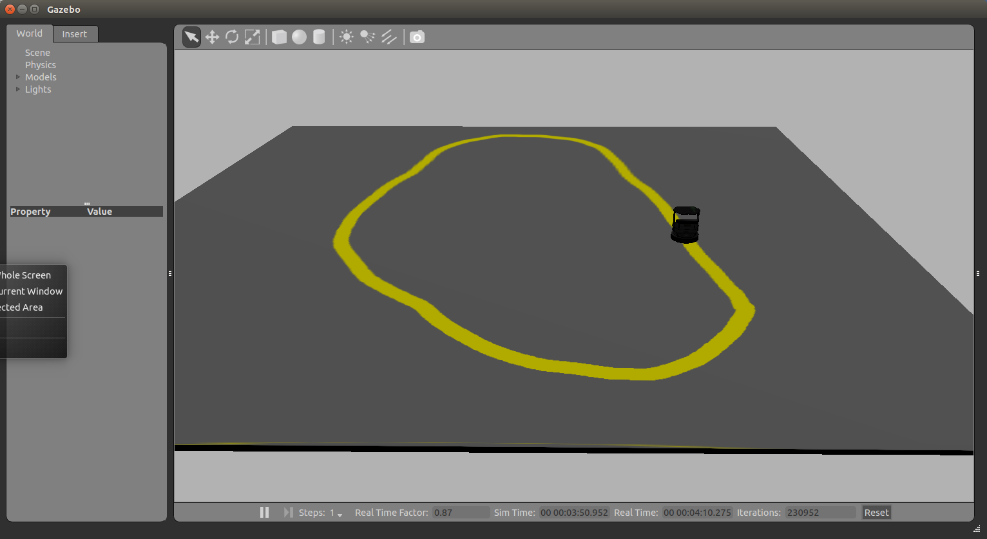
course.launch
roslaunch follow_bot course.launch

Slide 36
Follower.h
#include <ros/ros.h>
#include <image_transport/image_transport.h>
class ImageConverter {
private:
ros::NodeHandle nh;
image_transport::ImageTransport imageTransport;
image_transport::Subscriber imageSubscriber;
void imageCallback(const sensor_msgs::ImageConstPtr& msg);
public:
ImageConverter();
virtual ~ImageConverter();
};

Slide 37
Follower.cpp (1)
#include "Follower.h"
#include <cv_bridge/cv_bridge.h>
#include <sensor_msgs/image_encodings.h>
#include <opencv2/imgproc/imgproc.hpp>
#include <opencv2/highgui/highgui.hpp>
static const std::string OPENCV_WINDOW = "Image window";
Follower::Follower(): imageTransport(nh) {
imageSubscriber = imageTransport.subscribe("/camera/rgb/image_raw", 1,
&Follower::imageCallback, this);
// Create a display window
cv::namedWindow(OPENCV_WINDOW);
}
Follower::~Follower() {
// Close the display window
cv::destroyWindow(OPENCV_WINDOW);
}

Slide 38
Follower.cpp (2)
void Follower::imageCallback(const sensor_msgs::ImageConstPtr& msg) {
// convert the ROS image message to a CvImage
cv_bridge::CvImagePtr cv_ptr;
try {
cv_ptr = cv_bridge::toCvCopy(msg, sensor_msgs::image_encodings::BGR8);
}
catch (cv_bridge::Exception& e) {
ROS_ERROR("cv_bridge exception: %s", e.what());
return;
}
// Update the GUI window
cv::imshow(OPENCV_WINDOW, cv_ptr->image);
cv::waitKey(3);
}

Slide 39
main.cpp
#include "Follower.h"
int main(int argc, char **argv) {
ros::init(argc, argv, "follower");
Follower follower;
ros::spin();
return 0;
}

Slide 40
course.launch
Add the follower node to the launch file:
<launch>
<include file="$(find gazebo_ros)/launch/empty_world.launch">
<arg name="use_sim_time" value="true"/>
<arg name="debug" value="false"/>
<arg name="world_name" value="$(find follow_bot)/world/course.world"/>
</include>
...
<!-- Launch the follower node -->
<node name="follower" pkg="follow_bot" type="follower" output="screen"/>
</launch>

Slide 41
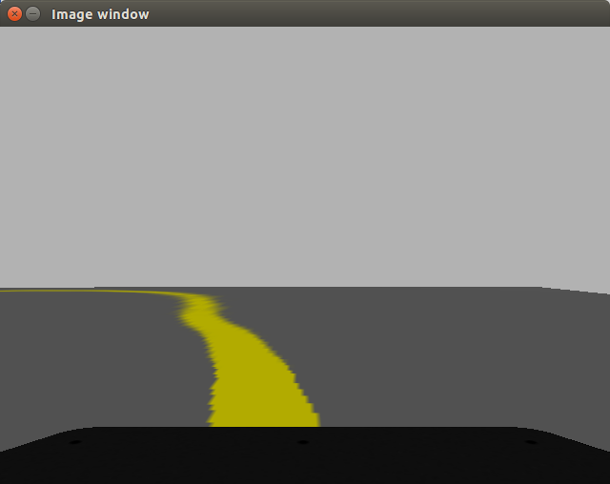
Follow-Bot
Run the launch file
A typical image from the Turtlebot’s camera:
$ roslaunch follow_bot course.launch

Slide 42
Detecting the Line
There are many strategies that can be used to detect and follow lines in various situations
Fortunately, in our case we are just going to consider an optimally painted and illuminated bright yellow line
Our strategy will be to filter a block of rows of the image by color and drive the robot toward the center of the pixels that pass the color filter

Slide 43
Filtering By Color
We now would like to find the yellow line in the Turtlebot’s image stream
Problem: RGB values are a function of the overall brightness as well as the color of the object
Solution: Transform RGB images into hue, saturation, value (HSV) images
The HSV image separates the RGB components into hue (color), saturation (color intensity), and value (brightness)
On the HSV image we can apply a threshold for hues near yellow to obtain a binary image in which pixels are either true (passed the filter) or false (they don’t pass the filter)

Slide 44
Converting to HSV
void ImageConverter::imageCallback(const sensor_msgs::ImageConstPtr& msg) {
// convert the ROS image message to a CvImage
cv_bridge::CvImagePtr cv_ptr;
try {
cv_ptr = cv_bridge::toCvCopy(msg, sensor_msgs::image_encodings::BGR8);
}
catch (cv_bridge::Exception& e) {
ROS_ERROR("cv_bridge exception: %s", e.what());
return;
}
// Convert input image to HSV
cv::Mat image = cv_ptr->image;
cv::Mat hsvImage;
cv:cvtColor(image, hsvImage, CV_BGR2HSV);
// Update the GUI window
cv::imshow(OPENCV_WINDOW, hsvImage);
cv::waitKey(3);
}

Slide 45
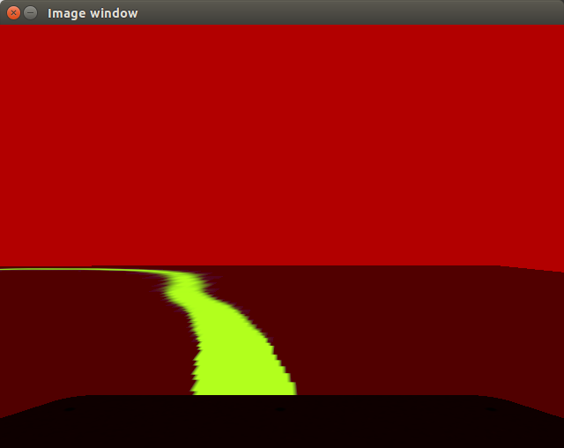
HSV Image
The HSV representation of a Turtlebot camera image

Slide 46
Filtering the Yellow Color
void ImageConverter::imageCallback(const sensor_msgs::ImageConstPtr& msg) {
// convert the ROS image message to a CvImage
cv_bridge::CvImagePtr cv_ptr;
try {
cv_ptr = cv_bridge::toCvCopy(msg, sensor_msgs::image_encodings::BGR8);
}
catch (cv_bridge::Exception& e) {
ROS_ERROR("cv_bridge exception: %s", e.what());
return;
}
// Convert input image to HSV
cv::Mat image = cv_ptr->image;
cv::Mat hsvImage;
cv:cvtColor(image, hsvImage, CV_BGR2HSV);
// Threshold the HSV image, keep only the yellow pixels
cv::Mat mask;
cv::Scalar lower_yellow(20, 100, 100);
cv::Scalar upper_yellow(30, 255, 255);
cv::inRange(hsvImage, lower_yellow, upper_yellow, mask);
// Update the GUI window
cv::imshow(OPENCV_WINDOW, mask);
cv::waitKey(3);
}

Slide 47
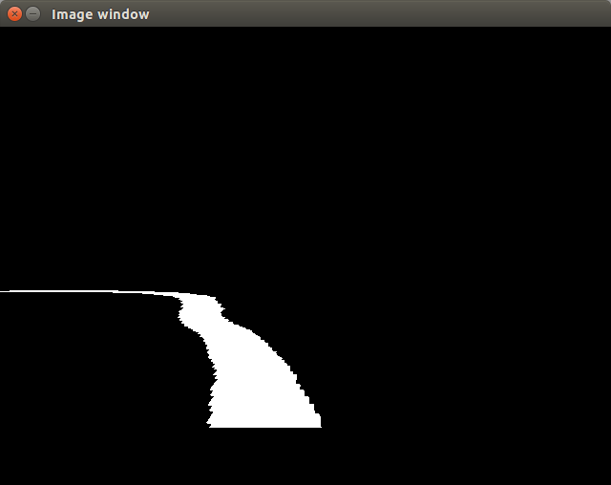
Filtered Binary Image
The binary image obtained by a hue filter on the HSV image

Slide 48
Detecting the Line Center
Our goal is to follow the line, not just to take interesting pictures of it!
To follow the line, we will use a simple strategy: we will only look at a 20-row portion of the image, starting three-quarters of the way down the image
Since we’re only concerned with the portion of the line that is in the field of view of the camera, 1 meter in front of the robot

Slide 49
Detecting the Line Center
void ImageConverter::imageCallback(const sensor_msgs::ImageConstPtr& msg) {
...
int width = mask.cols;
int height = mask.rows;
int search_top = 3 * height / 4;
int search_bottom = search_top + 20;
// Zero out pixels outside the desired region
for (int y = 0; y < height - 2; y++) {
if (y < search_top || y > search_bottom) {
for (int x = 0; x < width; x++) {
mask.at<cv::Vec3b>(y, x)[0] = 0;
mask.at<cv::Vec3b>(y, x)[1] = 0;
mask.at<cv::Vec3b>(y, x)[2] = 0;
}
}
}
// Update the GUI window
cv::imshow(OPENCV_WINDOW, mask);
cv::waitKey(3);
}

Slide 50
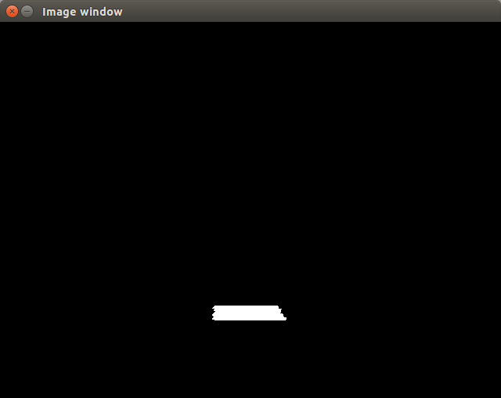
Detecting the Line Center

Slide 51
Detecting the Line Center
Now we will use the OpenCV moments() function to calculate the centroid of the blob of the binary image that passes our filter:
void ImageConverter::imageCallback(const sensor_msgs::ImageConstPtr& msg) {
...
// Use the moments() function to calculate the centroid of the blob of the binary image
cv::Moments M = cv::moments(mask);
if (M.m00 > 0) {
int cx = int(M.m10 / M.m00);
int cy = int(M.m01 / M.m00);
cv::circle(image, cv::Point(cx, cy), 20, CV_RGB(255, 0, 0), -1);
}
// Update the GUI window
cv::imshow(OPENCV_WINDOW, image);
cv::waitKey(3);
}

Slide 52

Detecting the Line Center

Slide 53
Following the Line
Now that we have a line detection scheme up and running, we can move on to the task of driving the robot such that the line stays near the center of the camera frame
We will use a simple P-controller (proportional), which means that a linear scaling of an error drives the control output

Slide 54
Following the Line
void ImageConverter::imageCallback(const sensor_msgs::ImageConstPtr& msg) {
...
// Use the moments() function to calculate the centroid of the blob of the binary image
cv::Moments M = cv::moments(mask);
if (M.m00 > 0) {
int cx = int(M.m10 / M.m00);
int cy = int(M.m01 / M.m00);
cv::circle(image, cv::Point(cx, cy), 20, CV_RGB(255, 0, 0), -1);
// Move the robot in proportion to the error signal
int err = cx - width / 2;
geometry_msgs::Twist cmd;
cmd.linear.x = 0.2;
cmd.angular.z = -(float)err / 100;
cmdVelPublisher.publish(cmd);
}
// Update the GUI window cv::imshow(OPENCV_WINDOW, image); cv::waitKey(3); }

Slide 55
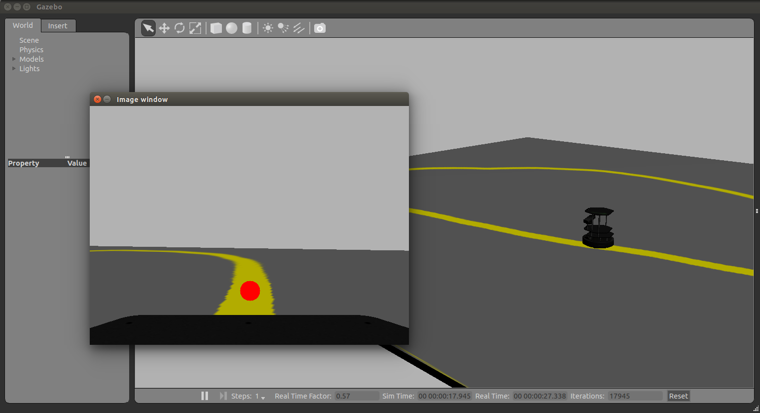
Following the Line

Slide 56
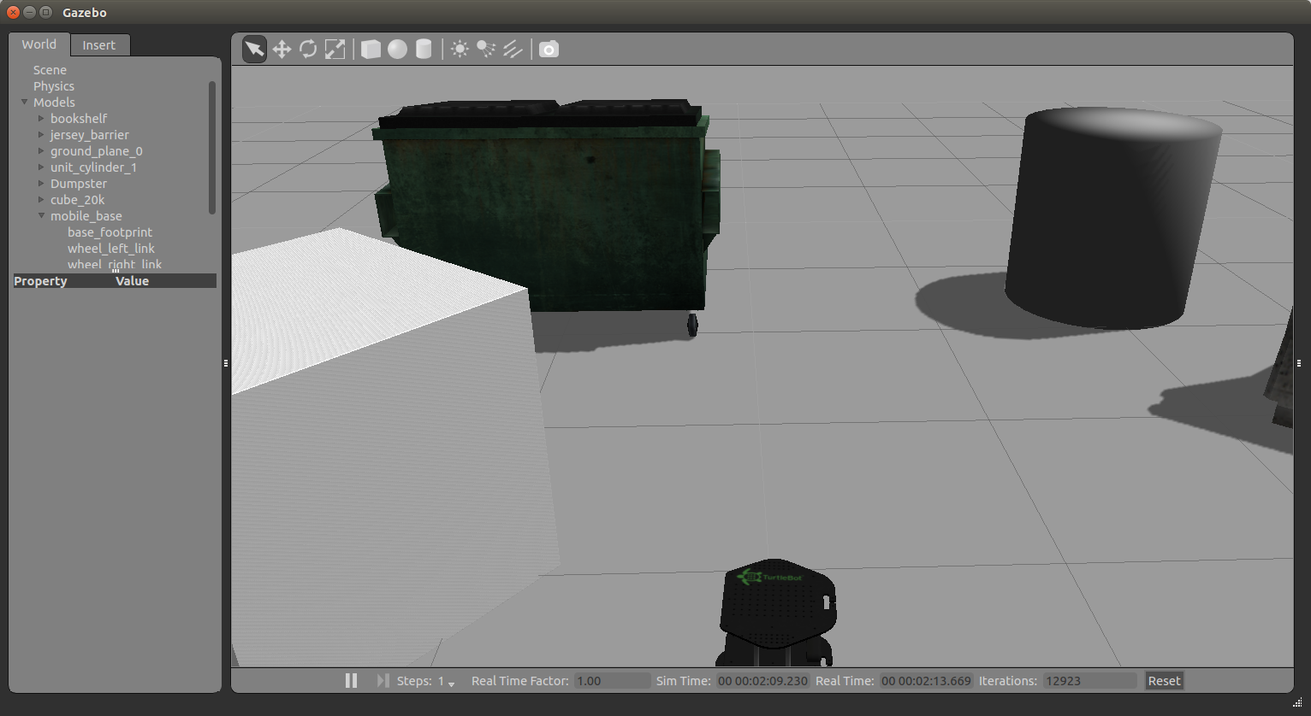
Ex. 10
Use Turtlebot’s camera to make it move towards the Dampster and stop when it is approximately 1m in front of it

