Slide 1

ROS – Lecture 11
October 2016
Behavior-Based Robotics
Where to go next?
Lecturer: Roi Yehoshua
roiyeho@gmail.com

Slide 2
Agenda
Behavior-based robotics
Decision making in ROS
Where to go next?

Slide 3
Behavior-Based Robotics
The world is fundamentally unknown and changing
Does not make sense to over-plan
Key idea: to develop a library of useful behaviors (controllers)
Switch among behaviors in response to environmental changes

Slide 4
Behavior
A behavior is a mapping of sensory inputs to a pattern of motor actions
Composed of:
Start conditions (preconditions) - what must be true to be executable
Actions - what changes once behavior executes
Stop conditions - when the behavior terminates

Slide 5
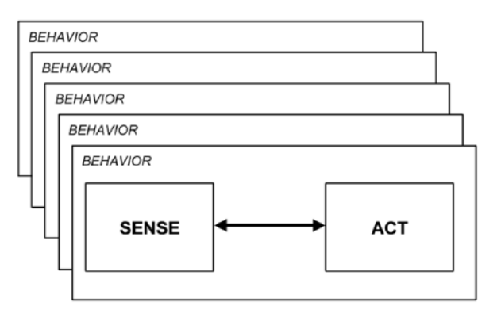
Behaviors
Behaviors are independent and operate concurrently
One behavior does not know what another behavior is doing or perceiving
The overall behavior of the robot is emergent
There is no explicit “controller” module which determines what will be done

Slide 6
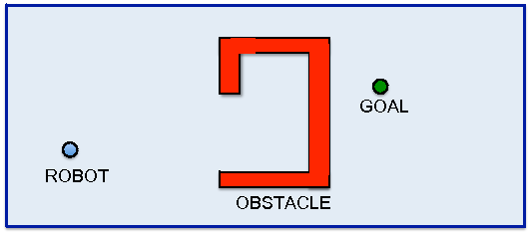
Example: Navigation
Problem: Go to a goal location without bumping into obstacles
Need at least two behaviors: Go-to-goal and Avoid-obstacles

Slide 7
Behaviors
Plan changes
Identify objects
Monitor change
Map
Explore
Wander
Avoid object

Slide 8
Behavior-Based Example
Create a new package gazebo_random_walk
Create a launch subdirectory within the package and add the following launch file to it
$ cd ~/catkin_ws/src
$ catkin_create_pkg behavior_based std_msgs rospy roscpp

Slide 9
Behavior Class – Header File
#include <vector>
using namespace std;
class Behavior {
private:
vector<Behavior *> _nextBehaviors;
public:
Behavior();
virtual bool startCond() = 0;
virtual bool stopCond() = 0;
virtual void action() = 0;
Behavior *addNext(Behavior *beh);
Behavior *selectNext();
virtual ~Behavior();
};

Slide 10
Behavior Class – cpp File
#include "Behavior.h"
#include <iostream>
Behavior::Behavior() {
}
Behavior::~Behavior() {
}
Behavior *Behavior::addNext(Behavior *beh) {
_nextBehaviors.push_back(beh);
return this;
}
Behavior *Behavior::selectNext() {
for (int i = 0; i < _nextBehaviors.size(); i++)
{
if (_nextBehaviors[i]->startCond())
return _nextBehaviors[i];
}
return NULL;
}

Slide 11
MoveForward Behavior - Header
#include "Behavior.h"
#include <ros/ros.h>
#include "sensor_msgs/LaserScan.h"
#include <cmath>
class MoveForward: public Behavior {
public:
MoveForward();
virtual bool startCond();
virtual void action();
virtual bool stopCond();
virtual ~MoveForward();
private:
const static double FORWARD_SPEED_MPS = 0.5;
const static double MIN_SCAN_ANGLE_RAD = -30.0/180 * M_PI;
const static double MAX_SCAN_ANGLE_RAD = +30.0/180 * M_PI;
const static float MIN_PROXIMITY_RANGE_M = 0.5;
ros::NodeHandle node;
ros::Publisher commandPub;
ros::Subscriber laserSub;
void scanCallback(const sensor_msgs::LaserScan::ConstPtr& scan);
bool keepMovingForward;
};

Slide 12
MoveForward Behavior – cpp (1)
#include "MoveForward.h"
#include "geometry_msgs/Twist.h"
MoveForward::MoveForward() {
commandPub = node.advertise<geometry_msgs::Twist>("cmd_vel", 10);
laserSub = node.subscribe("base_scan", 1, &MoveForward::scanCallback, this);
keepMovingForward = true;
}
bool MoveForward::startCond() {
return keepMovingForward;
}
void MoveForward::action() {
geometry_msgs::Twist msg;
msg.linear.x = FORWARD_SPEED_MPS;
commandPub.publish(msg);
ROS_INFO("Moving forward");
}
bool MoveForward::stopCond() {
return !keepMovingForward;
}

Slide 13
MoveForward Behavior – cpp (2)
void MoveForward::scanCallback(const sensor_msgs::LaserScan::ConstPtr& scan)
{
// Find the closest range between the defined minimum and maximum angles
int minIndex = ceil((MIN_SCAN_ANGLE_RAD - scan->angle_min) / scan->angle_increment);
int maxIndex = floor((MAX_SCAN_ANGLE_RAD - scan->angle_min) / scan->angle_increment);
float closestRange = scan->ranges[minIndex];
for (int currIndex = minIndex + 1; currIndex <= maxIndex; currIndex++) {
if (scan->ranges[currIndex] < closestRange) {
closestRange = scan->ranges[currIndex];
}
}
if (closestRange < MIN_PROXIMITY_RANGE_M) {
keepMovingForward = false;
} else {
keepMovingForward = true;
}
}
MoveForward::~MoveForward() {
}

Slide 14
TurnLeft Behavior - Header
#include "Behavior.h"
#include <ros/ros.h>
#include "sensor_msgs/LaserScan.h"
#include <cmath>
class TurnLeft: public Behavior {
public:
TurnLeft();
virtual bool startCond();
virtual void action();
virtual bool stopCond();
virtual ~TurnLeft();
private:
const static double TURN_SPEED_MPS = 1.0;
const static double MIN_SCAN_ANGLE_RAD = -30.0/180 * M_PI;
const static double MAX_SCAN_ANGLE_RAD = 0;
const static float MIN_PROXIMITY_RANGE_M = 0.5;
ros::NodeHandle node;
ros::Publisher commandPub;
ros::Subscriber laserSub;
void scanCallback(const sensor_msgs::LaserScan::ConstPtr& scan);
bool keepTurningLeft;
};

Slide 15
TurnLeft Behavior – cpp (1)
#include "TurnLeft.h"
#include "geometry_msgs/Twist.h"
TurnLeft::TurnLeft() {
commandPub = node.advertise<geometry_msgs::Twist>("cmd_vel", 10);
laserSub = node.subscribe("base_scan", 1, &TurnLeft::scanCallback, this);
keepTurningLeft = true;
}
bool TurnLeft::startCond() {
return keepTurningLeft;
}
void TurnLeft::action() {
geometry_msgs::Twist msg;
msg.angular.z = TURN_SPEED_MPS;
commandPub.publish(msg);
ROS_INFO("Turning left");
}
bool TurnLeft::stopCond() {
return !keepTurningLeft;
}

Slide 16
TurnLeft Behavior – cpp (2)
void TurnLeft::scanCallback(const sensor_msgs::LaserScan::ConstPtr& scan)
{
// Find the closest range between the defined minimum and maximum angles
int minIndex = ceil((MIN_SCAN_ANGLE_RAD - scan->angle_min) / scan->angle_increment);
int maxIndex = floor((MAX_SCAN_ANGLE_RAD - scan->angle_min) / scan->angle_increment);
float closestRange = scan->ranges[minIndex];
for (int currIndex = minIndex + 1; currIndex <= maxIndex; currIndex++) {
if (scan->ranges[currIndex] < closestRange) {
closestRange = scan->ranges[currIndex];
}
}
if (closestRange < MIN_PROXIMITY_RANGE_M) {
keepTurningLeft = true;
} else {
keepTurningLeft = false;
}
}
TurnLeft::~TurnLeft() {
}

Slide 17
Behavior-Based Robotics
Two main challenges in behavior-based robotics
Behavior selection - How do we select the correct behavior?
Behavior fusion – if several behaviors run in parallel:
How to merge the results?
How to determine weight of each behavior in the result?

Slide 18
State-Based Selection
Every state represents a behavior
Transitions are triggered by sensor readings
C
A
A
C
Start
B
C
A
D
A

Slide 19
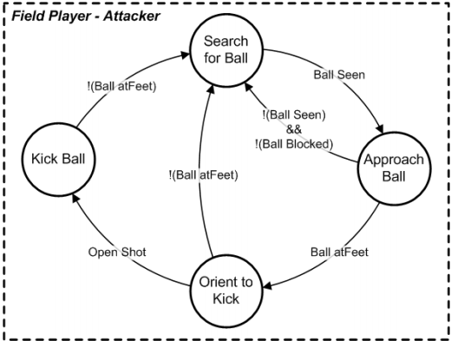
Example: Robot Soccer

Slide 20
Plan Class – Header file
#include <vector>
#include "Behavior.h"
using namespace std;
class Plan {
public:
Plan();
Behavior *getStartBehavior();
virtual ~Plan();
protected:
vector<Behavior *> behaviors;
Behavior *startBehavior;
};

Slide 21
Plan Class – cpp File
#include "Plan.h"
#include <iostream>
Plan::Plan() : startBehavior(NULL) {
}
Behavior *Plan::getStartBehavior() {
return startBehavior;
}
Plan::~Plan() {
}

Slide 22
ObstacleAvoidPlan – Header File
#include "Plan.h"
class ObstacleAvoidPlan: public Plan {
public:
ObstacleAvoidPlan();
virtual ~ObstacleAvoidPlan();
};

Slide 23
ObstacleAvoidPlan – cpp File
#include "ObstacleAvoidPlan.h"
#include "MoveForward.h"
#include "TurnLeft.h"
#include "TurnRight.h"
ObstacleAvoidPlan::ObstacleAvoidPlan() {
// Creating behaviors
behaviors.push_back(new MoveForward());
behaviors.push_back(new TurnLeft());
behaviors.push_back(new TurnRight());
// Connecting behaviors
behaviors[0]->addNext(behaviors[1]);
behaviors[0]->addNext(behaviors[2]);
behaviors[1]->addNext(behaviors[0]);
behaviors[2]->addNext(behaviors[0]);
startBehavior = behaviors[0];
}

Slide 24
Manager – Header File
#include "Plan.h"
#include "Behavior.h"
class Manager {
public:
Manager(Plan *plan);
void run();
virtual ~Manager();
private:
Plan *plan;
Behavior *currBehavior;
};

Slide 25
Manager – cpp File
#include "Manager.h"
#include <ros/ros.h>
Manager::Manager(Plan *plan) : plan(plan) {
currBehavior = plan->getStartBehavior();
}
void Manager::run()
{
ros::Rate rate(10);
if (!currBehavior->startCond()) {
ROS_ERROR("Cannot start the first behavior");
return;
}
while (ros::ok() && currBehavior != NULL) {
currBehavior->action();
if (currBehavior->stopCond()) {
currBehavior = currBehavior->selectNext();
}
ros::spinOnce();
rate.sleep();
}
ROS_INFO("Manager stopped");
}

Slide 26
Run.cpp
#include "Manager.h"
#include "ObstacleAvoidPlan.h"
#include <ros/ros.h>
int main(int argc, char **argv) {
ros::init(argc, argv, "behavior_based_wanderer");
ObstacleAvoidPlan plan;
Manager manager(&plan);
// Start the movement
manager.run();
return 0;
};

Slide 27
Behavior-Based Example
Create a launch subdirectory within the package and copy the launch file from gazebo_random_walk package
Change the following lines in the launch file

Slide 28
behavior_based_wanderer.launch
<launch>
<param name="/use_sim_time" value="true" />
<!-- Launch world -->
<include file="$(find gazebo_ros)/launch/willowgarage_world.launch"/>
<arg name="init_pose" value="-x -5 -y -2 -z 1"/>
<param name="robot_description" textfile="$(find r2d2_description)/urdf/r2d2.urdf"/>
<!-- Spawn robot's model -->
<node name="spawn_urdf" pkg="gazebo_ros" type="spawn_model" args="$(arg init_pose) -urdf -param robot_description -model my_robot" output="screen"/>
<node name="joint_state_publisher" pkg="joint_state_publisher" type="joint_state_publisher"/>
<node pkg="robot_state_publisher" type="robot_state_publisher" name="robot_state_publisher" output="screen"/>
<!-- Launch random walk node -->
<node name="behavior_based_wanderer" pkg="behavior_based" type="behavior_based_wanderer" output="screen"/>
</launch>

Slide 29
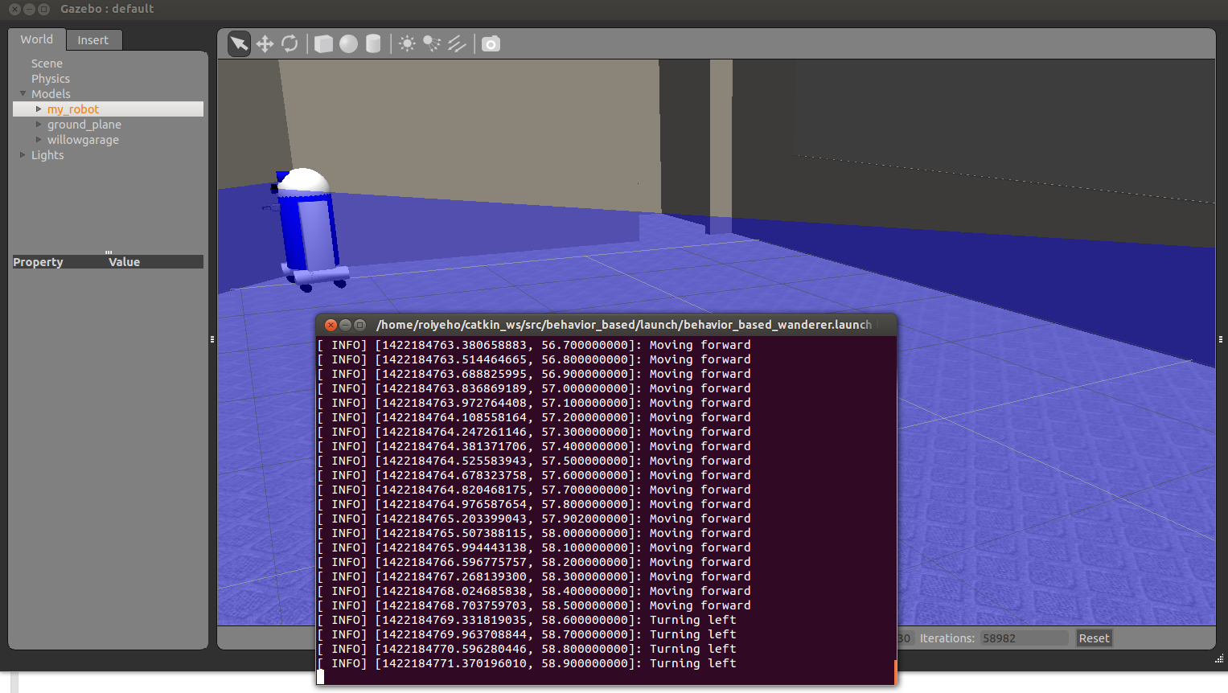
Behavior-Based Example

Slide 30
Decision Making in ROS
http://wiki.ros.org/decision_making
Light-weight, generic and extendable tools for writing, executing, debugging and monitoring decision making models through ROS standard tools
Supports different decision making models:
Finite State Machines
Hierarchical FSMs
Behavior Trees
BDI
Developed by Cogniteam

Slide 31
Where To Go Next?
There are still many areas of ROS to explore:
3-D image processing using PCL
Identifying your friends and family using face_recognition
Identifying and grasping objects on a table top
or how about playing chess?
Building knowledge bases with knowrob
Learning from experience using reinforcement_learning

Slide 32
Where To Go Next?
There are now over 2000 packages and libraries available for ROS
Click on the Browse Software link at the top of the ROS Wiki for a list of all ROS packages and stacks that have been submitted for indexing.
When you are ready, you can contribute your own package(s) back to the ROS community
Welcome to the future of robotics.
Have fun and good luck!

Slide 33


