Slide 1

ROS – Lecture 3
October 2016
ROS topics
Publishers and subscribers
roslaunch
Custom message types
Lecturer: Roi Yehoshua
roiyeho@gmail.com

Slide 2
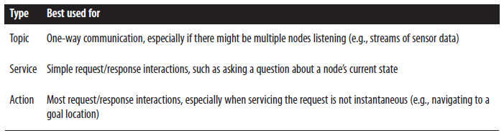
ROS Communication Types

Slide 3
ROS Topics
Topics implement a publish/subscribe communication mechanism
one of the more common ways to exchange data in a distributed system.
Before nodes start to transmit data over topics, they must first announce, or advertise, both the topic name and the types of messages that are going to be sent
Then they can start to send, or publish, the actual data on the topic.
Nodes that want to receive messages on a topic can subscribe to that topic by making a request to roscore.
After subscribing, all messages on the topic are delivered to the node that made the request.

Slide 4
ROS Topics
In ROS, all messages on the same topic must be of the same data type
Topic names often describe the messages that are sent over them
For example, on the PR2 robot, the topic /wide_stereo/right/image_color is used for color images from the rightmost camera of the wide-angle stereo pair

Slide 5
Topic Publisher
Manages an advertisement on a specific topic
Created by calling NodeHandle::advertise()
Registers this topic in the master node
Example for creating a publisher:
First parameter is the topic name
Second parameter is the queue size
Once all the publishers for a given topic go out of scope the topic will be unadvertised
ros::Publisher chatter_pub = node.advertise<std_msgs::String>("chatter", 1000);

Slide 6
Topic Publisher
To publish a message on a topic call publish()
Example:
The message’s type must agree with the type given as a template parameter to the advertise<>() call
std_msgs::String msg;
chatter_pub.publish(msg);

Slide 7
Talker and Listener
We’ll now create a package with two nodes:
talker publishes messages to topic “chatter”
listener reads the messages from the topic and prints them out to the screen
First create the package chat_pkg
Open the package source directory in Eclipse and add a C++ source file named Talker.cpp
Copy the following code into it
$ cd ~/catkin_ws/src
catkin_create_pkg chat_pkg std_msgs rospy roscpp

Slide 8
Talker.cpp
#include "ros/ros.h"
#include "std_msgs/String.h"
#include <sstream>
int main(int argc, char **argv)
{
ros::init(argc, argv, "talker"); // Initiate new ROS node named "talker"
ros::NodeHandle node;
ros::Publisher chatter_pub = node.advertise<std_msgs::String>("chatter", 1000);
ros::Rate loop_rate(10);
int count = 0;
while (ros::ok()) // Keep spinning loop until user presses Ctrl+C
{
std_msgs::String msg;
std::stringstream ss;
ss << "hello world " << count;
msg.data = ss.str();
ROS_INFO("%s", msg.data.c_str());
chatter_pub.publish(msg);
ros::spinOnce(); // Need to call this function often to allow ROS to process incoming messages
loop_rate.sleep(); // Sleep for the rest of the cycle, to enforce the loop rate
count++;
}
return 0;
}

Slide 9
Subscribing to a Topic
To start listening to a topic, call the method subscribe() of the node handle
This returns a Subscriber object that you must hold on to until you want to unsubscribe
Example for creating a subscriber:
1st parameter is the topic name
2nd parameter is the queue size
3rd parameter is the function to handle the message
ros::Subscriber sub = node.subscribe("chatter", 1000, messageCallback);

Slide 10
Listener.cpp
#include "ros/ros.h"
#include "std_msgs/String.h"
// Topic messages callback
void chatterCallback(const std_msgs::String::ConstPtr& msg)
{
ROS_INFO("I heard: [%s]", msg->data.c_str());
}
int main(int argc, char **argv)
{
// Initiate a new ROS node named "listener"
ros::init(argc, argv, "listener");
ros::NodeHandle node;
// Subscribe to a given topic
ros::Subscriber sub = node.subscribe("chatter", 1000, chatterCallback);
// Enter a loop, pumping callbacks
ros::spin();
return 0;
}

Slide 11
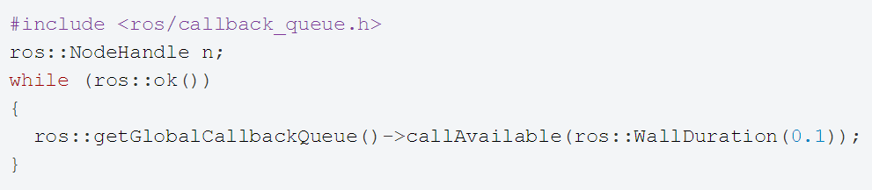
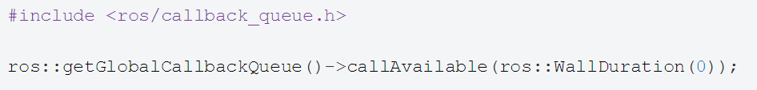
ros::spin() vs ros::spinOnce()
ros::spin() gives control over to ROS, which allows it to call all user callbacks
will not return until the node has been shutdown, either through a call to ros::shutdown() or a Ctrl-C.
ros::spinOnce() calls the callbacks waiting to be called at that point in time

Slide 12
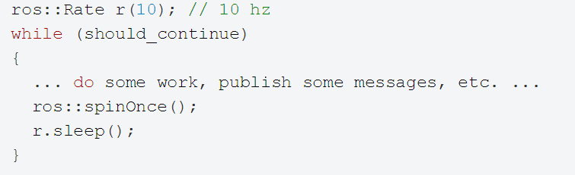
ros::spin() vs ros::spinOnce()
A common pattern is to call spinOnce() periodically:

Slide 13
Using Class Methods as Callbacks
Suppose you have a simple class, Listener:
Then the NodeHandle::subscribe() call using the class method looks like this:
class Listener
{
public: void callback(const std_msgs::String::ConstPtr& msg);
};
Listener listener;
ros::Subscriber sub = node.subscribe("chatter", 1000, &Listener::callback, &listener);

Slide 14
Compile the Nodes
Add the following to the package’s CMakeLists file
cmake_minimum_required(VERSION 2.8.3)
project(chat_pkg)
…
## Declare a cpp executable
add_executable(talker src/Talker.cpp)
add_executable(listener src/Listener.cpp)
## Specify libraries to link a library or executable target against
target_link_libraries(talker ${catkin_LIBRARIES})
target_link_libraries(listener ${catkin_LIBRARIES})

Slide 15
Building the Nodes
Now build the package and compile all the nodes using the catkin_make tool:
This will create two executables, talker and listener, at ~/catkin_ws/devel/lib/chat_pkg
cd ~/catkin_ws
catkin_make

Slide 16
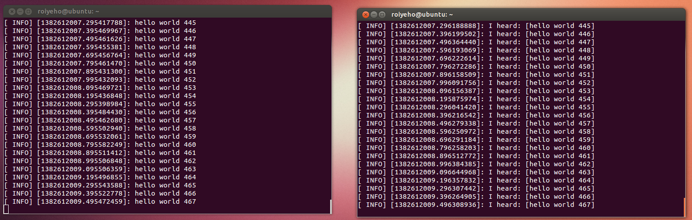
Running the Nodes From Terminal
Run roscore
Run the nodes in two different terminals:
$ rosrun chat_pkg talker
$ rosrun chat_pkg listener

Slide 17
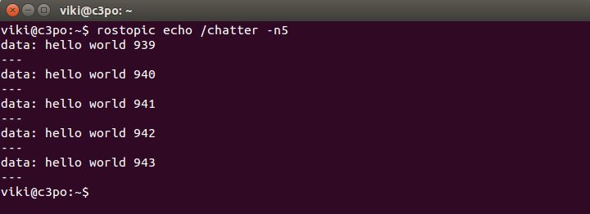
Running the Nodes From Terminal
You can use rosnode and rostopic to debug and see what the nodes are doing
Examples:
$rosnode info /talker
$rosnode info /listener
$rostopic list
$rostopic info /chatter
$rostopic echo /chatter

Slide 18
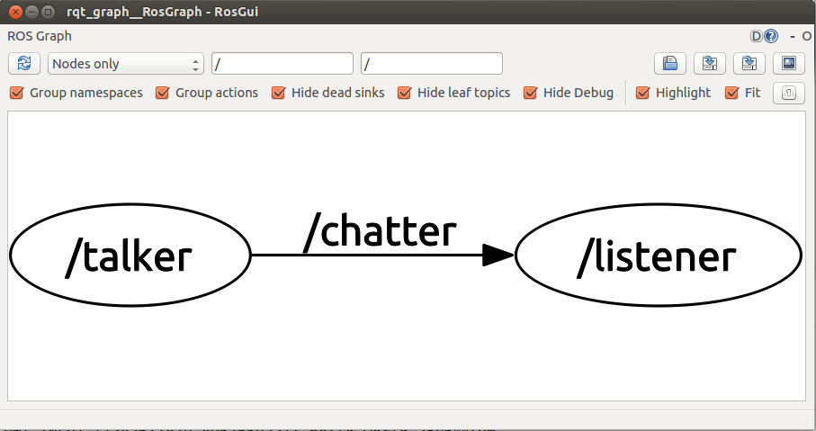
rqt_graph
rqt_graph creates a dynamic graph of what's going on in the system
Use the following command to run it:
$ rosrun rqt_graph rqt_graph

Slide 19
ROS Names
ROS names must be unique
If the same node is launched twice, roscore directs the older node to exit
To change the name of a node on the command line, the special __name remapping syntax can be used
The following two shell commands would launch two instances of talker named talker1 and talker2
$ rosrun chat_pkg talker __name:=talker1
$ rosrun chat_pkg talker __name:=talker2

Slide 20
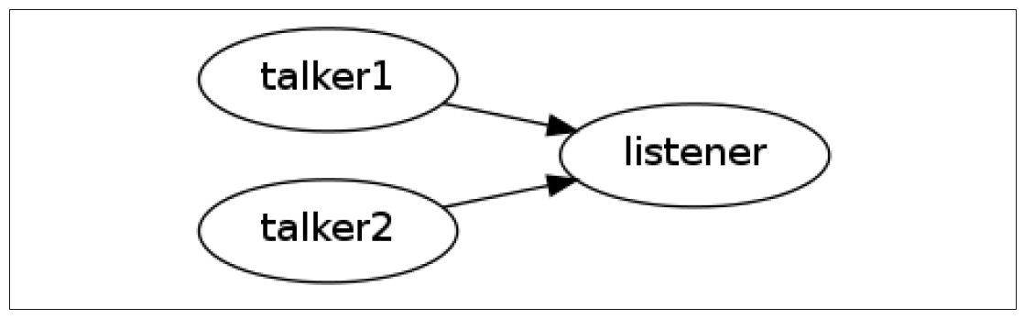
ROS Names
Instantiating two talker programs and routing them to the same receiver

Slide 21
roslaunch
a tool for easily launching multiple ROS nodes as well as setting parameters on the Parameter Server
roslaunch operates on launch files which are XML files that specify a collection of nodes to launch along with their parameters
By convention these files have a suffix of .launch
Syntax:
roslaunch automatically runs roscore for you
$ roslaunch PACKAGE LAUNCH_FILE

Slide 22
Launch File Example
Launch file for launching the talker and listener nodes:
Each <node> tag includes attributes declaring the ROS graph name of the node, the package in which it can be found, and the type of node, which is the filename of the executable program
output=“screen” makes the ROS log messages appear on the launch terminal window
<launch>
<node name="talker" pkg="chat_pkg" type="talker" output="screen"/>
<node name="listener" pkg="chat_pkg" type="listener" output="screen"/>
</launch>

Slide 23
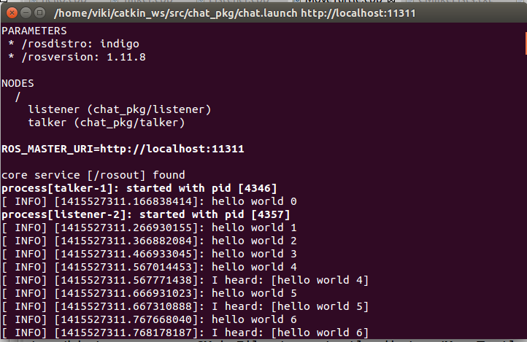
Launch File Example
$ roslaunch chat_pkg chat.launch

Slide 24
Velocity Commands
To make a robot move in ROS we need to publish Twist messages to the topic cmd_vel
This message has a linear component for the (x,y,z) velocities, and an angular component for the angular rate about the (x,y,z) axes
geometry_msgs/Vector3 linear
float64 x
float64 y
float64 z
geometry_msgs/Vector3 angular
float64 x
float64 y
float64 z

Slide 25
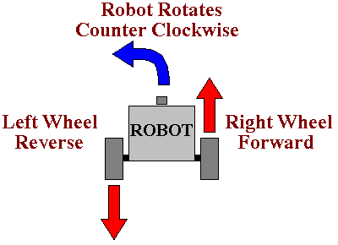
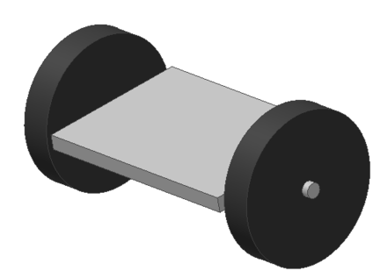
Differential Drive Robots
A differential wheeled robot consists of two independently actuated wheels, located on its two sides
The robot moves forward when both wheels turn forward, and spins in place when one wheel drives forward and one drives backward.

Slide 26
Differential Drive Robots
A differential drive robot can only move forward/backward along its longitudinal axis and rotate only around its vertical axis
The robot cannot move sideways or vertically
Thus we only need to set the linear x component and the angular z component in the Twist message
An omni-directional robot would also use the linear y component while a flying or underwater robot would use all six components

Slide 27
A Move Turtle Node
For the demo, we will create a new ROS package called my_turtle
In Eclipse add a new source file to the package called Move_Turtle.cpp
Add the following code
$ cd ~/catkin_ws/src
$ catkin_create_pkg my_turtle std_msgs rospy roscpp

Slide 28
MoveTurtle.cpp
#include "ros/ros.h"
#include "geometry_msgs/Twist.h"
int main(int argc, char **argv)
{
const double FORWARD_SPEED_MPS = 0.5;
// Initialize the node
ros::init(argc, argv, "move_turtle");
ros::NodeHandle node;
// A publisher for the movement data
ros::Publisher pub = node.advertise<geometry_msgs::Twist>("turtle1/cmd_vel", 10);
// Drive forward at a given speed. The robot points up the x-axis.
// The default constructor will set all commands to 0
geometry_msgs::Twist msg;
msg.linear.x = FORWARD_SPEED_MPS;
// Loop at 10Hz, publishing movement commands until we shut down
ros::Rate rate(10);
ROS_INFO("Starting to move forward");
while (ros::ok()) {
pub.publish(msg);
rate.sleep();
}
}

Slide 29
Launch File
Add move_turtle.launch to your package:
Run the launch file:
<launch>
<node name="turtlesim_node" pkg="turtlesim" type="turtlesim_node" />
<node name="move_turtle" pkg="my_turtle" type="move_turtle" output="screen" />
</launch>
$ roslaunch my_turtle move_turtle.launch

Slide 30
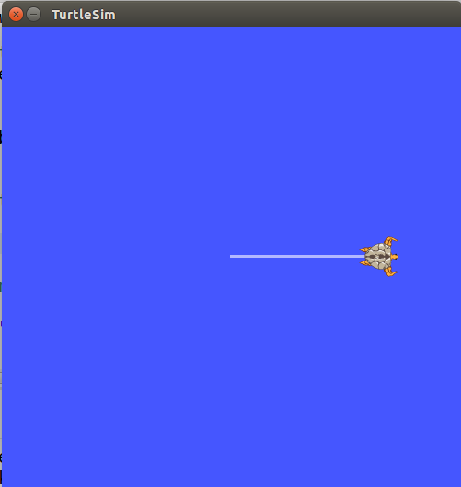
Move Turtle Demo
You should see the turtle in the simulator constantly moving forward until it bumps into the wall

Slide 31
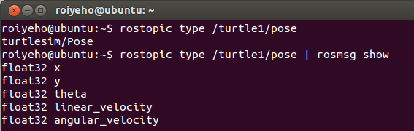
Print Turtle’s Pose
In order to print the turtle’s pose we need to subscribe to the topic /turtle1/pose
We can find the message type of the topic and its structure by running the command
The message turtlesim/Pose is defined in the turtlesim package, thus we need to include the header file “turtlesim/Pose.h” in our code
$ rostopic type /turtle1/pose| rosmsg show

Slide 32
MoveTurtle.cpp (1)
#include "ros/ros.h"
#include "geometry_msgs/Twist.h"
#include "turtlesim/Pose.h"
// Topic messages callback
void poseCallback(const turtlesim::PoseConstPtr& msg)
{
ROS_INFO("x: %.2f, y: %.2f", msg->x, msg->y);
}
int main(int argc, char **argv)
{
const double FORWARD_SPEED_MPS = 0.5;
// Initialize the node
ros::init(argc, argv, "move_turtle");
ros::NodeHandle node;
// A publisher for the movement data
ros::Publisher pub = node.advertise<geometry_msgs::Twist>("turtle1/cmd_vel", 10);
// A listener for pose
ros::Subscriber sub = node.subscribe("turtle1/pose", 10, poseCallback);

Slide 33
MoveTurtle.cpp (2)
// Drive forward at a given speed. The robot points up the x-axis.
// The default constructor will set all commands to 0
geometry_msgs::Twist msg;
msg.linear.x = FORWARD_SPEED_MPS;
// Loop at 10Hz, publishing movement commands until we shut down
ros::Rate rate(10);
ROS_INFO("Starting to move forward");
while (ros::ok()) {
pub.publish(msg);
ros::spinOnce(); // Allow processing of incoming messages
rate.sleep();
}
}

Slide 34
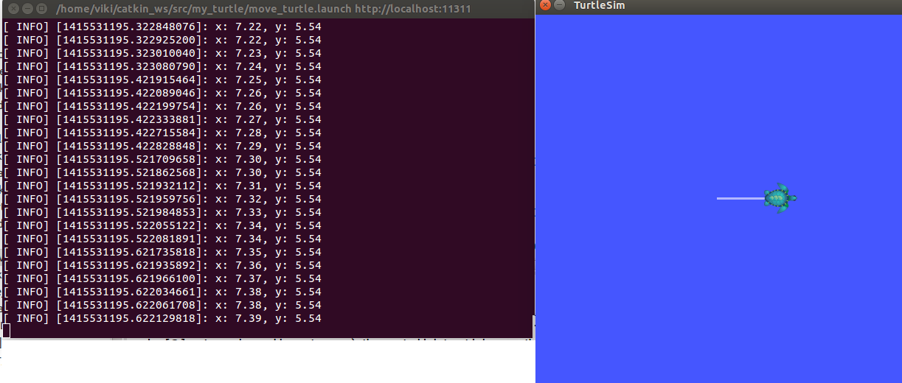
Print Turtle’s Pose
roslaunch my_turtle move_turtle.launch

Slide 35
Passing Arguments To Nodes
In the launch file you can use the args attribute to pass command-line arguments to node
In our case, we will pass the name of the turtle as an argument to move_turtle
<launch>
<node name="turtlesim_node" pkg="turtlesim" type="turtlesim_node" />
<node name="move_turtle" pkg="my_turtle" type="move_turtle" args="turtle1" output="screen"/>
</launch>

Slide 36
MoveTurtle.cpp
int main(int argc, char **argv)
{
const double FORWARD_SPEED_MPS = 0.5;
string robot_name = string(argv[1]);
// Initialize the node
ros::init(argc, argv, "move_turtle");
ros::NodeHandle node;
// A publisher for the movement data
ros::Publisher pub = node.advertise<geometry_msgs::Twist>(robot_name + "/cmd_vel", 10);
// A listener for pose
ros::Subscriber sub = node.subscribe(robot_name + "/pose", 10, poseCallback);
geometry_msgs::Twist msg;
msg.linear.x = FORWARD_SPEED_MPS;
ros::Rate rate(10);
ROS_INFO("Starting to move forward");
while (ros::ok()) {
pub.publish(msg);
ros::spinOnce(); // Allow processing of incoming messages
rate.sleep();
}
}

Slide 37
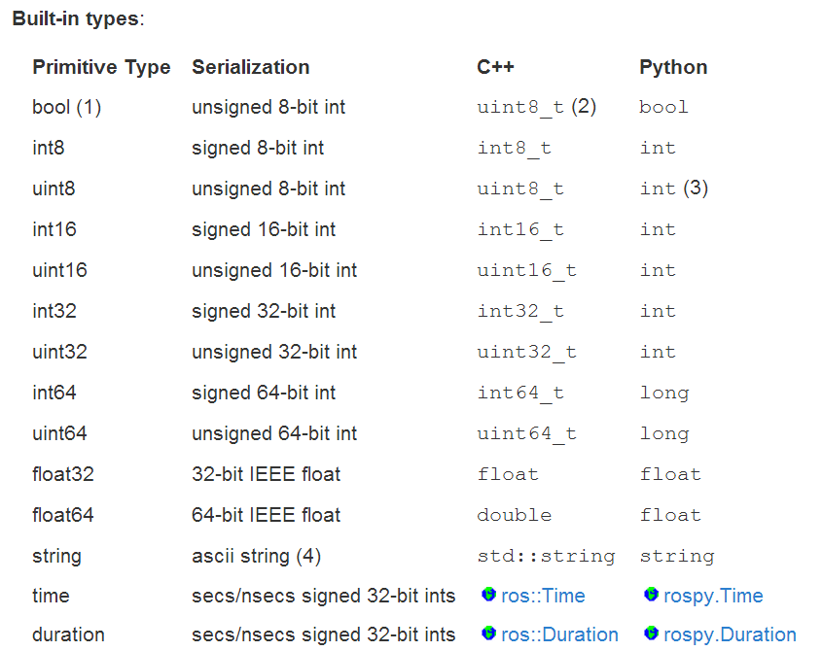
Creating Custom Messages
ROS offers a rich set of built-in message types
The std_msgs package defines the primitive types:

Slide 38
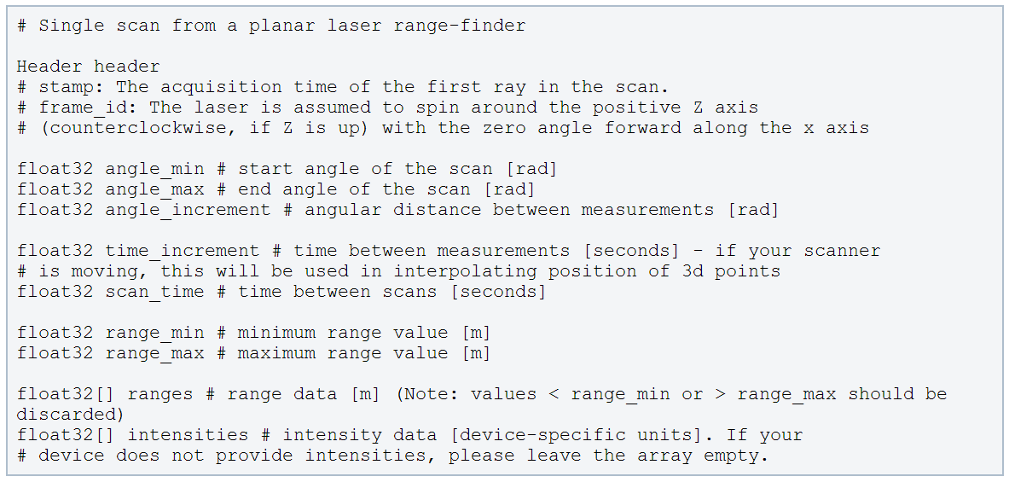
Creating Custom Messages
These primitive types are used to build all of the messages used in ROS
For example, (most) laser range-finder sensors publish sensor_msgs/LaserScan messages

Slide 39
Creating Custom Messages
Using standardized message types for laser scans and location estimates enables nodes can be written that provide navigation and mapping (among many other things) for a wide variety of robots
However, there are times when the built-in message types are not enough, and we have to define our own messages

Slide 40
msg Files
ROS messages are defined by special message-definition files in the msg directory of a package.
These files are then compiled into language-specific implementations that can be used in your code
Each line in the file specifies a type and a field name

Slide 41
Message Field Types
Field types can be:
a built-in type, such as "float32 pan" or "string name"
names of Message descriptions defined on their own, such as "geometry_msgs/PoseStamped"
fixed- or variable-length arrays (lists) of the above, such as "float32[] ranges" or "Point32[10] points“
the special Header type, which maps to std_msgs/Header

Slide 42
Creating Custom Messages
As an example we will create a new ROS message type that each robot will publish when it is ready to perform some task
Message type will be called RobotStatus
The structure of the message will be:
The header contains a timestamp and coordinate frame information that are commonly used in ROS
Header header
int32 robot_id
bool is_ready

Slide 43
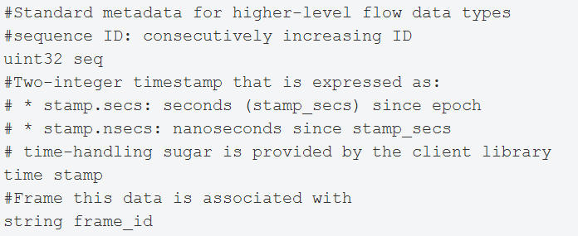
Message Header
stamp specifies the publishing time
frame_id specifies the point of reference for data contained in that message

Slide 44
Creating a Message Type
First create a new package called custom_messages
Now create a subdirectory msg and the file RobotStatus.msg within it
$ cd ~/catkin_ws/src
$ catkin_create_pkg custom_messages std_msgs rospy roscpp
$ cd ~/catkin_ws/src/custom_messages
$ mkdir msg
$ gedit msg/RobotStatus.msg

Slide 45
Creating a Message Type
Add the following lines to RobotStatus.msg:
Now we need to make sure that the msg files are turned into source code for C++, Python, and other languages
Header header
int32 robot_id
bool is_ready

Slide 46
Creating a Message Type
Open package.xml, and add the following two lines to it
Note that at build time, we need "message_generation", while at runtime, we need "message_runtime"
<build_depend>roscpp</build_depend>
<build_depend>rospy</build_depend>
<build_depend>std_msgs</build_depend>
<build_depend>message_generation</build_depend>
<run_depend>roscpp</run_depend>
<run_depend>rospy</run_depend>
<run_depend>std_msgs</run_depend>
<run_depend>message_runtime</run_depend>

Slide 47
Creating a Message Type
In CMakeLists.txt add the message_generation dependency to the find package call so that you can generate messages:
Also make sure you export the message runtime dependency:
find_package(catkin REQUIRED COMPONENTS
roscpp
rospy
std_msgs
message_generation
)
catkin_package(
# INCLUDE_DIRS include
# LIBRARIES multi_sync
CATKIN_DEPENDS roscpp rospy std_msgs message_runtime
# DEPENDS system_lib
)

Slide 48
Creating a Message Type
Find the following block of code:
Uncomment it by removing the # symbols and then replace the stand in Message*.msg files with your .msg file, such that it looks like this:
## Generate messages in the 'msg' folder
# add_message_files(
# FILES
# Message1.msg
# Message2.msg
# )
add_message_files(
FILES
RobotStatus.msg
)

Slide 49
Creating a Message Type
Now we must ensure the generate_messages() function is called
Uncomment these lines:
So it looks like:
# generate_messages(
# DEPENDENCIES
# std_msgs
# )
generate_messages(
DEPENDENCIES
std_msgs
)

Slide 50
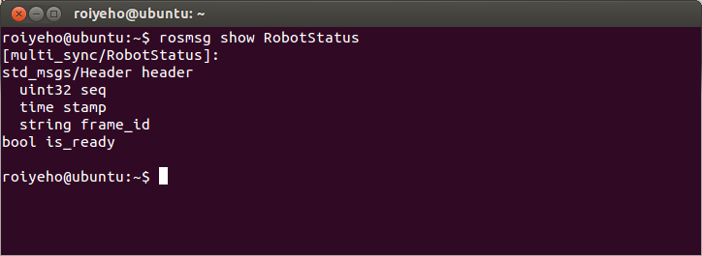
Using rosmsg
That's all you need to do to create a msg
Let's make sure that ROS can see it using the rosmsg show command:
$ rosmsg show [message type]

Slide 51
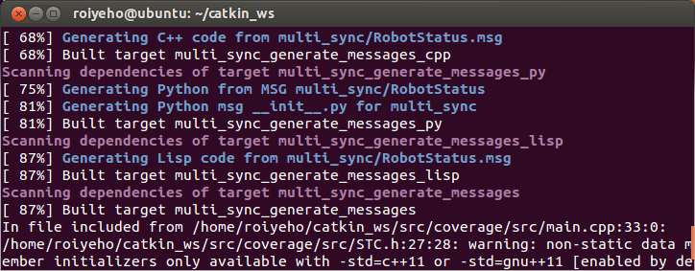
Building the Message Files
Now we need to make our package:
During the build, source files will be created from the .msg file:
$ cd ~/catkin_ws
$ catkin_make

Slide 52
Building the Message Files
Any .msg file in the msg directory will generate code for use in all supported languages.
The C++ message header file will be generated in ~/catkin_ws/devel/include/custom_messages/

Slide 53
RobotStatus.h
#include <std_msgs/Header.h>
namespace multi_sync
{
template <class ContainerAllocator>
struct RobotStatus_
{
typedef RobotStatus_<ContainerAllocator> Type;
RobotStatus_()
: header()
, robot_id(0)
, is_ready(false) {
}
typedef ::std_msgs::Header_<ContainerAllocator> _header_type;
_header_type header;
typedef uint32_t _robot_id_type;
_robot_id_type robot_id;
typedef uint8_t _is_ready_type;
_is_ready_type is_ready;
typedef boost::shared_ptr< ::multi_sync::RobotStatus_<ContainerAllocator> > Ptr;
typedef boost::shared_ptr< ::multi_sync::RobotStatus_<ContainerAllocator> const> ConstPtr;
boost::shared_ptr<std::map<std::string, std::string> > __connection_header;
}; // struct RobotStatus_
typedef ::multi_sync::RobotStatus_<std::allocator<void> > RobotStatus;

Slide 54
Importing Messages
You can now import the RobotStatus header file by adding the following line:
Note that messages are put into a namespace that matches the name of the package
#include "custom_messages/RobotStatus.h"

Slide 55
Ex. 3
Write a program that moves the turtle 1m forward from its current position, rotates it 45 degrees and then causes it to stop
Print the turtle’s initial and final locations

