Slide 1

ROS – Lecture 4
October 2016
Gazebo simulator
Reading Sensor Data
Wander-Bot
Lecturer: Roi Yehoshua
roiyeho@gmail.com

Slide 2
Simulators
In simulation, we can model as much or as little of reality as we desire
Sensors and actuators can be modeled as ideal devices, or they can incorporate various levels of distortion, errors, and unexpected faults
Automated testing of control algorithms typically requires simulated robots, since the algorithms under test need to be able to experience the consequences of their actions
Due to the isolation provided by the messaging interfaces of ROS, a vast majority of the robot’s software graph can be run identically whether it is controlling a real robot or a simulated robot

Slide 3
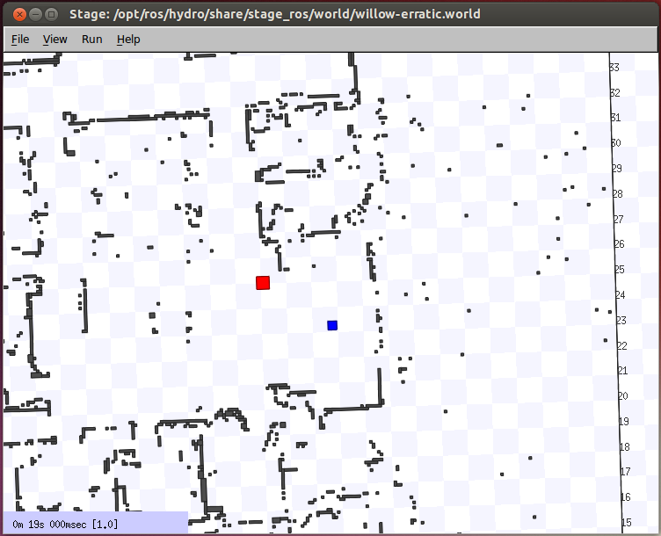
ROS Stage Simulator
http://wiki.ros.org/simulator_stage
A 2D simulator that provides a virtual world populated by mobile robots, along with various objects for the robots to sense and manipulate

Slide 4
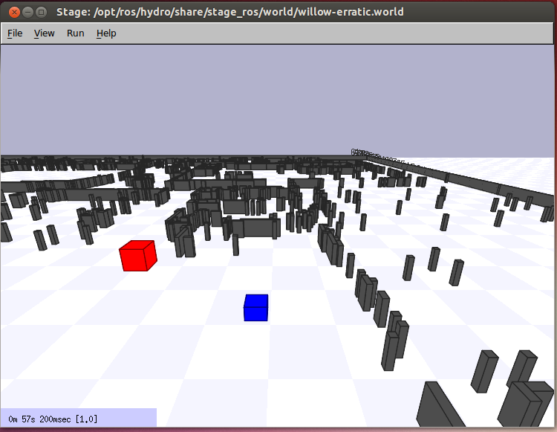
ROS Stage Simulator
In perspective view of the robot

Slide 5

Gazebo
A multi-robot simulator
Like Stage, it is capable of simulating a population of robots, sensors and objects, but does so in 3D
Includes an accurate simulation of rigid-body physics and generates realistic sensor feedback
Allows code designed to operate a physical robot to be executed in an artificial environment
Gazebo is under active development at the OSRF (Open Source Robotics Foundation)

Slide 6
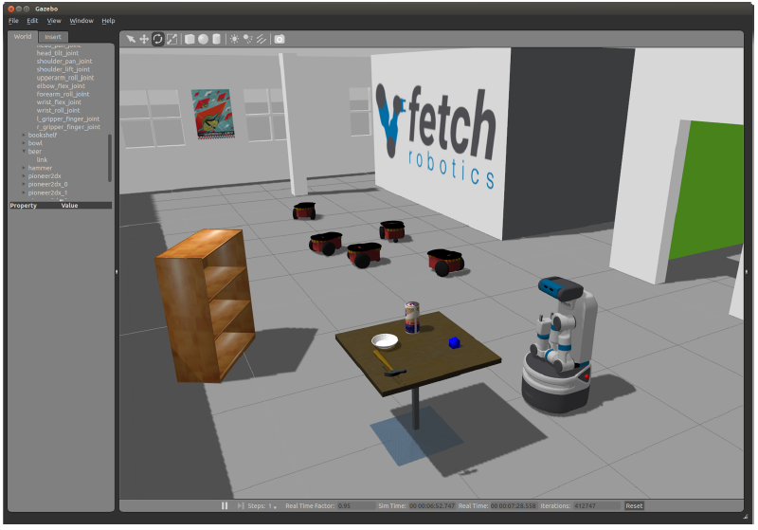
Gazebo
Gazebo Demo

Slide 7
Gazebo
ROS Indigo comes with Gazebo V2.2
Gazebo home page - http://gazebosim.org/
Gazebo tutorials - http://gazebosim.org/tutorials

Slide 8
Gazebo Architecture
Gazebo consists of two processes:
Server: Runs the physics loop and generates sensor data
Executable: gzserver
Libraries: Physics, Sensors, Rendering, Transport
Client: Provides user interaction and visualization of a simulation.
Executable: gzclient
Libraries: Transport, Rendering, GUI

Slide 9
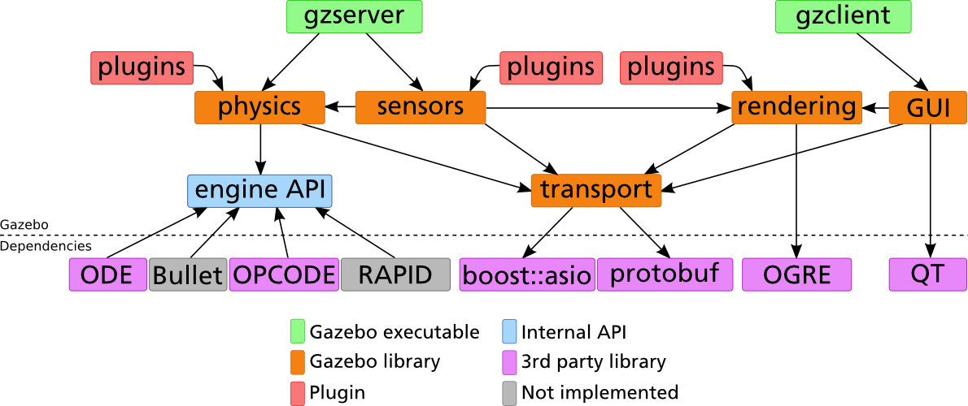
Gazebo Architecture

Slide 10
Running Gazebo from ROS
To launch Gazebo type:
Note: When you first launch Gazebo it may take a few minutes to update its model database
$ rosrun gazebo_ros gazebo

Slide 11
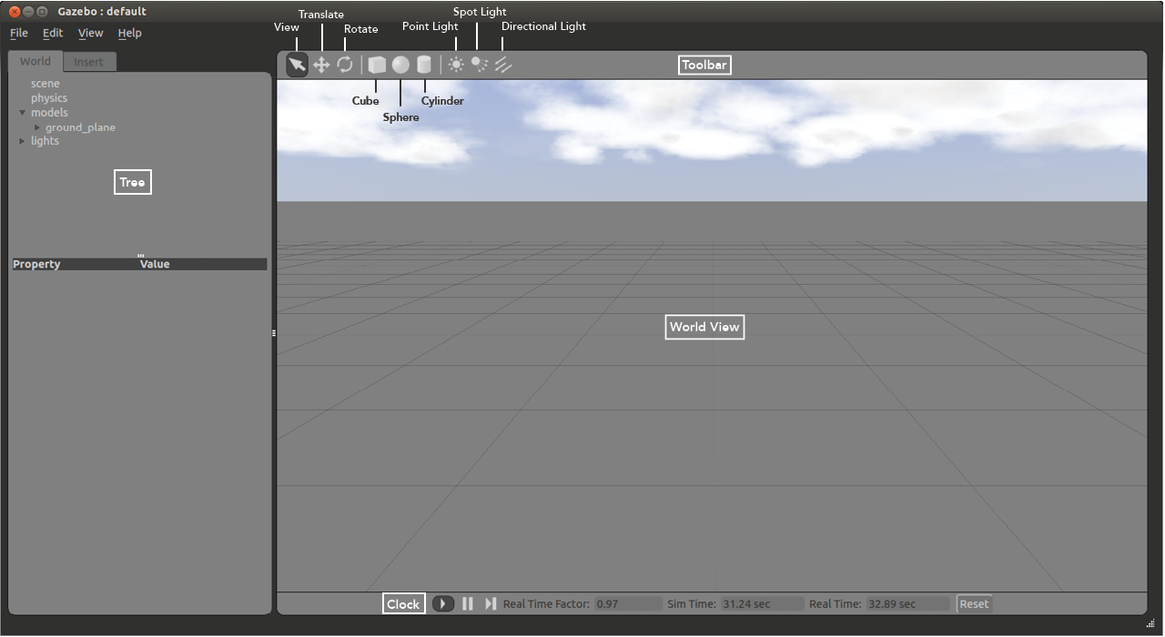
Gazebo User Interface

Slide 12
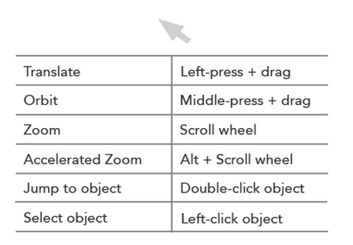
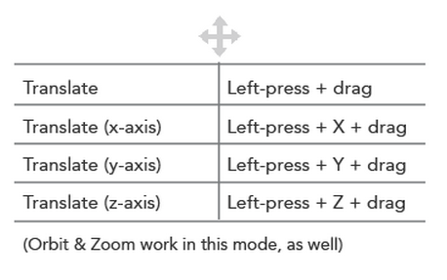
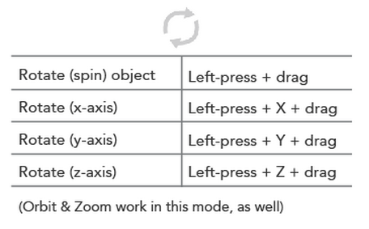
The World View
The World View displays the world and all of the models therein
Here you can add, manipulate, and remove models
You can switch between View, Translate and Rotate modes of the view in the left side of the Toolbar
View Mode
Translate Mode
Rotate Mode

Slide 13
Add a Model
To add a model to the world:
left-click on the desired model in the Insert Tab on the left side
move the cursor to the desired location in World View
left-click again to release
Use the Translate and Rotate modes to orient the model more precisely

Slide 14
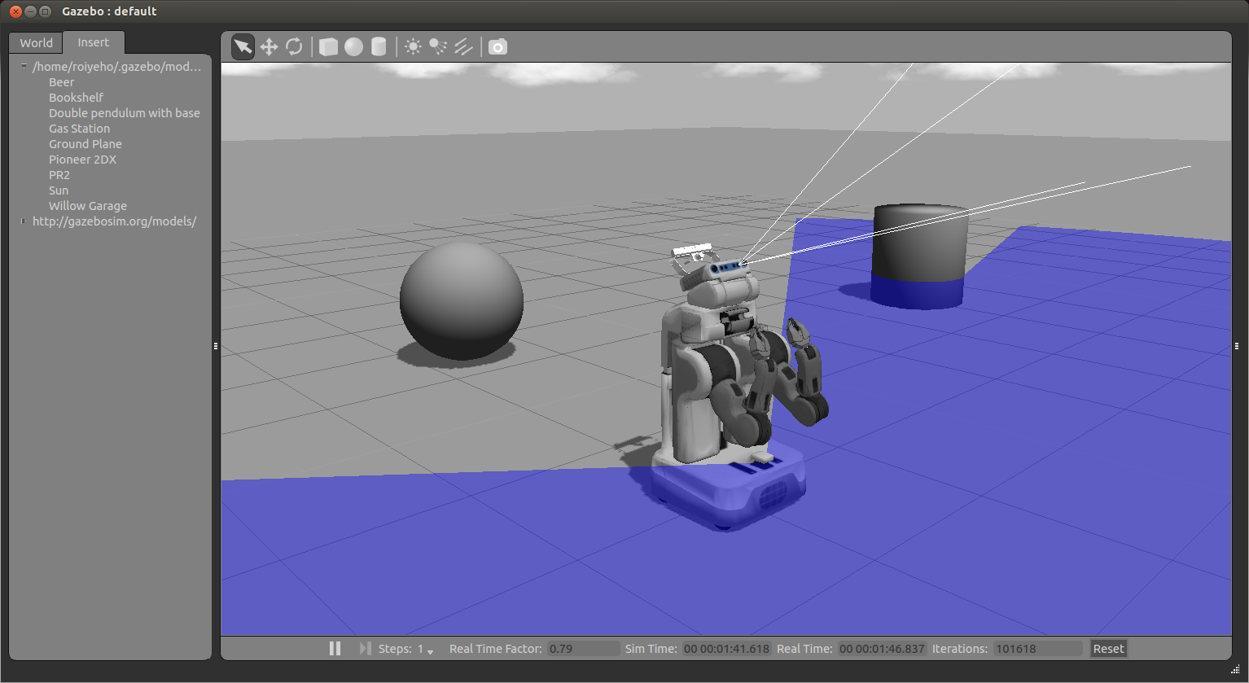
Inserting PR2 Robot

Slide 15
Models Item
The models item in the world tab contains a list of all models and their links
Right-clicking on a model in the Models section gives you three options:
Move to – moves the view to be directly in front of that model
Follow
View – allows you to view different aspects of the model, such as Wireframe, Collisions, Joints
Delete – deletes the model

Slide 16
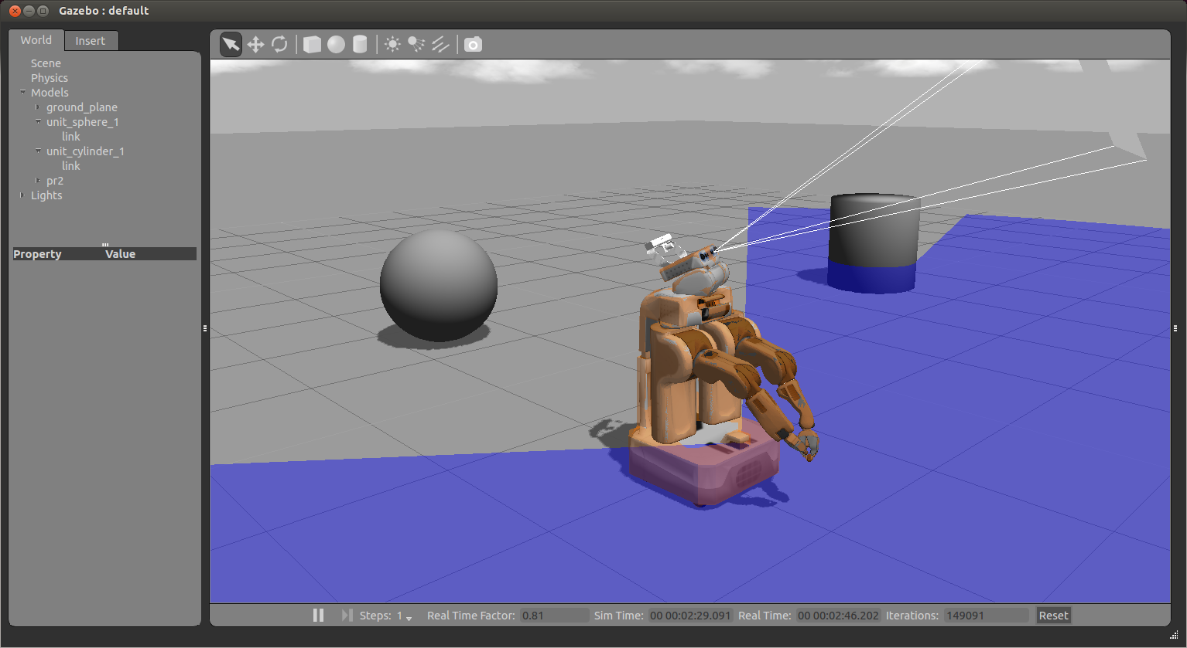
Collisions View

Slide 17
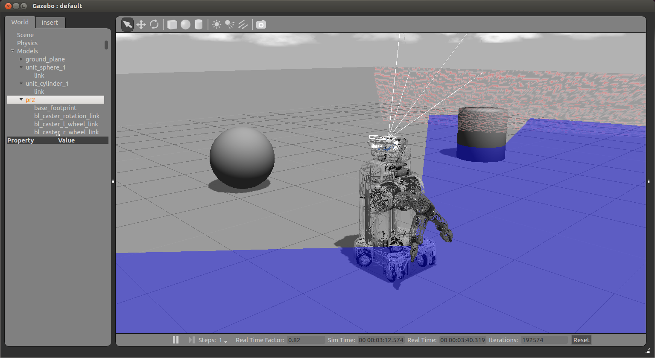
Wireframe View

Slide 18
Clock
You can start, pause and step through the simulation with the clock
It is located at the bottom of the World View
Real Time Factor: Displays how fast or slow the simulation is running in comparison to real time
A factor less than 1.0 indicates simulation is running slower than real time
Greater then 1.0 indicates faster than real time

Slide 19
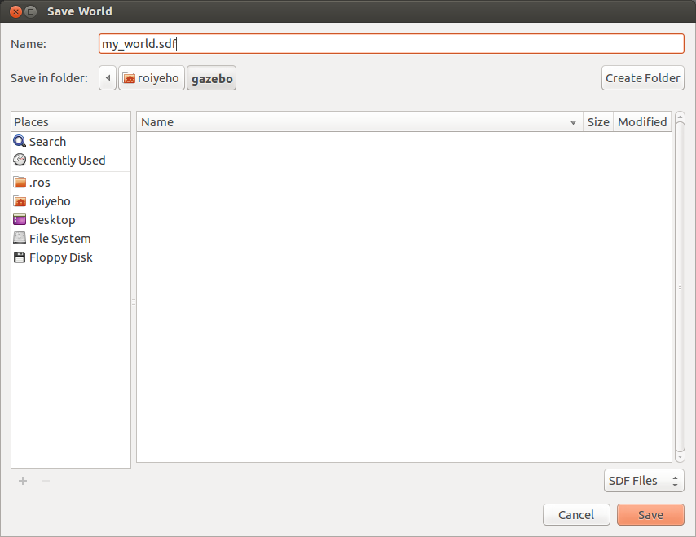
Saving a World
Once you are happy with a world it can be saved through the File->Save As menu.
Enter my_world.sdf as the file name and click OK

Slide 20
Loading a World
A saved world may be loaded on the command line:
The filename must be in the current working directory, or you must specify the complete path
$ gazebo my_world.sdf

Slide 21
World Description File
The world description file contains all the elements in a simulation, including robots, lights, sensors, and static objects
This file is formatted using SDF and has a .world extension
The Gazebo server (gzserver) reads this file to generate and populate a world

Slide 22
Example World Files
Gazebo ships with a number of example worlds
World files are found within the /worlds directory of your Gazebo resource path
A typical path might be /usr/share/gazebo-2.2
In gazebo_ros package there are built-in launch files that load some of these world files
For example, to launch willowgarage_world type:
$ roslaunch gazebo_ros willowgarage_world.launch

Slide 23
willowgarage.world
<?xml version="1.0" ?>
<sdf version="1.4">
<world name="default">
<include>
<uri>model://ground_plane</uri>
</include>
<include>
<uri>model://sun</uri>
</include>
<include>
<uri>model://willowgarage</uri>
</include>
</world>
</sdf>
In this world file snippet you can see that three models are referenced
The three models are searched for within your local Gazebo Model Database
If not found there, they are automatically pulled from Gazebo's online database

Slide 24
Launch World Files
In gazebo_ros package there are built-in launch files that load some of these world files
For example, to launch willowgarage_world type:
$ roslaunch gazebo_ros willowgarage_world.launch

Slide 25
willowgarage_world.launch
<launch>
<!-- We resume the logic in empty_world.launch, changing only the name of the world to be launched -->
<include file="$(find gazebo_ros)/launch/empty_world.launch">
<arg name="world_name" value="worlds/willowgarage.world"/> <!-- Note: the world_name is with respect to GAZEBO_RESOURCE_PATH environmental variable -->
<arg name="paused" value="false"/>
<arg name="use_sim_time" value="true"/>
<arg name="gui" value="true"/>
<arg name="headless" value="false"/>
<arg name="debug" value="false"/>
</include>
</launch>
This launch file inherits most of the necessary functionality from empty_world.launch
The only parameter we need to change is the world_name parameter, substituting the empty.world world file with willowgarage.world
The other arguments are simply set to their default values

Slide 26
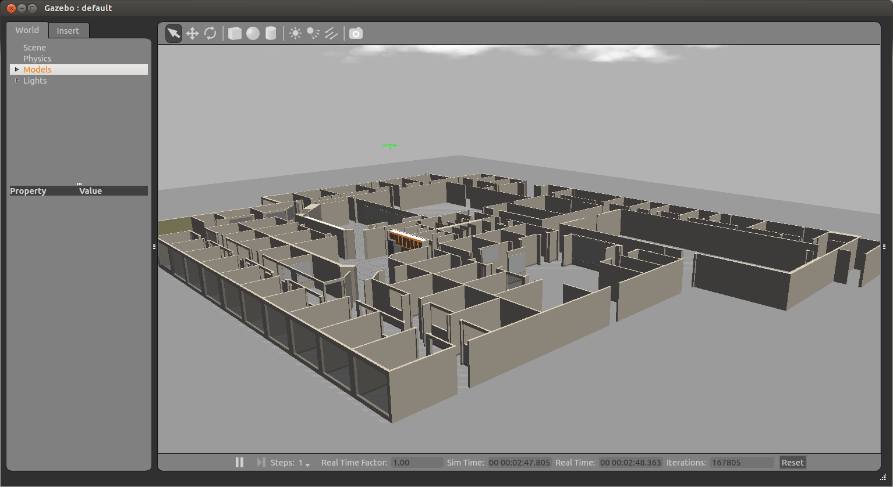
Willow Garage World

Slide 27
Model Files
A model file uses the same SDF format as world files, but contains only a single <model> tag
Once a model file is created, it can be included in a world file using the following SDF syntax:
You can also include any model from the online database and the necessary content will be downloaded at runtime
<include filename="model_file_name"/>

Slide 28
willowgarage Model SDF File
<?xml version="1.0" ?>
<sdf version="1.4">
<model name="willowgarage">
<static>true</static>
<pose>-20 -20 0 0 0 0</pose>
<link name="walls">
<collision name="collision">
<geometry>
<mesh>
<uri>model://willowgarage/meshes/willowgarage_collision.dae</uri>
</mesh>
</geometry>
</collision>
<visual name="visual">
<geometry>
<mesh>
<uri>model://willowgarage/meshes/willowgarage_visual.dae</uri>
</mesh>
</geometry>
<cast_shadows>false</cast_shadows>
</visual>
</link>
</model>
</sdf>

Slide 29
Components of Models
Links: A link contains the physical properties of one body of the model. This can be a wheel, or a link in a joint chain.
Each link may contain many collision, visual and sensor elements
Collision: A collision element encapsulates a geometry that is used to collision checking.
This can be a simple shape (which is preferred), or a triangle mesh (which consumes greater resources).
Visual: A visual element is used to visualize parts of a link.
Inertial: The inertial element describes the dynamic properties of the link, such as mass and rotational inertia matrix.
Sensor: A sensor collects data from the world for use in plugins.
Joints: A joint connects two links.
A parent and child relationship is established along with other parameters such as axis of rotation, and joint limits.
Plugins: A shared library created by a 3D party to control a model.

Slide 30
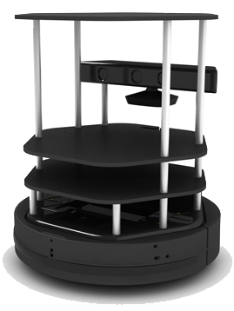
Meet TurtleBot
http://wiki.ros.org/Robots/TurtleBot
A minimalist platform for ROS-based mobile robotics education and prototyping
Has a small differential-drive mobile base
Atop this base is a stack of laser-cut “shelves” that provide space to hold a netbook computer and depth camera and other devices
Does not have a laser scanner
Despite this, mapping and navigation can work quite well for indoor spaces

Slide 31
Turtlebot Simulation
To install Turtlebot simulation stack type:
To launch a simple world with a Turtlebot, type:
$ sudo apt-get install ros-indigo-turtlebot-gazebo ros-indigo-turtlebot-apps ros-indigo-turtlebot-rviz-launchers
$ roslaunch turtlebot_gazebo turtlebot_world.launch

Slide 32
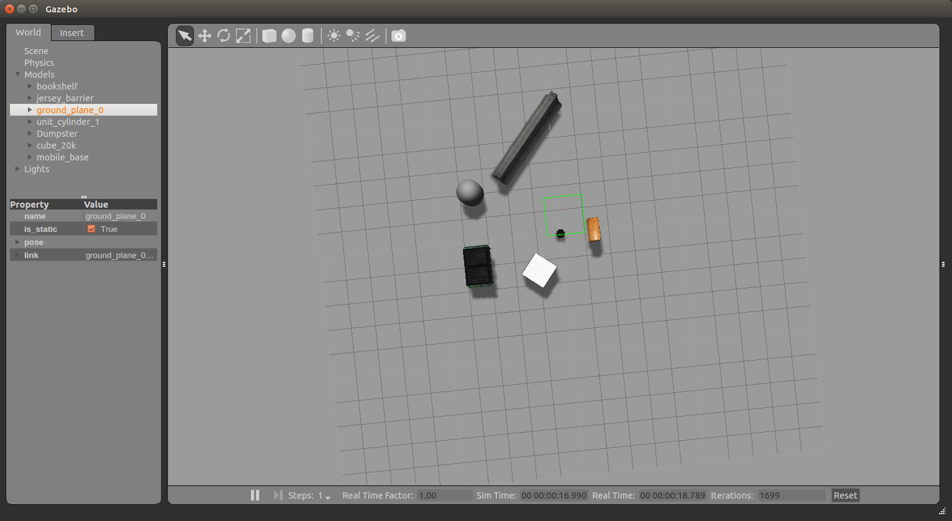
Turtlebot Simulation

Slide 33
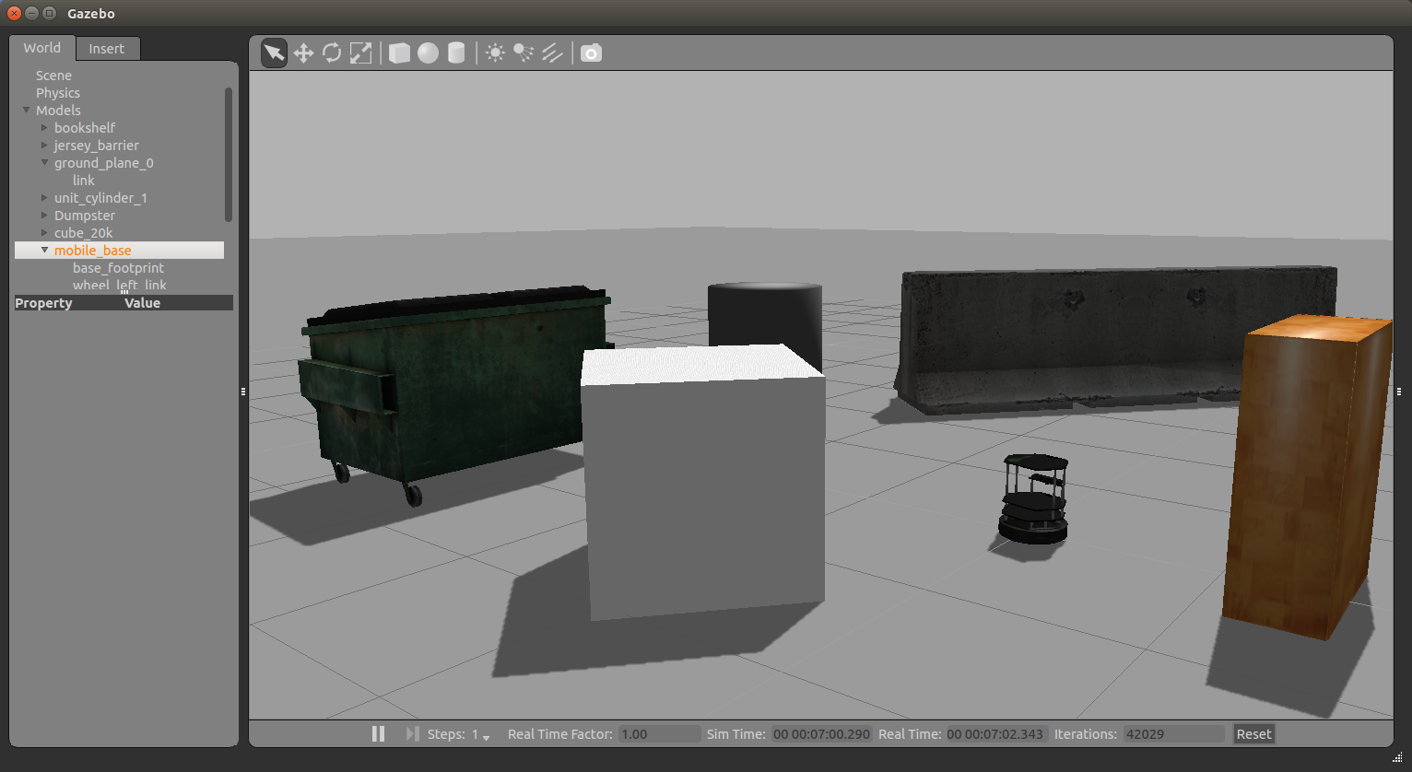
Turtlebot Simulation

Slide 34
Moving Turtlebot with Teleop
Let’s launch the teleop package so we can move it around the environment
Run the following command:
$ roslaunch turtlebot_teleop keyboard_teleop.launch

Slide 35
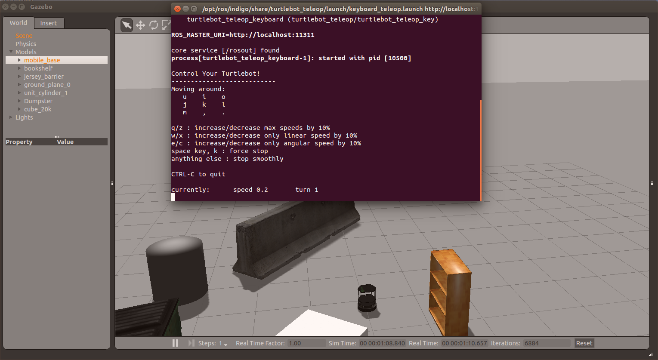
Moving Turtlebot with Teleop

Slide 36
Laser Scan Data
Laser data is published to the topic /base_scan
The message type that used to send information of the laser is sensor_msgs/LaserScan
You can see the structure of the message using
$ rosmsg show sensor_msgs/LaserScan

Slide 37
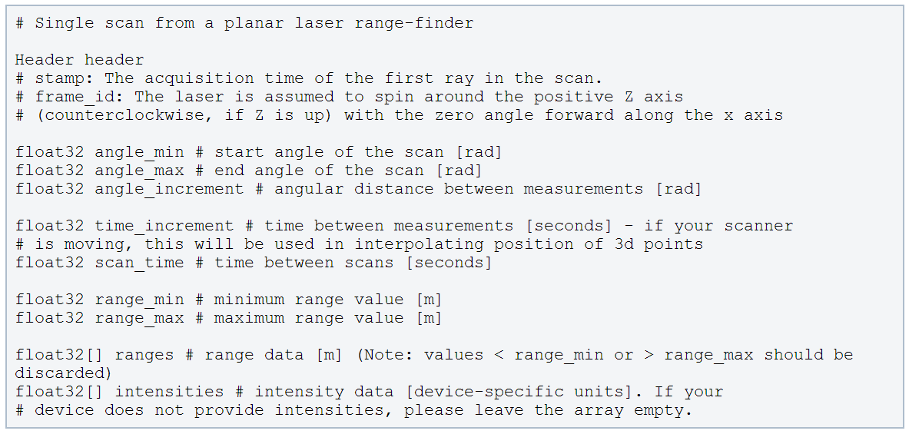
LaserScan Message
http://docs.ros.org/api/sensor_msgs/html/msg/LaserScan.html

Slide 38
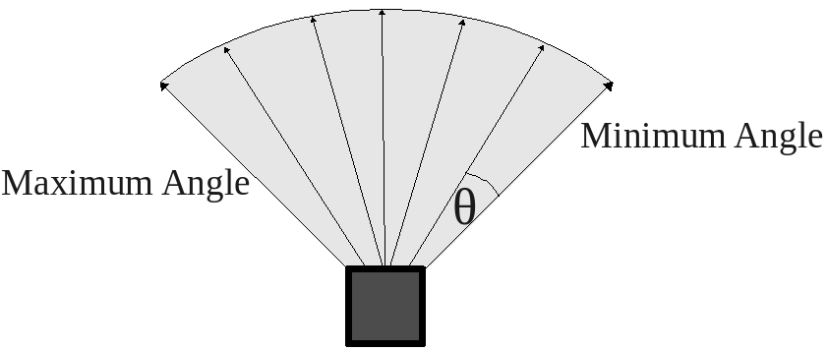
Laser Scanner

Slide 39
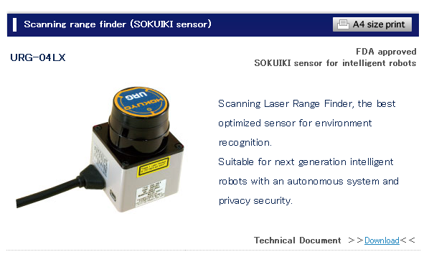
Hokuyo Laser
A common laser sensor used in robotics
http://www.hokuyo-aut.jp/02sensor/07scanner/urg_04lx.html

Slide 40
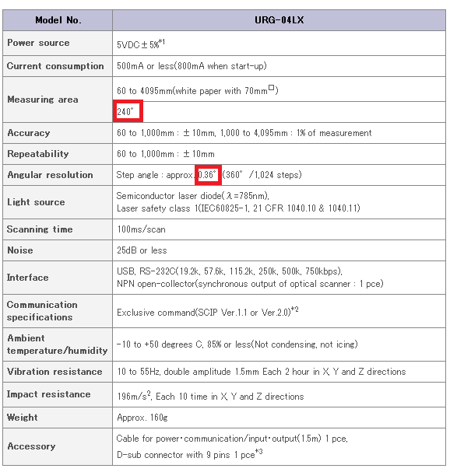
Hokuyo Laser

Slide 41
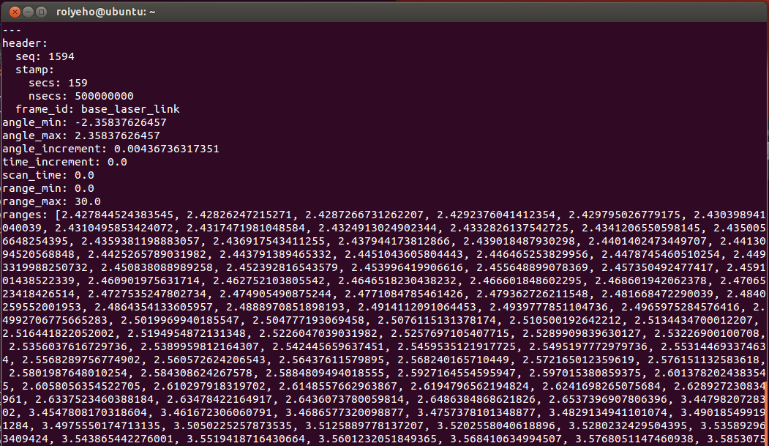
LaserScan Message
Example of a laser scan message from Stage: (rostopic echo /scan –n1)

Slide 42
Depth Image to Laser Scan
TurtleBot doesn’t have a LIDAR by default
However, the image from its depth camera can be used as a laser scan
The node depthimage_to_laserscan takes a depth image and generates a 2D laser scan based on the provided parameters
This node is run automatically when you run the turtlebot simulation in Gazebo
The output range arrays contain NaNs and +-Infs (when the range is less than range_min or larger than range_max)
Comparisons with NaNs always return false

Slide 43
Depth Image to Laser Scan
tutrlebot_world.launch
<launch>
...
<!-- Fake laser -->
<node pkg="nodelet" type="nodelet" name="laserscan_nodelet_manager" args="manager"/>
<node pkg="nodelet" type="nodelet" name="depthimage_to_laserscan"
args="load depthimage_to_laserscan/DepthImageToLaserScanNodelet laserscan_nodelet_manager">
<param name="scan_height" value="10"/>
<param name="output_frame_id" value="/camera_depth_frame"/>
<param name="range_min" value="0.45"/>
<remap from="image" to="/camera/depth/image_raw"/>
<remap from="scan" to="/scan"/>
</node>
</launch>

Slide 44
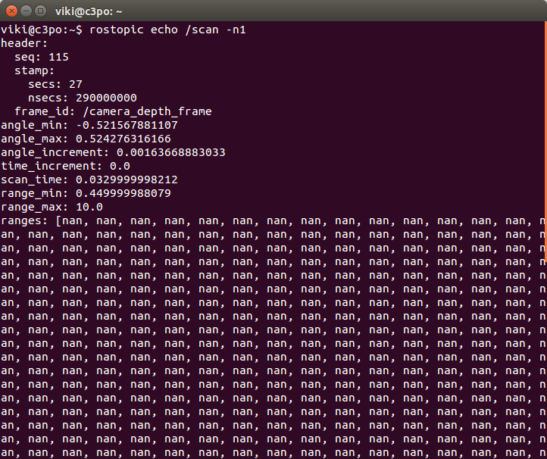
LaserScan Message
Example of a laser scan message from TurtleBot: (rostopic echo /scan –n1)

Slide 45
Wander-bot
We’ll now put all the concepts we’ve learned so far together to create a robot that can wander around its environment
This might not sound terribly earth-shattering, but such a robot is actually capable of doing meaningful work: there is an entire class of tasks that are accomplished by driving across the environment
For example, many vacuuming or other floor-cleaning tasks can be accomplished by cleverly algorithms where the robot, carrying its cleaning tool, traverses its environment somewhat randomly
The robot will eventually drive over all parts of the environment, completing its task

Slide 46
A Stopper Node
We’ll start with a node called stopper that will make the robot move forward until it detects an obstacle in front of it
We will use the laser sensor to detect the obstacle
Create a new package called wander_bot
$ cd ~/catkin_ws/src
$ catkin_create_pkg wander_bot std_msgs rospy roscpp

Slide 47
A Stopper Node
In Eclipse under the package’s src directory add a new class named Stopper
This will create Stopper.h and Stopper.cpp
Add a source file run_stopper.cpp
This will contain the main function

Slide 48
Stopper.h
#include "ros/ros.h"
#include "sensor_msgs/LaserScan.h"
class Stopper {
public:
// Tunable parameters
const static double FORWARD_SPEED = 0.5;
const static double MIN_SCAN_ANGLE = -30.0/180*M_PI;
const static double MAX_SCAN_ANGLE = +30.0/180*M_PI;
const static float MIN_DIST_FROM_OBSTACLE = 0.5; // Should be smaller than sensor_msgs::LaserScan::range_max
Stopper();
void startMoving();
private:
ros::NodeHandle node;
ros::Publisher commandPub; // Publisher to the robot's velocity command topic
ros::Subscriber laserSub; // Subscriber to the robot's laser scan topic
bool keepMoving; // Indicates whether the robot should continue moving
void moveForward();
void scanCallback(const sensor_msgs::LaserScan::ConstPtr& scan);
};

Slide 49
Stopper.cpp (1)
#include "Stopper.h"
#include "geometry_msgs/Twist.h"
Stopper::Stopper()
{
keepMoving = true;
// Advertise a new publisher for the robot's velocity command topic
commandPub = node.advertise<geometry_msgs::Twist>(" /cmd_vel_mux/input/teleop", 10);
// Subscribe to the simulated robot's laser scan topic
laserSub = node.subscribe("scan", 1, &Stopper::scanCallback, this);
}
// Send a velocity command
void Stopper::moveForward() {
geometry_msgs::Twist msg; // The default constructor will set all commands to 0
msg.linear.x = FORWARD_SPEED_MPS;
commandPub.publish(msg);
}

Slide 50
Stopper.cpp (2)
// Process the incoming laser scan message
void Stopper::scanCallback(const sensor_msgs::LaserScan::ConstPtr& scan)
{
bool isObstacleInFront = false;
// Find the closest range between the defined minimum and maximum angles
int minIndex = ceil((MIN_SCAN_ANGLE - scan->angle_min) / scan->angle_increment);
int maxIndex = floor((MAX_SCAN_ANGLE - scan->angle_min) / scan->angle_increment);
for (int currIndex = minIndex + 1; currIndex <= maxIndex; currIndex++) {
if (scan->ranges[currIndex] < MIN_DIST_FROM_OBSTACLE) {
isObstacleInFront = true;
break;
}
}
if (isObstacleInFront) {
ROS_INFO("Stop!");
keepMoving = false;
}
}

Slide 51
Stopper.cpp (3)
void Stopper::startMoving()
{
ros::Rate rate(10);
ROS_INFO("Start moving");
// Keep spinning loop until user presses Ctrl+C or the robot got too close to an obstacle
while (ros::ok() && keepMoving) {
moveForward();
ros::spinOnce(); // Need to call this function often to allow ROS to process incoming messages
rate.sleep();
}
}

Slide 52
run_stopper.cpp
#include "Stopper.h"
int main(int argc, char **argv) {
// Initiate new ROS node named "stopper"
ros::init(argc, argv, "stopper");
// Create new stopper object
Stopper stopper;
// Start the movement
stopper.startMoving();
return 0;
};

Slide 53
CMakeLists.txt
Edit the following lines in CMakeLists.txt:
cmake_minimum_required(VERSION 2.8.3)
project(my_stage)
…
## Declare a cpp executable
add_executable(stopper src/Stopper.cpp src/run_stopper.cpp)
## Specify libraries to link a library or executable target against
target_link_libraries(stopper ${catkin_LIBRARIES})

Slide 54
Launch File
Launch file for launching both Gazebo and the stopper node:
To run the launch file:
<launch>
<param name="/use_sim_time" value="true" />
<!-- Launch turtle bot world -->
<include file="$(find turtlebot_gazebo)/launch/turtlebot_world.launch"/>
<!-- Launch stopper node -->
<node name="stopper" pkg="wander_bot" type="stopper" output="screen"/>
</launch>
$ roslaunch wander_bot stopper.launch

Slide 55
ROS Clock
Normally, ROS client libraries use the computer's system clock as the "wall-clock“
When you are running a simulation or playing back logged data, it is often desirable to instead have the system use a simulated clock so that you can have accelerated, slowed, or stepped control over your system's perceived time
To support this, the ROS client libraries can listen to the /clock topic that is used to publish "simulation time“
For that purpose, set the /use_sim_time parameter to true before the node is initialized

Slide 56
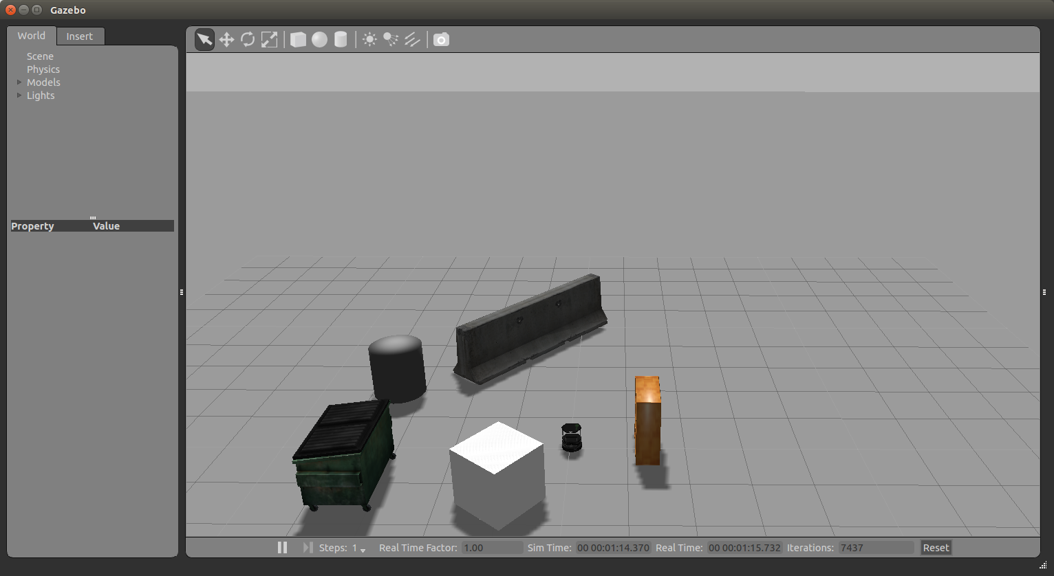
Turtlebot Initial Position

Slide 57
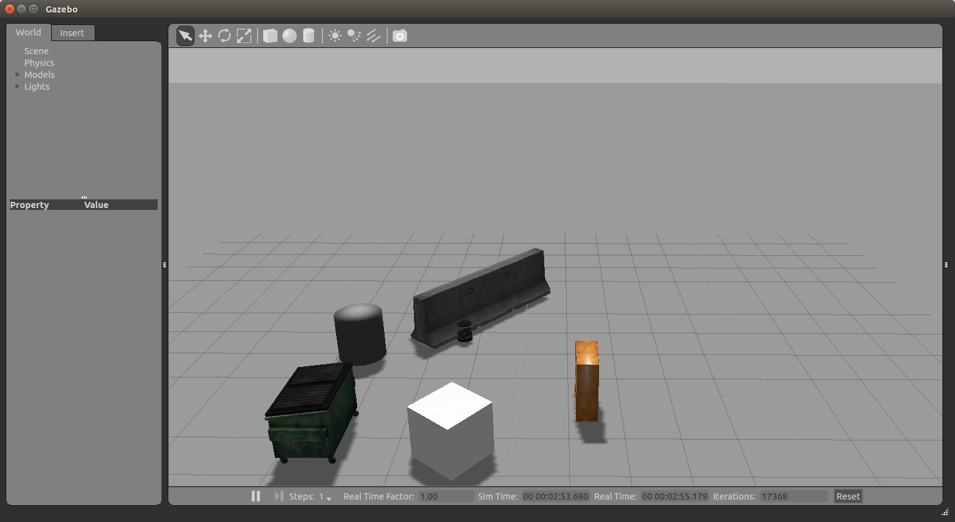
Turtlebot Final Position

Slide 58
Ex. 4 (For Submission)
Implement a simple walker algorithm much like a Roomba robot vaccum cleaner
The robot should move forward until it reaches an obstacle, then rotate in place until the way ahead is clear, then move forward again and repeat
Bonus: rotate the robot in the direction that is more free from obstacles

