Slide 1

ROS – Lecture 5
October 2016
Mapping in ROS
rviz
ROS Services
Lecturer: Roi Yehoshua
roiyeho@gmail.com

Slide 2
Why Mapping?
Building maps is one of the fundamental problems in mobile robotics
Maps allow robots to efficiently carry out their tasks, such as localization, path planning, activity planning, etc.
There are different ways to create a map of the environment

Slide 3
Cellular Decomposition
Decompose free space for path planning
Exact decomposition
Cover the free space exactly
Example: trapezoidal decomposition, meadow map
Approximate decomposition
Represent part of the free space, needed for navigation
Example: grid maps, quadtrees, Voronoi graphs

Slide 4
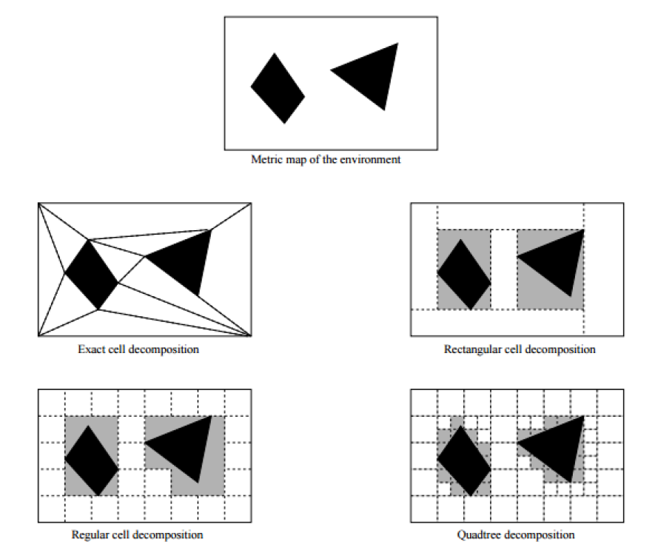
Cellular Decomposition

Slide 5
Occupancy Grid Map (OGM)
Maps the environment as a grid of cells
Cell sizes typically range from 5 to 50 cm
Each cell holds a probability value that the cell is occupied in the range [0,100]
Unknown is indicated by -1
Usually unknown areas are areas that the robot sensors cannot detect (beyond obstacles)

Slide 6
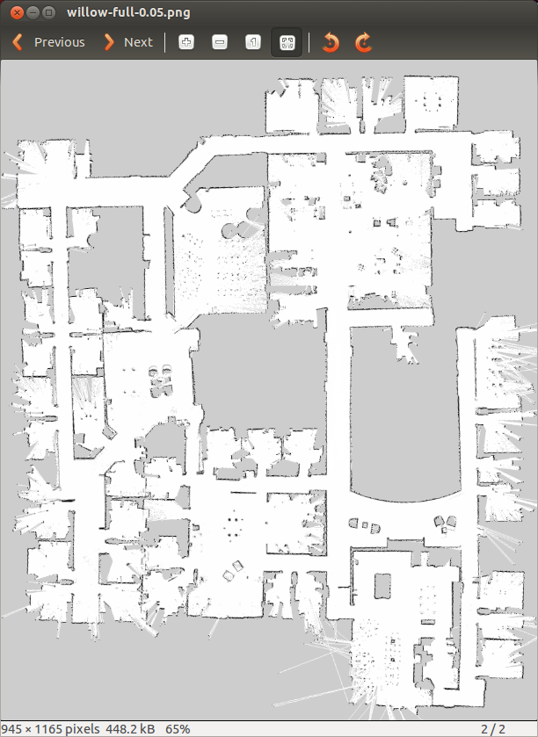
Occupancy Grid Map
White pixels represent free cells
Black pixels represent occupied cells
Gray pixels are in unknown state

Slide 7
Occupancy Grid Maps
Pros:
Simple representation
Speed
Cons:
Not accurate - if an object falls inside a portion of a grid cell, the whole cell is marked occupied
Wasted space

Slide 8
Maps in ROS
Map files are stored as images, with a variety of common formats being supported (such as PNG, JPG, and PGM)
Although color images can be used, they are converted to grayscale images before being interpreted by ROS
Associated with each map is a YAML file that holds additional information about the map

Slide 9
Map YAML File
resolution: Resolution of the map, meters / pixel
origin: 2D pose of the lower-left pixel as (x, y, yaw)
occupied_thresh: Pixels with occupancy probability greater than this threshold are considered completely occupied
free_thresh: Pixels with occupancy probability less than this threshold are considered completely free
image: map.pgm
resolution: 0.050000
origin: [-100.000000, -100.000000, 0.000000]
negate: 0
occupied_thresh: 0.65
free_thresh: 0.196

Slide 10
Editing Map Files
Since maps are represented as image files, you can edit them in your favorite image editor
This allows you to tidy up any maps that you create from sensor data, removing things that shouldn’t be there, or adding in fake obstacles to influence path planning
For example, you can stop the robot from planning paths through certain areas of the map by drawing a line across a corridor you don’t want to the robot to drive through

Slide 11
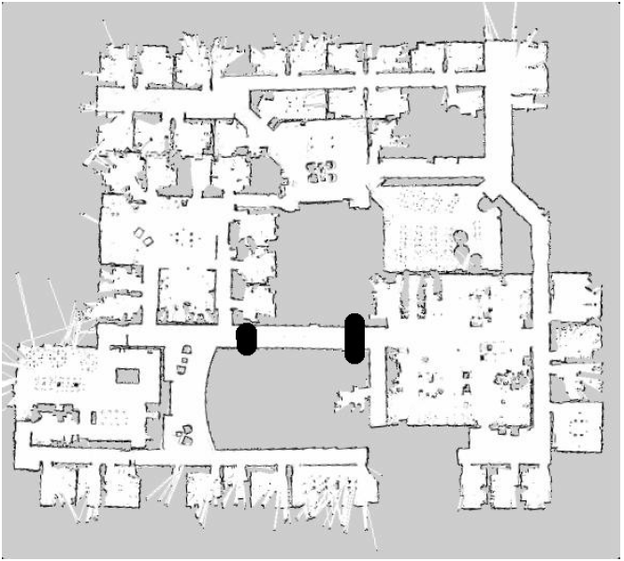
Editing Map Files

Slide 12
SLAM
Simultaneous localization and mapping (SLAM) is a technique used by robots to build up a map within an unknown environment while at the same time keeping track of their current location
A chicken or egg problem: An unbiased map is needed for localization while an accurate pose estimate is needed to build that map

Slide 13
Particle Filter – FastSLAM
Represent probability distribution as a set of discrete particles which occupy the state space
Main steps of the algorithm:
Start with a random distribution of particles
Compare particle’s prediction of measurements with actual measurements
Assign each particle a weight depending on how well its estimate of the state agrees with the measurements
Randomly draw particles from previous distribution based on weights creating a new distribution
Efficient: scales logarithmically with the number of landmarks in the map

Slide 14
Particle Filter

Slide 15
gmapping
http://wiki.ros.org/gmapping
The gmapping package provides laser-based SLAM as a ROS node called slam_gmapping
Uses the FastSLAM algorithm
It takes the laser scans and the odometry and builds a 2D occupancy grid map
It updates the map state while the robot moves
ROS with gmapping video

Slide 16
Install gmapping
gmapping is not part of ROS Indigo installation
To install gmapping run:
You may need to run sudo apt-get update before that to update package repositories list
$ sudo apt-get install ros-indigo-slam-gmapping

Slide 17
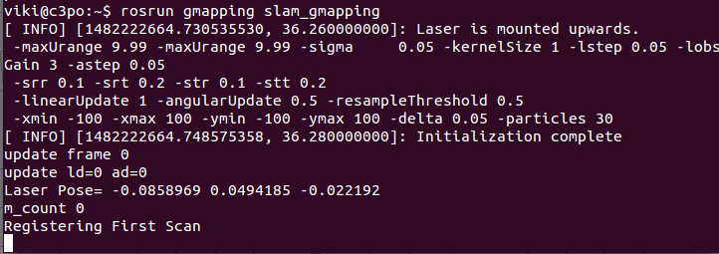
Run gmapping
First launch Gazebo with turtlebot
Now start gmapping in a new terminal window
$ roslaunch turtlebot_gazebo turtlebot_world.launch
$ rosrun gmapping slam_gmapping

Slide 18
Run gmapping
Now move the robot using teleop
Check that the map is published to the topic /map
Message type is nav_msgs/OccupancyGrid
Occupancy is represented as an integer with:
0 meaning completely free
100 meaning completely occupied
the special value -1 for completely unknown
$ roslaunch turtlebot_teleop keyboard_teleop.launch
$ rostopic echo /map -n1

Slide 19
Run gmapping

Slide 20
map_server
map_server allows you to load and save maps
To install the package:
To save dynamically generated maps to a file:
map_saver generates the following files in the current directory:
map.pgm – the map itself
map.yaml – the map’s metadata
$ sudo apt-get install ros-indigo-map-server
$ rosrun map_server map_saver [-f mapname]

Slide 21
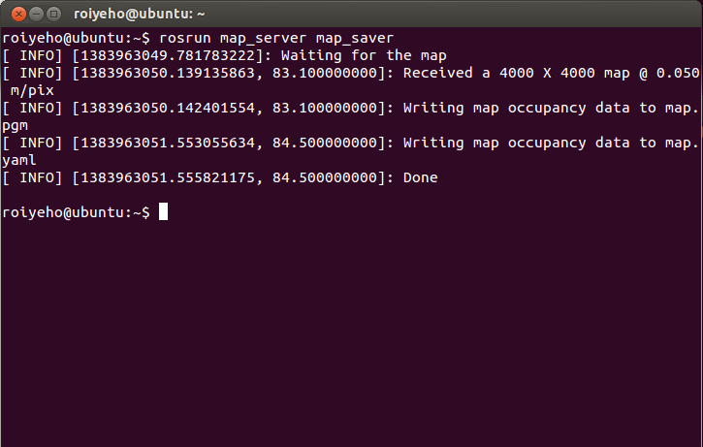
Saving the map using map_server

Slide 22
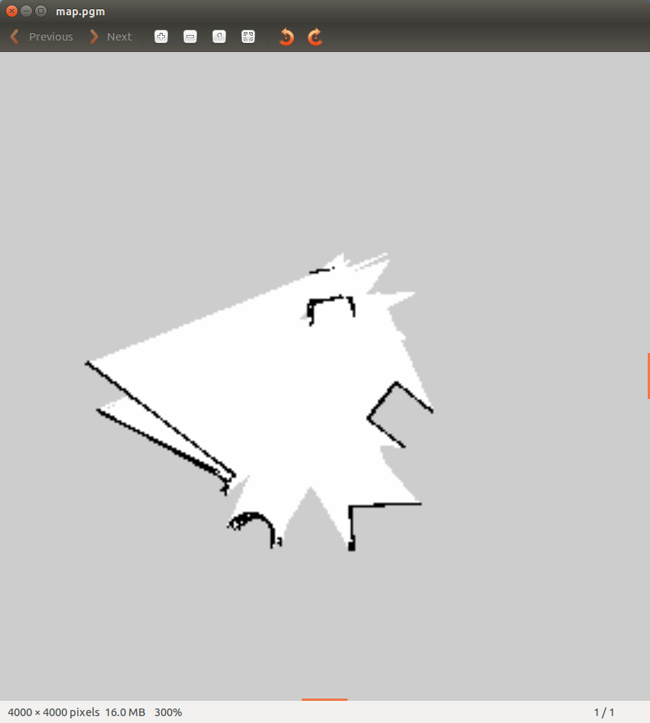
map_server
You can open the pgm file with the default Ubuntu image viewer program (eog)
$ eog map.pgm

Slide 23
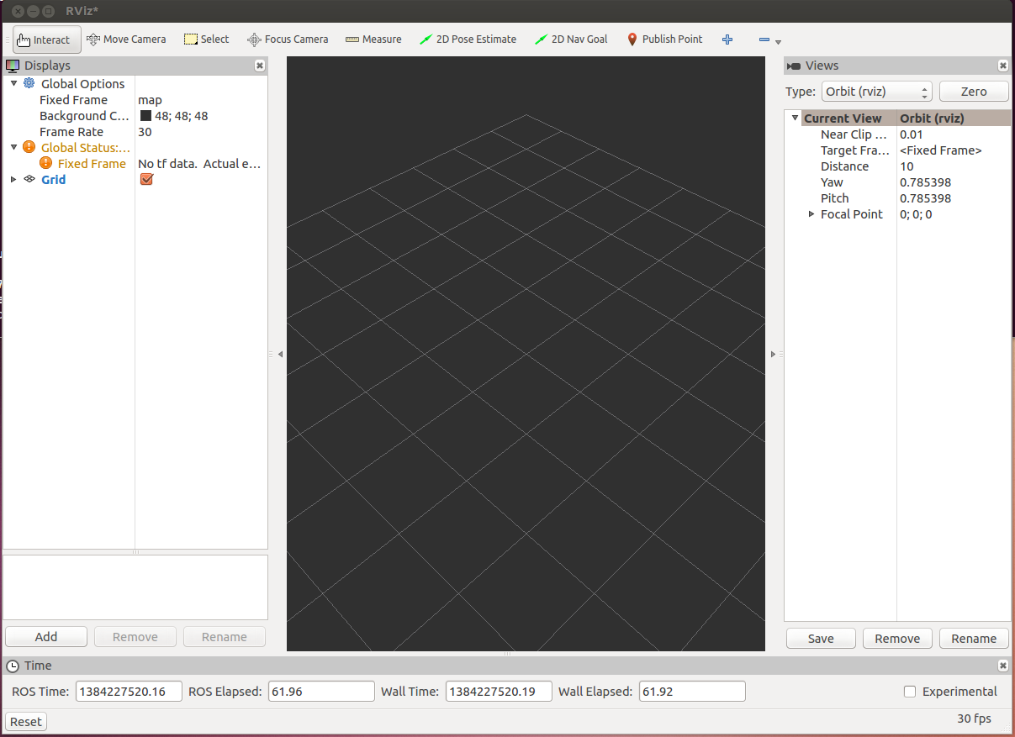
rviz
rviz is a ROS 3D visualization tool that lets you see the world from a robot's perspective
$ rosrun rviz rviz

Slide 24
rviz Useful Commands
Use right mouse button or scroll wheel to zoom in or out
Use the left mouse button to pan (shift-click) or rotate (click)

Slide 25
rviz Displays
The first time you open rviz you will see an empty 3D view
On the left is the Displays area, which contains a list of different elements in the world, that appears in the middle
Right now it just contains global options and grid
Below the Displays area, we have the Add button that allows the addition of more elements

Slide 26
rviz Displays
Messages Used | Description | Display name
 | Displays a set of Axes | Axes
sensor_msgs/JointStates | Shows the effort being put into each revolute joint of a robot. | Effort
sensor_msgs/Image sensor_msgs/CameraInfo | Creates a new rendering window from the perspective of a camera, and overlays the image on top of it. | Camera
 | Displays a 2D or 3D grid along a plane | Grid
nav_msgs/GridCells | Draws cells from a grid, usually obstacles from a costmap from the navigation stack. | Grid Cells
sensor_msgs/Image | Creates a new rendering window with an Image. | Image
sensor_msgs/LaserScan | Shows data from a laser scan, with different options for rendering modes, accumulation, etc. | LaserScan
nav_msgs/OccupancyGrid | Displays a map on the ground plane. | Map

Slide 27
rviz Displays
Messages Used | Description | Display name
visualization_msgs/Marker visualization_msgs/MarkerArray | Allows programmers to display arbitrary primitive shapes through a topic | Markers
nav_msgs/Path | Shows a path from the navigation stack. | Path
geometry_msgs/PoseStamped | Draws a pose as either an arrow or axes | Pose
sensor_msgs/PointCloud sensor_msgs/PointCloud2 | Shows data from a point cloud, with different options for rendering modes, accumulation, etc. | Point Cloud(2)
nav_msgs/Odometry | Accumulates odometry poses from over time. | Odometry
sensor_msgs/Range | Displays cones representing range measurements from sonar or IR range sensors. | Range
 | Shows a visual representation of a robot in the correct pose (as defined by the current TF transforms). | RobotModel
 | Displays the tf transform hierarchy. | TF

Slide 28
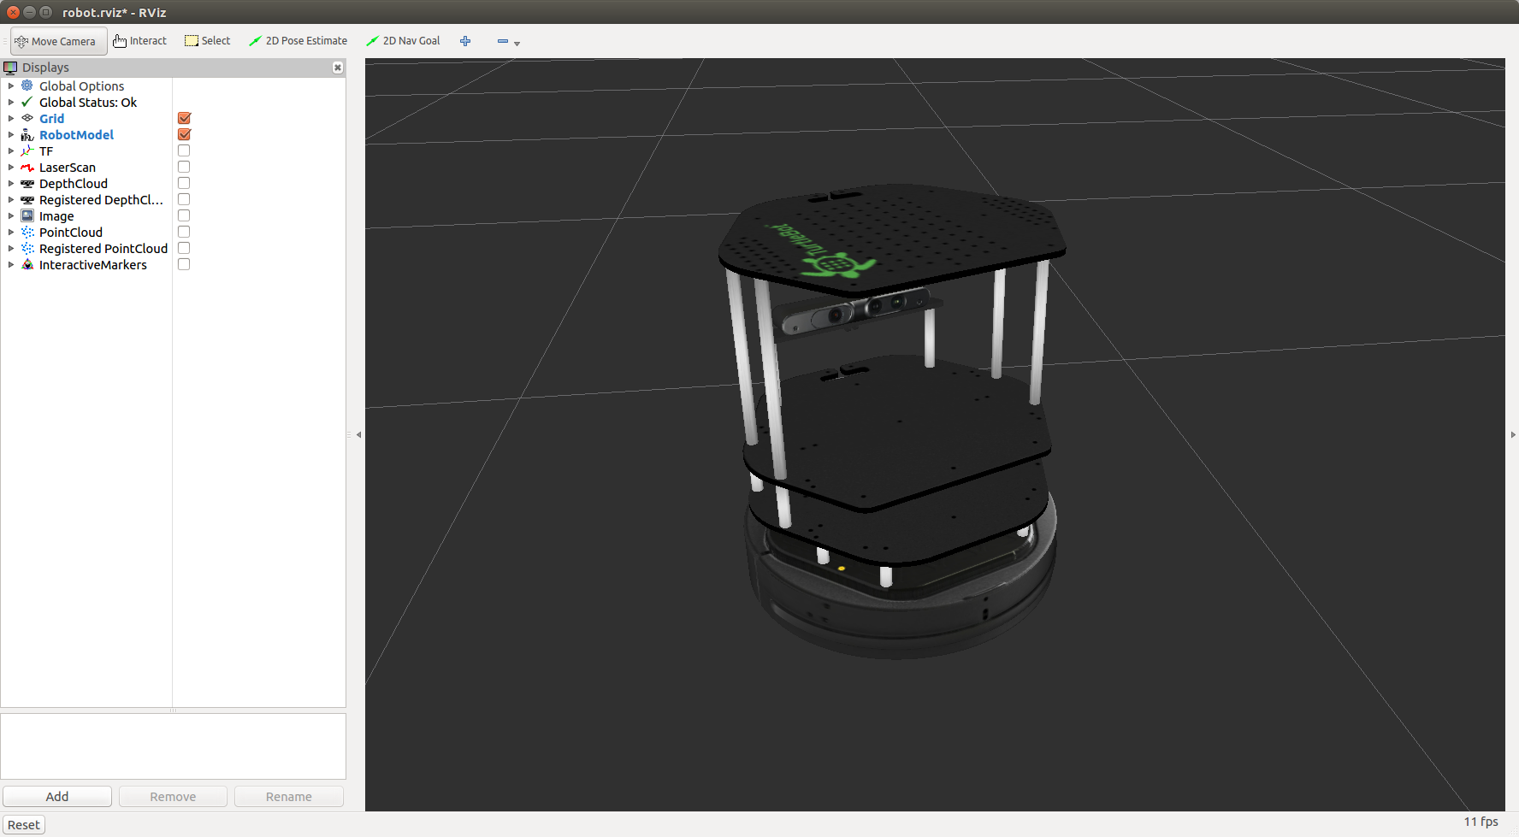
rviz with TurtleBot
You can start rviz already configured to visualize the robot and its sensor's output:
$ roslaunch turtlebot_rviz_launchers view_robot.launch

Slide 29
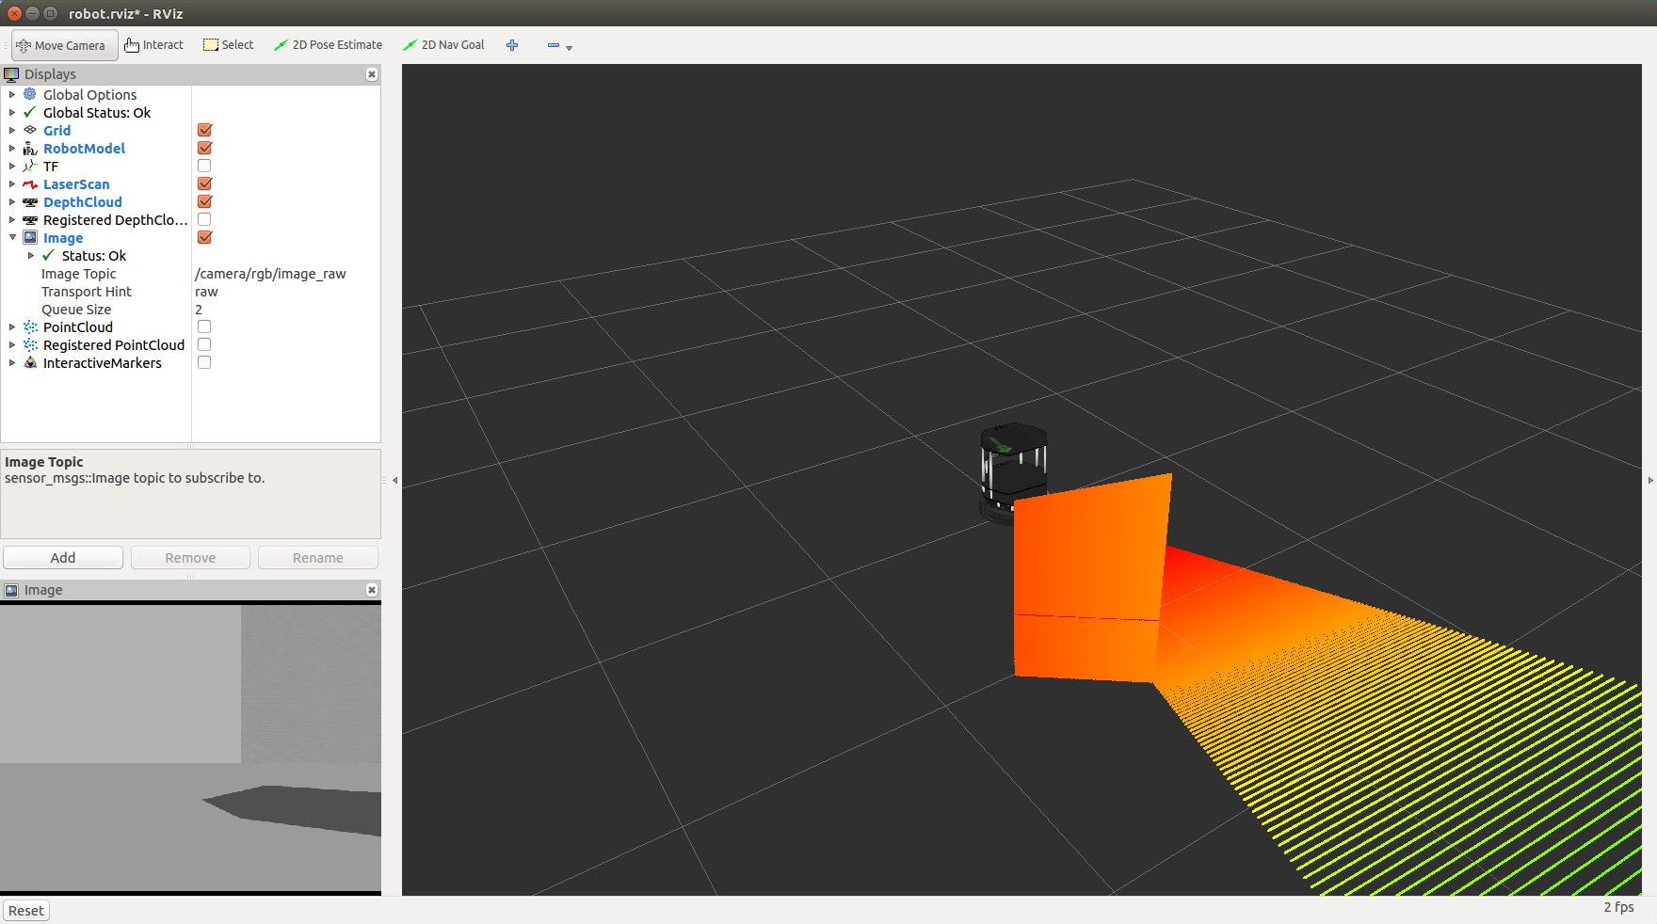
TurtleBot Image Display
To visualize any display you want, just click on its check button

Slide 30
Map Display
Add the Map display
Set the topic to /map
Now you will be able to watch the mapping progress in rviz

Slide 31
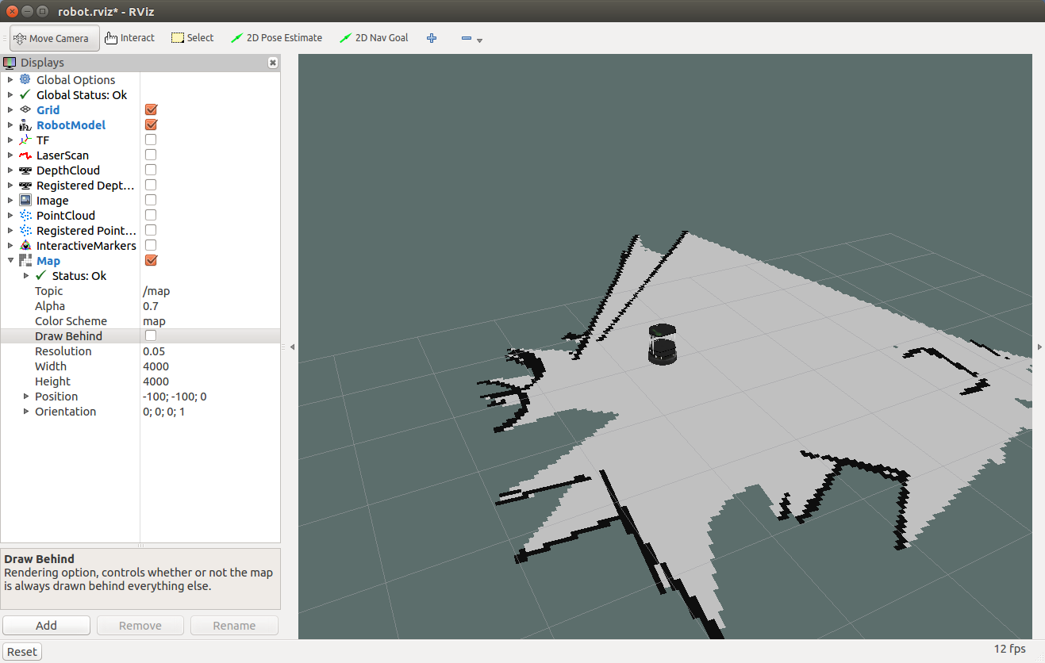
Map Display

Slide 32
Loading and Saving Configuration
You can save your rviz settings by choosing File > Save Config from the menu
Your settings will be saved to a .rviz file
Then, you can start rviz with your saved configuration:
$ rosrun rviz rviz -d my_config.rviz

Slide 33
Launch File for gmapping
<launch>
<!-- Run Gazebo with turtlebot -->
<include file="$(find turtlebot_gazebo)/launch/turtlebot_world.launch"/>
<!-- Run gmapping -->
<node name="gmapping" pkg="gmapping" type="slam_gmapping"/>
<!-- Open rviz -->
<include file="$(find turtlebot_rviz_launchers)/launch/view_robot.launch"/>
</launch>

Slide 34
Loading an Existing Map
Now instead of running gmapping, we will load the existing Turtlebot’s playground map
The map_server node in map_server package allows you to load existing maps
Takes as arguments the path to the map file and the map resolution (if not specified in the YAML file)

Slide 35
Loading an Existing Map
Now instead of running gmapping, we will learn how to load an existing map
The map_server node in map_server package allows you to load existing maps
Takes as arguments the path to the map file and the map resolution (if not specified in the YAML file)
Let’s load Turtlbot’s playground map and display it in rviz

Slide 36
Loading an Existing Map
<launch>
<!-- Run Gazebo with turtlebot -->
<include file="$(find turtlebot_gazebo)/launch/turtlebot_world.launch"/>
<!-- Load existing map -->
<node name="map_server" pkg="map_server" type="map_server" args="$(find turtlebot_gazebo)/maps/playground.yaml" />
<!-- Open rviz -->
<include file="$(find turtlebot_rviz_launchers)/launch/view_robot.launch"/>
</launch>

Slide 37
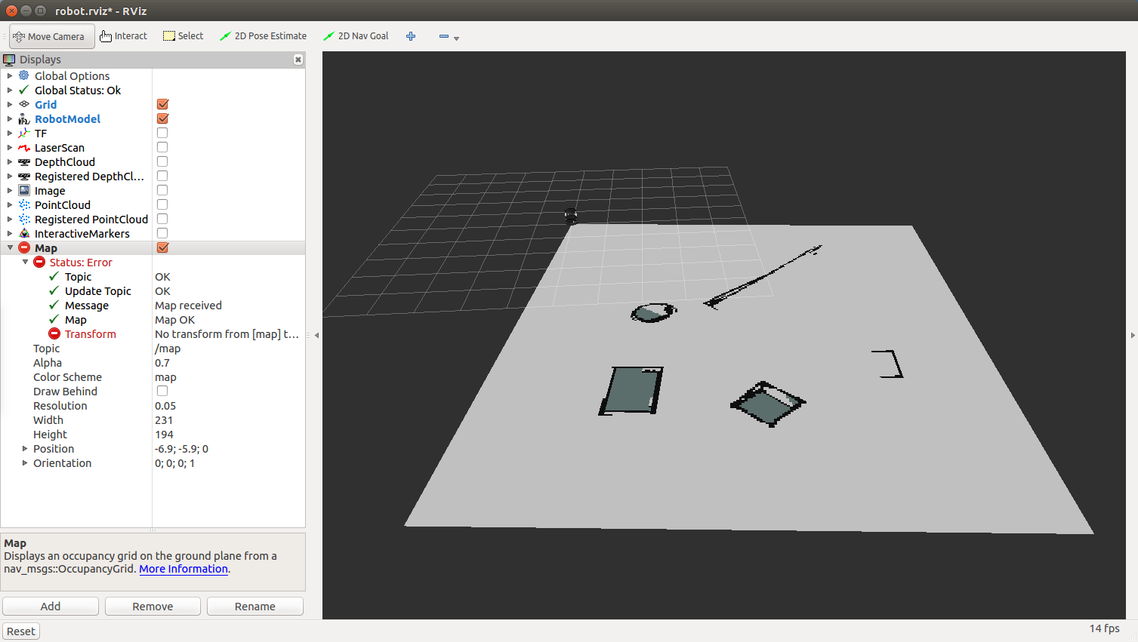
Loading an Existing Map

Slide 38
Loading an Existing Map
<launch>
<!-- Run Gazebo with turtlebot -->
<include file="$(find turtlebot_gazebo)/launch/turtlebot_world.launch"/>
<!-- Load existing map -->
<node name="map_server" pkg="map_server" type="map_server" args="$(find turtlebot_gazebo)/maps/playground.yaml" />
<!-- Open rviz -->
<include file="$(find turtlebot_rviz_launchers)/launch/view_robot.launch"/>
</launch>

Slide 39
Loading an Existing Map
Note that the robot doesn’t know its location relative to the map, that’s why rviz doesn’t show its location properly
In the next lesson we will learn how to provide this information to the robot
To fix this problem meanwhile we will add a static transform from /map to /odom (will be explained next lesson)

Slide 40
Loading an Existing Map
<launch>
<!-- Run Gazebo with turtlebot -->
<include file="$(find turtlebot_gazebo)/launch/turtlebot_world.launch"/>
<!-- Load existing map -->
<node name="map_server" pkg="map_server" type="map_server" args="$(find turtlebot_gazebo)/maps/playground.yaml" />
<!-- Publish a static transformation between /odom and /map -->
<node name="tf" pkg="tf" type="static_transform_publisher" args="0 0 0 0 0 0 /map /odom 100" />
<!-- Open rviz -->
<include file="$(find turtlebot_rviz_launchers)/launch/view_robot.launch"/>
</launch>

Slide 41
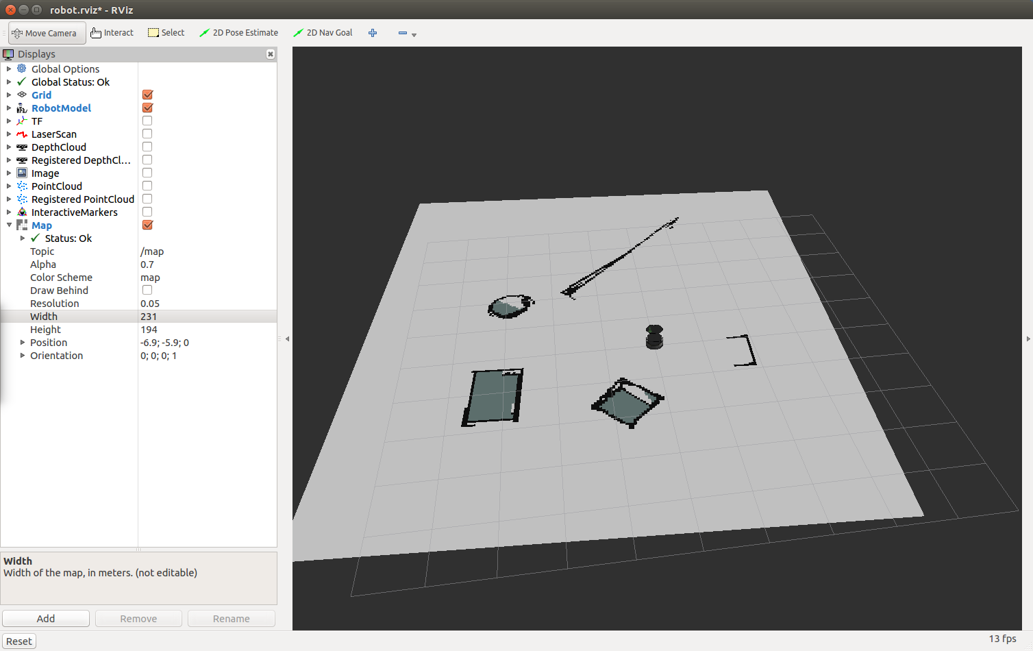
Loading an Existing Map

Slide 42
ROS Services
The next step is to learn how to load the map into the memory in our own code
So we can use it to plan a path for the robot
For that purpose we will use a ROS service called static_map provided by the map_server node

Slide 43
ROS Services
Services are just synchronous remote procedure calls
They allow one node to call a function that executes in another node
We define the inputs and outputs of this function similarly to the way we define new message types
The server (which provides the service) specifies a callback to deal with the service request, and advertises the service.
The client (which calls the service) then accesses this service through a local proxy

Slide 44
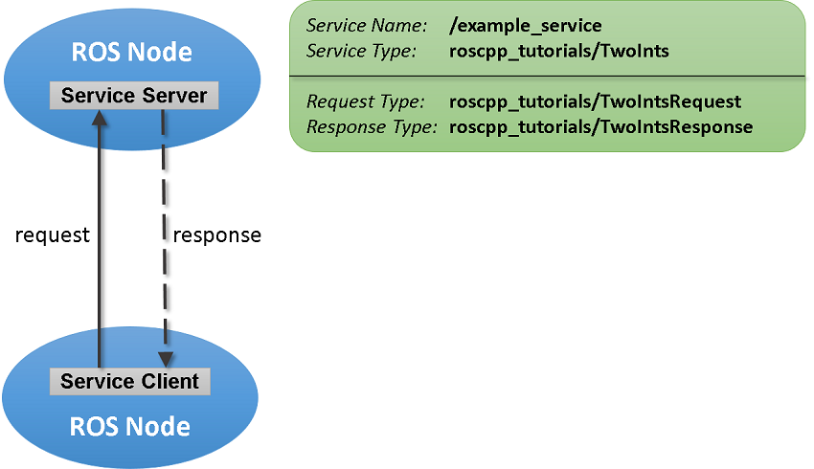
ROS Services

Slide 45
Using a Service
To call a service programmatically:
ros::NodeHandle nh;
ros::ServiceClient client = nh.serviceClient<my_package::Foo>("my_service_name");
my_package::Foo foo;
foo.request.<var> = <value>;
...
if (client.call(foo)) {
...
}
Service calls are blocking
If the service call succeeded, call() will return true and the value in srv.response will be valid
If the call did not succeed, call() will return false and the value in srv.response will be invalid

Slide 46
static_map Service
To get the OGM in a ROS node you can call the service static_map
This service gets no arguments and returns a message of type nav_msgs/OccupancyGrid
The message consists of two main structures:
MapMetaData – metdata of the map, contains:
resolution – map resolution in m/cell
width – number of cells in the y axis
height – number of cells in the x axis
int8[] data – the map’s data

Slide 47
Loading a Map in C++ (1)
#include <ros/ros.h>
#include <nav_msgs/GetMap.h>
#include <vector>
using namespace std;
// grid map
int rows;
int cols;
double mapResolution;
vector<vector<bool> > grid;
bool requestMap(ros::NodeHandle &nh);
void readMap(const nav_msgs::OccupancyGrid& msg);
void printGridToFile();

Slide 48
Loading a Map in C++ (2)
int main(int argc, char** argv)
{
ros::init(argc, argv, "mapping");
ros::NodeHandle nh;
if (!requestMap(nh))
exit(-1);
printGridToFile();
return 0;
}

Slide 49
Loading a Map in C++ (3)
bool requestMap(ros::NodeHandle &nh)
{
nav_msgs::GetMap::Request req;
nav_msgs::GetMap::Response res;
while (!ros::service::waitForService("static_map", ros::Duration(3.0))) {
ROS_INFO("Waiting for service static_map to become available");
}
ROS_INFO("Requesting the map...");
ros::ServiceClient mapClient = nh.serviceClient<nav_msgs::GetMap>("static_map");
if (mapClient.call(req, res)) {
readMap(res.map);
return true;
}
else {
ROS_ERROR("Failed to call map service");
return false;
}
}

Slide 50
Loading a Map in C++ (4)
void readMap(const nav_msgs::OccupancyGrid& map)
{
ROS_INFO("Received a %d X %d map @ %.3f m/px\n",
map.info.width,
map.info.height,
map.info.resolution);
rows = map.info.height;
cols = map.info.width;
mapResolution = map.info.resolution;
// Dynamically resize the grid
grid.resize(rows);
for (int i = 0; i < rows; i++) {
grid[i].resize(cols);
}
int currCell = 0;
for (int i = 0; i < rows; i++) {
for (int j = 0; j < cols; j++) {
if (map.data[currCell] == 0) // unoccupied cell
grid[i][j] = false;
else
grid[i][j] = true; // occupied (100) or unknown cell (-1)
currCell++;
}
}
}

Slide 51
Loading a Map in C++ (5)
void printGridToFile() {
ofstream gridFile;
gridFile.open("grid.txt");
for (int i = grid.size() - 1; i >= 0; i--) {
for (int j = 0; j < grid[0].size(); j++) {
gridFile << (grid[i][j] ? "1" : "0");
}
gridFile << endl;
}
gridFile.close();
}

Slide 52
Launch File
<launch>
<!-- Run Gazebo with turtlebot -->
<include file="$(find turtlebot_gazebo)/launch/turtlebot_world.launch"/>
<!-- Load existing map -->
<node name="map_server" pkg="map_server" type="map_server" args="$(find turtlebot_gazebo)/maps/playground.yaml" />
<!-- Publish a static transformation between /odom and /map -->
<node name="tf" pkg="tf" type="static_transform_publisher" args="0 0 0 0 0 0 /map /odom 100" />
<!-- Open rviz -->
<include file="$(find turtlebot_rviz_launchers)/launch/view_robot.launch"/>
<!-- Run load_map node -->
<node name="load_map" pkg="mapping" type="load_map" output="screen" cwd="node" />
</launch>

Slide 53
Output File
If you want to write the output file to the directory your node is running from, you can use the “cwd” attribute in the <node> tag
The default behavior is to use $ROS_HOME directory.
In our example, grid.txt will be written to ~/catkin_ws/devel/lib/mapping

Slide 54
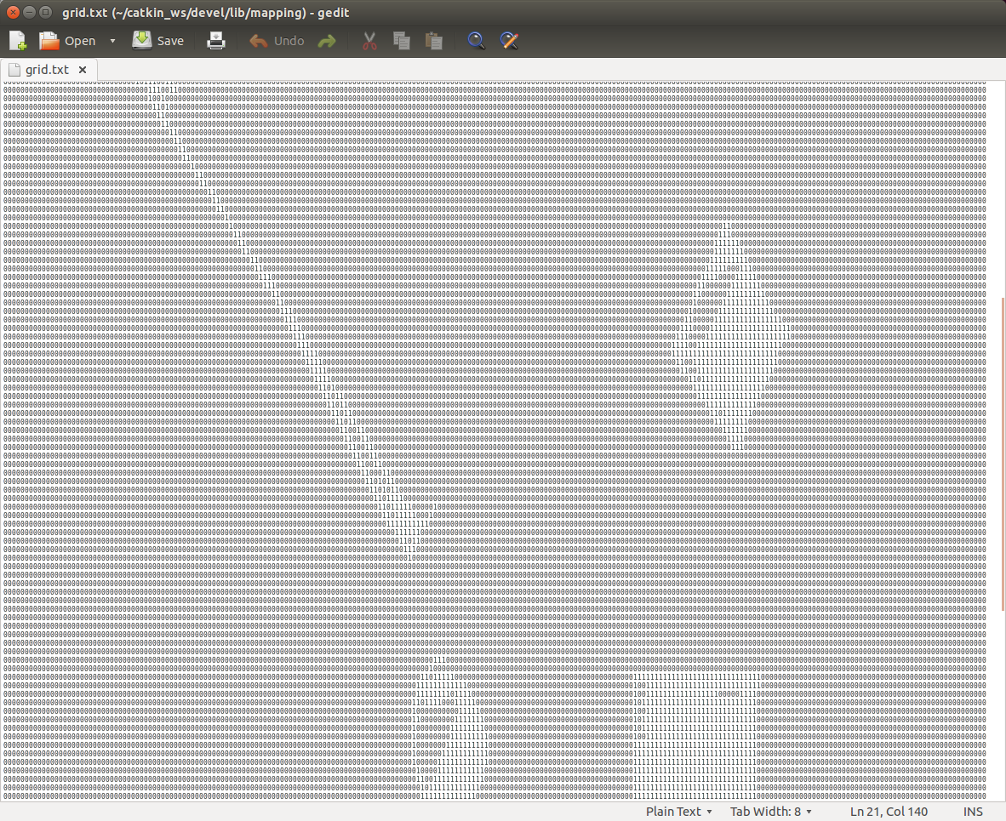
Loading a Map

Slide 55
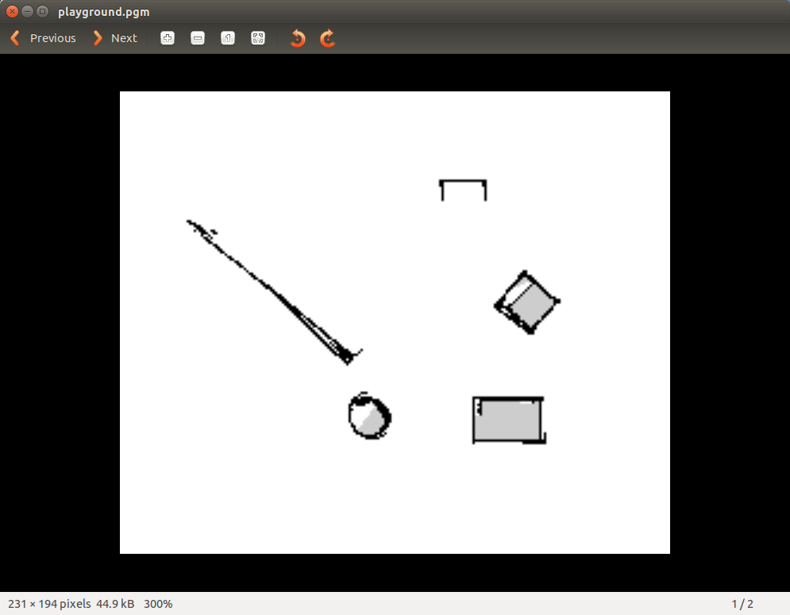
Ex. 5
Load playground.pgm map from turtlebot_gazebo/maps into memory
Inflate the obstacles in the map, so that the robot will not get too close to the obstacles
Save the inflated map into a new file by publishing the new map to /map topic and using map_saver

