Slide 1

ROS – Lecture 6
October 2016
ROS tf system
Get robot’s location on map
Lecturer: Roi Yehoshua
roiyeho@gmail.com

Slide 2
What is tf?
A robotic system typically has many coordinate frames that change over time, such as a world frame, base frame, gripper frame, head frame, etc.
tf is a transformation system that allows making computations in one frame and then transforming them to another at any desired point in time
tf allows you to ask questions like:
What is the current pose of the base frame of the robot in the map frame?
What is the pose of the object in my gripper relative to my base?
Where was the head frame relative to the world frame, 5 seconds ago?

Slide 3
Pros of tf
Distributed system – no single point of failure
No data loss when transforming multiple times
No computational cost of intermediate data transformations between coordinate frames
The user does not need to worry about which frame their data started
Information about past locations is also stored and accessible (after local recording was started)

Slide 4
tf Nodes
There are two types of tf nodes:
Publishers – publish transforms between coordinate frames on /tf
Listeners – listen to /tf and cache all data heard up to cache limit

Slide 5
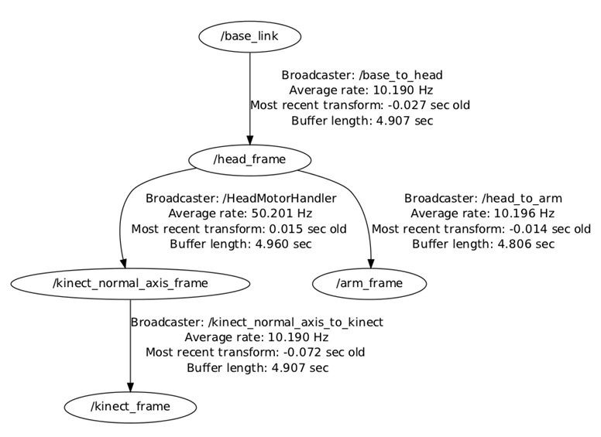
Transform Tree
TF builds a tree of transforms between frames
Can support multiple disconnected trees
Transforms only work within the same tree

Slide 6
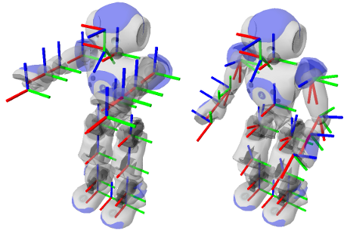
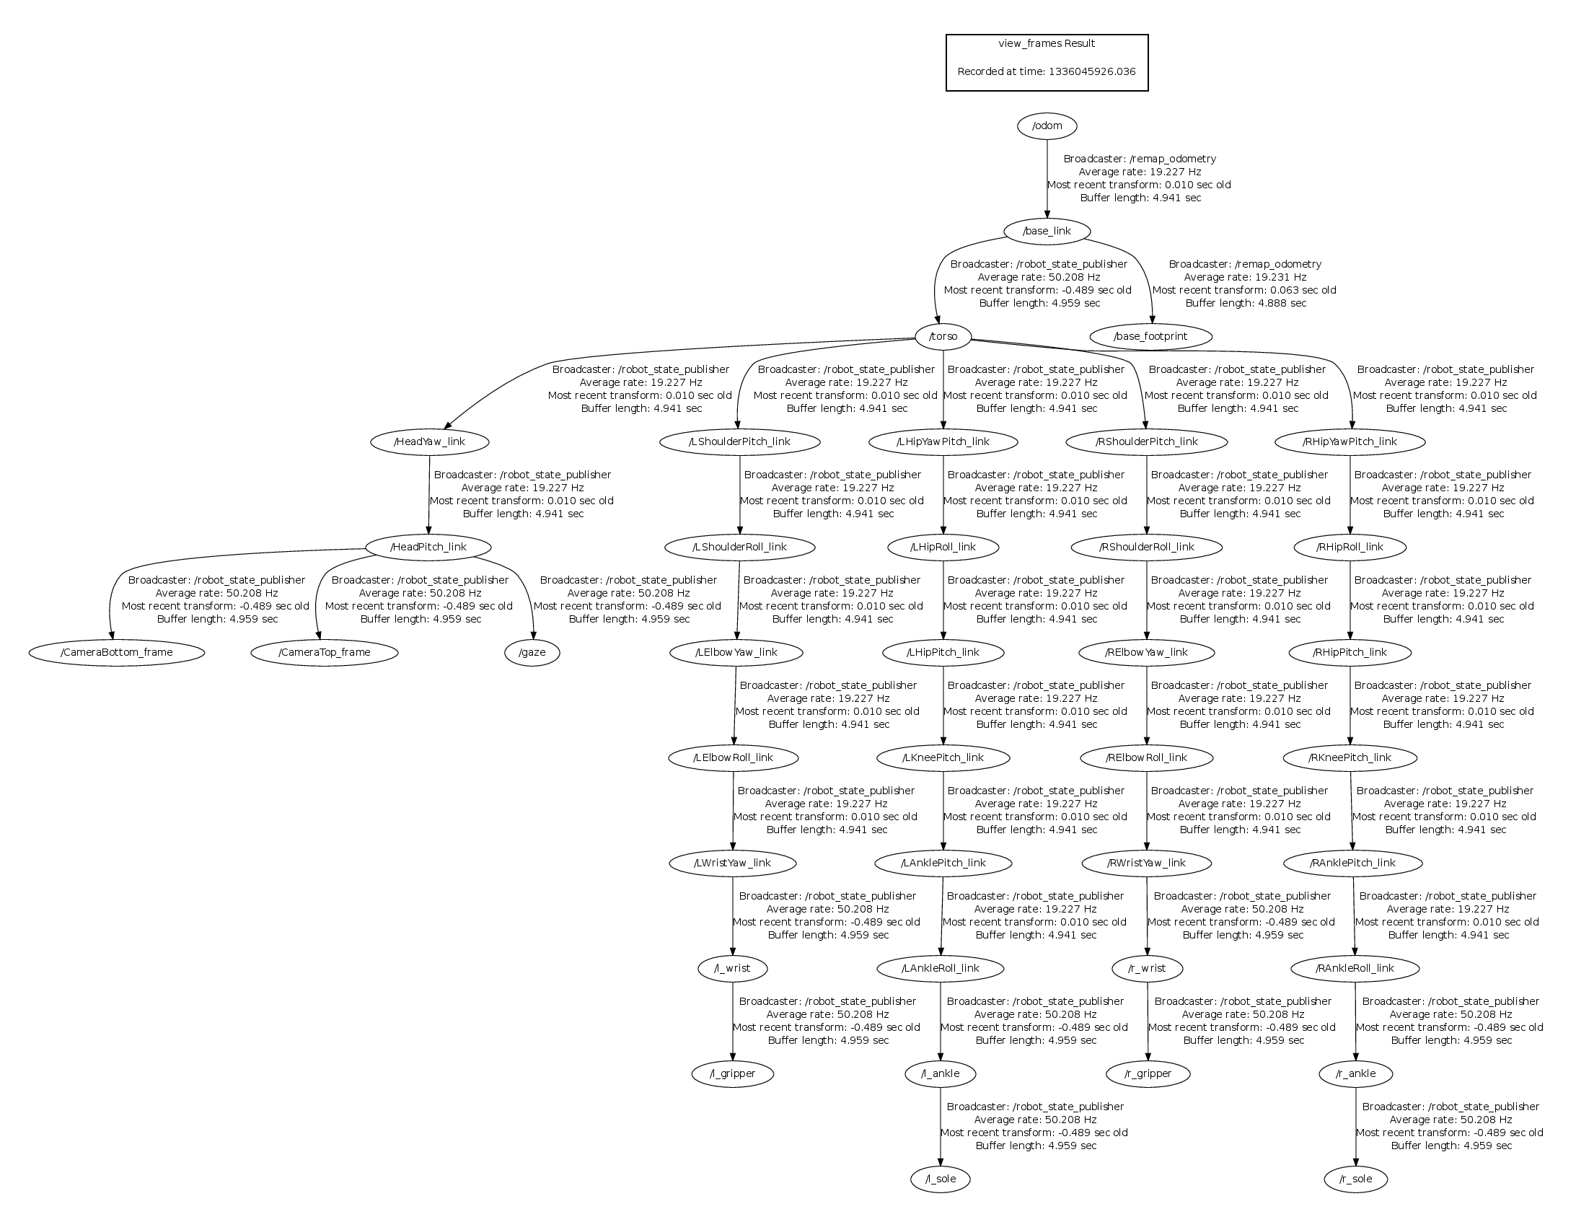
Transform Tree Example
Nao’s TF tree

Slide 7
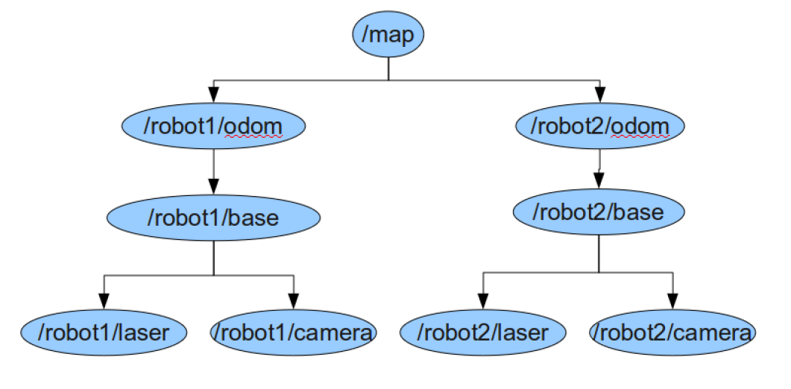
How To Use the TF Tree
Given the following TF tree, let’s say we want robot2 to navigate based on the laser data of robot1

Slide 8
How To Use the TF Tree
Inverse Transform
Forward Transform

Slide 9
tf Demo
Launch the turtle_tf_demo by typing:
In another terminal run the turtle_tf_listener
Now you should see a window with two turtles where one follows the other
You can drive the center turtle around in the turtlesim using the keyboard arrow keys
$ roslaunch turtle_tf turtle_tf_demo.launch
$ rosrun turtle_tf turtle_tf_listener
$ rosrun turtlesim turtle_teleop_key

Slide 10
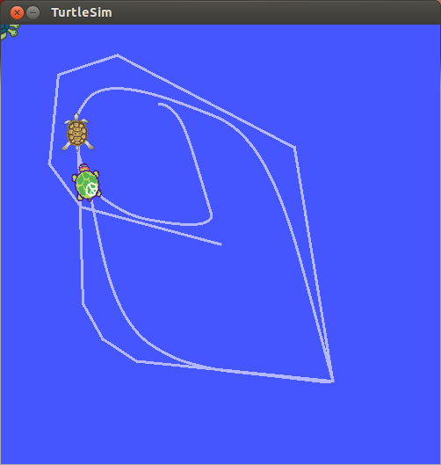
tf Demo

Slide 11
tf Demo
This demo is using the tf library to create three coordinate frames: a world frame, a turtle1 frame, and a turtle2 frame.
A tf broadcaster publishes the turtle coordinate frames and a tf listener computes the distance between the turtle frames to follow the other turtle

Slide 12
tf Command-line Tools
view_frames: visualizes the full tree of coordinate transforms
tf_monitor: monitors transforms between frames
tf_echo: prints specified transform to screen
roswtf: with the tfwtf plugin, helps you track down problems with tf
static_transform_publisher is a command line tool for sending static transforms

Slide 13
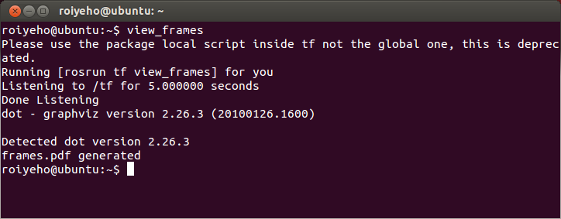
view_frames
view_frames creates a diagram of the frames being broadcast by tf over ROS
To view the tree write:
$ evince frames.pdf

Slide 14
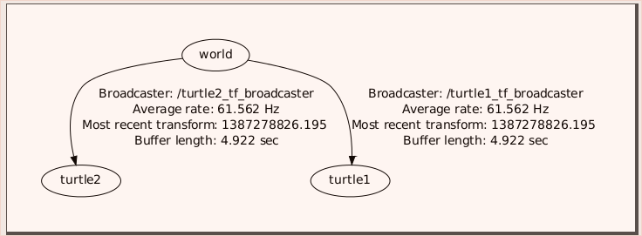
view_frames
The TF tree:

Slide 15
tf_echo
tf_echo reports the transform between any two frames broadcast over ROS
Usage:
Let's look at the transform of the turtle2 frame with respect to turtle1 frame which is equivalent to: T_{turtle1_turtle2} = T_{turtle1_world} * T_{world_turtle2}
$ rosrun tf tf_echo [reference_frame] [target_frame]
$ rosrun tf tf_echo turtle1 turtle2

Slide 16
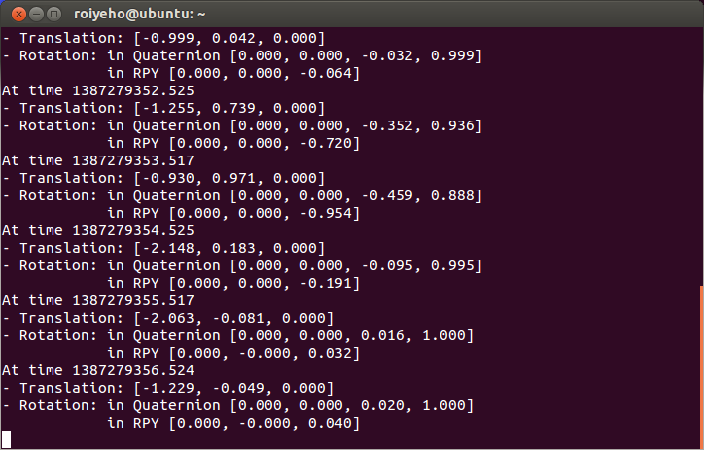
tf_echo
As you drive your turtle around you will see the transform change as the two turtles move relative to each other

Slide 17
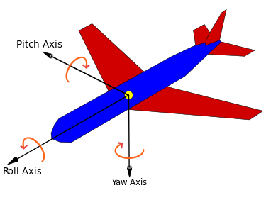
Rotation Representation
There are many ways to represent rotations:
Euler angles yaw, pitch, and roll about Z, Y, X axes respectively
Rotation matrix
Quaternions

Slide 18
Quaternions
In mathematics, quaternions are a number system that extends the complex numbers
The fundamental formula for quaternion multiplication (Hamilton, 1843):
Quaternions find uses in both theoretical and applied mathematics, in particular for calculations involving 3D rotations such as in computers graphics and computer vision
i² = j² = k² = ijk = −1

Slide 19

Quaternions and Spatial Rotation
Any rotation in 3D can be represented as a combination of a vector u (the Euler axis) and a scalar θ (the rotation angle)
A rotation with an angle of rotation θ around the axis defined by the unit vector
is represented by

Slide 20
Quaternions and Spatial Rotation
Quaternions give a simple way to encode this axis–angle representation in 4 numbers
Can apply the corresponding rotation to a position vector using a simple formula
http://en.wikipedia.org/wiki/Quaternions_and_spatial_rotation
Advantages of using quaternions:
Nonsingular representation
there are 24 different possibilities to specify Euler angles
More compact (and faster) than matrices.

Slide 21
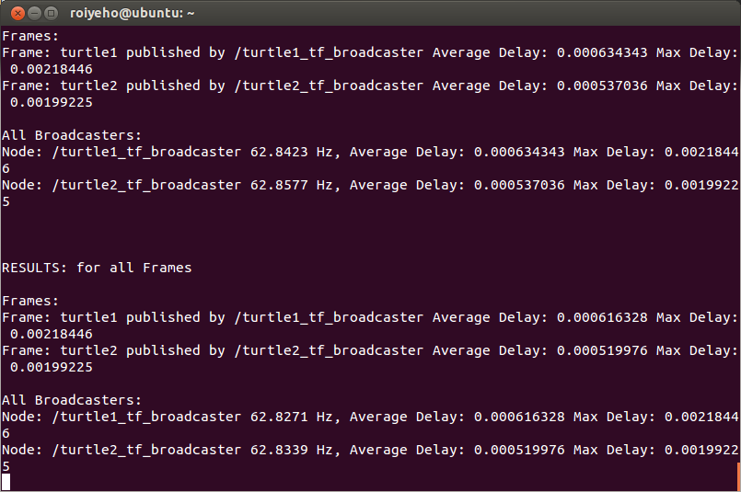
tf_monitor
Print information about the current coordinate transform tree to console
$ rosrun tf tf_monitor

Slide 22
rviz and tf
Let's look at our turtle frames using rviz
Start rviz with the turtle_tf configuration file using the -d option for rviz:
On the left side bar you will see the frames broadcast by tf
Note that the fixed frame is /world
The fixed frame is assumed not to be moving over time
As you drive the turtle around you will see the frames change in rviz
$ rosrun rviz rviz -d `rospack find turtle_tf`/rviz/turtle_rviz.rviz

Slide 23
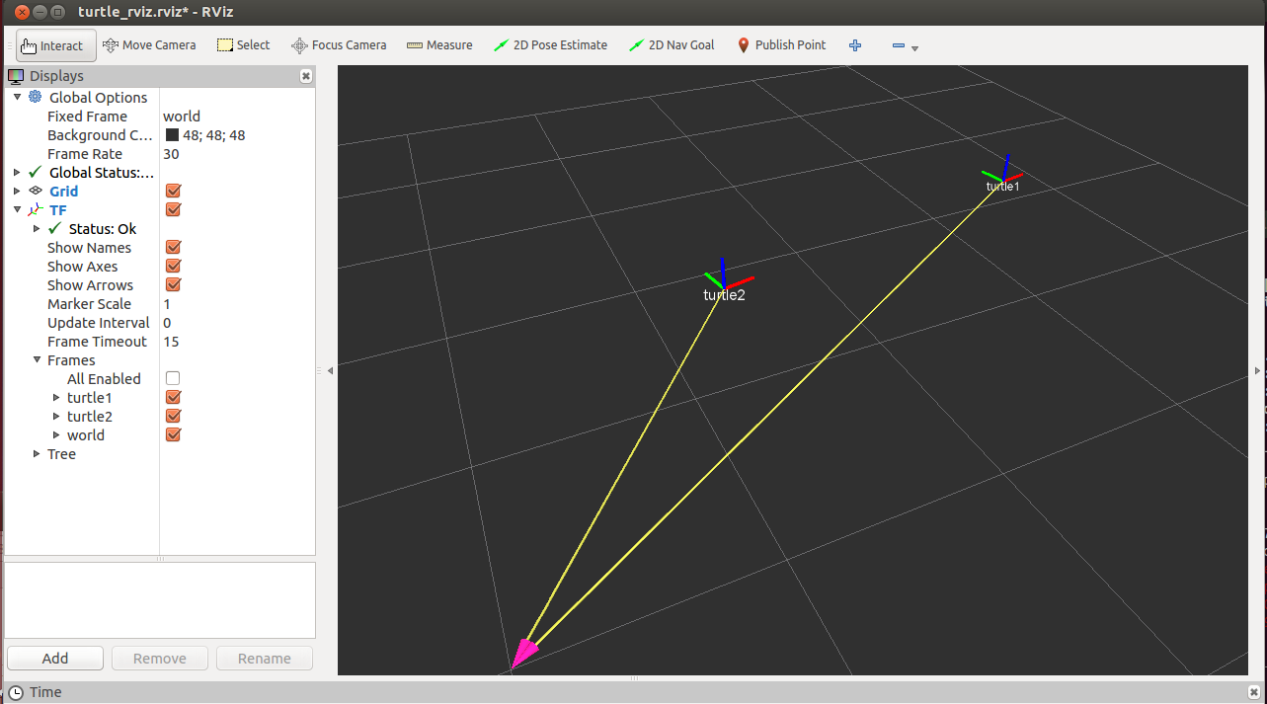
rviz and tf

Slide 24
Broadcasting Transforms
A tf broadcaster sends out the relative pose of coordinate frames to the rest of the system
A system can have many broadcasters, each provides information about a different part of the robot
We will now write the code to reproduce the tf demo

Slide 25
Writing a tf broadcaster
First create a new package called tf_demo that depends on tf, roscpp, rospy and turtlesim
Build the package by calling catkin_make
Open the package in Eclipse and add a new source file called tf_broadcaster.cpp
$ cd ~/catkin_ws/src
$ catkin_create_pkg tf_demo tf roscpp rospy turtlesim

Slide 26
tf_broadcaster.cpp (1)
#include <ros/ros.h>
#include <tf/transform_broadcaster.h>
#include <turtlesim/Pose.h>
std::string turtle_name;
void poseCallback(const turtlesim::PoseConstPtr& msg)
{
static tf::TransformBroadcaster br;
tf::Transform transform;
transform.setOrigin(tf::Vector3(msg->x, msg->y, 0.0));
tf::Quaternion quaternion;
transform.setRotation(tf::createQuaternionFromYaw(msg->theta));
br.sendTransform(tf::StampedTransform(transform, ros::Time::now(), "world", turtle_name));
}

Slide 27
tf_broadcaster.cpp (2)
int main(int argc, char** argv){
ros::init(argc, argv, "my_tf_broadcaster");
if (argc != 2) {
ROS_ERROR("need turtle name as argument");
return -1;
};
turtle_name = argv[1];
ros::NodeHandle node;
ros::Subscriber sub = node.subscribe(turtle_name + "/pose", 10, &poseCallback);
ros::spin();
return 0;
};

Slide 28
Sending Transforms
Sending a transform with a TransformBroadcaster requires 4 arguments:
The transform object
A timestamp, usually we can just stamp it with the current time, ros::Time::now()
The name of the parent frame of the link we're creating, in this case "world"
The name of the child frame of the link we're creating, in this case this is the name of the turtle itself
br.sendTransform(tf::StampedTransform(transform, ros::Time::now(), "world", turtle_name));

Slide 29
Running the Broadcaster
Create tf_demo.launch in the /launch subfolder
Run the launch file
<launch>
<!-- Turtlesim Node-->
<node pkg="turtlesim" type="turtlesim_node" name="sim"/>
<node pkg="turtlesim" type="turtle_teleop_key" name="teleop" output="screen"/>
<!-- tf broadcaster node -->
<node pkg="tf_demo" type="turtle_tf_broadcaster"
args="/turtle1" name="turtle1_tf_broadcaster" />
</launch>
$ cd ~/catkin_ws/src
$ roslaunch tf_demo tf_demo.launch

Slide 30
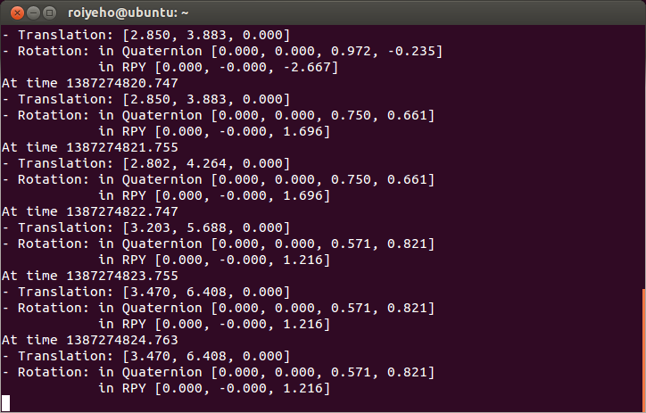
Checking the Results
Use the tf_echo tool to check if the turtle pose is actually getting broadcast to tf:
$ rosrun tf tf_echo /world /turtle1

Slide 31
Writing a tf listener
A tf listener receives and buffers all coordinate frames that are broadcasted in the system, and queries for specific transforms between frames
Next we'll create a tf listener that will listen to the transformations coming from the tf broadcaster
Add tf_listener.cpp to your project with the following code

Slide 32
tf_listener.cpp (1)
#include <ros/ros.h>
#include <tf/transform_listener.h>
#include <turtlesim/Spawn.h>
#include <geometry_msgs/Twist.h>
int main(int argc, char** argv) {
ros::init(argc, argv, "my_tf_listener");
ros::NodeHandle node;
ros::service::waitForService("spawn");
ros::ServiceClient add_turtle =
node.serviceClient<turtlesim::Spawn>("spawn");
turtlesim::Spawn srv;
add_turtle.call(srv);
ros::Publisher turtle_vel =
node.advertise<geometry_msgs::Twist>("turtle2/cmd_vel", 10);
tf::TransformListener listener;
ros::Rate rate(10.0);

Slide 33
tf_listener.cpp (2)
while (node.ok()) {
tf::StampedTransform transform;
try {
listener.waitForTransform("/turtle2", "/turtle1", ros::Time(0), ros::Duration(10.0));
listener.lookupTransform("/turtle2", "/turtle1", ros::Time(0), transform);
} catch (tf::TransformException ex) {
ROS_ERROR("%s",ex.what());
}
geometry_msgs::Twist vel_msg;
vel_msg.angular.z = 4 * atan2(transform.getOrigin().y(),
transform.getOrigin().x());
vel_msg.linear.x = 0.5 * sqrt(pow(transform.getOrigin().x(), 2) +
pow(transform.getOrigin().y(), 2));
turtle_vel.publish(vel_msg);
rate.sleep();
}
return 0;
};

Slide 34
Creating a TransformListener
To use the TransformListener, we need to include the tf/transform_listener.h header file
Once the listener is created, it starts receiving tf transformations over the wire, and buffers them for up to 10 seconds
The TransformListener object should be scoped to persist otherwise its cache will be unable to fill and almost every query will fail
A common method is to make the TransformListener object a member variable of a class

Slide 35
Core Methods of TransformListener
LookupTransform()
Get the transform between two coordinate frames
WaitForTransform()
Block until timeout or transform is available
CanTransform()
Test if a transform is possible between to coordinate frames

Slide 36
lookupTransform
To query the listener for a specific transformation, you need to pass 4 arguments:
We want the transform from this frame ...
... to this frame.
The time at which we want to transform. Providing ros::Time(0) will get us the latest available transform.
The object in which we store the resulting transform.
listener.lookupTransform("/turtle2", "/turtle1", ros::Time(0), transform);

Slide 37
Running the Listener
Add the following lines to CMakeLists.txt
Build the package by calling catkin_make
add_executable(tf_listener src/tf_listener.cpp)
target_link_libraries(tf_listener
${catkin_LIBRARIES}
)

Slide 38
Launch File
Add the following lines to tf_demo.launch
<launch>
<!-- Turtlesim Node-->
<node pkg="turtlesim" type="turtlesim_node" name="sim"/>
<node pkg="turtlesim" type="turtle_teleop_key" name="teleop" output="screen"/>
<!-- tf broadcaster node -->
<node pkg="tf_demo" type="tf_broadcaster"
args="/turtle1" name="turtle1_tf_broadcaster" />
<!-- Second broadcaster node -->
<node pkg="tf_demo" type="tf_broadcaster"
args="/turtle2" name="turtle2_tf_broadcaster" />
<!-- tf listener node -->
<node pkg="tf_demo" type="tf_listener" name="listener" />
</launch>

Slide 39
Check the Results
To see if things work, simply drive around the first turtle using the arrow keys (make sure your terminal window is active, not your simulator window), and you'll see the second turtle following the first one!

Slide 40
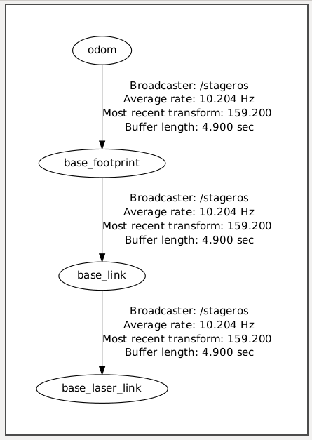
Typical TF Frames
odom – the self consistent coordinate frame using the odometry measurements only
base_footprint – the base of the robot at zero height above the ground
base_link – the base link of the robot, placed at the rotational center of the robot
base_laser_link – the location of the laser sensor

Slide 41
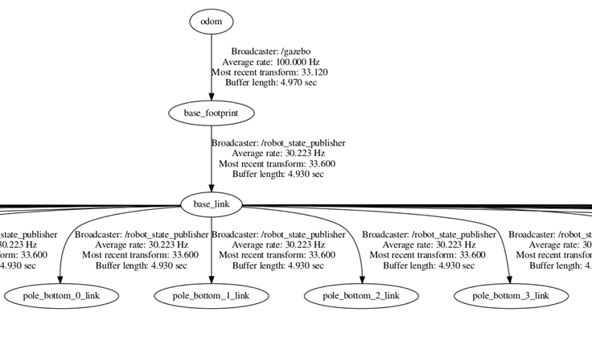
Turtlebot TF Frames

Slide 42
Find Robot Location
We’ll now see an example how to use tf to determine the robot's current location in the world
First, we would like to change the TurtleBot initial location in Gazebo (default is x=0,y=0)
You can change the initial location in by setting the environment variable ROBOT_INITIAL_POSE, e.g.:
To get robot’s location in its own coordinate frame (i.e., relative to its starting location on the map) create a TF listener from the /base_footprint to the /odom frame
$ export ROBOT_INITIAL_POSE="-x -1 -y -2"

Slide 43
robot_location.cpp (1)
#include <ros/ros.h>
#include <tf/transform_listener.h>
using namespace std;
int main(int argc, char** argv){
ros::init(argc, argv, "robot_location");
ros::NodeHandle node;
tf::TransformListener listener;
ros::Rate rate(2.0);
listener.waitForTransform("/odom", "/base_footprint", ros::Time(0), ros::Duration(10.0));

Slide 44
robot_location.cpp (2)
while (ros::ok()){
tf::StampedTransform transform;
try {
listener.lookupTransform("/odom", "/base_footprint", ros::Time(0), transform);
double x = transform.getOrigin().x();
double y = transform.getOrigin().y();
cout << "Current position: (" << x << "," << y << ")" << endl;
} catch (tf::TransformException &ex) {
ROS_ERROR("%s",ex.what());
}
rate.sleep();
}
return 0;
}

Slide 45
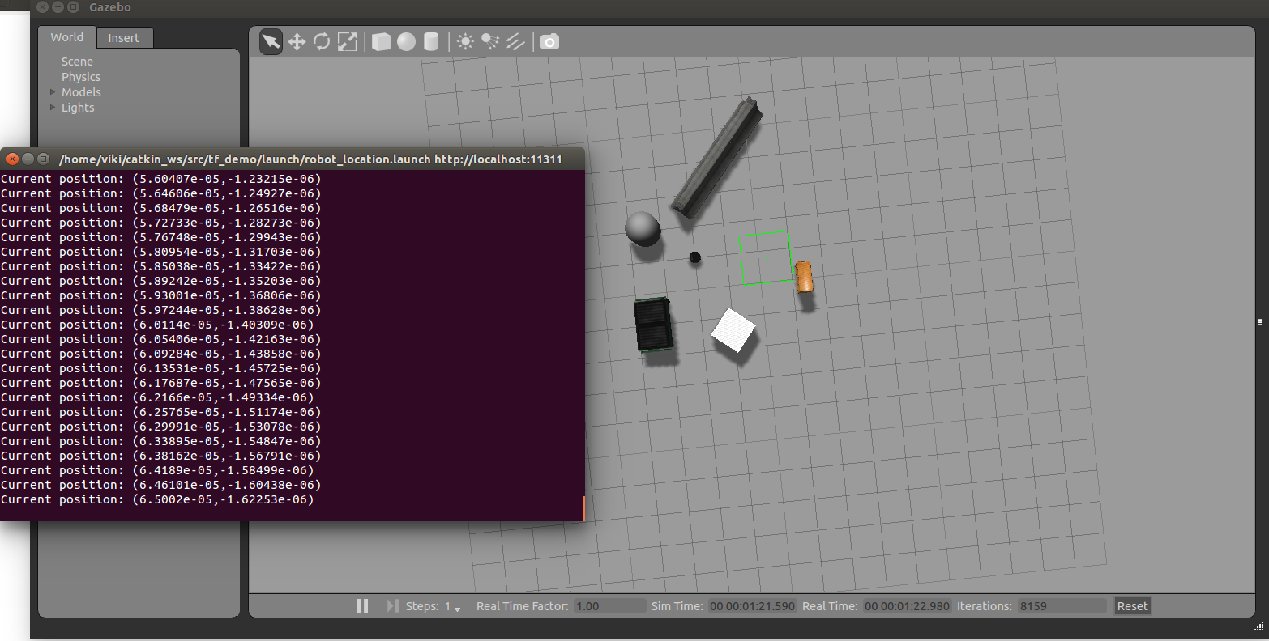
Find Robot Location

Slide 46
Static Transform Publisher
In order to get the robot’s location in the global coordinate frame, an map->odom transform needs to be published by some node
This transformation is typically published by one of ROS mapping or localization nodes (next lesson)
When assuming perfect localization of the robot, you can publish a static (fixed) transform between these frames
<launch>
<!-- Publish a static transformation between /map and /odom -->
<node name="tf" pkg="tf" type="static_transform_publisher" args="-1 -2 0 0 0 0 /map /odom 100" />
</launch>

Slide 47
Find Robot Location
Change the TF listener to listen to the transform from /base_footprint /map in order to get the robot’s location in the map’s frame
while (ros::ok()){
tf::StampedTransform transform;
try {
listener.lookupTransform("/map", "/base_footprint", ros::Time(0), transform);
double x = transform.getOrigin().x();
double y = transform.getOrigin().y();
cout << "Current position: (" << x << "," << y << ")" << endl;
} catch (tf::TransformException &ex) {
ROS_ERROR("%s",ex.what());
}
rate.sleep();
}
return 0;
}

Slide 48
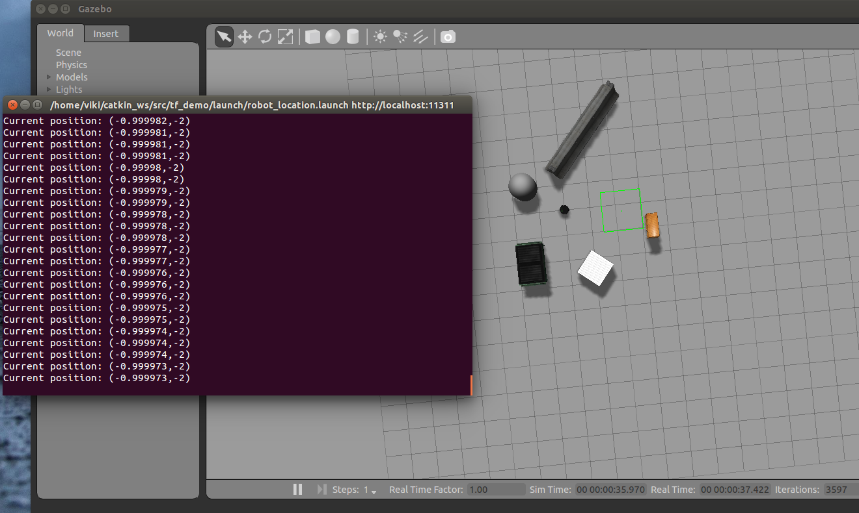
Find Robot Location

Slide 49
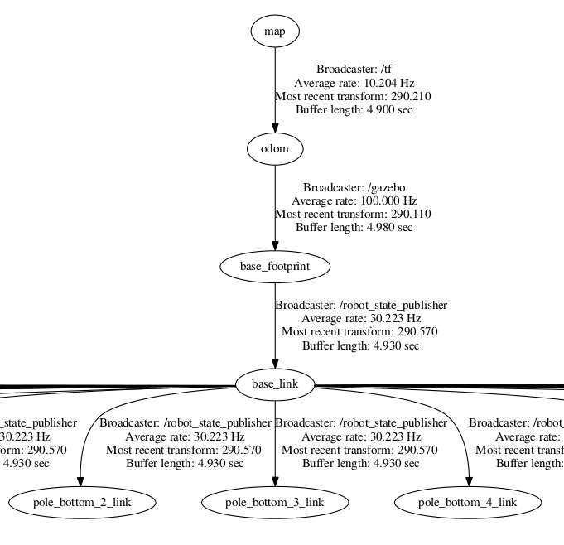
New TF Tree

Slide 50
Final Launch File
<launch>
<param name="/use_sim_time" value="true"/>
<!-- Run Gazebo with turtlebot -->
<include file="$(find turtlebot_gazebo)/launch/turtlebot_world.launch"/>
<!-- Publish a static transformation between /odom and /map -->
<node name="tf" pkg="tf" type="static_transform_publisher" args="-1 -2 0 0 0 0 /map /odom 100" />
<!– Run node -->
<node name="robot_location" pkg="tf_demo" type="robot_location" output="screen" /> </launch>

Slide 51
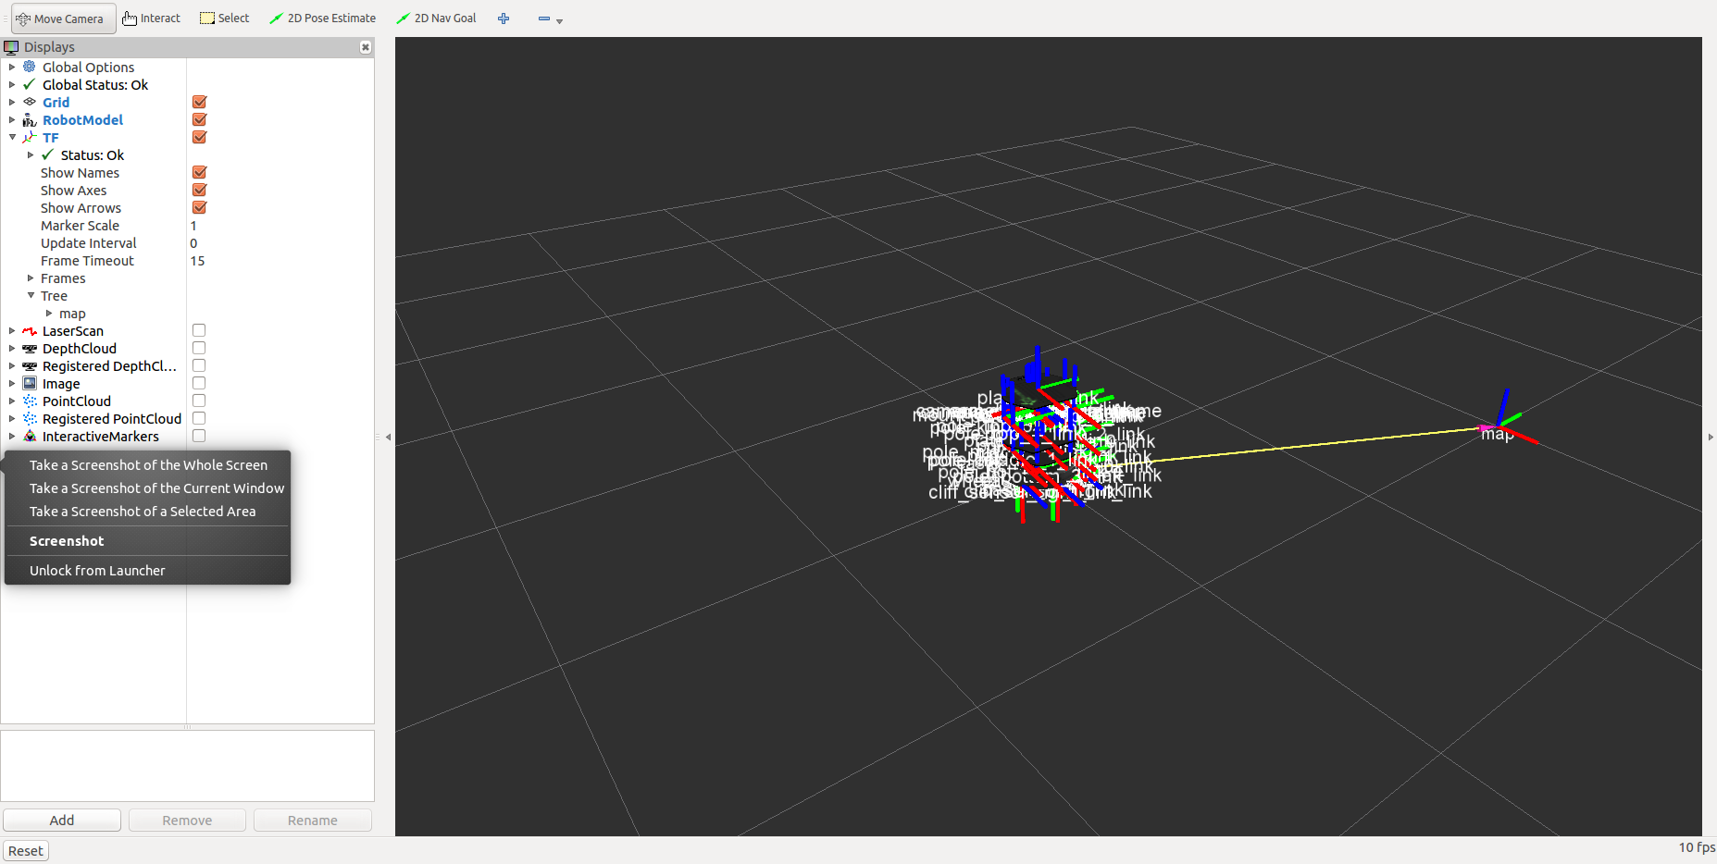
Watch the TF Frames in rviz
Run rviz
Click the TF display checkbox
$ roslaunch turtlebot_rviz_launchers view_robot.launch

Slide 52
Ex. 6
Write functions that translate the robot’s current position in the world (x, y) to the cell in the grid map (i, j) in which the robot is located and vice versa
that take into account the map resolution
Print the initial cell that the robot is located at the start

