Slide 1

ROS – Lecture 7
October 2016
ROS navigation stack
Costmaps
Localization
Sending goal commands (from rviz)
Lecturer: Roi Yehoshua
roiyeho@gmail.com

Slide 2
Robot Navigation
One of the most basic things that a robot can do is to move around the world.
To do this effectively, the robot needs to know where it is and where it should be going
This is usually achieved by giving the robot a map of the world, a starting location, and a goal location
In the previous lesson, we saw how to build a map of the world from sensor data.
Now, we’ll look at how to make your robot autonomously navigate from one part of the world to another, using this map and the ROS navigation packages

Slide 3
ROS Navigation Stack
http://wiki.ros.org/navigation
The goal of the navigation stack is to move a robot from one position to another position safely (without crashing or getting lost)
It takes in information from the odometry and sensors, and a goal pose and outputs safe velocity commands that are sent to the robot
ROS Navigation Introductory Video

Slide 4
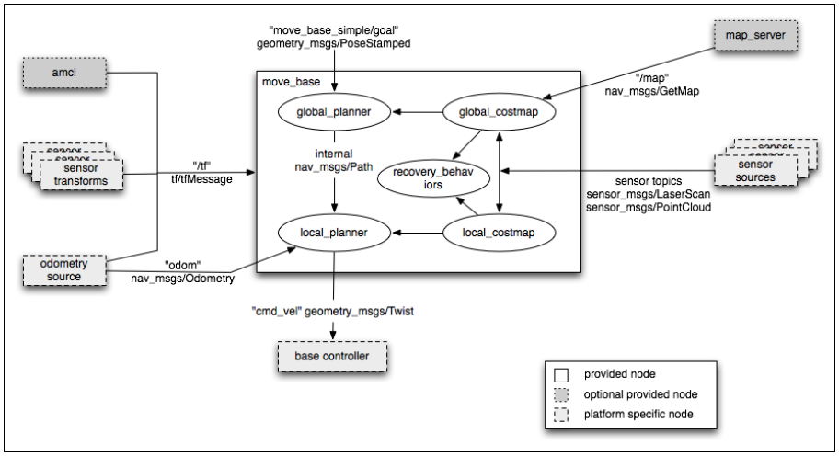
ROS Navigation Stack

Slide 5
Navigation Stack Main Components
Description | Package/Component
offers map data as a ROS Service | map_server
provides laser-based SLAM | gmapping
a probabilistic localization system | amcl
implementation of a fast global planner for navigation | global_planner
implementations of the Trajectory Rollout and Dynamic Window approaches to local robot navigation | local_planner
links together the global and local planner to accomplish the navigation task | move_base

Slide 6
Navigation Main Steps
Goal
AMCL
Path Planner
move_base
/cmd_vel +
/odom
Base Controller

Slide 7
Install Navigation Stack
The navigation stack is not part of the standard ROS Indigo installation
To install the navigation stack type:
$ sudo apt-get install ros-indigo-navigation

Slide 8
Navigation Stack Requirements
Three main hardware requirements
The navigation stack can only handle a differential drive and holonomic wheeled robots
It can also do certain things with biped robots, such as localization, as long as the robot does not move sideways
A planar laser must be mounted on the mobile base of the robot to create the map and localization
Alternatively, you can generate something equivalent to laser scans from other sensors (Kinect for example)
Its performance will be best on robots that are nearly square or circular

Slide 9
Navigation Planners
Our robot will move through the map using two types of navigation—global and local
The global planner is used to create paths for a goal in the map or a far-off distance
The local planner is used to create paths in the nearby distances and avoid obstacles

Slide 10
Global Planner
NavFn provides a fast interpolated navigation function that creates plans for a mobile base
The global plan is computed before the robot starts moving toward the next destination
The planner operates on a costmap to find a minimum cost plan from a start point to an end point in a grid, using Dijkstra’s algorithm
The global planner generates a series of waypoints for the local planner to follow

Slide 11
Local Planner
Chooses appropriate velocity commands for the robot to traverse the current segment of the global path
Combines sensory and odometry data with both global and local cost maps
Can recompute the robot's path on the fly to keep the robot from striking objects yet still allowing it to reach its destination
Implements the Trajectory Rollout and Dynamic Window algorithm

Slide 12
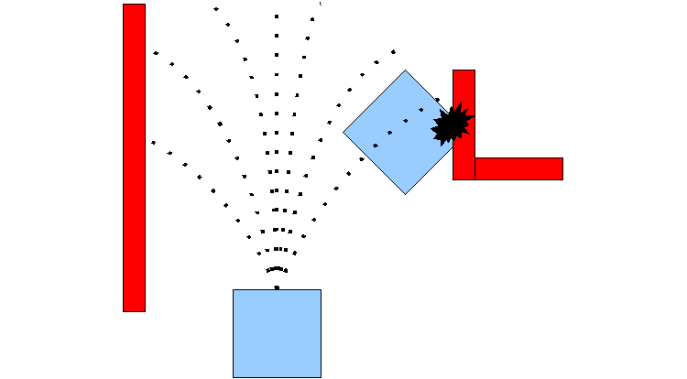
Trajectory Rollout Algorithm
Taken from ROS Wiki http://wiki.ros.org/base_local_planner

Slide 13
Trajectory Rollout Algorithm
Discretely sample in the robot's control space (dx,dy,dθ)
For each sampled velocity, perform forward simulation from the robot's current state to predict what would happen if the sampled velocity were applied for some (short) period of time
Evaluate each trajectory resulting from the forward simulation, using a metric that incorporates characteristics such as: proximity to obstacles, proximity to the goal, proximity to the global path, and speed
Discard illegal trajectories (those that collide with obstacles)
Pick the highest-scoring trajectory and send the associated velocity to the mobile base
Rinse and repeat

Slide 14
Local Planner Parameters
The file base_local_planner.yaml contains a large number of ROS Parameters that can be set to customize the behavior of the base local planner
Grouped into several categories:
robot configuration
goal tolerance
forward simulation
trajectory scoring
oscillation prevention
global plan

Slide 15
Costmap
A data structure that represents places that are safe for the robot to be in a grid of cells
It is based on the occupancy grid map of the environment and user specified inflation radius
There are two types of costmaps in ROS:
Global costmap is used for global navigation
Local costmap is used for local navigation
Each cell in the costmap has an integer value in the range [0 (FREE_SPACE), 255 (UNKNOWN)]
Managed by the costmap_2d package

Slide 16
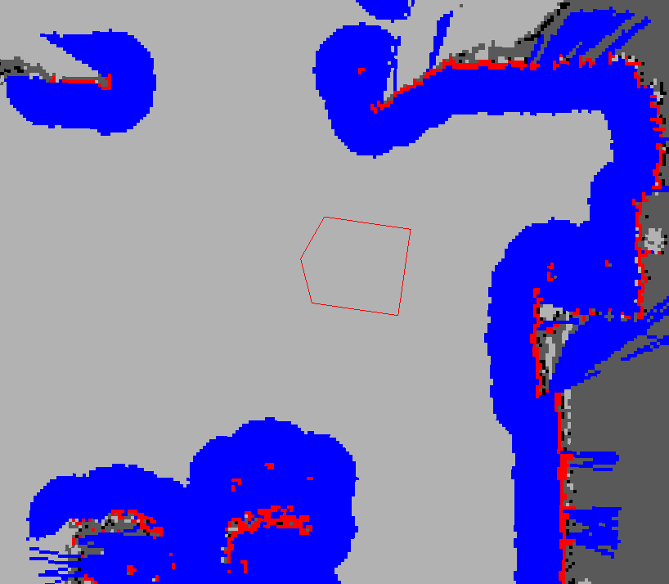
Costmap Example
Taken from ROS Wiki http://wiki.ros.org/costmap_2d

Slide 17
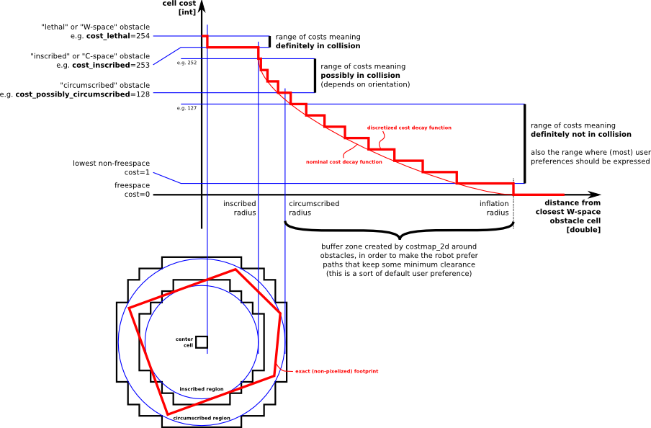
Inflation
Inflation is the process of propagating cost values out from occupied cells that decrease with distance

Slide 18
Map Updates
The costmap performs map update cycles at the rate specified by the update_frequency parameter
In each cycle:
sensor data comes in
marking and clearing operations are perfomed in the underlying occupancy structure of the costmap
this structure is projected into the costmap where the appropriate cost values are assigned as described above
obstacle inflation is performed on each cell with a LETHAL_OBSTACLE value
This consists of propagating cost values outwards from each occupied cell out to a user-specified inflation radius

Slide 19
Costmap Parameters Files
Configuration of the costmaps consists of three files:
costmap_common_params.yaml
global_costmap_params.yaml
local_costmap_params.yaml
http://wiki.ros.org/costmap_2d/hydro/obstacles

Slide 20
Localization
Localization is the problem of estimating the pose of the robot relative to a map
Localization is not terribly sensitive to the exact placement of objects so it can handle small changes to the locations of objects
ROS uses the amcl package for localization

Slide 21
AMCL
amcl is a probabilistic localization system for a robot moving in 2D
It implements the adaptive Monte Carlo localization approach, which uses a particle filter to track the pose of a robot against a known map
The algorithm and its parameters are described in the book Probabilistic Robotics by Thrun, Burgard, and Fox (http://www.probabilistic-robotics.org/)
Currently amcl works only with laser scans
However, it can be extended to work with other sensors

Slide 22
AMCL
amcl takes in a laser-based map, laser scans, and transform messages, and outputs pose estimates
Subscribed topics:
scan – Laser scans
tf – Transforms
initialpose – Mean and covariance with which to (re-) initialize the particle filter
map – the map used for laser-based localization
Published topics:
amcl_pose – Robot's estimated pose in the map, with covariance.
Particlecloud – The set of pose estimates being maintained by the filter

Slide 23
move_base
The move_base package lets you move a robot to desired positions using the navigation stack
The move_base node links together a global and local planner to accomplish its navigation task
It may optionally perform recovery behaviors when the robot perceives itself as stuck

Slide 24
TurtleBot Navigation
turtlebot_navigation package includes demos of map building using gmapping and localization with amcl, while running the navigation stack
In param subdirectory it contains configuration files for TurtleBot navigation

Slide 25
Navigation Configuration Files
Description | Configuration File
global planner configuration | global_planner_params.yaml
navfn configuration | navfn_global_planner_params.yaml
local planner configuration | dwa_local_planner_params.yaml
costmap configuration files | costmap_common_params.yaml global_costmap_params.yaml local_costmap_params.yaml
move base configuration | move_base_params.yaml
amcl configuration | amcl.launch.xml

Slide 26
Autonomous Navigation of a Known Map
amcl_demo.launch - launch file for navigation demo
<launch>
<!-- Map server -->
<arg name="map_file" default="$(env TURTLEBOT_GAZEBO_MAP_FILE)"/>
<node name="map_server" pkg="map_server" type="map_server" args="$(arg map_file)" />
<!-- Localization -->
<arg name="initial_pose_x" default="0.0"/>
<arg name="initial_pose_y" default="0.0"/>
<arg name="initial_pose_a" default="0.0"/>
<include file="$(find turtlebot_navigation)/launch/includes/amcl.launch.xml">
<arg name="initial_pose_x" value="$(arg initial_pose_x)"/>
<arg name="initial_pose_y" value="$(arg initial_pose_y)"/>
<arg name="initial_pose_a" value="$(arg initial_pose_a)"/>
</include>
<!-- Move base -->
<include file="$(find turtlebot_navigation)/launch/includes/move_base.launch.xml"/>
</launch>

Slide 27
Autonomous Navigation of a Known Map
Launch Gazebo with turtlebot
Run the navigation demo
$ roslaunch turtlebot_gazebo turtlebot_world.launch
$ roslaunch turtlebot_gazebo amcl_demo.launch

Slide 28
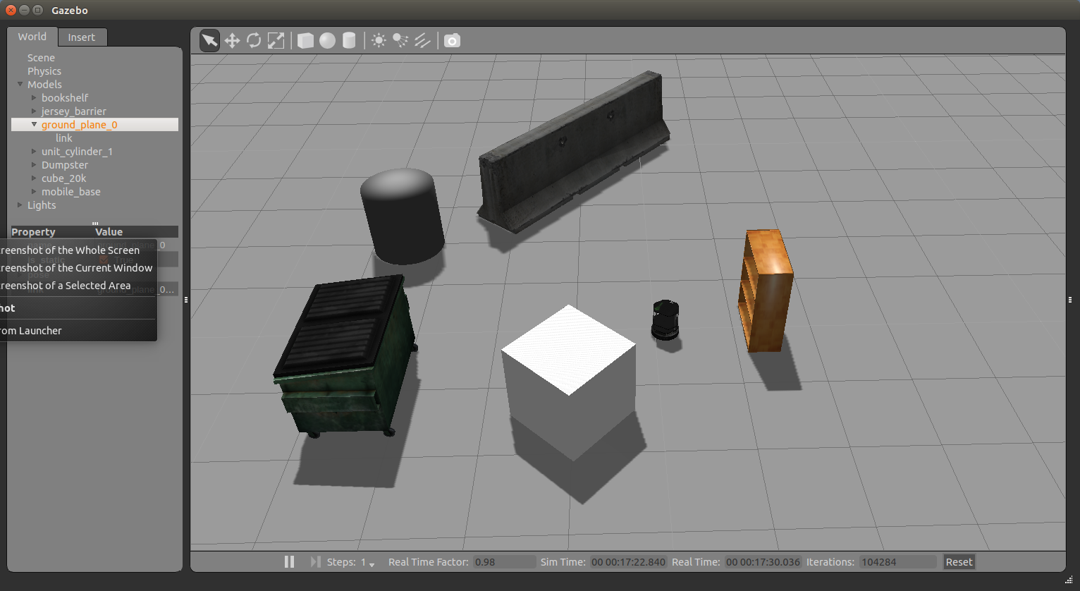
Autonomous Navigation of a Known Map

Slide 29
rviz with Navigation Stack
rviz allows you to:
Provide an approximate location of the robot (when starting up, the robot doesn’t know where it is)
Send goals to the navigation stack
Display all the visualization information relevant to the navigation (planned path, costmap, etc.)
Launch rviz:
$ roslaunch turtlebot_rviz_launchers view_navigation.launch

Slide 30
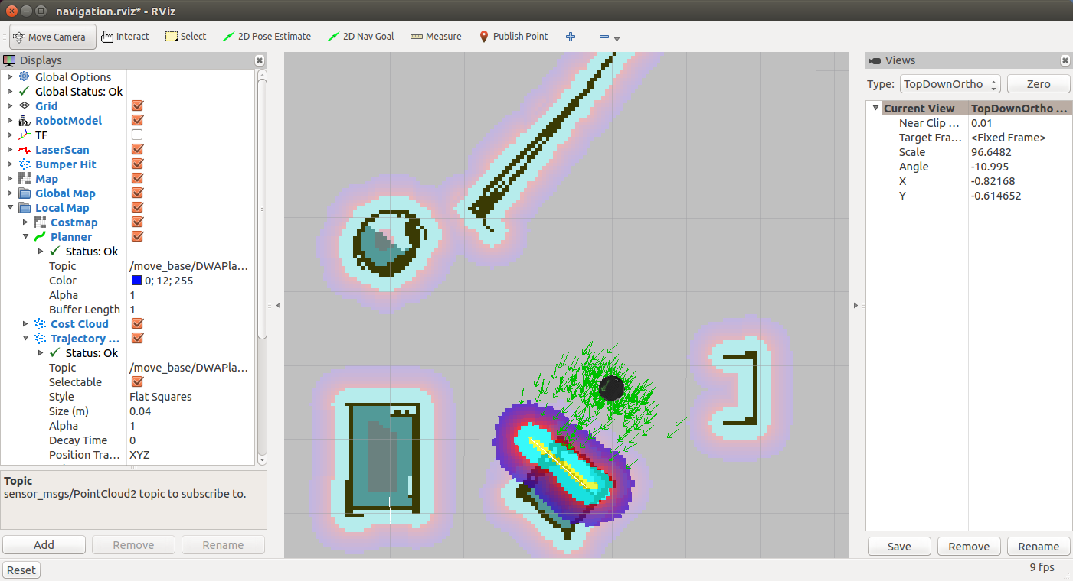
rviz with Navigation Stack

Slide 31
Localize the TurtleBot
When starting up the TurtleBot doesn't know where it is
For example, let’s move the robot in Gazebo to (-1,-2)
Now to provide it its approximate location on the map:
Click the "2D Pose Estimate" button
Click on the map where the TurtleBot approximately is and drag in the direction the TurtleBot is pointing
You will see a collection of arrows which are hypotheses of the position of the TurtleBot
The laser scan should line up approximately with the walls in the map
If things don't line up well you can repeat the procedure

Slide 32
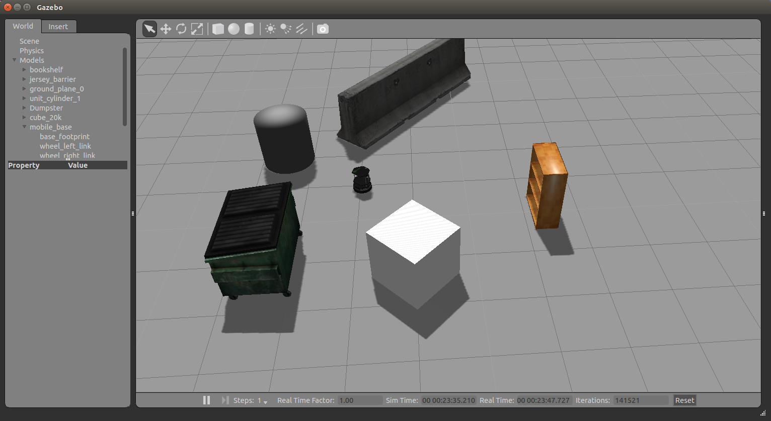
Localize the TurtleBot

Slide 33
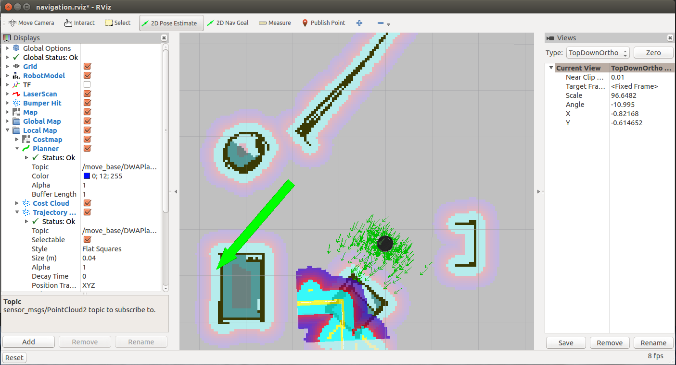
Localize the TurtleBot

Slide 34
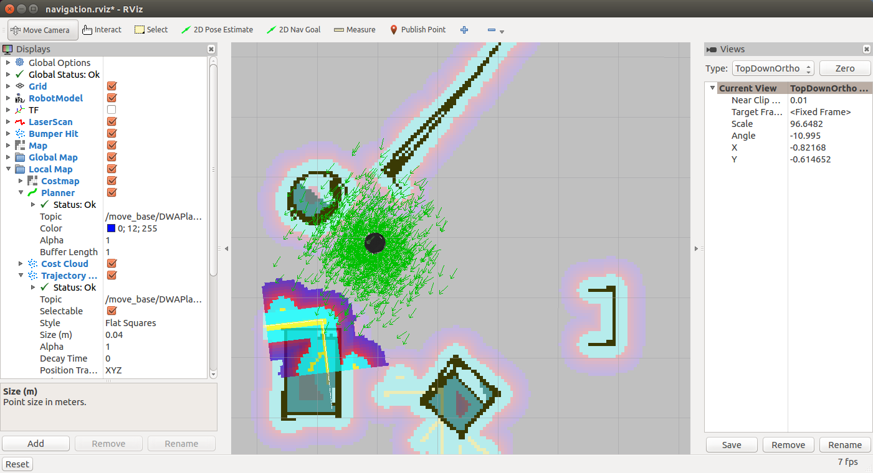
Localize the TurtleBot

Slide 35
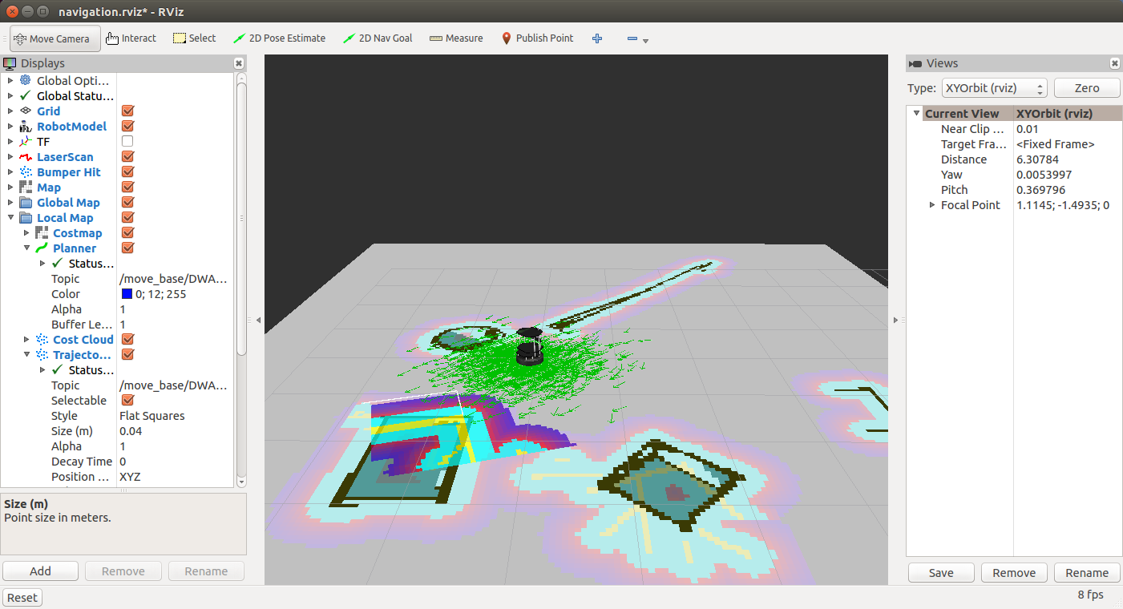
Localize the TurtleBot
You can change the current view (on right panel):

Slide 36
Particle Cloud in rviz
The Particle Cloud display shows the particle cloud used by the robot's localization system
The spread of the cloud represents the localization system's uncertainty about the robot's pose
As the robot moves about the environment, this cloud should shrink in size as additional scan data allows amcl to refine its estimate of the robot's position and orientation
To watch the particle cloud in rviz:
Click Add Display and choose Pose Array
Set topic name to /particlecloud

Slide 37
Teleoperation
The teleoperation can be run simultaneously with the navigation stack
It will override the autonomous behavior if commands are being sent
It is often a good idea to teleoperate the robot after seeding the localization to make sure it converges to a good estimate of the position

Slide 38
Send a Navigation Goal
With the TurtleBot localized, it can then autonomously plan through the environment
To send a goal:
Click the "2D Nav Goal" button
Click on the map where you want the TurtleBot to drive and drag in the direction where it should be pointing at the end
If you want to stop the robot before it reaches it's goal, send it a goal at it's current location

Slide 39
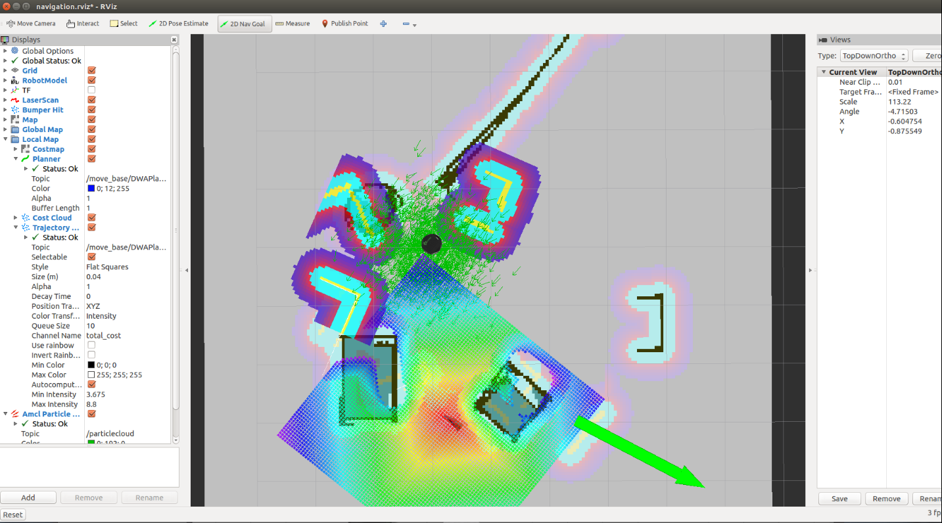
Send a Navigation Goal

Slide 40
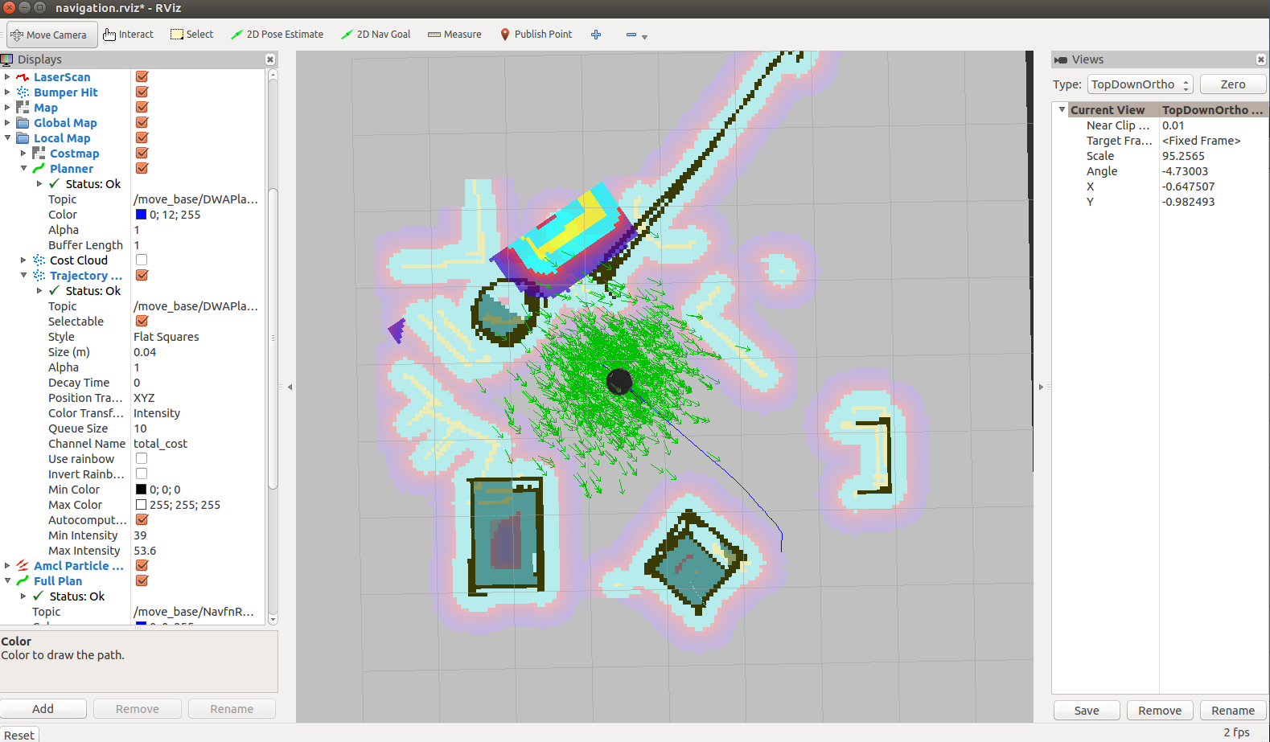
Robot Moves to Destination

Slide 41
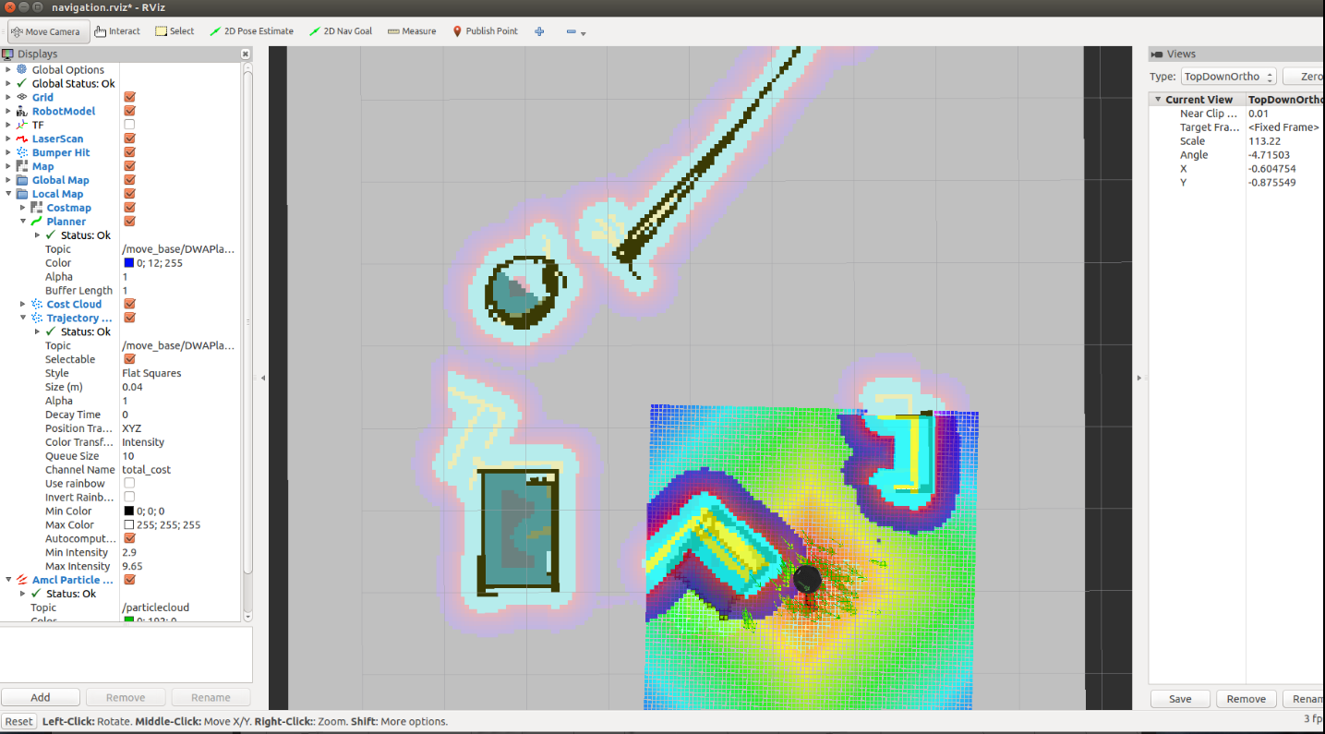
Final Pose

Slide 42
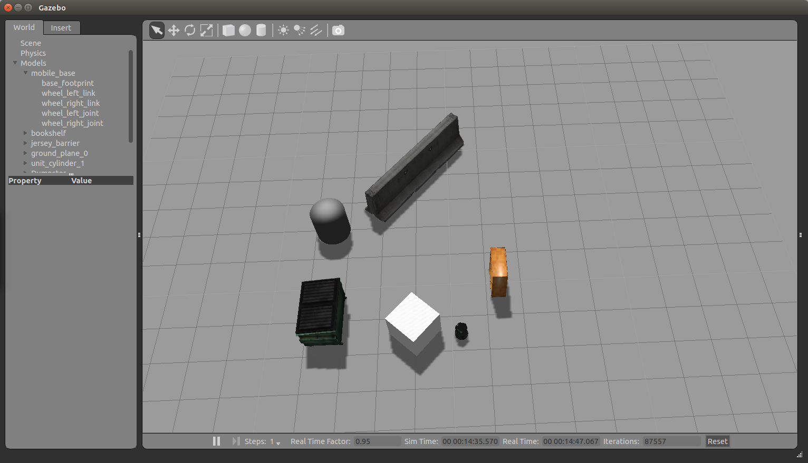
Final Pose In Gazebo

Slide 43
Navigation Plans in rviz
NavFn Plan
Displays the full plan for the robot computed by the global planner
Topic: /move_base_node/NavfnROS/plan
Global Plan
Shows the portion of the global plan that the local planner is currently pursuing
Topic: /move_base_node/TrajectoryPlannerROS/global_plan
Local Plan
Shows the trajectory associated with the velocity commands currently being commanded to the base by the local planner
Topic: /move_base_node/TrajectoryPlannerROS/local_plan

Slide 44
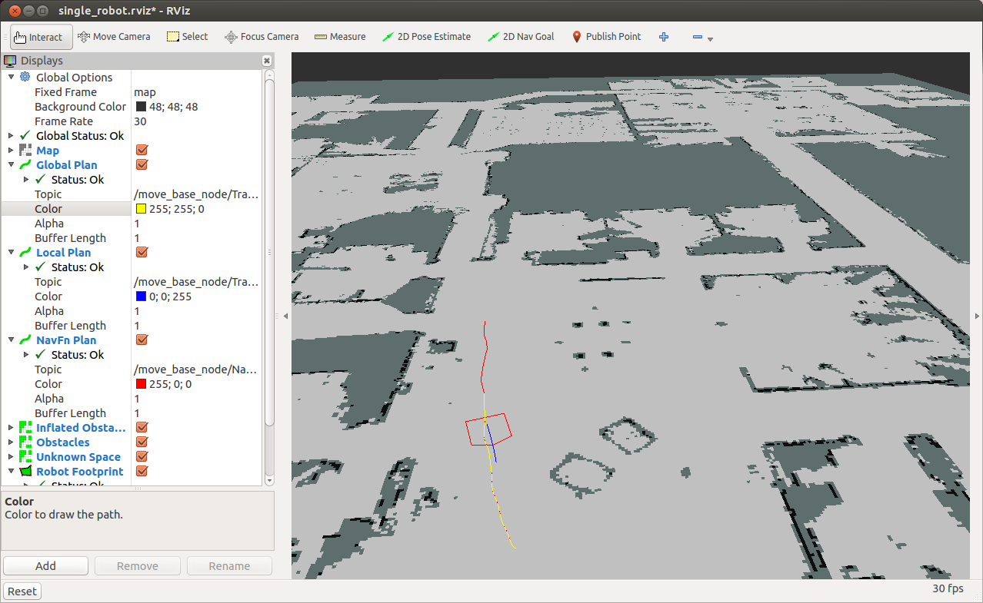
Navigation Plans in rviz
NavFn Plan
Local Plan
Global Plan

Slide 45
rqt_reconfigure
A tool for changing dynamic configuration values
To launch rqt_reconfigure, run:
The navigation stack parameters will appear under move_base_node
$ rosrun rqt_reconfigure rqt_reconfigure

Slide 46
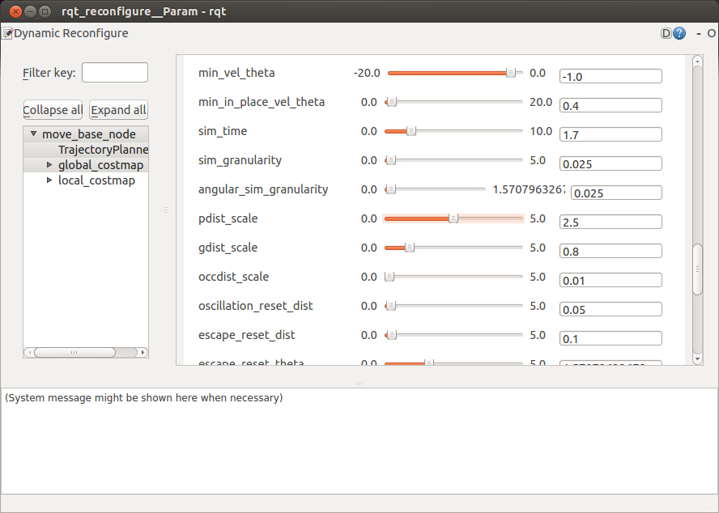
rqt_reconfigure

Slide 47
Ex. 7
Implement a simple navigation algorithm (based on A*) that will use the grid representation of the map to compute a route for the robot from its current location to a given goal location

