Slide 1

ROS – Lecture 8
October 2016
ROS actions
Sending goal commands from code
Making navigation plans
Lecturer: Roi Yehoshua
roiyeho@gmail.com

Slide 2
Actions
http://wiki.ros.org/actionlib
While services are handy for simple get/set interactions like querying status and managing configuration, they don’t work well with long-running tasks
such as sending a robot to some distant location
ROS actions are the best way to implement interfaces to time-extended, goal-oriented behaviors
Similar to the request and response of a service, an action uses a goal to initiate a behavior and sends a result when the behavior is complete
But the action further uses feedback to provide updates on the behavior’s progress toward the goal and also allows for goals to be canceled
Actions are asynchronous (in contrast to services)

Slide 3
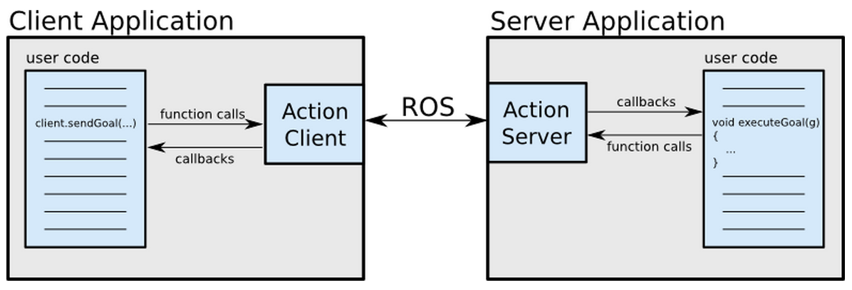
Action Client-Server Interaction

Slide 4
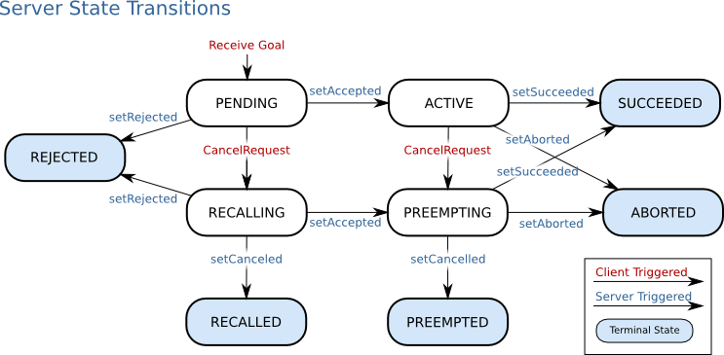
Action Server State Transitions

Slide 5
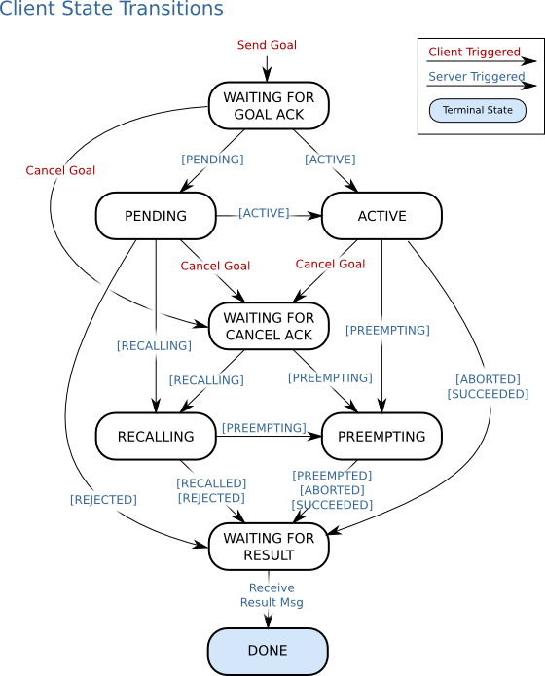
Action Client State Transitions

Slide 6
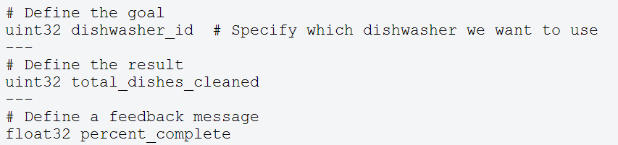
.action File
The action specification is defined in an .action file
These files are placed in the package’s ./action directory
Example for an action file:

Slide 7
.action File
From the action file the following message types are generated:
DoDishesAction.msg
DoDishesActionGoal.msg
DoDishesActionResult.msg
DoDishesActionFeedback.msg
DoDishesGoal.msg
DoDishesResult.msg
DoDishesFeedback.msg
These messages are then used internally by actionlib to communicate between the ActionClient and ActionServer

Slide 8
SimpleActionClient
A simple client implementation which supports only one goal at a time
The action client is templated on the action definition, specifying what message types to communicate to the action server with
The action client c’tor also takes two arguments:
The server name to connect to
A boolean option to automatically spin a thread
If you prefer not to use threads (and you want actionlib to do the 'thread magic' behind the scenes), this is a good option for you.

Slide 9
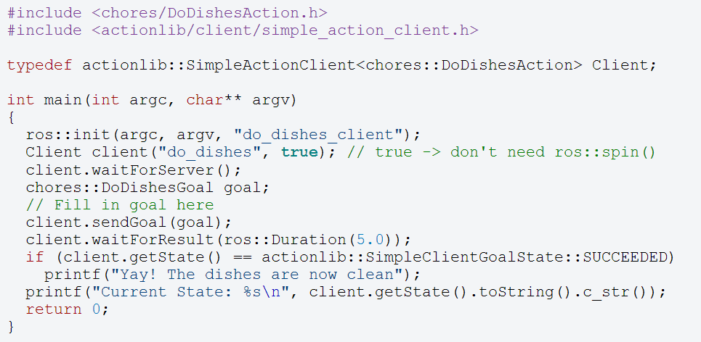
SimpleActionClient

Slide 10
SendGoals
The next code is a simple example to send a goal to move the robot from the C++ code
In this case the goal would be a PoseStamped message that contains information about where the robot should move to in the world
http://wiki.ros.org/navigation/Tutorials/SendingSimpleGoals

Slide 11
SendGoals
First create a new package called send_goals
This package depends on the following packages:
actionlib
geometry_msgs
move_base_msgs
$ cd ~/catkin_ws/src
$ catkin_create_pkg send_goals std_msgs rospy roscpp actionlib tf geometry_msgs move_base_msgs

Slide 12
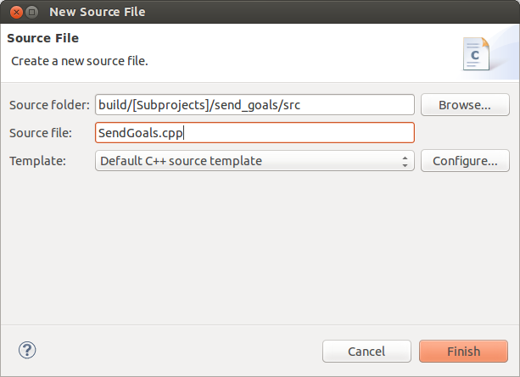
SendGoals
Open the project file in Eclipse
Under the src subdirectory, create a new file called SendGoals.cpp

Slide 13
SendGoals.cpp (1)
#include <ros/ros.h>
#include <move_base_msgs/MoveBaseAction.h>
#include <actionlib/client/simple_action_client.h>
#include <tf/transform_datatypes.h>
typedef actionlib::SimpleActionClient<move_base_msgs::MoveBaseAction> MoveBaseClient;
int main(int argc, char** argv) {
ros::init(argc, argv, "send_goals_node");
// Get the goal's x, y and angle from the launch file
double x, y, theta;
ros::NodeHandle nh;
nh.getParam("goal_x", x);
nh.getParam("goal_y", y);
nh.getParam("goal_theta", theta);
// create the action client
MoveBaseClient ac("move_base", true);
// Wait 60 seconds for the action server to become available
ROS_INFO("Waiting for the move_base action server");
ac.waitForServer(ros::Duration(60));
ROS_INFO("Connected to move base server");

Slide 14
SendGoals.cpp (2)
// Send a goal to move_base
move_base_msgs::MoveBaseGoal goal;
goal.target_pose.header.frame_id = "map";
goal.target_pose.header.stamp = ros::Time::now();
goal.target_pose.pose.position.x = x;
goal.target_pose.pose.position.y = y;
// Convert the Euler angle to quaternion
double radians = theta * (M_PI/180);
tf::Quaternion quaternion;
quaternion = tf::createQuaternionFromYaw(radians);
geometry_msgs::Quaternion qMsg;
tf::quaternionTFToMsg(quaternion, qMsg);
goal.target_pose.pose.orientation = qMsg;
// Send the goal command
ROS_INFO("Sending robot to: x = %f, y = %f, theta = %f", x, y, theta);
ac.sendGoal(goal);

Slide 15
SendGoals.cpp (3)
// Wait for the action to return
ac.waitForResult();
if (ac.getState() == actionlib::SimpleClientGoalState::SUCCEEDED)
ROS_INFO("You have reached the goal!");
else
ROS_INFO("The base failed for some reason");
return 0;
}

Slide 16
Converting Euler Angle to Quaternion
It is easier to define the goal pose with Euler angles rather than with quaternions
The following code translates the angle from radians to quaternion representation:
double theta = 90.0;
double radians = theta * (M_PI/180);
tf::Quaternion quaternion;
quaternion = tf::createQuaternionFromYaw(radians);
geometry_msgs::Quaternion qMsg;
tf::quaternionTFToMsg(quaternion, qMsg);
goal.target_pose.pose.orientation = qMsg;

Slide 17
SendGoals Launch File
<launch>
<param name="goal_x" value="2" />
<param name="goal_y" value="-2" />
<param name="goal_theta" value="180" />
<param name="/use_sim_time" value="true"/>
<!-- Launch turtle bot world -->
<include file="$(find turtlebot_gazebo)/launch/turtlebot_world.launch"/>
<!-- Launch navigation stack with amcl -->
<include file="$(find turtlebot_gazebo)/launch/amcl_demo.launch"/>
<!-- Launch rviz -->
<include file="$(find turtlebot_rviz_launchers)/launch/view_navigation.launch"/>
<!-- Launch send goals node -->
<node name="send_goals_node" pkg="send_goals" type="send_goals_node" output="screen"/>
</launch>

Slide 18
SendGoals Demo
Launch send_goals.launch:
You should now see rviz opens and the robot moves from its initial pose to the target pose defined in the launch file
$ roslaunch send_goals send_goals.launch

Slide 19
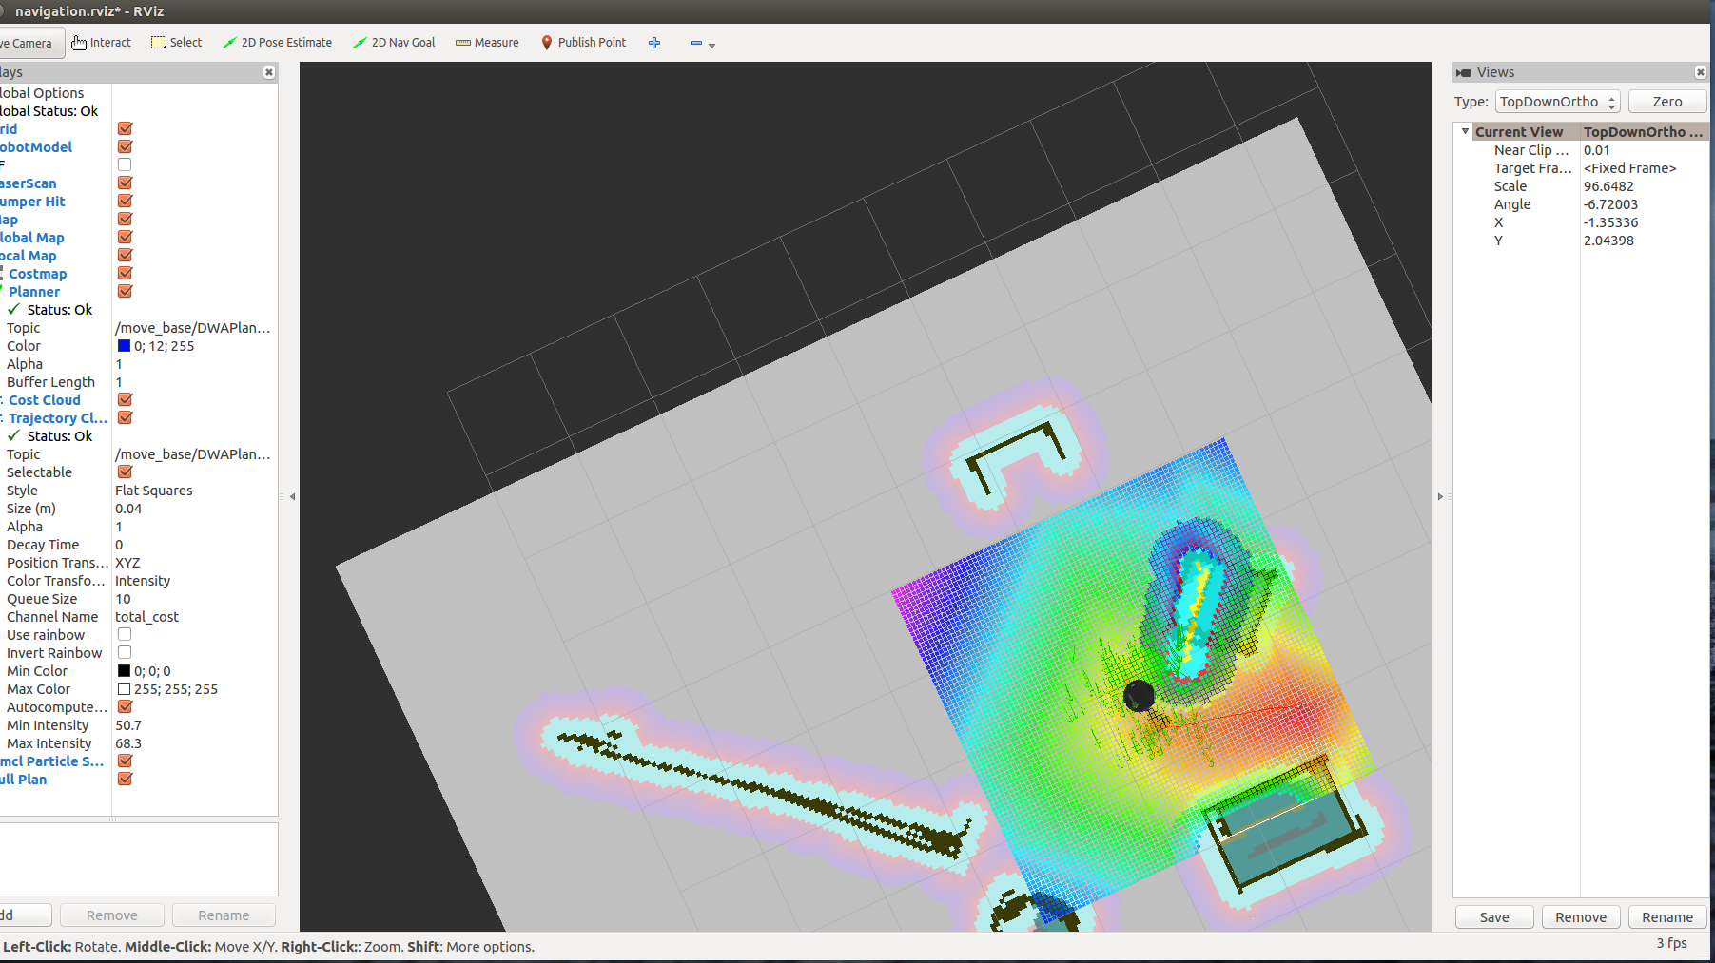
SendGoals Demo

Slide 20
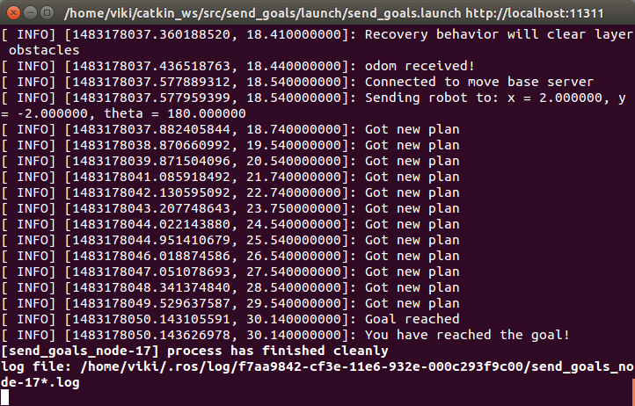
SendGoals Demo

Slide 21
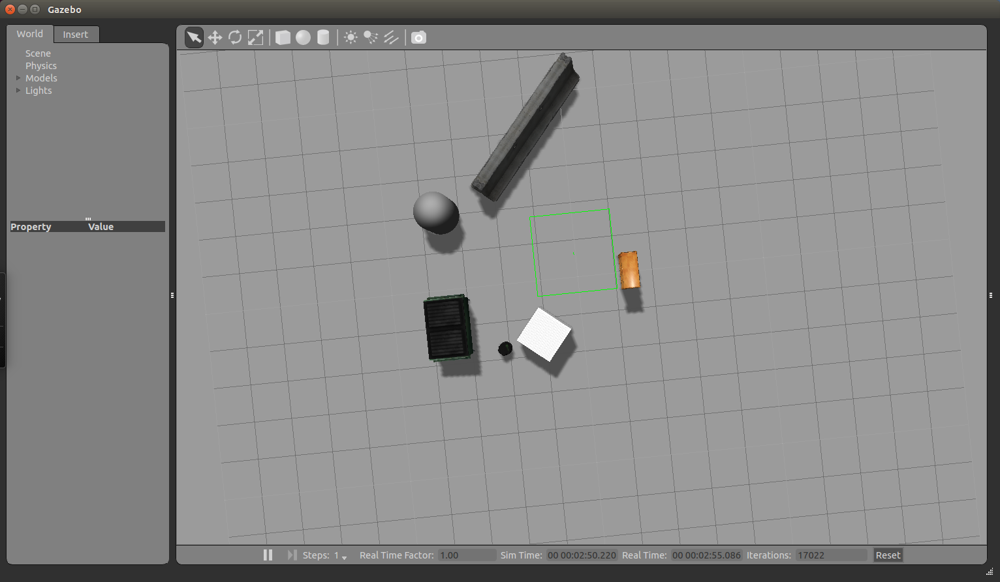
SendGoals Demo

Slide 22
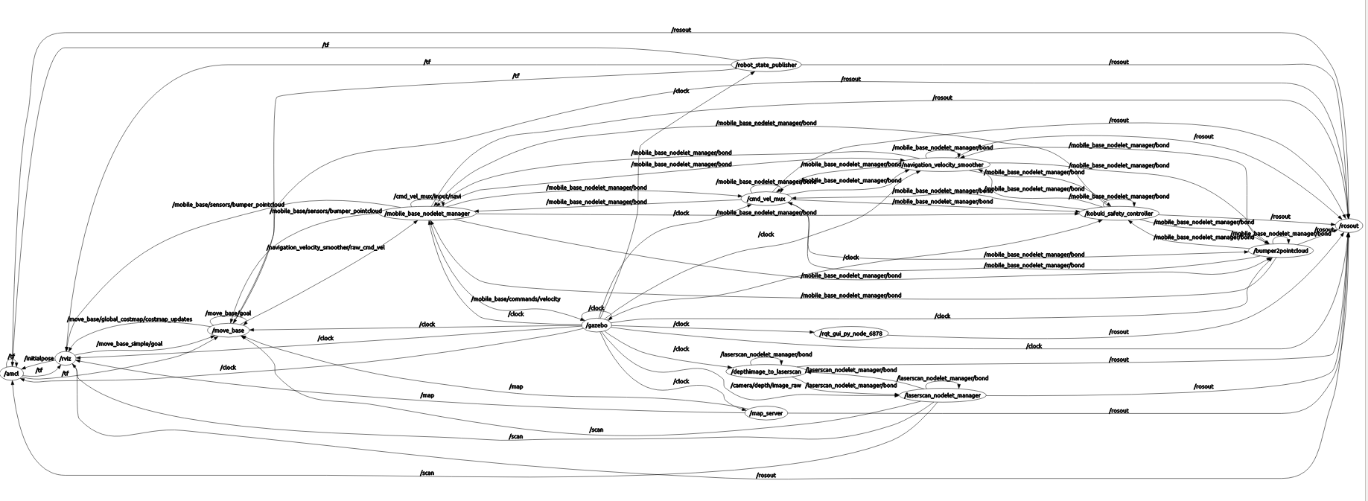
Nodes Graph

Slide 23
make_plan service
Allows an external user to ask from move_base a route to a given pose
without actually moving the robot
Arguments:
Start pose
Goal pose
Goal tolerance
Returns a message of type nav_msgs/GetPlan

Slide 24
make_plan Node
In our send_goal package we will now create a make_plan_node that will call the make_plan service and print the output path of the plan
Add a new C++ file called MakePlan.cpp

Slide 25
MakePlan.cpp (1)
#include <ros/ros.h>
#include <nav_msgs/GetPlan.h>
#include <geometry_msgs/PoseStamped.h>
#include <string>
using std::string;
#include <boost/foreach.hpp>
#define forEach BOOST_FOREACH
double goalTolerance = 0.5;
void fillPathRequest(nav_msgs::GetPlan::Request &req);
void callPlanningService(ros::ServiceClient &serviceClient, nav_msgs::GetPlan &srv);

Slide 26
MakePlan.cpp (2)
int main(int argc, char** argv)
{
ros::init(argc, argv, "make_plan_node");
ros::NodeHandle nh;
// Init service query for make plan
string service_name = "move_base/make_plan";
while (!ros::service::waitForService(service_name, ros::Duration(3.0))) {
ROS_INFO("Waiting for service move_base/make_plan to become available");
}
ros::ServiceClient serviceClient = nh.serviceClient<nav_msgs::GetPlan>(service_name, true);
if (!serviceClient) {
ROS_FATAL("Could not initialize get plan service from %s", serviceClient.getService().c_str());
return -1;
}
nav_msgs::GetPlan srv;
fillPathRequest(srv.request);
if (!serviceClient) {
ROS_FATAL("Persistent service connection to %s failed", serviceClient.getService().c_str());
return -1;
}
callPlanningService(serviceClient, srv);
}

Slide 27
MakePlan.cpp (3)
void fillPathRequest(nav_msgs::GetPlan::Request &request)
{
request.start.header.frame_id = "map";
request.start.pose.position.x = 0;
request.start.pose.position.y = 0;
request.start.pose.orientation.w = 1.0;
request.goal.header.frame_id = "map";
request.goal.pose.position.x = 2.0;
request.goal.pose.position.y = -2.0;
request.goal.pose.orientation.w = 1.0;
request.tolerance = goalTolerance;
}

Slide 28
MakePlan.cpp (4)
void callPlanningService(ros::ServiceClient &serviceClient, nav_msgs::GetPlan &srv)
{
// Perform the actual path planner call
if (serviceClient.call(srv)) {
if (!srv.response.plan.poses.empty()) {
forEach(const geometry_msgs::PoseStamped &p, srv.response.plan.poses) {
ROS_INFO("x = %f, y = %f", p.pose.position.x, p.pose.position.y);
}
}
else {
ROS_WARN("Got empty plan");
}
}
else {
ROS_ERROR("Failed to call service %s - is the robot moving?", serviceClient.getService().c_str());
}
}

Slide 29
make_plan.launch
<launch>
<param name="goal_x" value="2" />
<param name="goal_y" value="-2" />
<param name="goal_theta" value="180" />
<param name="/use_sim_time" value="true"/>
<!-- Launch turtle bot world -->
<include file="$(find turtlebot_gazebo)/launch/turtlebot_world.launch"/>
<!-- Launch navigation stack with amcl -->
<include file="$(find turtlebot_gazebo)/launch/amcl_demo.launch"/>
<!-- Launch send goals node -->
<node name="make_plan_node" pkg="send_goals" type="make_plan_node" output="screen"/>
</launch>

Slide 30
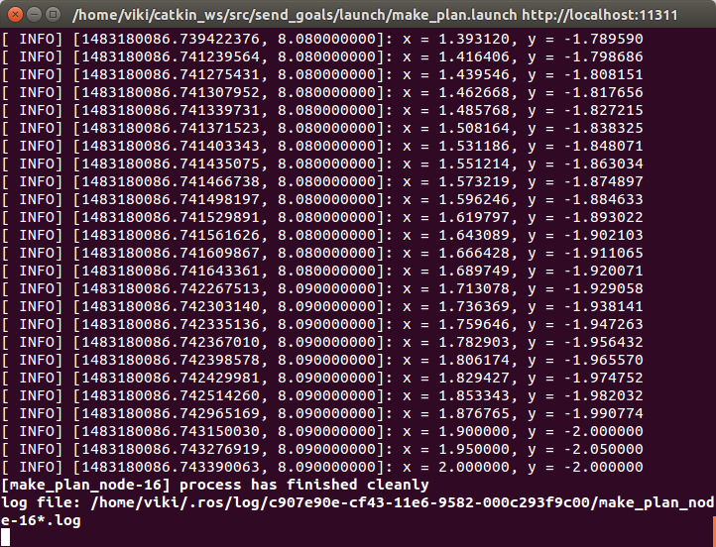
Running make_plan Node

