Slide 1

ROS – Lecture 9
October 2016
Robot 3D Models (URDF)
Simulation Description Files (SDF)
Lecturer: Roi Yehoshua
roiyeho@gmail.com

Slide 2
URDF
Unified Robot Description Format (URDF) is an XML format for representing a robot model
In this file you define:
Kinematic and dynamic description of the robot
Visual representation of the robot
Collision model of the robot
A list of robots described by URDF files can be found here: http://wiki.ros.org/urdf/Examples

Slide 3
URDF Format
The description of a robot consists of a set of link (part) elements, and a set of joint elements connecting the links together
A typical robot description looks like this:
<robot name="pr2">
<link> ... </link>
<link> ... </link>
<link> ... </link>
<joint> .... </joint>
<joint> .... </joint>
<joint> .... </joint>
</robot>

Slide 4
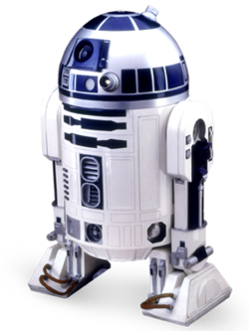
URDF Turorials
We’re going to build a visual model of a robot that vaguely looks like R2D2
All of the robot models and launch files mentioned here can be found in the urdf_tutorial package (already installed with ROS)

Slide 5
One Shape
First, we’re just going to create one simple shape
Look at 01-myfirst.urdf:
This creates a robot with the name myfirst, that contains only one link, whose visual component is just a cylinder 0.6 meters long with a 0.2 meter radius.
<?xml version="1.0"?>
<robot name="myfirst">
<link name="base_link">
<visual>
<geometry>
<cylinder length="0.6" radius="0.2"/>
</geometry>
</visual>
</link>
</robot>

Slide 6
Watching the 3D Model in rviz
display.launch (in urdf_tutorial package)
<launch>
<arg name="model" />
<arg name="gui" default="False" />
<param name="robot_description" textfile="$(arg model)" />
<param name="use_gui" value="$(arg gui)"/>
<node name="joint_state_publisher" pkg="joint_state_publisher" type="joint_state_publisher"></node>
<node name="robot_state_publisher" pkg="robot_state_publisher" type="state_publisher" />
<node name="rviz" pkg="rviz" type="rviz" args="-d $(find urdf_tutorial)/urdf.rviz" />
</launch>

Slide 7
Watching the 3D Model in rviz
This launch file does three things:
Loads the specified model into the parameter server
Runs nodes to publish the JointState and transforms
Starts rviz with a configuration file
To run the launch file type
If you are in the same directory where the urdf file is:
If you are in a different directory:
$ roslaunch urdf_tutorial display.launch model:=01-myfirst.urdf
$ roslaunch urdf_tutorial display.launch model:='$(find urdf_tutorial)/urdf/01-myfirst.urdf'

Slide 8
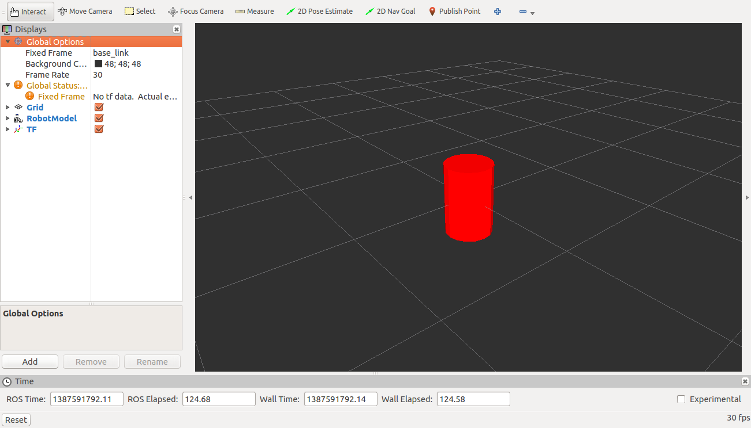
Watching the 3D Model in rviz

Slide 9
Multiple Links
In order to add more link elements to the urdf, you need to define joints
The joint is connects a parent and a child link
There are different types of joints
We’ll start with fixed joints

Slide 10
02-multipleshapes.urdf
<?xml version="1.0"?>
<robot name="multipleshapes">
<link name="base_link">
<visual>
<geometry>
<cylinder length="0.6" radius="0.2"/>
</geometry>
</visual>
</link>
<link name="right_leg">
<visual>
<geometry>
<box size="0.6 .2 .1"/>
</geometry>
</visual>
</link>
<joint name="base_to_right_leg" type="fixed">
<parent link="base_link"/>
<child link="right_leg"/>
</joint>
</robot>

Slide 11
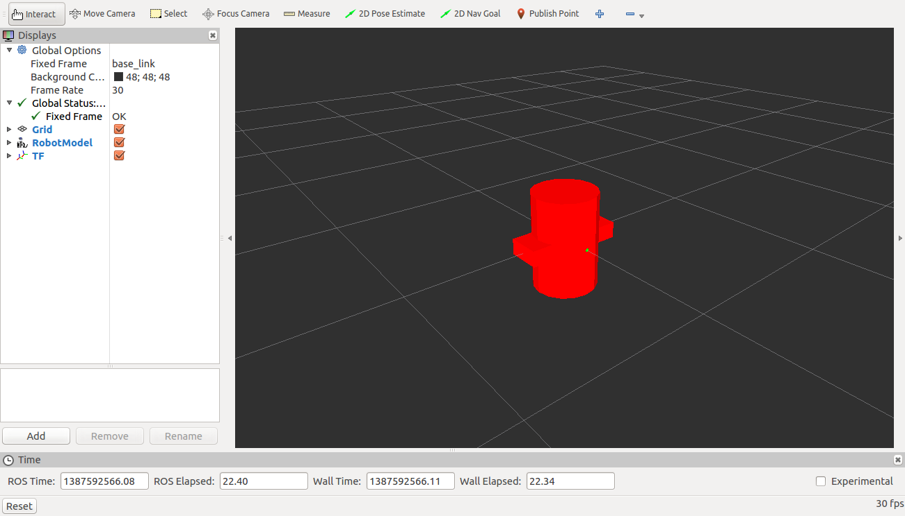
Multiple Links
$ roslaunch urdf_tutorial display.launch model:=02-multipleshapes.urdf

Slide 12
Origins
Both of the shapes overlap with each other, because they share the same origin
If we want them not to overlap we must define more origins
Both the link and the joint elements may contain origin tags

Slide 13
Link’s Origin Tag
<origin> - defines where the center of the visual element should be relative to its origin
defaults to identity if not specified
Properties:
xyz – represents the offset
defaults to zero vector
rpy - represents the rotation (roll, pitch, yaw)
defaults to identity

Slide 14
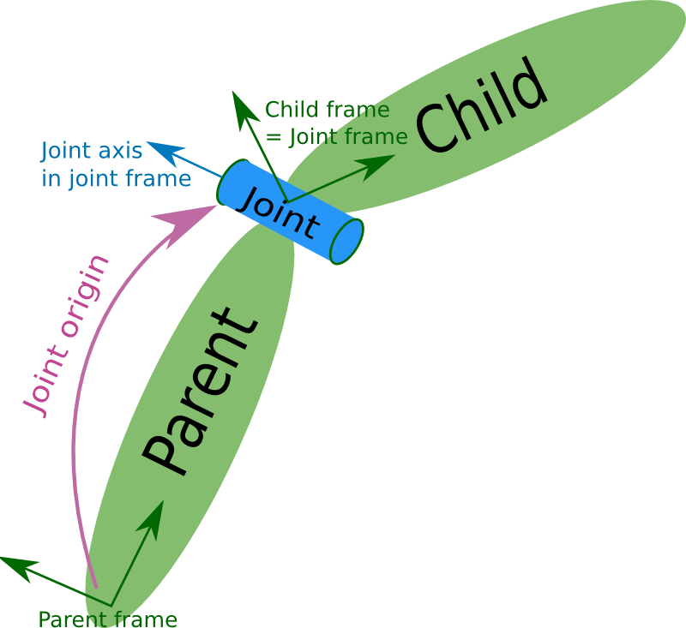
Joint’s Origin Tag
<origin> - This is the transform from the parent link to the child link. The joint is located at the origin of the child link
defaults to identity if not specified)
Has the same properties like the link’s origin tag (xyz and rpy)

Slide 15
03-origins.urdf
<?xml version="1.0"?>
<robot name="origins">
<link name="base_link">
<visual>
<geometry>
<cylinder length="0.6" radius="0.2"/>
</geometry>
</visual>
</link>
<link name="right_leg">
<visual>
<geometry>
<box size="0.6 .2 .1"/>
</geometry>
<origin rpy="0 1.57075 0" xyz="0 0 -0.3"/>
</visual>
</link>
<joint name="base_to_right_leg" type="fixed">
<parent link="base_link"/>
<child link="right_leg"/>
<origin xyz="0.22 0 .25"/>
</joint>
</robot>

Slide 16
Origins
The joint’s origin is defined in terms of the parent’s reference frame.
In this case the origin for the child link will be .22 meters in the x direction (right) and .25 meters in the z direction (up)
The leg’s visual origin defines where the center of the visual element should be relative to its origin
Here we want the leg to attach at the top, so we offset the origin down by setting the z offset to be -.3 meters
And since we want the long part of the leg to be parallel to the z axis, we rotate the visual part PI/2 around the Y axis

Slide 17

Examining the Model
$ roslaunch urdf_tutorial display.launch model:=03-origins.urdf

Slide 18
Material Girl
That’s very cute, but not all robots are red…
The material tag of the visual element allows you to specify the material used by the link element
Properties:
name – name of the material. Can refer to a previously defined material.
<color> (optional)
rgba The color of a material specified by set of four numbers representing red/green/blue/alpha, each in the range of [0,1].
<texture> (optional)
The texture of a material is specified by a filename

Slide 19
04-materials.urdf (1)
<?xml version="1.0"?>
<robot name="materials">
<link name="base_link">
<visual>
<geometry>
<cylinder length="0.6" radius="0.2"/>
</geometry>
<material name="blue">
<color rgba="0 0 .8 1"/>
</material>
</visual>
</link>
<link name="right_leg">
<visual>
<geometry>
<box size="0.6 .2 .1"/>
</geometry>
<origin rpy="0 1.57075 0" xyz="0 0 -0.3"/>
<material name="white">
<color rgba="1 1 1 1"/>
</material>
</visual>
</link>

Slide 20
04-materials.urdf (2)
<joint name="base_to_right_leg" type="fixed">
<parent link="base_link"/>
<child link="right_leg"/>
<origin xyz="0.22 0 .25"/>
</joint>
<link name="left_leg">
<visual>
<geometry>
<box size="0.6 .2 .1"/>
</geometry>
<origin rpy="0 1.57075 0" xyz="0 0 -0.3"/>
<material name="white"/>
</visual>
</link>
<joint name="base_to_left_leg" type="fixed">
<parent link="base_link"/>
<child link="left_leg"/>
<origin xyz="-0.22 0 .25"/>
</joint>
</robot>

Slide 21
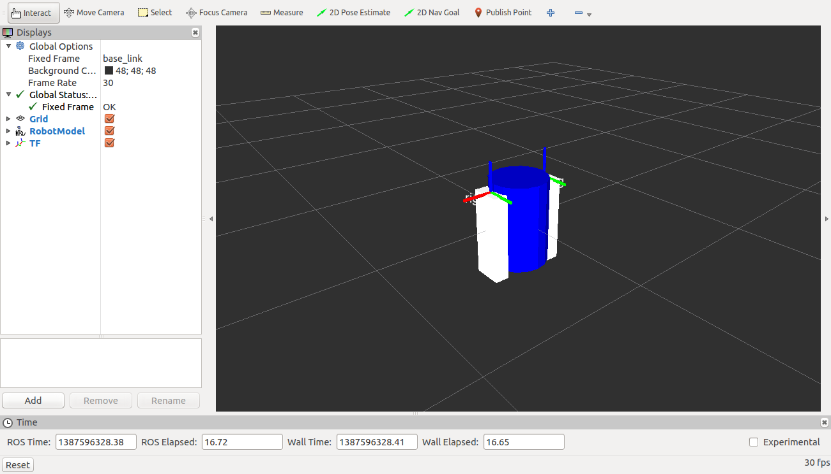
Examining the Model
$ roslaunch urdf_tutorial display.launch model:=04-materials.urdf

Slide 22
Loading Meshes to Our Model
Mesh files allow you to define more realistic elements than just using basic geometric objects/blocks
It is possible to load meshes generated by us or to use meshes of other models.
For our model we will use the PR2's gripper

Slide 23
Loading Meshes to Our Model
<link name="left_gripper">
<visual>
<origin rpy="0.0 0 0" xyz="0 0 0"/>
<geometry>
<mesh filename="package://pr2_description/meshes/gripper_v0/l_finger.dae"/>
</geometry>
</visual>
</link>

Slide 24
pr2_description
To borrow the meshes from PR2, you’ll need to install the pr2_description package:
The package contains robot description files for PR2, organized into subdirectories as follows:
urdf/ contains urdf descriptions of various parts of the PR2 (arm, torso, etc.)
robots/ contains urdf descriptions of the full robot, that refer to the macros in urdf/
gazebo/ contains urdf descriptions of simulated PR2 components, like the simulated battery controller
meshes/ contains mesh files (.stl,.dae) for visualization and collision properties
$ sudo apt-get install ros-hydro-pr2-description

Slide 25
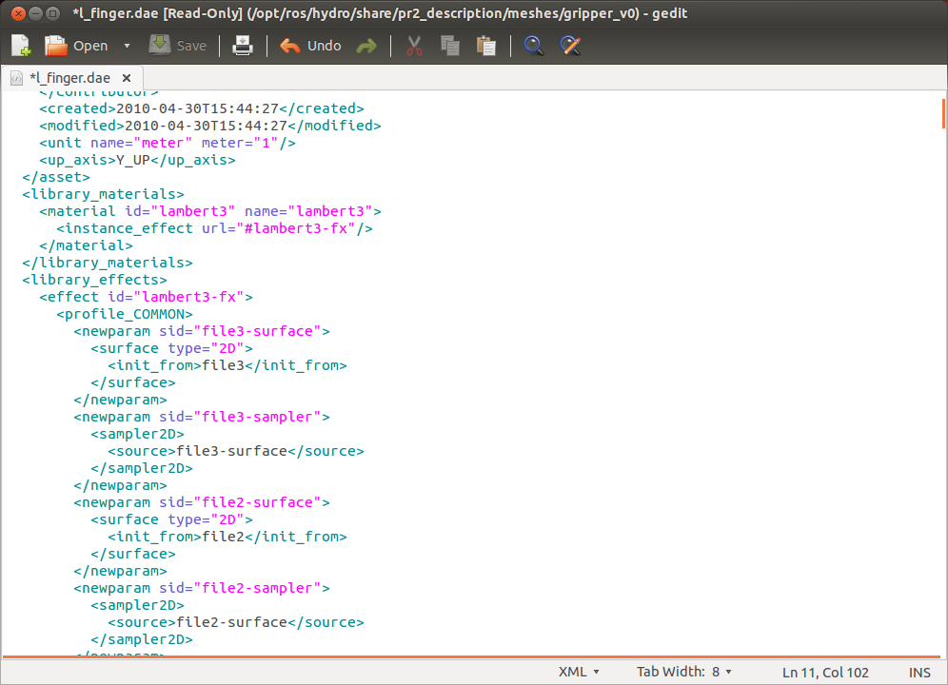
Example of a Collada File

Slide 26
Finishing the Model
Let's finish the design by adding some parts: left and right bases, four wheels and an arm with a gripper
The final urdf file is located at 05-visual.urdf

Slide 27
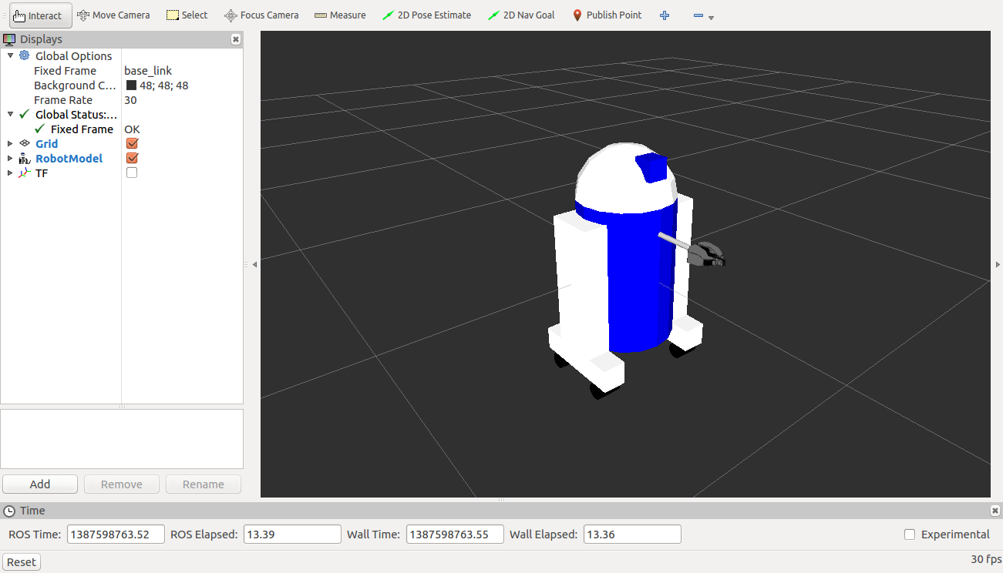
Finishing the Model
$ roslaunch urdf_tutorial display.launch model:=05-visual.urdf

Slide 28
Building a Movable Robot Model
To convert the model into a robot that can actually move, the only thing you have to do is take care of the type of the joints it uses
In the previous model, all of the joints were fixed
Now we are going to explore different types of flexible joints

Slide 29
Joint Types
revolute - a hinge joint that rotates along the axis and has a limited range specified by the upper and lower limits
continuous - a continuous hinge joint that rotates around the axis and has no upper and lower limits
prismatic - a sliding joint that slides along the axis, and has a limited range specified by the upper and lower limits
fixed - This is not really a joint because it cannot move
floating - This joint allows motion for all 6 degrees of freedom
planar - This joint allows motion in a plane perpendicular to the axis

Slide 30
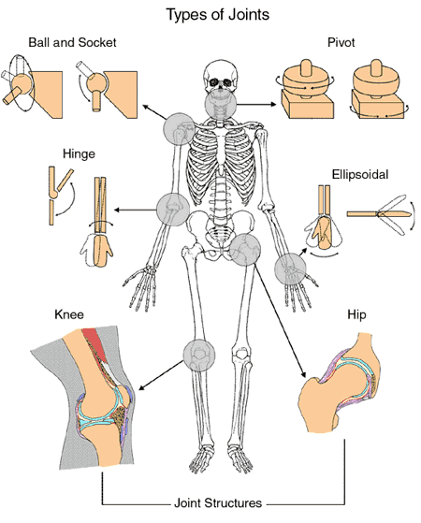
Joint Types
Compare to joint types in the human body:

Slide 31
The Head
<joint name="head_swivel" type="continuous">
<parent link="base_link"/>
<child link="head"/>
<axis xyz="0 0 1"/>
<origin xyz="0 0 0.3"/>
</joint>
The connection between the body and the head is a continuous joint, meaning that it can take on any angle from -∞ to +∞
The only additional information we have to add is the axis of rotation (the <axis> tag), which specifies a vector around which the head will rotate.
the vector "0 0 1" means it will rotate around the z axis

Slide 32
The Wheels
<joint name="right_front_wheel_joint" type="continuous">
<axis xyz="0 0 1"/>
<parent link="right_base"/>
<child link="right_front_wheel"/>
<origin rpy="0 1.57075 0" xyz="0 0.133333333333 -0.085"/>
<limit effort="100" velocity="100"/>
<dynamics damping="0.0" friction="0.0"/>
</joint>
The wheels are also modeled as continuous joints, so that they can roll in both directions forever

Slide 33
The Gripper
<joint name="left_gripper_joint" type="revolute">
<axis xyz="0 0 1"/>
<limit effort="1000.0" lower="0.0" upper="0.548" velocity="0.5"/>
<origin rpy="0 0 0" xyz="0.2 0.01 0"/>
<parent link="gripper_pole"/>
<child link="left_gripper"/>
</joint>
The right and the left gripper joints are modeled as revolute joints
This means that they rotate in the same way that the continuous joints do, but they have strict limits
Hence, we must include the <limit> tag specifying the upper and lower limits of the joint (in radians)
We also must specify a maximum velocity and effort for this joint

Slide 34
The Gripper Arm
<joint name="gripper_extension" type="prismatic">
<parent link="base_link"/>
<child link="gripper_pole"/>
<limit effort="1000.0" lower="-0.38" upper="0" velocity="0.5"/>
<origin rpy="0 0 1.57075" xyz="0 0.19 .2"/>
</joint>
The gripper arm is modeled as a prismatic joint
This means that it moves along an axis, not around it
This translational movement is what allows our robot model to extend and retract its gripper arm
The limits of the prismatic arm are specified in the same way as a revolute joint, except that the units are meters, not radians

Slide 35
Building a Movable Robot Model
06_flexible.urdf is the new urdf with flexible joints

Slide 36
Joint State Publisher
http://wiki.ros.org/joint_state_publisher
This package contains a tool for setting and publishing joint state values for a given URDF
Publishes sensor_msgs/JointState messages for all the non-fixed joints of the robot
Can be used in conjunction with the robot_state_publisher node to also publish transforms for all joint states

Slide 37
Joint State Publisher GUI
To visualize and control this model, type:
This will also pop up a GUI that allows you to control the values of all the non-fixed joints
Play with the model some and see how it moves
$ roslaunch urdf_tutorial display.launch model:=06-flexible.urdf gui:=True

Slide 38

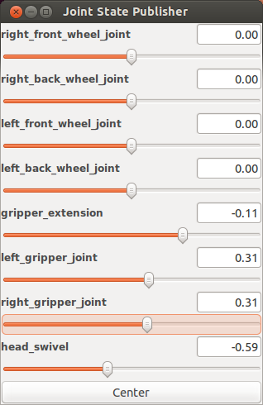
Joint State Publisher GUI

Slide 39
Adding Physical and Collision Properties
If you want to simulate the robot on Gazebo or any other simulation software, it is necessary to add physical and collision properties
We need to set on every link the dimension of the geometry to calculate the possible collisions, the weight that will give us the inertia, and so on.
07-physics.urdf is the new URDF with the physical properties

Slide 40
Collision
The collision element is a direct subelement of the link object, at the same level as the visual tag
The collision element defines its shape the same way the visual element does, with a geometry tag
The format for the geometry tag is exactly the same here as with the visual.
You can also specify an origin in the same way as a subelement of the collision tag (as with the visual)

Slide 41
Collision Element Example
<link name="base_link">
<visual>
<geometry>
<cylinder length="0.6" radius="0.2"/>
</geometry>
<material name="blue">
<color rgba="0 0 .8 1"/>
</material>
</visual>
<collision>
<geometry>
<cylinder length="0.6" radius="0.2"/>
</geometry>
</collision>
</link>

Slide 42
Collision
Usually the collision geometry is defined exactly the same as the visual geometry
There are two main cases where you wouldn’t:
Quicker Processing - Doing collision detection for two meshes is a lot more computational complex than for two simple geometries. Hence, you may want to replace the meshes with simpler geometries in the collision element.
Safe Zones - You may want to restrict movement close to sensitive equipment. For instance, if we didn’t want anything to collide with R2D2’s head, we might define the collision geometry to be a cylinder encasing his head to prevent anything from getting to near his head.

Slide 43
Inertia
Inertia is the resistance of any physical object to any change in its state of motion, including changes to its speed and direction
It is the tendency of objects to keep moving in a straight line at constant velocity
The inertia tensor depends on both the mass and the distribution of mass of the object
A good explanation on inertia tensor can be found here
The 3x3 rotational inertia matrix is specified with the inertia element
ixx | ixy | ixz
ixy | iyy | iyz
ixz | iyz | izz

Slide 44
Inertia Example
<link name="base_link">
<visual>
<geometry>
<cylinder length="0.6" radius="0.2"/>
</geometry>
<material name="blue">
<color rgba="0 0 .8 1"/>
</material>
</visual>
<collision>
<geometry>
<cylinder length="0.6" radius="0.2"/>
</geometry>
</collision>
<inertial>
<mass value="10"/>
<inertia ixx="1.0" ixy="0.0" ixz="0.0" iyy="1.0" iyz="0.0" izz="1.0"/>
</inertial>
</link>

Slide 45
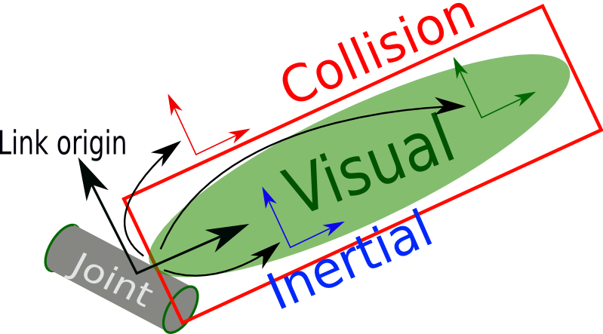
Link Element Summary
The link element describes a rigid body with an inertia, visual and collision features

Slide 46
Joint Element Summary
The joint element describes the kinematics and dynamics of the joint and also specifies the safety limits of the joint

Slide 47
Xacro
Notice the size of the 07-physics.urdf file
It has 414 lines of code to define our robot (!)
Imagine if you start to add cameras and other geometries, the file will start to increase and its maintenance will become even more complicated
Xacro helps to reduce the overall size of the URDF file and makes it easier to read and maintain.
It also allows us to create modules and reuse them to create repeated structures such as several arms or legs

Slide 48
Using Xacro
As its name implies, xacro is a macro language.
The xacro program runs all of the macros and outputs the result as a urdf file
Typical usage:
You can also automatically generate the urdf in a launch file:
$ rosrun xacro xacro.py model.xacro > model.urdf
<param name="robot_description" command="$(find xacro)/xacro.py '$(find pr2_description)/robots/pr2.urdf.xacro'" />

Slide 49
Using Xacro
In the xacro file, you must specify a namespace in order for the file to parse properly.
For example, these are the first two lines of a valid xacro file:
<?xml version="1.0"?>
<robot xmlns:xacro="http://www.ros.org/wiki/xacro" name="robot1_xacro">

Slide 50
Constants
We can use xacro to declare constant values
This way we can avoid putting the same value in a lot of lines and will make it easier to maintain changes.
You can define constants using <xacro:property> tag, usually located at the top of the file
Then to use the constant’s value, you can write ${name_of_variable}

Slide 51
Constants Example
<xacro:property name="width" value=".2" />
<xacro:property name="bodylen" value=".6" />
<link name="base_link">
<visual>
<geometry>
<cylinder radius="${width}" length="${bodylen}"/>
</geometry>
<material name="blue">
<color rgba="0 0 .8 1"/>
</material>
</visual>
<collision>
<geometry>
<cylinder radius="${width}" length="${bodylen}"/>
</geometry>
</collision>
</link>

Slide 52
Math
You can build up arbitrarily complex expressions in the ${} construct using the four basic operations (+,-,*,/), the unary minus, and parenthesis.
Exponentiation and modulus are not supported.
Examples:
<cylinder radius="${wheeldiam/2}" length=".1"/>
<origin xyz="${reflect*(width+.02)} 0 .25" />

Slide 53
Macros
Macros are the most useful component of the xacro package
Example for a simple macro:
This code will generate the following:
<xacro:macro name="default_origin">
<origin xyz="0 0 0" rpy="0 0 0"/>
</xacro:macro>
<xacro:default_origin />
<origin xyz="0 0 0" rpy="0 0 0"/>

Slide 54
Parameterized Macros
You can also parameterize macros so that they don’t generate the same exact text every time
When combined with the math functionality, this is even more powerful.
An inertia macro example:
<xacro:macro name="default_inertial" params="mass">
<inertial>
<mass value="${mass}" />
<inertia ixx="1.0" ixy="0.0" ixz="0.0"
iyy="1.0" iyz="0.0"
izz="1.0" />
</inertial>
</xacro:macro>
<xacro:default_inertial mass="10"/>

Slide 55
Example of a Leg Macro
<xacro:macro name="leg" params="prefix reflect">
<link name="${prefix}_leg">
<visual>
<geometry>
<box size="${leglen} .2 .1"/>
</geometry>
<origin xyz="0 0 -${leglen/2}" rpy="0 ${pi/2} 0"/>
<material name="white">
<color rgba="1 1 1 1"/>
</material>
</visual>
<collision>
<geometry>
<box size="${leglen} .2 .1"/>
</geometry>
<origin xyz="0 0 -${leglen/2}" rpy="0 ${pi/2} 0"/>
</collision>
<xacro:default_inertial mass="10"/>
</link>
<joint name="base_to_${prefix}_leg" type="fixed">
<parent link="base_link"/>
<child link="${prefix}_leg"/>
<origin xyz="${reflect*(width+.02)} 0 .25" />
</joint>
<!-- A bunch of stuff cut -->
</xacro:macro>
<xacro:leg prefix="right" reflect="1" />
<xacro:leg prefix="left" reflect="-1" />

Slide 56
Examining the Xacro
Here is the xacro used in the R2D2 model
Number of lines was reduced from 414 to 236
To see the model generated by the xacro file, run:
$ roslaunch urdf_tutorial xacrodisplay.launch model:=08-macroed.urdf.xacro

Slide 57
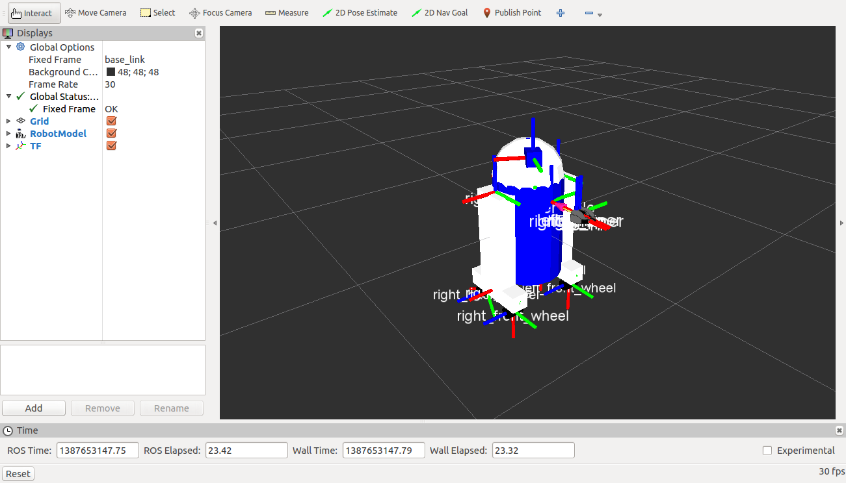
Examining the Xacro

Slide 58
URDF Verification
The robot model stack includes the command line tool check_urdf
It's called with a single command line argument naming a file
It attempts to parse the file as a URDF description, and either prints a description of the resulting kinematic chain, or an error message

Slide 59
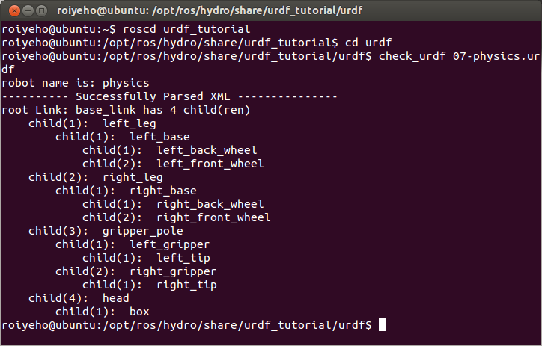
URDF Verification
For example, to run this tool on the R2D2 urdf:
$ check_urdf 07-physics.urdf

Slide 60
URDF Visualization
To get a graphviz diagram of your urdf file, type:
The result is a file called physics.pdf that looks something like this:
$ cp 07-physics.urdf /tmp
$ urdf_to_graphiz /tmp/07-physics.urdf
$ evince /tmp/physics.pdf

Slide 61
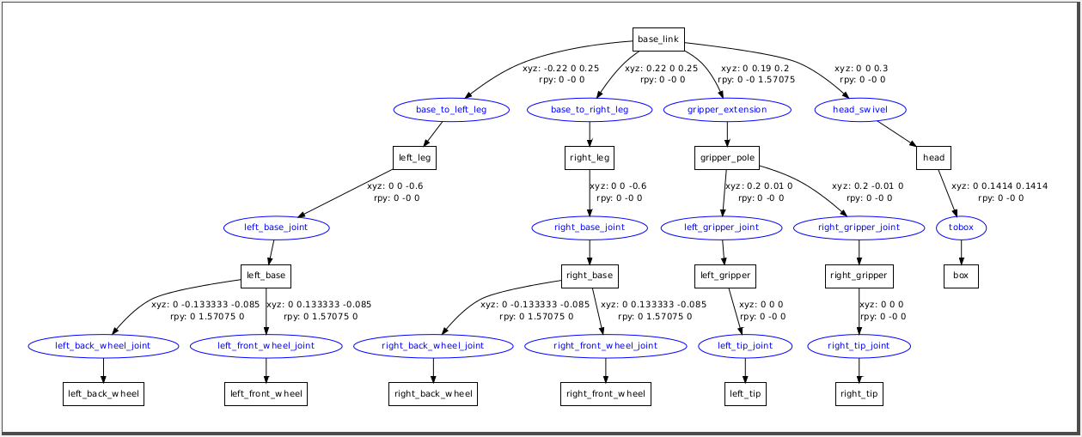
URDF Visualization

Slide 62
PR2 URDF
To see the PR2 URDF graphically, first create the urdf file by running:
Then run the urdf_to_graphiz tool:
$ rosrun xacro xacro.py `rospack find pr2_description`/robots/pr2.urdf.xacro > /tmp/pr2.urdf
$ rosrun urdfdom urdf_to_graphiz /tmp/pr2.urdf
$ evince /tmp/pr2.urdf

Slide 63
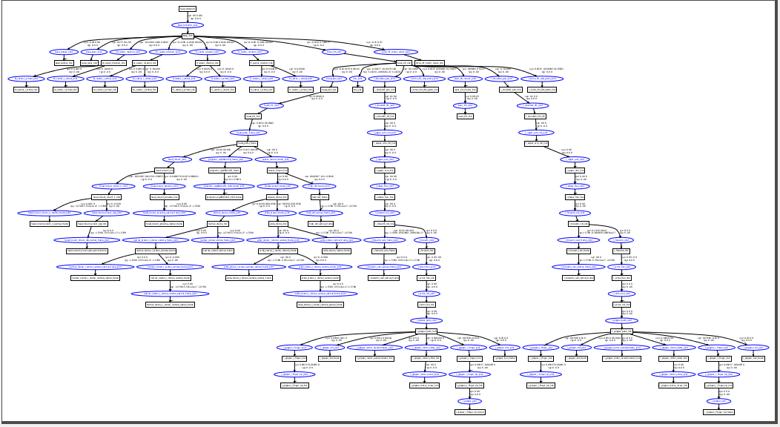
PR2 URDF

Slide 64
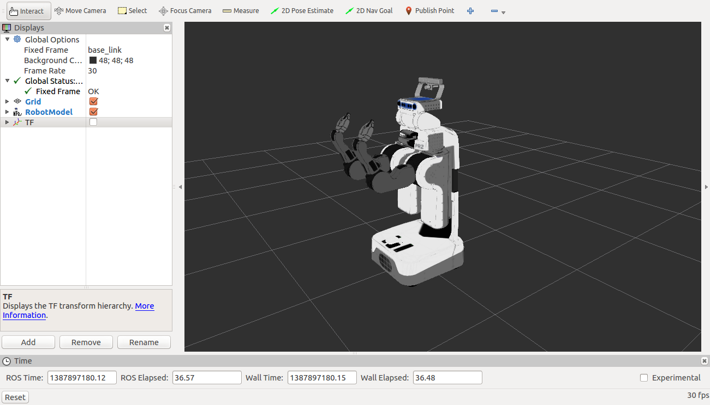
Watch PR2 in rviz
To watch PR2’s urdf in rviz, follow these steps:
$ cd /tmp
$ roslaunch urdf_tutorial display.launch model:=pr2.urdf gui:=True

Slide 65
Simulation Description Format (SDF)
SDF is an XML format that describes objects and environments for robot simulators, visualization, and control
It contains a complete description for everything from the world level down to the robot level, including:
Scene: Ambient lighting, sky properties, shadows.
Physics: Gravity, time step, physics engine.
Models: Collection of links, collision objects, joints, and sensors.
Lights: Point, spot, and directional light sources.
Plugins: World, model, sensor, and system plugins.
http://gazebosim.org/sdf.html

Slide 66
SDF vs URDF
URDF can only specify the kinematic and dynamic properties of a single robot in isolation
URDF can not specify the pose of the robot itself within a world
It cannot specify objects that are not robots, such as lights, heightmaps, etc.
Lacks friction and other properties
SDF is a complete description for everything from the world level down to the robot level

Slide 67
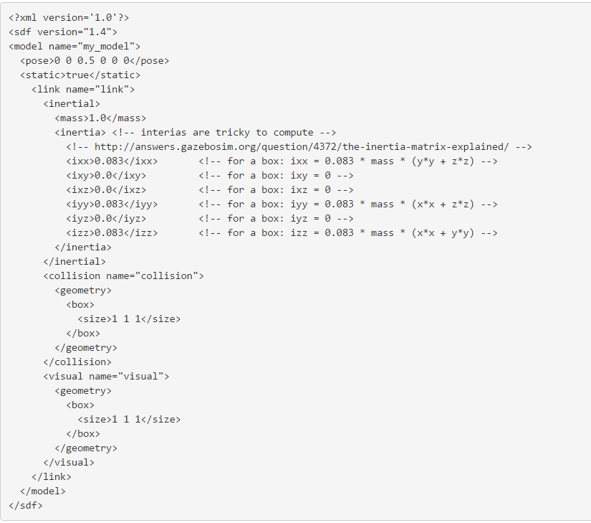
Box Model Example in SDF

Slide 68
Using URDF In Gazebo
To use a URDF file in Gazebo, some additional simulation-specific tags must be added to work properly with Gazebo
Adding these tags saves you from having to create a separate SDF file from scratch and duplicating description formats
Under the hood, Gazebo converts the URDF to SDF automatically

Slide 69
Using URDF In Gazebo
Required
An <inertia> element within each <link> element must be properly specified and configured
It’s important to specify both the <visual> and <collision> tags for each link, otherwise Gazebo will treat the link as "invisible" to laser scanners and collision checking
Optional
Add a <gazebo> element for every <link>
Convert visual colors to Gazebo format
Convert stl files to dae files for better textures
Add sensor plugins
Add a <gazebo> element for every <joint>
Set proper damping dynamics
Add actuator control plugins
Add a <gazebo> element for the <robot> element
Add a <link name="world"/> link if the robot should be rigidly attached to the world/base_link

Slide 70
The <gazebo> Element
The <gazebo> element is an extension to the URDF used for specifying additional properties needed for simulation purposes in Gazebo
None of the elements within a <gazebo> element are required because default values will be automatically included
There are 3 types of <gazebo> elements - for the <robot>, <link> tags, and <joint> tags

Slide 71
Spawn URDF Robots in Gazebo
To launch your URDF-based robot into Gazebo you use ROS service all spawn method
The spawn_model node in gazebo_ros package makes a service call request to the gazebo ROS node in order to add a custom URDF into Gazebo
You can use this script in the following way:
$ rosrun gazebo_ros spawn_model -file `rospack find r2d2_description`/urdf/r2d2.urdf -urdf -x 0 -y 0 -z 1 -model r2d2

Slide 72
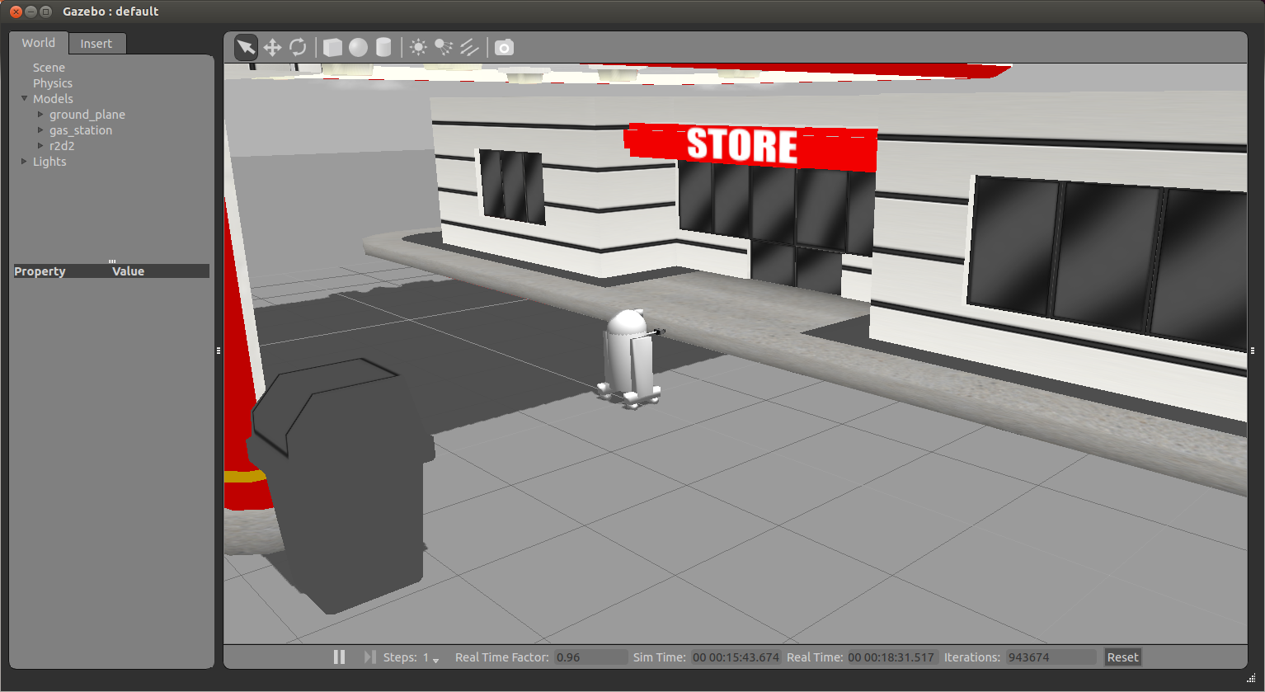
Spawn URDF Robots

Slide 73
Spawn XACRO Robots in Gazebo
If your URDF is not in XML format but rather in XACRO format, you can make a similar modification to your launch file
For example, to spawn a PR2 robot add the following to your launch file:
<!-- Convert an xacro and put on parameter server -->
<param name="robot_description" command="$(find xacro)/xacro.py $(find pr2_description)/robots/pr2.urdf.xacro" />
<!-- Spawn a PR2 robot into Gazebo -->
<node name="spawn_pr2_urdf" pkg="gazebo_ros" type="spawn_model" args="-param robot_description -urdf -x 2 -model pr2" />

Slide 74
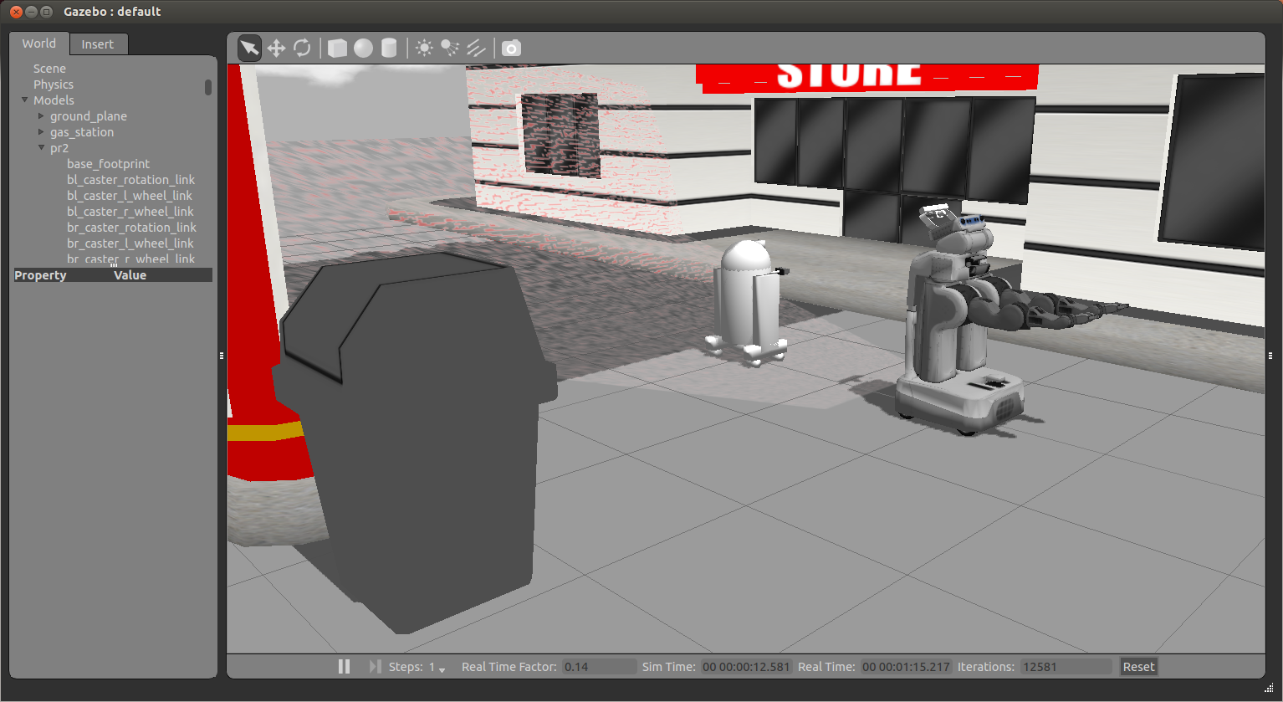
XACRO Example with PR2

Slide 75
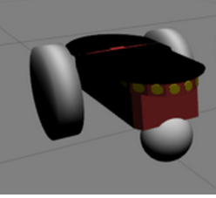
Ex. 9
Create a URDF model for the following robot
The robot contains 4 links (base, left and right wheels and a caster) and 3 joints that connect the wheels and the caster to the base
Attach to the robot's body a mesh taken from the Pioneer robot's model (model://pioneer2dx/meshes/chassis.dae)

