Slide 1

Scientific Data Services
Bob Simons
bob.simons@noaa.gov
NOAA Fisheries Service
Environmental Research Division
Pacific Grove, CA

Slide 2
I encourage data providers to…
From a users standpoint:
getting data into their favorite application is too hard!
Provide lots of metadata
Use metadata standards
Store metadata with the data
Provide web services and web applications
Use the OPeNDAP server request/response protocol
Offer the data in many file formats
Use standard time formats

Slide 3
Provide lots of metadata
What is obvious to you now, won’t be in 10 years.
Even now, the details are not obvious to all users.

Slide 4
Use metadata standards
Standards promote discoverability and interoperability – connections to the wider oceanographic community
CF - Climate and Forecast
ACDD - Attribute Convention for Dataset Discovery
FGDC – Federal Geographic Data Committee
ISO 19115/19139

Slide 5
Store metadata with the data
If separate, users may not find the metadata.
If separate, someday the metadata may be lost forever.

Slide 6
Provide web services and web applications
Web Application - a web page with a form.
Great for humans with a browser,
but can’t be automated.
(Imagine making 1000 requests by hand!)
Not consistent with other web applications.
Web Service - a request URL generates a response. RESTful.
Great for computer programs and scripts.
(Easy to automate!)
Build web applications on top of web services

Slide 7
Use the OPeNDAP server request/response protocol
Goals
  Includes schema and metadata
  User-oriented – easy to work with, easy subset selection
Options
  Protocol Buffers, Thrift, Avro, MessagePack, …
  Google’s GQL, Yahoo’s YQL
  DiGIR, TAPIR
  OGC’s WFS, SOS (Sensor Observation Service)
  OPeNDAP
  (Open Source Project for Network Data Access Protocol)
  Was DODS (Distributed Oceanographic Data Systems)
  (Thank you, Glenn Flierl!)

Slide 8
OPeNDAP
For gridded data (e.g., THREDDS server)
For tabular data (sequences)

Slide 9
Offer the data in many file formats
Different users have different favorite applications.
Don’t make users waste their time converting data from one format to another!

Slide 10
Use standard time formats
Problem: “Jan 2, 1985”, 02-JAN-1985, 1/2/85,
1985-01-02, Year+DayOfYear+TimeOfDay,
“seconds since 1970-01-01T00:00:00Z”,
“days since 1-1-1”, local time vs. GMT/Zulu time
Solution:
  Time as a human- and computer-friendly string:
  ISO 8601:2004(E) format
  e.g., 2011-09-12T17:00:00Z
  Time as a computer-friendly number:
  Unix Time in UDUNITS format
  “seconds since 1970-01-01T00:00:00Z”
  (no leap seconds?)

Slide 11
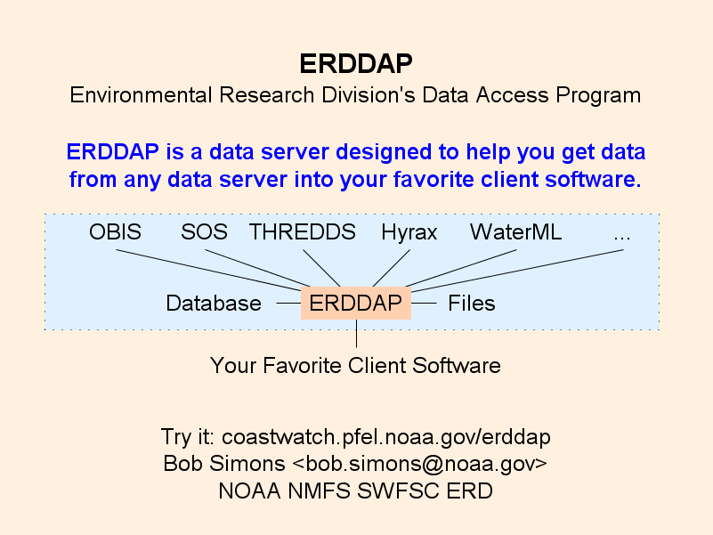

Slide 12
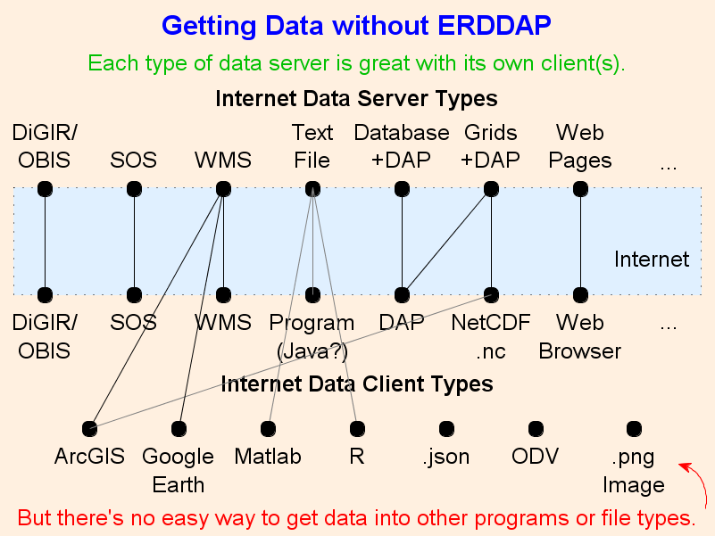

Slide 13
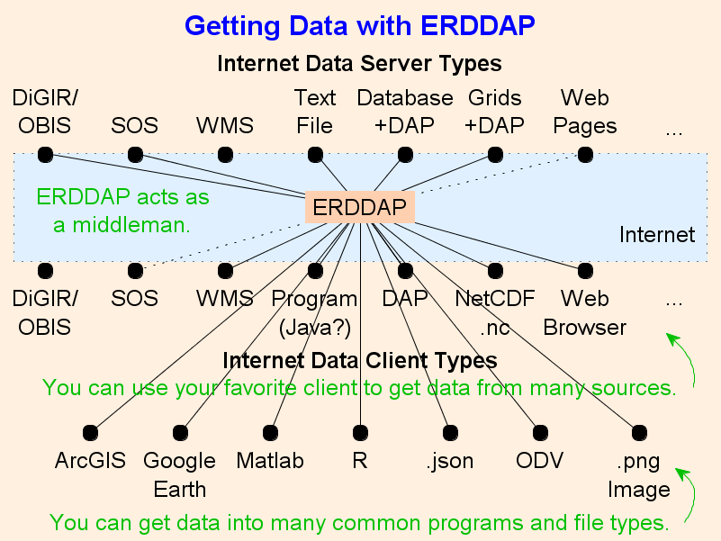

Slide 14
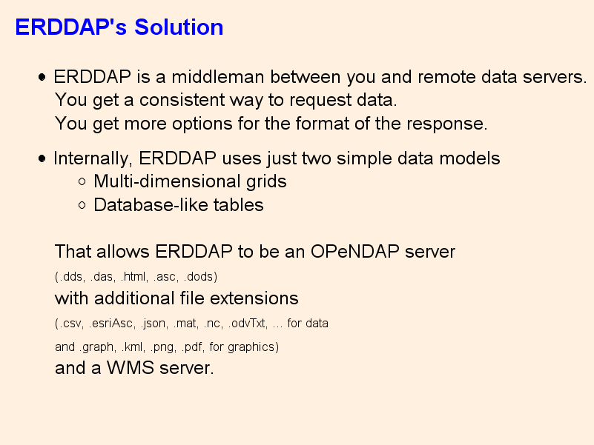

Slide 15
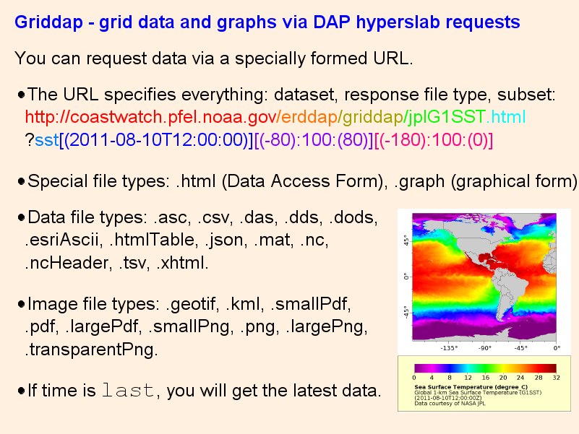

Slide 16
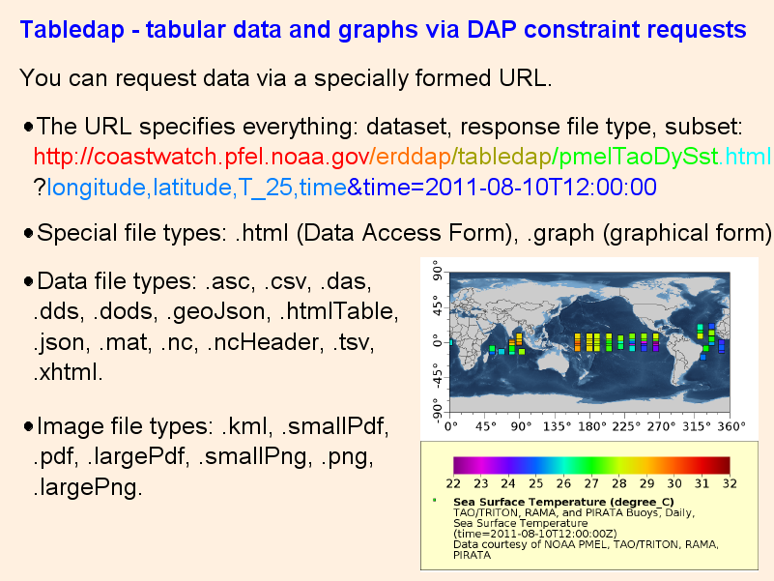

Slide 17
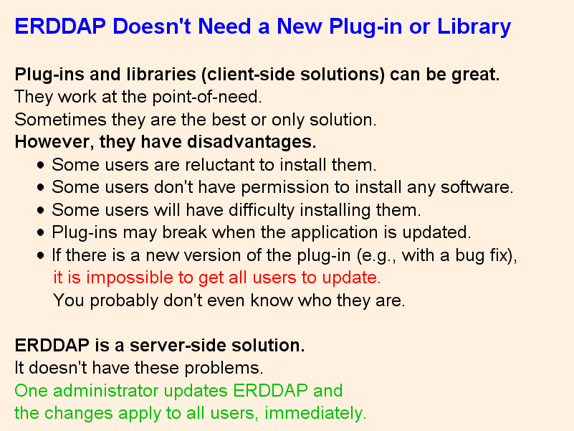

Slide 18
