Slide 1
Predicting smallholder crop yield in Ethiopia
Team Adwa - Qiyas / IADE Training Program, Addis Ababa University - 5 Oct 2026
- Task: regress yield_tons_per_ha for 3,750 leaderboard plots using only information known at or before planting.
- Three raw exports: plot survey (15,090 train / 3,750 test, 5 regions x 5 crops, 2021-2024), regional monthly weather (232 rows), market prices (100 rows).
- All three are messy: many spellings of region, -999 sentinels, blanks, duplicate weather keys, 4 prices recorded in the wrong unit.
- Approach: clean with train-fitted statistics, join the growing season (planting month + 3 months), engineer weather features, compare five models.
- Final model mlp_neural_net (tuned): holdout RMSE 0.478 t/ha, 5-fold CV 0.481 +/- 0.005, R2 0.885.

Slide 2
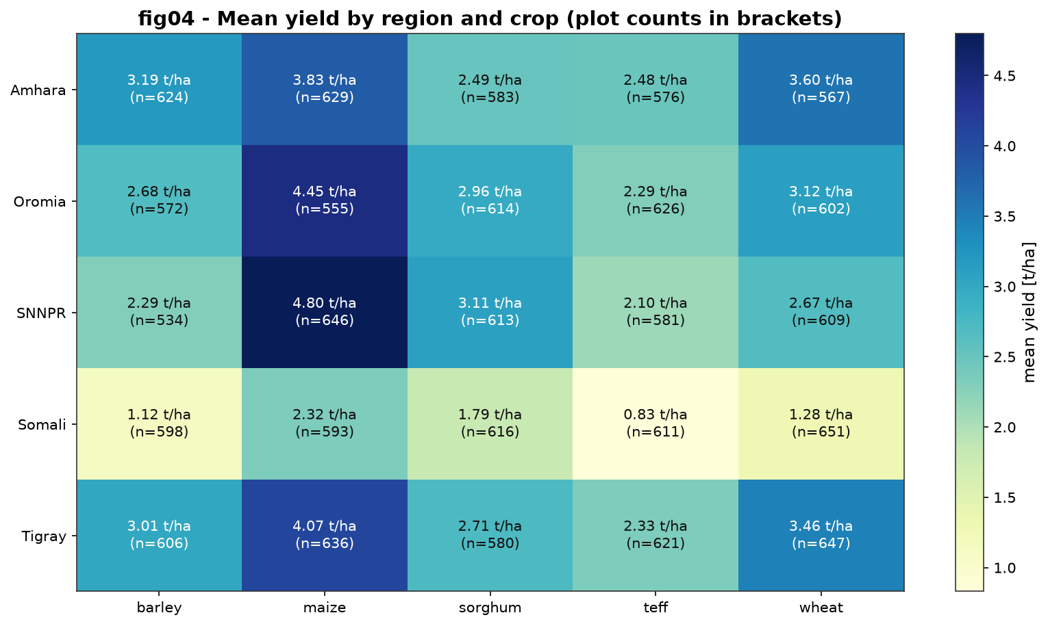
Cleaning and integration (Deliverable A)
Join map, audit and integrity checks - reports/A_cleaning_and_integration.md
- Labels standardised: 19 raw region spellings -> 5, 21 crop spellings -> 5, identical sets in every table (A2).
- -999 sentinels and blanks imputed with train medians, extreme values capped at the train 99.5th percentile, 6 duplicate weather keys averaged away.
- Weather: missing region-year-month cells filled from the region-month climatology; season = planting month + 3 months.
- Both joins many-to-one, row counts unchanged (15,090 / 3,750), match rate 100%, 0 unmatched plots; 19.4% of train and 19.9% of test plots have a partial window, flagged by wx_n_months_observed.
- 17/17 automated integrity checks PASS (A7).

Slide 3
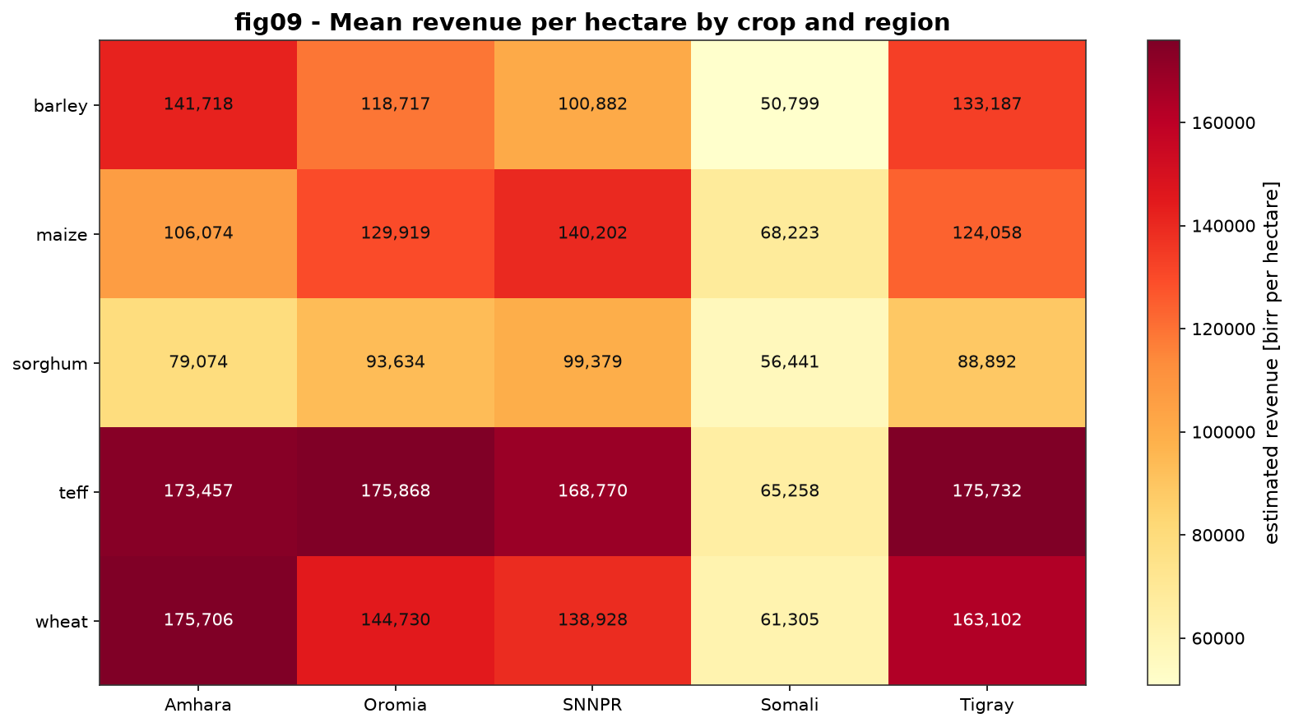
What the data says (Deliverables B and C)
Two findings - full analysis in reports/B_analysis_report.md
- Finding 1 - the crop x region cell matters more than either alone: SNNPR x maize averages 4.80 t/ha while Somali x teff averages 0.83 t/ha, a 3.97 t/ha gap.
- Finding 2 - price, not tonnage, decides revenue: teff earns the most per hectare (151,596 birr/ha) even though it is not the highest-yielding crop; improved seed adds 20.1% yield across crops.

Slide 4
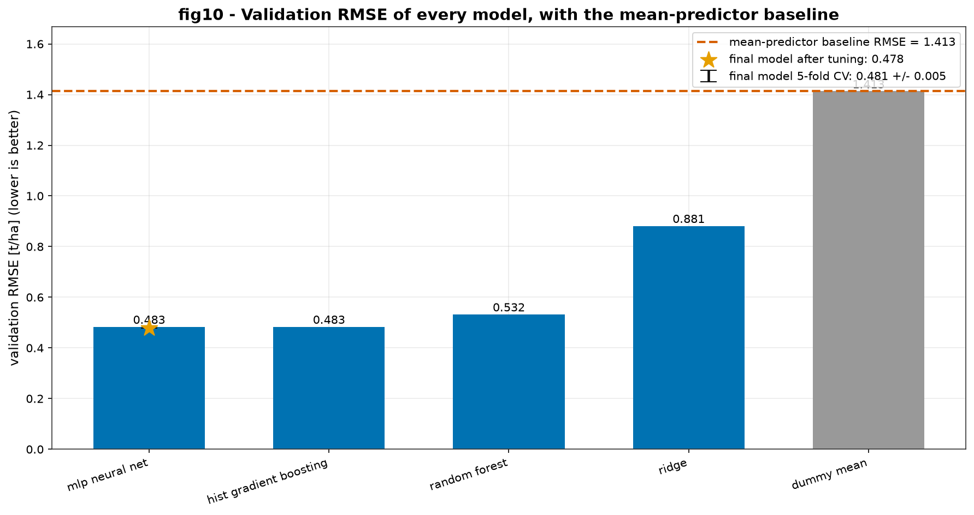
Modeling and evaluation (Deliverable D)
Same 80/20 split (seed 42), same features, held-out data only
- Five models: mean baseline 1.413 -> Ridge 0.881 -> random forest 0.532 -> HGB 0.483 -> mlp_neural_net 0.483 RMSE.
- 5-fold CV: 0.481 +/- 0.005 (runner-up hist_gradient_boosting 0.484) - CV and the single split agree.
- Weather ablation: 0.483 with weather vs 0.518 without (6.6% more error once weather is removed).
- Out-of-time 2021-2023 -> 2024: RMSE 0.564 (+0.083 vs the random split) - a real but modest season penalty.
- Tuning: 16 candidates x 3 folds, 0.483 -> 0.478 RMSE.

Slide 5
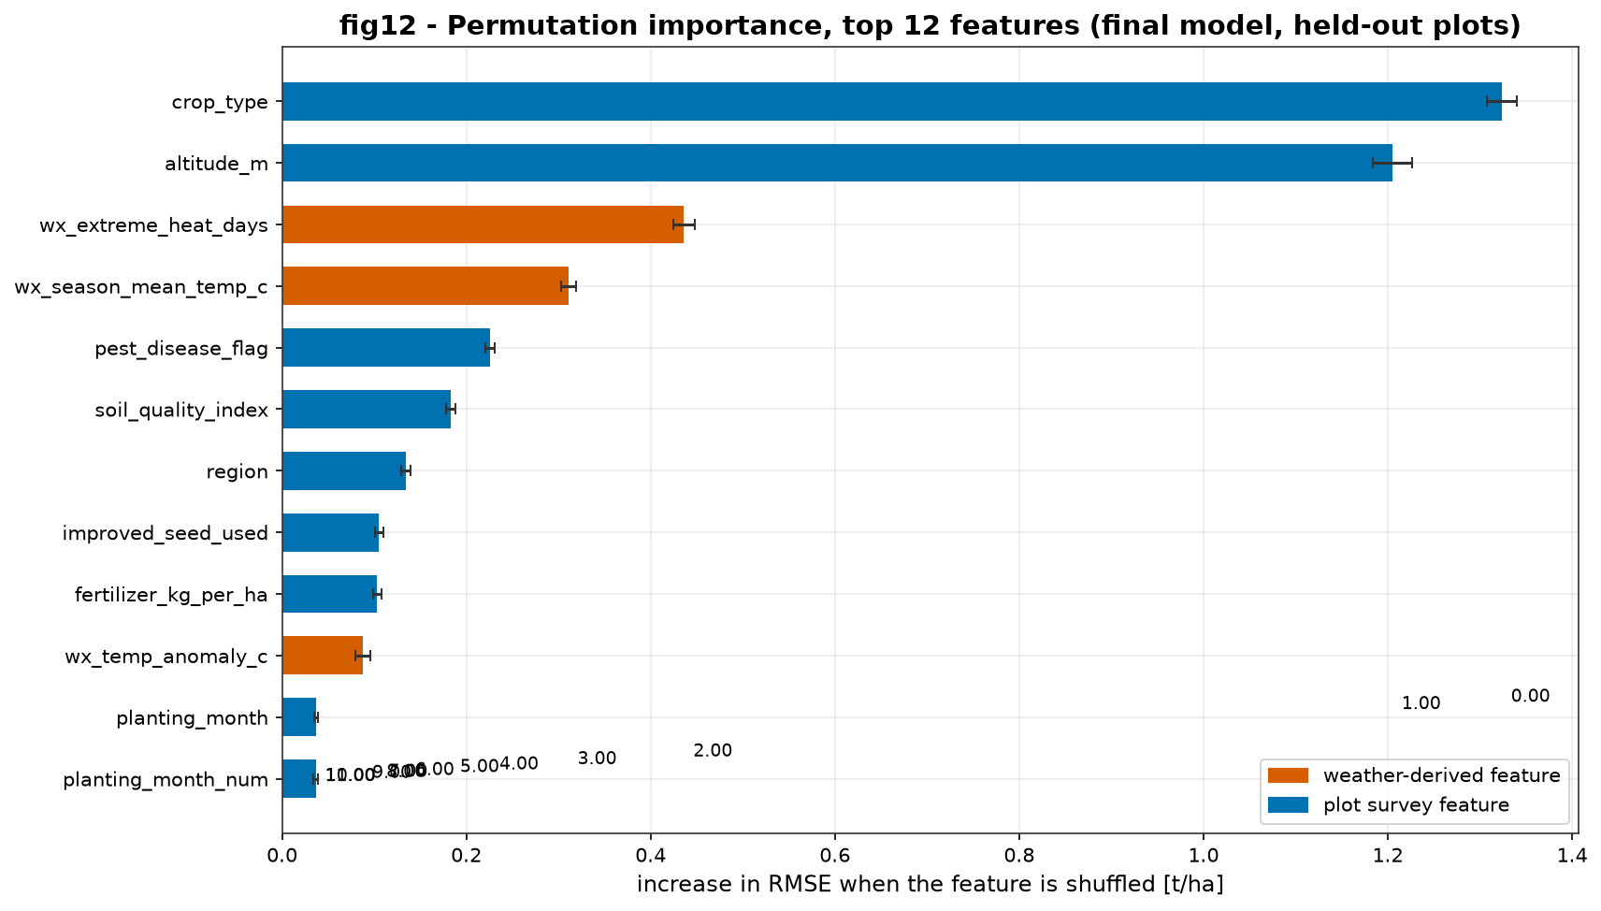
Errors, score, demo and next steps (D7-D9, E, G)
Error analysis, what we changed, and the live demo
- Hardest group: maize (RMSE 0.626 t/ha), worst region Amhara (0.545); error grows with altitude (corr -0.10) and the model under-predicts the > 5.5 t/ha tail.
- Because of D7 we tested two extra interaction features - RMSE moved to 0.494, i.e. it did not help, so we kept the 21-feature model (D8).
- Plain language: typical error 0.35 t/ha = 13% of average yield = about 15,976 birr/ha at the average price (D9).
- Score: submission/team_adwa_submission.csv - 3,750 plots, validated (G4). The leaderboard key is hidden, so our defensible number is the validation RMSE above.
- Demo: streamlit run app/app.py - weather and price are looked up automatically.
- Next: prediction intervals, per-region fairness monitoring, retraining as seasons arrive.

