Slide 1
Customer Behavior Analysis
Presented By:
Ernestine Pravina

Slide 2
AGENDA
1.Problem Statement
2.Objective
3.Datasets
4.Customer Journey and Engagement Analysis
5.Customer Review Analysis
6.Marketing Effectiveness
7.Business Recommendations

Slide 3
1.Problem Statement
Shop Easy, an online retail business, is experiencing a decline in customer engagement and conversion rates, despite investing heavily in marketing campaigns. The company has observed:
Reduced Customer Interactions: Fewer customers are engaging with the website and marketing content.
Decreased Conversion Rates: A decline in the percentage of site visitors making purchases.
High Marketing Expenses: Increased spending on digital marketing but without a proportional increase in revenue.
Customer Feedback Gaps: Poorly understood customer preferences due to lack of structured feedback analysis.

Slide 4
2.Objective
To address these challenges, Shop Easy's Marketing and Customer Experience teams have reached out for a data-driven solution that analyses customer behaviour, reviews, and journey patterns using SQL and Python.
Shop Easy is struggling with low customer engagement, poor conversion rates, and ineffective marketing strategies.
The business needs a data-driven approach using SQL and Python to analyse:
Customer journey behaviour: Identify bottlenecks in the purchase process.
Customer reviews & feedback: Understand sentiment and satisfaction trends.
Marketing effectiveness: Measure the impact of engagement on conversion.
Product & demographic analysis: Identify high-performing products and customer segments.
The objective is to provide insights that will help Shop Easy improve engagement, optimize marketing spend, and boost overall conversions.

Slide 5
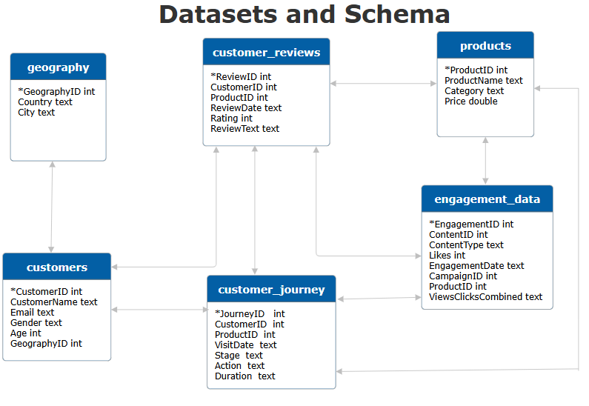
3.Datasets

Slide 6
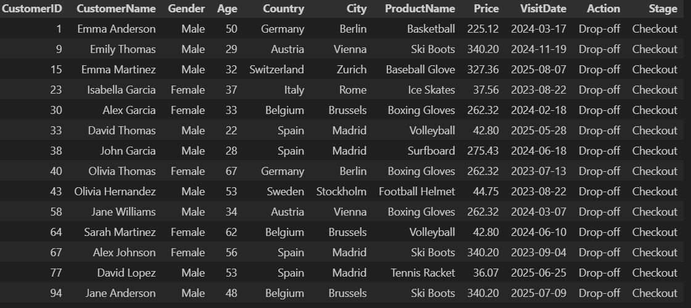

4.Customer Journey and Engagement Analysis
1.Identify drop-off points in the customer journey.
Customers are dropping off while they’re checking out the page. The drop off count is 14.

Slide 7
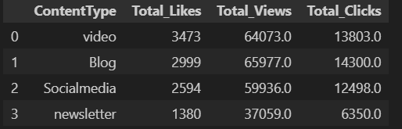
Find common actions leading to successful conversions
Top content type for conversion is video.

Slide 8
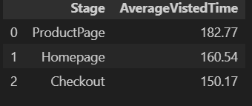
Calculating average duration per stage for engagement insights
It is evident that to have successful conversion while customers clicking or viewing the Home page (Average visit time 160.54) or Product page ((Average visit time 182.77) where they are mostly spending their time.

Slide 9
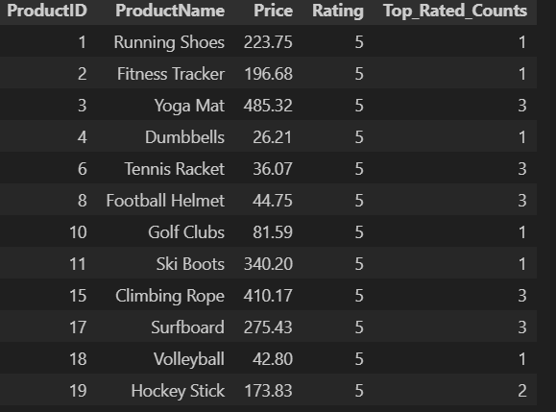
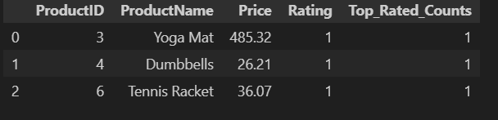
5.Customer Reviews Analysis
1.Lowest-rated products
2.Highest-rated products

Slide 10
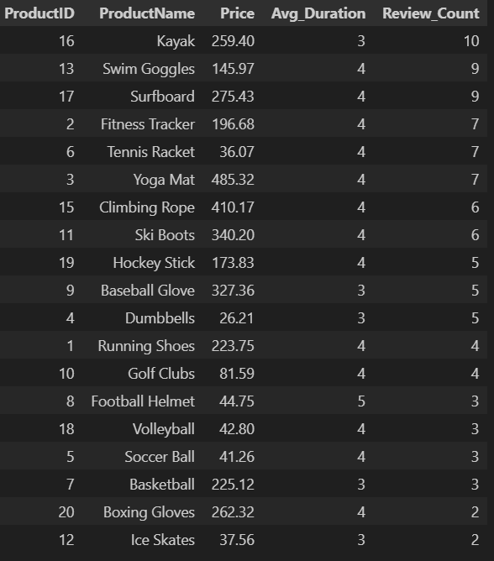
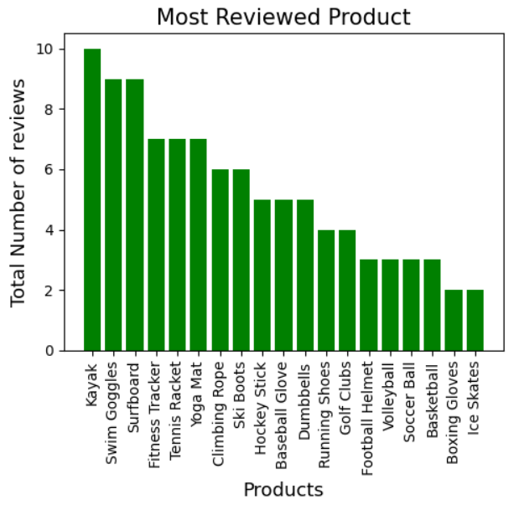
The Average visited time(Avg_duration) and Review_count

Slide 11
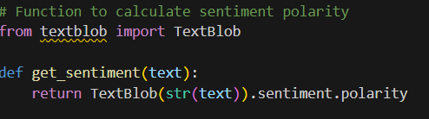
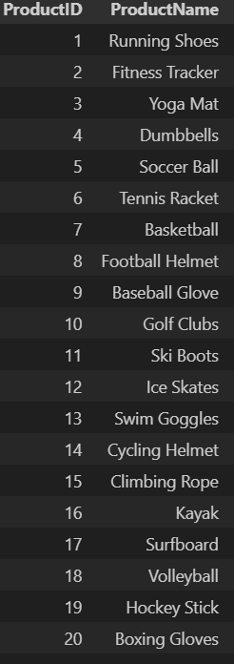
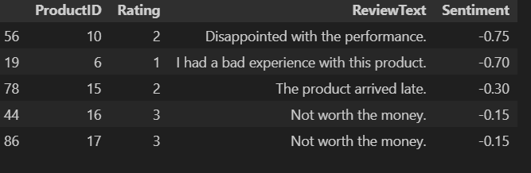
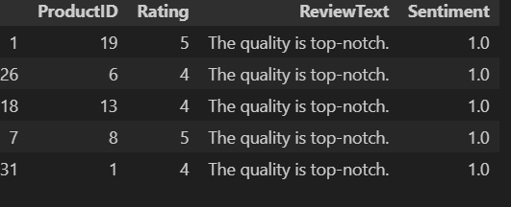
Basic sentiment analysis in Python

Slide 12
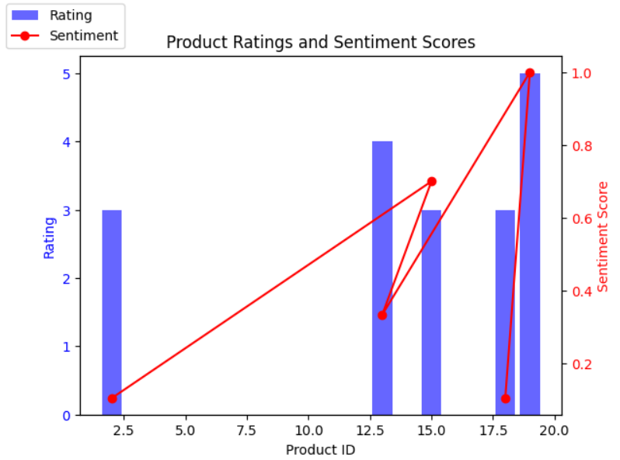
Bar twinx plot

Slide 13
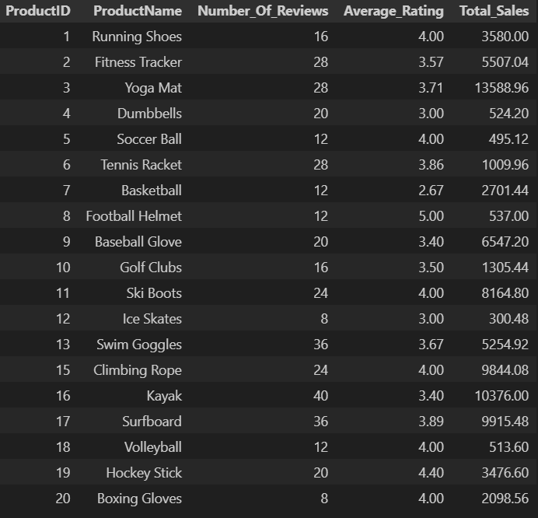
Correlate review trends with product performance
Yoga mat, Tennis racket, Dumbbells are equally having both positive and negative reviews
Products such as Kayak, Surfboard, Swim goggles are the frequent selling product as well as customers shown interest to leave the reviews
Products with less priced are most liked by the customers and they are also appreciated the quick delivery of the product.
By analysing the negative reviews, customers are quite disappointed with the products Basket Ball, Dumbbell, Fitness Tracker and Tennis Racket.
Few customers felt price of the product could be cheaper

Slide 14
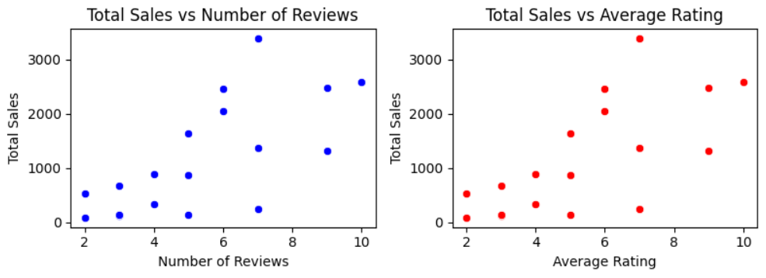
Scatter plot

Slide 15
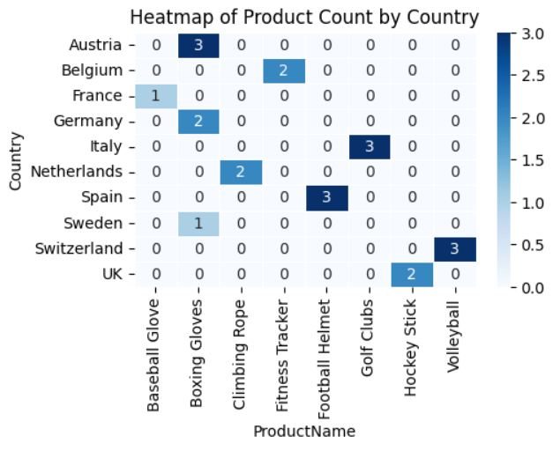
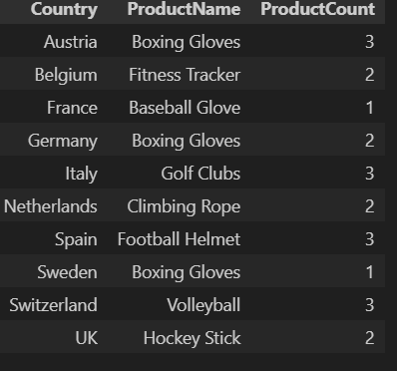
6.Marketing Effectiveness
Retention rate is only 5.26%, meaning most customers do not return.
Out of 19 buyers, 18 are first-time buyers, indicating a lack of customer retention strategies.
Each region has different top-performing products, but the sales numbers are low.

Slide 16
7.Business Recommendations
*Optimize Best-Selling Products by Region
Tailor regional marketing campaigns based on top-selling products.
Offer localized promotions and ensure optimal inventory levels.
*Enhance Customer Support & Engagement
Introduce AI chatbots and live support to reduce cart abandonment.
Improve delivery speed and return policies to increase trust.
Boost social media engagement to strengthen brand loyalty.
*Leverage Data for Continuous Improvement
Use predictive analytics to identify customers at risk of churning.
Conduct A/B testing to optimize marketing and website performance.
Regularly track customer satisfaction scores to drive enhancements.
*Increase Customer Retention
Implement loyalty programs with reward points and discounts for repeat purchases.
Use personalized follow-ups via email with product recommendations.
Offer a subscription model for frequently purchased items.
*Convert First-Time Buyers into Repeat Customers
Provide first-purchase incentives like discounts on second orders.
Improve product quality based on negative feedback.
Enhance post-purchase engagement with email surveys and onboarding content.

Slide 17
Conclusion
By focusing on customer loyalty, product personalization, and regional insights, businesses can significantly improve retention rates and customer satisfaction. Implementing these strategies will lead to higher sales, stronger brand loyalty, and a better overall shopping experience.

