Slide 1
Hosting applications in containers
Build and deploy scalable systems with Docker

Slide 2
Containers
Executable package with software + “everything needed”
Isolated environment
Separation of concerns
Developers create software and manage dependencies
IT operations focus on deployment
Benefits:
Resource usage
Consistent environment
Scaling
Platform independence (portability; testing, staging, production env.)
Isolation (cleanup, uncontrolled resource usage, …)

Slide 3
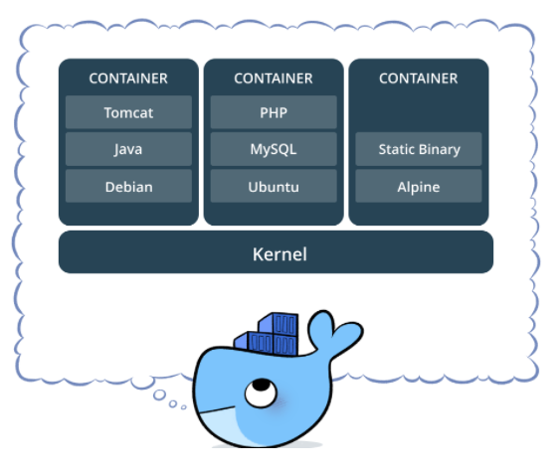

Slide 4
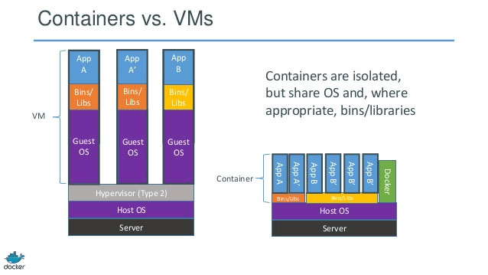
Containers vs VMs
Many OS vs one OS
Resource consumption
Application startup
Isolation
Containers are more lightweight

Slide 5
Combining containers and VMs
Yes (VMs are good place where to run your container)
Better utilization of hardware

Slide 6
Container platforms
Docker (main focus today)
Rkt
Biggest docker competitor
Runs on Linux
LXC
Earlier Docker version was build on it
LXD
+System hosting
OpenVZ
+System hosting
Quite old

Slide 7
Docker
Most popular container platform
Meant for application hosting
Open source
It runs on Linux. (you can run it on Windows and OS X but via a Linux virtual machine)

Slide 8
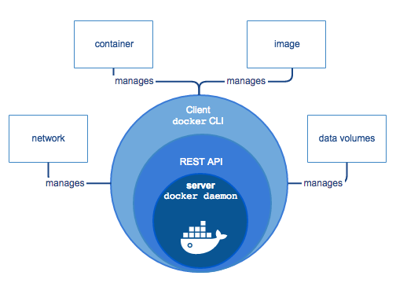
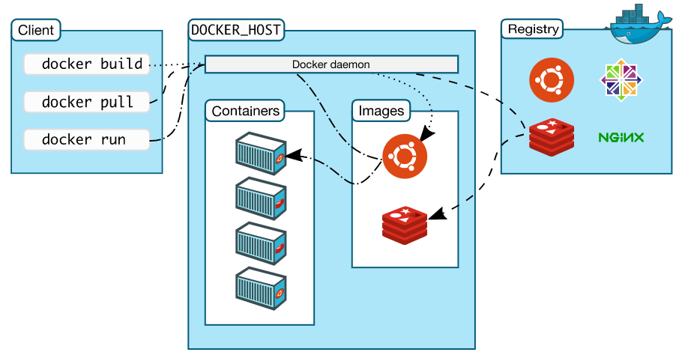
Docker architecture
Docker client – talks to the docker daemon
Docker engine (client-server)
Docker daemon (server)
REST API
CLI
Image
“snapshot” of container, immutable
build from dockerfile
Container
Instance of image
Image repositories (Docker Hub, Docker Cloud)

Slide 9
MariaDB example
docker pull
docker images
docker ps (-a)
docker run
docker start
docker stop
docker rm(i)

Slide 10

Dockerfile
Instructions how to build docker image
Parent image
Common starting point (.NET core, Ubuntu, database)
FROM is always first instruction
Base image
no parent - scratch (minimal image)
no FROM or FROM scratch
Build context

Slide 11
.dockerignore
build context
Dockerfile is part of it
can be defined recursively
is sent to Docker daemon “Sending build context to Docker daemon 35.33kB”
.dockerignore file excludes files that are not relevant for build
similar syntax as .gitignore

Slide 12
docker-compose
tool for defining and running multi-container Docker applications
yaml configuration
list of services
configuration how to build images for these services (can contain path to service docker file)

Slide 13
.NET Core 2.0
docker build -t (can target git repository)
docker-compose build
docker-compose up

Slide 14
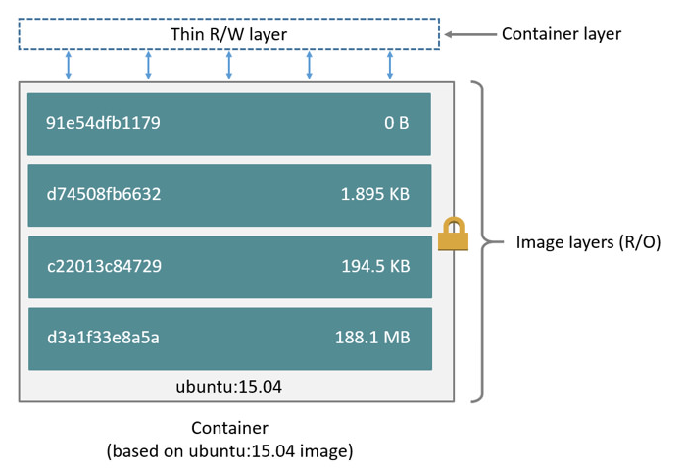
Docker layers (images and containers)
Images consist of layers
Layers can be reused
Containers are top R/W layer
not persistent
Next layer is set of differences compared to previous one

Slide 15
Docker - storage drivers
Control how images and containers are stored and managed
More than one is supported
overlay 2 , aufs, devicemapper, vfs, zfs, brtfs …
Priority list – depend also on linux distribution (Ubuntu vs. Fedora)
Can be modified (except for Windows and Mac)
File level (aufs, overlay 2, …) vs. Block level (brtfs, zfs, …)
What happens when you change storage drive?

Slide 16
Docker – application data
Volumes
file/directory on host machine is mounted into a container
best choice for data storing
Bind mounts
file/directory on host machine is mounted into a container
Docker CLI cannot be used to manage bind-mounts
tmpfs mounts
stored in memory/swap (nor container R/W layer, nor host filesystem)
cleared when container is stopped

Slide 17
Docker volumes
Recommended storage for writing data
/var/lib/docker/volumes/
Persistent
Shared between containers
Management through Docker CLI
Usages
environment variables
database
…

Slide 18
MariaDB example
docker volume
docker inspect
docker --mount source=volume_name,target=/path
docker volume create

Slide 19
Docker - Networking
Containers have their own IPs (not accessible from outside)
outgoing connections are allowed
Container MAC address is generated from its IP
DNS is the same as host uses
Docker host has IP (can be accessed from outside)
Port binding (port forwarding)
must be set during creation
nginx

Slide 20
Docker – Networking
Network drivers
bridge (default)
overlay
connect multiple docker daemons
host
host’s network is used directly (no isolation)
available for swarm services
macvlan
container is assigned MAC address
for legacy reasons
none

Slide 21
Bridge network
communication between containers on the same docker host
default bridge network
created automatically (all container connect to it unless specified otherwise)
communication via IP address
User defined bridge networks
containers expose all ports to each other
no ports are exposed to the outside world
communication via container name
can connect/disconnect on fly

Slide 22
phpMyAdmin + MariaDB
docker network create
docker network inspect
docker network connect
docker -p:8080:80

Slide 23
Docker commands
docker exec
docker attach
docker commit
docker exec -it [container_id] ./bin/bash

Slide 24
Swarm
Cluster of docker engines (pool of docker hosts becomes one)
Node
physical or virtual machine running docker engine
manager - scheduling, cluster state maintenance, … (Kubernetes)
worker
Define state -> docker maintains it
Service
image representing microservice
deployed to swarm (after service creation/update orchestrator schedules tasks)
Replicated/global services

Slide 25
Exercise

