Slide 1
Recursion

Slide 2
The Recursion Pattern
Classic example – the factorial function:
n! = 1· 2· 3· ··· · (n-1)· n
Recursive definition:
int factorial(int n)
{
if (n == 0) // base case
return 1;
else if (n == 0) // recursive case
return n * factorial(n-1);
}

Slide 3
Content of a Recursive Method
Base case(s)
Values of the input variables for which we perform no recursive calls are called base cases (there should be at least one base case).
Every possible chain of recursive calls must eventually reach a base case.
Recursive calls
Calls to the current method.
Each recursive call should be defined so that it makes progress towards a base case.

Slide 4
My Perspective (useful for many problems you see)
Decomposition
Decompose the problem into smaller identical problems
Base case
Smallest problem with known solution
Composition
Compose the solutions for smaller problems

Slide 5
To differentiate the base case
From the “recursive” case [decomposition/composition]
You must have ?

Slide 6
The Recursion Pattern
Decomposition into smaller problems?
Base case: smallest problem?
Composition of solutions?
int factorial(int n) // n >= 0
{
if (n == 0)
return 1;
else
return n * factorial(n-1);
}

Slide 7
Visualizing Recursion
Recursion trace
A box for each recursive call
An arrow from each caller to callee
An arrow from each callee to caller showing return value
Example
return
4
*
call
6
=
24
final answer
recursiveFactorial
(
4
)
return
3
*
call
2
=
6
recursiveFactorial
(
3
)
return
2
*
call
1
=
2
recursiveFactorial
(
2
)
return
1
*
call
1
=
1
recursiveFactorial
(
1
)
return
call
1
recursiveFactorial
(
0
)

Slide 8
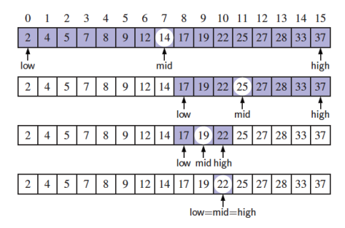
Binary Search
We consider three cases:
If the target equals data[mid], then we have found the target.
If target < data[mid], then we recur on the first half of the sequence.
If target > data[mid], then we recur on the second half of the sequence.

Slide 9
Binary Search
Search for an integer (target) in an ordered list (data)
Returns location if found, otherwise -1
int binarySearch(int data[], int target, int low, int high)
{
if (low > high) // empty interval; no match
return -1;
else
{
int mid = (low + high) / 2;
if (target == data[mid])
return mid;
else if (target < data[mid]) // look in the first half
return binarySearch(data, target, low, mid – 1);
else // look in the second half
return binarySearch(data, target mid + 1, high);
}

Slide 10
Binary Search
Search for an integer (target) in an ordered list (data)
Returns location if found, otherwise -1
int binarySearch(int data[], int target, int low, int high)
{
if (low > high) // empty interval; no match
return -1;
else
{
int mid = (low + high) / 2;
if (target == data[mid])
return mid;
else if (target < data[mid]) // look in the first half
return binarySearch(data, target, low, mid – 1);
else // look in the second half
return binarySearch(data, target mid + 1, high);
}
Decomposition?
Base case?
Composition?

Slide 11
Key operation: comparison
Number of comparisons needed for an array of size n
When does the worst case occur?
When does the best case occur?

Slide 12
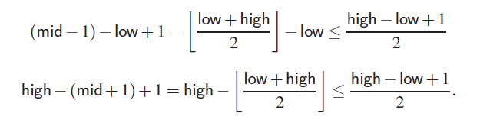
Analyzing Binary Search
After a comparison, ~half is left
The remaining portion of the list is of size high – low + 1
After one comparison, this becomes one of the following:
Thus, each recursive call divides the search region in half; hence, there can be at most log n levels

Slide 13
Worst-case Analysis
Item not in the array (size N)
T(N) = number of comparisons with array elements
T(1) = 1
T(N) = 1 + T(N / 2)

Slide 14
Worst-case Analysis
Item not in the array (size N)
T(N) = number of comparisons with array elements
T(1) = 1
T(N) = 1 + T(N / 2)

Slide 15
Worst-case Analysis
Item not in the array (size N)
T(N) = number of comparisons with array elements
T(1) = 1
T(N) = 1 + T(N / 2)
= 1 + [1 + T(N / 4)]

Slide 16
Worst-case Analysis
Item not in the array (size N)
T(N) = number of comparisons with array elements
T(1) = 1
T(N) = 1 + T(N / 2)
= 1 + [1 + T(N / 4)]
= 2 + T(N / 4)
= 2 + [1 + T(N / 8)]

Slide 17
Worst-case Analysis
Item not in the array (size N)
T(N) = number of comparisons with array elements
T(1) = 1
T(N) = 1 + T(N / 2) ←
= 1 + [1 + T(N / 4)]
= 2 + T(N / 4) ←
= 2 + [1 + T(N / 8)]
= 3 + T(N / 8) ←
= …

Slide 18
Worst-case Analysis
Item not in the array (size N)
T(N) = number of comparisons with array elements
T(1) = 1
T(N) = 1 + T(N / 2) ←
= 1 + [1 + T(N / 4)]
= 2 + T(N / 4) ←
= 2 + [1 + T(N / 8)]
= 3 + T(N / 8) ←
= …
= k + T(N / 2^{k} ) [1]

Slide 19
Worst-case Analysis
T(N) = k + T(N / 2^{k} ) [1]

Slide 20
Worst-case Analysis
T(N) = k + T(N / 2^{k} ) [1]
T(N / 2^{k} ) gets smaller until the base case: T(1)
2^{k} = N
k = log₂N

Slide 21
Worst-case Analysis
T(N) = k + T(N / 2^{k} ) [1]
T(N / 2^{k} ) gets smaller until the base case: T(1)
2^{k} = N
k = log₂N
Replace terms with k in [1]:
T(N) = log₂N + T(N / N)
= log₂N + T(1)
= log₂N + 1

Slide 22
Worst-case Analysis
T(N) = k + T(N / 2^{k} ) [1]
T(N / 2^{k} ) gets smaller until the base case: T(1)
2^{k} = N
k = log₂N
Replace terms with k in [1]:
T(N) = log₂N + T(N / N)
= log₂N + T(1)
= log₂N + 1
O(log₂N) algorithm
We used recurrence equations

Slide 23
Linear Recursion
Test for base cases
Every possible chain of recursive calls must eventually reach a base case.
Recur once
Perform a single recursive call
Might branch to one of several possible recursive calls
makes progress towards a base case.

Slide 24
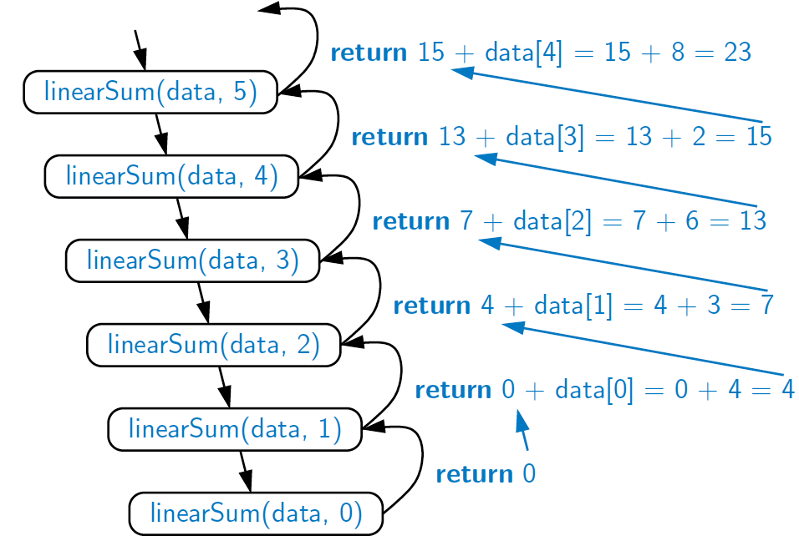
Example of Linear Recursion
Recursion trace of linearSum(data, 5) called on array data = [4, 3, 6, 2, 8]
Algorithm linearSum(A, n):
Input:
Array, A, of integers
Integer n such that
0 ≤ n ≤ |A|
Output:
Sum of the first n integers in A
if n = 0 then
return 0
else
return
linearSum(A, n - 1) + A[n - 1]

Slide 25
Example of Linear Recursion
Recursion trace of linearSum(data, 5) called on array data = [4, 3, 6, 2, 8]
Algorithm linearSum(A, n):
Input:
Array, A, of integers
Integer n such that
0 ≤ n ≤ |A|
Output:
Sum of the first n integers in A
if n = 0 then
return 0
else
return
linearSum(A, n - 1) + A[n - 1]
Decomposition?
Base case?
Composition?

Slide 26
Reversing an Array
Algorithm reverseArray(A, low, high):
Input: An array A and nonnegative integer indices low and high
Output: The reversal of the elements in A starting at index low and ending at high
Decomposition?
Base case?
Composition?

Slide 27
Reversing an Array
Algorithm reverseArray(A, low, high):
Input: An array A and nonnegative integer indices low and high
Output: The reversal of the elements in A starting at index low and ending at high
if low < high then
reverseArray(A, low + 1, high − 1)
Swap A[low] and A[high]
return

Slide 28
Defining Arguments for Recursion
sometimes requires additional parameters
reverseArray(A, low, high)
not reverseArray(A)
void reverseArray(int data[], int low, int high)
{
if (low < high)
{
reverseArray(data, low + 1, high – 1);
int temp = data[low];
data[low] = data[high];
data[high] = temp;
}
}

Slide 29
Computing Powers
The power function, p(x,n)=x^{n}, can be defined recursively:
This leads to an power function that runs in O(n) time (for we make n recursive calls)
Can we do better?

Slide 30
Recursive Squaring
We can derive a more efficient linearly recursive algorithm by using repeated squaring:
For example,
2⁴ = 2^{(4/2)2} = (2^{4/2})² = (2²)² = 4² = 16
2⁵ = 2^{1+(4/2)2} = 2(2^{4/2})² = 2(2²)² = 2(4²) = 32
2⁶ = 2^{(6/ 2)2} = (2^{6/2})² = (2³)² = 8² = 64
2⁷ = 2^{1+(6/2)2} = 2(2^{6/2})² = 2(2³)² = 2(8²) = 128

Slide 31
Recursive Squaring Method
Algorithm Power(x, n):
Input: A number x and integer n >= 0
Output: The value x^{n}
if n = 0 then
return 1
if n is odd then
y = Power(x, (n - 1)/ 2)
return x · y ·y
else
y = Power(x, n/ 2)
return y · y

Slide 32
Recursive Squaring Method
Algorithm Power(x, n):
Input: A number x and integer n >= 0
Output: The value x^{n}
if n = 0 then
return 1
if n is odd then
y = Power(x, (n - 1)/ 2)
return x · y ·y
else
y = Power(x, n/ 2)
return y · y
Decomposition?
Base case?
Composition?

Slide 33
Analysis
Algorithm Power(x, n):
Input: A number x and integer n >= 0
Output: The value x^{n}
if n = 0 then
return 1
if n is odd then
y = Power(x, (n - 1)/ 2)
return x · y · y
else
y = Power(x, n/ 2)
return y · y
Each time we make a recursive call we halve the value of n; hence, we make log n recursive calls. That is, this method runs in O(log n) time.
It is important that we use a variable twice here rather than calling the method twice.

Slide 34
Analysis
Algorithm Power(x, n):
Input: A number x and integer n >= 0
Output: The value x^{n}
if n = 0 then return 1
else if n = 1 then return x
else if n is odd then
y = Power(x, (n - 1)/ 2)
return x · y · y
else
y = Power(x, n/ 2)
return y · y
More formally, similar to binary search:
T(n) is # of multiplications
T(n) = 1 + T(n/2)
T(1) = 0
…
O(log n) algorithm

Slide 35
Tail Recursion
linearly recursive method makes its recursive call as its last step.
The array reversal method is an example.
Such methods can be easily converted to non-recursive methods (which saves on some resources).
Example:
Algorithm IterativeReverseArray(A, low, high ):
Input: An array A and indices low and high
Output: The reversal of the elements in A starting at index low and ending at high
while low < high do
Swap A[low] and A[high ]
low = low + 1
high = high - 1
return

Slide 36
Binary Recursion
two recursive calls for each non-base case.

Slide 37
Binary Recursion
Problem: add all the numbers in an integer array A:
Algorithm BinarySum(A, i, n):
Input: An array A and integers i and n
Output: The sum of the n integers in A starting at index i
if n = 1 then
return A[i]
return BinarySum(A, i, n/ 2) + BinarySum(A, i + n/ 2, n/ 2)
Example trace:
0
,
8
0
,
4
4
,
4
0
,
2
2
,
2
4
,
2
6
,
2
0
,
1
1
,
1
2
,
1
3
,
1
4
,
1
5
,
1
6
,
1
7
,
1

Slide 38
Binary Recursion
Problem: add all the numbers in an integer array A:
Algorithm BinarySum(A, i, n):
Input: An array A and integers i and n
Output: The sum of the n integers in A starting at index i
if n = 1 then
return A[i]
return BinarySum(A, i, n/ 2) + BinarySum(A, i + n/ 2, n/ 2)
Example trace:
Decomposition?
Base case?
Composition?
0
,
8
0
,
4
4
,
4
0
,
2
2
,
2
4
,
2
6
,
2
0
,
1
1
,
1
2
,
1
3
,
1
4
,
1
5
,
1
6
,
1
7
,
1

Slide 39
Computing Fibonacci Numbers
Fibonacci numbers are defined recursively:
F₀ = 0
F₁ = 1
F_{i} = F_{i-1} ⁺ F_{i-2} for i > 1.
Recursive algorithm (first attempt):
Algorithm BinaryFib(k):
Input: Nonnegative integer k
Output: The kth Fibonacci number F_{k}
if k = 1 then
return k
else
return BinaryFib(k − 1) + BinaryFib(k − 2)

Slide 40
Computing Fibonacci Numbers
Fibonacci numbers are defined recursively:
F₀ = 0
F₁ = 1
F_{i} = F_{i-1} ⁺ F_{i-2} for i > 1.
Recursive algorithm (first attempt):
Algorithm BinaryFib(k):
Input: Nonnegative integer k
Output: The kth Fibonacci number F_{k}
if k = 1 then
return k
else
return BinaryFib(k − 1) + BinaryFib(k − 2)
Decomposition?
Base case?
Composition?

Slide 41
Analysis
Let n_{k} be the number of operations by BinaryFib(k)
n₀ = 1
n₁ = 1
n₂ = n₁ + n₀ + 1 = 1 + 1 + 1 = 3
n₃ = n₂ + n₁ + 1 = 3 + 1 + 1 = 5
n₄ = n₃ + n₂ + 1 = 5 + 3 + 1 = 9
n₅ = n₄ + n₃ + 1 = 9 + 5 + 1 = 15
n₆ = n₅ + n₄ + 1 = 15 + 9 + 1 = 25
n₇ = n₆ + n₅ + 1 = 25 + 15 + 1 = 41
n₈ = n₇ + n₆ + 1 = 41 + 25 + 1 = 67.
Note that n_{k} at least doubles every other time

Slide 42
Analysis
Let n_{k} be the number of recursive calls by BinaryFib(k)
n₀ = 1
n₁ = 1
n₂ = n₁ + n₀ + 1 = 1 + 1 + 1 = 3 2^{k/2} = 2¹ = 2
n₃ = n₂ + n₁ + 1 = 3 + 1 + 1 = 5
n₄ = n₃ + n₂ + 1 = 5 + 3 + 1 = 9 2^{k/2} = 2² = 4
n₅ = n₄ + n₃ + 1 = 9 + 5 + 1 = 15
n₆ = n₅ + n₄ + 1 = 15 + 9 + 1 = 25 2^{k/2}= 2³ = 8
n₇ = n₆ + n₅ + 1 = 25 + 15 + 1 = 41
n₈ = n₇ + n₆ + 1 = 41 + 25 + 1 = 67. 2^{k/2}= 2⁴ = 16
Note that n_{k} at least doubles every other time
n_{k} > 2^{k/2} . It is exponential!

Slide 43
A Better Fibonacci Algorithm
Use linear recursion instead
Algorithm LinearFibonacci(k):
Input: A nonnegative integer k
Output: Pair of Fibonacci numbers (F_{k} , F_{k−1})
if k = 1 or 0 then
return (k, 0)
else
(F_{k−1}, F_{k−2}) = LinearFibonacci(k − 1)
return (F_{k−1}+ F_{k−2}, F_{k−1})
k−1 recursive calls. It is linear.

Slide 44
A Better Fibonacci Algorithm
Use linear recursion instead
Algorithm LinearFibonacci(k):
Input: A nonnegative integer k
Output: Pair of Fibonacci numbers (F_{k} , F_{k−1})
if k = 1 or 0 then
return (k, 0)
else
(F_{k−1}, F_{k−2}) = LinearFibonacci(k − 1)
return (F_{k−1} + F_{k−2}, F_{k−1})
Decomposition?
Base case?
Composition?

Slide 45
Multiple Recursion
makes potentially many recursive calls
not just one or two

Slide 46
Summation puzzles
pot + pan = bib
Each character/variable has a different digit
pot
+ pan
-----
bib
p=?
o=?
t=?
a=?
n=?
b=?
i=?

Slide 47
Summation puzzles
pot + pan = bib
Each character/variable has a different digit
pot
+ pan
-----
bib
p=4
o=2
t=1
a=3
n=7
b=8
i=5
421
+ 437
-----
858

Slide 48
Example
Slide by Matt Stallmann included with permission.
cbb + ba = abc
a, b, or c could be 7,8, or 9

Slide 49
Example
Slide by Matt Stallmann included with permission.
a, b, or c could be 7, 8, or 9
cbb + ba = abc
799 + 98 = 897
[] {a,b,c}
[a] {b,c}
a=7
[b] {a,c}
b=7
[c] {a,b}
c=7
1st var is 7
[ab] {c}
a=7,b=8
c=9
[ac] {b}
a=7,c=8
b=9
[ca] {b}
c=7,a=8
b=9
[cb] {a}
c=7,b=8
a=9
[ba] {c}
b=7,a=8
c=9
[bc] {a}
b=7,c=8
a=9
2nd var is 8;
3rd must be 9
might be able to
stop sooner

Slide 50
Example
Slide by Matt Stallmann included with permission.
Decomposition?
Base case?
Composition? (hint: going down, not up)
cbb + ba = abc
799 + 98 = 897
[] {a,b,c}
[a] {b,c}
a=7
[b] {a,c}
b=7
[c] {a,b}
c=7
[ab] {c}
a=7,b=8
c=9
[ac] {b}
a=7,c=8
b=9
[ca] {b}
c=7,a=8
b=9
[cb] {a}
c=7,b=8
a=9
[ba] {c}
b=7,a=8
c=9
[bc] {a}
b=7,c=8
a=9
might be able to
stop sooner

Slide 51
Visualizing PuzzleSolve
cbb + ba = abc
a, b, or c could be 7,8, or 9
Initial call
PuzzleSolve
(
3
,
()
,{
a
,
b
,
c
}
)
PuzzleSolve
(
2
,
b
,{
a
,
c
}
)
PuzzleSolve
(
2
,
c
,{
a
,
b
PuzzleSolve
}
)
(
2
,
a
,{
b
,
c
}
)
PuzzleSolve
(
1
,
ab
,{
c
}
)
PuzzleSolve
(
1
,
ba
,{
c
}
)
PuzzleSolve
(
1
,
ca
,{
b
}
)
abc
bac
cab
PuzzleSolve
(
1
,
ac
,{
b
}
)
PuzzleSolve
(
1
,
bc
,{
a
}
)
PuzzleSolve
(
1
,
cb
,{
a
}
)
acb
bca
cba
b=7
c=8
a=9
1st var is 7, 2nd var is 8, 3rd var is 9

Slide 52
Algorithm for Multiple Recursion
Algorithm PuzzleSolve(k,S,U):
Input: Integer k, sequence S, and set U (universe of elements to test)
Output: Enumeration of all k-length extensions to S using elements in U without repetitions and output all S that solve the puzzle
Unew = U
for each e in U do
Remove e from Unew {e is now being used}
Add e to the end of S {e is part of sequence}
if k = 1 then
Test whether S is a configuration that solves the puzzle
if S solves the puzzle then
output “Solution found: ” S
else
PuzzleSolve(k - 1, S, Unew)
Add e back to Unew {e is now unused}
Remove e from the end of S {e is not part of sequence}
return

