Slide 1

Arrays

Slide 2
Array Definition
An array is a sequenced collection of variables all of the same type. Each variable, or cell, in an array has an index, which uniquely refers to the value stored in that cell. The cells of an array, A, are numbered 0, 1, 2, and so on.
Each value stored in an array is often called an element of that array.
A
0
1
2
i
n

Slide 3
Array Length and Capacity
Since the length of an array determines the maximum number of things that can be stored in the array ---capacity.
In Java, the length of an array named a can be accessed using the syntax a.length.
numbered 0, 1, 2, and so on, up through a.length−1,
the cell with index k can be accessed with syntax a[k].
a
0
1
2
k
n

Slide 4
Declaring Arrays
The first way to create an array:
elementType arrayName[size];
The elementType
base type or class name,
arrayName
Valid identifier

Slide 5
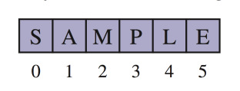
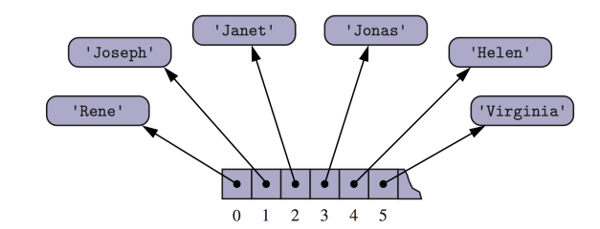
Arrays of Characters or Object/struct References
An array can store primitive elements, such as characters.
An array can also store references to structs.

Slide 6
Adding an Entry
To add an entry e into array board at index i, we need to make room for it by shifting forward the n − i entries board[i], …, board[n – 1]
board
0
1
2
i
n
board
0
1
2
i
n
board
e
0
1
2
i
n

Slide 7
Removing an Entry
To remove the entry e at index i, we need to fill the hole left by e by shifting backward the n − i − 1 elements board[i + 1], …, board[n – 1]
board
e
0
1
2
i
n
board
0
1
2
i
n
board
0
1
2
i
n

Slide 8
Disadvantages of arrays?

Slide 9
Disadvantages of arrays?
Need to know the maximum size before hand
If elements need to be kept in order
Inserting/deleting an element requires moving (lots of) elements
Can there be a faster way?

