Slide 1
Priority Queues

Slide 2
Priority Queue ADT
Main functions
insert(k, v) inserts an entry with key k and value v
removeMin() removes and returns the entry with the smallest key, or null if the the priority queue is empty
Book: remove()
the largest key, instead of the smallest key

Slide 3
Priority Queue ADT
A priority queue stores a collection of entries
Each entry is a pair (key, value)

Slide 4
Priority Queue ADT
Additional functions
min() returns, but does not remove, an entry with smallest key, or null if the the priority queue is empty
size()
isEmpty()
Applications:
Standby flyers
Auctions
Stock market

Slide 5
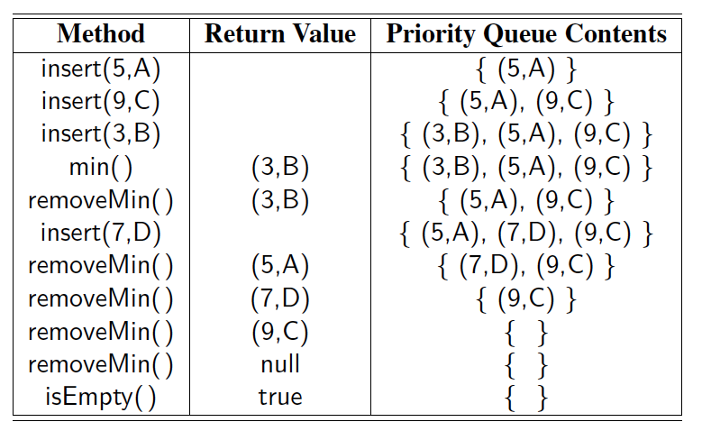
Example
A sequence of priority queue methods:

Slide 6
Total Order Relations
Keys in a priority queue can be arbitrary objects on which an order is defined
Two distinct entries in a priority queue can have the same key
Mathematical concept of total order relation ≤
Comparability property: either x ≤ y or y ≤ x
Antisymmetric property: x ≤ y and y ≤ x ⇒ x = y
Transitive property: x ≤ y and y ≤ z ⇒ x ≤ z

Slide 7
Entry ADT
An entry in a priority queue is
a key-value pair
Priority queues store entries to allow for efficient insertion and removal based on keys
functions:
getKey: returns the key for this entry
getValue: returns the value associated with this entry

Slide 8
Sequence-based Priority Queue
Implementation with an unsorted list
Implementation with a sorted list
4
5
2
3
1
1
2
3
4
5

Slide 9
Time Complexity
 | unsorted | sorted
Insert(entry)
RemoveMin() [min()]

Slide 10
Worst-case Time Complexity
 | unsorted | sorted
Insert(entry) | O(1) | O(N)—array [log N to find the spot, but N moves] O(N)—linked list
RemoveMin() [min()] | O(N) | O(1) [array—descending order]

