Slide 1
Graphs
1843
ORD
SFO
802
337
1743
LAX
1233
DFW

Slide 2
Graphs
A graph is a pair (V, E), where
V is a set of nodes, called vertices
E is a collection of pairs of vertices, called edges
Vertices and edges are positions and store elements
Example:
A vertex represents an airport and stores the three-letter airport code
An edge represents a flight route between two airports and stores the mileage of the route
849
PVD
1843
ORD
142
SFO
802
LGA
337
1743
1387
HNL
2555
1099
LAX
1233
DFW
1120
MIA

Slide 3
Edge Types
Directed edge
ordered pair of vertices (u,v)
first vertex u is the origin
second vertex v is the destination
e.g., a flight
Undirected edge
unordered pair of vertices (u,v)
e.g., a flight route
Directed graph
all the edges are directed
e.g., flight network
Undirected graph
all the edges are undirected
e.g., route network
flight
AA 1206
ORD
PVD
849
miles
ORD
PVD

Slide 4
Applications
Electronic circuits
Printed circuit board
Integrated circuit
Transportation networks
Highway network
Flight network
Computer networks
Local area network
Internet
Web
Databases
Entity-relationship diagram

Slide 5
Terminology
End vertices (or endpoints) of an edge
U and V are the endpoints of a
Edges incident on a vertex
a, d, and b are incident on V
Adjacent vertices
U and V are adjacent
Degree of a vertex
X has degree 5
Not used in this course
Parallel edges
h and i are parallel edges
Self-loop
j is a self-loop
V
a
b
h
j
U
d
X
Z
c
e
i
W
g
f
Y

Slide 6
Terminology (cont.)
Path
sequence of alternating vertices and edges
begins with a vertex
ends with a vertex
each edge is preceded and followed by its endpoints
Simple path
path such that all its vertices and edges are distinct
Examples
P₁=(V,b,X,h,Z) is a simple path
P₂=(U,c,W,e,X,g,Y,f,W,d,V) is a path that is not simple
V
a
b
P₁
d
U
X
Z
P₂
h
c
e
W
g
f
Y

Slide 7
Terminology (cont.)
Cycle
circular sequence of alternating vertices and edges
each edge is preceded and followed by its endpoints
Simple cycle
cycle such that all its vertices and edges are distinct
Examples
C₁=(V,b,X,g,Y,f,W,c,U,a,↵) is a simple cycle
C₂=(U,c,W,e,X,g,Y,f,W,d,V,a,↵) is a cycle that is not simple
V
a
b
d
U
X
Z
C₂
h
e
C₁
c
W
g
f
Y

Slide 8
Properties
Property 1
Σ_{v} deg(v) = 2m
Proof: each edge is counted twice
Property 2
In an undirected graph with no self-loops and no parallel edges
m ≤ n (n − 1)/2
Proof: (n−1) + (n-2) + … +1
What is the bound for a directed graph?
Notation
n number of vertices
m number of edges
deg(v) degree of vertex v
Example
n = 4
m = 6
deg(v) = 3

Slide 9
Vertices and Edges
A graph is a collection of vertices and edges.
A Vertex
stores an arbitrary element provided by the user (e.g., an airport code)
We assume it supports a method, element(), to retrieve the stored element.
An Edge
stores an associated object (e.g., a flight number, travel distance, cost), retrieved with the element( ) method.

Slide 10
Graph ADT
getAdjacentVertices(v)
Given vertex v, return adjacent vertices
areAdjacent(u,v)
Are vertices u and v adjacent?
…

Slide 11
Representing a Graph
Linked lists
Arrays

Slide 12
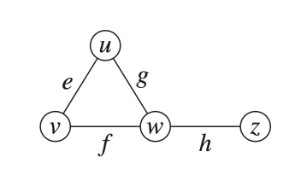
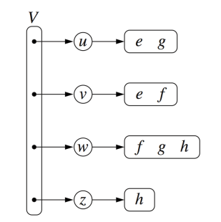
Adjacency Lists
for each vertex
sequence of vertices
Sequence of vertices with edge information
v
w
u
w
u
v
z
w

Slide 13
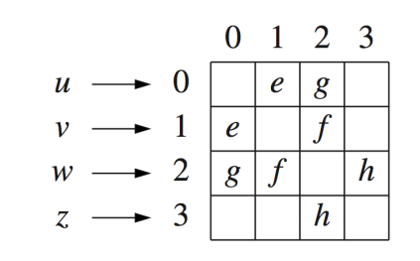
Adjacency Matrix
2D-array array
Content
Edge struct for edge
Null for no edge
Content
1 for edge
0 for no edge

Slide 14
Time/Space Complexity in Big-O
N vertices
assuming the index of a vertex is known
 | Adjacency Lists | Adjacency Matrix
Space
getAdjacentVertices(v)
areAdjacent(u,v)

Slide 15
Time/Space Complexity in Big-O
N vertices
assuming the index of a vertex is known
 | Adjacency Lists | Adjacency Matrix
Space | O( N² ) | O( N² )
getAdjacentVertices(v) | O(N) | O(N)
areAdjacent(u,v) | O(N) | O(1)

Slide 16
Time/Space Complexity for Sparse Graphs
Each vertex is adjacent to some (not many) other vertices [e.g. Social network]
Max degree is d (<< N)
 | Adjacency Lists | Adjacency Matrix
Space
getAdjacentVertices(v)
areAdjacent(u,v)

Slide 17
Time/Space Complexity for Sparse Graphs
Each vertex is adjacent to some (not many) other vertices
Max degree is d (<< N)
 | Adjacency Lists | Adjacency Matrix
Space | O(dN) | O( N² )
getAdjacentVertices(v) | O(d) | O(N)
areAdjacent(u,v) | O(d) | O(1)

