Slide 1
The Greedy Method and Text Compression

Slide 2
Greedy Method
A general algorithm design with the following elements:
configurations: different choices, collections, or values to find (e.g. paths, spanning trees)
objective function: a score assigned to configurations (e.g. path distance, total edge weight)

Slide 3
Greedy Method
A general algorithm design with the following elements:
configurations: different choices, collections, or values to find (e.g. paths, spanning trees)
objective function: a score assigned to configurations (e.g. path distance, total edge weight)
best when problems have the greedy-choice property:
a globally-optimal solution can be found by
a series of (best/greedy) local improvements from a starting configuration.
(e.g. choose the smallest D[v] value in Dijkstra, choose the smallest weighted edge in Kruksal)

Slide 4
Text Compression
Given a string X, efficiently encode X into a smaller string Y
Saves memory and/or bandwidth
A good approach: Huffman encoding
Compute frequency f(c) for each character c.
Encode high-frequency characters with short code words
Use an optimal encoding tree to determine the code words

Slide 5
Encoding Tree Example
A code is a mapping of each character of an alphabet to a binary code-word
00 | 010 | 011 | 10 | 11
a | b | c | d | e

Slide 6
Encoding Tree Example
A code is a mapping of each character of an alphabet to a binary code-word
A prefix code is a binary code such that no code-word is the prefix of another code-word
E.g 00 is not a prefix of 010 or 011
00 | 010 | 011 | 10 | 11
a | b | c | d | e

Slide 7
Encoding Tree Example
A code is a mapping of each character of an alphabet to a binary code-word
A prefix code is a binary code such that no code-word is the prefix of another code-word
An encoding tree represents a prefix code
Each external node stores a character
The code word of a character is given by the path from the root to the external node storing the character (0 for a left child and 1 for a right child)
0
1
00 | 010 | 011 | 10 | 11
a | b | c | d | e
0
1
0
1
a
1
d
e
0
b
c

Slide 8
Encoding a string into bits
string = abeac
00 010 11 00 011 [spaces added]
ie 000101100011
0
1
00 | 010 | 011 | 10 | 11
a | b | c | d | e
0
1
0
1
a
1
d
e
0
b
c

Slide 9
Decoding bits into a string
000101100011
000101100011 -> a
000101100011 -> b
000101100011 -> e
000101100011 -> a
000101100011 -> c
Not ambiguous because each code-word is not a prefix of another code-word
“Prefix code”
0
1
0
1
0
1
a
1
d
e
0
b
c

Slide 10
Encoding Tree Optimization
Given a text string X,
find a prefix code for the characters of X that yields a small encoding for X
Frequent characters should have long code-words
Rare characters should have short code-words
Example
X = abracadabra
T₁ encodes X into 29 bits
T₂ encodes X into 24 bits
T₁
T₂
c
d
b
a
b
r
a
r
c
d

Slide 11
Hoffman algorithm
11
X = abracadabra
a
6
Frequencies
2
4
a | b | c | d | r
5 | 2 | 1 | 1 | 2
c
d
b
r
6
2
4
a
b
c
d
r
5
2
1
1
2
a
c
d
b
r
5
2
2
4
a
b
c
d
r
a
c
d
b
r
5
2
2
5

Slide 12
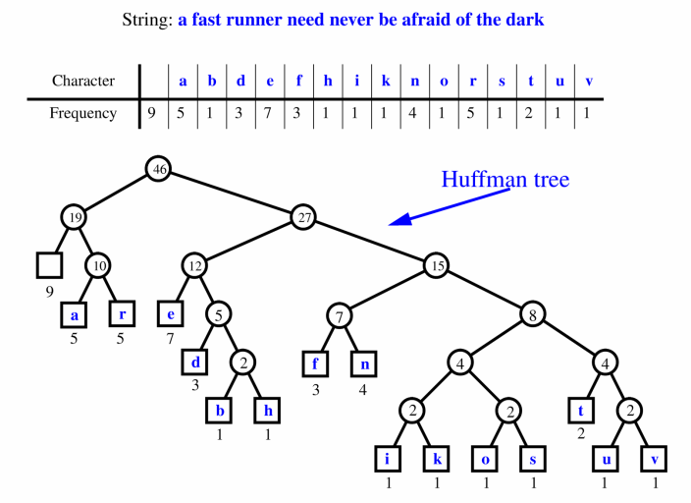
Extended Huffman Tree Example

Slide 13
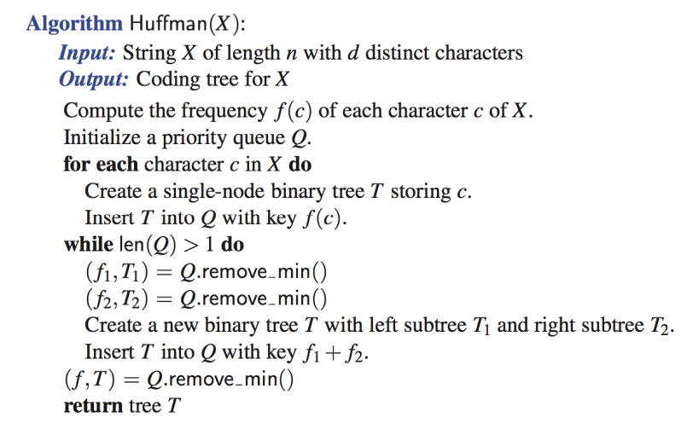
Huffman’s Algorithm

Slide 14
Huffman’s Algorithm
Greedy choice/step

Slide 15
Huffman’s Algorithm
Given a string X
Huffman’s algorithm constructs a prefix code
that minimizes the size of the encoding of X
optimal when each symbol (e.g. letter) has a separate code

Slide 16
Time Complexity
n = size of X
d = # of distinct characters in X
Find frequency of each character
?
d insertions into priority queue (Q)
?
2 * (d-1) removeMin operations from Q
?
d-1 insertions into Q
?
Total: ?

Slide 17
Time Complexity
n = size of X
d = # of distinct characters in X
Find frequency of each character
O(n)
d insertions into priority queue (Q)
O(d) [bottom up heap construction]
2 * (d-1) removeMin operations from Q
O(d log d)
d-1 insertions into Q
O(d log d)
Total: O(n + d + d log d) –> O(n + d log d)

Slide 18
Skipping the rest

Slide 19
The Fractional Knapsack Problem (not in book)
Given: A set S of n items, with each item i having
b_{i} - a positive benefit
w_{i} - a positive weight
Goal: Choose items with maximum total benefit but with weight at most W.
If we are allowed to take fractional amounts, then this is the fractional knapsack problem.
In this case, we let x_{i} denote the amount we take of item i
Objective: maximize
Constraint:

Slide 20
Example
Given: A set S of n items, with each item i having
b_{i} - a positive benefit
w_{i} - a positive weight
Goal: Choose items with maximum total benefit but with weight at most W.
“knapsack”
Solution:
1 ml of 5
2 ml of 3
6 ml of 4
1 ml of 2
Items:
1
2
3
4
5
Weight:
4 ml
8 ml
2 ml
6 ml
1 ml
Benefit:
$12
$32
$40
$30
$50
10 ml
Value:
3
4
20
5
50
($ per ml)

Slide 21
The Fractional Knapsack Algorithm
Greedy choice: Keep taking item with highest value (benefit to weight ratio)
Since
Run time: O(n log n). Why?
Correctness: Suppose there is a better solution
there is an item i with higher value than a chosen item j, but x_{i}<w_{i}, x_{j}>0 and v_{i}<v_{j}
If we substitute some i with j, we get a better solution
How much of i: min{w_{i}-x_{i}, x_{j}}
Thus, there is no better solution than the greedy one
Algorithm fractionalKnapsack(S, W)
Input: set S of items w/ benefit b_{i} and weight w_{i}; max. weight W Output: amount x_{i} of each item i to maximize benefit w/ weight at most W
for each item i in S
x_{i} ← 0
v_{i} ← b_{i} / w_{i} {value}
w ← 0 {total weight}
while w < W
remove item i w/ highest v_{i}
x_{i} ← min{w_{i} , W - w}
w ← w + min{w_{i} , W - w}

Slide 22
Task Scheduling (not in book)
Given: a set T of n tasks, each having:
A start time, s_{i}
A finish time, f_{i} (where s_{i} < f_{i})
Goal: Perform all the tasks using a minimum number of “machines.”
Machine 3
Machine 2
Machine 1
1
2
3
4
5
6
7
8
9

Slide 23
Task Scheduling Algorithm
Greedy choice: consider tasks by their start time and use as few machines as possible with this order.
Run time: O(n log n). Why?
Correctness: Suppose there is a better schedule.
We can use k-1 machines
The algorithm uses k
Let i be first task scheduled on machine k
Machine i must conflict with k-1 other tasks
But that means there is no non-conflicting schedule using k-1 machines
Algorithm taskSchedule(T)
Input: set T of tasks w/ start time s_{i} and finish time f_{i}
Output: non-conflicting schedule with minimum number of machines
m ← 0 {no. of machines}
while T is not empty
remove task i w/ smallest s_{i}
if there’s a machine j for i then
schedule i on machine j
else
m ← m + 1
schedule i on machine m

Slide 24
Example
Given: a set T of n tasks, each having:
A start time, s_{i}
A finish time, f_{i} (where s_{i} < f_{i})
[1,4], [1,3], [2,5], [3,7], [4,7], [6,9], [7,8] (ordered by start)
Goal: Perform all tasks on min. number of machines
Machine 3
Machine 2
Machine 1
1
2
3
4
5
6
7
8
9

