Slide 1
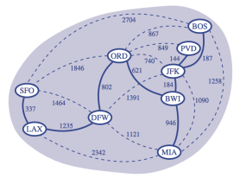
Minimum Spanning Trees

Slide 2
Minimum Spanning Trees
Spanning subgraph
Subgraph of a graph G containing all the vertices of G
Spanning tree
Spanning subgraph that is itself a (free) tree
Minimum spanning tree (MST)
Spanning tree of a weighted graph with minimum total edge weight
Applications
Communications networks
Transportation networks
ORD
10
1
PIT
DEN
6
7
9
3
DCA
4
STL
8
5
2
DFW
ATL

Slide 3
Prim-Jarnik’s Algorithm
Similar to Dijkstra’s algorithm
pick an arbitrary vertex s to start
grow the MST as a cloud of vertices
store with each vertex v label d(v)
smallest weight of an edge connecting v to a vertex in the cloud
At each step:
add to the cloud the vertex u outside the cloud with the smallest distance label
update the labels of the vertices adjacent to u

Slide 4
Example
∞
2
7
D
B
4
8
9
∞
2
5
F
C
8
8
3
E
A
7
7
0

Slide 5
Example
∞
2
7
D
B
4
8
9
∞
2
5
F
C
8
8
3
E
A
7
7
0
7
2
7
D
B
4
5
9
∞
2
5
F
C
8
8
3
E
A
7
7
0

Slide 6
Example
∞
7
2
7
D
2
7
D
B
4
B
4
8
9
∞
5
9
∞
2
5
F
2
5
F
C
8
C
8
8
3
8
3
E
E
A
7
7
A
7
7
0
0
7
2
7
D
B
4
5
9
∞
2
5
F
C
8
8
3
E
A
7
7
0

Slide 7
Example
∞
7
2
7
D
2
7
D
B
4
B
4
8
9
∞
5
9
∞
2
5
F
2
5
F
C
8
C
8
8
3
8
3
E
E
A
7
7
A
7
7
0
0
7
7
2
7
D
7
D
B
4
2
B
4
5
9
∞
9
4
2
5
F
5
5
C
2
F
8
C
8
8
3
3
E
8
A
7
E
0
7
A
7
7
0

Slide 8
Example (contd.)
7
2
7
D
B
4
5
9
4
2
5
F
C
8
8
3
E
A
7
3
7
0
7
D
2
B
4
5
9
4
2
5
F
C
8
8
3
E
A
7
3
0

Slide 9
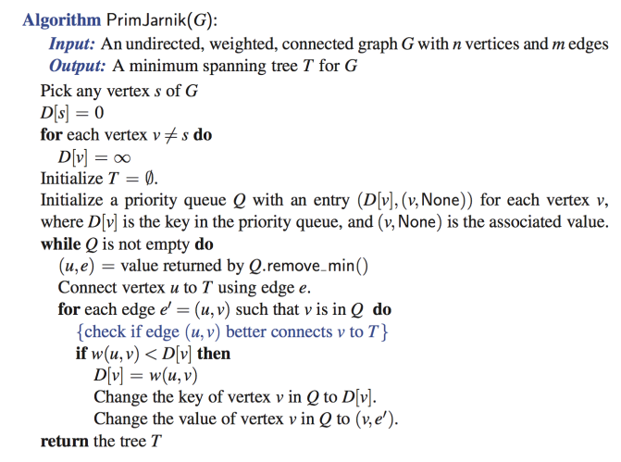
Prim-Jarnik Pseudo-code
//u is new vertex in the cloud
//for each adjacent v of u

Slide 10
Analysis
Similar to Dijkstra’s algorithm
n insertions to Q
O(n log n) [O(n) bottom-up heap construction]
n removeMin operations with Q
O(n log n)
m replaceKey operations with Q
O(m log n)
Total: O((n + m) log n)

Slide 11
Kruskal’s Algorithm
Discuss some properties that the algorithm uses

Slide 12
Cycle Property
Cycle Property:
Let T be a minimum spanning tree of a weighted graph G
Let e be an edge of G that is not in T and
Let C be the cycle formed by adding e to T
For every edge f of C, weight(f) ≤ weight(e)
f
8
4
C
9
2
6
3
e
8
7
7

Slide 13
Cycle Property
Cycle Property:
Let T be a minimum spanning tree of a weighted graph G
Let e be an edge of G that is not in T and
Let C be the cycle formed by adding e to T
For every edge f of C, weight(f) ≤ weight(e)
Proof:
By contradiction
If weight(f) > weight(e) we can get a spanning tree of smaller weight by replacing e with f
f
8
4
C
9
2
6
3
e
8
7
7
Replacing f with e yields a better spanning tree
f
8
4
C
9
2
6
3
e
8
7
7

Slide 14
Partition Property
U
V
f
7
Partition Property:
Consider a partition of the vertices of G into subsets U and V
Let e be an edge of minimum weight across the partition
There is a minimum spanning tree of G containing edge e
4
9
2
5
8
8
e
3
6

Slide 15
Partition Property
U
V
f
7
Partition Property:
Consider a partition of the vertices of G into subsets U and V
Let e be an edge of minimum weight across the partition
There is a minimum spanning tree of G containing edge e
Proof:
Let T be an MST of G
If T does not contain e, consider the cycle C formed by e with T and let f be an edge of C across the partition
By the cycle property, weight(f) ≤ weight(e)
Thus, weight(f) = weight(e)
We obtain another MST by replacing f with e
4
9
2
5
8
8
e
3
6
Replacing f with e yields another MST
U
V
f
7
4
9
2
5
8
8
e
3
6

Slide 16
Kruskal’s Approach
Maintain a partition of the vertices into clusters(clouds)
Initially, single-vertex clusters
Keep an MST for each cluster
Merge “closest” clusters and their MSTs
A priority queue stores the edges outside clusters
Key: weight; Element: edge
At the end of the algorithm
One cluster and one MST

Slide 17
Example
G
B
8
4
9
E
6
1
5
F
C
11
3
2
7
D
H
A
10

Slide 18
Example
G
B
8
4
9
E
6
1
5
F
C
11
3
2
7
D
H
A
10
G
B
8
4
9
E
6
1
5
F
C
11
3
2
7
D
H
A
10

Slide 19
Example
G
G
B
8
8
4
B
4
9
E
6
9
E
6
1
5
F
1
5
F
C
11
3
C
11
3
2
2
7
D
H
7
H
A
D
10
A
10
G
B
8
4
9
E
6
1
5
F
C
11
3
2
7
D
H
A
10

Slide 20
Example
G
G
B
8
8
4
B
4
9
E
6
9
E
6
1
5
F
1
5
F
C
11
3
C
11
3
2
2
7
D
H
7
H
A
D
10
A
10
G
G
B
8
B
8
4
4
9
E
6
9
E
6
1
5
F
1
5
F
C
11
3
C
11
3
2
2
7
D
H
7
H
D
A
10
A
10

Slide 21
Example (contd.)
G
B
8
4
9
E
6
1
5
F
C
11
3
2
7
D
H
A
10

Slide 22
Example (contd.)
G
B
8
4
9
E
6
1
5
F
C
11
3
2
7
D
H
A
10
G
B
8
4
9
E
6
1
5
F
C
11
3
2
7
D
H
A
10

Slide 23
Example (contd.)
G
G
B
8
8
4
B
4
9
E
6
9
E
6
1
5
F
1
5
F
C
11
3
C
11
3
2
2
7
D
H
7
H
D
A
10
A
10
two steps
G
B
8
4
9
E
6
1
5
F
C
11
3
2
7
D
H
A
10

Slide 24
Example (contd.)
G
G
B
8
8
4
B
4
9
E
6
9
E
6
1
5
F
1
5
F
C
11
3
C
11
3
2
2
7
D
H
7
H
D
A
10
A
10
four steps
two steps
G
G
B
8
B
8
4
4
9
E
6
9
E
6
1
5
F
1
5
F
C
11
3
C
11
3
2
2
7
D
H
7
D
H
A
10
A
10

Slide 25
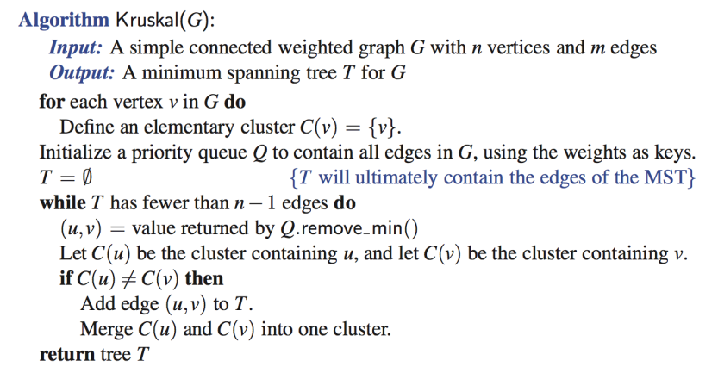
Kruskal’s Algorithm

Slide 26
Analysis of Kruskal’s Algorithm
m insertions into Q (priority queue)
m removeMin operations from Q
Clustering the vertices

Slide 27
Data structure for a partition
a collection of disjoint sets, with operations:
makeSet(u): create a set consisting of u
find(u): return the set storing u
union(A, B): replace set A with their union

Slide 28
List-based Partition
Each set is stored in a sequence
Each element has a reference back to the set
find(u)
returns the set of which u is a member
O(1) time
union(A,B)
move the elements of the smaller set to the sequence of the larger set
and update their references
O(min(|A|, |B|)) time

Slide 29
Union operations
When doing a union
move elements from the smaller set to the larger set
Each time an element is moved
it goes to a set of size at least double its old set
Thus, each element can be moved at most O(log n) times
n vertices (n-1 unions)
Each vertex is moved at most O(log n) times
O(n log n)

Slide 30
Partition-Based Implementation
Priority Queue operations: O(m log n)
m insertions: O(m log m) [O(m) bottom-up heap]
m removeMin operations: O(m log m)
m = O(n^2)
O(log m) = O(log n^2) = O(2 log n) = O(log n)
O(m log m) = O(m log n)

Slide 31
Partition-Based Implementation
Priority Queue operations: O(m log n)
m insertions: O(m log m) [O(m) bottom-up heap]
m removeMin operations: O(m log m)
m = O(n^2)
O(log m) = O(log n^2) = O(2 log n) = O(log n)
O(m log m) = O(m log n)
Union-Find operations: O(m + n log n)
2m find operations: O(m)
n - 1 union operations: O(n log n)
Total: O( m log n + m + n log n)
O((n+ m) log n)

Slide 32
Complexity of MST algorithms
 | Prim-Jarnik | Kruskal
Time complexity | O( (n+m) log n ) | O( (n+m) log n )
 | Easier to implement | Easier conceptually

Slide 33
Skipping the rest

Slide 34
Baruvka’s Algorithm (Exercise)
Like Kruskal’s Algorithm, Baruvka’s algorithm grows many clusters at once and maintains a forest T
Each iteration of the while loop halves the number of connected components in forest T
The running time is O(m log n)
Algorithm BaruvkaMST(G)
T ← V {just the vertices of G}
while T has fewer than n − 1 edges do
for each connected component C in T do
Let edge e be the smallest-weight edge from C to another component in T
if e is not already in T then
Add edge e to T
return T

Slide 35
Example of Baruvka’s Algorithm (animated)
Slide by Matt Stallmann included with permission.
2
4
3
8
5
8
9
4
7
4
9
3
1
6
6
6
5
4
2
4
3
8
5
9
4
7
3
1
6
6
5
4

