Slide 1
Singly Linked Lists

Slide 2
Singly Linked List
A singly linked list is a concrete data structure consisting of a sequence of nodes, starting from a head pointer
Each node stores
element
link to the next node
next
element
node
head
∅
A
B
C
D

Slide 3
Review: struct in C
struct Node
{
char element[4];
struct Node *next;
};
typedef struct Node NODE;
…
NODE *myNode = (NODE *) malloc( sizeof(NODE) );
Is myNode
a. the created node, or
b. a pointer to the created node?

Slide 4
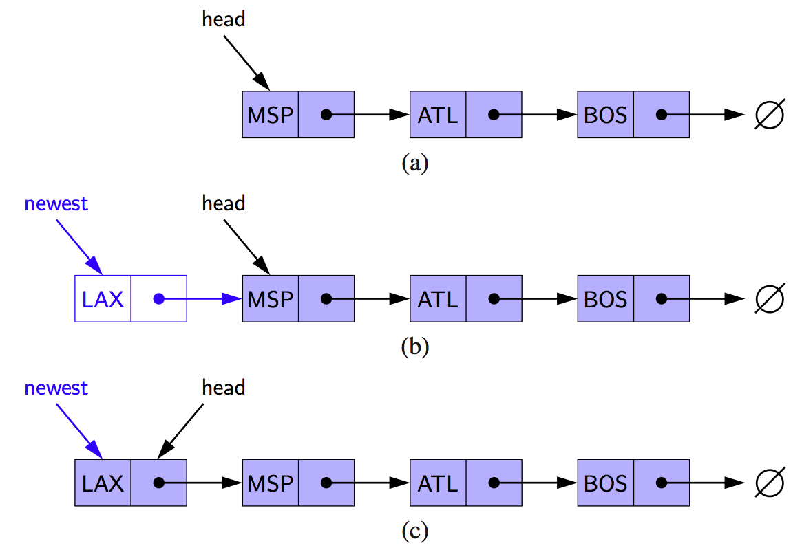
Inserting at the Head
Allocate new node
Insert new element
Have new node point to old head
Update head to point to new node

Slide 5
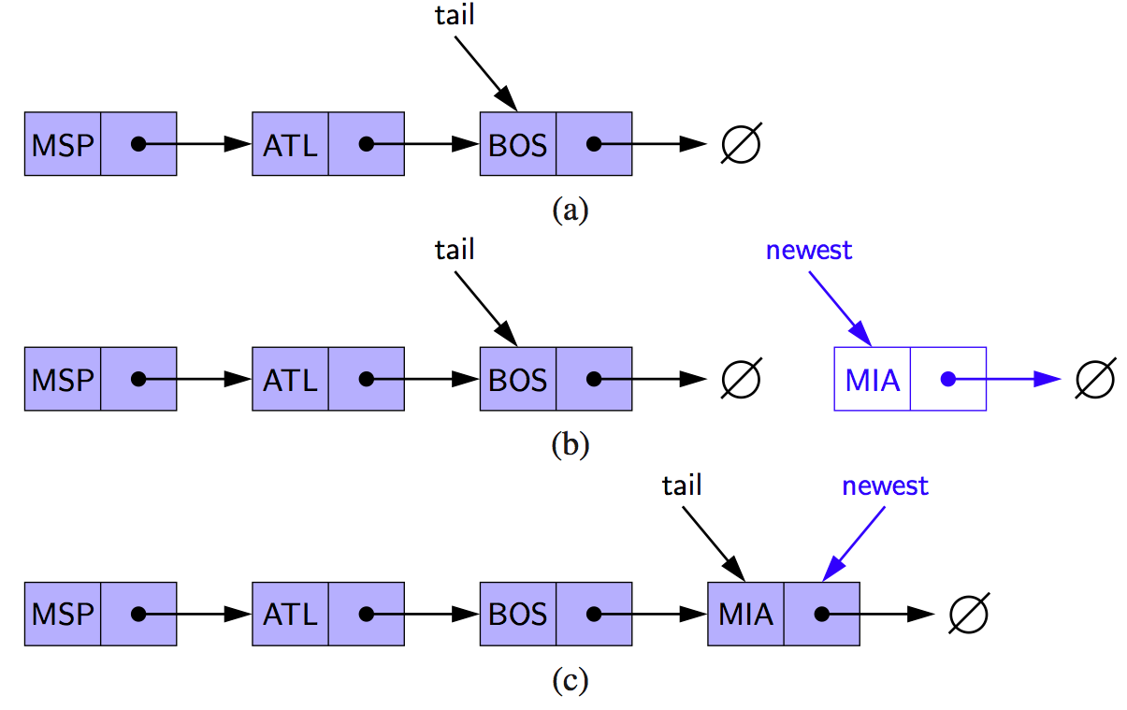
Inserting at the Tail
Allocate a new node
Insert new element
Have new node point to null
Have old last node point to new node
Update tail to point to new node

Slide 6
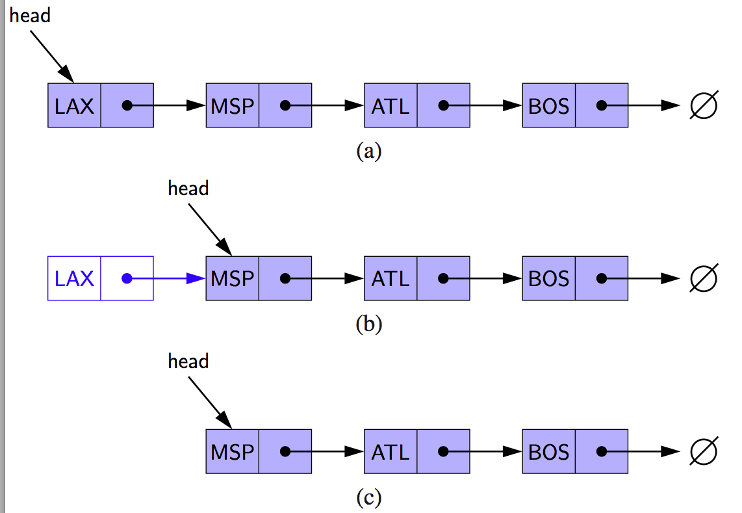
Removing at the Head
Update head to point to next node in the list
Free the remove node

Slide 7
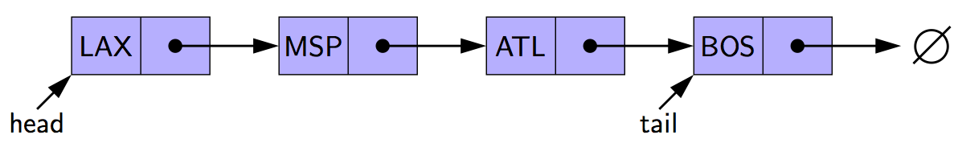
Removing at the Tail
Removing at the tail of a singly linked list is not efficient!
There is no constant-time way to update the tail to point to the previous node

Slide 8
List ADT (Abstract Data Type)
Operations:
Insert an item
Delete an item
Replace the i-th item

Slide 9
List ADT (Abstract Data Type)
Operations:
Insert an item
Delete an item
Replace the i-th item
Representations:
Sequential (arrays)
Linked (linked lists)

Slide 10
List ADT (size N, # of steps in the worst case)
 | Sequential Representation (arrays) | Linked Representation (linked lists)
Insert an item
Delete an item
Replace the i-th item

Slide 11
List ADT of size N # of steps in the worst case
 | Sequential Representation (arrays) | Linked Representation (linked lists)
Insert an item | Shift N items O(N) | Traverse N items O(N)
Delete an item | Shift N-1 items O(N) | Traverse N items O(N)
Replace the i-th item | Direct access to a[i] O(1) | Traverse N items O(N)

Slide 12
Space comparison
List of size N
maximum Capacity MaxSize in array
Assume
data/element uses 4 bytes
Next pointer uses 4 bytes
 | Array | Linked list
Space

Slide 13
Space comparison
List of size N
maximum Capacity MaxSize in array
Assume
data/element uses 4 bytes
Next pointer uses 4 bytes
 | Array | Linked list
Space | 4 * MaxSize | 8 * N

Slide 14
Circularly Linked Lists

Slide 15
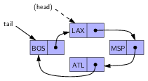
tail (but no head)

Slide 16
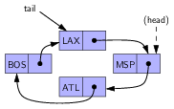
Rotation
What are the instructions?

Slide 17
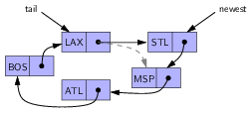
Insertion at (head)
(head)
What are the instructions?

