Slide 1
Stacks

Slide 2

The Stack ADT
The Stack ADT stores arbitrary objects
Insertions and deletions follow the last-in first-out scheme (LIFO)
Think of a spring-loaded plate dispenser

Slide 3
Main stack operations
push(S, item)
inserts an element
item pop(S)
removes and returns the last inserted element

Slide 4
Auxiliary stack operations
item top(S)
returns the last inserted element without removing it
integer size(S)
returns the number of elements stored
boolean isEmpty(S)
indicates whether no elements are stored

Slide 5
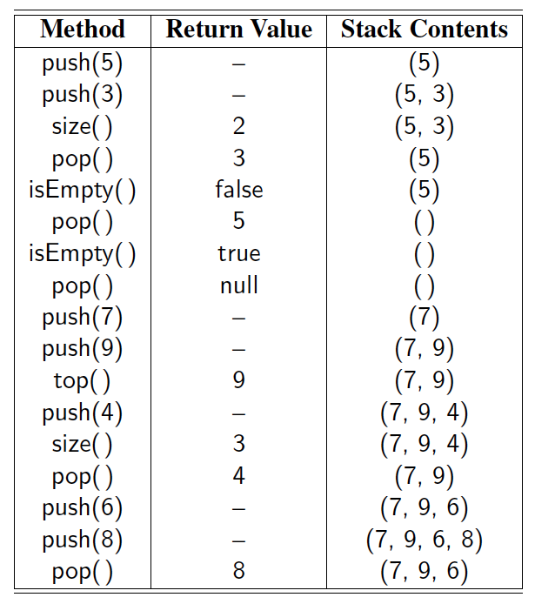
Example
Omitting parameter S in the table

Slide 6
Applications of Stacks
Direct applications
Page-visited history in a Web browser
Undo sequence in a text editor
Chain of method calls in the Java Virtual Machine
Indirect applications
Auxiliary data structure for algorithms
Component of other data structures

Slide 7
Function Stack
keeps track of the chain of active function with a stack
When a function is called, a frame is pushed onto the stack containing
Local variables and return value
Program counter, keeping track of the statement being executed
When a function ends, its frame is popped from the stack and control is passed to the function on top of the stack
Allows for recursion
main() { int i = 5; foo(i); }
foo(int j) { int k; k = j+1; bar(k); }
bar(int m) { … }
bar
PC = 1 m = 6
foo
PC = 3 j = 5
k = 6
main
PC = 2 i = 5

Slide 8
Array-based Stack
A simple way of implementing the Stack ADT uses an array
We add elements from left to right
A variable keeps track of the index of the top element
Algorithm size(S)
return S->t + 1
Algorithm pop(S)
if isEmpty(S) then
return null
else
S->t ← S->t − 1
return S->data[S->t + 1]
…
S->data
0
1
2
t

Slide 9
Array-based Stack (cont.)
The array storing the stack elements may become full
A push operation will print error
Limitation of the array-based implementation
Not intrinsic to the Stack ADT
Algorithm push(S, item)
if t = S->length − 1 then
print stack is full error
else
S->t ← S->t + 1
S->data[S->t] ← item
…
S->data
0
1
2
t

Slide 10
Can we use a linked list instead of an array?
Top of the stack?
What are the tradeoffs between linked lists and arrays?

Slide 11
Worst-case time complexity
N items on the stack
Operation | Array | Linked List
Push
Pop

Slide 12
Worst-case time complexity
N items on the stack
Operation | Array | Linked List
Push | O(1) | O(1)
Pop | O(1) | O(1)

Slide 13
Parentheses Matching
Each “(”, “{”, or “[” must be paired with a matching “)”, “}”, or “[”
correct: ( )(( )){([( )])}
correct: ((( )(( )))) {([( )])}
incorrect: )(( )){([( )])}
incorrect: ({[ ])}
incorrect: (

Slide 14
How to match parentheses with a stack?

Slide 15
Parentheses that match
([]{})
Stack (top of the stack is on the right)
(
([
(
({
(
empty

Slide 16
Parentheses that don’t match
([)
Stack (top of the stack is on the right)
(
([
Sees a ), but the top is [

Slide 17
HTML Tag Matching
For fully-correct HTML, each <name> should pair with a matching </name>
<body>
<center>
<h1> The Little Boat </h1>
</center>
<p> The storm tossed the little
boat like a cheap sneaker in an
old washing machine. The three
drunken fishermen were used to
such treatment, of course, but
not the tree salesman, who even as
a stowaway now felt that he
had overpaid for the voyage. </p>
<ol>
<li> Will the salesman die? </li>
<li> What color is the boat? </li>
<li> And what about Naomi? </li>
</ol>
</body>
The Little Boat
The storm tossed the little boat
like a cheap sneaker in an old
washing machine. The three
drunken fishermen were used to
such treatment, of course, but not
the tree salesman, who even as
a stowaway now felt that he had
overpaid for the voyage.
1. Will the salesman die?
2. What color is the boat?
3. And what about Naomi?

Slide 18
Arithmetic Expressions
Infix expression (notation)
Regular notation
x + y
(x – y) / 2
Postfix expression (notation)
x y +
x y – 2 /

Slide 19
Evaluating Postfix Expressions
if a variable
push the value of the variable
if an operator
pop two items, perform the operation, and push the result
x y + 2 /
(x + y) / 2 in infix notation

Slide 20
Evaluating Postfix Expressions
x y + 2 / [(x+y)/2 in infix notation]
Assume x has 10 and y has 20
Stack (top is far right):
10
10, 20
30
30, 2
15

Slide 21
Evaluating Infix Expressions
Slide by Matt Stallmann included with permission.
14 – 3 * 2 + 7 = (14 – (3 * 2) ) + 7
Operator precedence
* has precedence over +/–
Associativity
operators of the same precedence group
evaluated from left to right
Example: (x – y) + z rather than x – (y + z)
Idea: push each operator on the stack, but first pop and perform higher and equal precedence operations.

Slide 22
Algorithm on an Example Expression
Slide by Matt Stallmann included with permission.
Operator ≤ has lower precedence than +/–
14 ≤ 4 – 3 * 2 + 7
4
–
14
≤
3
*
$
$
4
–
7
$
14
≤
F
+
-2
+
5
+
14
≤
14
≤
2
2
3
*
3
*
6
4
–
4
–
4
–
-2
+
14
≤
14
≤
14
≤
14
≤

Slide 23
Highest since …
2017: “Brent Crude Spikes To Highest Since July 2015”
2008: “[…] turnout in the western states […], the highest since 1960”
2006: “Americans' Optimism About Stock Market Highest Since 2000”

Slide 24
Computing Spans
Given an an array X, the span S[i] of X[i] is
the maximum number of consecutive elements X[j] immediately preceding X[i]
such that X[j] ≤ X[i]
Spans have applications to financial analysis
E.g., stock at 52-week high
X
6 | 3 | 4 | 5 | 2
1 | 1 | 2 | 3 | 1
S

Slide 25
Algorithm 1
For each index i
Scan backward to find a higher value
Array size is N
Worst-case time complexity?

Slide 26
Quadratic Algorithm
Algorithm spans1(X, n)
Input array X of n integers
Output array S of spans of X #
S ← new array of n integers n
for i ← 0 to n − 1 do n
s ← 1 n
while s ≤ i ∧ X[i − s] ≤ X[i] 1 + 2 + …+ (n − 1)
s ← s + 1 1 + 2 + …+ (n − 1)
S[i] ← s n
return S 1
Algorithm spans1 runs in O(n²) time

Slide 27
Computing Spans with a Stack
We keep in a stack the indices of the last element that is taller when “looking back”
We scan the array from left to right
Let i be the current index
We pop indices from the stack until we find index j such that X[i] < X[j]
We set S[i] ← i − j
We push i onto the stack

Slide 28
Algorithm 2
Keep on the stack the last building that is taller than the current one
Root top that can’t be seen
Ie. While a building is shorter on the stack
Pop the building

Slide 29
Algorithm 2
While shorter building on the stack
pop the building
Push current building
Stack (top on the right)
0 [push 0]

Slide 30
Algorithm 2
While shorter building on the stack
pop the building
Push current building
Stack (top on the right)
0 [push 0]
0,1 [push 1]

Slide 31
Algorithm 2
While shorter building on the stack
pop the building
Push current building
Stack (top on the right)
0 [push 0]
0,1 [push 1]
0,2 [pop 1, push 2]

Slide 32
Algorithm 2
While shorter building on the stack
pop the building
Push current building
Stack (top on the right)
0 [push 0]
0,1 [push 1]
0,2 [pop 1, push 2]
0,2,3 [push 3]

Slide 33
Algorithm 2
While shorter building on the stack
pop the building
Push current building
Stack (top on the right)
0 [push 0]
0,1 [push 1]
0,2 [pop 1, push 2]
0,2,3 [push 3]
0,2,4 [pop 3, push 4]

Slide 34
Algorithm 2
While shorter building on the stack
pop the building
Push current building
Stack (top on the right)
0 [push 0]
0,1 [push 1]
0,2 [pop 1, push 2]
0,2,3 [push 3]
0,2,4 [pop 3, push 4]
0,2,5 [pop 4, push 5]

Slide 35
Algorithm 2
While shorter building on the stack
pop the building
Push current building
Stack (top on the right)
0 [push 0]
0,1 [push 1]
0,2 [pop 1, push 2]
0,2,3 [push 3]
0,2,4 [pop 3, push 4]
0,2,5 [pop 4, push 5]
0,6 [pop 5,2; push 6]

Slide 36
Algorithm 2
While shorter building on the stack
pop the building
Push current building
Stack (top on the right)
0 [push 0]
0,1 [push 1]
0,2 [pop 1, push 2]
0,2,3 [push 3]
0,2,4 [pop 3, push 4]
0,2,5 [pop 4, push 5]
0,6 [pop 5,2; push 6]
0,6,7 [push 7]

Slide 37
Algorithm 2
Stack (top on the right) Span
0 [push 0] 1
0,1 [push 1] 1
0,2 [pop 1, push 2] 2
0,2,3 [push 3] 1
0,2,4 [pop 3, push 4] 2
0,2,5 [pop 4, push 5] 3
0,6 [pop 5,2; push 6] 6
0,6,7 [push 7] 1
How to get the span?

Slide 38
Algorithm 2
Stack (top on the right) Span
0 [push 0] 1
0,1 [push 1] 1
0,2 [pop 1, push 2] 2
0,2,3 [push 3] 1
0,2,4 [pop 3, push 4] 2
0,2,5 [pop 4, push 5] 3
0,6 [pop 5,2; push 6] 6
0,6,7 [push 7] 1
How to get the span?

Slide 39
Algorithm 2
Stack (top on the right) Span
0 [push 0] 1
0,1 [push 1] 1
0,2 [pop 1, push 2] 2
0,2,3 [push 3] 1
0,2,4 [pop 3, push 4] 2
0,2,5 [pop 4, push 5] 3
0,6 [pop 5,2; push 6] 6
0,6,7 [push 7] 1
What is the time complexity (stack operations)?

Slide 40
Linear Time Algorithm
Each index of the array
Is pushed into the stack exactly one
Is popped from the stack at most once
The statements in the while-loop are executed at most n times
Algorithm spans2 runs in O(n) time
Algorithm spans2(X, n) #
S ← new array of n integers n
A ← new empty stack 1
for i ← 0 to n − 1 do n
while (¬isEmpty(A) ∧
X[top(A)] ≤ X[i] ) do n
pop(A) n
if isEmpty(A) then n
S[i] ← i + 1 n
else
S[i] ← i − top(A) n
push(A,i) n
return S 1

Slide 41
Worst-case Analysis
N data items
 | Algorithm 1 | Algorithm 2
Time Complexity
Space Complexity

Slide 42
Worst-case Analysis
N data items
 | Algorithm 1 | Algorithm 2
Time Complexity | O(N²) | O(N)
Space Complexity | O(N) | O(N)

