Slide 1
ML001: Road Analytics
Course: CSE541 Computer Vision and CSE523 Machine Learning (Winter 2022)
Faculty : Mehul S.Raval
Student Name: Yagnik Bhavsar
Roll No: AU2149006

Slide 2
Recap
We discussed about classification and developed a Alexnet_{[1]} model for our drone dataset.
We achieved 80 % of accuracy with Alexnet + GAP mechanism.
We trained our model for only vehicles but further we can do same for Road markings , Road structure, Road signs.

Slide 3
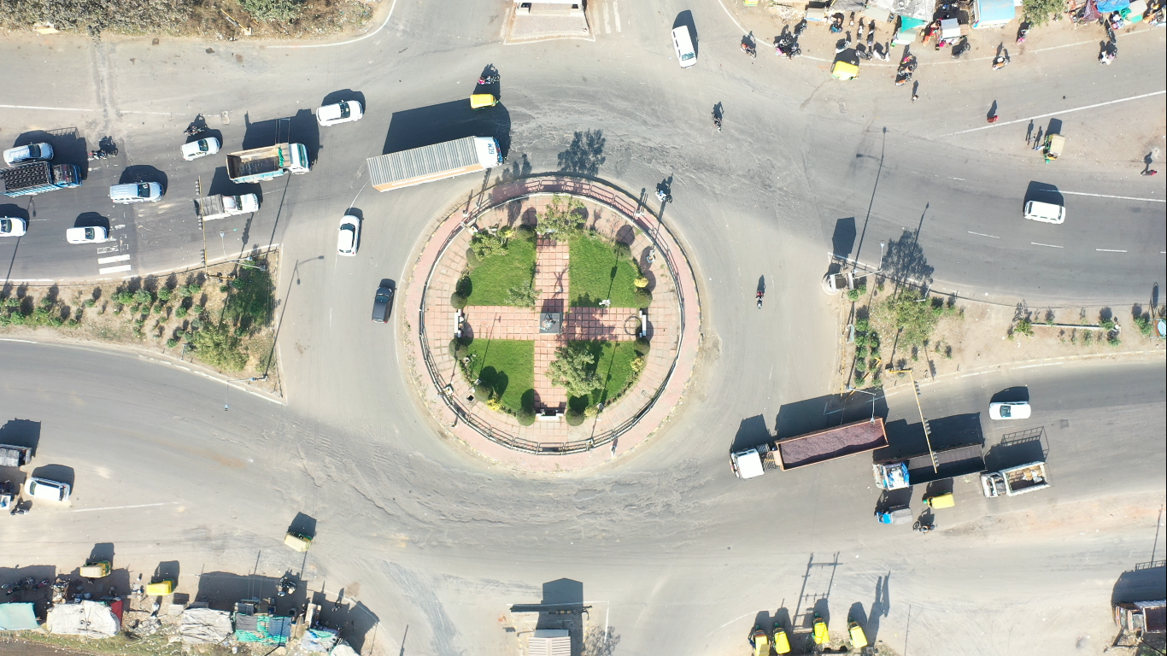
Introduction
Roundabout

Slide 4
Introduction
“If you can’t measure it, you can’t improve it”
Measurable road- objects :
Vehicles, Road markings , Road structure, Road signs
Vehicle’s trajectories
So, further we need detector and tracker for analysis of road scene.

Slide 5
Object Detector
Object detector = Classifier + localization
For localization we can use region proposal algorithms. Currently, we are using below algorithms,
Sliding window
Selective search_{[2]}

Slide 6
Object Detector(AlexNet+Sliding window)
Sliding window parameters,
32 x 32, 64 x 64 and, 128 x 128 sized windows
After testing we found that localisation accuracy is very bad and also false positives are more.
Selective search is taking 1-2 minutes to propose regions so, we are not using it.
Finally, we conclude that we need better object detector.

Slide 7
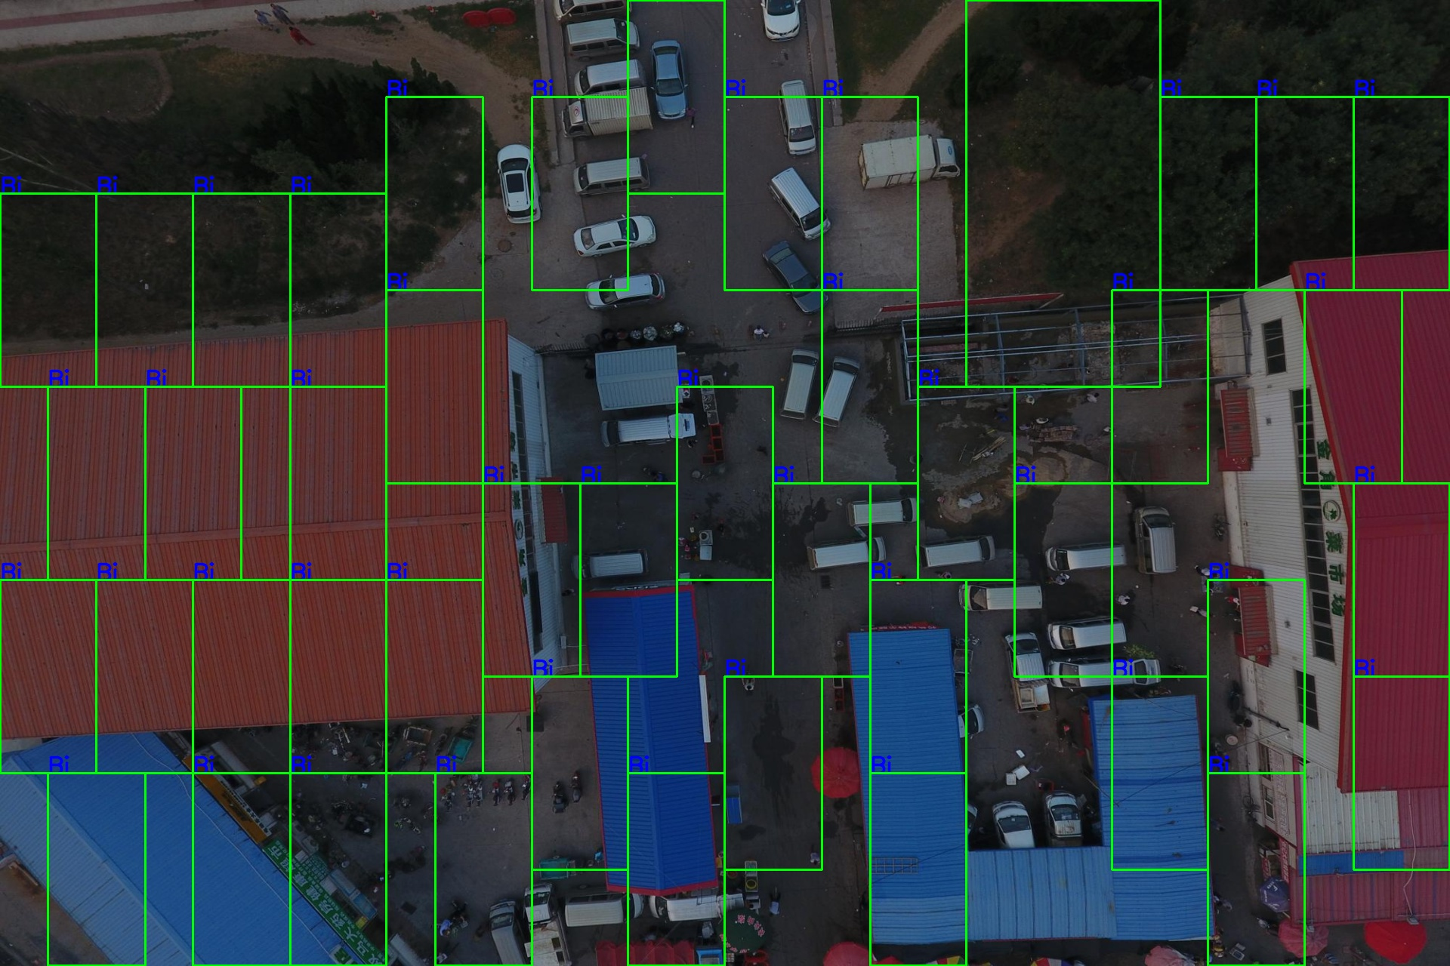

Slide 8
Object detector
We are using Yolov5s_{[3]} as object detector to get better detection and localization accuracy.
Input Image size: 640 x 640
0.34 mAP@0.5
Testing time
0.4 ms pre-processing
22.2 ms inference
1.2ms NMS

Slide 9
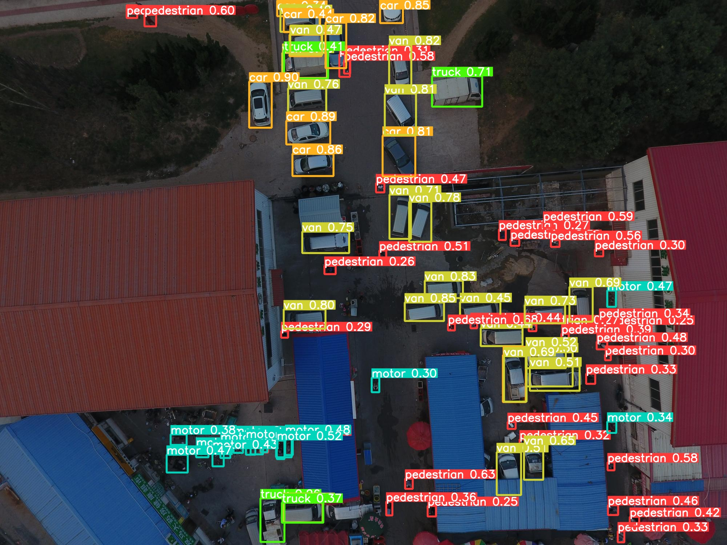

Slide 10
Tracking
Trajectory is very useful parameter in road analytics. Ex: anomaly detection, driver behaviour analysis
In our case, we need multi object tracker. There are various algorithms available for it,
SORT_{[4]}
DeepSORT_{[5]}
Byte Track_{[6]}

Slide 11
Which tracker to use ?
Below we are listing some of the characteristics of good tracker and based on that one can choose a tracker,
Real time response
Avoid repetitive detection
ID switching rate should be small
Should be able to track objects in case of occlusion, lost detections and misclassification

Slide 12
DeepSORT
DeepSORT is an extension of SORT(Simple Online and Real time) algorithm.
Online tracker
Tracking by detection framework
Kalman filter- Object motion model_{[7]}
Hungarian algorithm- Object association_{[8]}
IoU score
Convolution score
Feature based similarity score- VeRID model

Slide 13
Working of DeepSORT
Do object detections (@T+1) using detector
Predict the bounding boxes(for detections @T) using Kalman state model
Assign track IDs using hungarian algorithm
IoU/ Cosine similarity score
Update the kalman state model

Slide 14
Vehicle Re-Identification Model_{[9]}
Used to find similarity between two objects in consecutive frames.
Here, resnet model is trained for re-identification.
We have trained two different models one with cosine similarity and other one is without any metric.

Slide 15
VeRI- 776 Dataset_{[9]}
We are using VeRI 776 dataset for distance metric learning.
We have trained two models on this dataset
Resnet50 _{[10]}
Cosine metric Model (customised Resnet) _{[11]}

Slide 16
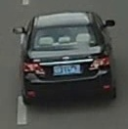
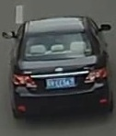
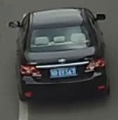
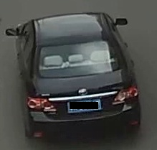
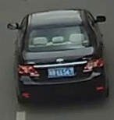
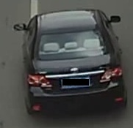
VeRI- 776 Dataset

Slide 17

Yolov5 + Resnet50

Slide 18
Yolov4 + Cosine Metric Model

Slide 19
Result
During testing of both the models we found that, cosine metric model is giving us very less ID switching.
Both the models are giving 15 FPS and other outcomes looks similar.

Slide 20
Future work
With the help of tracker get trajectory of vehicles
Based on trajectory of vehicles detect anomaly in given video

Slide 21
References
A. Krizhevsky, I. Sutskever, and G. E. Hinton, “Imagenet classification with deep convolutional neural networks,” in Advances in Neural Information Processing Systems, F. Pereira, C. J. C. Burges, L. Bottou, and K. Q. Weinberger, Eds., vol. 25. Curran Associates, Inc., 2012. [Online]. Available: https://proceedings.neurips.cc/paper/2012/file/c399862d3b9d6b76c8436e924a68c45b-Paper.pdf

Slide 22
References
Uijlings, J., van de Sande, K., Gevers, T. and Smeulders, A., 2013. Selective Search for Object Recognition. International Journal of Computer Vision, 104(2), pp.154-171.
Bochkovskiy, Alexey & Wang, Chien-Yao & Liao, Hong-yuan. (2020). YOLOv4: Optimal Speed and Accuracy of Object Detection.
Bewley, Alex et al. “Simple online and realtime tracking.” 2016 IEEE International Conference on Image Processing (ICIP) (2016): 3464-3468.

Slide 23
References
Wojke, Nicolai et al. “Simple online and realtime tracking with a deep association metric.” 2017 IEEE International Conference on Image Processing (ICIP) (2017): 3645-3649.
Zhang, Yifu et al. “ByteTrack: Multi-Object Tracking by Associating Every Detection Box.” ArXiv abs/2110.06864 (2021): n. Pag.
Kalman, Rudolph Emil. "A new approach to linear filtering and prediction problems." (1960): 35-45.
Kuhn, Harold W. "The Hungarian method for the assignment problem." Naval research logistics quarterly 2.1‐2 (1955): 83-97.

Slide 24
References
Liu, Xinchen & Liu, Wu & Mei, Tao & Ma, Huadong. (2016). A Deep Learning-Based Approach to Progressive Vehicle Re-identification for Urban Surveillance. 9906. 869-884. 10.1007/978-3-319-46475-6_53.
He, Kaiming et al. “Deep Residual Learning for Image Recognition.” 2016 IEEE Conference on Computer Vision and Pattern Recognition (CVPR) (2016): 770-778.

Slide 25
References
Wojke, Nicolai and Alex Bewley. “Deep Cosine Metric Learning for Person Re-identification.” 2018 IEEE Winter Conference on Applications of Computer Vision (WACV) (2018): 748-756.

