Slide 1
ML001: Road Analytics
Course: CSE541 Computer Vision and CSE523 Machine Learning (Winter 2022)
Faculty : Mehul S.Raval
Student Name: Yagnik Bhavsar
Roll No: AU2149006

Slide 2
Introduction
Road analytics is a broad subject under which we analyse a road (more specifically particular road segment like bridge, roundabout) and answer below questions:
Is it safe ?
Is it useful ?
Is it designed as per norms of IRC ?

Slide 3
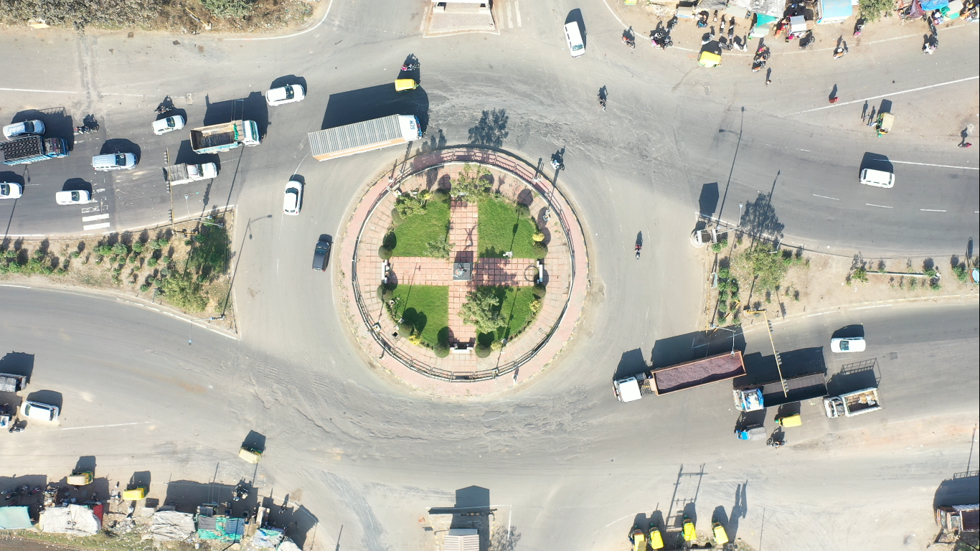
Introduction
Roundabout

Slide 4
Introduction
“If you can’t measure it, you can’t improve it”
Measurable road- objects :
Vehicles
Road markings
Road structure
Road signs

Slide 5
Problem Statement
In recent years, unmanned aerial vehicle (UAV) has been increasingly applied to traffic monitoring, driver behaviour analysis, road infrastructure analysis and , traffic flow analysis.
Here, primary task is vehicle recognition.
“What are the challenges in this task ?”

Slide 6
Challenges
Colors
Only top view available- monotonic appearance
Camera orientation
Camera movement (due to self-stabilization)
UAV altitude
Shadow effects

Slide 7
Solution
Broadly there are two kinds of solution available,
LIDAR based
Vision based
Vision based solution _{[1]} is cheaper and provides reasonable accuracy.
ML based, Ex: SVM
DL based, Ex: CNN

Slide 8
Existing Systems
Mostly variants of CNN are widely used for such task.
Alexnet_{[3]}
CNN-SVM_{[6]}
SPPnet_{[4]}
Alexnet + GAP_{[5]}
YOLO
R-CNN
Fast R-CNN and Faster R-CNN

Slide 9
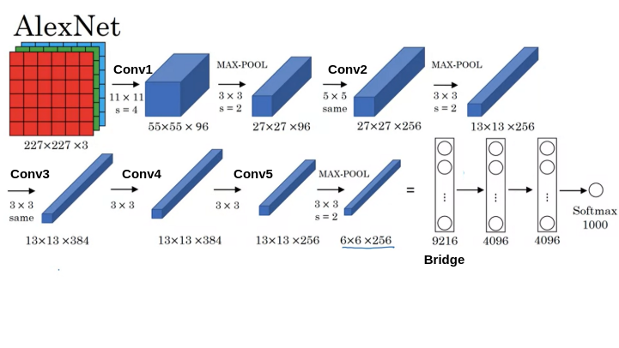
Conventional Alexnet_{[3]}
* from google search

Slide 10
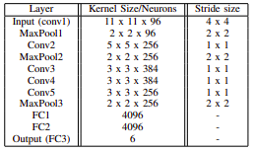
Modified Alexnet ( 50 x 50 )

Slide 11
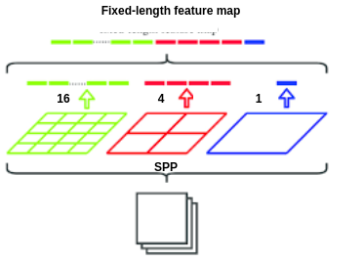
SPPnet_{[4]}
* from google search

Slide 12
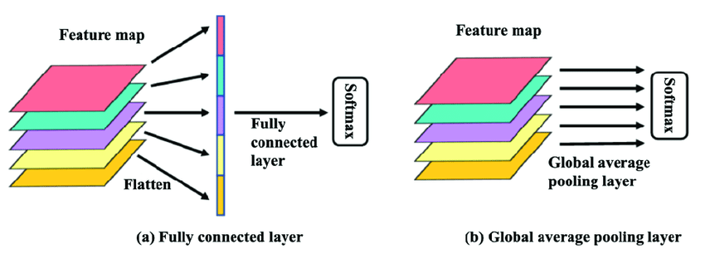
Global Average Pooling(GAP)_{[5]}
* from google search

Slide 13
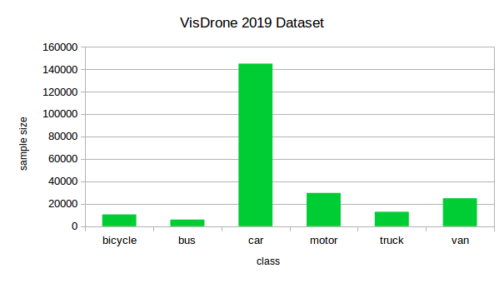
VisDrone 2019 Dataset _{[2]}

Slide 14
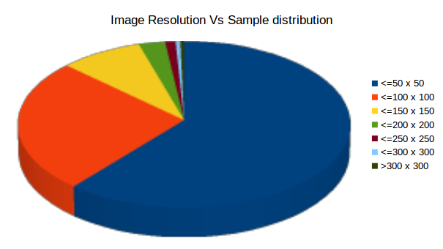
VisDrone 2019 Dataset

Slide 15










Bicycle,
Motorcycle

Slide 16



















Car, Truck, Van, Bus

Slide 17
Techniques
Imbalanced dataset
Weighted loss function
Overfitting caused by fully connected layers
Dropout _{[7]}
GAP
Requirement of fixed input image size
SPP
GAP

Slide 18
Result
Model | Val-Accuracy | Test-Accuracy
Modified Alexnet | 0.80 | 0.74
Alexnet + GAP | 0.82 | 0.78
Conv + GAP | 0.78 | 0.77

Slide 19
Future work
Test full-frame with model ( bounding box accuracy)
Implement anomaly detection using image processing
Test complete system

Slide 20
References
M. Haris and A. Glowacz, “Road object detection: A comparative study of deep learning-based algorithms,” Electronics, vol. 10, no. 16, 2021. [Online]. Available: https://www.mdpi.com/2079-9292/10/16/1932
P. Zhu, L. Wen, D. Du, X. Bian, H. Fan, Q. Hu, and H. Ling, “Detection and tracking meet drones challenge,” IEEE Transactions on Pattern Analysis and Machine Intelligence, pp. 1–1, 2021.

Slide 21
References
A. Krizhevsky, I. Sutskever, and G. E. Hinton, “Imagenet classification with deep convolutional neural networks,” in Advances in Neural Information Processing Systems, F. Pereira, C. J. C. Burges, L. Bottou, and K. Q. Weinberger, Eds., vol. 25. Curran Associates, Inc., 2012. [Online]. Available: https://proceedings.neurips.cc/paper/2012/file/c399862d3b9d6b76c8436e924a68c45b-Paper.pdf
K. He, X. Zhang, S. Ren, and J. Sun, “Spatial pyramid pooling in deep convolutional networks for visual recognition,” CoRR, vol. abs/1406.4729, 2014. [Online]. Available: http://arxiv.org/abs/1406.4729

Slide 22
References
M. Lin, Q. Chen, and S. Yan, “Network in network,” 12 2013.
S. Karungaru, L. Dongyang, and K. Terada, “Vehicle detection and type classification based on cnn-svm,” International Journal of Machine Learning and Computing, vol. 11, pp. 304–310, 08 2021.
G.E. Hinton, N. Srivastava, A. Krizhevsky, I. Sutskever, and R.R. Salakhutdinov. Improving neural networks by preventing co-adaptation of feature detectors. arXiv preprint arXiv:1207.0580, 2012.

