Slide 1
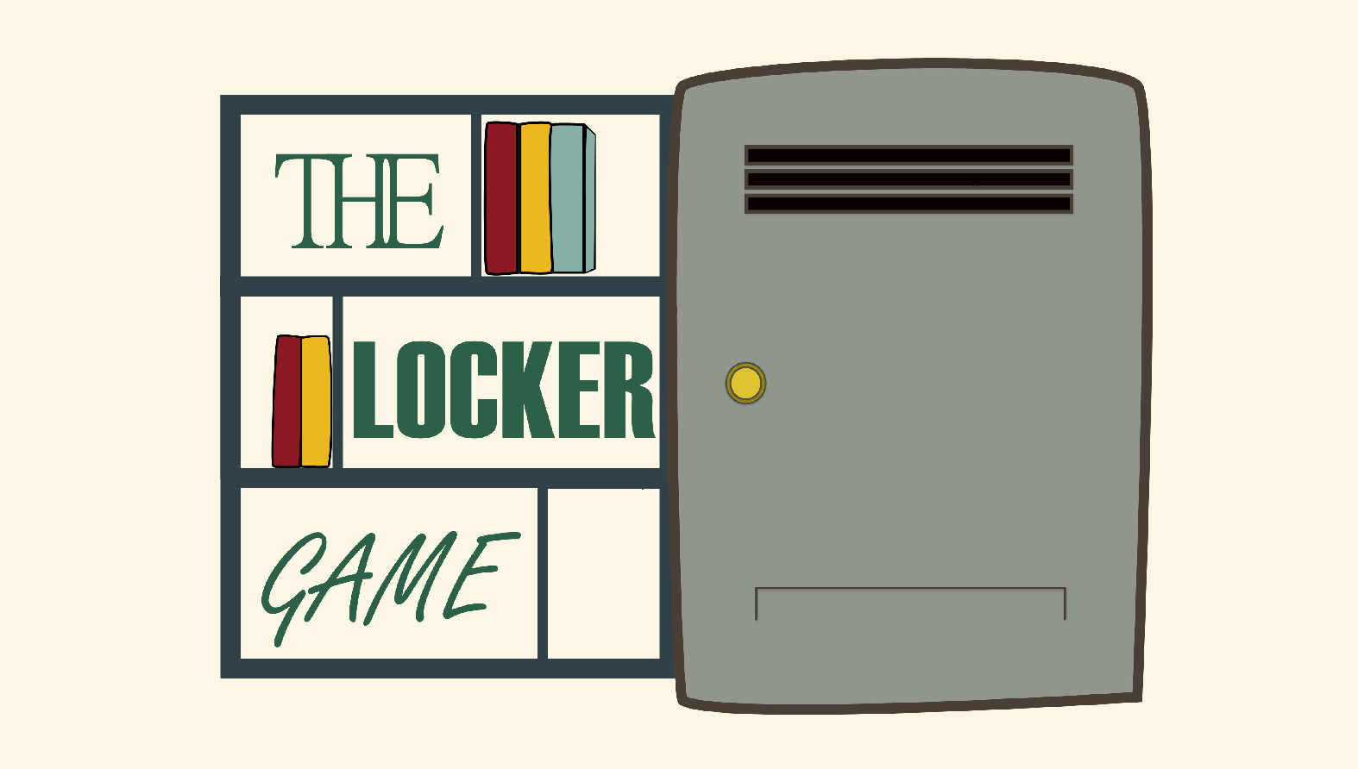
Next… & Questions
More empirical evidence; Control vs Treatment
Follow up study to confirm the hypothesis: interaction, visualization, and easier and faster to work with.
Have a full EVG (not some aspects);
BIG QUESTION: Did performance improve after using an EVG?
Notes:
The data was collected in a three-part package (see package at the end). The first part of the package presents the problem and asks the student to solve it following Pólya’s steps and documenting each in writing. The second part asked the students the same but with the aid of the Locker Game. The last part is a questionnaire/survey about the experience of solving the problem without and with the Locker Game.

Slide 2


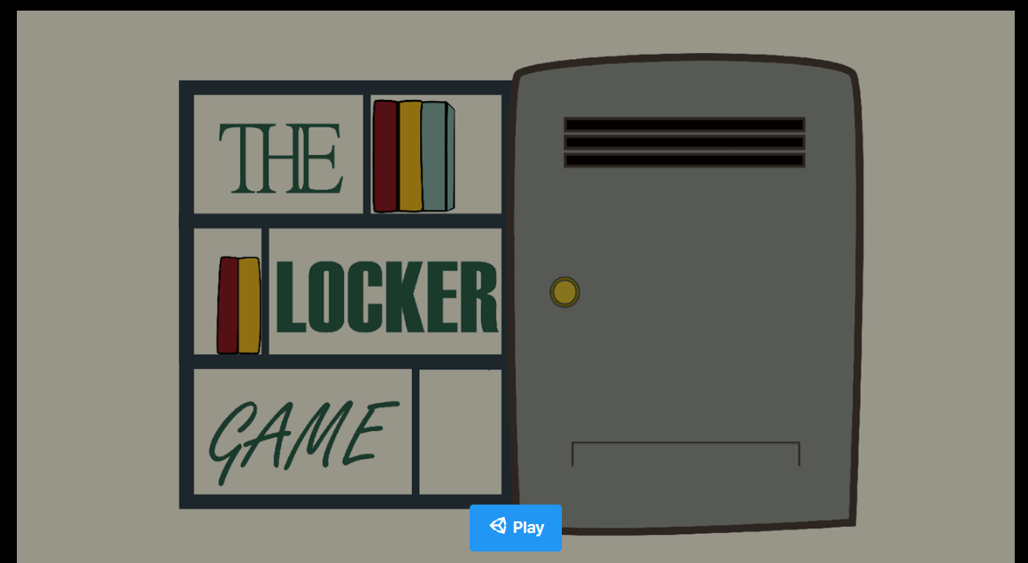

The Locker Problem
Game
How to use it:
1. on to start the game.
Click
Notes:
https://play.unity.com/mg/other/lockers-ver-999-webpublish-2

Slide 3

The Locker Problem
Game
How to use it:
2. Press “Enter”
Notes:
https://play.unity.com/mg/other/lockers-ver-999-webpublish-2

Slide 4
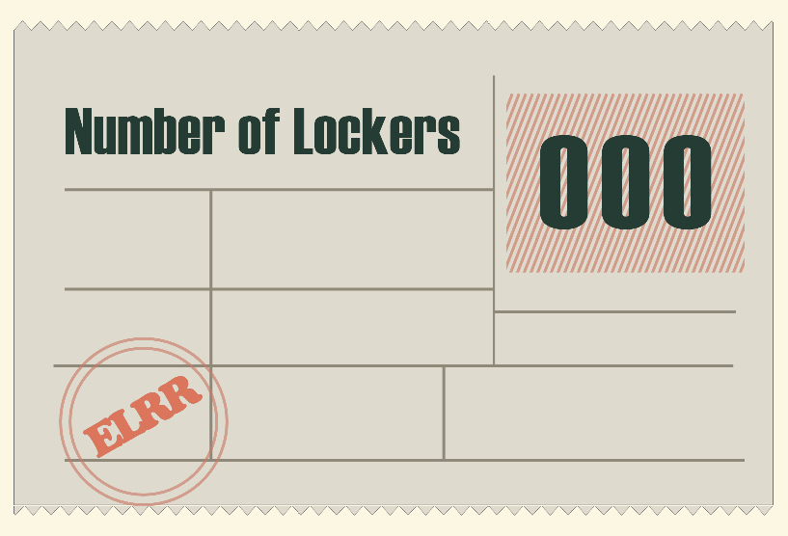
The Locker Problem
Game
How to use it:
3. Enter the numbers of lockers from 1 to 999 and press “Enter”.
# of Locker Here
Notes:
https://play.unity.com/mg/other/lockers-ver-999-webpublish-2

Slide 5
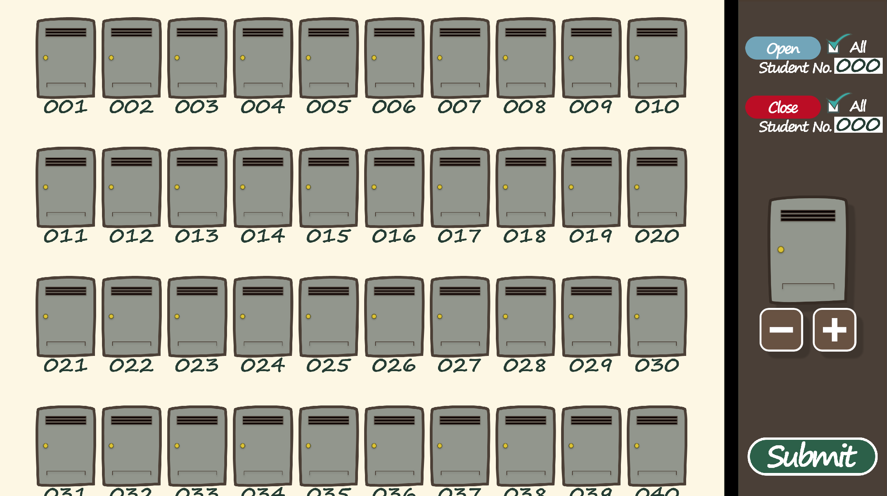


The Locker Problem
Game
How to use it:
4. Click on the individual lockers to open and close.
Close
Open
Scroll down and up to navigate through the lockers.
Notes:
https://play.unity.com/mg/other/lockers-ver-999-webpublish-2

Slide 6

The Locker Problem
Game
How to use it:
6. In game buttons
7. Press “M” to go back to the menu.
Open
Close
All or by student number
8. In case of emergency (game broke), refresh.
‘-’ remove locker
‘+’ add locker
Submit your answer (you can also press enter)
Thank you for playing my game!
Notes:
https://play.unity.com/mg/other/lockers-ver-999-webpublish-2

