Slide 1
184.269 Advanced Internet Computing
Project Topic 1
Services Engineering
Andreas Sehr
Bernhard Denner
Wolfgang Renz
Reza Anwar
Manuela Weilharter

Slide 2
Assignment
Functionalities
register / unregister / login
check bill
query the sentiment
Technologies
C#, MySql Database
WCF, IIS, BPMN

Slide 3
Assignment
Stage 1
Design the Business Processes (with BPMN)
Identify the Base Services
Implement the Base Services
Deploy to an Internet Information Server (IIS)

Slide 4
Business Process Model and Notation (BMPN)
standard for business process modeling
graphical notation for specifying business processes
support business process management
Provide a standard notation understandable by all business stakeholders

Slide 5
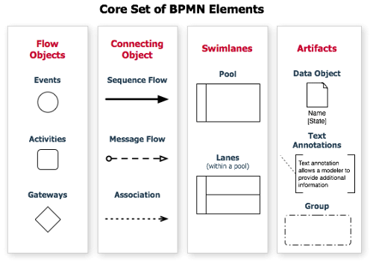
Business Process Model and Notation (BMPN)

Slide 6
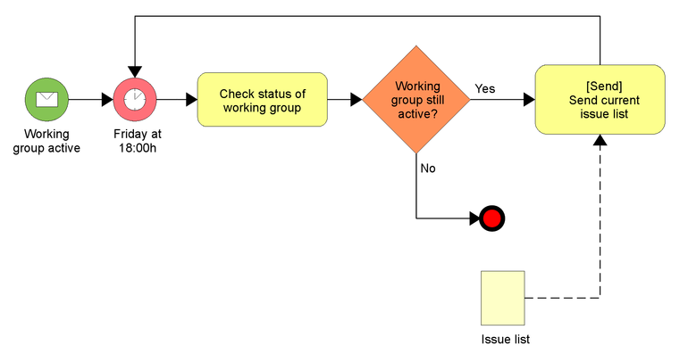
Business Process Model and Notation (BMPN)

Slide 7
Windows Communication Foundation
Runtime and set of APIs for service oriented applications.
Based on .Net Framework
Used to design, implement and deploy distributed applications
Supports Interoperability with other WCF applications or webservices defined by WSDL

Slide 8
Microsoft Internet Information Services
Part of Windows Server family.
Mainly a webserver application, but supports ftp, ftps, smtp, nntp either.
Delivers not only html files, renders them either. For instance ASP files.

Slide 9
MySQL
Relational Database Management System
Open Source
Good documentation and big community.
Possibility to sign enterprise support for production level.

Slide 10
Services
3 basic services
Authentication (login / register)
Billing
Sentiment

Slide 11
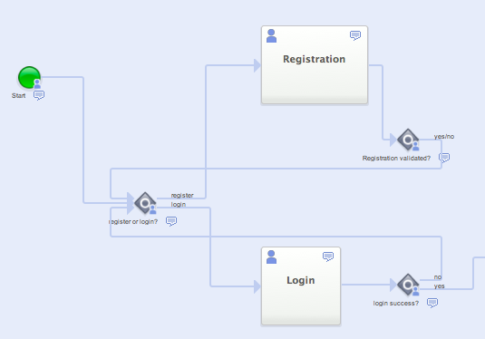
Authentication Service

Slide 13
Sentiment Service
Steps
1. Get the first 500 Search Results for the company name from Twitter using TweetSharp (API wrapper for Twitter)
2. Send all english tweets to the Sentiment Analysis using sentiment140.com
3. Interpret the response
4. Calculate the sentiment value

Slide 14
Sentiment Service
Request
{"data": [{"text": "I love microsoft.", "query": "microsoft"},
{"text": "I hate microsoft.", "query": "microsoft"}]}
Response
{"data": [{"text": "I love microsoft.", "polarity": 4},
{"text": "I hate microsoft.", "polarity": 0}]}
Polarity Values
- 0... negative
- 2... neutral
- 4... positive

Slide 16

The End
Thank you for your attention!

