Slide 1
184.269 Advanced Internet Computing
Project Topic 1
Services Engineering
Andreas Sehr
Bernhard Denner
Wolfgang Renz
Reza Anwar
Manuela Weilharter

Slide 2
Recap of Stage 1

Slide 3
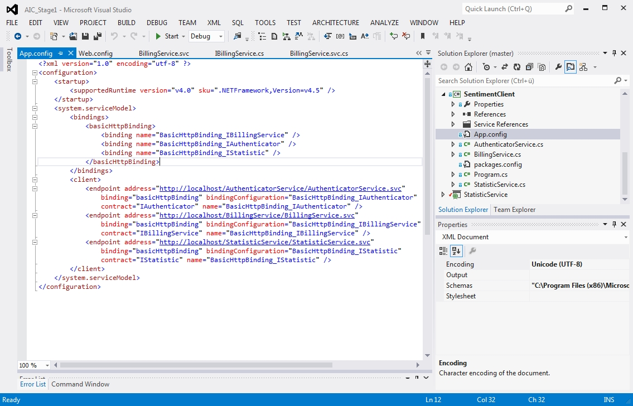
Implementing Services with WCF

Slide 4
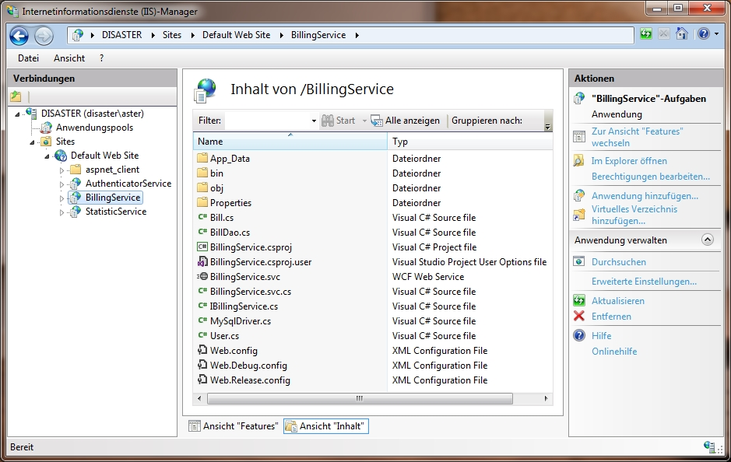
Deploying Services to IIS

Slide 5
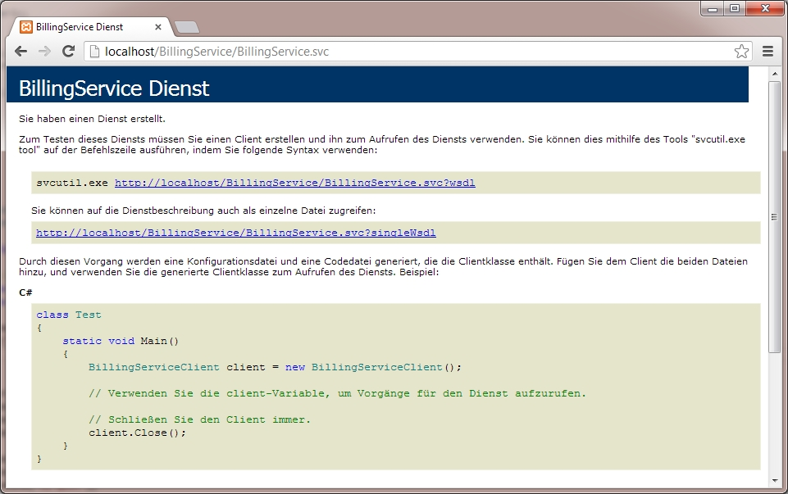
Service on IIS

Slide 6
Stage 2 – WS-BPEL

Slide 7
Stage 2 – WS-BPEL
Web Services Business Process Execution Language
XML based
Specifying executable business processes
Interaction through web service operations

Slide 8
Stage 2 – WS-BPEL
Orchestration language
Programming in the large
Basic Activities: assign, invoke, wait
Structured Activities: if, switch, foreach, while

Slide 9
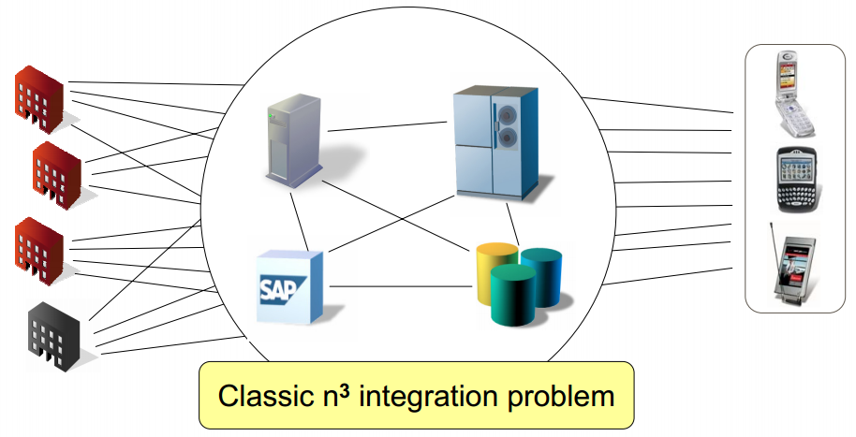
Stage 2 – BPEL Use Case
Global Telco – Before BPEL
Source: http://www.oasis-open.org

Slide 10
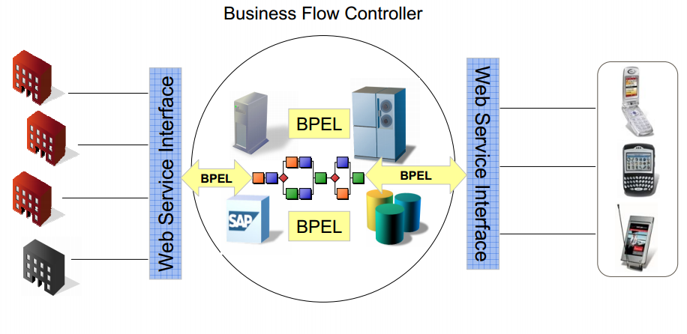
Stage 2 – BPEL Use Case
Global Telco – After BPEL
Source: http://www.oasis-open.org

Slide 11
Stage 2 – Apache ODE
Apache Orchestration Director Engine
Executing processes following WS-BPEL
  Sending and receiving
  Data manipulation
  Exception handling

Slide 12

The End
Thank you for your attention!

