Slide 1
Telco Customer Churn Erdei Roland 2020. 12. 03. Mérési adatok vizuális elemzése
Exploratory data analysis Logistic regression

Slide 2
Questions
Extra szolgáltatásainkat mennyien használják, található-e ezek között korrelációt, bármely extra szolgáltatás összefügg a churn-el?
Mennyit fizetnek azok, akik a cég mellett maradnak és mennyi azok, akik nem, található ebben valamiféle pattern?
Milyen feltételek esetén a legvalószínűbb, hogy a felhasználó elhagyja a cég szolgáltatásait?
Milyen eszközzel és mennyire lehet megjósolni a feature-k segítségével a churn-t?

Slide 3
Python jupyter notebook Numpy, pandas, seaborn, matplotlib, plotly pandas profiling sklearn

Slide 4
Customer churn is the percentage of customers that stopped using your company's product or service during a certain time frame.
Original data:
7043 rows (customers)
21 columns (feature)
After cleaning:
7043 rows (customers)
21 columns (feature) – deleted ID, added number of services used

Slide 5
Features I.
customerID - Customer ID
Gender - Whether the customer is a male or a female
SeniorCitizen - Whether the customer is a senior citizen or not (1, 0)
Partner - Whether the customer has a partner or not (Yes, No)
Dependents - Whether the customer has dependents or not (Yes, No)
Tenure - Number of months the customer has stayed with the company
PhoneService - Whether the customer has a phone service or not (Yes, No)
MultipleLines - Whether the customer has multiple lines or not (Yes, No, No phone service)
InternetService - Customer’s internet service provider (DSL, Fiber optic, No)
OnlineSecurity - Whether the customer has online security or not (Yes, No, No internet service)
OnlineBackup - Whether the customer has online backup or not (Yes, No, No internet service)
DeviceProtection - Whether the customer has device protection or not (Yes, No, No internet service)
TechSupport - Whether the customer has tech support or not (Yes, No, No internet service)

Slide 6
Features II.
StreamingTV - Whether the customer has streaming TV or not (Yes, No, No internet service)
StreamingMovies - Whether the customer has streaming movies or not (Yes, No, No internet service)
Contract - The contract term of the customer (Month-to-month, One year, Two year)
PaperlessBilling - Whether the customer has paperless billing or not (Yes, No)
PaymentMethod - The customer’s payment method (Electronic check, Mailed check, Bank transfer (automatic), Credit card (automatic))
MonthlyCharges - The amount charged to the customer monthly
TotalCharges - The total amount charged to the customer
Churn - Whether the customer churned or not (Yes or No)

Slide 7
Data cleaning and reshaping
Chaging Yes/No columns to categorical data type
Converting TotalCharges feature in to float type and filling N/A values
Changing 'No internet service' to 'No’ and coverting it to categorical data type ('OnlineSecurity', 'OnlineBackup', 'DeviceProtection', 'TechSupport', 'StreamingTV', 'StreamingMovies’)
Churn rate ~26.5% (1869 customers)
Features: 17 Category, 2 Float, 2 Int
Notes:
ID feature deleted
Added number of services feature – where ‚Yes’
TotalCharges: originally was a String, converted to float and it was missleading, because there were 0 N/A, but there were „ „ values
IQR - interquartile range – checking
Pandas Profiling report

Slide 8
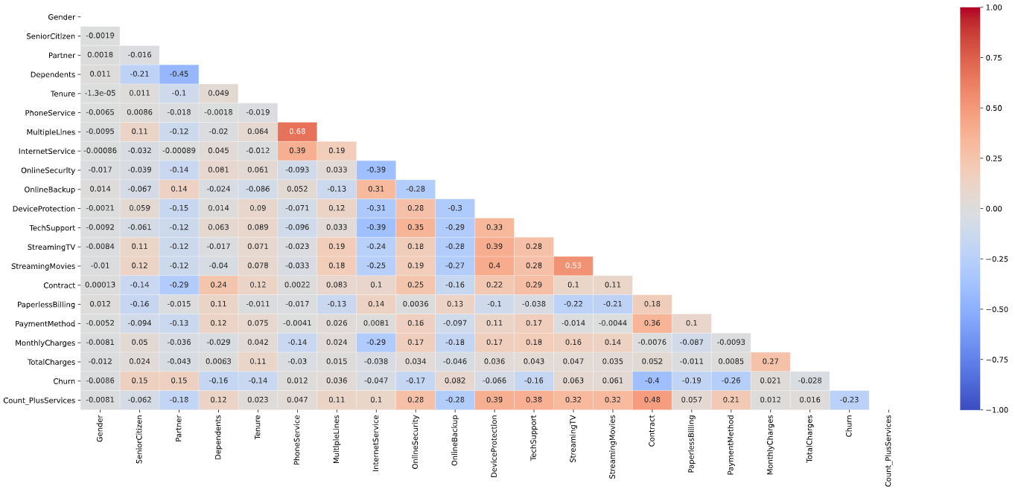
Correlation heatmap
Notes:
Finding(s):
Dependents and Partner features have inverse correlation relationship
Churn and Contract have inverse correlation relationship
Internet Service and Online Security have inverse correlation relationship
Tech Support and Internet Service have inverse correlation relationship
Count Plus Services and Online Backup have inverse correlation relationship
Streaming TV and Streaming Movies have positive correlation relationship
Multiple Lines and Phone Service have positive correlation relationship
Count Plus Services and Contract have positive correlation relationship
Device Protection and Streaming Movires have positive correlation relationship

Slide 9
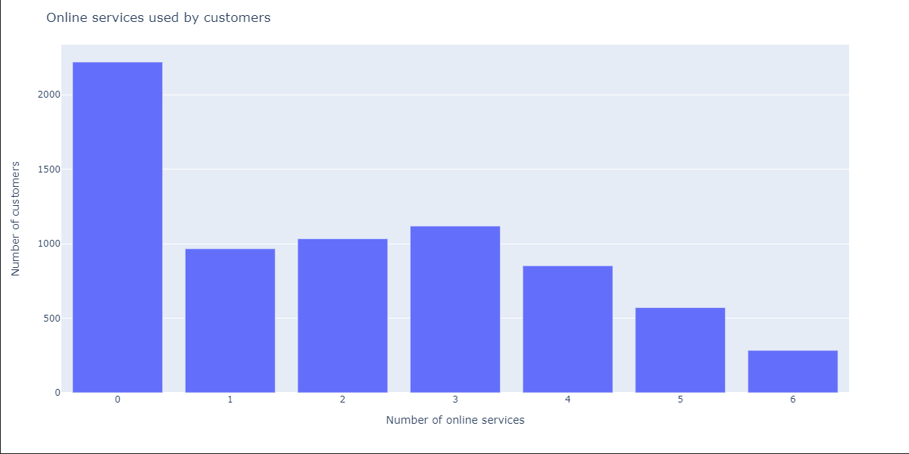
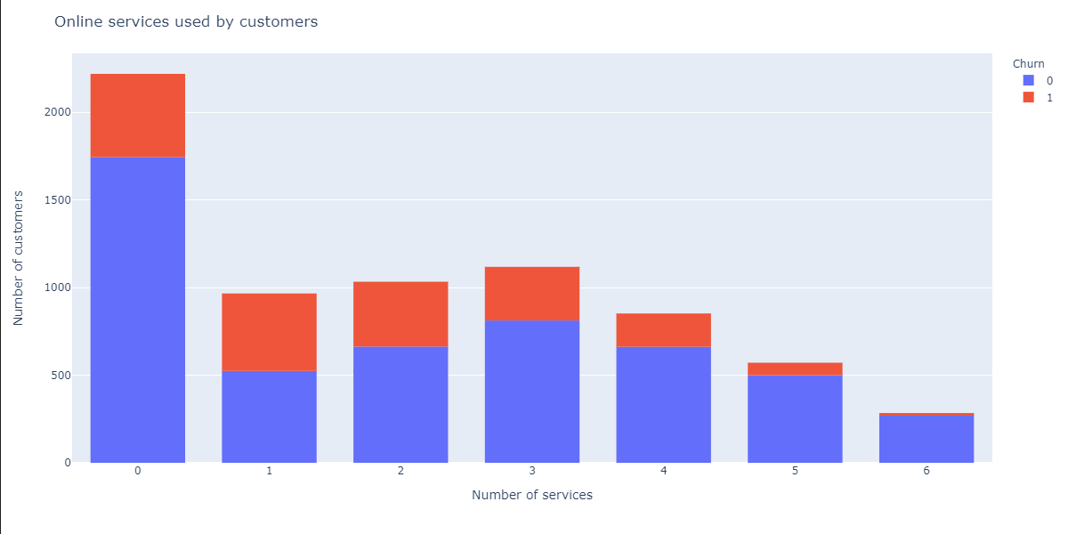
Number of services used by customers
Notes:
Finding(s):
~31% of the customers do not use any of the online services
Most of the customers use 1-2-3 services
Only 4% uses all the 6 services, 12% uses 5 services
Customers who are availing just one Online Service are churning highest
As the number of online services increases beyond one service, the less is the proportion of churn

Slide 10
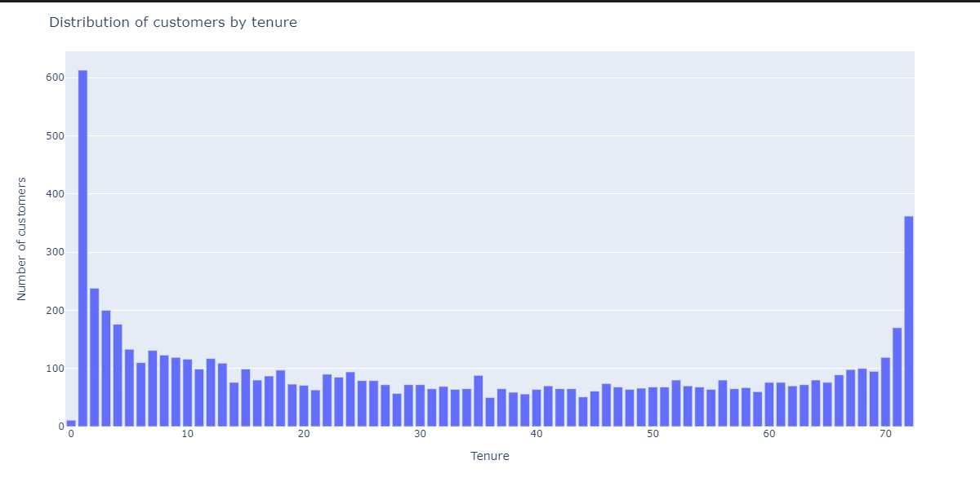
Distribution of customers by tenure
Notes:
Finding(s):
There is a lot of new customers
Also there are a lot of 50-60-70 month customers

Slide 11
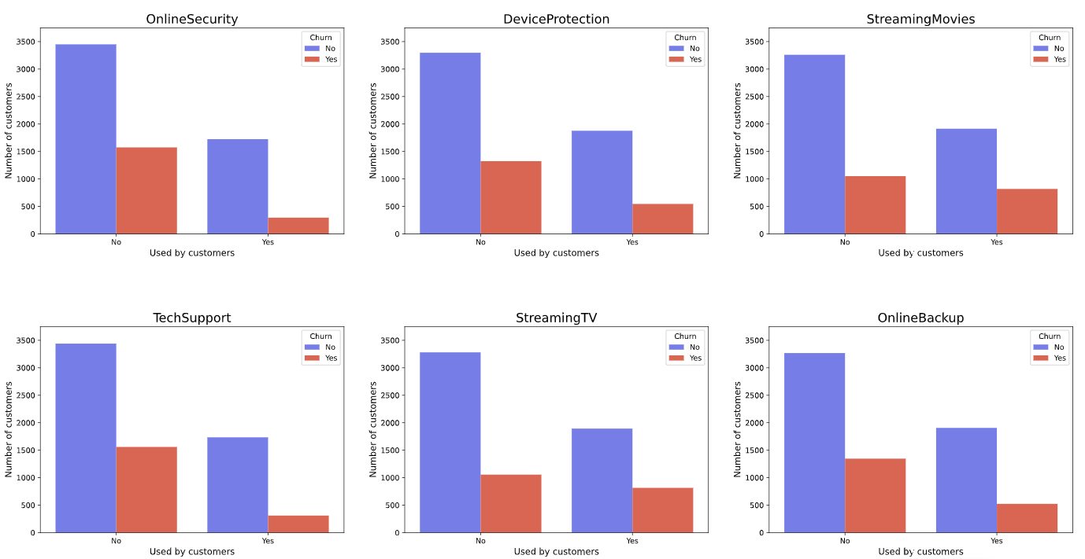
Countplots I.
 | Online Security | Device Protection | Streaming Movies | Tech Support | Streaming TV | Online Backup
No | 5024 | 4621 | 4311 | 4999 | 4336 | 4614
Yes | 2019 | 2422 | 2732 | 2044 | 2707 | 2429
Notes:
Finding(s):
Streaming Movies and Streaming TV is the 2 most popular services (~39%)
Online Security and TechSupport is the least popular (~29%)
Although Streaming Movies and Streaming TV is the 2 most popular services the churning rate is high => the quality can be a factor
Online Security and TechSupport is the least popular, however the churning rate is low => the services probably not popular among customers and not because of the quality

Slide 12
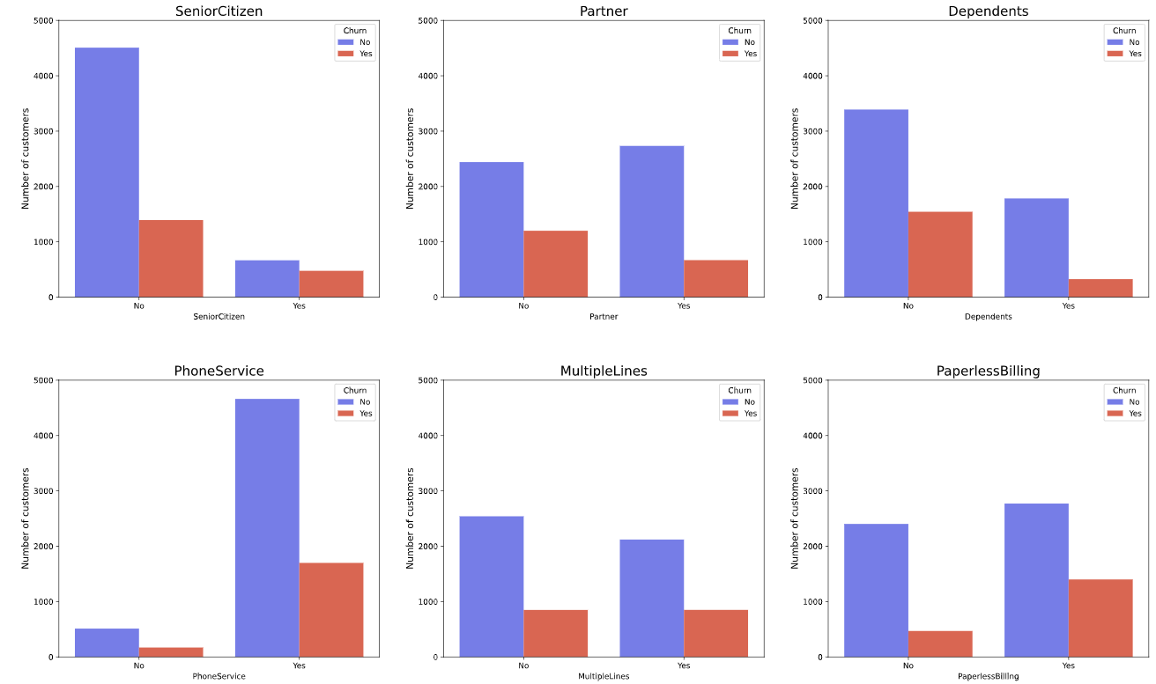
Countplots II.
 | Senior Citizen | Partner | Dependents | Phone Service | Multiple Lines | Paperless Billing
No | 5901 | 3641 | 4933 | 682 | 3390 | 2872
Yes | 1142 | 3402 | 2110 | 6361 | 2971 | 4171
Notes:
Finding(s):
~16% of the customers are Senior Citizens
Paperless Billing is more popular than Regular Billing
~90% of the customers have Phone Service
~47% of them have Multiple Lines
Senior Citizens churning in a higher rate
Other churning rates are close to the average churning rate (~26%)

Slide 13
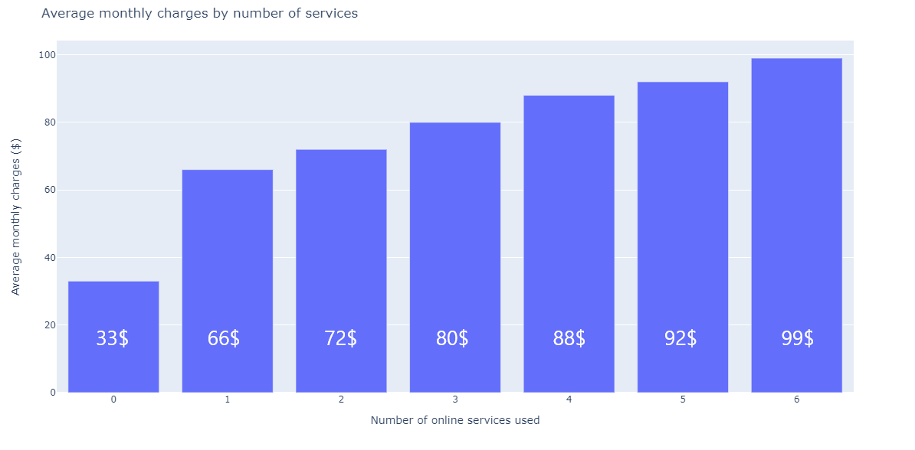
Average monthly charges
Notes:
Finding(s):
Customers who does not avail any internet service are paying $33
While those with one service are paying double $66
As the number of services availed increases, the Average Monthly Charges are increasing linearly

Slide 14
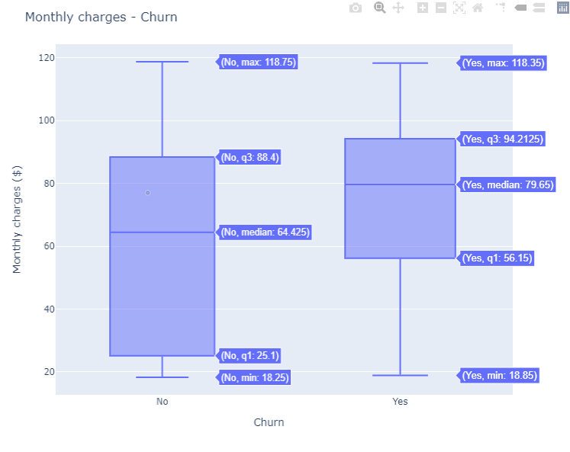
Monthly charges & Churn
Notes:
Finding(s):
The higher the monthly charges, the higher possibility of Churn
Non churners are paying an average of $64.45, while churners are paying $79.65 average
There is a possibility that the price is too high

Slide 15
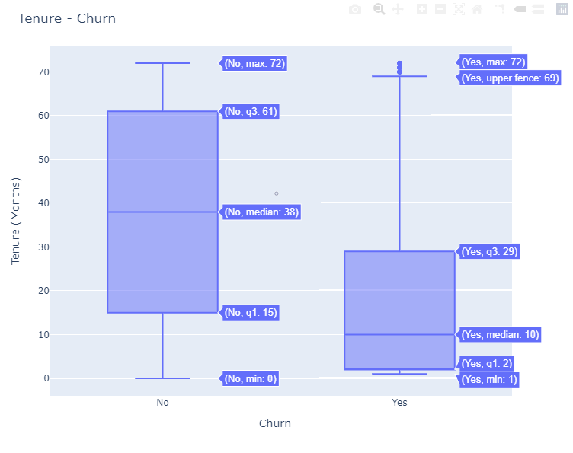
Tenure & Churn
Notes:
Finding(s):
Shorter the tenure, higher is the possibility of Churn (Non-Churn customers: ~38, Churned customers: ~10)

Slide 16
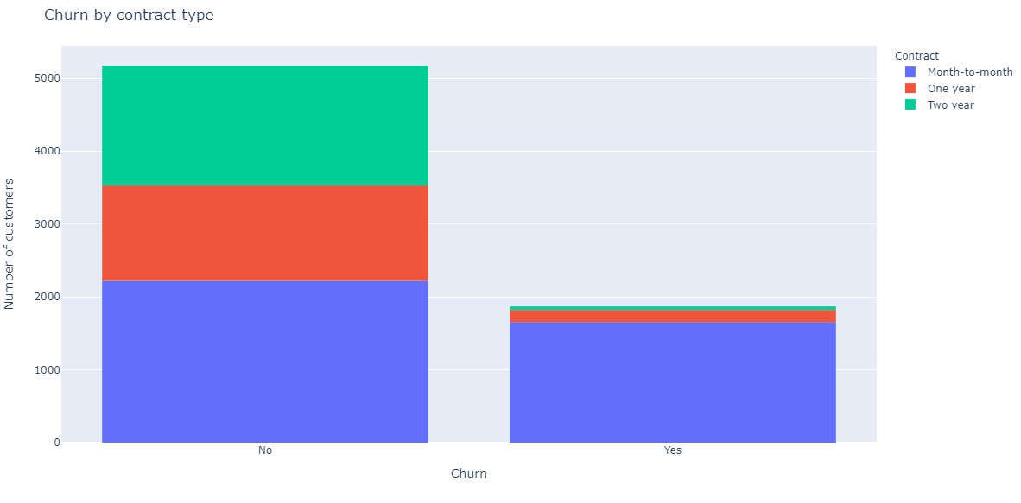
Contract type
Contract
Month-to-month | 3875
Two year | 1695
One year | 1473
Notes:
Finding(s):
Month-to-month contract is the most popular ~55%
Two year and One year is close to each other
Customers with Month-to-Month contract are churning in alarming proportions, while two-year contract customers are churning least

Slide 17
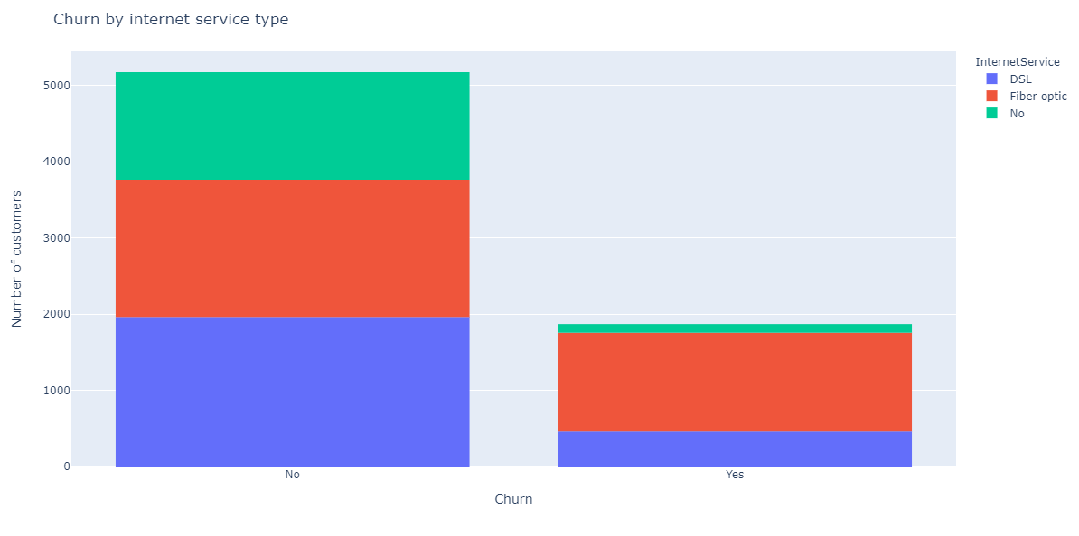
Internet service
 | Internet Service
Fiber optic | 3096
DSL | 2421
No | 1526
Notes:
Finding(s):
Only 22% of the customers don't have internet
44% have Fiber optic and 34% have DSL
Customers with Fiber Optic internet service are churning in alarming proportions

Slide 18
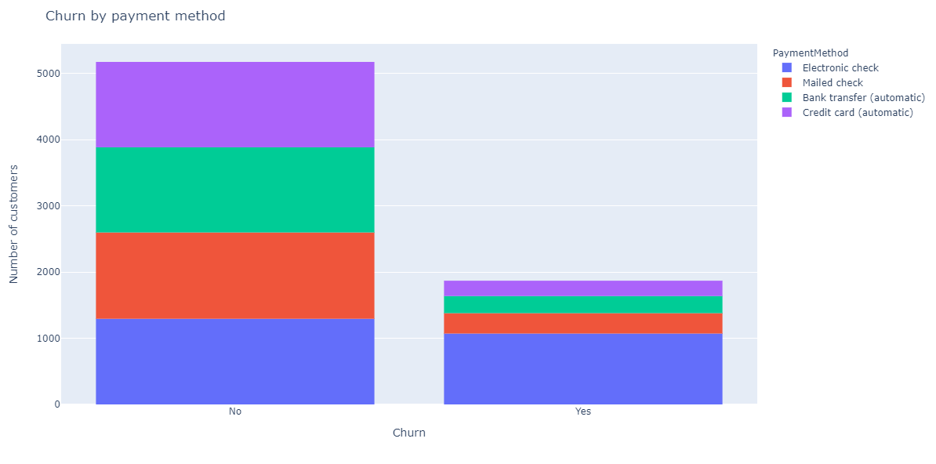
Payment method
Payment Method
Electronic check | 2365
Mailed check | 1612
Bank transfer (automatic) | 1544
Credit card (automatic) | 1522
Notes:
Finding(s):
Most of the customers payment method is Electronic check
~44% uses automatic payment method Only ~23% needs to be mailed
Customers with Electronic Check as mode of payment are churning in higher proportion (almost 50%), while other payment method has ~15%

Slide 19
Conclusion
Streaming TV and Streaming Movies usually used together, they are the 2 most popular services, but the churning rate is high => the quality can be a factor
Online Security and TechSupport is the least popular, but the churning rate is low => probably the services are just not popular
Customers who are availing just one Online Service are churning highest
Senior Citizens churning in a higher rate
~31% of the customers do not use any of the online services
Only 4% uses all the 6 services, 12% uses 5 services
The higher the monthly charges, the higher possibility of Churn
Non churners are paying just over 64.45, while churners are paying nearly 79.65 => there is a possibility that the price is too high
Shorter the tenure, higher is the possibility of Churn (Non-Churn customers: ~38, Churned customers: ~10)

Slide 20
Logistic regression
Logistic regression is used to model the probability of a certain class or event existing such as pass/fail, win/lose, alive/dead or healthy/sick. The logistic regression model itself simply models probability of output in terms of input and does not perform statistical classification.
 | 0 | 1 | All
0 | 1169 | 213 | 1382
1 | 125 | 254 | 379
All | 1294 | 467 | 1761
Train | 5282 row
Test | 1761 row
Overall Accuracy: 80.806%
Notes:
A logisztikus regresszió megbecsüli egy bizonyos esemény (a függő változó) bekövetkezésének valószínűségét. Az elemzés során azt vizsgáljuk, hogy ez az esemény bekövetkezik-e, vagy sem. Ehhez meg kell vizsgálnunk az összes olyan tényezőt, amely összefüggésbe hozható az eseménnyel.
Multinomiális típusú - több, mint két kategóriája van
75%-25%
7043 customers
Random seed

