Slide 1
Craft Beer Analysis
Edward Roske
January 9, 2020
Notes:
Hello, my name is Edward Roske and I’ve been doing some analysis of craft beers and breweries. As Budweiser is the largest brand inside of Anheuser-Busch, which itself is the largest American division of AB Inbev, it’s important that Budweiser continue it’s dominance as the craft beer movement marches forward.
{ADVANCE SLIDE}

Slide 2
Brewery Analysis by State
29
32
47
39
28
Notes:
Since Bud Lite and Budweiser control approximately 25% of the market share in the United States alone, I’ve focused this analysis on the United States. It’s our greatest area of potential risk, but also our greatest area of potential opportunity.
As of the time of this data, the largest number of breweries are in:
{ANIMATE} Colorado at 47.
{ANIMATE} California at 39.
{ANIMATE} Michigan at 32.
{ANIMATE} Oregon at 29..
{ANIMATE} and The Great State of Texas at 28.
On the opposite end, some states like each of the Dakotas, West Virginia, and the District of Columbia only have a single brewery.
In other words, there are some areas ripe for growth, and we’ll get back to those at the end of the presentation.
{ADVANCE}

Slide 3
IBU Analysis by State
Notes:
Here we have average IBUs by State.
Be aware that a large number of beers (over 1,000) are missing IBUs: breweries tend to provide them for Pale Ales but many other beers are missing, so we’ve for the purposes of this analysis, I’ve replaced the missing IBUs with the overall median.
There are some notable standouts.
{ANIMATE} Kansas and Iowa have the lowest averages.
{ANIMATE} West Virginia, Mississippi, and Delaware have the highest state average IBUs, but be aware that each of those states has only 1 to 2 breweries per state, so those may be outliers.
{ADVANCE}

Slide 4
ABV Analysis by State
Notes:
Unlike the IBUs, only 62 beers are missing ABVs. Leading to much more variance.
{ANIMATE} Utah has the lowest ABV in the country, because they also have the most restrictive beer laws in the country. Beer with greater than 4% alcohol by weight can only be sold in very specific retail locations.
{ANIMATE} West Virginia and the District of Columbia have the highest ABVs but again, there’s only 1 brewery, as of the time of this data, in each of those locations.
Kudos to that one brewery in West Virginia: they make their beer bitter and they make it strong.
{ADVANCE}

Slide 5
ABV Analysis by Ounces
Notes:
I felt that this boxplot was helpful for analyzing the distribution of ABV for each packaging size.
As you can see, 12-ounce and 32-ounce beers have the lowest median ABV, {ANIMATE} that’s the line in the middle there.
12-ounce beers also have the lowest spread, the lowest distribution, of ABVs, {ANIMATE} that’s the height of the box there above 12.
{ANIMATE} The 19.2 and 24-ounce beers fall into the so-called “bomber” category. These beers not only have the widest distribution of ABVs, they also have the highest median averages. Although the also have a wide-spread, the 19.2-ounce beers have clearly the highest ABV on average.
{ADVANCE}

Slide 6
ABV vs IBU Analysis
Notes:
In this graph, you see that in the craft beer market, not only does their ABV tend to be higher than the 3.3% beers common at supermarkets across America, as the bitter units increase, ABV tends to as well.
We’ve marked IPAs with green dots, Ales that aren’t IPAs with red dots, and beers that aren’t Ales with blue dots.
On that note, you’ll notice that there aren’t many high IBU beers that aren’t Ales.
But for beers listing IBUs, there is a correlation between IBUs increasing and ABVs increasing.
Let’s hide the non-Ales.
{ADVANCE}

Slide 7
ABV vs IBU Analysis
Prediction Accuracy: 81%+
Notes:
First notice that within the Ale family, IPAs actually have lower IBUs which is why we see more blue dots on the left and more red dots on the right.
Also notice that while for IPAs, as IBUs increase, ABVs increase as well,
The change is even stronger for non-IPA Ales. For these Ales, as IBUs increase, the alcohol by volume increases even faster.
Because of this unique relationship, it’s actually possible using a simple K-Nearest Neighbor (KNN) model to predict whether a beer is an IPA or another Ale {ANIMATE} with greater than 81% accuracy.
Now the big question: what does this mean for us?
{ADVANCE}

Slide 8
Opportunities
Notes:
Where are the opportunities for Budweiser specifically and not the craft beer industry as a whole? There seem to be two immediate areas we need to take advantage of:
#1) There seems to be a desire to have a greater variety of beer beyond our traditional American-style lagers. We are not considered, today at least, a player in the higher-alcohol and the IPA markets, both of which are prevalent in the craft brewery space.
{ADVANCE}

Slide 9
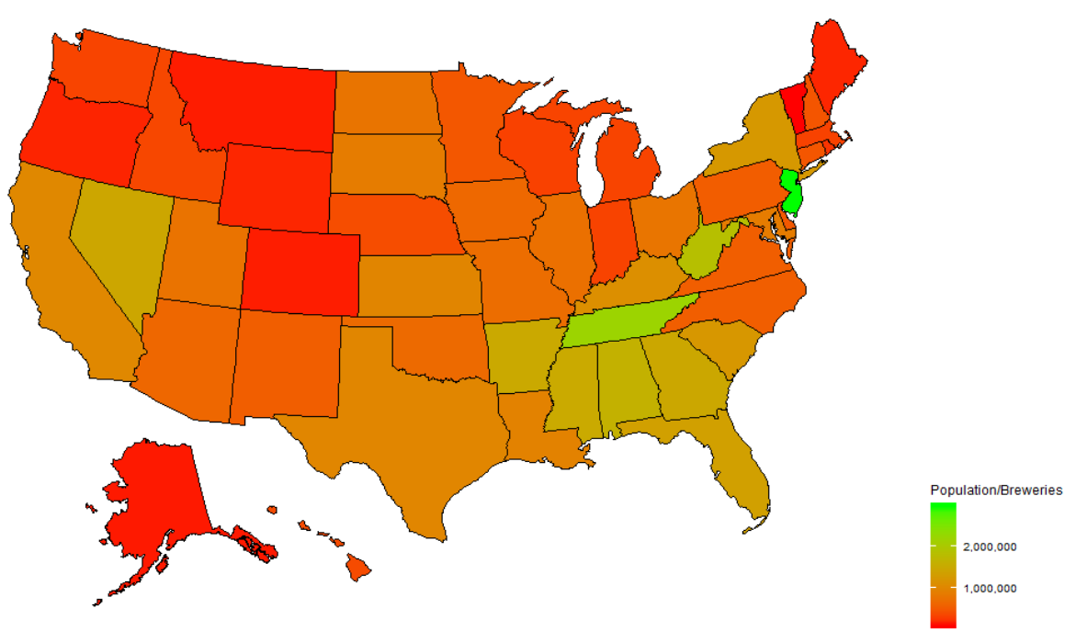
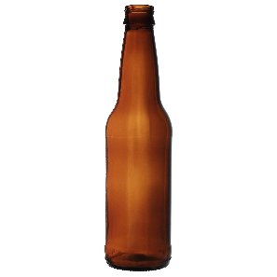
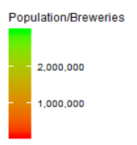
Brewery Analysis by State: Population per Brewery as of 2015
Notes:
And #2) While some states are over-saturated, other states are dramatically under-served.
This chart is population in each state divided by the number of breweries in each state.
Red areas are oversaturated (too many breweries for the population in that state). Notice how over-saturated the Northwest and Mountain states are.
But the Green areas need new craft breweries.
I advise that we buy existing craft breweries (or open new ones) starting with {ANIMATE} Tennessee {ANIMATE} and New Jersey.
Other possibilities could include {ANIMATE} West Virginia {ANIMATE} and Nevada.
Are there headwinds? Sure: some of those states have archaic blue laws dating back to prohibition, but we not only have the lobbying power to change those laws, we have the capital to take advantage of them when they do change.
In the meantime, I suggest we buy up the craft breweries available in those states and position ourselves for future growth.
{ADVANCE}

Slide 10
Craft Beer Analysis
Edward Roske
January 9, 2020
Notes:
My name is Edward Roske, and I hope that you found this information valuable.
The future is bright at Budweiser, and I’ll drink to that.
{END PRESENTATION}

Slide 11
Questions
How many breweries are present in each state?
Merge beer data with the breweries data. Print the first 6 observations and the last six observations to check the merged file. (RMD only, this does not need to be included in the presentation or the deck.)
Address the missing values in each column.
Compute the median alcohol content and international bitterness unit for each state. Plot a bar chart to compare.
Which state has the maximum alcoholic (ABV) beer? Which state has the most bitter (IBU) beer?
Comment on the summary statistics and distribution of the ABV variable.
Is there an apparent relationship between the bitterness of the beer and its alcoholic content? Draw a scatter plot. Make your best judgment of a relationship and EXPLAIN your answer.
Budweiser would also like to investigate the difference with respect to IBU and ABV between IPAs (India Pale Ales) and other types of Ale (any beer with “Ale” in its name other than IPA). You decide to use KNN classification to investigate this relationship. Provide statistical evidence one way or the other. You can of course assume your audience is comfortable with percentages … KNN is very easy to understand conceptually.
In addition, while you have decided to use KNN to investigate this relationship (KNN is required) you may also feel free to supplement your response to this question with any other methods or techniques you have learned. Creativity and alternative solutions are always encouraged.
Knock their socks off! Find one other useful inference from the data that you feel Budweiser may be able to find value in. You must convince them why it is important and back up your conviction with appropriate statistical evidence.

