Slide 1
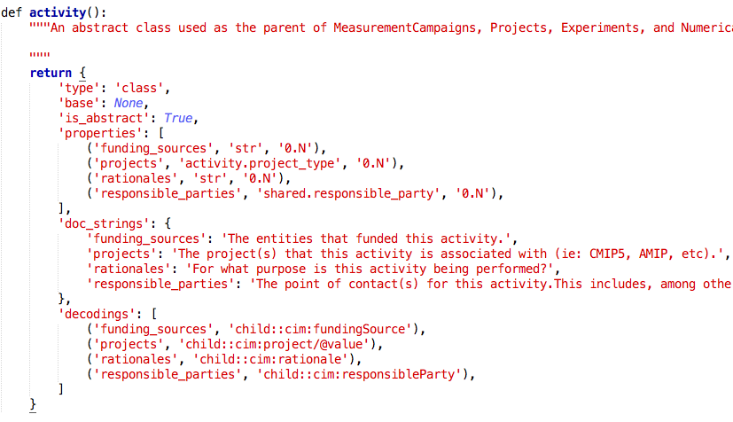
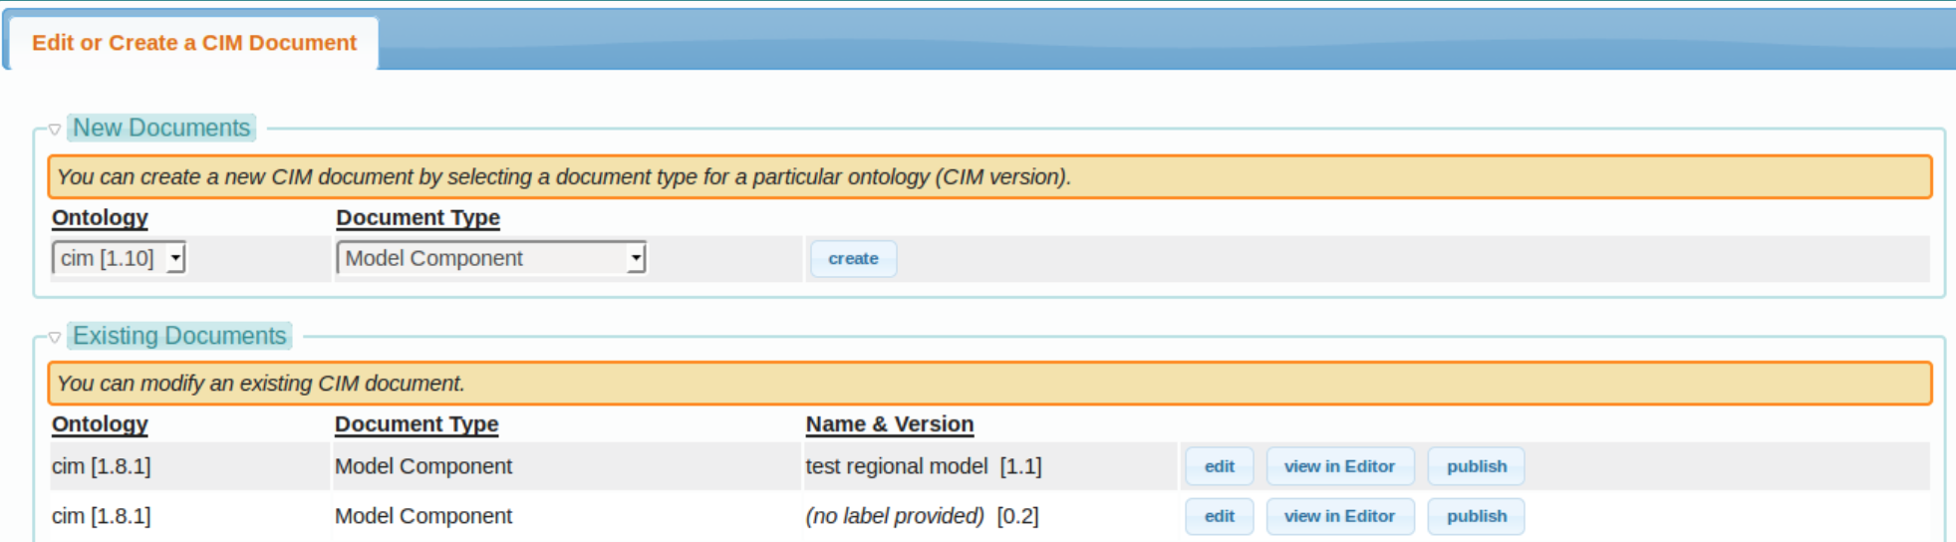
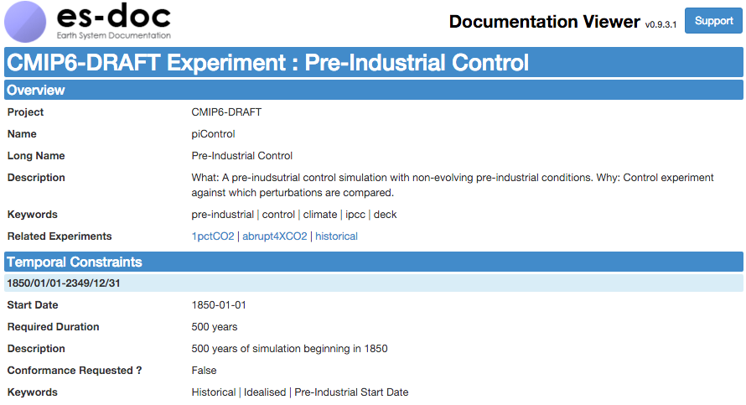
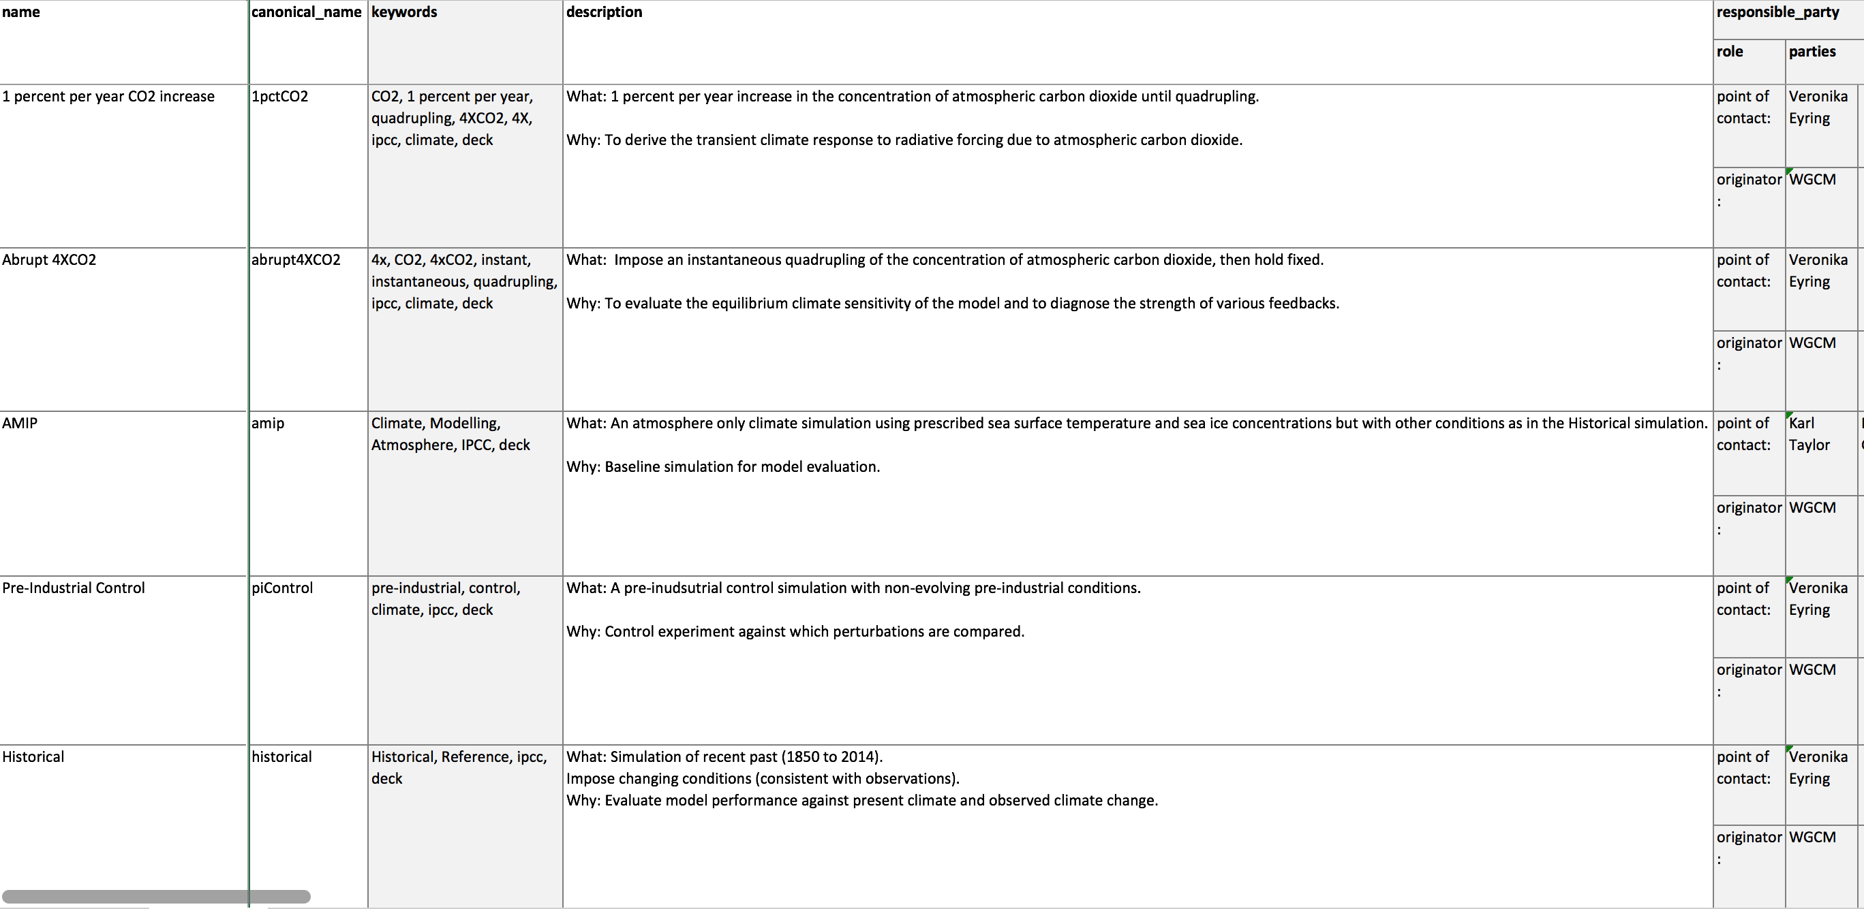








Earth System Documentation (ES-DOC) Preparations for CMIP6
Mark A. Greenslade (1), Sebastien Denvil (1), Sylvia Murphy (2), Allyn Treshanksy (2), Charlotte Pascoe (3). Bryan Lawrence (4), Eric Guilyardi (4), David Hassle (4), Mark Elkington (5), Emma Hibling (5)
1. Institut Pierre Simon Laplace, Paris, France. 2. NOAA, Colorado, USA. 3. STFC, UK. 4. University of Reading, UK. 5. UK Met Office, UK.
The Earth System Documentation (ES-DOC) is a multi-national, multi-institutional collaboration that supplies services in support of earth system documentation creation, analysis & dissemination. The ES-DOC project has been preparing for CMIP6 by enhancing existing documentation standards & tools, and by ensuring that a rich eco-system is in place so as to streamline document creation. Users will in due course be able to access CMIP6 documentation via the ES-DOC search, view & compare online tools.
1. WGCM Requirements
High-level requirements expressed at WGCM meeting
2. Documentation Standard Upgraded (CIM v2)
Enchancement of model forcings & process definitions
3. Controlled Vocabularies Upgraded
Realm based model process documentation
Standardisation of model forcings
Simplification of model components
Streamlining of model documentation
Automation of cimulation documentation
Closer coordination with modelling groups
Adopting a narrative based approach
Atmosphere
Atmospheric Chemistry
Atmospheric Aerosols
Land
Land Ice
Sea Ice
Ocean
Ocean Bio-Geochemistry
4. New Documentation Creation Tools
Spreadsheets and a new online questionniare are available
5. Powerful Scripting Library = pyesdoc
Python library simplifies document lifecycle management
6. Experimental Definitions Published
Draft CMIP6 experimental definitions are alrady published
Low level documentation management library
Integrated into all ES-DOC tools & services
Supports both CIM v1 & v2 ontologies
Supports documentation creation, I/O, archival, validation, publishing, search.
Integrated with controlled vocabularies
Unit tested, open source & pip installable
IPSL & MOHC committed to using it internally

