Slide 1
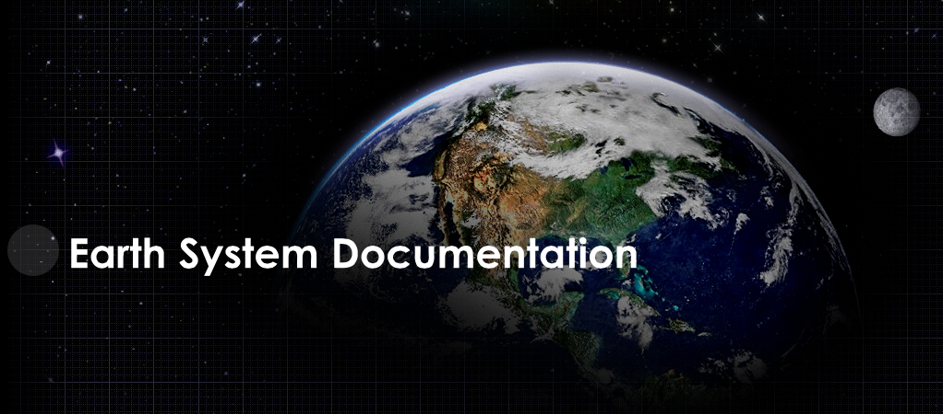


Slide 2
ES-DOC
Earth Science Documentation
OBJECTIVE | Creation, exploitation & dissemination of standards (e.g. CIM) based earth system modelling metadata
FUNDING | EX-ARCH, NOAA, IPSL
HISTORY | 04 / 2012 Metafor WP4 evolution
“WHO” | EU - IPSL, BADC, DKRZ US - NOAA, NCAR, PCMDI
HOW | Development of standards based open source tools and web services
LICENSING | GPL / CeCILL

Slide 3
ES-DOC
Target User Community
Modellers
Scientists
Students
Impacts Community
Politicians
Media
Public
CIM

Slide 4
ES-DOC
Target Documentation Types
Models
Experiments
Simulations
Grids
Data
Ensembles
Quality
CIM

Slide 5
ES-DOC
Target Technical Challenges
Versions
Encodings
Languages (human)
Languages (programming)
Representations
Formats
Devices
CIM

Slide 6
ES-DOC
Meta-Programming Framework (pycim_mp)
Problem 1 | CIM Schema
Problem 2 | CIM XML Encoding
Solution | Meta-Programming Frmework
Result | Decoupled and agile in relation to CIM schemas, encodings and language bindings.

Slide 7
ES-DOC
API - Web Service
PUBLISH | Create
 | Retrieve
 | Update
 | Delete
SEARCH | ID / version
 | Type / name
 | Dataset id
 | File id
 | DRS
COMPARE | C1 = Model component properties

Slide 8
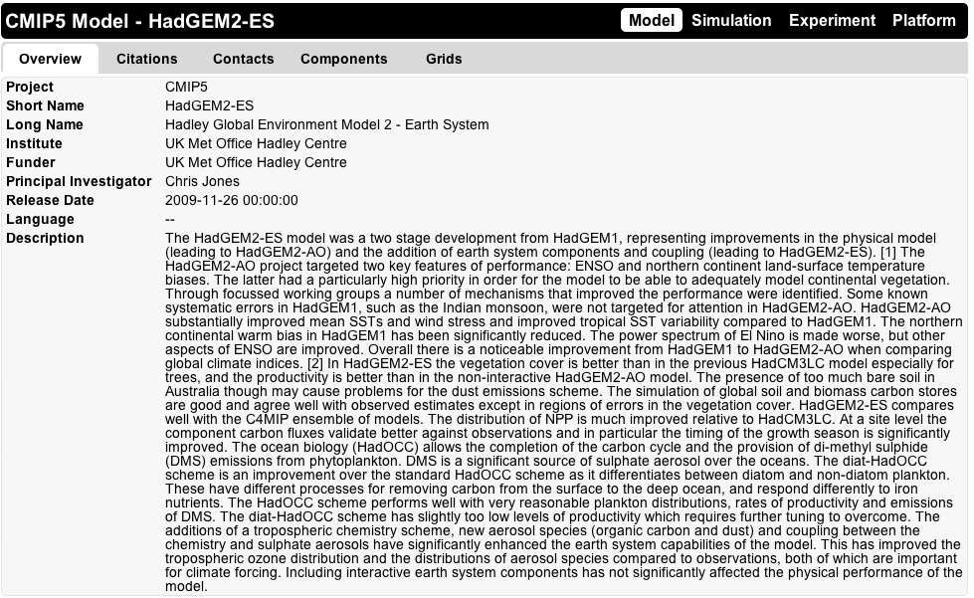
ES-DOC
Tools - Document Viewer
Clientèle @ 01/02/2013
Metafor Questionnaire
ESGF-P2P Node Front End
DyCore 2012 Portal
IPSL Prodiguer Portal
Technology
Javascript / HTML
AJAX (API)
JSON

Slide 9
ES-DOC
Tools - Comparator
C1 - Model Component Properties
Step 1 | Select Models
Step 2 | Select Components
Step 3 | Selection Properties
Step 4 | View Report
Step 5 | Export to CSV

Slide 10
ES-DOC
Futures
Sustainable Funding Controlled Vocabularies Comparators Automated Documentation EXA-Scale

