Slide 1







Documenting CMIP6 with ES-DOC
Mark A. Greenslade
Institute Pierre Simon Laplace
The ES-DOC Team
IPSL – FR, NCAS – UK, STFC – UK, NOAA – US, GFDL-US, DKRZ – DE
EGU 2017 PICO Presentation Session CL5.13
Towards CMIP6 internationally coordinated climate modeling experiments:
the role and use of modeling and observation research infrastructures

Slide 2
Timeline
Timeline
Phase 1
Phase 2
Phase 3
Phase 4
Links
Phase 1
Experimental Protocols
Q1 2016 - Q2 2017
Phase 2
Model Descriptions
Q2 2017 – Q4 2018
Phase 3
Ensemble & Simulations
Q3 2017– Q1 2019
Phase 4
Performance & Errata
Q1 2018 – Q4 2019
MIP
Model
Conformance
Dataset Errata
Experiment
Realm
Ensemble
Machine
Numerical Requirement
Ensemble Member
Performance
Simulation
Citation / Responsible Party / Document Link

Slide 3
Experiments
Timeline
Phase 1
Phase 2
Phase 3
Phase 4
Links
MIP
Extensive interactions with WCRP & MIPs
A single spreadsheet used to capture > 1000 documents
Major task was mapping:
MIPs --> Experiments
Experiments --> Requirements
Mandated by WCRP as reference CMIP6 experimental documentation
Online @ documentation.es-doc.org/cmip6
Experiment
Numerical Requirement
Forcing Constraint
Temporal Constraint
Ensemble Requirement
Multi-Ensemble
Spreadsheet
Q1 2016 – Q2 2017
Charlotte Pascoe @ NCAS, UK

Slide 4
Models
Timeline
Phase 1
Phase 2
Phase 3
Phase 4
Links
Model
Top-Level
Realms defined by WCRP-CMIP, e.g. ocean
ES-DOC co-ordinates with realm experts to define specializations:
Processes - e.g. ocean advection
Properties – e.g. monotonic flux limiter for vertical tracer
ES-DOC co-ordinates with WGCM to define short tables
Institutes create documents using various tools
Aerosols
Land-Surface
Atmosphere
Ocean
Atmos-Chem
Ocean-BG-Chem
Land-Ice
Sea-Ice
Realm
Processes
Properties
IPython, Questionnaire, Scripts
Q2 2017– Q4 2018
Eric Guilyardi @ IPSL, FR

Slide 5
Ensembles
Timeline
Phase 1
Phase 2
Phase 3
Phase 4
Links
Ensemble document(s) auto-initialized when datasets are published
Institutes must supply experimental requirement conformances:
A spreadsheet to be filled in with default conformances
A spreadsheet per MIP with specific/non conformances
CMIP6 NetCDF files have a futher_info_url header which will link to the full set of published ensemble documentation
Ensemble
Ensemble Member
Simulation
Conformance
Scripts, Spreadsheets
Q1 2016 – Q2 2017
David Hassell @ NCAS, UK

Slide 6
Performance & Errata
Timeline
Phase 1
Phase 2
Phase 3
Phase 4
Links
After simulations have been run:
Metrics concerning HPC performance can be published
Performance information is linked to relevant ensembles
As dataset errors are discovered:
Errata information is published
Persistent Identifier (PID) services are notified
Dataset Errata
Machine
Performance
IPython, Scripts, Questionnaire
Q1 2018 – Q4 2019
David Hassell @ NCAS, UK / Guillaume Levavasseur IPSL, FR

Slide 7
Links
Timeline
Phase 1
Phase 2
Phase 3
Phase 4
Links
Email
cmip6-help@es-doc.org
Further information
https://es-doc.org/cmip6
Published Documents
https://documentation.es-doc.org/cmip6
Social Media
https://twitter.com/esdocumentation
Source Code
https://github.com/ES-DOC

Slide 8
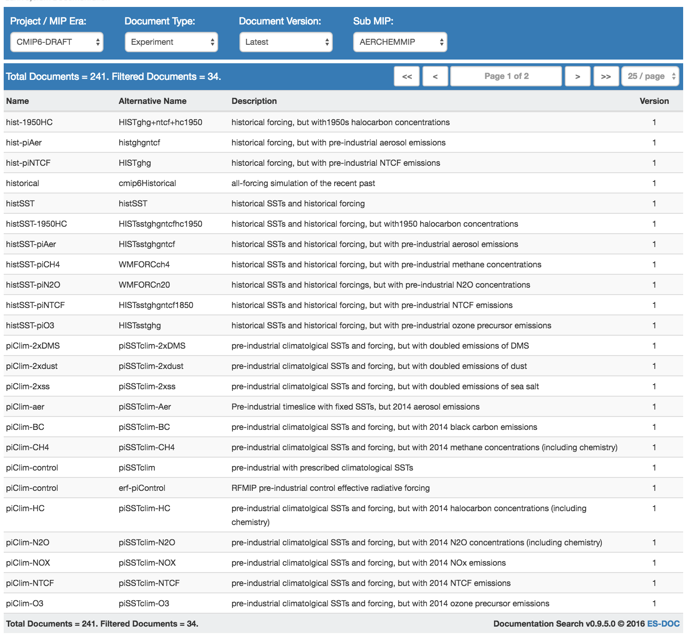
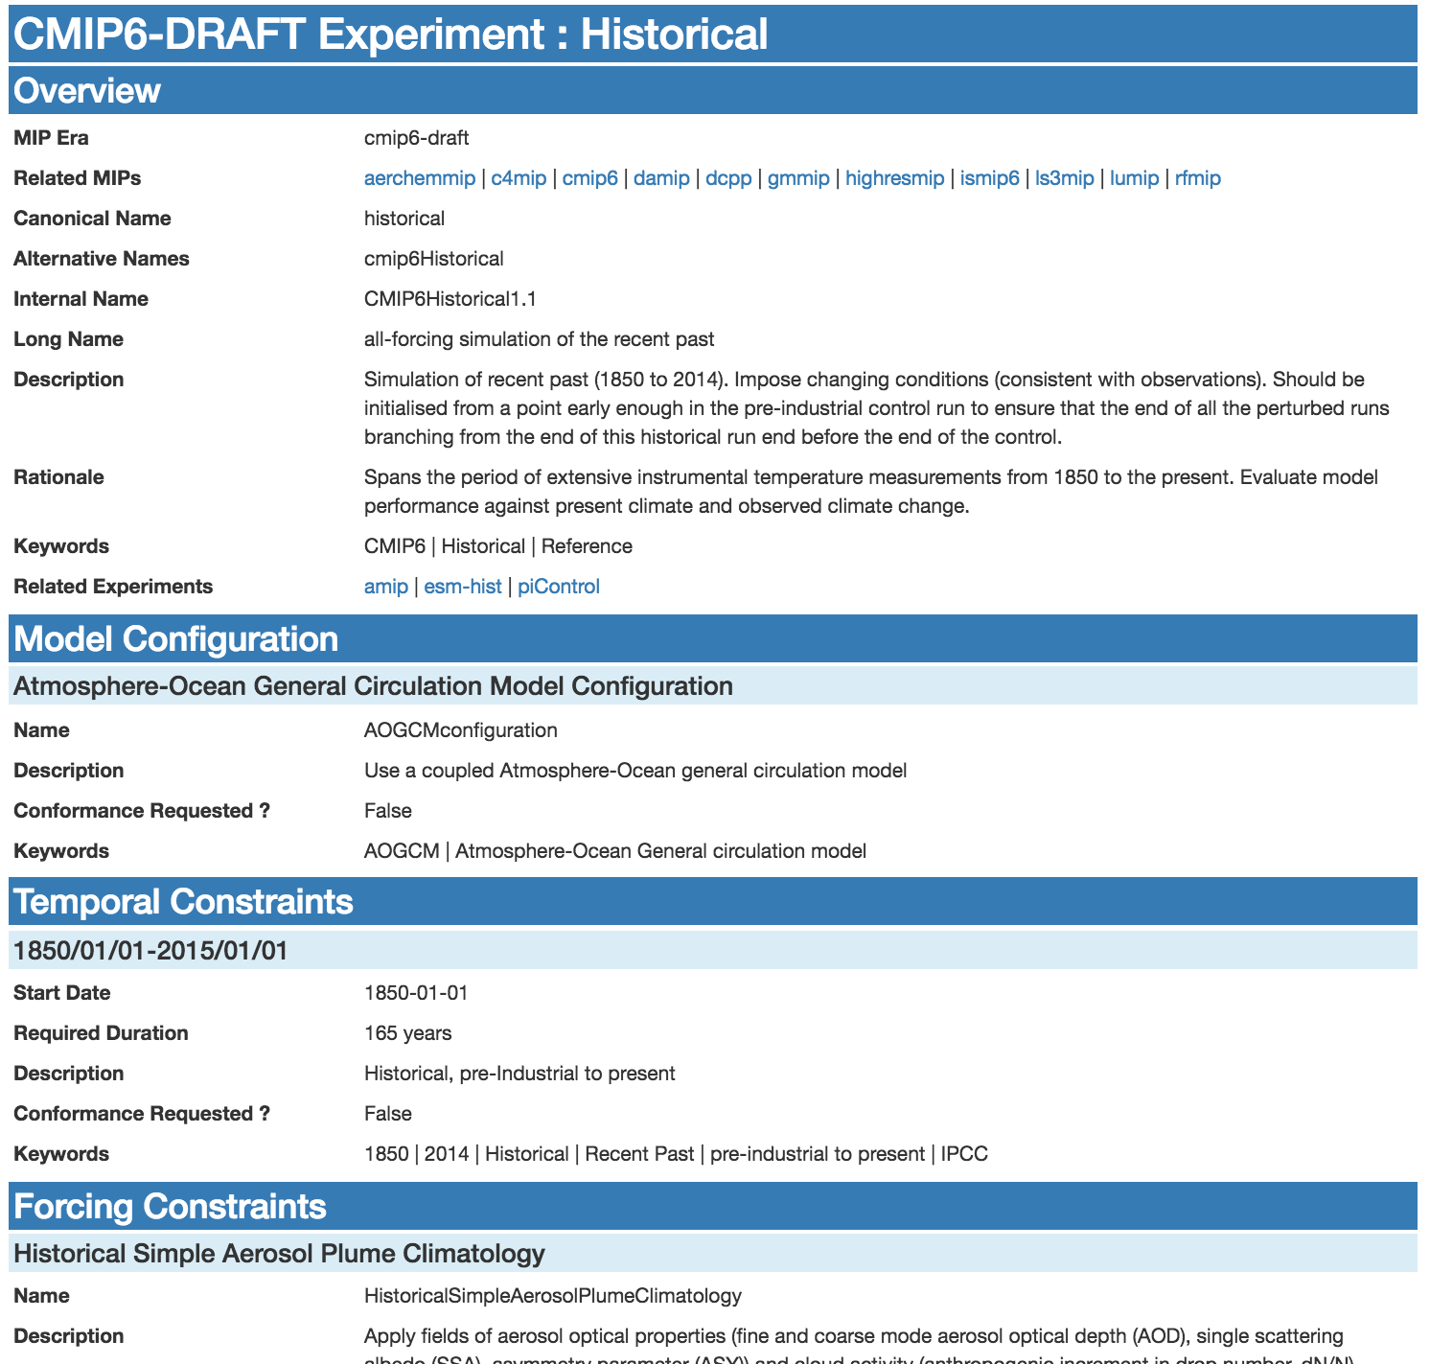
Phase 1: Experimental Protocols
Documentation published @ documentation.es-doc.org/cmip6
Links to

Slide 9
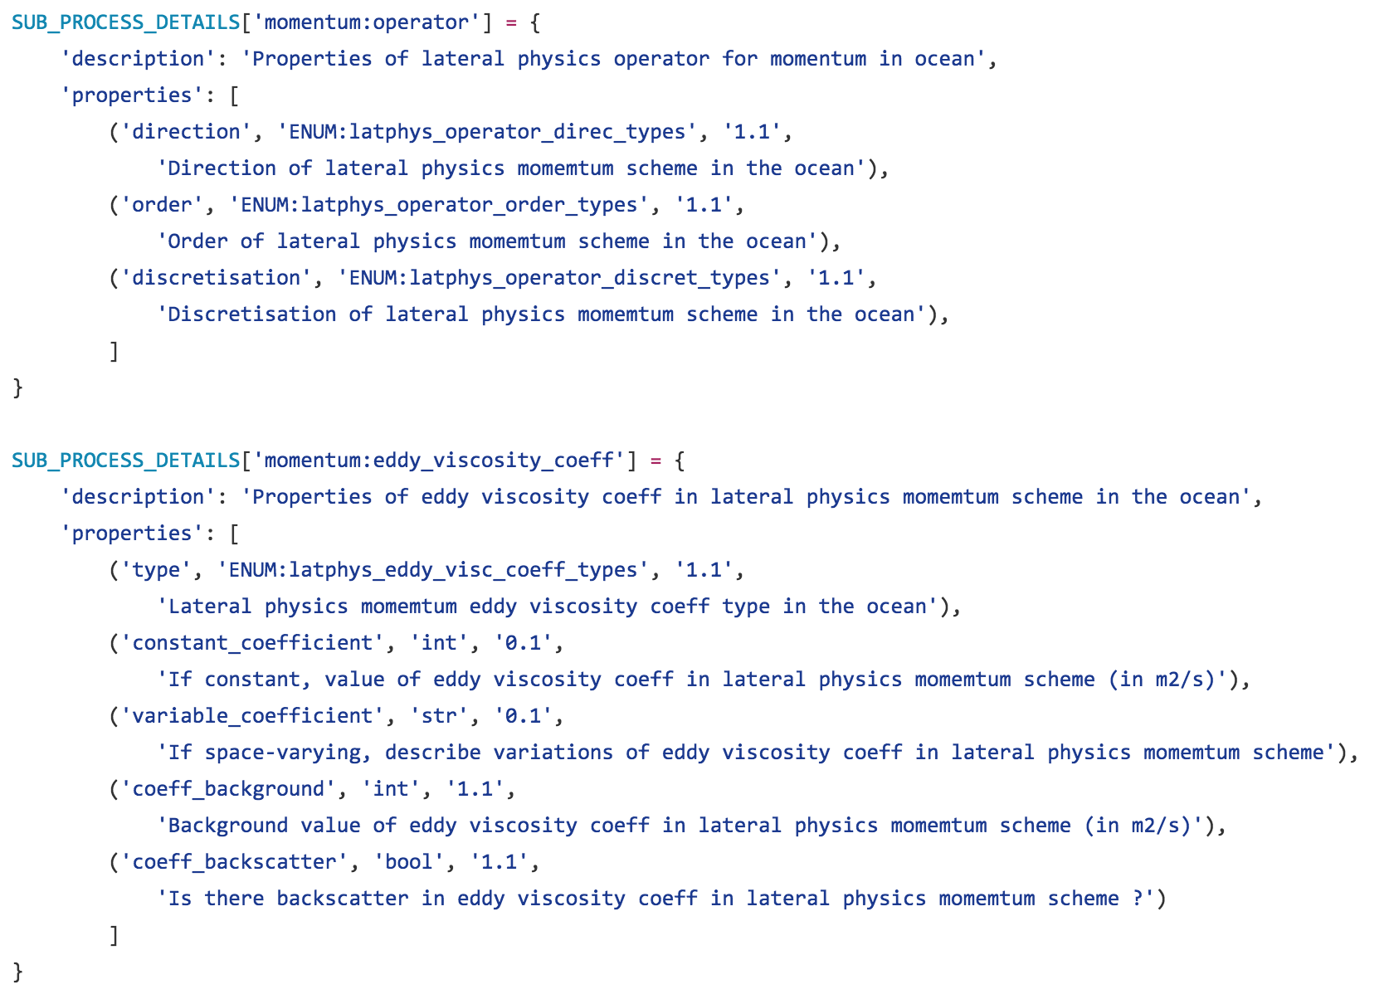
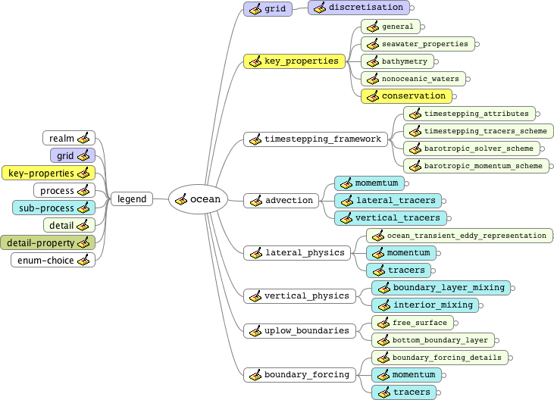
Phase 2: Model Descriptions
Specializations defined & owned by community
Python View
Mind-Map View (auto-generated)

Slide 10
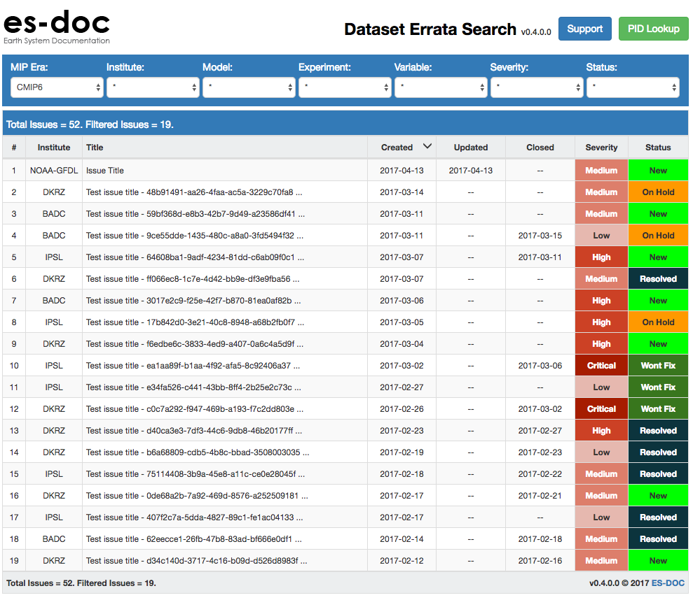
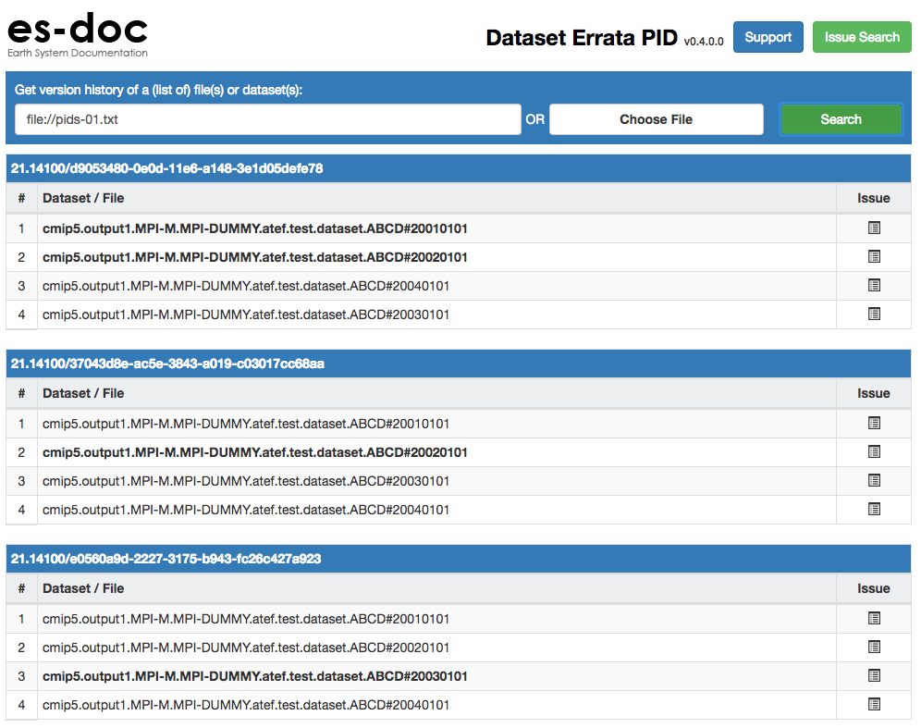
Phase 4: Performance & Errata
Search & view dataset errata
Resolve errata from persistent identifiers

Slide 11
Success Criteria
Comprehensive & standardized documentation of CMIP6
Better understanding of ensemble variance
Auto-generation of IPCC tables – e.g. table 12.1
Documentation driven model inter-comparison
A sustainable climate modelling documentation infrastructure

