Slide 1
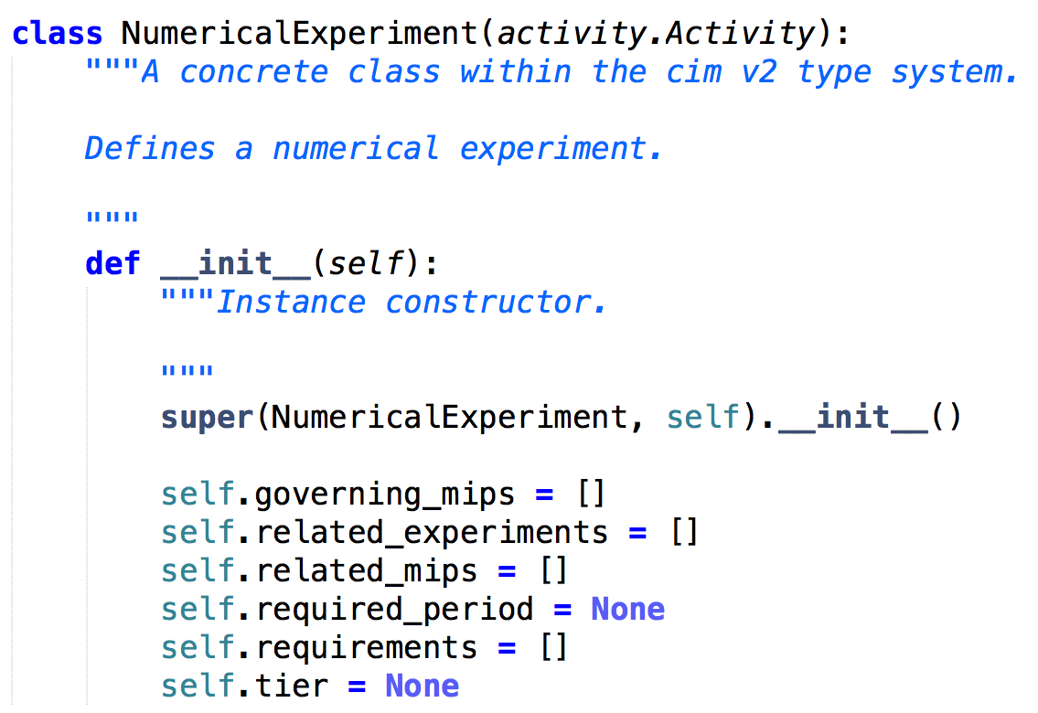
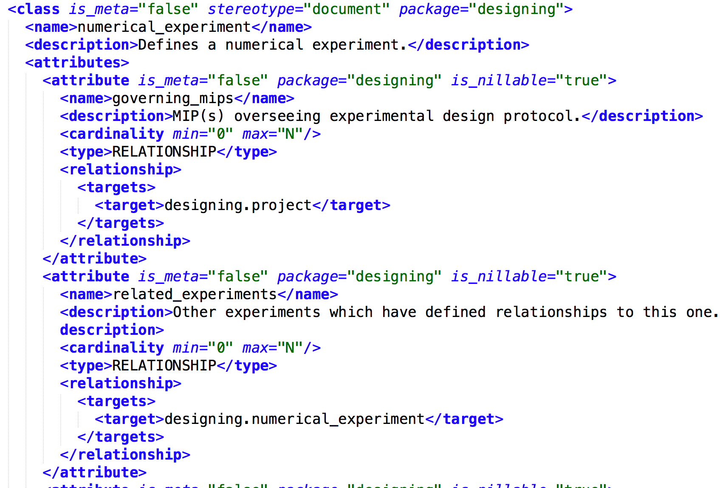
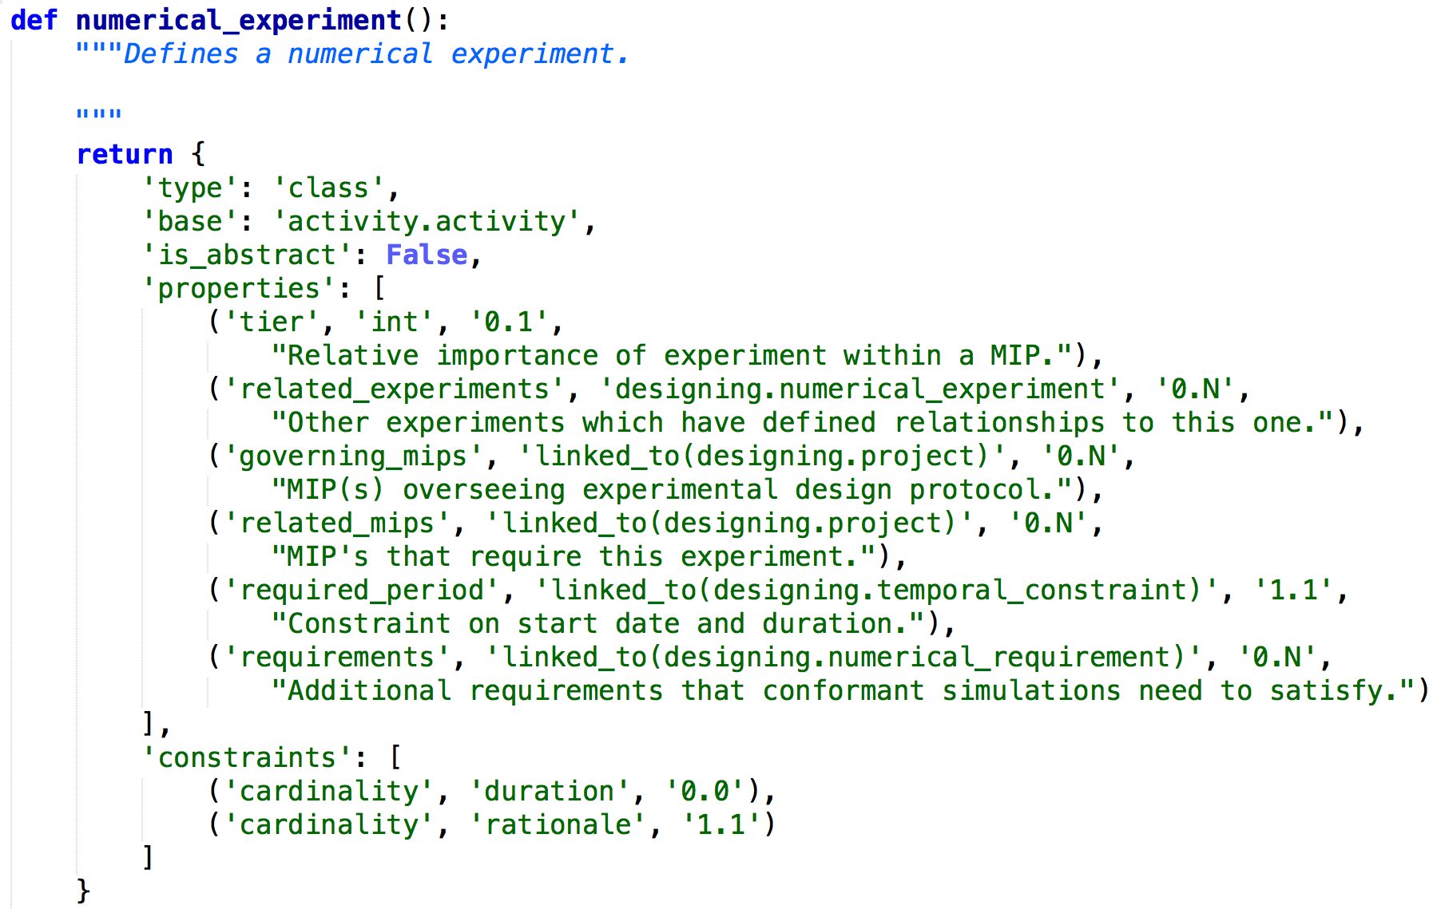
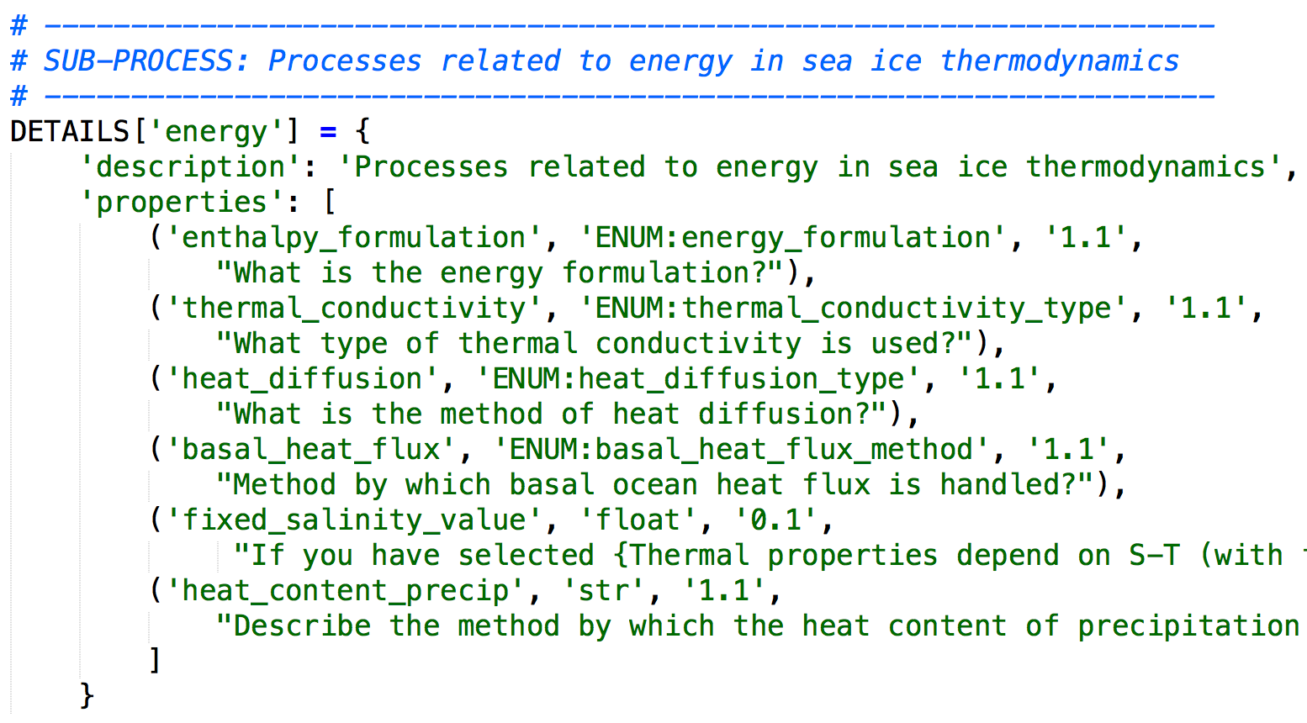
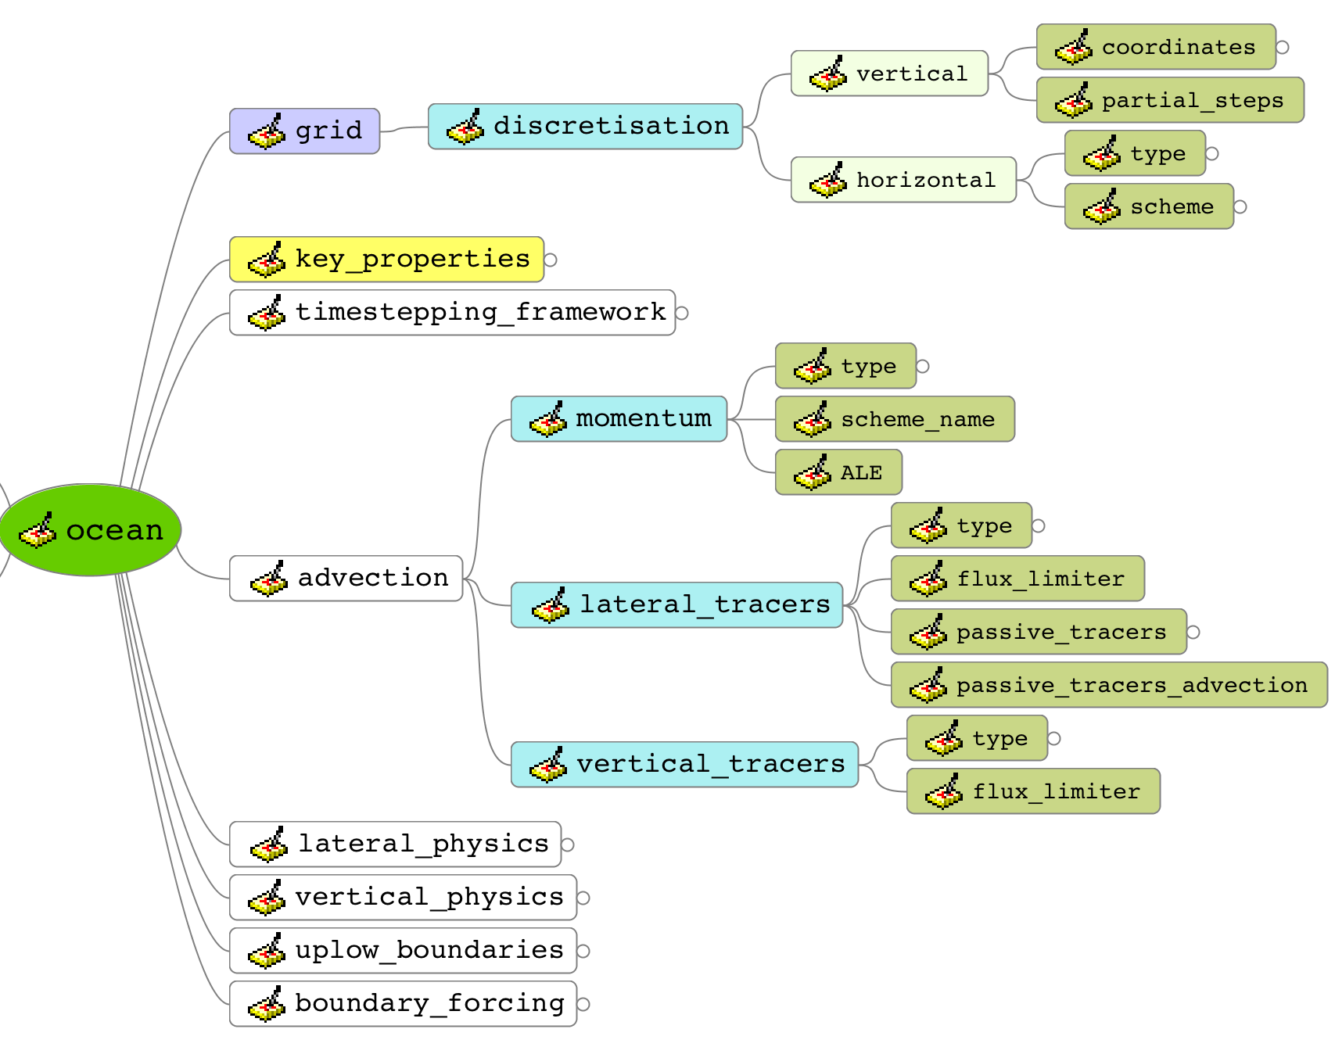
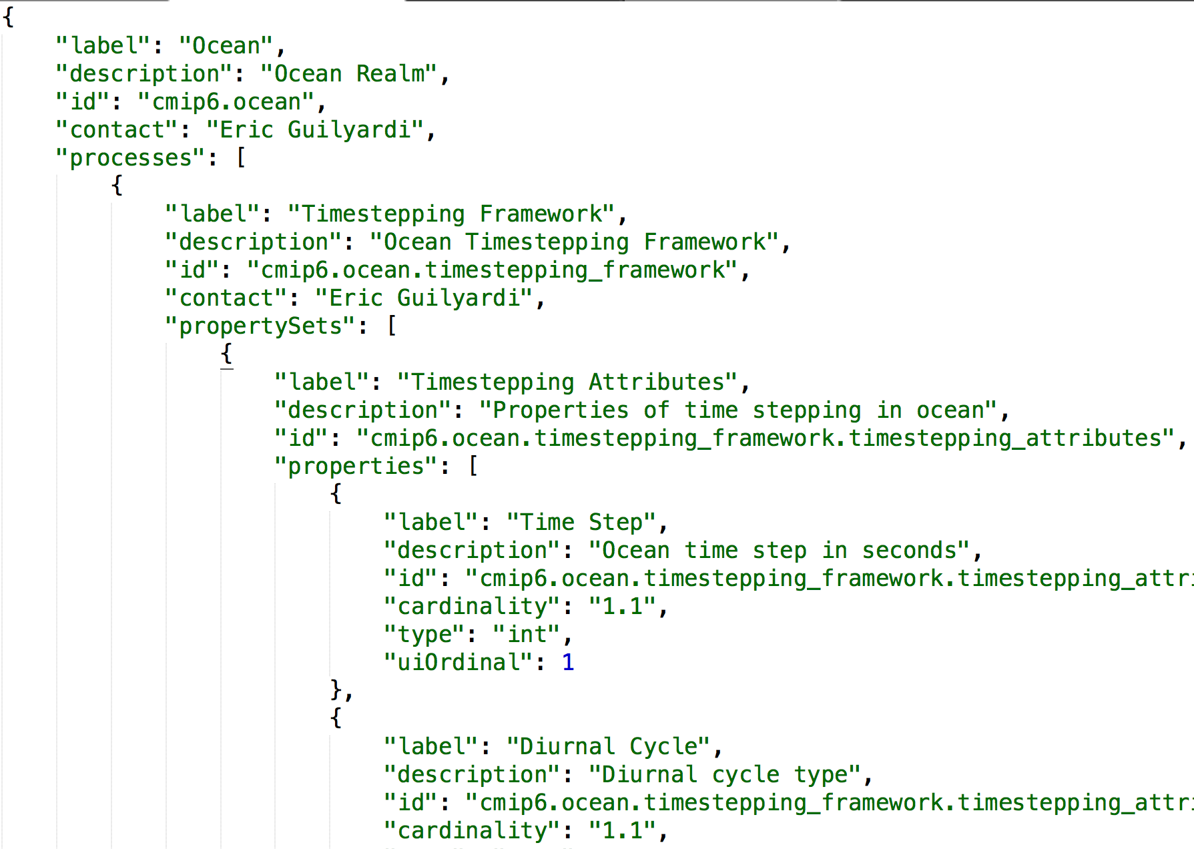
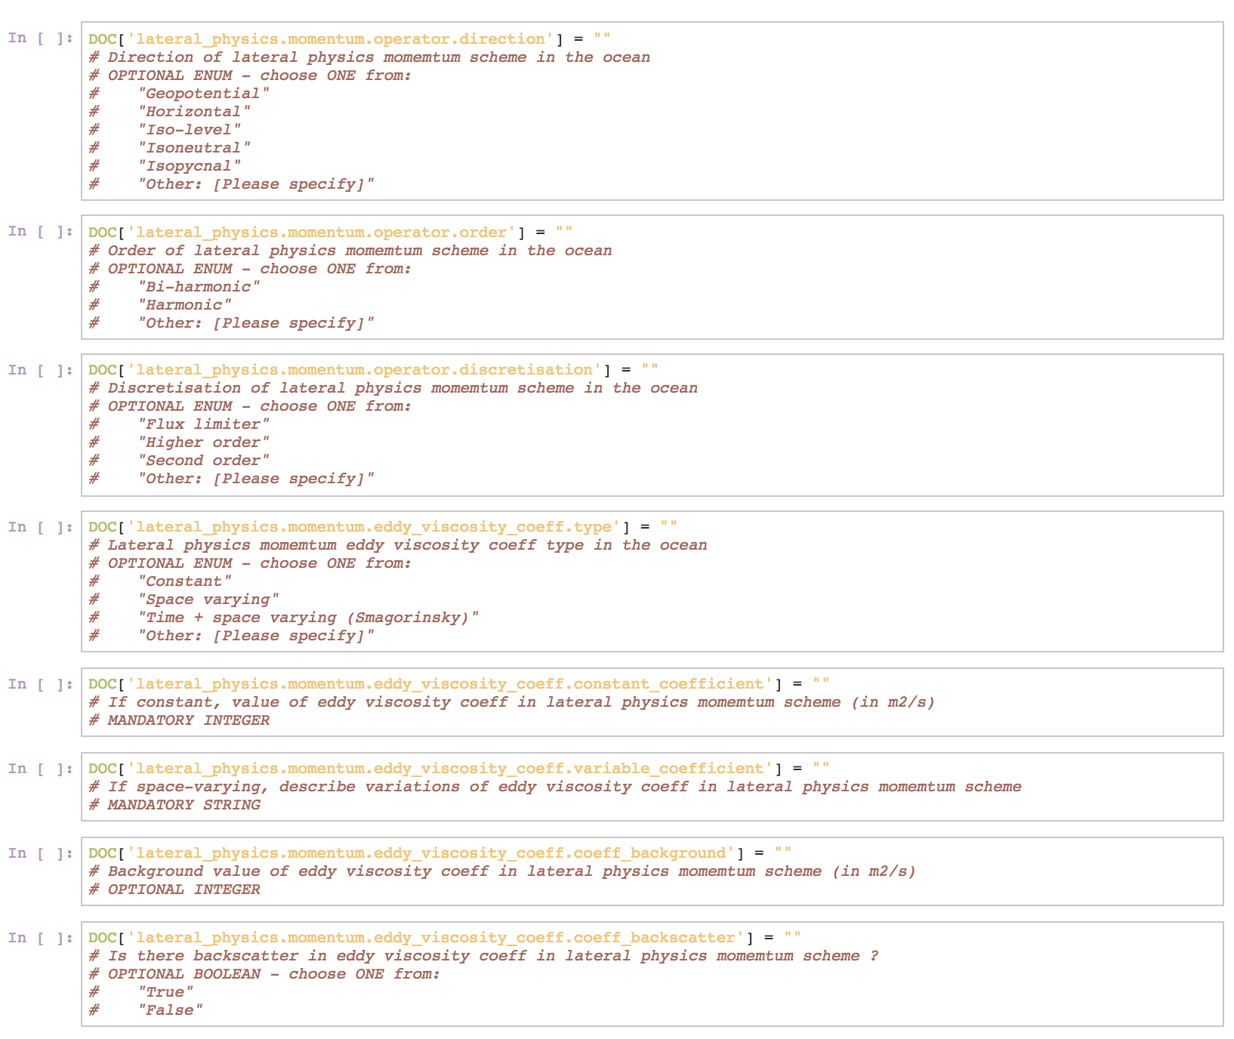







The centrality of meta-programming in the ES-DOC eco-system
Mark A. Greenslade & The ES-DOC team
CIM Data Model
CMIP6 Specialisations
Define
9 Packages, 68 classes, 22 enums
8 realms + top-level
Activity
Data
Designing
Top-Level
Aerosols
Atmos
DRS
Platform
Science
Atmos Ch
Land
Land Ice
Validate
Shared
Software
Time
Ocean
Ocean bg
Sea Ice
Mind-Maps, Python, Config Files, Notebooks
Parse
Generate

