Slide 1




ES-DOC: CIM-2 & CMIP6 From definitions to specializations a technical overview
Mark A. Greenslade
Institut Pierre Simon Laplace (IPSL)

Slide 2
Part 1: CIM v2.0

Slide 3

CIM v2.0 – Definition
A data model for documenting climate modelling experiments, processes, output, simulations, workflows.
The data model is partitioned into packages, each package addressing a particular documentation/problem space.
An eco-system of tools & services is built upon the data model.

Slide 4
CIM v2.0 – Packages
Activity
Data
Designing
DRS
Platform
Science
Shared
Software
Time

Slide 5
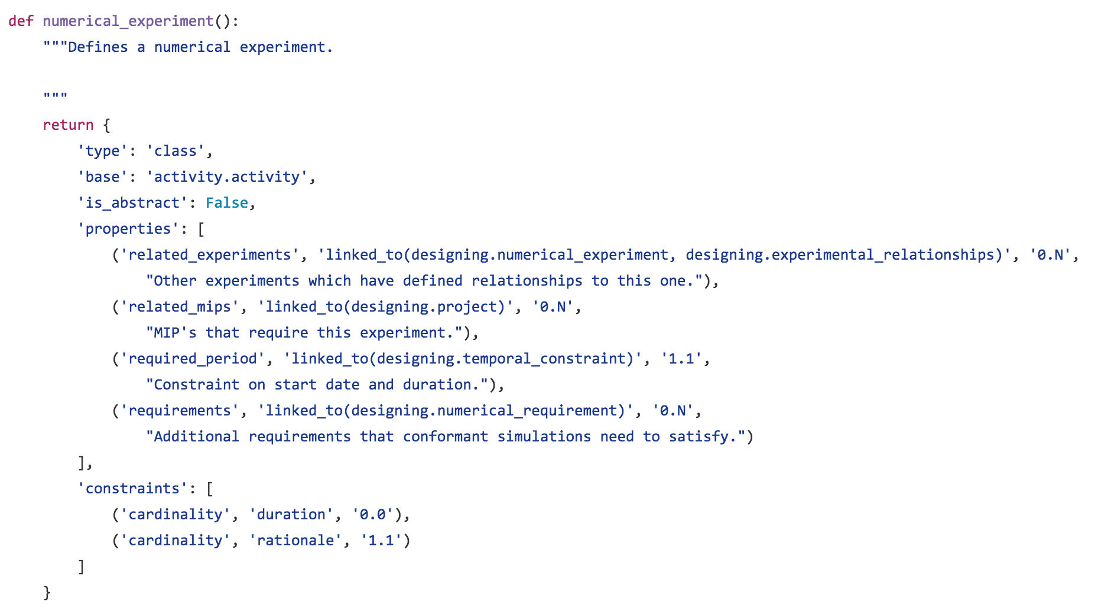
CIM v2.0 – Class Definition

Slide 6
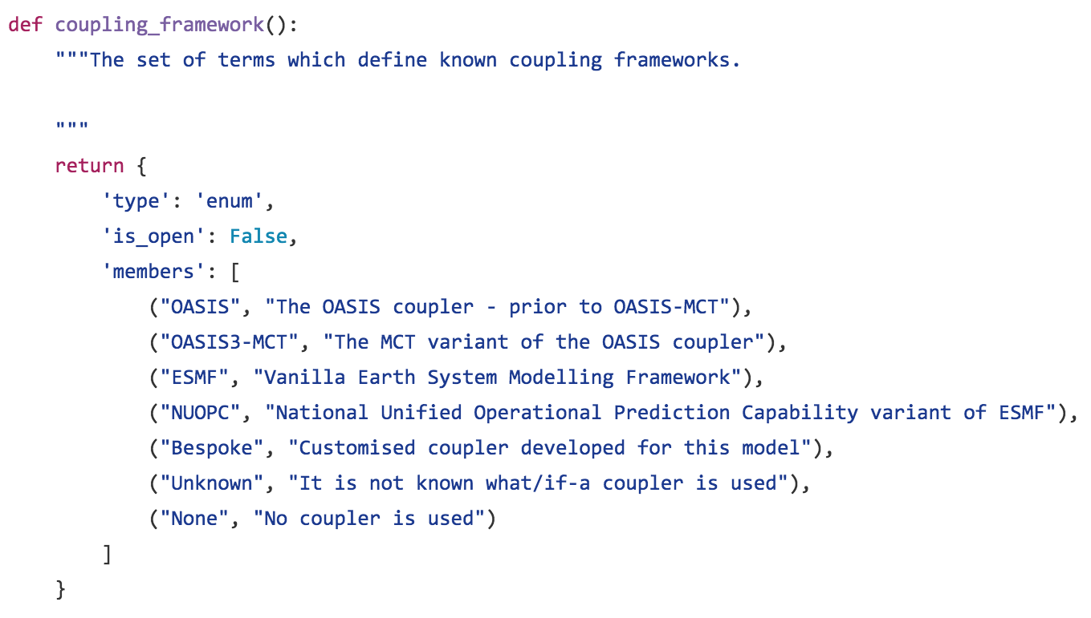
CIM v2.0 – ENUM Definition

Slide 7
CIM v2.0 – Tooling
Definitions
Validator
Parser
Generators

Slide 8
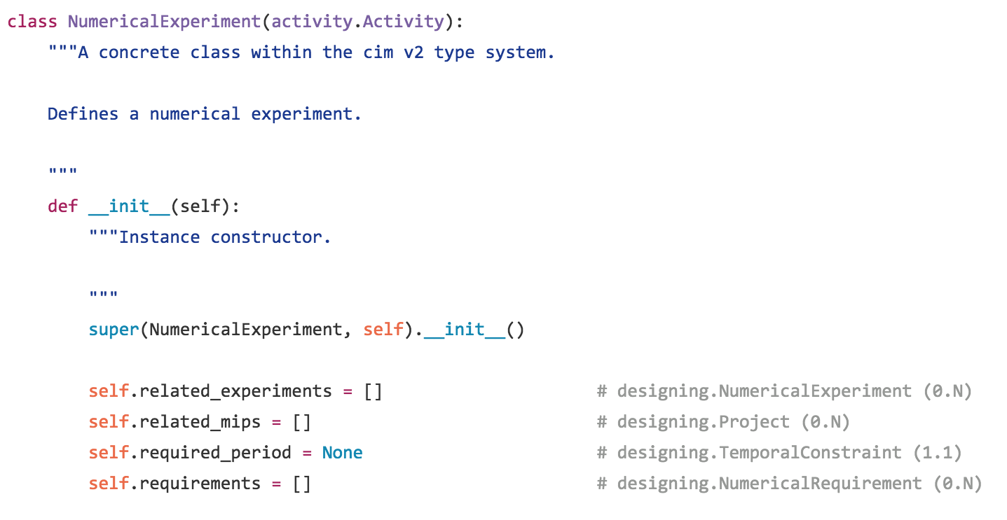
CIM v2.0 – Tooling – Generator Output

Slide 9
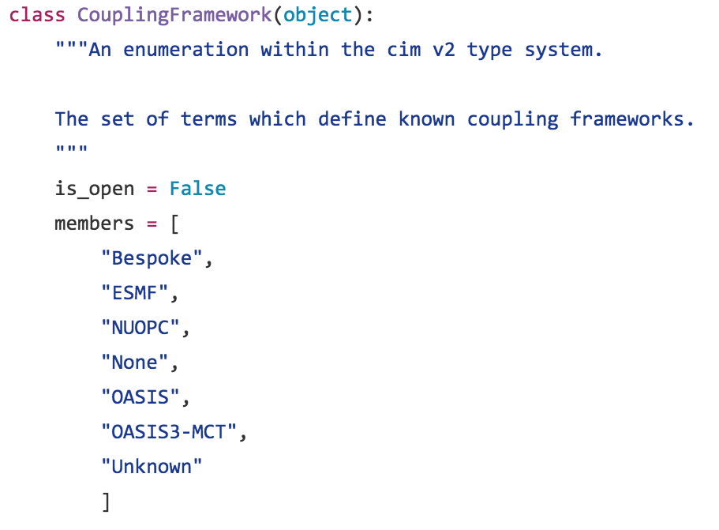
CIM v2.0 – Tooling – Generator Output

Slide 10
CIM v2.0 - PYESDOC
pyesdoc = python client to the esdoc eco-system
at the heart of the ES-DOC eco-system
mature, unit-tested
pip install pyesdoc
Create
Search
Publish
Archival
XML / JSON
I/O

Slide 11
CIM v2.0 - PYESDOC
CMIP6 Experiments Spreadsheet
PYESDOC
Archived
CIM 2.0
Documents
pyesdoc usage scenario – transforming a spreadsheet into archived CIM 2.0 documents

Slide 12
CIM v2.0 - PYESDOC
Archived
CIM 2.0
JSON Documents
PYESDOC
HTML pages
pyesdoc usage scenario – transforming documents into HTML pages

Slide 13
CIM v2.0 - PYESDOC
CIM 2.0
Document
(JSON | XML)
PYESDOC
Validation report
pyesdoc usage scenario – validating a CIM 2.0 document

Slide 14
CIM v2.0 - PYESDOC
Local
CIM 2.0
Documents
PYESDOC
Documents published to web-service
pyesdoc usage scenario – publishing documents to ES-DOC web-service

Slide 15
CIM v2.0 - Web Assets
Web Services
api.es-doc.org
Search
search.es-doc.org
View
view.es-doc.org
Compare
compare.es-doc.org

Slide 16
CIM v2.0 – Web Service
Web Service Endpoints @ api.es-doc.org
Publishing
/2/document/create
/2/document/delete
/2/document/retrieve
/2/document/update
Search
/2/document/search-drs
/2/document/search-externalid
/2/document/search-id
/2/document/search-name
/2/summary/search
/2/summary/search-setup

Slide 17
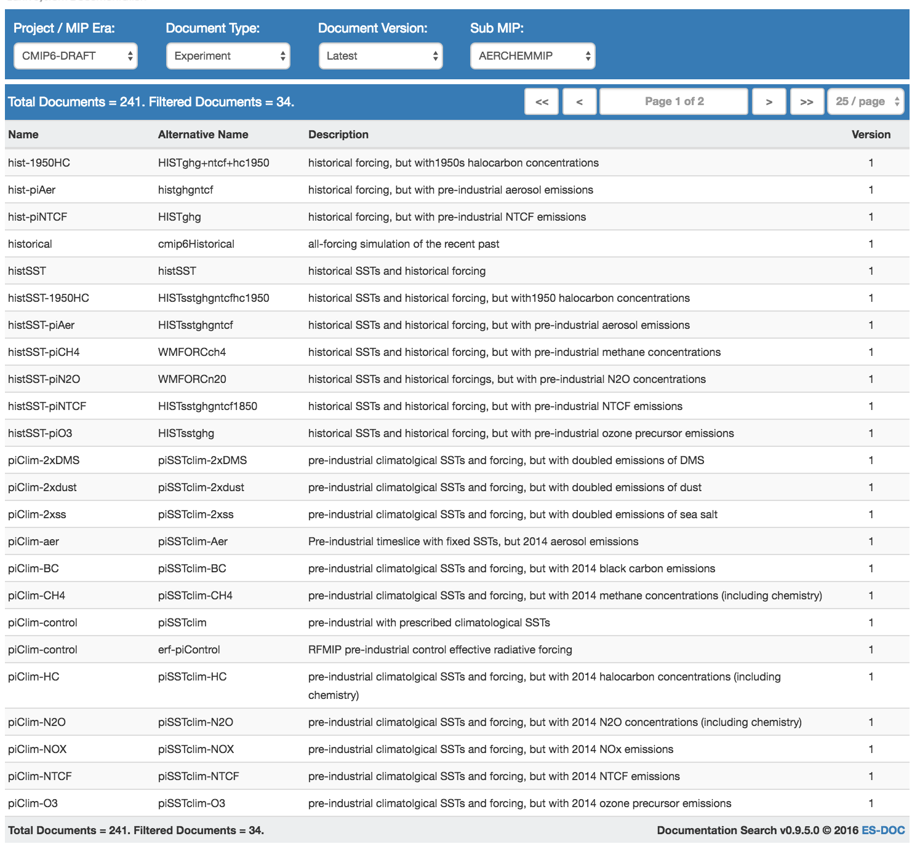
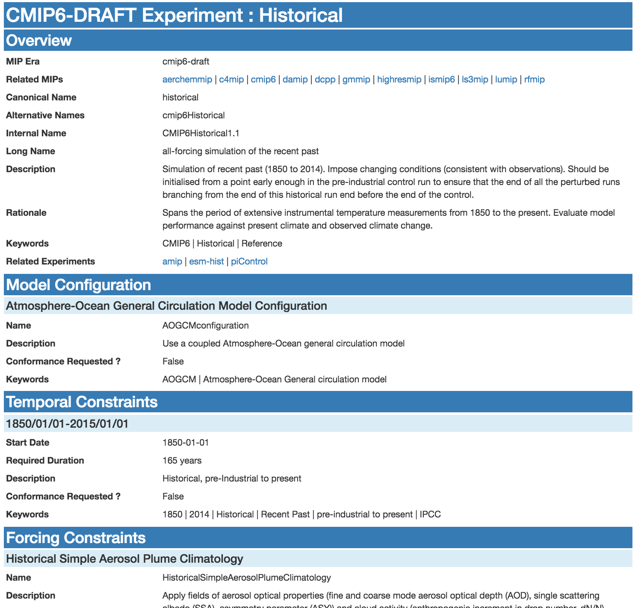
CIM v2.0 – Search & View
Documentation search & view @ search.es-doc.org

Slide 18
Ipython Notebook
http://barcelona-rda.es-doc.org
~/pyesdoc/exploring-pyesdoc.ipynb

Slide 19
Part 2: CMIP6 Specializations

Slide 20
CMIP6 Specializations – Problem Space
CIM 2.0 is a set of static data structures – think standardization.
However on a project by project basis we need to capture much finer grained documentation – think fluid scientific narratives.
Specializations allow the scientific community to decide what (model) documentation they wish to capture.
The CIM moves from the foreground to the background (where it belongs).

Slide 21
CMIP6 Specializations – Problem Space
Consider capturing information related to a model’s :
ocean advection schema;
ocean lateral & vertical physics;
atmosphere transport layer;
sea-ice radiative properties;
ocean bio-geochemistry boundary forcing;
Only the community can decide what to capture – not ES-DOC.

Slide 22
CMIP6 Specializations – Community role
Let the community own a set of specializations per modelling realm:
Let the community define a specialization per realm process.
Let the community automatically validate each specialization.
Let the community automatically generate artefacts, e.g. mindmaps.

Slide 23
CMIP6 Specializations – ES-DOC role
Let ES-DOC guide the realm experts via workshops & training resources.
Let ES-DOC aggregate the various specializations.
Let ES-DOC build value added downstream tools.
Let ES-DOC ensure visibility of final documentation.

Slide 24
CMIP6 Specializations - GitHub
One GitHub repo per modelling realm – community owned
https://github.com/ES-DOC/cmip6-specializations-aerosols
https://github.com/ES-DOC/cmip6-specializations-atmosphere
https://github.com/ES-DOC/cmip6-specializations-atmospheric-chemistry
https://github.com/ES-DOC/cmip6-specializations-landice
https://github.com/ES-DOC/cmip6-specializations-landsurface
https://github.com/ES-DOC/cmip6-specializations-ocean
https://github.com/ES-DOC/cmip6-specializations-ocean-bgc
https://github.com/ES-DOC/cmip6-specializations-seaice

Slide 25
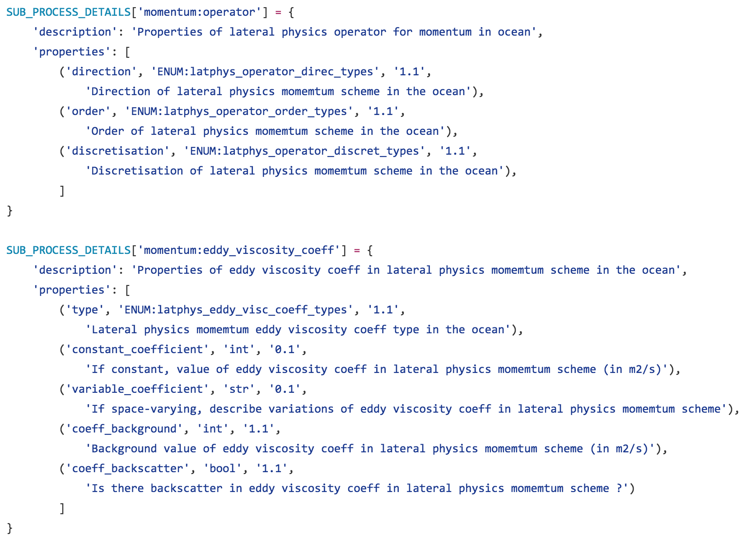
CMIP6 Specializations - Authoring
Very simple python data structures
Help guides & support from ES-DOC
Validation tool to sanity check
Great for small workshops

Slide 26
CMIP6 Specializations - Tooling
Specializations
Validator
Parser
Generators

Slide 27
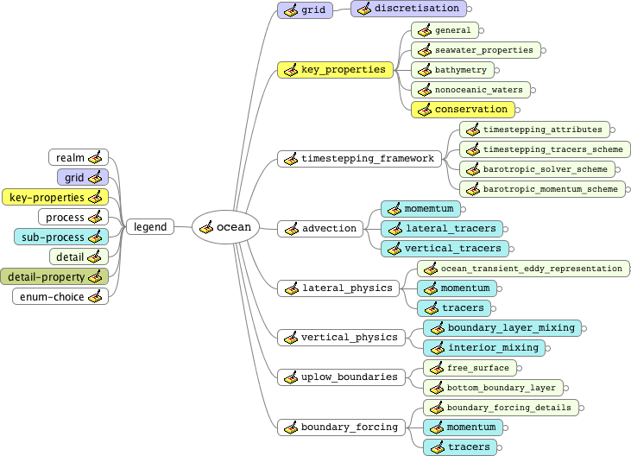
CMIP6 Specializations - Mindmap

Slide 28
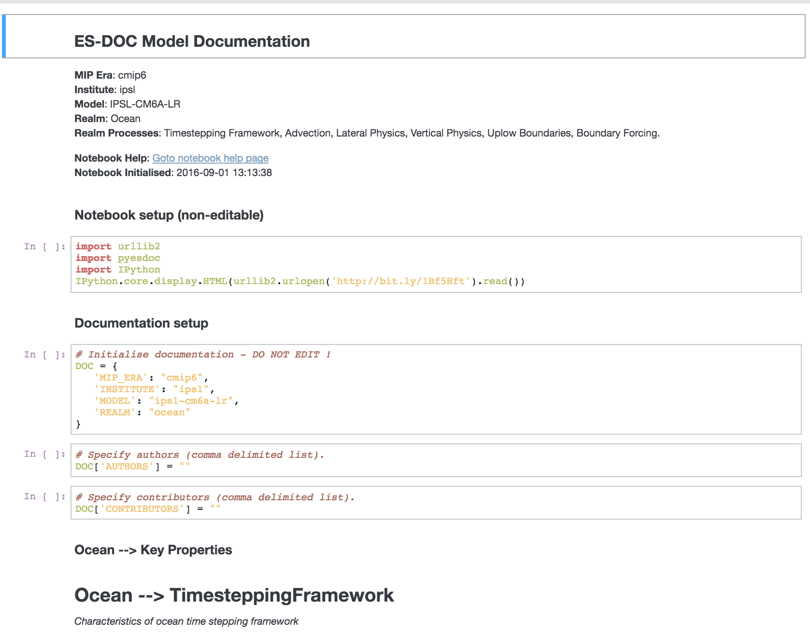
CMIP6 Specializations – IPython Notebooks
IPython notebooks are generated from specializations.
One notebook per model per realm.
As the specializations evolve, so do the notebooks.

Slide 29
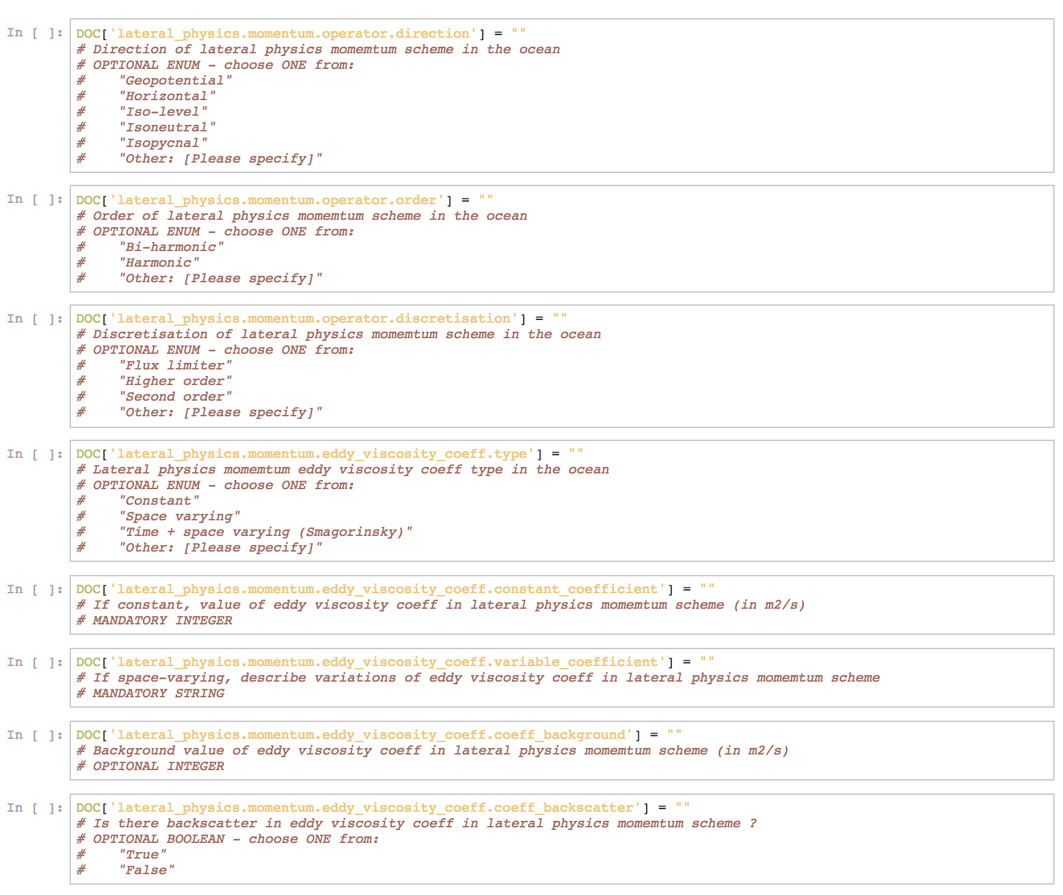
CMIP6 Specializations – IPython Notebooks
The notebooks can be iteratively completed over time.
The notebooks will be hosted by ES-DOC.
Light-weight but effective solution to gathering a lot of complex information.

Slide 30
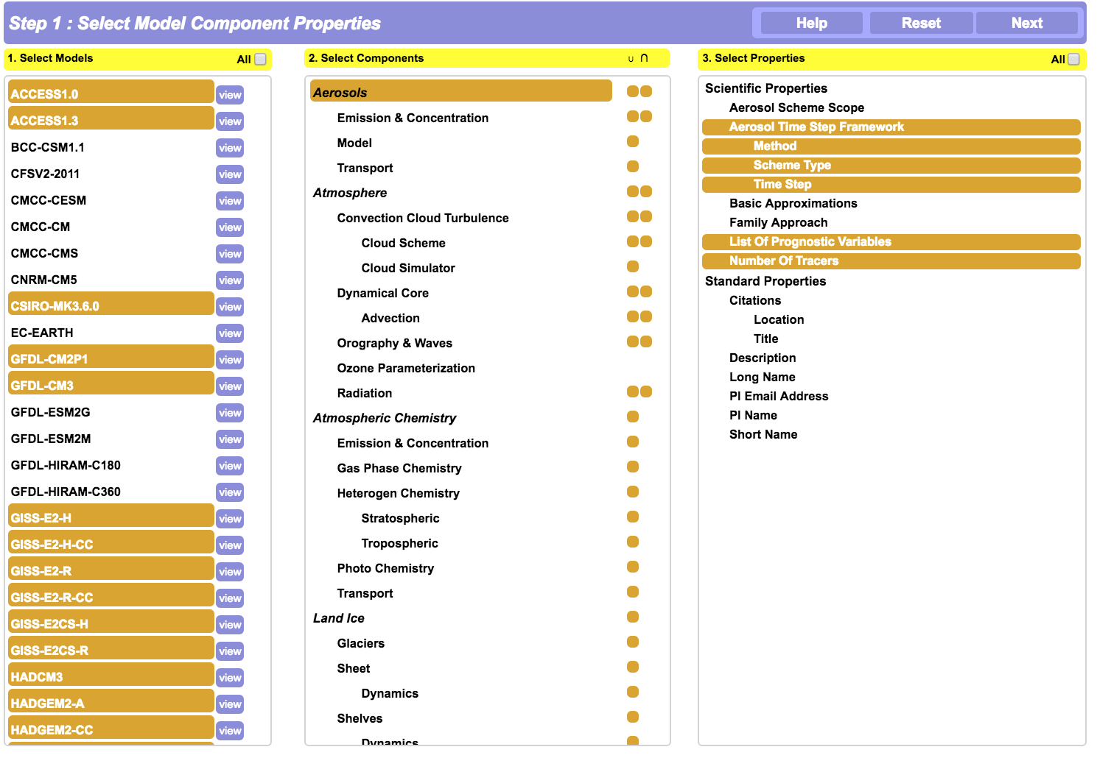
CMIP6 Specializations – Comparator
Model comparison
@ compare.es-doc.org

Slide 31
Ipython Notebook
http://barcelona-rda.es-doc.org
~/cmip6/seaice.ipynb

Slide 32
Part 3: CMIP6 Vocabularies

Slide 33
PYESSV
pyessv = python vocabulary manager
at the heart of the ES-DOC eco-system
mature, unit-tested
https://github.com/ES-DOC/pyessv.git
Create
Load
Parse
Archival
XML / JSON
I/O

Slide 34
PYESSV-ARCHIVE
pyessv-archive = vocabulary archive
https://github.com/ES-DOC/pyessv-archive.git
Iniitialized with WCRP-CMIP6 vocabularies

Slide 35
Ipython Notebook
http://barcelona-rda.es-doc.org
~/pyessv/pyessv-and-cmip6.ipynb

