Slide 1

ES-DOC
Earth Science Documentation
OBJECTIVE | Generation & exploitation of standards (e.g. CIM) based metadata
HISTORY | Started 03 / 2012 Extension of Metafor WP4
HOW | Development of open source tool and web services
LICENSE | GPL / CeCILL

Slide 2
ES-DOC
Community
Modellers
Scientists
Students
Impacts Community
Politicians
Media
Public
CIM
Targeting CIM documentation to a diverse community

Slide 3
ES-DOC
Development
Versions | 1.5, 2.0
Encodings | xml, json, yaml, base64
Languages | python, java, fortran, javascript
Representations | text, visual (2D/3D)
Formats | HTML, PDF
Devices | browser, command line
CIM
Delivering CIM documentation to an array of platforms

Slide 4
ES-DOC
Product 0 : Meta-Programming Framework
Problem 1 | CIM schema
Problem 2 | CIM XML Encoding
Solution | Meta-Programming Frmework
Result | Decoupled and agile in relation to CIM schemas, encodings and language bindings.

Slide 5
ES-DOC
Product 1 : Web Service API
REST - DOCUMENT | Publishing & retrieval of documents
QUERY – by ID | Search repository by project, id, & version
QUERY – by Name | Search repository by project, type, & name
QUERY – by Dataset ID | Search repository by project & dataset id
QUERY – by File ID | Search repository by project & file id
QUERY – by DRS | Search repository by DRS mappings
REPORT – Model Property | Return 2D matrix of model property values

Slide 6
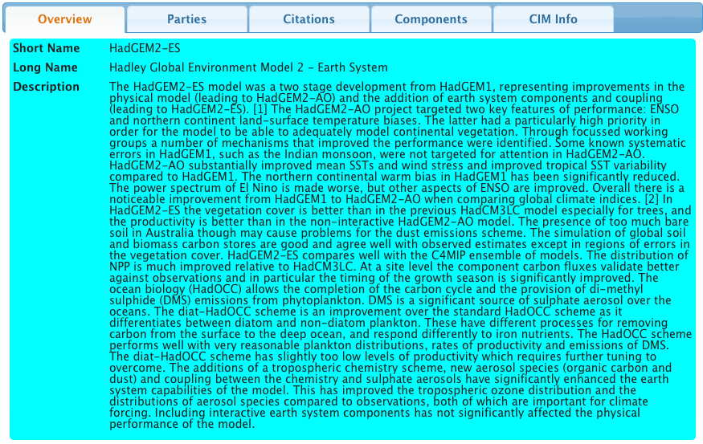
ES-DOC
Product 2 : Document Viewer
Clientèle @ 01/10/2012
ESGF-P2P Node Front End
DyCore 2012 Portal
IPSL Prodiguer Portal
Technology
Javascript / HTML
Web Services (CIM API)
JSON

Slide 7
ES-DOC
Product 3 : Reports Viewer
Step 1 | Select : Models
Step 2 | Select : Components / Properties
Step 3 | Selection : Refine, Export, Import
Step 4 | Report : Generate, View, Export (CSV)

Slide 8
ES-DOC
Open Source Projects @ 01/10/2012
Nom | Language | Description | Source Code
pycim-mp | python | Code Generator | https://github.com/ES-DOC/pycim-mp
pycim | python | Decoder / Encoder | https://github.com/ES-DOC/pycim
pylons-cim-api | python | Web Service API | https://github.com/ES-DOC/pylons-cim-api
pylons-cim-portal | html | Web Site | https://github.com/ES-DOC/pylons-cim-portal
jscim | javascript | HTML Viewer Reports Viewer | https://github.com/ES-DOC/jscim

