Slide 1

ES-DOC
Earth Science Documentation
OBJECTIVE | International dissemination of CIM metadata
HISTORY | Extension of Metafor project (WP4)
HOW | Development of open source tools and web services
LICENSE | GPL / CeCILL

Slide 2
ES-DOC
Community
Modellers
Scientists
Students
Impacts Community
Politicians
Media
Public
CIM
Targeting CIM documentation to a diverse community

Slide 3
ES-DOC
Development
Versions | 1.x, 2.x
Encodings | xml, json, yaml, base64
Languages | python, java, fortran, javascript
Representations | text, visual (2D/3D)
Formats | HTML, PDF
Devices | browser, tablet, command line
CIM
Delivering CIM documentation to an array of platforms

Slide 4
ES-DOC
Open Source Projects @ 01/09/2012
Project | Language | Description | Source Code
jscim | javascript | HTML Viewer | https://github.com/ES-DOC/jscim
pycim | python | Decoder / Encoder | https://github.com/ES-DOC/pycim
pycim-mp | python | Code Generator | https://github.com/ES-DOC/pycim-mp
pylons-cim-api | python | Web Service API | https://github.com/ES-DOC/pylons-cim-api
pylons-cim-portal | html | Web Site | https://github.com/ES-DOC/pylons-cim-portal

Slide 5
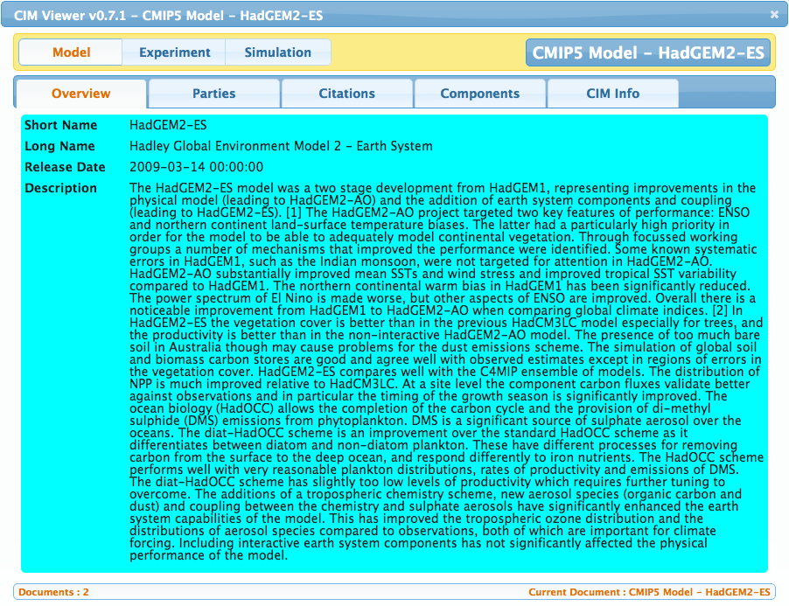
ES-DOC
Javascript Plugin - Document Viewer
Clientèle @ 01/04/2012
ESGF-P2P Node Front End
KNMI Impacts Portal
IPSL Prodiguer Portal
Technology
HTML
Javascript
AJAX (to API's)
JSON

Slide 6
ES-DOC
Web Service API's
REST - DOCUMENT | Publishing & retrieval of documents
QUERY – by ID | Search repository by project, id, & version
QUERY – by Name | Search repository by project, type, & name
QUERY – by Dataset ID | Search repository by project & dataset id
QUERY – by File ID | Search repository by project & file id
QUERY – by DRS | Search repository by DRS mappings
COMPARISON - BASIC | Compare 2 documents

