Slide 1

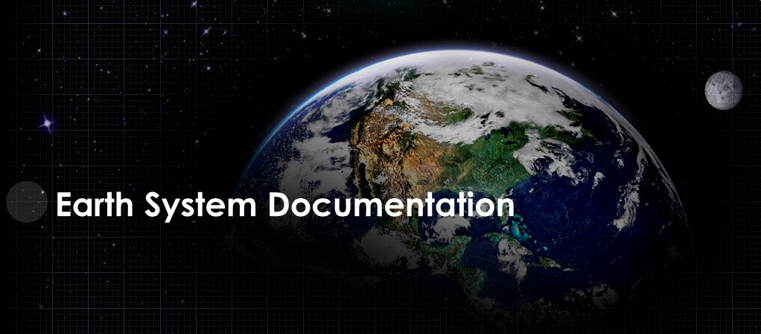
http://es-doc.org

Slide 2
Mission
Standards based eco-system in support of earth system modelling documentation creation, analysis & dissemination.

Slide 3
Strategic Relevance
EXA-Scale search enhancement
IPCC reports generation
Model inter-comparison
Realtime simulation documentation

Slide 4
Funders
IPSL (EU)
NOAA (US)
ISENES-2 (EU)
NCAS (UK)

Slide 5
PI’s
Venkatramani Balaji (US - GFDL)
Cecelia DeLuca (US - NOAA)
Sébastien Denvil (EU - IPSL)
Eric Guilyardi (EU - IPSL)
Bryan Lawrence (EU - BADC)
Karl Taylor (US - PCMDI)

Slide 6
Core Team
Sylvia Murphy (US - NOAA)
Allyn Treshansky (US - NOAA)
Mark Greenslade (EU - IPSL)

Slide 7
Services
Engage scientific community
Nurture standards, e.g. CIM
Advocacy
Governance
Dissemination
Outreach

Slide 8
Tools
Create
Search
View
Compare
Visualize

Slide 9
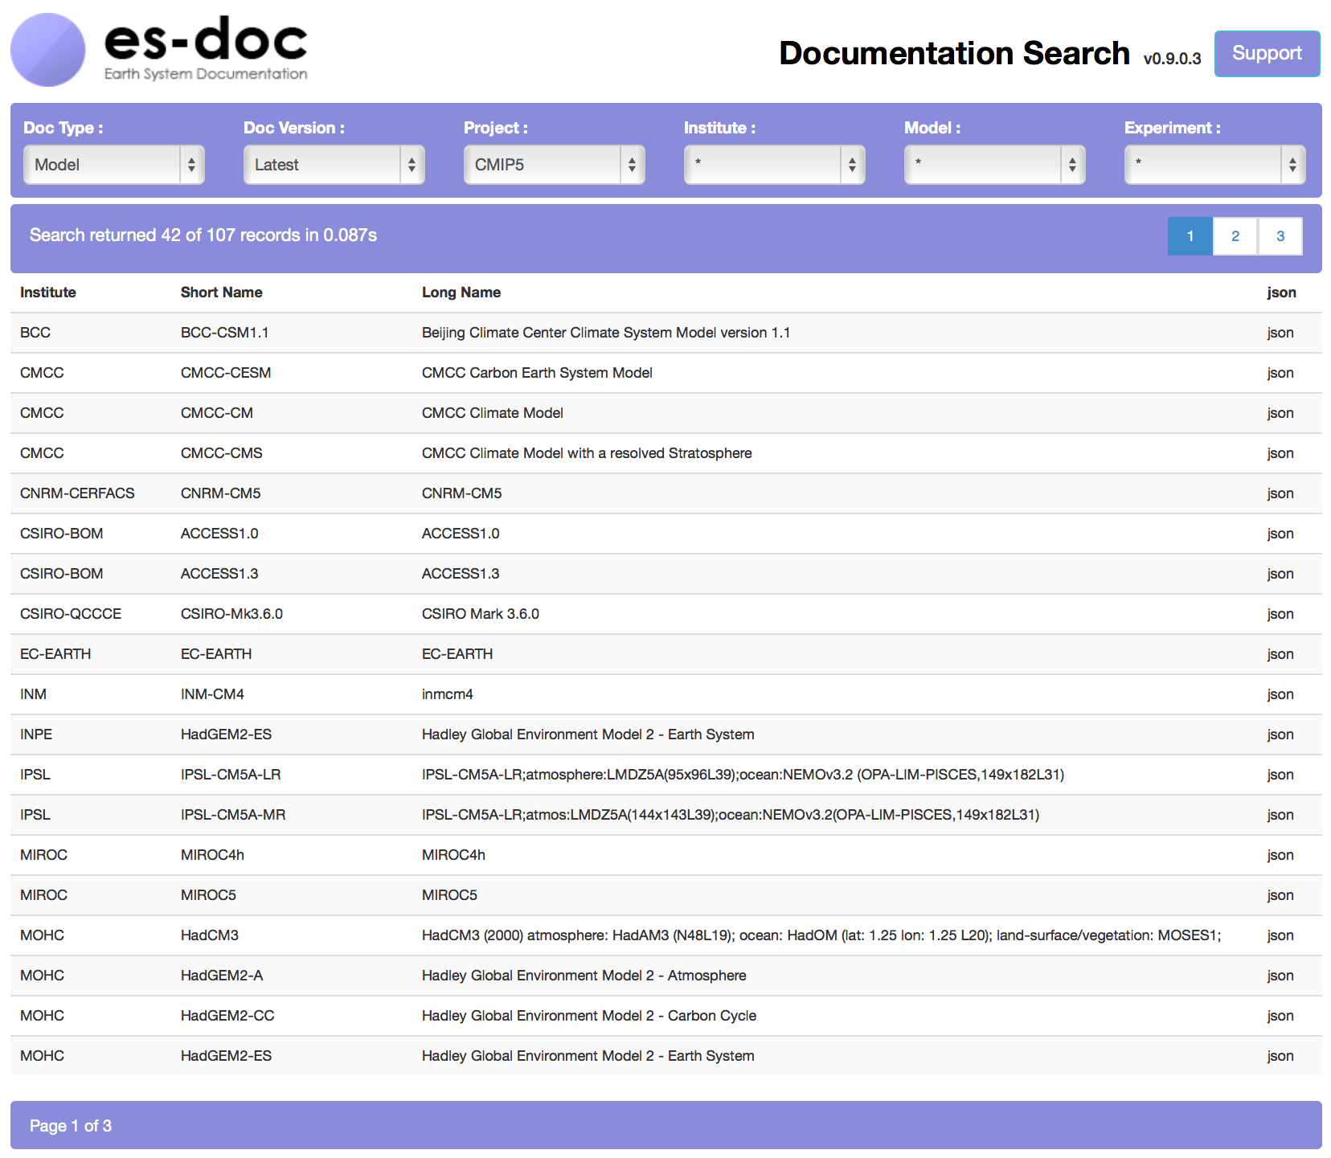

Slide 10
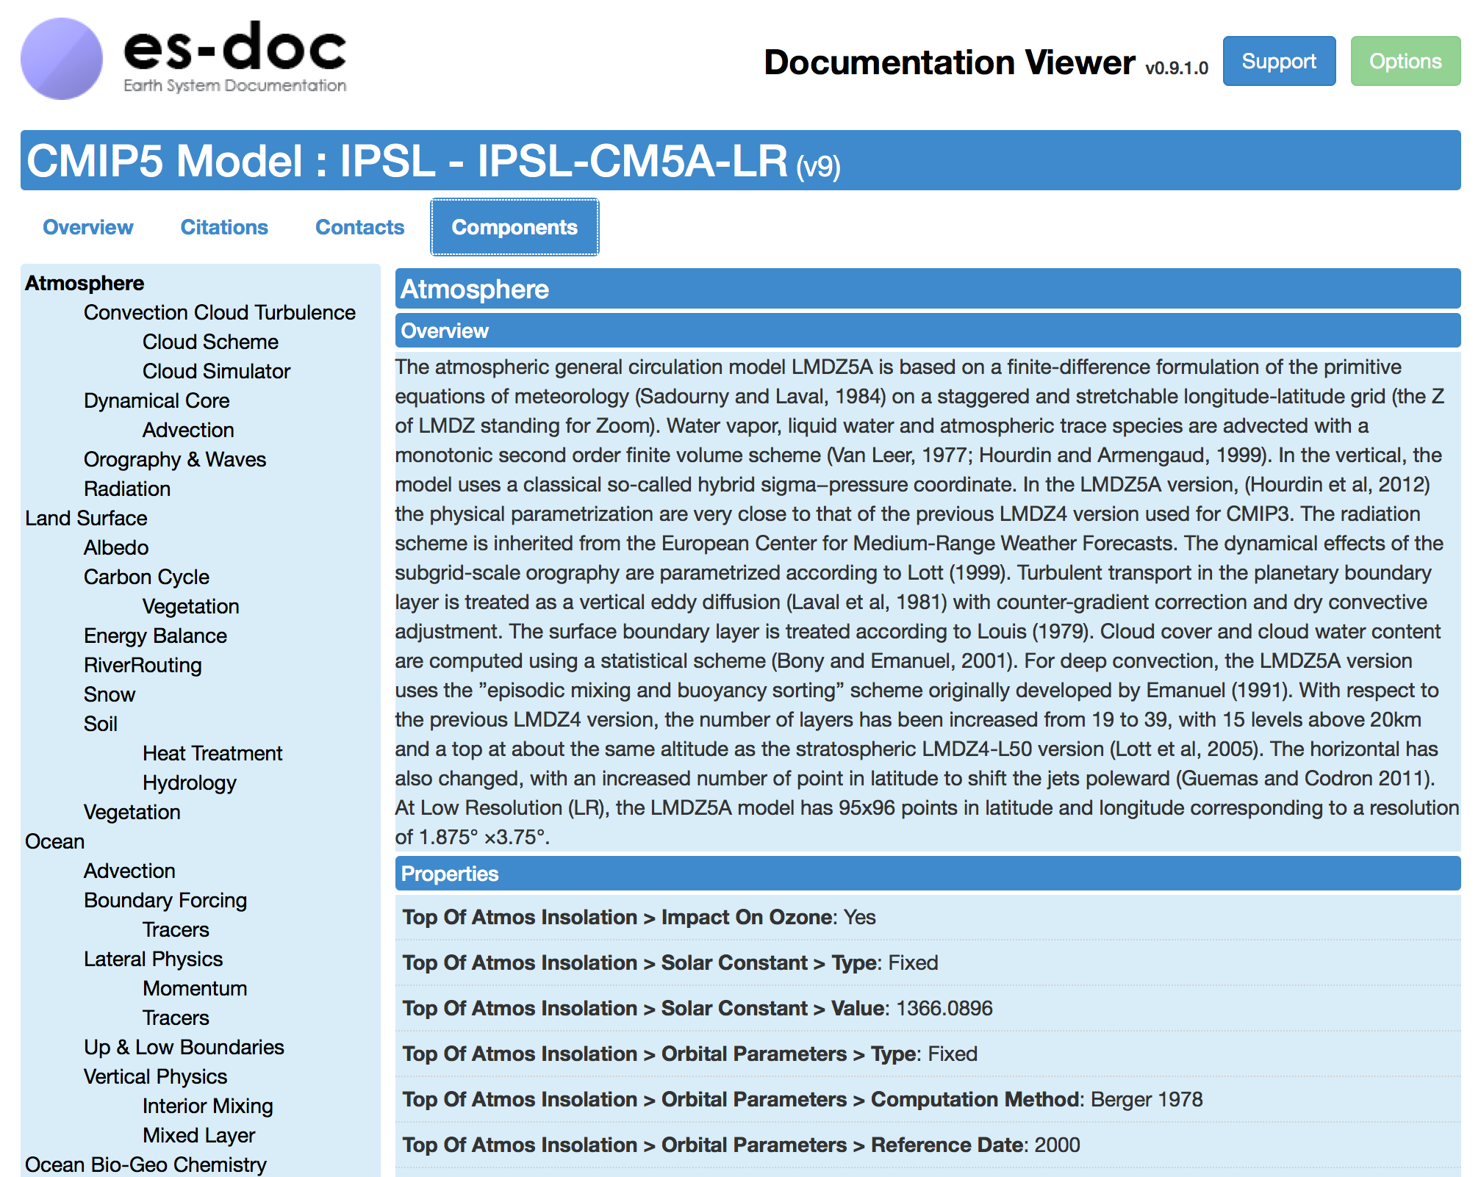

Slide 11
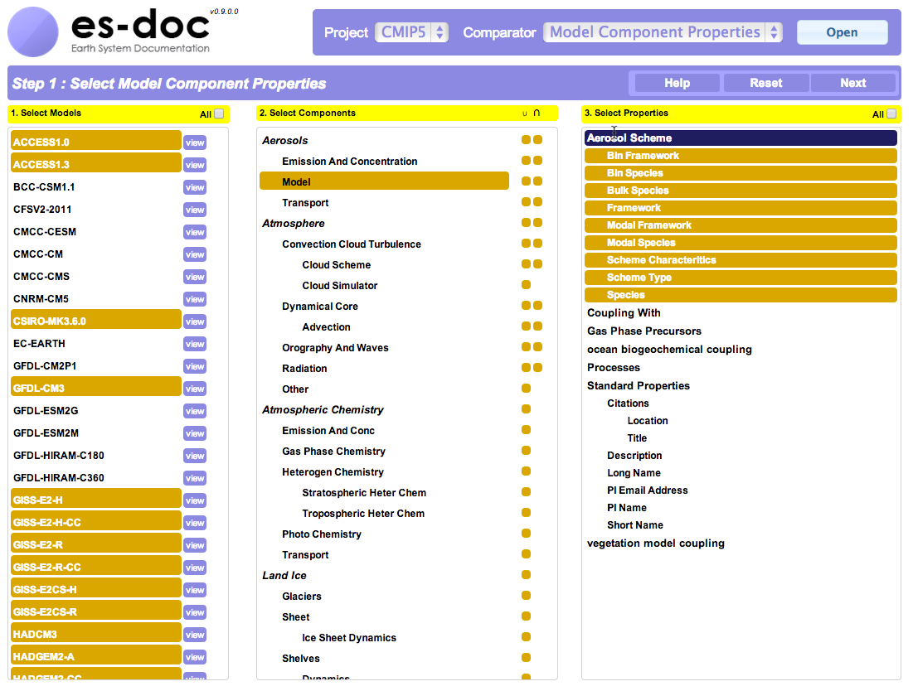

Slide 12
PYESDOC & CMIP6
Groups will be able to leverage pyesdoc in order to output documentation at simulation runtime.
E.G. MOHC already writes metadata to internal databases. Mark Elkington and Emma Hibling are developing a pyesdoc adaptor.

Slide 13
PYESDOC
Create
I/O
Parse
Publish
Search
Serialise
Validate

Slide 14
http://es-doc.org

